Slide 1


Creative and Scientific Thinking
Prepared by Prof. Shereen Taie
CRE252
Information Technology Department
Lecture 7

Slide 2




Creative and Scientific
Thinking
Lecture 7
CRE252
Information Technology Department
Prepared by
Prof. Shereen Taie
www.midocean.ae

Slide 3
Learning Objectives:
Problem Solving Steps
Techniques for Generating Solutions
Individual Techniques
Chapter
03
www.midocean.ae

Slide 4
Problem Solving Steps
Chapter
03
www.midocean.ae

Slide 5

WHY DO WE NEED PROBLEM SOLVING?
To be in control of what happens and to avoid bad decisions.
Chapter
03
www.midocean.ae

Slide 6
Problem-Solving Steps:
Recognize that there is a problem
Identify the problem
Generate alternative solutions
Chapter
03
www.midocean.ae

Slide 7
Problem-Solving Steps
4. Evaluate the alternative solutions
5. Choose among the alternative solutions
6. Implement the chosen solution
7. Choose a Follow Up Date to Evaluate
Chapter
03
www.midocean.ae

Slide 8

Chapter
03
Recognize that there is a problem
www.midocean.ae

Slide 9
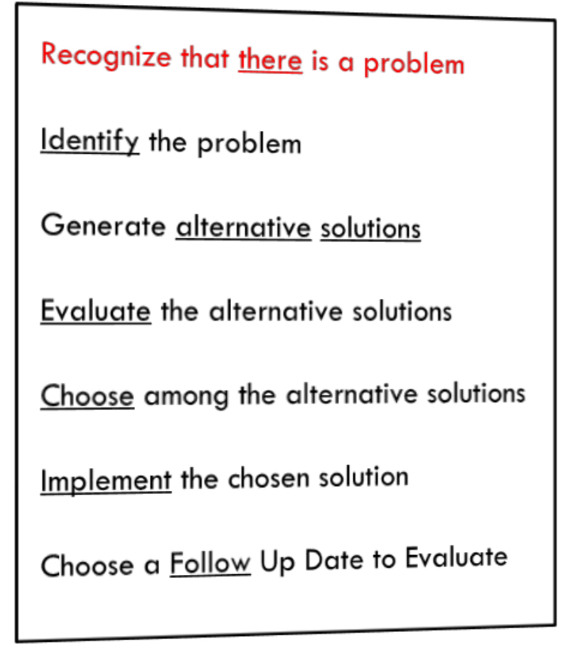

Problem-Solving Steps: 1-Recognize that there is a problem
1-Recognize that there is a problem
Chapter
03
www.midocean.ae

Slide 10

1. Techniques for Recognizing Problems:
Comparison against others
Monitor for weak signals
Comparison of current performance with objectives or past performance
Listing complaints
Chapter
03
www.midocean.ae

Slide 11
Chapter
Identify the problem
03
www.midocean.ae

Slide 12
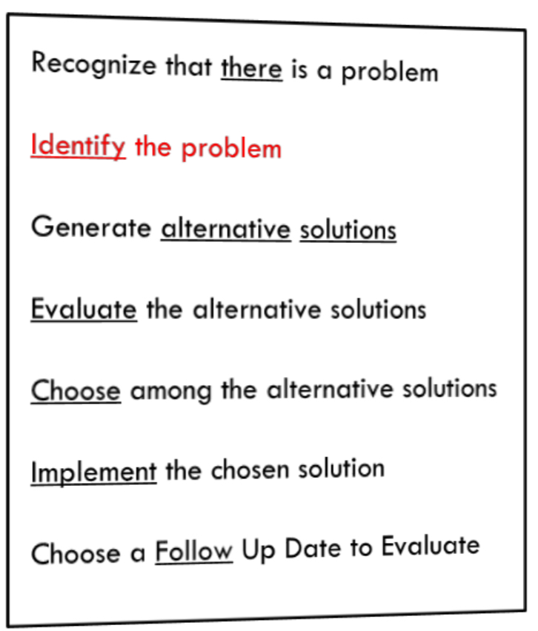

2. Identify the Problem: Ask Who?
Who– what – when – where – why - How
Chapter
03
www.midocean.ae

Slide 13
2. Identify the Problem: Ask Who?
Who says that this is a problem?
Who caused or is causing the problem?
Whom does it or will it affect?
Who has done something about the problem (tried to solve it)?
Chapter
03
www.midocean.ae

Slide 14
2. Identify the Problem: Ask What?
Who– What – when – where – why - How
Chapter
03
www.midocean.ae

Slide 15
2. Identify the Problem: Ask What?
What happened or will happen?
What are the symptoms?
What are the consequences to others?
What circumstances surround the occurrence of the problem?
What is not functioning as desired?
Chapter
03
www.midocean.ae

Slide 16
2. Identify the Problem: Ask When?
Who– What – When – where – why - How
Chapter
03
www.midocean.ae

Slide 17
2. Identify the Problem: Ask When?
When did it or will it happen?
When did it first occur?
Chapter
03
www.midocean.ae

Slide 18
2.Identify the Problem: Ask Where?
Who– What – When – Where – why - How
Chapter
03
www.midocean.ae

Slide 19
2.Identify the Problem: Ask Where?
Where is the problem occurring?
Where did it or will it have an impact?
Chapter
03
www.midocean.ae

Slide 20
2.Identify the Problem: Ask Where?
Who– What – When – Where – Why - How
Chapter
03
www.midocean.ae

Slide 21
2.Identify the Problem: Ask Why?
Why is this a problem?
Why did it or will it occur?
Why was nothing done to prevent the problem from occurring?
Why is a response needed now?
Chapter
03
www.midocean.ae

Slide 22
2.Identify the Problem: Ask Where?
Who– What – When – Where – Why - How
Chapter
03
www.midocean.ae

Slide 23
2.Identify the Problem: Ask How?
How should the process be working?
How are others dealing with this or similar problems?
Chapter
03
www.midocean.ae

Slide 24
Techniques for Identifying the Problem
Creating Why-Why Diagram
  a Tree Diagram where each child statement is determined simply by asking ‘why’ the parent occurs.
Chapter
03
www.midocean.ae

Slide 25
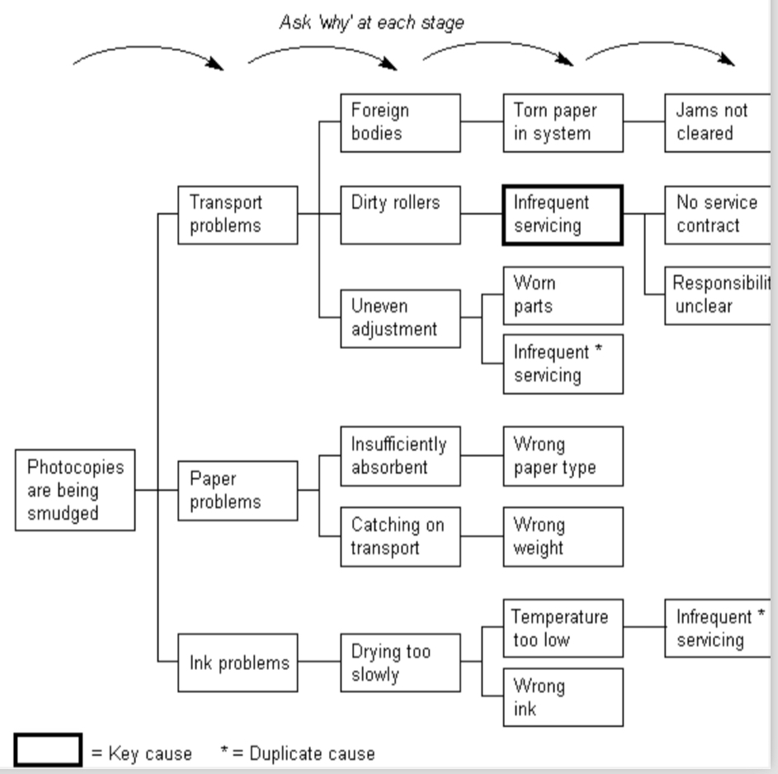
Techniques for Identifying the Problem
Chapter
03
www.midocean.ae

Slide 26
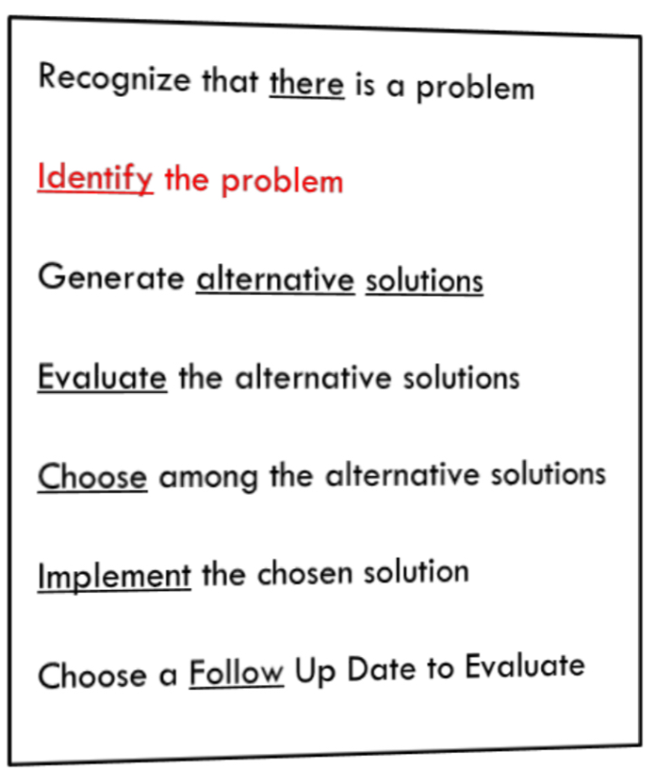
Problem Statement:
Problem Statement is the end result of problem identification.
Brief, clear, to-the-point identification of the specific problem to be addressed, including the key rationale for why it should be solved.
Chapter
03
www.midocean.ae

Slide 27
Chapter
Individual Techniques for Generating Solutions
03
www.midocean.ae

Slide 28
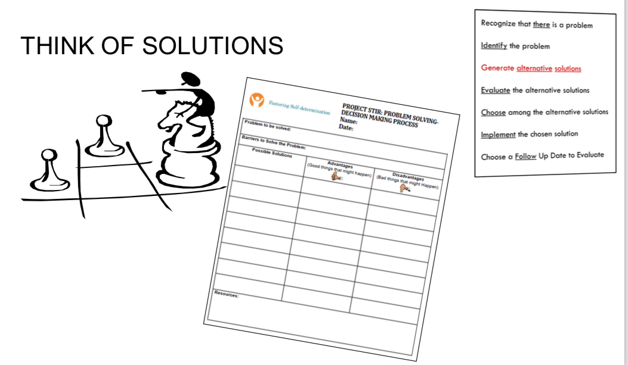
3-Problem Solving: THINK OF SOLUTIONS:
Chapter
03
www.midocean.ae

Slide 29
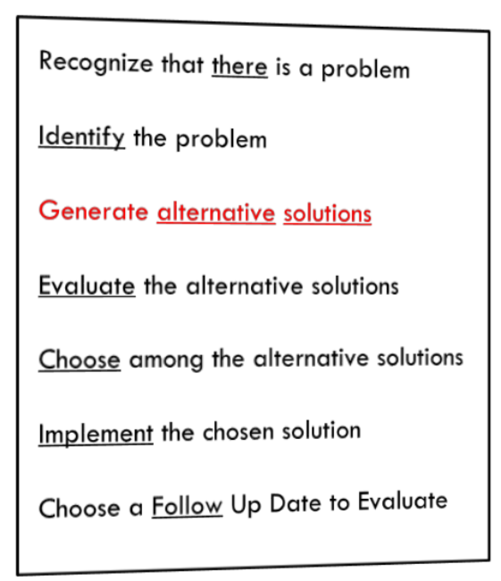

3.Generate Alternative solutions:
Generate ideas.
Do not eliminate any possible solutions until several have been discussed.
Chapter
03
www.midocean.ae

Slide 30
Questions To Encourage Ideas
What if…?
How can we improve…?
How will the Optimist Member and/or the community benefit?
Are we forgetting anything?
What’s the next step?
Chapter
03
www.midocean.ae

Slide 31
Questions To Encourage Ideas
6. What can we do better…?
7. What do you think about…?
8. What should we add?
9. What should we eliminate?
10. What other ideas do you have...?
Chapter
03
www.midocean.ae

Slide 32
Techniques to Generate ideas
Individual Techniques for Generating Solutions (Mind mapping)
Group Techniques for Generating Solutions(BrainStorming)
Chapter
03
www.midocean.ae

Slide 33
Individual Techniques for Generating Solutions:
Mind mapping:
A diagram used to represent words, ideas, tasks or other items linked to and arranged radially around a central key word or idea
Chapter
03
www.midocean.ae

Slide 34
Individual Techniques for Generating Solutions:
Mind mapping:
Definition:
A visual picture of a group of ideas, concepts or issues.
Chapter
03
www.midocean.ae

Slide 35
Individual Techniques for Generating Solutions:
Mind mapping:
Purpose:
Unblock our thinking.
See an entire idea or several ideas on one sheet of paper.
Chapter
03
www.midocean.ae

Slide 36

Individual Techniques for Generating Solutions:
Mind mapping:
Purpose:
See how ideas relate to one another.
Look at things in a new and different way.
Chapter
03
www.midocean.ae

Slide 37
Why Mind Map?
Organize thoughts when brainstorming
Effective method of taking notes
Harnesses the full range of skills– word, image, number, logic, rhythm, color and spatial awareness
Aid creativity, memory, and specifically the recall of information.
Chapter
03
www.midocean.ae

Slide 38
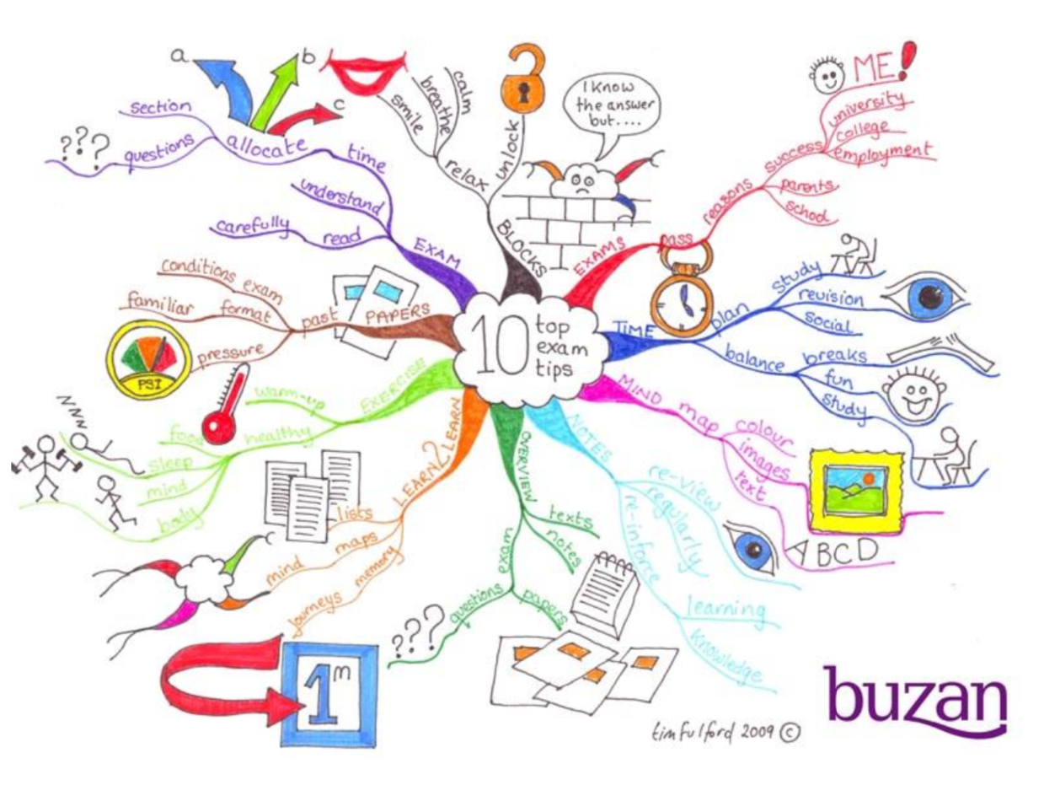
Chapter
03
www.midocean.ae

Slide 39

Chapter
03
www.midocean.ae

Slide 40



Thank You

