Slide 1


Slide 2

Project Contracts

Slide 3
Project Contracts
A project is a temporary organization to which the owners assign resources to achieve their development objectives. For anything but the smallest projects, the owner will not have sufficient resources in-house, and so will need to procure additional resources from outside.
Thus contracting is an essential part of project management. It is the way the project owner brings in additional resources to create the project organization.

Slide 4
Project Contracts
Targeted environment
The owner should want all the resources to be motivated to achieve the objectives. In order to do this, the owners should create a contracting environment which encourages a cooperative organization, and aligns the contractors’ objectives with theirs.

Slide 5
Project Contracts
Targeted environment
They should not create a conflict organization, in which the contractors have a completely different set of objectives. Unfortunately, project owners so often aim for the latter under the misguided view that it will give them a better outcome, whereas all they create is a lose–lose outcome.

Slide 6
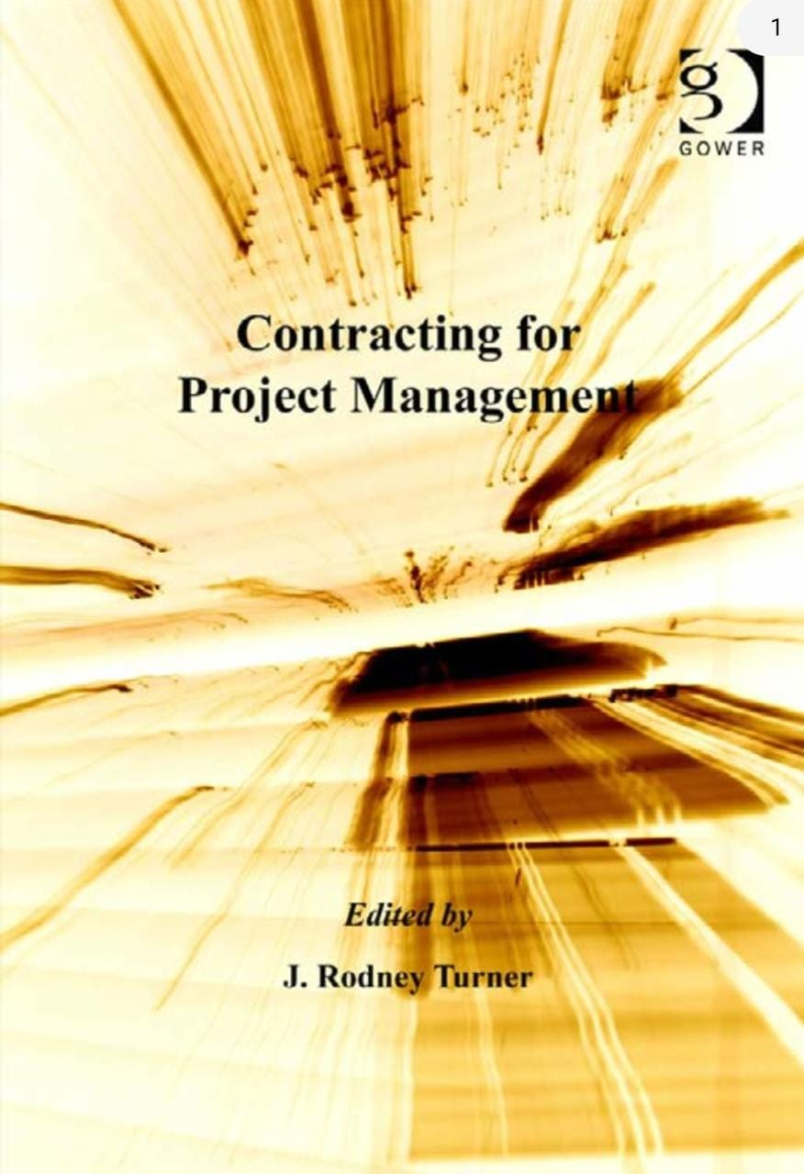

Slide 7
The book aims to:
The book aims to provide an introduction to project contract
management for project managers.
The first four chapters describe forms of contract. The remaining five chapters are each on a separate topic. There is a chapter giving an overview of contract law, followed by a chapter on partnering, benchmarking and incentive contracts.

Slide 8
The next chapter describes how the owner procures contracts and materials. This is followed by a chapter written from the perspective of the contractors, describing how they should bid for work.
The book aims to:
Finally, there is a chapter on variations, claims and disputes.

Slide 9

Roles and responsibilities in project contract management
Chapter 1
This chapter aims to define roles various parties can fulfil on a project, especially the managerial roles. It then describes how different types of contract attempt to define these roles, and deals with the relationship that arises between the clients, their contractors and subcontractors.

Slide 10
Roles and responsibilities in project contract management
Chapter 1
It then describes some of the other more modern, but now common, approaches. There are integrative approaches, which give the contractor responsibility for more steps of the life cycle, and there are managerial approaches, which give the contractor greater management responsibility. Finally, he considers some of the emergent routes now being used. He also describes the terms and conditions for the employment of project managers.

Slide 11
Contracts and payment structures
Chapter 2
In Chapter 2, it describes the other dimension of contract forms, the different methods of pricing contracts. These include fixed price, cost plus and re-measurement contracts. He then considers how the contract price is set, and how progress is measured and payments made as the project progresses.

Slide 12
Contracts and payment structures
Chapter 2
It starts with an overview of the contract forms as described by Nigel Smith, and includes a section on the factors to be considered when choosing contract forms.

Slide 13
Farsighted project contract management
Chapter 3
In Chapter 3, it derive a methodology for choosing contract forms. as a start with the premise that the aim of project contract management should be to build a cooperative project organization in which the contractors are motivated to achieve the owner’s objectives.
The contract needs to be set up in a way that properly motivates the contractor. It also needs to be farsighted and flexible enough to deal with unforeseen circumstances as they arise.

Slide 14
Farsighted project contract management
Chapter 3
It then describes two schemas from the transaction cost literature. One measures the ability of a contract form to incentivize and appropriately reward the contract, taking account of the risk. The other measures its ability to provide farsighted, flexible governance. then describing modern practice in choosing different contract forms, and use that to derive a methodology.

Slide 15
Standard forms of contract
Chapter 4
It describes the use of standard forms, and give a listing of some of those available.
Parties to a contract can draw up a bespoke contract document at the start of every project. However, that is both inefficient and subject to error. Better to use standard forms of contract, which are tried and tested, based on expert knowledge and readily available. Almost every industry has standard forms of contract, especially the three branches of the construction industry.

Slide 16
Standard forms of contract
Chapter 5
In Chapter 5, it gives an overview of contract law. its coverage is primarily based on English law, but most of the elements of English contract law are common in other legal systems. It describes the elements of contract formation, including offer, acceptance and consideration.

Slide 17
Standard forms of contract
Chapter 5
Finally, it describes the terms of the contract called conditions and warranty. These include issues such as the price of the contract and payment, quality and performance, guarantees and exclusions, the passing of property and risk, delivery, completion and possible damages in the event of breach.

Slide 18
Partnering, benchmarking and incentive contracts
Chapter 6
In Chapter 6, it describes partnering. These types of contract are becoming increasing popular and aim to remove the adversarial culture that has built up in the construction industry.
It defines partnering and describe its key elements. It then considers its benefits to both parties and barriers to its successful achievement.

Slide 19
Procurement
Chapter 7
There now follow two chapters about how the client and contractor go about entering into a contract.
In the first, Chapter 7, it describes project procurement. It considers the special characteristics of project purchasing and the role of the project purchasing manager.

Slide 20
Procurement
Chapter 7
It then describes the procurement of contracts and subcontracts, and the purchasing of goods and equipment. There are two short sections on the amendment of purchase orders and electronic data interchange.

Slide 21
Bidding
Chapter 8
Contract management is often written from the client’s perspective.
In Chapter 8, it addresses that balance. It describes how a contracting organization should bid for work.

Slide 22
Bidding
Chapter 8
There are three stages in the bid process:
Contract negotiation
Before receiving the invitation to tender
Bid preparation and submission

Slide 23
Managing variations, claims and disputes
Chapter 9
The main purpose of the contract is to describe how the relationship will work. However, it would be dangerously complacent to assume it will work perfectly every time.
It is therefore necessary to deal with situations where it will be less than perfect. In most cases, the changes to the contract will be relatively small and they can be dealt with simply. It is even possible to deal with quite large changes within the structures of most contracts.

Slide 24
Managing variations, claims and disputes
Chapter 9
However, in the worst cases there is disagreement about the extent of the change, or who is responsible. That may lead to a more extensive claim and, if either party disagrees about the claim, possibly to a dispute.
In Chapter 9, it describes variations, claims and disputes.

Slide 25

What I expect from you?

Slide 26

What I expect from you?

Slide 27



What I expect from you?

Slide 28

What I expect from you?

Slide 29

What I expect from you?
merna@esu.ac.ae

Slide 30


