Slide 1

Risk control techniques
Lecture 9
Everyone’s Smart
University
PMG510
Project Risk Management

Slide 2

Types of controls
There are a range of controls that can be applied to hazard risks.
The most convenient classification system is to describe these controls as preventive, corrective, directive and detective.
The relationship between these four types of controls and the dominant risk of response for different levels of risks is illustrated on the risk matrix shown in the figure below.

Slide 3
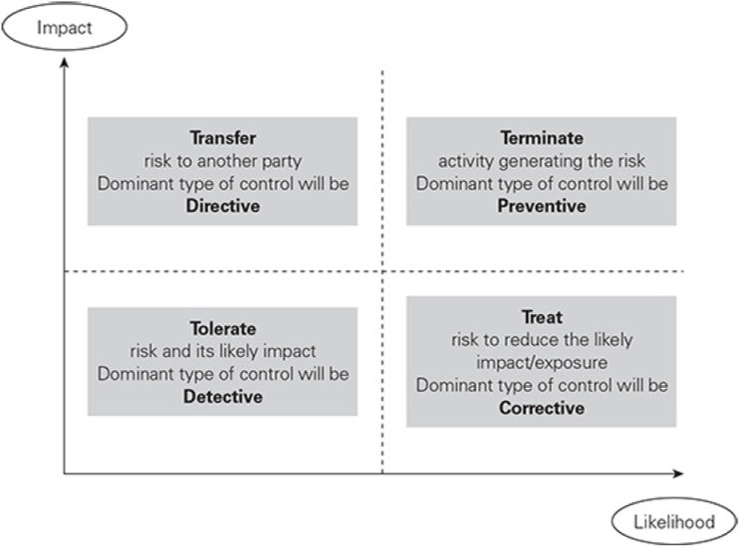
Types of controls

Slide 4
Types of controls
Preventive controls are designed to limit the possibility of an undesirable hazard event occurring.
The majority of controls implemented in organizations in response to hazard risks are preventive controls.
For health and safety risks, preventive controls will include substituting a less hazardous material in the activity or enclosing the activity so that employee exposure to dust or fumes is eliminated.

Slide 5
Types of controls
Corrective controls are designed to correct undesirable circumstances and reduce unacceptable risk exposures.
Such controls provide a key method whereby the risk is treated so that it becomes less likely to occur and/or the impact is much reduced.
In general terms, corrective controls are designed to correct the situation.

Slide 6
Types of controls
Preventive controls are relevant to actions that are taken before the event occurs. The nature of detective controls means that they relate to circumstances after the event has occurred. Corrective and directive controls can be relevant to loss prevention, damage limitation and cost containment. These are the three phases of loss control.

Slide 7
Types of controls
The relevance of the types of controls to the bow-tie presentation of the risk management process is shown in the Figure below.

Slide 8
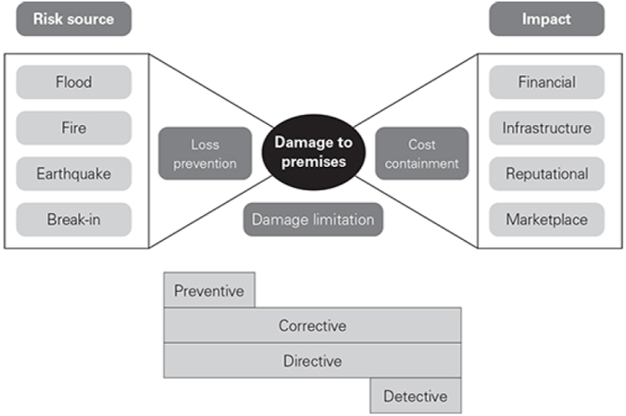
Types of controls

Slide 9
Types of controls
Directive controls are designed to ensure that a particular outcome is achieved. In health and safety terms, directive controls would include instructions/directions given to employees to follow, for example, in the use of personal protective equipment. Training in how to respond to a particular risk event and detailed instructions and procedures are directive controls.
Detective controls are designed to identify occasions when an undesirable outcome has occurred. The control is intended to detect when these undesirable events have happened, to ensure that the circumstances do not deteriorate further.

Slide 10
Preventive controls
These are the most important type of risk controls, and all organizations will use preventive controls to treat certain types of risks.
The advantage of preventive controls is that they eliminate the hazard, so that no further consideration of it is required.

Slide 11
Preventive controls
Examples of preventive controls include the separation of duty, whereby no person has authority to act without the consent of another when paying an invoice. Also, expenditure systems should prevent the same person from ordering goods and then authorizing the payment for them. In health and safety terms, preventive controls include the elimination or removal of the hazard and providing a less risky substitute. For example, a hazardous chemical used in a cleaning operation may be substituted with a less harmful alternative.

Slide 12
Corrective controls
Corrective controls are the next option after it has been decided that preventive controls are not technically feasible, operationally desirable or cost-effective. Corrective controls are capable of producing an entirely satisfactory result, whereby the current level of risk is reduced to within the risk appetite of the organization.

Slide 13
Corrective controls
Examples of corrective controls can be found in the management of health and safety at work. Engineering containment by way of barriers or guards is a very well-established type of corrective control. In relation to fraud exposures, use of passwords or other access controls can be considered to be corrective controls. Staff rotation and regular change of supervisors also fit into this category of controls.

Slide 14
Corrective controls
Sometimes, corrective controls are over-engineered and their cost is disproportionate to the benefit that is achieved. It is for risk management practitioners and internal auditors, as well as employees themselves, to identify where expensive and/or ineffective corrective controls have been implemented.

Slide 15
Directive controls
Organizations will be familiar with the directive controls, because staff will need to be advised of the correct way of undertaking specific tasks.
Where tasks involve a level of risk, documented procedures, together with information, training and instruction, can be seen as directive controls.
Therefore, directive controls are likely to be in place for most risks, regardless of whether other types of controls also exist.

Slide 16
Directive controls
An example of directive controls is the requirement to wear personal protective equipment when undertaking potentially dangerous activities. Staff will need to be trained in the correct use of the equipment and a level of supervision will be required in order to ensure that it is used correctly.

Slide 17
Directive controls
Directive controls, especially in relation to health and safety risks, represent a low level of control that may require constant supervision in order to ensure that the correct procedures are being followed.

Slide 18
Detective controls
Detective controls are those procedures that identify when the hazard has materialized.
Examples of detective controls include stock or asset checks to ensure that stock or assets have not been removed without authorization. Bank reconciliation exercises can detect unauthorized transactions. Also, postimplementation reviews can detect the lessons learnt from projects that can be applied in future.

Slide 19
Detective controls
Detective controls are closely related to review and monitoring exercises undertaken as part of the risk management process.
The disadvantage of the detective controls is that the risk will already have materialized before it is detected.
Detection of fraud is often only possible after the fraud has taken place. However, there are considerable advantages in detecting fraud early, so that the nature and scale of the fraud may be reduced and the scope for future similar fraudulent activities eliminated.

Slide 20
Detective controls
Even in health and safety arrangements, there is scope for the use of detective controls.
By having detective controls to identify the early symptoms of these occupational ill health conditions, employees will be diagnosed early and further exposure can be eliminated.
Examples of these types of controls in health and safety include early detection of lung disease from dust exposure, skin conditions such as dermatitis and finally deafness caused by exposure to occupational noise.

Slide 21
Detective controls
Even in health and safety arrangements, there is scope for the use of detective controls.
By having detective controls to identify the early symptoms of these occupational ill health conditions, employees will be diagnosed early and further exposure can be eliminated.
Examples of these types of controls in health and safety include early detection of lung disease from dust exposure, skin conditions such as dermatitis and finally deafness caused by exposure to occupational noise.

