Slide 3
The target of the lecture
We will discover that PMBOK 6th Edition (2017-2022) provides PJOMS that aim to solve the poor project operations technicality (PJOT) that was the root cause of the project failure, and it should be conducting an effective project compliance integration (PCI) that will deliver a unique product with positive project value added (PVA) to the business, as it is not only failed on the practical front but also maximized the project failure rate.

Slide 4

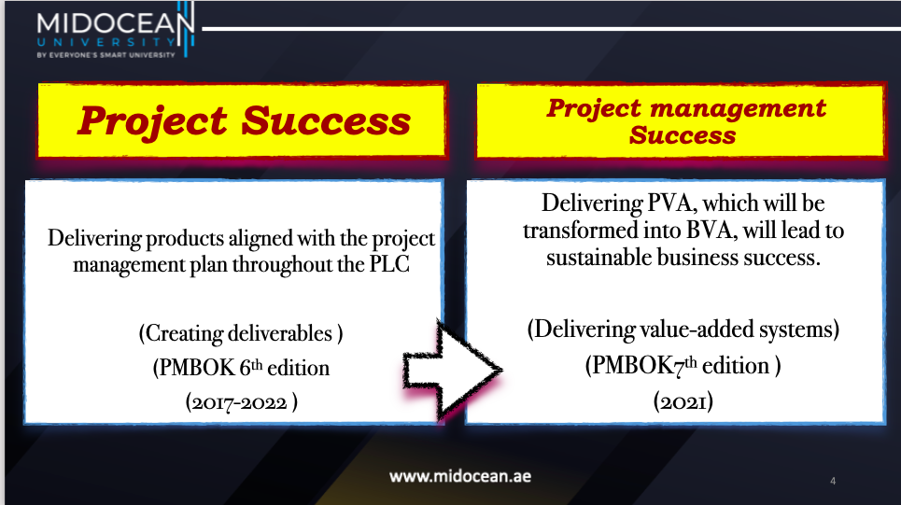

Slide 5
Part one
The impact of applying PJOM throughout the project management on the sustainability of business success

Slide 6
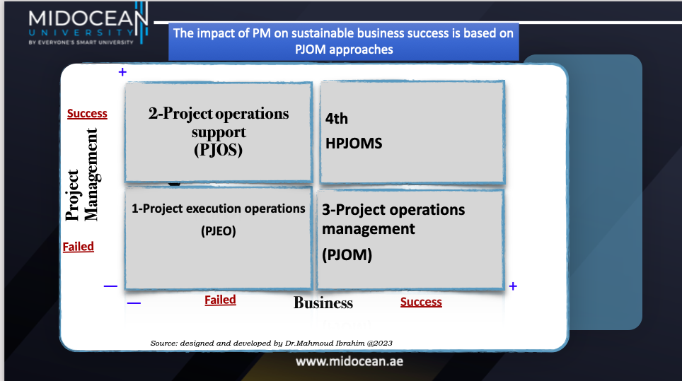

Slide 7
1-Project execution operations (PJEO)
-Business is failed :No matter for the quality of the product or the customer satisfaction and business publicity with weak competitive position.
 PM is failed :Negative PVA based on Missing Project operations management system (PJOMS).
- Project is failed : did not deliver any product

Slide 8
2-Project operations support
(PJOS)
- Business fails, no matter the quality of the product, customer satisfaction, or business publicity, with a weak competitive position.
 PM is delivering a negative PVA based on the Missing Project Operations Management System (PJOMS).
-A project is successful based on achieving the PMP (project management plan). but does not deliver the required product and fails to achieve the project goals, based on the PMP (project management plan).

Slide 9
3-Project operations management
(PJOM)
- Business is successful: no matter the quality of the product, customer satisfaction, or business publicity, it has a weak competitive position but
-having valuable lessons learned
-may postpone or reject the poor project.
-may start a huge investment in developing the PM. (as building a HPMPQS and HPJOMS)
 PM is a negative PVA based on the Missing Project Operations Management System (PJOMS).
.The project failed because it did not deliver any products related to the BPP.

Slide 10
4^{-HPJOMS}
.Business is success: maximum care for the quality of the product and customer satisfaction with positive business publicity and an intelligent competitive position.
 PM has succeeded in delivering a positive PVA based on a well-developed holistic Holistic Project operations management system (HPJOMS).
.The project is fully successful: it delivered the unique fit product to the BPP.

Slide 11
Conclusion
-Applying the fit PJOM that delivers value-added and the unique product to the business will increase its sustainability.
So the organization should identify, design, develop, tailor and select the most fit PJOM to make the PM successful and increase the project success rate.

Slide 12
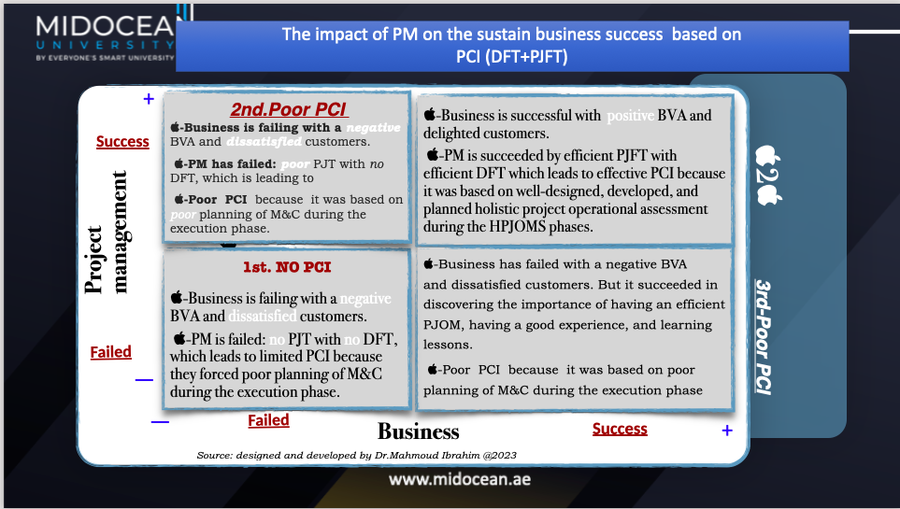

Slide 13
Conclusion
The business has an in-depth need for superior PCI based on the full integration between the HPMQS and HPJOMS to get the potential BVA and sustain business success.

Slide 14
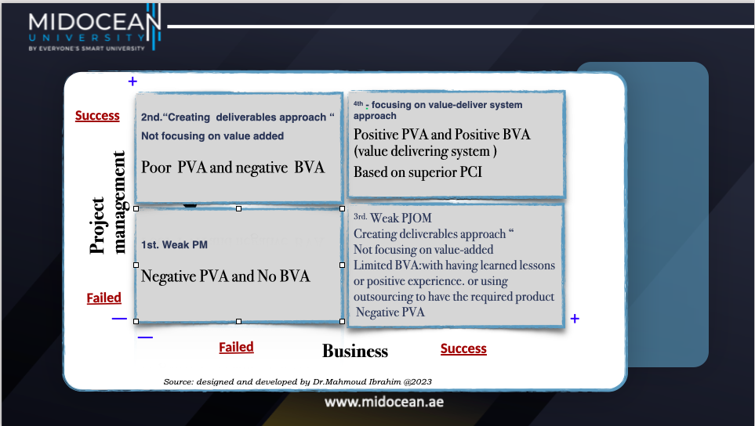

Slide 15
Conclusion
The PM of the company should focus on shifting from creating deliverables by applying PJOMS to creating value for the business by applying HPJOMS.

Slide 16
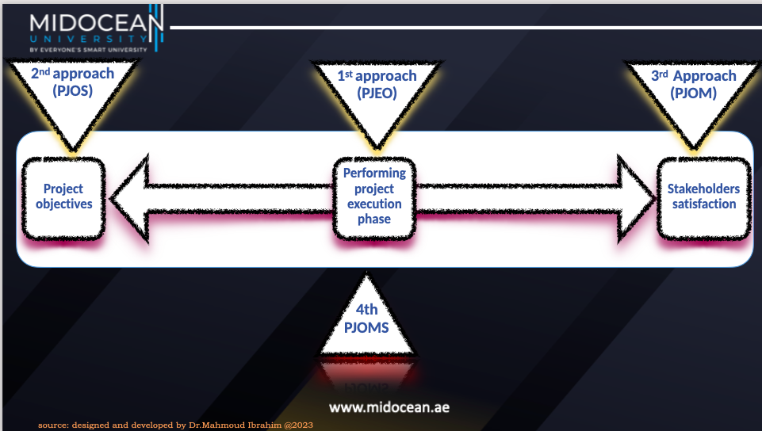

Slide 17
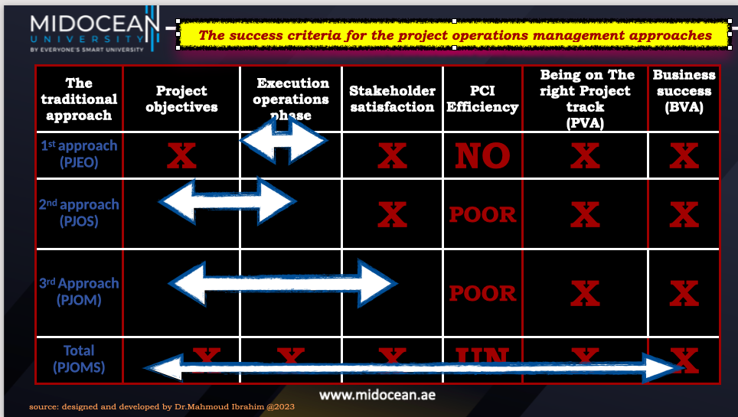

Slide 18
Part two
The project operations management approaches and its ability to catch up with the right PVA and its BVA for business success

Slide 19

First approach

Slide 20
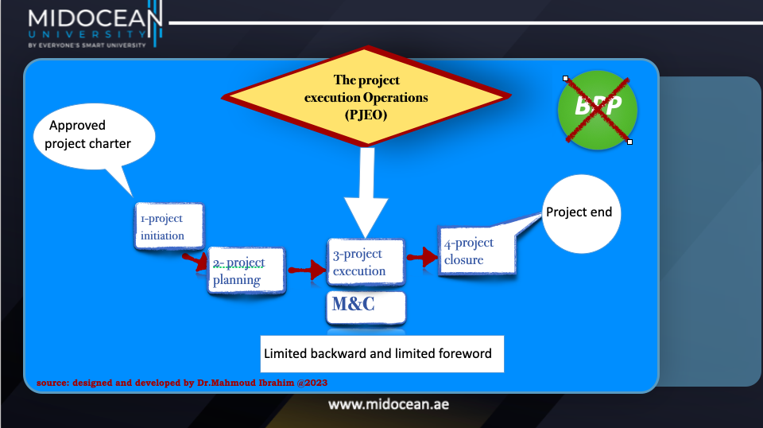

Slide 21

The end up results of this approach is ….

Slide 22
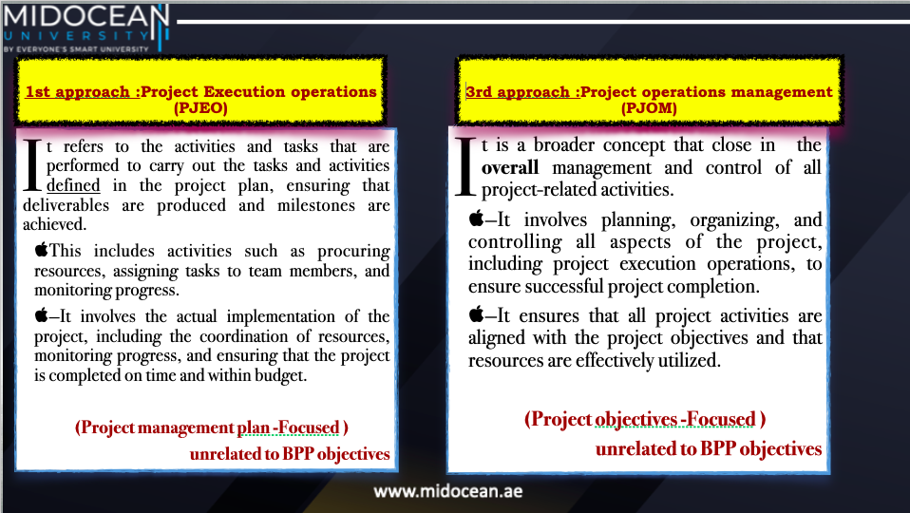
source: designed and developed by Dr.Mahmoud Ibrahim @2023

Slide 23
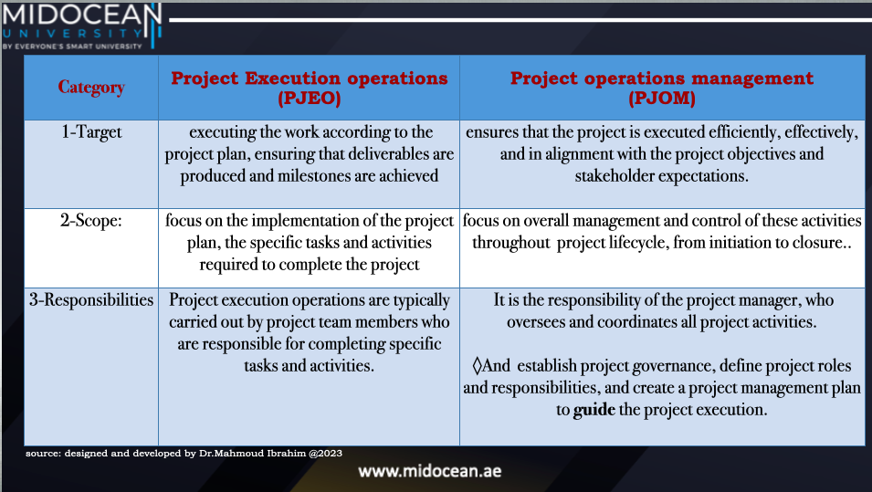

Slide 24
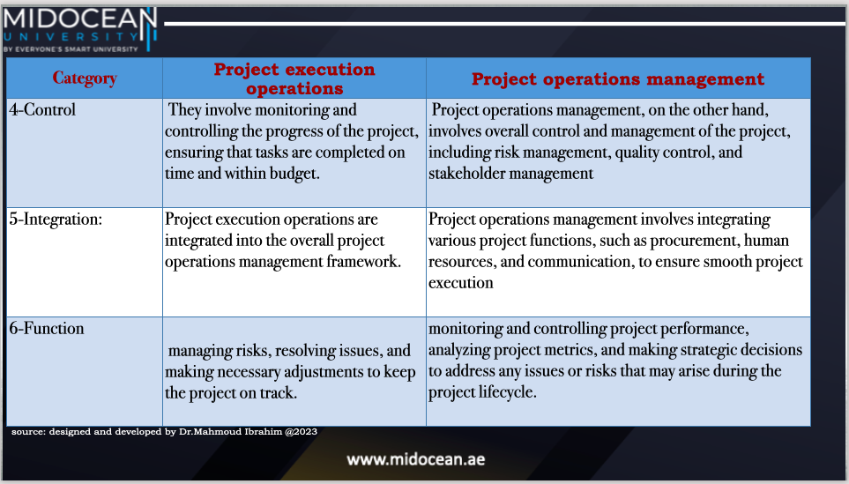

Slide 25
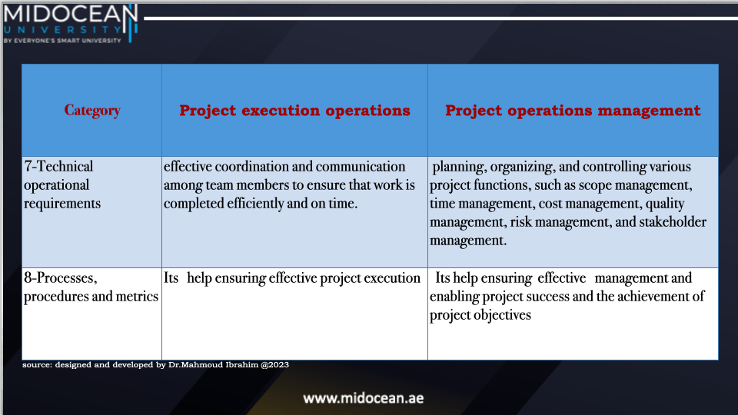

Slide 26
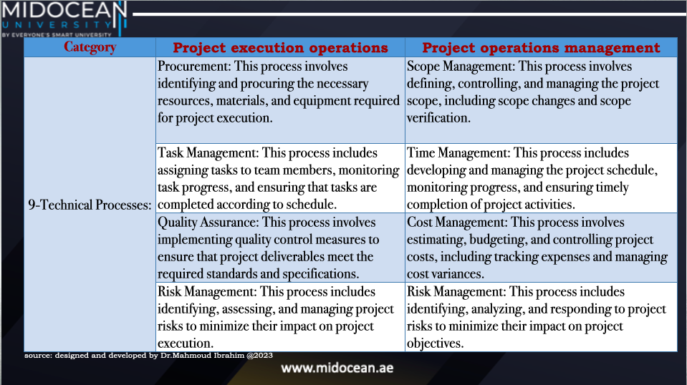

Slide 27
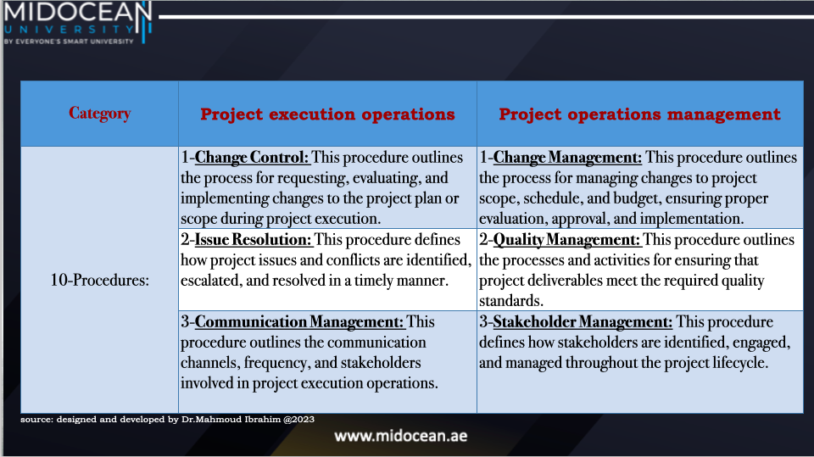

Slide 28
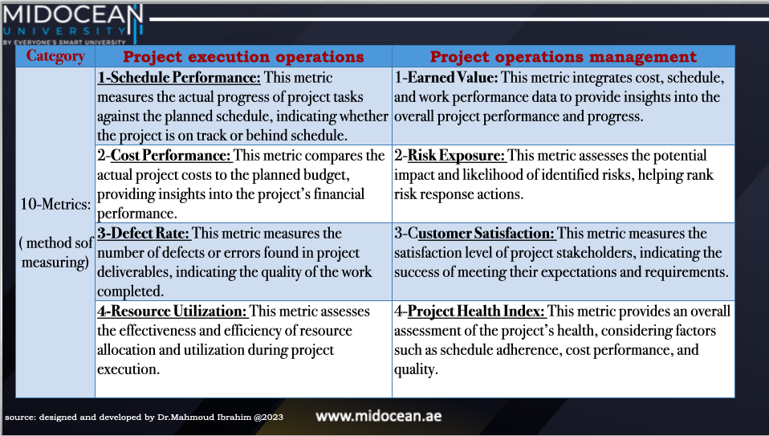
source: designed and developed by Dr.Mahmoud Ibrahim @2023

Slide 29
The 2nd approach :
The project operations support (PJOS)
It is the process of assessing a project's outcomes and deliverables against predetermined project objectives based on the project's efficiency and quality in terms of cost, time, scope, and stakeholder satisfaction by external operational company team or outsourcing .

Slide 30
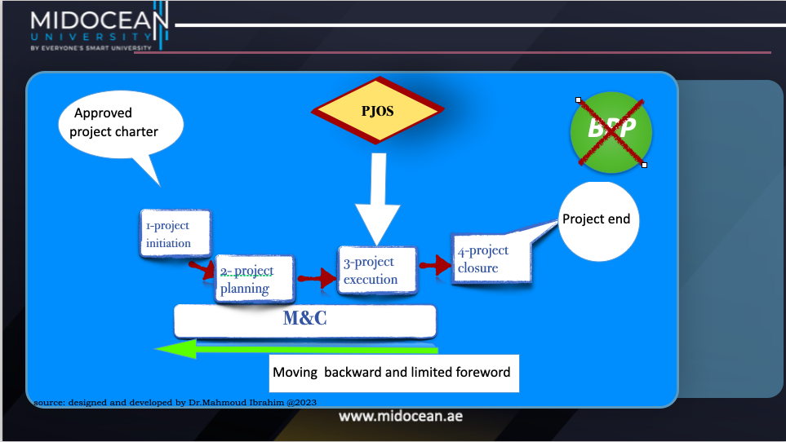

Slide 31
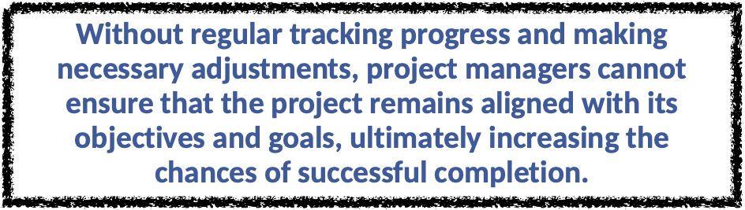
The end up results of this approach is ….

Slide 32
The 3rd approach :(Project operations management )
PJOM
It is the processes, activities, and techniques involved in monitoring and evaluating the performance, in addition to tracking and controlling the progress of a project throughout the PLC, as follows:
.Regarding the project performance operation:
It involves monitoring the performance of individual team members, ensuring that they are meeting their deadlines, and delivering quality work.
.Regarding the project progress operation:
It involves identifying and addressing any deviations from the planned schedule, identifying risks and taking corrective actions, and ensuring that the project stays on track to meet its goals and objectives.

Slide 33
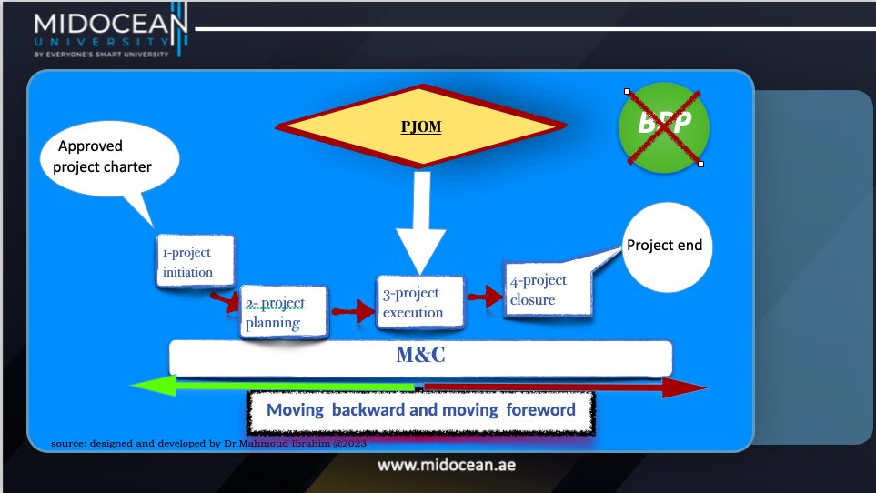

Slide 34
PJOM benefit
It is crucial for project managers to have a comprehensive understanding of both project performance analysis and project progress operation management in order to effectively lead and manage a project to successful completion!!!!!!

Slide 35
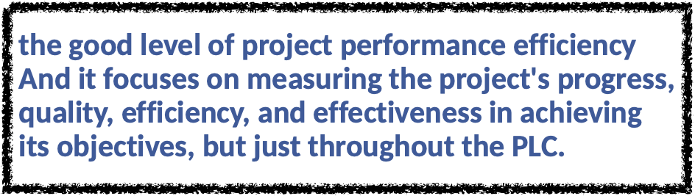
The end up results of this approach is ….

Slide 36
The 4th approach :
The project operations management system
(PJOMS)
It is a comprehensive framework that encompasses the planning, execution, and control of all activities related to project operations. It involves the integration of various tools, techniques, and methodologies to effectively manage resources, timelines, and budgets.
According to the Project Management Institute (PMI), a project operations management system should also include risk assessment and mitigation strategies, stakeholder communication, and continuous monitoring and evaluation.

Slide 37
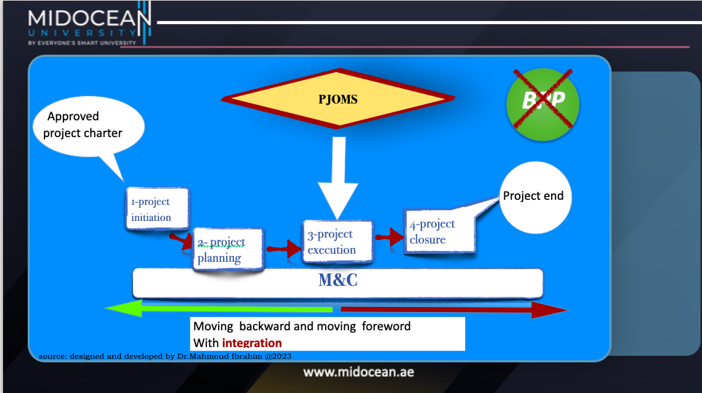

Slide 38
The benefit of the PJOMS
These two operations are crucial for managing projects effectively and ensuring their successful completion, as follows:
1. By carefully managing the project's cost, time, scope, and stakeholder satisfaction, project managers can ensure that the project remains within budget, meets deadlines, fulfills requirements, and satisfies the needs and expectations of all stakeholders involved.
2. By carefully managing project progress, operation allows for day-to-day oversight and adjustment, ensuring that tasks are completed on schedule, milestones are achieved, and any potential issues or roadblocks are addressed in a timely manner.
By combining effective cost and stakeholder management with vigilant project progress tracking, project managers can drive successful project completion and deliver desired outcomes.

Slide 39
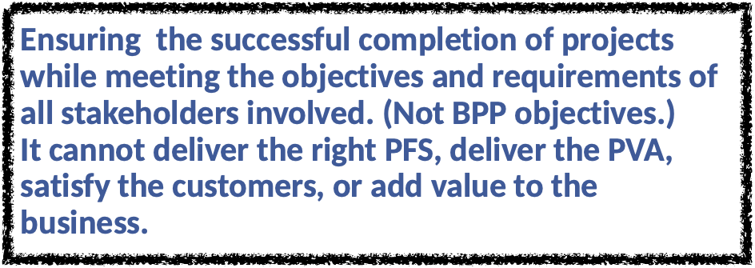
The end up results of this approach is ….

Slide 40
CONCLUSION
All the project operations management approaches From focusing on project processes just for completing the project based on its PMP (short term) until the fulfillment of project objectives throughout the PLC (long term), this did lead to losing the right track of closing BPP and delivering value added to the business and this is the main problem.
Thus, the PJOM approaches did lead to raise the project failure rate as they focused on the project objectives only without managing the BPP objectives.

Slide 41
CLOSING
All the PJOM approaches from the PMBOK 1st edition to the 6th edition are just fully focused on project completion with limited project success and away from managing the effective success of the PM (project management).

Slide 42


