Slide 1

Project Financial Management
Prepared by
Dr. Walaa Mohamed
Lecture 6
Everyone’s Smart
University
PMG 615
Financial Modeling and Evaluation (part one)

Slide 2

Objective of this lecture
This lecture covers:
The input assumptions for the ﬁnancial model
The output assumptions for the ﬁnancial model
Project costs and funding

Slide 3


Financial modeling
Financial modeling is the task of building an abstract representation of a real world financial situation. This is a mathematical model designed to represent the performance of a financial asset or portfolio of a business, project, or any other investment.

Slide 4
Financial model
An adequate ﬁnancial model is an essential tool for ﬁnancial evaluation of the project. It serves several purposes:
Pre-Financial Close
  Initial evaluation and reevaluation of the project’s ﬁnancial aspects and returns for the Sponsors during the development phase.
  Formulating the ﬁnancial provisions of the Project Contracts (including use as a bidding model to calculate a Tariff if the Sponsors have to bid for the project, checking LD calculations, etc.)
  Structuring the ﬁnance and reviewing the beneﬁts to the Sponsors of different ﬁnancial terms
  As part of the lenders’ due-diligence process
  Quantifying critical issues in the ﬁnance negotiations

Slide 5
Financial model
An adequate ﬁnancial model is an essential tool for ﬁnancial evaluation of the project. It serves several purposes (continued):
    Post-Financial Close
      As a budgeting tool
      As a basis for lenders to review the changing long-term prospects for the project and thus their continuing exposure

Slide 6
Financial model
      The ﬁnancial model covers the whole of the Project Company’s operations, not just the project, and thus takes into account, for example, tax and accounting issues that may affect the ﬁnal cash ﬂow of the Project Company. Although separate and parallel ﬁnancial models may be developed by the Sponsors and the lenders, it is often more efﬁcient for a single model to be developed jointly. This may mean that the Sponsors develop the model initially and then work on it jointly with the lenders, depending on the timing of the lenders’ involvement in the project. The Sponsors may then use the model to calculate their own returns, taking into account the ownership structure of the Project Company, the results of which are not of concern to the lenders.

Slide 7
Financial model
MODEL INPUTS
The input assumptions for the ﬁnancial model for the Project Company can be classiﬁed into five main areas:
    Macroeconomic assumptions
    Project costs and funding structure
    Operating revenues and costs
    Loan drawings and debt service
    Taxation and accounting
    These inputs need to take account of the terms of the Project Contracts, including expected and required completion of construction, timing of payments or receipts, and calculation of penalties or bonuses.

Slide 8
Financial model
1. MODEL INPUTS (continued)
These input assumptions are used to calculate projections of the project’s cash ﬂow, which serves as a basis for calculations of investors’ returns and lenders’ debt cover ratios. The model must be able to calculate a reasonable range of sensitivity scenarios.
The inputs are usually entered in separate input sheets (e.g., one for speciﬁc assumptions such as project costs, and one for long-term macroeconomic and operating assumptions that cover the life of the project). Inputs should not be scattered throughout the model, as someone not familiar with it will ﬁnd it much harder to understand what is going on.

Slide 9
Financial model
MODEL INPUTS (continued)
To calculate the investors’ returns correctly the ﬁnancial model should cover the whole period from when the initial development costs on the project are incurred to the end of the project life, although for the purposes of the lenders the model is only needed from Financial Close, with past expenditure on project development being “day 0” ﬁgures.

Slide 10
Financial model
MODEL OUTPUTS
The model outputs are a series of calculations:
Construction phase costs
Drawdown of equity
Drawdown and repayment of debt
Interest calculations
Operating revenues and costs
Tax
Proﬁt and loss account (income statement)
Balance sheet
Cash ﬂow (source and use of funds)
Lenders’ cover ratios and investors’ returns
A summary sheet usually sets out the key results on one page, such as:
Summary of project costs and funding
Cash ﬂow summary
Lenders’ cover ratios
Investors’ returns

Slide 11
Financial model (Inputs)
MACROECONOMIC ASSUMPTIONS
Macroeconomic input assumptions are those that are not directly related to the project, but that affect its ﬁnancial results. Such assumptions may include:
Inﬂation
Commodity prices
  Interest rates
  Exchange rates
  Economic growth
  Ideally, macroeconomic assumptions for modeling projections should be taken from an objective source unconnected with the Sponsors; for example, most major banks produce general economic research with generic projections that can be used for this purpose.

Slide 12
Financial model (Inputs)
1.1. INFLATION
Inﬂation should be taken into account in the ﬁnancial model, as it may be misleading to draw up projections on a “real” basis.
Different indices may need to be used as a basis for projections of inﬂation in different types of revenue or cost, for example:
  Consumer price inﬂation (CPI) in the Host Country for general operating costs
  Indices of employment costs in the country of suppliers or providers of services to the project, in relation to these costs
  Industrial price inﬂation for the cost of spare parts
  Speciﬁc price indices for commodities produced by or purchased by the project (supply and demand in the commodity’s own market may affect its price more than general inﬂation)

Slide 13
Financial model (Inputs)
1.2. COMMODITY PRICES
One of the key problems of project ﬁnance is that projects are often developed when commodity prices are high, and assume that these high prices will continue, underestimating the effect of the development of the project itself, and others like it, on the market for the commodity. (Or conversely, if a project is developed using a commodity as a fuel or raw material when it is at a low price, it is assuming that this low price will continue.)
Commodity price movements may be very violent on a short-term basis, whereas project ﬁnance is inevitably a long-term business; therefore, it must be demonstrated that the project is robust enough to deal with signiﬁcant ﬂuctuations in commodity prices

Slide 14
Financial model (Inputs)
1.3. INTEREST RATES
If the interest rate on the debt is to be ﬁxed throughout the term of the debt, the assumption for this rate should be used for projections. However, even in such cases, another ﬂoating (short term) interest rate will probably have to be projected for earnings on surplus funds held by the Project Company as security for lenders or prior to distribution to investors.

Slide 15
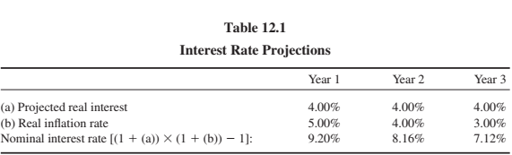
Financial model (Inputs)
1.3. INTEREST RATES (continued)
There are two approaches to projecting short term interest rates: either (a) an assumption can be made as to the rate itself, or (b) “real” interest rates (i.e., the interest rate after allowing for inﬂation) can be used for this purpose, and the actual interest rate is determined by the assumed CPI rate. In the latter case, as shown in Table 12.1, if a real interest rate of, say, 4% is used, the projected nominal interest rate is the real interest rate adjusted for the rate of inﬂation using the “Fisher formula:”

Slide 16
Financial model (Inputs)
1.4. EXCHANGE RATES AND CURRENCY OF THE MODEL
If a Project Company raises debt and equity funding in its Host Country’s currency, and all its construction and operating costs and revenues are in that currency, the question of exchange rates becomes irrelevant. If this is not the case, the ﬁnancial model should still be prepared in the Host Country’s currency, with the ability to make assumptions about long-term ex- change rate movements between this currency and other currencies used for the costs or funding of the project. Overseas investors and lenders may feel it prefer- able to have the model in their home currency, but this is likely to give inaccurate or misleading results (e.g., because of the effect of exchange rate movements on tax payments, and because some costs will inevitably be in the Host Country’s currency). It is not difﬁcult for the model to generate reports that translate the results of projections in the Host Country’s currency to the relevant foreign currency, thus maintaining the accuracy of the calculations, but presenting the results in a more convenient form.

Slide 17
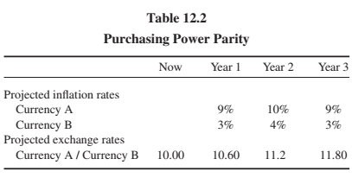
Financial model (Inputs)
1.4. EXCHANGE RATES AND CURRENCY OF THE MODEL
There are two approaches to projecting exchange rates between currencies, similar to those for projecting interest rates: either (a) speciﬁc assumptions can be made as to the future exchange rates, or (b) purchasing power parity rates can be used. The latter calculation takes the difference in projected inﬂation rates between the two currencies and adjusts the exchange rate accordingly, based on the assumption that the future exchange rate between the two currencies will move in line with their inﬂation differential (see Table 12.2. In year 1, with a difference between the two inﬂation rates of 6% in favor of Currency B, Currency A depreciates against Currency B by 6%, and so on.

Slide 18
Financial model (Inputs)
1.5. GDP AND TRAFFIC GROWTH
Infrastructure projects may be affected by the general growth rate of the economy, which translates itself into trafﬁc for the project. For example, there has been a fairly consistent ratio between the rate of long-term growth in air travel and GDP, with air travel’s growth at twice that of GDP. Thus, assumptions in the GDP growth rate are crucial for an airport-related project. A similar situation is likely to apply for a project involving road trafﬁc or other forms of transportation.

Slide 19
Financial model (Inputs)
2. PROJECT COSTS AND FUNDING
The next stage in the detailed modeling process is the preparation of a budget for the construction costs from the Project Company’s point of view and determining how these are to be funded.
2.1. PROJECT COSTS
The project cost budget takes into account costs incurred since the beginning of the project development and covers the period until the project is complete and ready to operate. A typical budget for a process plant or infrastructure project is likely to include:
Development costs. These are the costs incurred by the Sponsors (and charged on to the Project Company), or by the Project Company itself, in the period prior to Financial Close. Sponsors need to agree among themselves to a methodology for allocating their own costs to the project, including staff overheads and travel costs, which are likely to be signiﬁcant over a long development period. Costs of the Sponsors’ or Project Company’s advisers also need to be taken into account.

Slide 20
Financial model (Inputs)
2.1. PROJECT COSTS (continued)
Development fees. Project economics may allow one or more Sponsors to take out an initial fee from the Project Company for developing the project, and thus realize an upfront proﬁt. This ﬁgure may ﬂuctuate (or be eliminated entirely) as the ﬁnancial evaluation of the project develops.
Project Company costs. These include costs after Financial Close such as:
  Personnel costs
  Ofﬁce and equipment
  Costs for Permits and licenses
  Owner’s Engineer costs (for construction supervision)
  Training and mobilization costs.

Slide 21
Financial model (Inputs)
2.1. PROJECT COSTS (continued)
Construction phase insurance.
EPC Contract price.
Start-up costs. These are costs for any fuel or raw materials used by the EPC Contractor during the testing and start-up of the project, before ﬁnal completion; in some projects it may also be possible to earn some revenue from the project’s output during this period to offset these costs.
EPC contract: A form of building contract used for a large or otherwise complex project under which the builder (the EPC contractor) will deliver a completed project on a turnkey basis. EPC contract is an abbreviation for engineering, procurement and construction contract.

Slide 22
Financial model (Inputs)
2.1. PROJECT COSTS (continued)
Initial spares. These are costs for initial stocks of spare parts (if these are not included in the EPC Contract).
Working capital. The working capital required for operation of the project is the amount of money required to cover the time difference over the Project Company’s invoicing cycle between payment of operating costs and receipt of revenues in cash. The initial working capital requirement can be calculated as the costs that the Project Company has to incur until it receives its ﬁrst revenues. These costs may include:
  Initial inventories of fuel or other raw materials
  Ofﬁce and personnel costs
  The ﬁrst operating insurance premium
  Any timing differences between payments for input supplies and product outputs

Slide 23
Financial model (Inputs)
2.1. PROJECT COSTS (continued)
Taxes. These include taxes payable on the various project costs, such as VAT or sales taxes.
Financing costs. These include:
  Loan arrangement and underwriting fees
  Loan or security registration costs
  Costs of lenders’ advisers (both before and after Financial Close)
  Interest during construction (IDC)
Contingency. The contingency needs to be added to the project costs.

Slide 24
Contingency reserves
Contingency reserves are established to cover project risks that are identified and unknown. When, where, and how much money will be spent is not known until the risk event occurs.
Project “owners” are often reluctant to set up project contingency funds that seem to imply the project plan might be a poor one. Some perceive the contingency fund as an add-on slush fund. Others say they will face the risk when it materializes. Usually, such reluctance to establish contingency reserves can be overcome with documented risk identification, assessment, contingency plans, and plans for when and how funds will be disbursed.

Slide 25
Contingency funding
In practice, contingencies run from 1 to 10 percent in projects similar to past projects. However, in unique and high-technology projects it is not uncommon to find contingencies running in the 20 to 60 percent range. Use and rate of consumption of reserves must be closely monitored and controlled.
In practice, the contingency reserve fund is typically divided into budget and management reserve funds for control purposes. Budget reserves are set up to cover identified risks; these reserves are those allocated to specific segments or deliverables of the project. Management reserves are set up to cover unidentified risks and are allocated to risks associated with the total project.

Slide 26
Contingency funding
1. Budget reserves
These reserves are identified for specific work packages or segments of a project found in the baseline budget or work breakdown structure. For example, a reserve amount might be added to “computer coding” to cover the risk of “testing” showing a coding problem.
The budget reserve should be communicated to the project team. This openness suggests trust and encourages good cost performance. However, distributing budget reserves should be the responsibility of both the project manager and the team members responsible for implementing the specific segment of the project. If the risk does not materialize, the funds are removed from the budget reserve. Thus, budget reserves decrease as the project progresses.

Slide 27
Contingency funding
2. Management Reserves
These reserve funds are needed to cover major unforeseen risks and, hence, are applied to the total project. For example, a major scope change may appear necessary midway in the project. Because this change was not anticipated or identified, it is covered from the management reserve. Management reserves are established after budget reserves are identified and funds established.
These reserves are independent of budget reserves and are controlled by the project manager and the “owner” of the project. The “owner” can be internal (top management) or external to the project organization. Most management reserves are set using historical data and judgments concerning the uniqueness and complexity of the project.

Slide 28
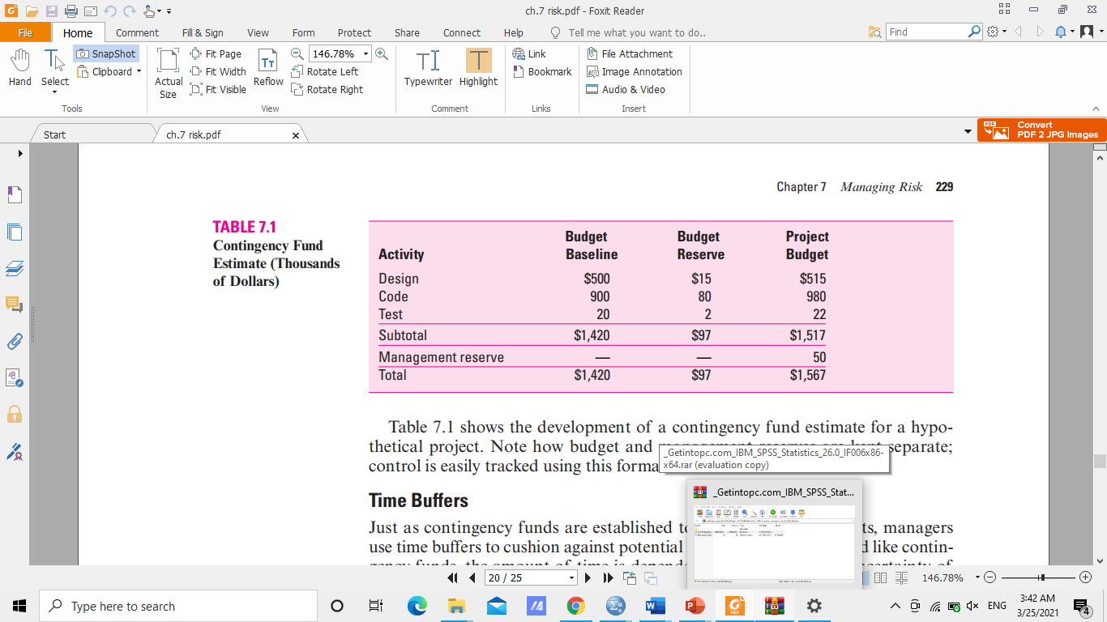
Table 7.1 shows the development of a contingency fund estimate for a hypothetical project. Note how budget and management reserves are kept separate; control is easily tracked using this format.

Slide 29
Financial model
2. PROJECT COSTS AND FUNDING
2.2 PROJECT FUNDING
Based on the cost plan, the funding plan is drawn up to cover the total amount of funding required, divided into debt and equity.
The Project Company should not use a short-term loan to ﬁnance working capital; this is a permanent requirement, which should be covered by the long-term project ﬁnance. However, it may be useful to have part of the project ﬁnance in the form of a revolving credit for working capital (i.e., allowing the Project Company to repay some of the ﬁnancing when it has surplus cash, and reborrow it again when cash is short). This may reduce the required level of Sponsors’ equity and thus also be advantageous for this reason.
Separate short-term funding may be required for VAT or other taxes payable during construction that are recovered from offsetting against taxes on revenues once operations begin.

Slide 30


Resources:
Principles of Project Finance
By:E.R. Yescombe
First edition
www.yescombe.com

Slide 31


Thank you for your attention!

