Slide 1



Introduction to Finance
Prepared by
Dr. Hoda Metwally
MGM 237
Introductory Lecture

Slide 2



Introduction to Finance
Introductory Lecture
MGM 237
Prepared by
Dr. Hoda Metwally

Slide 3


Introduction to Finance
Prepared by
Dr. Hoda Metwally

Slide 4

Introduction
Dr. Hoda Metwally
PhD Degree in Accounting
Faculty of Business- Ain Shams University.
Experience in teaching Accounting.

Slide 5
Introduction
What is Finance?
Finance is the Science and art of money management.
Finance is concerned with the study of operations, institutions, markets and various financial instruments associated with the transfer of funds in the form of individuals, companies and governments.

Slide 6
Introduction
Financing for individuals
Finance is concerned with studying the decisions of individuals to invest their wealth in the following:
• Amount of spending
• the amount of savings
• How to invest their savings

Slide 7
Introduction
Financing for companies
Finance is concerned with studying the decisions of companies to invest their wealth in the following:
• How does the company provide the necessary funding?
• How does the company invest the funds available to it to achieve the largest possible profit?
• How to take a decision to reinvest the profits of the company or distribute it to the investors?

Slide 8
Introduction
Definition of Financial system
Financial system is a system that facilitates the movement of capital between individuals and institutions within the economy through providing various financial means and mechanisms for exchanging money, such as investors, lenders, and debtors.

Slide 9
Introduction
Financial system elements
• Financial institutions
• Financial Markets
• Financial Instruments

Slide 10
Introduction
These elements work together to facilitate the transfer of capital in the various components of the financial system, the financial system exists at the local, regional and state levels, and the financial system plays an effective role in the process of economic development by connecting savers with investors, which contributes to the creation and maximization of capital gains.
• The money system provides tools to transfer money from savers who have idle money and redistribute them effectively to investors who are able to create investments and achieve profits.

Slide 11
Introduction
Risk
There is always a risk incorporated in every investment like shares or debentures. The two major components of risk systematic risk and unsystematic risk, which when combined results in total risk. The systematic risk is a result of external and uncontrollable variables, which are not industry or security specific and affects the entire market leading to the fluctuation in prices of all the securities.

Slide 12
Introduction
On the other hand, unsystematic risk refers to the risk which emerges out of controlled and known variables, that are industry or security specific.
Systematic risk cannot be eliminated by diversification of portfolio, whereas the diversification proves helpful in avoiding unsystematic risk.

Slide 13
Introduction
Portfolio Diversification
Most people have heard the old saying, "Don't put all your eggs in one basket.
Diversification is a risk management strategy that mixes a wide variety of investments within a portfolio. A diversified portfolio contains a mix of distinct asset types and investment vehicles in an attempt at limiting exposure to any single asset or risk.
The rationale behind this technique is that a portfolio constructed of different kinds of assets will, on average, yield higher long-term returns and lower the risk of any individual holding or security.

Slide 14
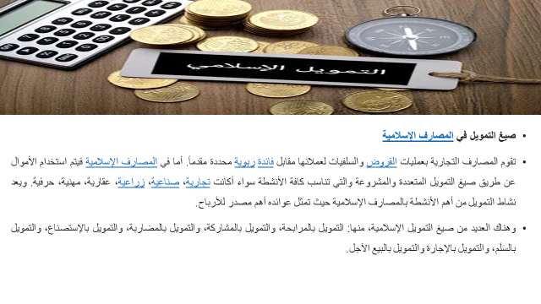

Slide 15


Thank You

