Slide 1




AWS Cloud Security Foundations– AWS-CSF
Dr. Ibrahim Gomaa
Lecture 10: Responding to and Managing an Incident

Slide 2



Lecture
Course Outline
10
Lecture 10: Responding to and Managing an Incident
Topics
Identifying an incident
AWS services that support the discovery
and recognition phase
AWS services that support the resolution
and recovery phase
Best practices for handling an incident
Lab
Remediating an Incident by Using AWS Config and Lambda
Knowledge check
AWS Cloud Security Foundations– AWS-CSF
Lecture 10: Responding to and Managing an Incident
Dr. Ibrahim Gomaa

Slide 3
Lecture
10
Responding to and Managing an Incident
Identifying an incident
AWS Cloud Security Foundations– AWS-CSF
Lecture 10: Responding to and Managing an Incident
Dr. Ibrahim Gomaa

Slide 4
Lecture
Identifying an incident
10
Incident recognition and response
Is a set of information security policies and procedures that you can use to identify, contain, and eliminate cyberattacks
Enables an organization to quickly detect and halt attacks
Helps you to minimize damage and prevent future attacks
AWS Cloud Security Foundations– AWS-CSF
Lecture 10: Responding to and Managing an Incident
Dr. Ibrahim Gomaa

Slide 5
Lecture
Identifying an incident
10
Recognizing incidents
Not all events are incidents in need of immediate remedy.
Let’s take a look at a few examples of such events:
Logging in from a remote location
Failing hard drive that is still fully operational
Employee trying to access resources that they shouldn't access
AWS Cloud Security Foundations– AWS-CSF
Lecture 10: Responding to and Managing an Incident
Dr. Ibrahim Gomaa

Slide 6
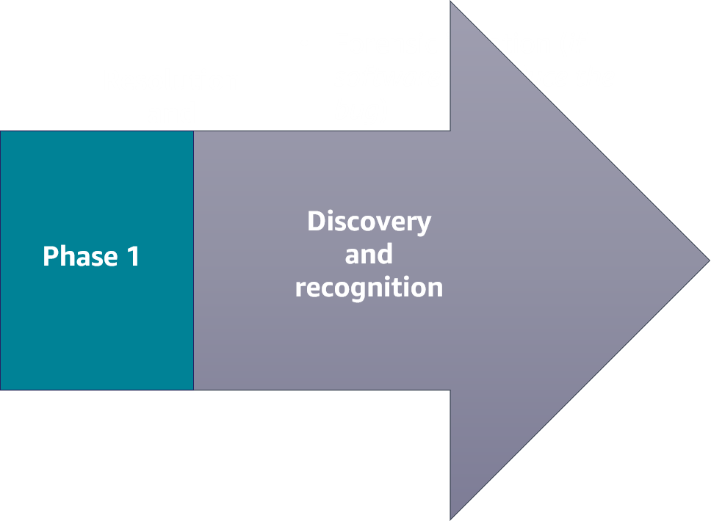
Lecture
Identifying an incident
10
Phase 1: Discovery and recognition
Incident response has two phases. The first phase is the discovery and recognition phase
Incident identification, logging, and categorization
Incident notification and escalation
Investigation and diagnosis
AWS Cloud Security Foundations– AWS-CSF
Lecture 10: Responding to and Managing an Incident
Dr. Ibrahim Gomaa

Slide 7
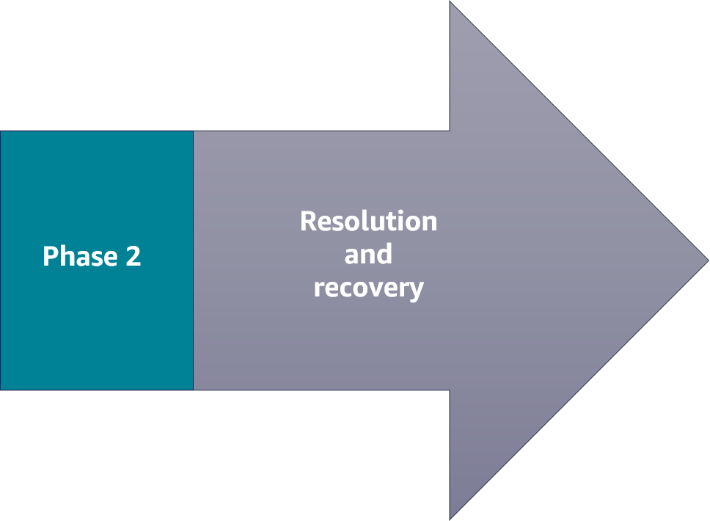
Lecture
Identifying an incident
10
Phase 2: Resolution and recovery
Forensic isolation (if software, reproduce the bug)
Stage a fix: Reproduce the issue, apply a fix, and test
Deploy the fix: Push any new infrastructure as code,
or any new application code to production
Incident closure: Resolve the incident
Automate theses processes wherever possible, and run game days in staging (safe) environments to fine-tune your corporate-wide incident response process.
AWS Cloud Security Foundations– AWS-CSF
Lecture 10: Responding to and Managing an Incident
Dr. Ibrahim Gomaa

Slide 8
Lecture
10
Responding to and Managing an Incident
AWS services that support the discovery and recognition phase
AWS Cloud Security Foundations– AWS-CSF
Lecture 10: Responding to and Managing an Incident
Dr. Ibrahim Gomaa

Slide 9






Lecture
AWS services that support the discovery and recognition phase
10
Discovery and recognition phase
AWS Trusted Advisor
Amazon CloudWatch
Amazon Inspector
Amazon GuardDuty
AWS Shield
AWS Config
AWS Cloud Security Foundations– AWS-CSF
Lecture 10: Responding to and Managing an Incident
Dr. Ibrahim Gomaa

Slide 10
Lecture
AWS services that support the discovery and recognition phase
10
AWS Trusted Advisor
Draws upon best practices learned from serving hundreds of thousands of AWS customers
Inspects your AWS environment, and then makes recommendations when opportunities exist to improve performance and help close security gaps
AWS Trusted Advisor
AWS Cloud Security Foundations– AWS-CSF
Lecture 10: Responding to and Managing an Incident
Dr. Ibrahim Gomaa

Slide 11
Lecture
AWS services that support the discovery and recognition phase
10
Amazon CloudWatch
Provides a reliable, scalable, and flexible monitoring solution that you can start using within minutes
Automatically displays metrics about every AWS service that you use
Provides the ability to create alarms that watch metrics and send notifications
Amazon CloudWatch
AWS Cloud Security Foundations– AWS-CSF
Lecture 10: Responding to and Managing an Incident
Dr. Ibrahim Gomaa

Slide 12
Lecture
AWS services that support the discovery and recognition phase
10
Amazon Inspector
Is a vulnerability management service that continuously scans your AWS workloads for vulnerabilities
Automatically discovers and scans Amazon Elastic Compute Cloud (Amazon EC2) instances and container images that reside in Amazon Elastic Container Registry (Amazon ECR)
Creates a finding when it discovers a vulnerability or network issue
Amazon Inspector
AWS Cloud Security Foundations– AWS-CSF
Lecture 10: Responding to and Managing an Incident
Dr. Ibrahim Gomaa

Slide 13
Lecture
AWS services that support the discovery and recognition phase
10
Amazon GuardDuty
Is a continuous security monitoring service
Identifies unexpected and potentially unauthorized or malicious activity
Uses threat intelligence feeds: such as lists of malicious IP addresses and domains, and machine learning to identify unexpected and potentially unauthorized and malicious activity within your AWS environment, For example, GuardDuty can detect compromised EC2 instances serving malware or mining bitcoin
Amazon GuardDuty
AWS Cloud Security Foundations– AWS-CSF
Lecture 10: Responding to and Managing an Incident
Dr. Ibrahim Gomaa

Slide 14
Lecture
AWS services that support the discovery and recognition phase
10
AWS Shield
Automatically protects an enterprise network from a distributed denial of service (DDoS) attack
Offers the AWS Shield Advanced managed threat protection service to improve your security posture with additional DDoS detection, mitigation, and response capabilities
AWS Shield
AWS Cloud Security Foundations– AWS-CSF
Lecture 10: Responding to and Managing an Incident
Dr. Ibrahim Gomaa

Slide 15
Lecture
AWS services that support the discovery and recognition phase
10
AWS Config
Is a continuous monitoring and assessment service
Provides the ability to view current and historic configurations of a resource and use this information to troubleshoot outages
Sends notifications when changes occur
Integrates with other AWS services to remediate issues
AWS Config
AWS Cloud Security Foundations– AWS-CSF
Lecture 10: Responding to and Managing an Incident
Dr. Ibrahim Gomaa

Slide 16
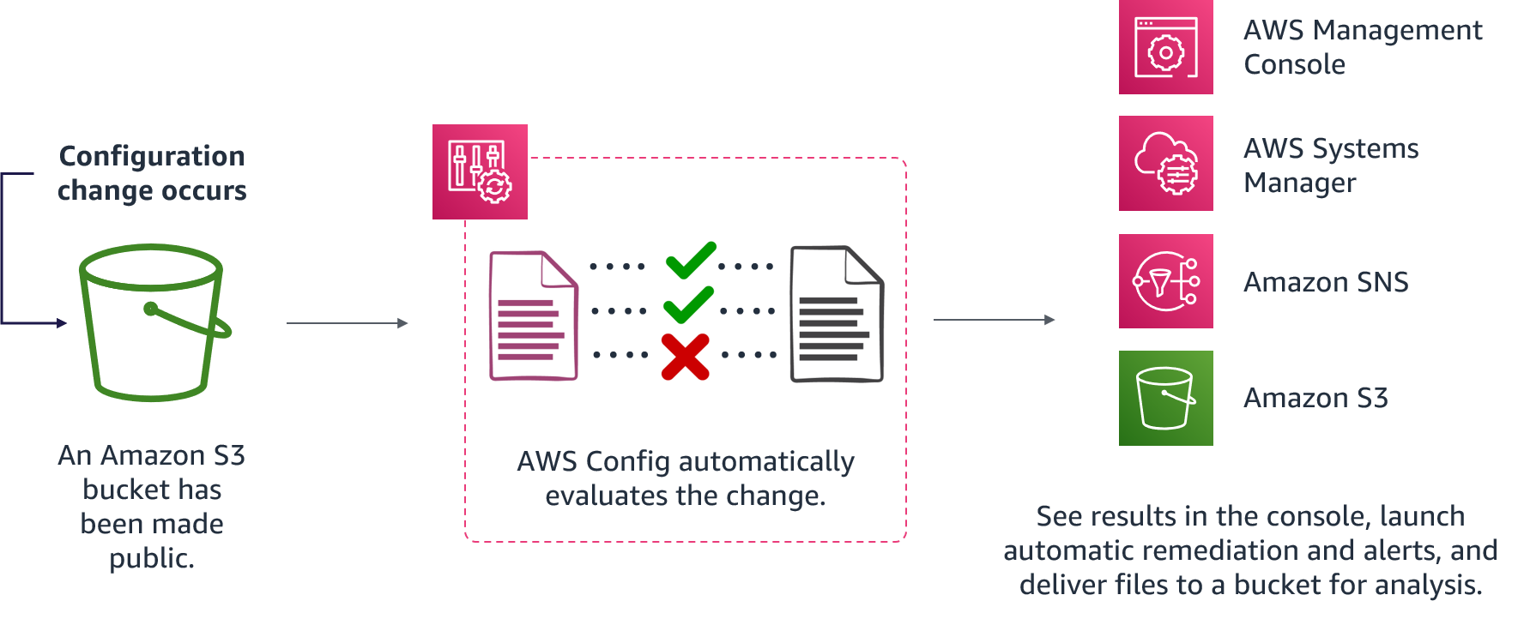
Lecture
AWS services that support the discovery and recognition phase
10
Evaluating AWS Config rules
AWS Cloud Security Foundations– AWS-CSF
Lecture 10: Responding to and Managing an Incident
Dr. Ibrahim Gomaa

Slide 17
Lecture
10
Responding to and Managing an Incident
AWS services that support the resolution and recovery phase
AWS Cloud Security Foundations– AWS-CSF
Lecture 10: Responding to and Managing an Incident
Dr. Ibrahim Gomaa

Slide 18





Lecture
AWS services that support the resolution and recovery phase
10
Resolution and recovery
AWS Systems Manager
AWS CloudFormation
Event-driven responses
is a computer program that is written to respond to actions generated by the user or the system.
Amazon Simple Notification Service (Amazon SNS)
AWS Step Functions
AWS Lambda
AWS Cloud Security Foundations– AWS-CSF
Lecture 10: Responding to and Managing an Incident
Dr. Ibrahim Gomaa

Slide 19
Lecture
AWS services that support the resolution and recovery phase
10
AWS Systems Manager
Gives you visibility and control of your infrastructure on AWS
Provides a unified user interface so that you can view operational data from multiple AWS services
Provides the ability to group resources by application and view operational data for monitoring and troubleshooting
Helps you to keep your instances in their defined state and perform on-demand changes, such as updating applications or running shell scripts
AWS Systems Manager
AWS Cloud Security Foundations– AWS-CSF
Lecture 10: Responding to and Managing an Incident
Dr. Ibrahim Gomaa

Slide 20
Lecture
AWS services that support the resolution and recovery phase
10
AWS CloudFormation
Helps you model and set up your AWS resources so that you can spend less time managing those resources and more time focusing on your applications that run in AWS
Provides the ability to create a template that describes all the AWS resources that you want
Can be used to re-create a staging environment inside an isolated, or forensic, virtual private cloud (VPC)
AWS CloudFormation
AWS Cloud Security Foundations– AWS-CSF
Lecture 10: Responding to and Managing an Incident
Dr. Ibrahim Gomaa

Slide 21
Lecture
AWS services that support the resolution and recovery phase
10
Amazon Simple Notification Service (Amazon SNS)
Is an event-driven web service that provides the ability for applications, end users, and devices to instantly send and receive notifications from the cloud
Amazon Simple Notification Service (Amazon SNS)
AWS Cloud Security Foundations– AWS-CSF
Lecture 10: Responding to and Managing an Incident
Dr. Ibrahim Gomaa

Slide 22

Lecture
AWS services that support the resolution and recovery phase
10
AWS Step Functions
Is a visual workflow service that developers use to build distributed applications, and automate IT and business processes
Provides the ability to create event-driven workflows to manage failures, retries, parallelization, service integrations, and observability so that developers can focus on higher value business logic
AWS Step Functions
When an enterprise experiences abnormalities, implementing Step Functions can help you to create complex business logic in event-driven workflows that connect services, systems, or people within minutes
AWS Cloud Security Foundations– AWS-CSF
Lecture 10: Responding to and Managing an Incident
Dr. Ibrahim Gomaa

Slide 23

Lecture
AWS services that support the resolution and recovery phase
10
AWS Lambda
Is a serverless, event-driven compute service that provides the ability to run code on demand without provisioning or managing servers
Lambda functions are stateless
AWS Lambda
AWS Cloud Security Foundations– AWS-CSF
Lecture 10: Responding to and Managing an Incident
Dr. Ibrahim Gomaa

Slide 24
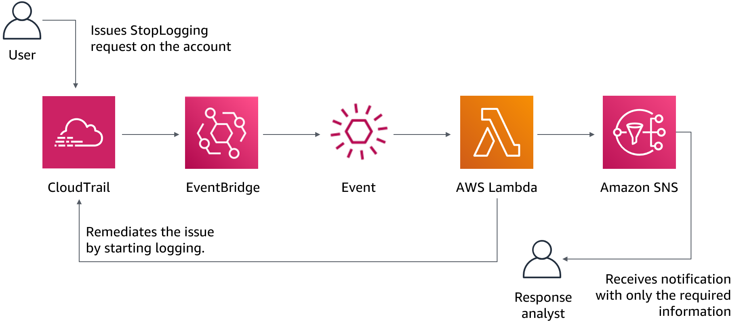
Lecture
AWS services that support the resolution and recovery phase
10
Lambda for incident response
AWS Cloud Security Foundations– AWS-CSF
Lecture 10: Responding to and Managing an Incident
Dr. Ibrahim Gomaa

Slide 25
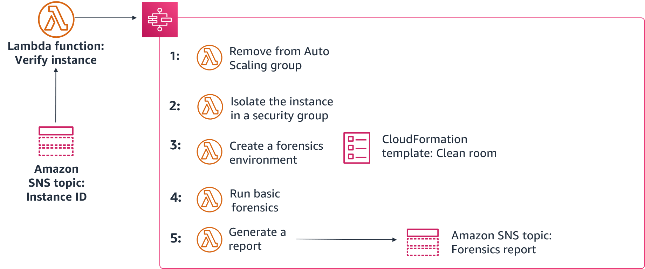
Lecture
AWS services that support the resolution and recovery phase
10
Working together for incident response
an example of how to use Step Functions, Lambda, CloudFormation, and Amazon SNS to remediate a compromised instance.
Then, a Lambda function verifies the ID and, if compromised, initiates the following Step Functions workflow:
First, a script or third-party tool pushes an instance ID to an SNS topic
AWS Cloud Security Foundations– AWS-CSF
Lecture 10: Responding to and Managing an Incident
Dr. Ibrahim Gomaa

Slide 26
Lecture
10
Responding to and Managing an Incident
Best practices for handling an incident
AWS Cloud Security Foundations– AWS-CSF
Lecture 10: Responding to and Managing an Incident
Dr. Ibrahim Gomaa

Slide 27
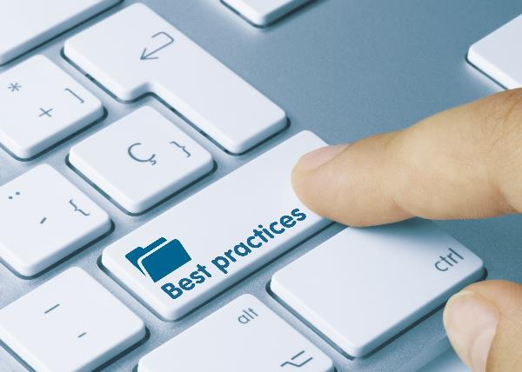
Lecture
Best practices for handling an incident
10
Industry best practices for handling incidents
Identify key personnel, external resources, and tooling.
Automate containment capabilities.
Develop incident response plans.
Pre-provision access and tools.
Run incident response game days.
AWS Cloud Security Foundations– AWS-CSF
Lecture 10: Responding to and Managing an Incident
Dr. Ibrahim Gomaa

Slide 28
Lecture
10
Responding to and Managing an Incident
Thanks
AWS Cloud Security Foundations– AWS-CSF
Lecture 10: Responding to and Managing an Incident
Dr. Ibrahim Gomaa

