Slide 1


Project Quality
Management
Prepared by Dr. Ehab Mahmoud
PMG 354
Ishikawa Basic Tools
Lecture 03

Slide 2



Project Quality
Management
Lecture 3
PMG354
Ishikawa Basic Tools
Prepared by
Dr. Ehab Mahmoud

Slide 3

Lecture
Objectives
03
At the end of this lecture, we expect to acquire a knowledge about Ishikawa basic seven tools that are used to monitor the quality level in achieving projects.

Slide 4

Lecture
Contents
03
Types of Data
Basic Tools of Quality
  Cause and effect diagram
  Check Sheets
  Histogram
  Pareto Diagram
  Process Control Chart
  Scatter Diagram
  Flowchart

Slide 5
Types of Data
Chapter
03
Attribute
Is a quality characteristic that is either present or absent, conforming or not conforming, within tolerance or out of tolerance, complete or incomplete
(invoices percent, number of lost complaints, mistakes per week)
Attributes data are collected by counting
Variable
Is evaluated in terms of measurable values on a continuous scale
(time waiting for service, number of hours per week correcting documents, days from ordering to delivering)
Variables data are collected through measurement

Slide 6
Basic Tools of Quality
Chapter
03
Ishikawa adapted and invented seven basic chart/diagram tools of quality, so that the normal person could analyze and interpret data to identify a problem in the process

Slide 7
The Seven Tools
Chapter
03
Cause and effect (Ishikawa / Fish Bone) diagram - what causes the problems?
Check sheets - how often it occurs or is done?
Histograms - what do overall variations look like?
Pareto diagram - which are the big problems?
Process control charts - which variations to control and how?
Scatter diagram - what are the relationships between factors?
Flow Charts - identify problem areas and opportunities for process improvement.

Slide 8
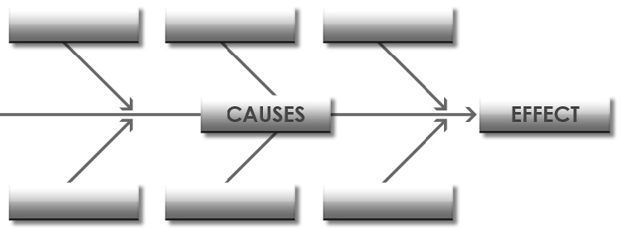
1. Cause and Effect Diagram
Chapter
03

Slide 9
1. Cause and Effect Diagram
Chapter
03
Also called: Ishikawa diagram, Fishbone diagram.
It is an excellent tool for organizing and documenting potential causes of problems in all areas and at all levels in the organization.
It identifies many possible causes for an effect or problem so that further data collection and analysis can be carried out.
No statistics involved.

Slide 10
1. Cause and Effect Diagram
Chapter
03
It looks like a “Fish Skeleton”.
It can be used through a brainstorming session.
It easily sorts ideas into useful/helpful categories which makes improvement easier.
Methods
Man-Power
Cause 1
Cause 2
Cause 3
Effect
Machine
Materials

Slide 11
1. Cause and Effect Diagram
Chapter
03
The 4 Ss (used in service industry) | The 8 Ps (used in service industry) | The 8 Ms (used in manufacturing)
Surroundings Suppliers Systems Skills | Product = Service Price Place Promotion People Process Physical Evidence Productivity & Quality | Machine Method Material Man-Power Measurement Mother Nature Management Maintenance

Slide 12
Constructing Cause and Effect Diagram
1. Cause and Effect Diagram
Chapter
03
Step 1 - Identify the Problem
Step 2 - Draw “spine” and “bones”
Step 3 – Identify different areas where problems may arise from (may be there are sub-problems).
Employees
Inventory Decline
System

Slide 13
1. Cause and Effect Diagram
Chapter
03
Step 4 – Identify what these specific causes could be.
Employees
Attitude
Training
New trainee
Inventory Decline
Benefits
Practices
Anti-theft tags poorly designed
Expensive products out in the open area
No security / supervision
System

Slide 14
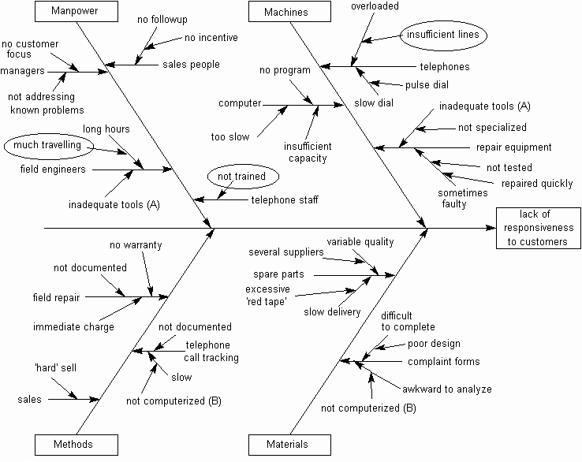
Cause and Effect Diagrams - Example
1. Cause and Effect Diagram
Chapter
03

Slide 15
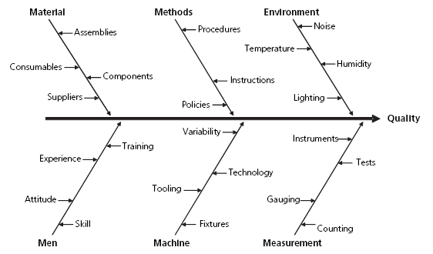
1. Cause and Effect Diagram
Chapter
03
Cause-and-Effect Diagram to identify the factors affecting quality.

Slide 16
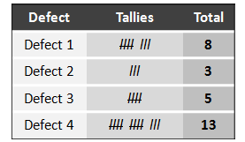
Chapter
2. Check Sheets
03

Slide 17
Chapter
2. Check Sheets
03
Also called: defect concentration diagram
A check sheet is a structured, prepared form for collecting and analyzing data.
Check sheet used when:
  Data can be observed and collected time after time by the same person or at the same location,
  Collecting data on the frequency or patterns of events, problems, defects, defect location, defect causes, etc.
  Collecting data from a production process.

Slide 18
Constructing Check Sheets
Chapter
2. Check Sheets
03
Decide what event or problem will be observed.
Decide when data will be collected and for how long.
Design the form. Set it up so that data can be recorded simply by making check marks or similar symbols and so that data do not have to be recopied for analysis.
Label all spaces on the form.
Test the check sheet for a short trial period to be sure it collects the appropriate data and is easy to use.
Each time the targeted event or problem occurs, record data on the check sheet.

Slide 19
Check Sheets – Example: Copier Problem Check Sheet
Chapter
2. Check Sheets
03
Total | Fri. | Thurs. | Wednes. | Tues. | Mon. | Problem Type
 |  |  |  |  |  | Setup routines not standardized
 |  |  |  |  |  | Missing equipment for setup
 |  |  |  |  |  | Failure to separate internal and external tasks
 |  |  |  |  |  | Extensive machine resetting and paper change
 |  |  |  |  |  | Other
 |  |  |  |  |  | Total

Slide 20
Chapter
2. Check Sheets
03
Check Sheets – Example: Telephone interruptions Check Sheet
Total | Fri. | Thurs. | Wednes. | Tues. | Mon. | Problem Type/Reason
20 |  |  |  |  |  | Wrong number
10 |  |  |  |  |  | Information request
19 |  |  |  |  |  | Other
49 | 13 | 8 | 10 | 6 | 12 | Total

Slide 21
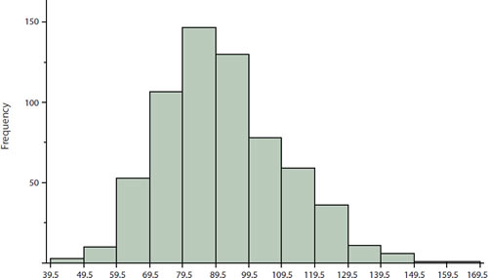
Chapter
3. Histogram
03

Slide 22
Chapter
3. Histogram
03
Also called: Bar chart
Histogram is a graphical representation of the variation in a set of data to show frequency distributions.
Patterns can be seen that would be difficult to see in an ordinary table of numbers.
Histogram used when the data are numerical, and when you want to see the shape of the data distribution, especially when determining whether the output of a process is distributed approximately normally.

Slide 23
Constructing a Histogram
Chapter
3. Histogram
03
Collect data (preferably 50 or more observations of an item).
Arrange all values in an ascending order.
Compute: Sum, Mean and Range of data
Use range to estimate beginning and end of the Histogram.

Slide 24
Histograms - Example
Chapter
3. Histogram
03
Let’s say the owner of a factory wants a distribution of Thursday Night Sales.
These numbers represent the customers order at the order window at the store.
Data Set from last Thursday
2 1 2 2 4 1 3 1 2 1 2 4 3 4 1 4 3 2 2 3 2 1 2 2 1 2 2 1 4 2 2 1 2 1 2 2 1 2 1 2 1 2 1 2 1 2 1 2 2 2 1 2 1 2 1 1 2 2 2 3 1 4 2 2 3 2 2 2 1 2 3 2 2 4 2 2 4 4 1 2 2 2 3 2 2 1 2 2 4 2 1 4 2 1 7 2 1 2 2 1 2 1 1 2 1 2 2 2 1 2 2 1 2 2 2 2 4 2 4

Slide 25
Histograms - Example
Chapter
3. Histogram
03
Mean = 2.032258, Max = 7 , Min = 1 , Range = 6
Frequency | Orders
33 | 1
65 | 2
8 | 3
12 | 4
0 | 5
0 | 6
1 | 7
# times ordered
Units of product

Slide 26
Histograms - Example
Chapter
3. Histogram
03
This was helpful to factory in showing orders frequencies, variation, and forecasting next Thursday’s demand.
Knowing that the average customer will order 2 units of products can be implemented into factory’s strategic plan.
By taking at least 2 units will be ready at peak hours, this can improve factory’s customer service and speed. It makes the line move much faster making the perceived quality higher for the customer.
First value= 33X1+65X2+8X3+12X4+5X0+6X0+1X7=242
Second value= 33+65+8+12+0+0+1=119
Mean=242/119=2.032

Slide 27
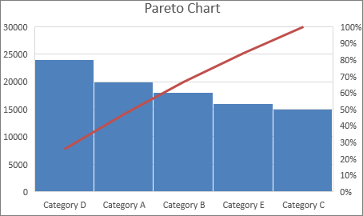
Chapter
4. Pareto Diagram
03

Slide 28
Chapter
4. Pareto Diagram
03
Also called: Pareto chart, Pareto analysis.
Pareto diagram is very similar to Histograms, but it shows percentages, and prepared to show frequency of occurrences.
Pareto analysis separates the vital few from the trivial many and provides direction for selecting projects for improvement.
A Pareto diagram is a bar graph.
  The lengths of the bars represent frequency, cost, time, money; and are arranged with longest bars on the left and the shortest to the right.
  In this way the chart shows which situations are more significant.
ا

Slide 29
Chapter
4. Pareto Diagram
03
Pareto diagram used to analyze data about the frequency of problems or causes in a process, and when there are many problems or causes and you want to focus on the most significant.
Sometimes it is used after doing a cause-and-effect analysis, to count the frequency of different causal factors, and to identify problems.
So, it is used to identify and prioritize problems to be solved.

Slide 30
Constructing Pareto Chart
Chapter
4. Pareto Diagram
03
Determine the categories of problems or causes to be compared.
Collect and Summarize the Data. Create a four-column table with the headings of “problem category”, “frequency”.
  Problem category: list the categories of problems or causes.
  Frequency: write the total for each of the categories over the selected period.

Slide 31
Chapter
4. Pareto Diagram
03
Label the left-hand vertical axis.
  Make sure the labels are spaced in equal intervals from 0 to a round number equal to or just larger than the total of all counts.
  Provide a caption to describe the unit of measurement being used (frequency, quantity, cost and time).
Label the horizontal axis.
  Label the categories from largest to smallest.
Plot a bar for each category.
  The height of each bar should equal the count for that category.

Slide 32
Chapter
4. Pareto Diagram
03
Add a cumulative line.
  This is optional.
  Label the right axis from 0 to 100%, and line up the 100% with the grand total on the left axis.
Continue the process for all the bars.
  Connect the dots, starting at the top of the first bar.
  The last dot should reach 100 percent on the right scale.
Add title, legend, and date.
Analyze the diagram.

Slide 33
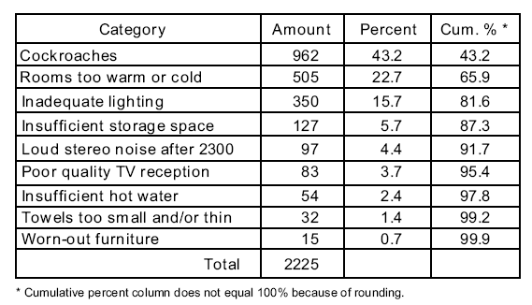
Pareto Chart – Hotel Example
Chapter
4. Pareto Diagram
03
Left
Y-
Axis
962/2225
= 0.432*100
= 43.2
22.7+43.2
= 65.9
Registered Complaints
Causes/
/Problems
X-
Axis
Right
Y-
Axis

Slide 34
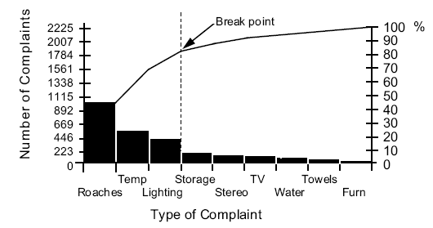
Pareto Chart – Hotel Example
Chapter
4. Pareto Diagram
03
80% line
Cumulative
Problems

Slide 35
Chapter
4. Pareto Diagram
03
Pareto Chart – Customer Complaint Example
Types of customer complaints
70
60
50
40
30
20
10
Documents
Product quality
Packaging
Delivery
0
Other

Slide 36
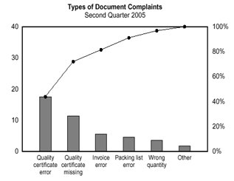
Chapter
4. Pareto Diagram
03
Types of customer complaints - Documents
Taking the largest category, “documents,” from Example1, breaks it down into six categories of document related complaints, and shows cumulative values.
80% line
80% of problems caused by 20% of complaints
Significant few
Insignificant
many
Quality certificate
error
Quality certificate missing
Invoice
error
Packing
error
Wrong quality
Other

Slide 37
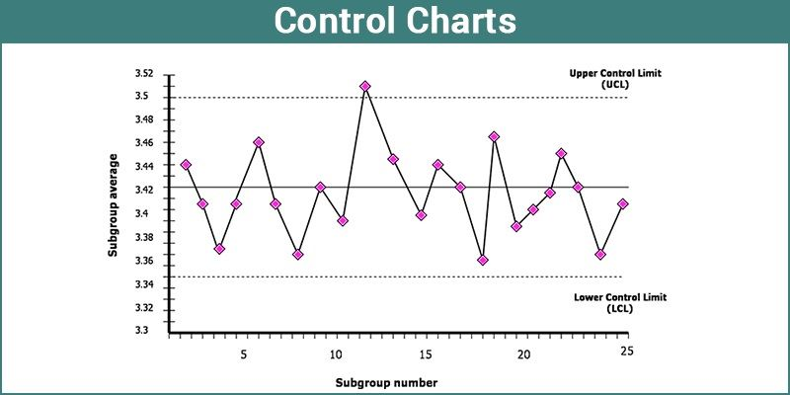
Chapter
5. Process Control Chart
03

Slide 38
Chapter
5. Process Control Chart
03
Also called: statistical process control (SPC)
The control chart is a graph used to study how a process changes over time and data are plotted in time order.
It help understand the nature of variation in a process.
It used to distinguish between common causes and special causes in process variation to identify the effects of special causes.
A control chart always has a central line for the average, an upper line for the upper control limit and a lower line for the lower control limit. These lines are determined from historical data.

Slide 39
Chapter
5. Process Control Chart
03
By comparing current data to these lines, you can draw conclusions about whether the process variation is consistent (in control) or is unpredictable (out of control, affected by special causes of variation).
Control Chart used when:
  Controlling ongoing processes by finding and correcting problems as they occur.
  Want to make judgments of the process performance over a certain period of time.
  Determining whether a process is stable (in statistical control).
  Analyzing patterns of process variation from special causes (non-routine events) or common causes (built into the process).
  Determining whether your quality improvement project should aim to prevent specific problems or to make fundamental changes to the process.

Slide 40
Process Control Charts – Factory Example
Chapter
5. Process Control Chart
03
A quality control department wants to get in on the control chart action for die as follows:
  Upper Limit = 17 inches
  Average Diameter = 16 inches
  Lower Limit = 15 inches

Slide 41
Process Control Charts – Factory Example
Chapter
5. Process Control Chart
03
Upper Limit
17 inches
Lower Limit
15 Inches
X
=16 inches
Dies within specifications were acceptable
One abnormally small die is “uncommon” and should be examined for quality control
Small Die

Slide 42
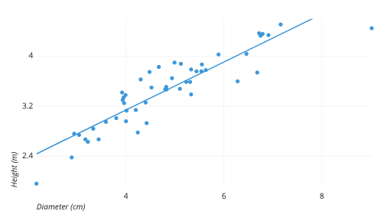
Chapter
6. Scatter Diagram
03

Slide 43
Chapter
6. Scatter Diagram
03
Also called: Scatter plot, X–Y graph
2-Dimensional X/Y plots, used to show relationship between independent (x) and dependent (y) variables.
It graphs pairs of numerical data, with one variable on each axis, to look for/ examine a relationship between them (direct or indirect relationship).
If the variables are correlated/connected, the points will fall along a line or curve. The better the correlating, the higher the points will hug the line.

Slide 44
Constructing Scatter Diagram
Chapter
6. Scatter Diagram
03
Collect pairs of data where a relationship is suspected.
Draw a graph with the independent variable on the horizontal axis and the dependent variable on the vertical axis. For each pair of data, put a dot or a symbol where the x-axis value intersects the y-axis value. (If two dots fall together, put them side by side, touching, so that you can see both).
Look at the pattern of points to see if a relationship is obvious. If the data clearly form a line or a curve, you may stop. The variables are correlated. Otherwise, complete plotting points. Scatter diagrams will generally show one of six possible correlations between the variables:

Slide 45
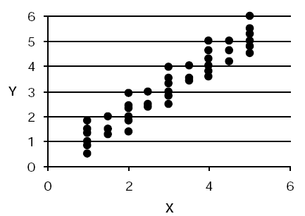
Strong Positive Correlation
Chapter
6. Scatter Diagram
03
The value of Y clearly increases as the value of X increases.

Slide 46
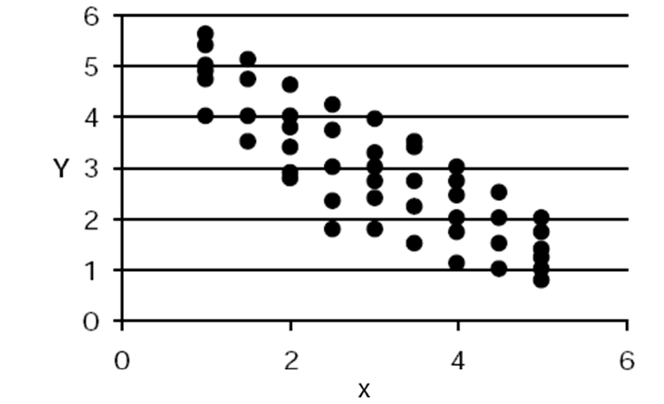
Chapter
6. Scatter Diagram
03
Strong Negative Correlation
The value of Y clearly decreases as the value of X increases.

Slide 47
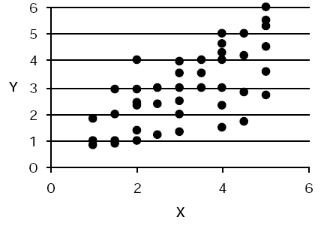
Chapter
6. Scatter Diagram
03
Weak Positive Correlation
The value of Y increases slightly as the value of X increases.

Slide 48
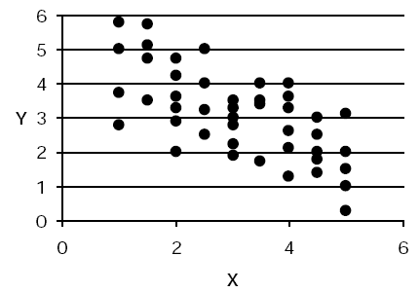
Chapter
6. Scatter Diagram
03
Weak Positive Correlation
The value of Y decreases slightly as the value of X increases.

Slide 49
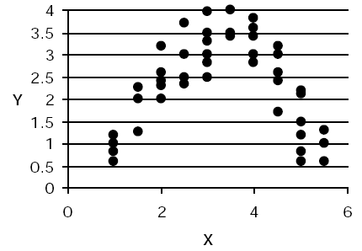
Chapter
6. Scatter Diagram
03
Complex Correlation
The value of Y seems to be related to the value of X, but the relationship is not easily determined.

Slide 50
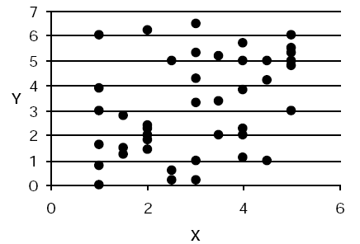
Chapter
6. Scatter Diagram
03
No Correlation
  There is no demonstrated connection between the two variables.

Slide 51
Scatter Diagram – Factory Example
Chapter
6. Scatter Diagram
03
Minutes Defective products
10 1
45 8
30 5
75 20
60 14
20 4
25 6
In this simple example, you can find the existing relationship without much difficulty but… the Scatter Plot will make this easier to see.

Slide 52
Scatter Diagram – Factory Example
Chapter
6. Scatter Diagram
03
There is a direct relationship between time spent in production by employees and defects. As Time production increases, so does the number of defects.
Defective products
Production time (minutes)

Slide 53
Scatter Diagram – Factory Example
Chapter
6. Scatter Diagram
03
There is obviously some kind of process problem with the number of defective products being produced.
Maybe the machine are not good from working too fast.
Or maybe morale is low and there is just uninterested work being done.
Whatever the case, if this was happening, quality improvements would have to be studied and implemented.

Slide 54
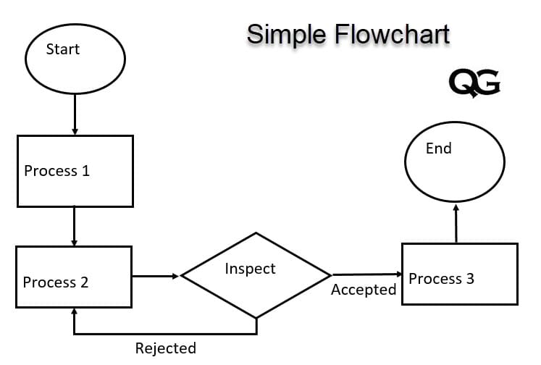
Chapter
7. Flowchart
03

Slide 55
Chapter
7. Flowchart
03
  A flow chart is a symbolic representation showing all of the steps of a process in a sequence to show the nature and flow of the steps in a process.
Flow charts can be used in identify problem areas and opportunities for process improvement.
Process/
instructions or actions
  The start or end
  of a process
Decision
Data
Process
flow

Slide 56
Chapter
7. Flowchart
03
Flow chart help facilitator guide the discussion by asking questions such as "What happens next?" "Who makes the decision at this point?" and "What operation is performed here?"
Flow chart can answer these questions:
  How does this operation affect the customer?
  Can we improve or eliminate this operation?
  Should we control a critical quality characteristic at this point?

Slide 57
Chapter
7. Flowchart
03
FLOW CHART
SIMPLE
CROSS-FUNCTIONAL
HORIZONTAL
VERTICAL

Slide 58
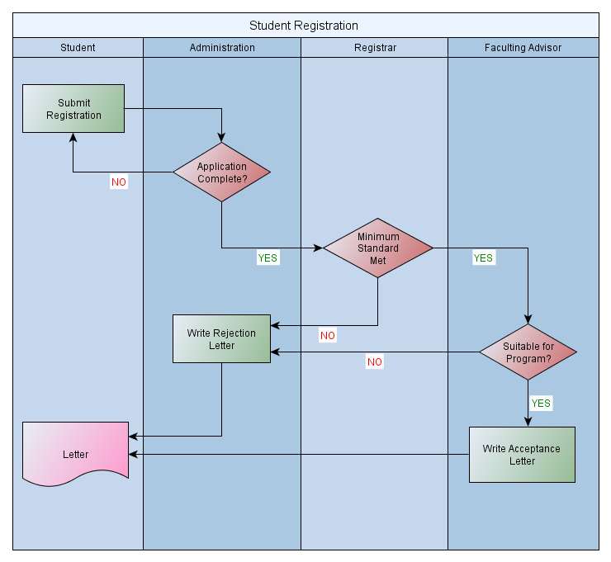
Simple Flowchart Example
Chapter
7. Flowchart
03
Make sure every feedback loop is closed

Slide 59
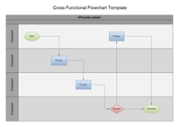
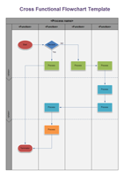
Cross-functional Flowchart
Chapter
7. Flowchart
03
Types | Sample | Description
Horizontal |  | Bands representing functional units run horizontally across the drawing page, highlighting the functional unit.
Vertical |  | Bands representing the functional units run vertically from the top to the bottom of the page, highlighting the milestones/phases

Slide 60
Chapter
7. Flowchart
03
Horizontal Cross-functional Flowchart Example
Order received
N
y
Order fulfillment process

Slide 61
Chapter
7. Flowchart
03
Horizontal Cross-functional Flowchart Example

Slide 62



Thank You

