Slide 1


Master of Financial Technology
Prepared by Dr. Yara Ibrahim
FIN 615
Finance Concepts
Orientation Lecture

Slide 2

www.midocean.ae

Slide 3

FinTech
The word ‘FinTech’ is simply a combination of the words ‘financial’ and ‘technology’.
It describes the use of technology to deliver financial services and products to consumers. This could be in the areas of banking, insurance, investing – anything that relates to finance.
Increasingly, FinTech is coming to represent technologies that are disrupting traditional financial services, including mobile payments, money transfers, loans, fundraising and asset management.
www.midocean.ae

Slide 4
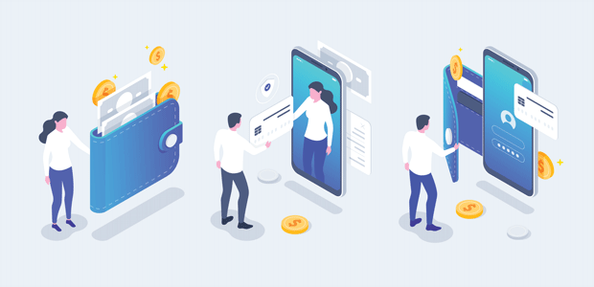
www.midocean.ae

Slide 5
Fintech Evolution
When fintech emerged in the 21st century, the term was initially applied to the technology employed at the backend systems of established financial institutions, such as banks.
From 2018 or so to 2022, there was a shift to consumer-oriented services. Fintech now includes different sectors and industries such as education, retail banking, fundraising and nonprofit, and investment management, to name a few.
Fintech also includes the development and use of cryptocurrencies, such as Bitcoin.
www.midocean.ae

Slide 6
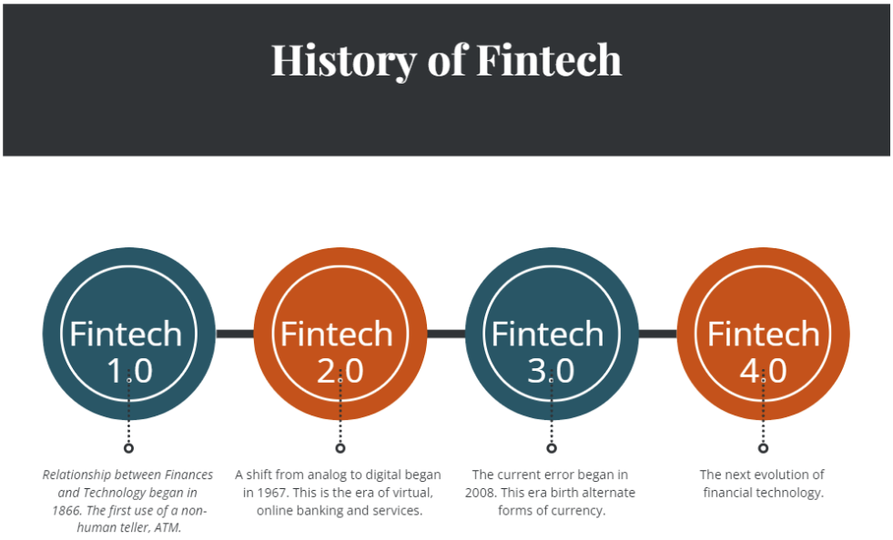
Fintech Evolution
www.midocean.ae

Slide 7
FinTech Drivers
A number of factors have conflated to turn FinTech into the poster child that continues to grab the headlines.
  The rapid rate of technology development, high level of smart phone penetration which have enabled service improvements, especially faster payments.
  In today’s digital age, people are seeking easy access, convenience, efficiency and speed. Given the level of service expectations from customers, there is no excuse for businesses not to embrace the latest technologies – and those who refuse will certainly be losing business.
  Moreover, the widespread adoption of mobile and internet technology is being driven by a change in demographics in emerging markets with a more technology savvy and connected generation of middle-income investors. As the income of this younger generation increases over time, it is expected that it will further drive the market size for FinTech.
www.midocean.ae
Notes:
The rapid rate of technology development, high level of smart phone penetration which have enabled service improvements, especially faster payments.
In today’s digital age, people are seeking easy access, convenience, efficiency and speed. They want to conduct transactions via mobile technology platforms and applications, and such activities include managing their financial lives – from tracking their overall spending to applying for a loan and optimising their investment strategies.
Given the level of service expectations from customers, there is no excuse for businesses not to embrace the latest technologies – and those who refuse will certainly be losing business.
Moreover, the widespread adoption of mobile and internet technology is being driven by a change in demographics in emerging markets with a more technology savvy and connected generation of middle-income investors. Investors between the ages of 18 and 34 are more likely to be internet and smartphone users and to participate in social media networks, compared to those aged 35 and older.
As the income of this younger generation increases over time, it is expected that it will further drive the market size for FinTech

Slide 8
FinTech Drivers
FinTech firms have attracted substantial investment in recent years, while public interest has grown significantly.
Most firms have remained small reflecting their knowledge-based business model, but investment in them has risen substantially.
Moreover, COVID-19 has significantly accelerated digital trends. The rapid demand for and use of digital platforms, digital banking, no-touch payments and other FinTech-related services in every region of the world has driven many financial services companies to increase their FinTech investments.
Further, the pandemic has encouraged digitally retail customers to consider new payment methods, with 38 per cent of consumers reporting having discovered a new payment provider during the lockdown.
www.midocean.ae

Slide 9
FinTech Key Players, Products and Trends
When people think of FinTech, they often focus on start-ups that are breaking into areas that banks and other legacy financial institutions have dominated
However, the ecosystem of FinTech companies is considerably broader and covers:
  Incumbent, well-established financial institutions such as HSBC, Barclays, Bank of America and Allstate, which are acquiring or working with FinTech start-ups and building their own innovative solutions;
  Big technology companies that are active in the financial services space but not exclusively so, such as Apple, Google, Facebook, and Twitter;
  Companies that provide infrastructure or technology that facilitates financial services transactions, such as MasterCard, Fiserv, First Data, various financial market utilities, and exchanges such as NASDAQ; and
  Disruptors – the fast-moving companies, often start-ups, focused on a particular innovative technology or process, such as mobile payments, and automated investing.
www.midocean.ae

Slide 10

FinTech Key Players, Products and Trends
As an umbrella term, FinTech covers many technological disruptions related to finance.
They can be classified in several categories: payments, insurance, investment advice, securities clearance and settlement, and alternative funding platforms, all of which are enabled by cross-cutting technologies such as data analytics, blockchain and cybersecurity.
www.midocean.ae

Slide 11
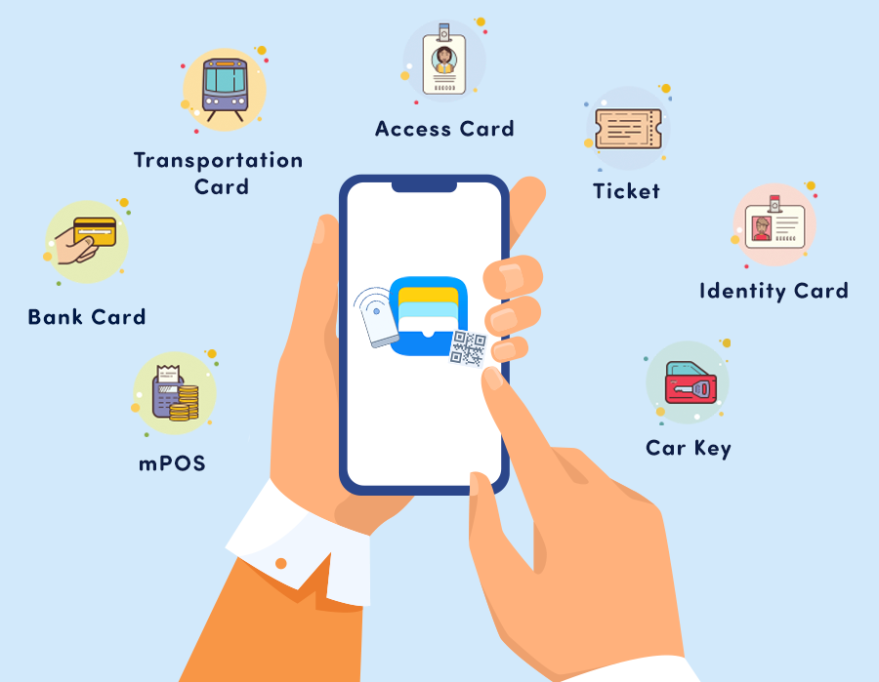
1. Mobile payments and e-wallets
Mobile payments and e-wallets have made a huge impact on how people transact.
Most mobile payment systems are based on a prepaid balance that is transferred by SMS, near-field communication, or using codes, but post-paid or real-time payments are also possible. A natural extension of mobile payments, mobile wallets let users store money and credit cards on their mobile devices and transact through their phones without ever opening their actual wallet.
Google’s Android pay and Apple’s Apple Pay are two of the most well-known mobile wallets.
Paypal has been considered as one of the pioneers of the digital payments industry.
www.midocean.ae

Slide 12
2. Electronic Banking
Mobile access and the internet have been transformational, allowing the gains from technological progress to be shared directly with billions of individual consumers whose mobile devices are now portals for accessing a full range of financial services.
This massive decentralization is opening the door to crowdfunding platforms that disintermediate banks and directly connect those looking for financing with potential investors.
Crowdfunding now means that one can raise money quickly and cheaply from people all over the world that one has never met. It has democratised the process of finding start-up capital and shortened the timeline from perhaps months of meetings to as little as a few weeks
www.midocean.ae

Slide 13

3. Artificial intelligence (AI) and big data
Artificial intelligence (AI) and big data can dissect and analyse large databases through advanced algorithms to derive patterns used to predict behaviour and prices, and ultimately even mimic human judgement in automated decisions.
Related applications can automate credit approvals or advice, facilitate regulatory compliance and fraud detection, and automate the trading of financial assets.
www.midocean.ae

Slide 14

4. Machine learning
A sub-category of AI, machine learning is a method of teaching computers to analyse data, learn from it and then make a determination or prediction regarding new data.
Rather than hand-coding a specific set of instructions to accomplish a particular task, machine learning essentially uses algorithms to allow a system to learn from data.
Machine learning algorithms could be more accurate than humans in some respects, but their outputs come with limited reasoning attached.
Institutions and relevant service providers have already started using machine learning for a variety of purposes, such as credit scoring, for which machine learning could improve services and pricing customisation, given its ability to process significantly larger amounts of data input than classic statistics analysis.
www.midocean.ae
Notes:
For example, a number of new entrant FinTech firms are capitalising on this opportunity by leveraging on large amounts of data to produce challenger credit scoring models that assess creditworthiness faster and supposedly more accurately, and possibly also in cases where conventional data is not available.

Slide 15

5. Biometrics
Biometrics identifies individuals through unique physical characteristics, such as facial recognition, fingerprint and iris verification, as well as behavioural patterns, such as voice identification.
Biometric authentication gives financial institutions independence from passwords, PINs, and tokens, which are susceptible to attack, and can offer significant opportunities, ranging from security to mobile payment solutions.
Notably, however, biometrics is not fool-proof and consequences of any security breach involving biometric information are likely to be much more serious than a security breach involving a password or a PIN.
www.midocean.ae

Slide 16
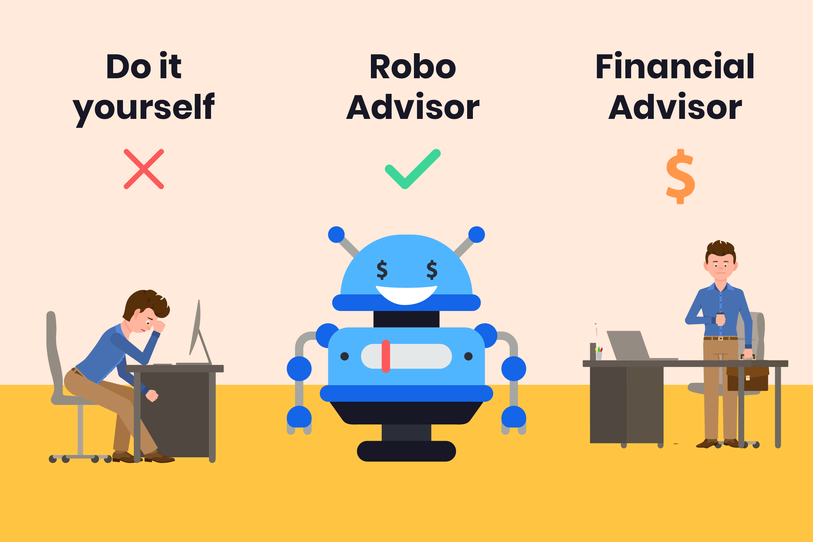
6. Robo-advice
Robo-advice is an online service that uses algorithms to automatically perform many investment tasks done by a human financial adviser.
Initially offered by start-ups, robo-advice is now part of the suite of services offered by major financial institutions such as Vanguard, Schwab and Fidelity.
Since they are less expensive than a human adviser, they democratize access to financial advice – they can take on customers with few savings since adding one more person will not cost much more.
While an automated advice model could help mitigate some of the risks associated with human advisers and managing a large salesforce, ultimately the design of the robo-advice model is crucial and a poorly designed model could lead to systemic mis-selling.
www.midocean.ae

Slide 17
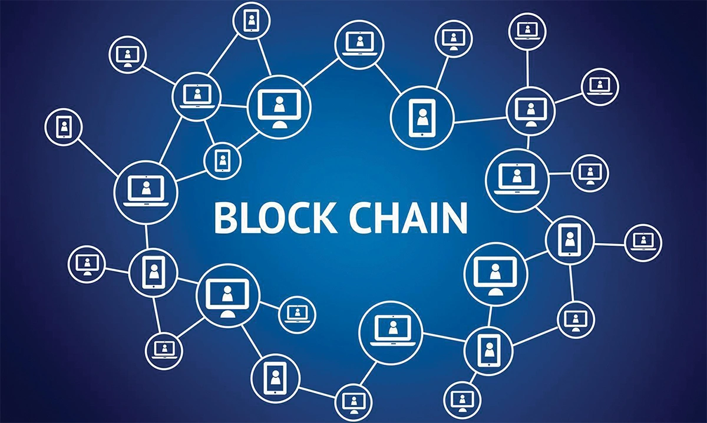
7. Blockchain
Blockchain is a unique type of computerized ledger, which relies on cryptographic techniques and new methods for consensus to capture and secure the data.
It is designed to be read by a computer, rather than by the human eye.
The following traits characterize blockchain:
  the ledger is shared among and worked on by multiple participants, none of which has a single point of control over it;
  an ever-growing chain of ledger entries (‘blocks’) links the entire history in such a way as to prevent tampering with or rewriting past records; and
  digitally signed transactions or instructions indicate intent to record or modify data, or to transfer digital assets.
www.midocean.ae
Notes:
Blockchain technology offers a commonly agreed record of truth to multiple, mutually distrusting participants in an economic system. It uses a decentralised, peer-to-peer network comprised of many users, which maintains a ledger of transactions and relies upon multiple users to confirm the veracity and authenticity of such transactions using cryptography.
Blockchain essentially provides a ‘record book’ of each component of a transaction and this record book is maintained and instantaneously authenticated on a network that is shared between a theoretically infinite number of computers.
When all the members of the network approve a transaction, that transaction is added to the record book and such a transaction cannot be tampered with or altered.
A research report from Goldman Sachs offers a concise summary, explaining the core concept of how the consensus mechanism functions in a blockchain:
(1) It is a database containing transactions between two or more parties, where the copies of this database are replicated across multiple locations and computers being the nodes.
(2) This database is made of ‘a chain of blocks’, with each block containing data such as details of the transaction – the seller, the buyer, the price, the contract terms and other relevant details.
(3) The transaction information contained in each block is validated by all nodes in the network via an algorithm called ‘hashing’. The transaction is valid if the result of hashing is confirmed by all nodes.

Slide 18
Master of Financial Technology
The Master of Financial Technology focuses on developing FinTech services. The program emphasizes the systematic understanding of new digital models in financial services, how technology and innovation are changing financial practices, quantitative finance skills, and applying technologies to financial services.
www.midocean.ae

Slide 19
Program Learning Outcomes
Implement different financial technologies using advanced algorithms with a clear understanding of software and hardware architectures.
Use statistical and quantitative analysis and predictive and exploratory models to make financial decisions.
Conceptualize, analyze, design, and implement digital services for building FinTech applications.
Analysis, design, and implement artificial intelligence systems, including biometrics, prediction systems, and object recognition.
www.midocean.ae

Slide 20
Course Basic Information
Course Instructor | Dr Yara Magdy
Course Title | Finance Concepts
Course Code | FIN 615
Credit Hours | 3
Program | Master of Financial Technology
Faculty | Faculty of Humanities
Language of Instruction | English
Teaching References | Madura, J. (2013). Financial Markets and Institutions. Cenage Learning Arthur J. Keown, John D. Martin, and J. Willian Petty (2017). Foundations of Finance. Pearson.
www.midocean.ae

Slide 21
Course Description
The course emphasizes particularly banks and credit markets, and their role in generating economic growth as well as financial crises. Basic economic theories and models developed to understand these phenomena are covered, and the theoretical analysis is complemented with a historical perspective.
www.midocean.ae

Slide 22
Course Aim
Upon completion of this course, students should be able to:
  Discuss and critically assess different approaches to valuation, including the present value rule and discounting.
  Summarize the evidence on historical returns of different assets.
  List and explain the types of securities that firms can issue to finance themselves.
  Outline and describe the historical development of financial markets and institutions.
  Discuss and critically assess the historical evolution of forms of banking and of banking regulation.
  Understand the types and nature of financial system.
  Analyze financial statements.
  Evaluate projects using capital budgeting techniques.
www.midocean.ae

Slide 23
Course Syllabus
Week | Topic
Week 1 | Orientation Session
Week 2 | Introduction to Financial System
Week 3 | Financial Markets
Week 4 | Foundations of Financial Management
Week 5 | Financial Statements & Analysis - Part 1
Week 6 | Financial Statements & Analysis - Part 2
Week 7 | Financial Statements & Analysis - Part 3
Week 8 | Time Value of Money – Part 1
Week 9 | Time Value of Money – Part 2
Week 10 | Capital Budgeting – Part 1
Week 11 | Capital Budgeting – Part 2
Week 12 | Discussion
Week 13 | Final Exams
www.midocean.ae

Slide 24
Teaching and Learning Methods
Lectures
Discussion
Problem Solving
Quizzes
Final exams
www.midocean.ae

Slide 25



Thank You

