Slide 1

Probability and Statistics
Prepared by Dr.Israa Lewaa
Lecture 2
STA 201
Descriptive Statistics

Slide 2

Chapter
02
Descriptive Statistics
1- Frequency Distributions and Their Graphs
2- More Graphs and Displays
3- Measures of Central Tendency
4- Measures of Variation
5- Measures of Position

Slide 3
Chapter
02
Frequency Distributions and their Graphs
1- Frequency Distributions
2- Graphs of Frequency Distributions

Slide 4
Chapter
02
Frequency Distributions and their Graphs
A frequency distribution is a table that shows classes or intervals of data entries with a count of the number of entries in each class. The frequency f of a class is the number of data entries in the class.
To Draw the frequency table, determine the three items:
1- number of classes
2- Range
3- Class Width

Slide 5
Chapter
02
Frequency Distributions and their Graphs
A frequency distribution is a table that shows classes or intervals of data entries with a count of the number of entries in each class. The frequency f of a class is the number of data entries in the class.
To Draw the frequency table, determine the three items:
1- number of classes
2- Range
3- Class Width

Slide 6
Chapter
02
Example 1
The following sample data set lists the prices (in dollars) of 30 portable global positioning system (GPS) navigators. Construct a frequency distribution that has seven classes.
Construct a Frequency Distribution from a Data Set
90 | 130 | 200 | 400 | 350 | 70 | 325 | 250 | 150 | 250
275 | 270 | 150 | 130 | 59 | 200 | 160 | 450 | 300 | 130
220 | 100 | 200 | 400 | 200 | 250 | 95 | 180 | 170 | 150

Slide 7
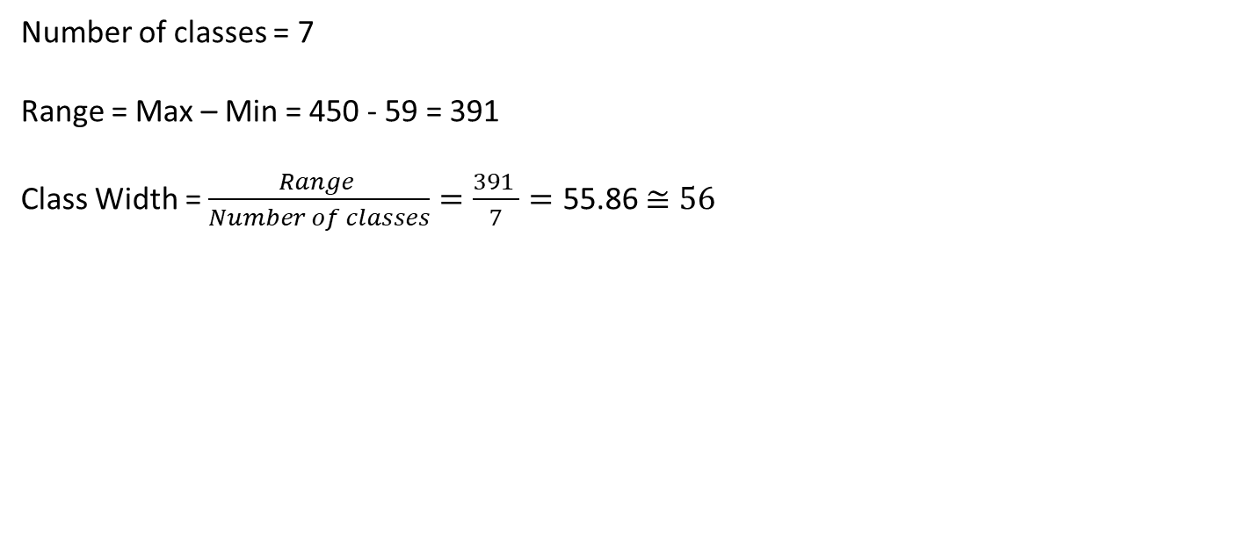
Chapter
02
Solution of Example 1
Number of classes = 7
Range = Max – Min = 450 - 59 = 391
Class Width = $\frac{Range }{Number of classes}=\frac{391 }{7}=\text{55.86}$ $≅56$
90 | 130 | 200 | 400 | 350 | 70 | 325 | 250 | 150 | 250
275 | 270 | 150 | 130 | 59 | 200 | 160 | 450 | 300 | 130
220 | 100 | 200 | 400 | 200 | 250 | 95 | 180 | 170 | 150

Slide 8
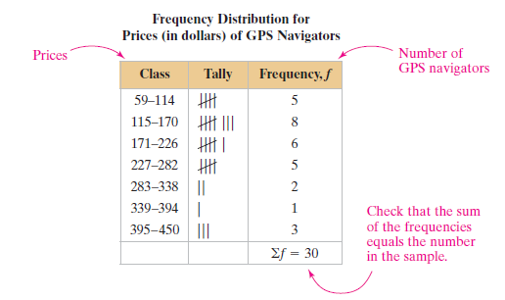

Chapter
02
Frequency Distributions and their Graphs
Class Width = $56$
90 | 130 | 200 | 400 | 350 | 70 | 325 | 250 | 150 | 250
275 | 270 | 150 | 130 | 59 | 200 | 160 | 450 | 300 | 130
220 | 100 | 200 | 400 | 200 | 250 | 95 | 180 | 170 | 150

Slide 9
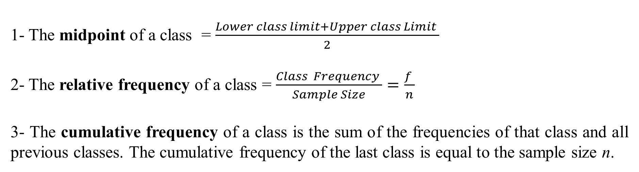
Chapter
02
Cumulative Frequency Distributions
1- The midpoint of a class = $\frac{Lower class limit+Upper class Limit }{2}$
2- The relative frequency of a class = $\frac{Class Frequency }{Sample Size}=\frac{f }{n}$
3- The cumulative frequency of a class is the sum of the frequencies of that class and all previous classes. The cumulative frequency of the last class is equal to the sample size n.

Slide 10
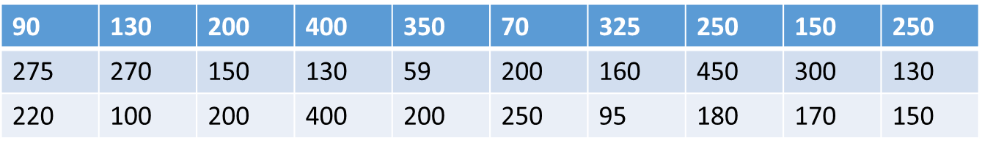
Chapter
02
Example 2
The following sample data set lists the prices (in dollars) of 30 portable global positioning system (GPS) navigators. Construct a frequency distribution that has seven classes.
Find the mid point, Relative frequency and a Cumulative Frequency Distribution from a Data Set above

Slide 11

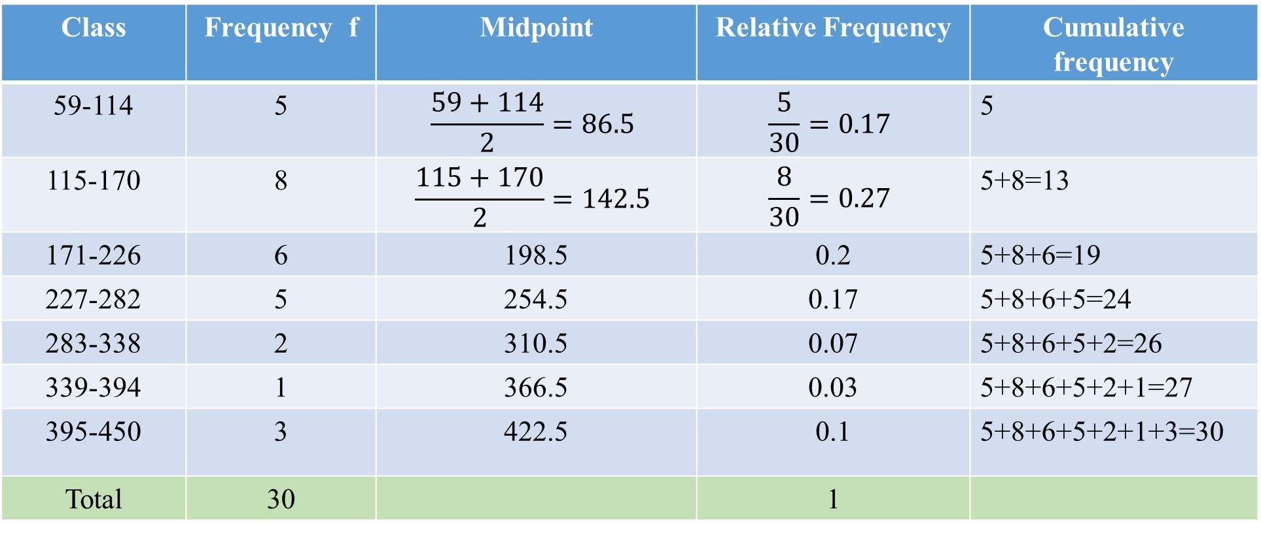
Chapter
02
Solution of Example 2
Class | Frequency f | Midpoint | Relative Frequency | Cumulative frequency
59-114 | 5 | $$\frac{59+114}{2}=86.5$$ | $$\frac{5}{30}=0.17$$ | 5
115-170 | 8 | $$\frac{115+170}{2}=142.5$$ | $$\frac{8}{30}=0.27$$ | 5+8=13
171-226 | 6 | 198.5 | 0.2 | 5+8+6=19
227-282 | 5 | 254.5 | 0.17 | 5+8+6+5=24
283-338 | 2 | 310.5 | 0.07 | 5+8+6+5+2=26
339-394 | 1 | 366.5 | 0.03 | 5+8+6+5+2+1=27
395-450 | 3 | 422.5 | 0.1 | 5+8+6+5+2+1+3=30
Total | 30 |  | 1

Slide 12
Chapter
02
Graphs of Frequency Distributions
1- Frequency Histogram Frequency Histogram
2- Frequency Polygon
3- Relative Frequency Histogram
4- Ogive

Slide 13
Chapter
02
Frequency Histogram
Frequency histogram is a bar graph that represents the frequency distribution of a data set. A histogram has the following properties.
1. The horizontal scale is quantitative and measures the data values.
2. The vertical scale measures the frequencies of the classes.
3. Consecutive bars must touch.

Slide 14
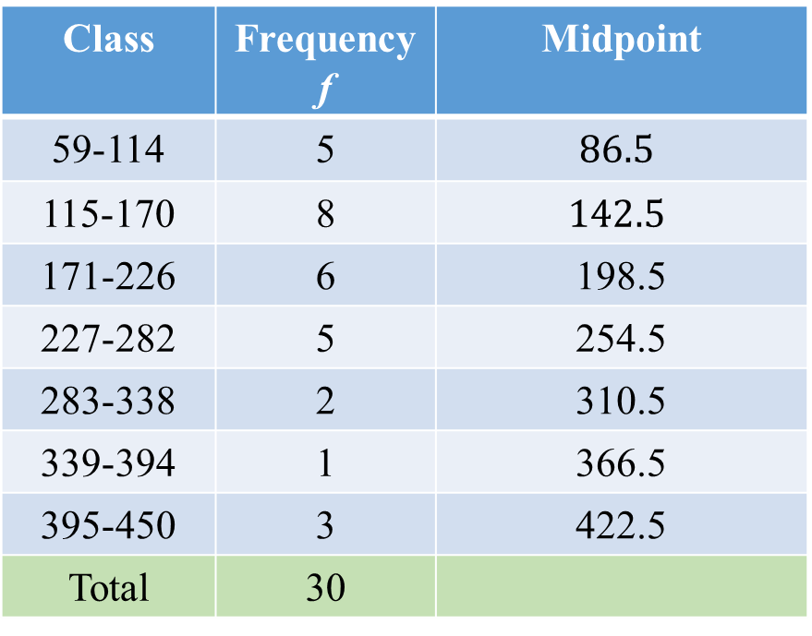
Chapter
02
Example 3
Draw the frequency Histogram based on the data in the below table:
Class | Frequency f | Midpoint
59-114 | 5 | $$86.5$$
115-170 | 8 | $$142.5$$
171-226 | 6 | 198.5
227-282 | 5 | 254.5
283-338 | 2 | 310.5
339-394 | 1 | 366.5
395-450 | 3 | 422.5
Total | 30

Slide 15
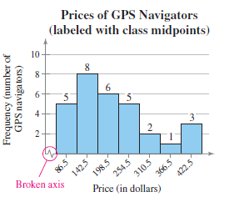
Chapter
02
Frequency Histogram
Midpoint

Slide 16
Chapter
02
Frequency Polygon
A frequency polygon is a line graph that emphasizes the continuous change in frequencies.

Slide 17
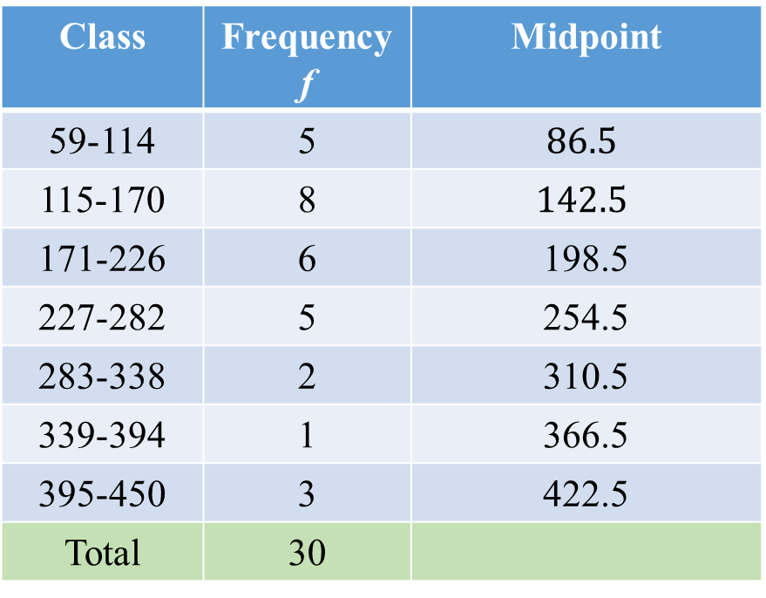
Chapter
02
Example 4
Draw the frequency Polygon based on the data in this table:
Class | Frequency f | Midpoint
59-114 | 5 | $$86.5$$
115-170 | 8 | $$142.5$$
171-226 | 6 | 198.5
227-282 | 5 | 254.5
283-338 | 2 | 310.5
339-394 | 1 | 366.5
395-450 | 3 | 422.5
Total | 30
An increase of midpoints by 56 and the same for other points

Slide 18
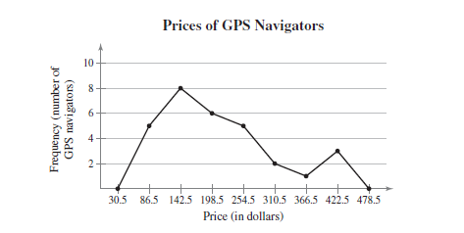
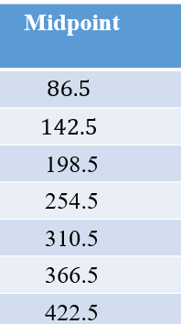
Chapter
02
Solution of Example 4
Frequency Polygon Graph
frequency Polygon

Slide 19
Chapter
02
Relative Frequency Histogram
A relative frequency histogram has the same shape and the same horizontal scale as the corresponding frequency histogram. The difference is that the vertical scale measures the relative frequencies, not frequencies.

Slide 20
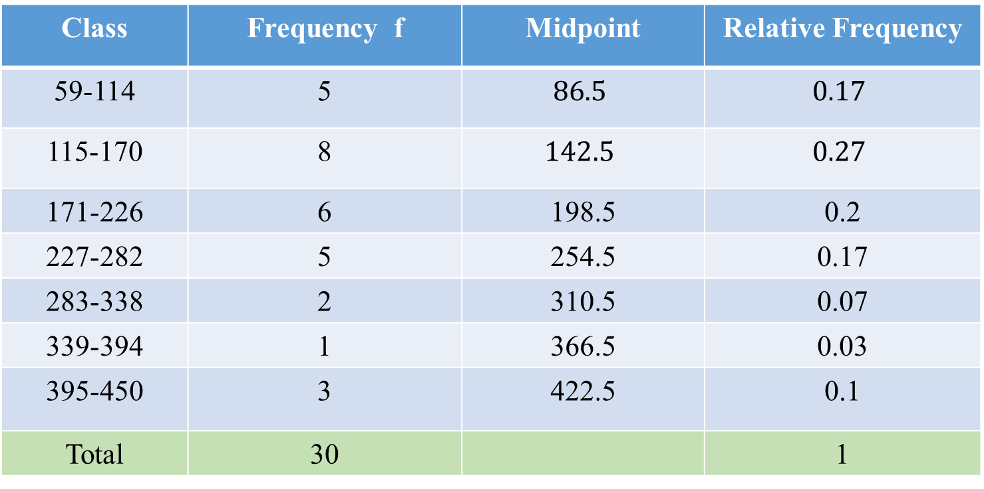
Chapter
02
Example 5
Draw the relative frequency Histogram based on the data in this table:
Class | Frequency f | Midpoint | Relative Frequency
59-114 | 5 | $$86.5$$ | $$0.17$$
115-170 | 8 | $$142.5$$ | $$0.27$$
171-226 | 6 | 198.5 | 0.2
227-282 | 5 | 254.5 | 0.17
283-338 | 2 | 310.5 | 0.07
339-394 | 1 | 366.5 | 0.03
395-450 | 3 | 422.5 | 0.1
Total | 30 |  | 1

Slide 21
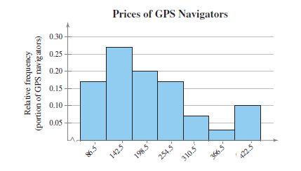
Chapter
02
Solution of Example 5
Relative frequency Histogram Graph

Slide 22
Chapter
02
Steps for constructing an Ogive
Construct a cumulative frequency distribution.
2. Specify the horizontal and vertical scales. The horizontal scale consists of upper class boundaries, and the vertical scale measures cumulative frequencies.
3. Plot points thon the graph.
4. Connect the points in order from left to right.
5. The graph should start at the lower boundary of the first class (cumulative frequency is zero) and should end at the upper boundary of the last class (cumulative frequency is equal to the sample size).

Slide 23
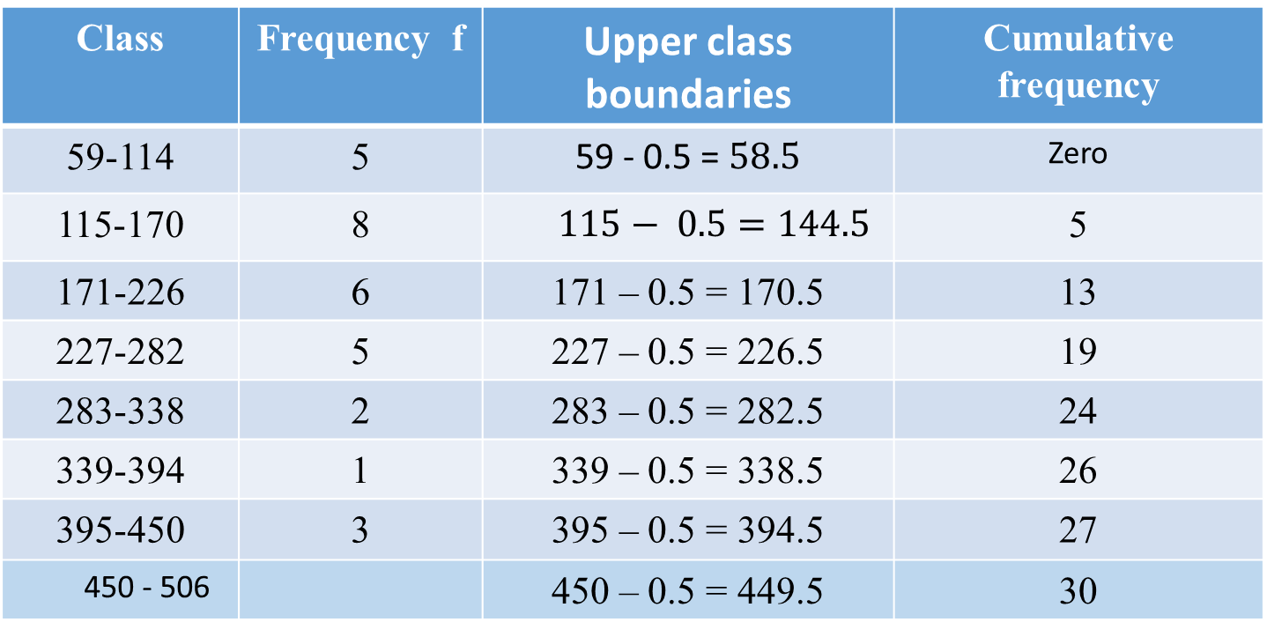
Chapter
02
Example 6
Draw Ogive based on the data in the below table:
Class | Frequency f | Upper class boundaries | Cumulative frequency
59-114 | 5 | 59 - 0.5 = $58.5$ | Zero
115-170 | 8 | $115− 0.5=144.5$ | 5
171-226 | 6 | 171 – 0.5 = 170.5 | 13
227-282 | 5 | 227 – 0.5 = 226.5 | 19
283-338 | 2 | 283 – 0.5 = 282.5 | 24
339-394 | 1 | 339 – 0.5 = 338.5 | 26
395-450 | 3 | 395 – 0.5 = 394.5 | 27
450 - 506 |  | 450 – 0.5 = 449.5 | 30

Slide 24
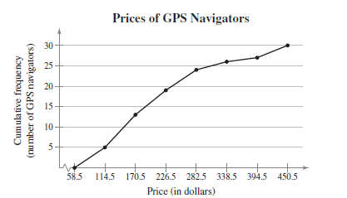
Chapter
02
Solution of Example 6
Ogive Graph

Slide 25
Chapter
02
Frequency Distributions and their Graphs
1- Frequency Distributions and Their Graphs
2- More Graphs and Displays
3- Measures of Central Tendency
4- Measures of Variation
5- Measures of Position

Slide 26
Chapter
02
Measures of Central Tendency
We have three measures of Central Tendency:
1- Mean
2- Median
3- Mode

Slide 27
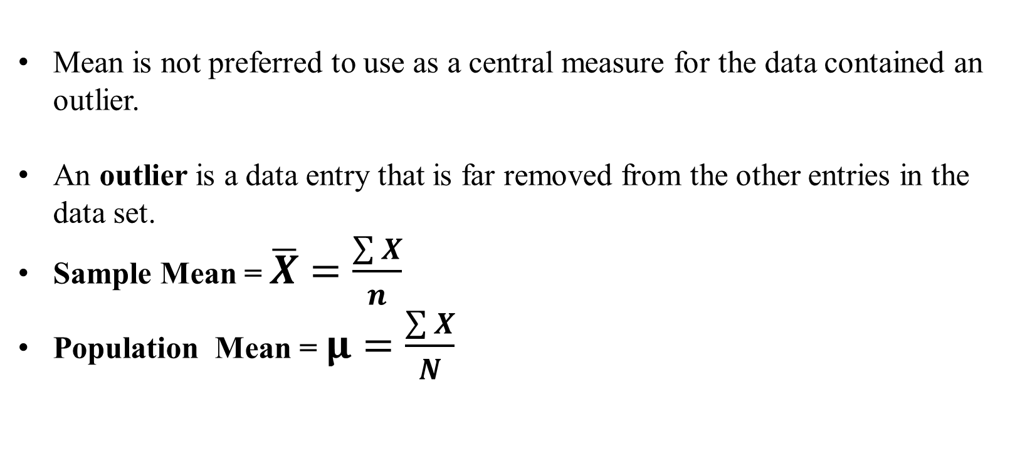
Chapter
02
Important Notes
Mean is not preferred to use as a central measure for the data contained an outlier.
An outlier is a data entry that is far removed from the other entries in the data set.
Sample Mean = $\overline{X}=\frac{\sum{X}}{n}$
Population Mean = $μ=\frac{\sum{X}}{N}$

Slide 28
Chapter
02
Example 7
Given the following Macroeconomics exam grades for a sample of 6 students:
81 75 66 16 90 90
Calculate the central tendency measures and state the best central measure for this data.

Slide 29
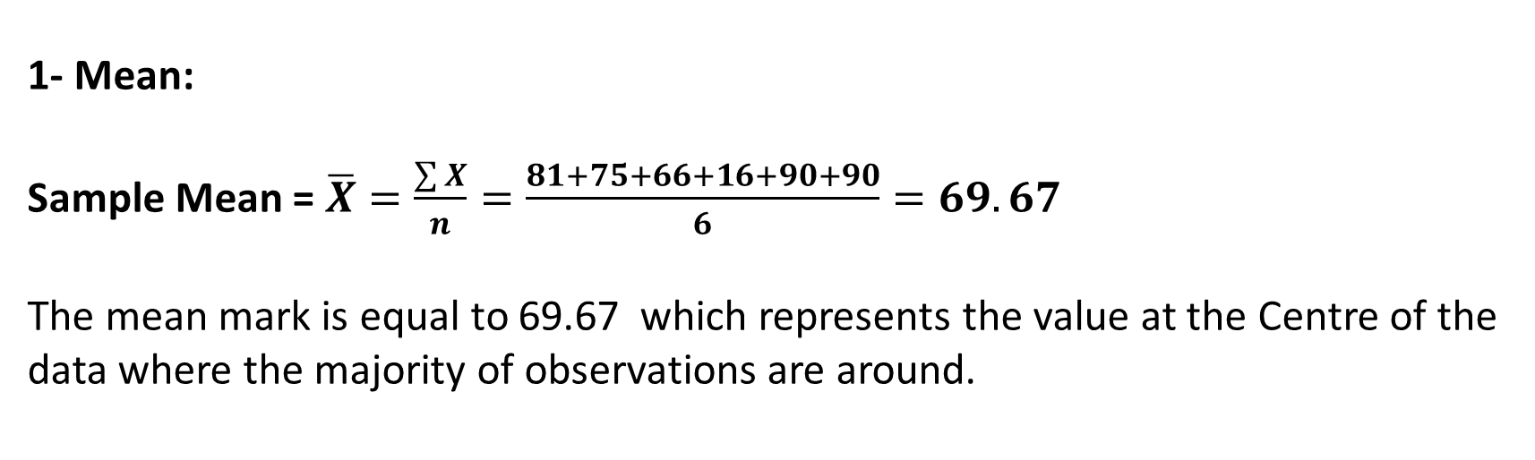
Chapter
02
Solution of Example 7
1- Mean:
Sample Mean = $\overline{X}=\frac{\sum{X}}{n}=\frac{81+75+66+16+90+90}{6}=69.67$
The mean mark is equal to 69.67 which represents the value at the Centre of the data where the majority of observations are around.

Slide 30
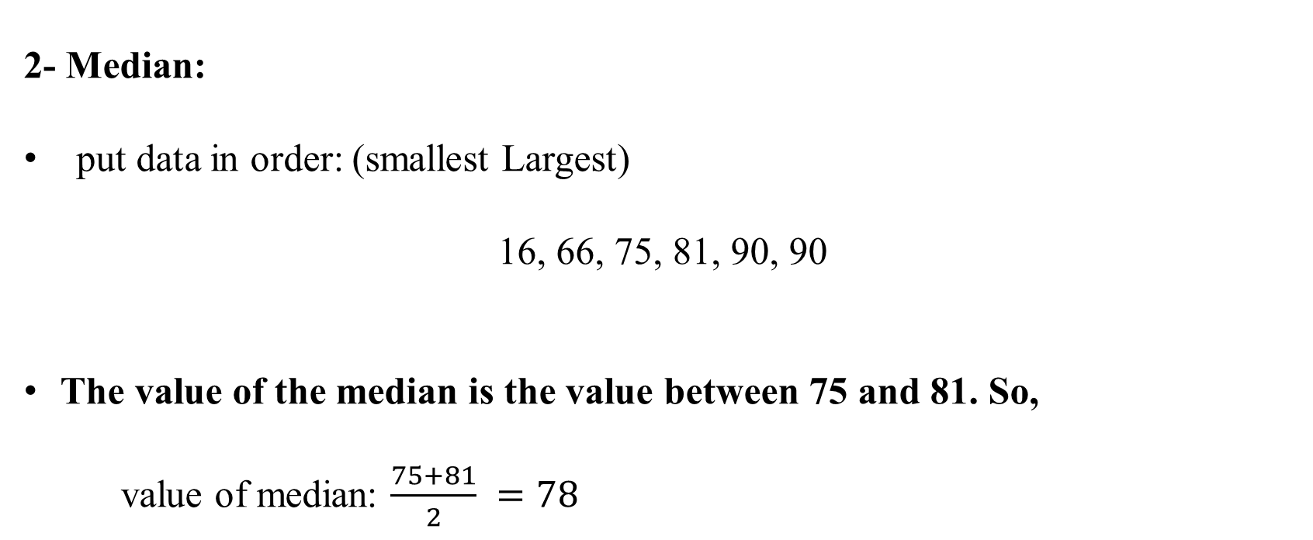
Chapter
02
Solution of Example 7
2- Median:
put data in order: (smallest Largest)
16, 66, 75, 81, 90, 90
The value of the median is the value between 75 and 81. So,
value of median: $\frac{75+81}{2} =78$

Slide 31
Chapter
02
Solution of Example 7
3- Mode:
The most repeated number in the data. So,
Mode = 90
Since there is an outlier which is (16). Therefore, the best central measure is the median NOT the mean.

Slide 32
Chapter
02
Measures of Variation
We have three measures of Variations:
1- Range
2- Variance
3- Standard deviation

Slide 33
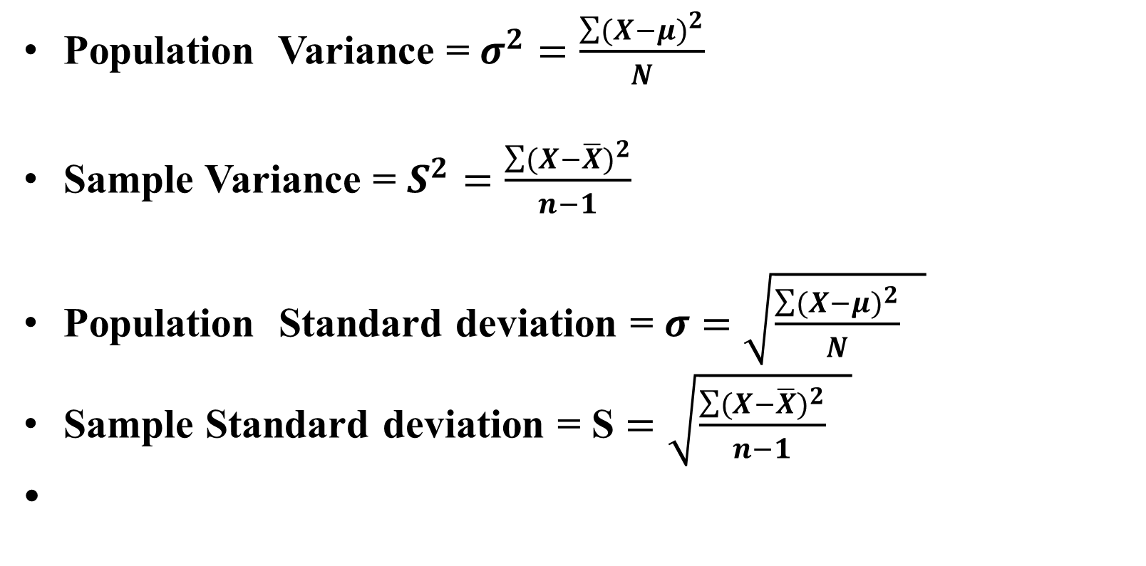
Chapter
02
Important Notes
Population Variance = $σ^{2}=\frac{\sum{{(X−μ)}^{2}}}{N}$
Sample Variance = $S^{2}=\frac{\sum{{(X−\overline{X})}^{2}}}{n−1}$
Population Standard deviation = $σ$ $=\sqrt{\frac{\sum{{(X−μ)}^{2}}}{N} }$
Sample Standard deviation = S $=\sqrt{\frac{\sum{{(X−\overline{X})}^{2}}}{n−1} }$

Slide 34
Chapter
02
Example 8
Given the following Macroeconomics exam grades for a sample of 6 students.
81 75 66 84 96
Calculate the dispersion measures for the above data

Slide 35
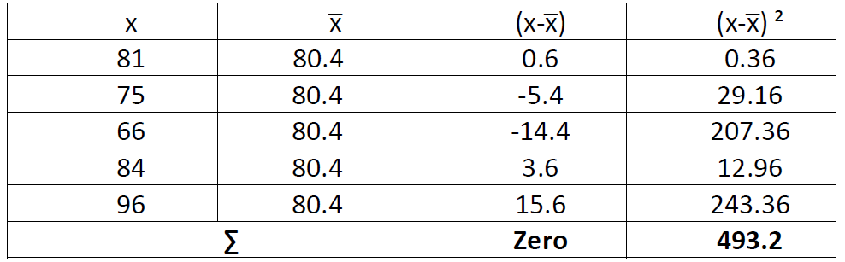
Chapter
02
Solution of Example 8
1- Range = Max – Min = 96- 66 = 30
2- Sample Variance = $S^{2}=\frac{\sum{{(X−\overline{X})}^{2}}}{n−1}$

Slide 36

Chapter
02
Solution of Example 8
1- Range = Max – Min = 96- 66 = 30
2- Sample Variance = $S^{2}=\frac{\sum{{(X−\overline{X})}^{2}}}{n−1}= \frac{493.2}{5−1}=\text{12}\text{3.3 }$
3- Sample Standard deviation = S $=\sqrt{\frac{\sum{{(X−\overline{X})}^{2}}}{n−1} }=\sqrt{123.3 }=11.1$

Slide 37
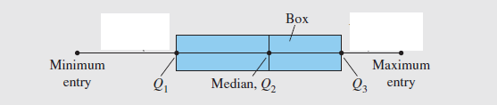
Chapter
02
Measures of Position
Q1 is the first Quartile
Q2 is the Second Quartile ( Median )
Q3 is the third Quartile
Interquartile range IQR = Q3 - Q1
Box Plot

Slide 38
Chapter
02
Example 9
The number of nuclear power plants in the top 15 nuclear power-producing
countries in the world are listed.
Find the first, second, and third quartiles of the data set.
Calculate IQR
Draw the Box plot

Slide 39
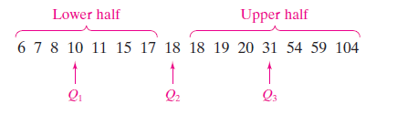
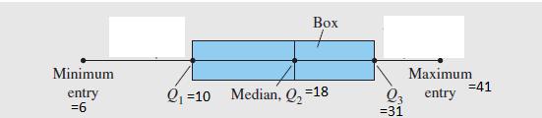
Chapter
02
Solution of Example 9
Put data in order: (smallest Largest)
IQR = Q3 – Q1 = 31 – 10 = 21
Box Plot

Slide 40
Chapter
02
Chapter Summary
Measures of Central Tendency:
1- Mean
2- Median
3- Mode
Measures of Position:
1- First Quartile
2- Second Quartile
3- Third Quartile
4- IQR
5- Box Plot
Frequency Distributions
Graphs and Displays:
1- Frequency Histogram
2- Frequency Polygon
3- Relative Frequency Histogram
4- Ogive
Measures of Variation:
1- Range
2- Variance
3- Standard deviation

