Slide 1


Data analysis using SPSS
Final Project
Prepared by Walid Soliman
Lecture 9

Slide 2


Validity and Reliability
Lecture 8
Final Project
Prepared by Walid Soliman
www.midocean.ae

Slide 3
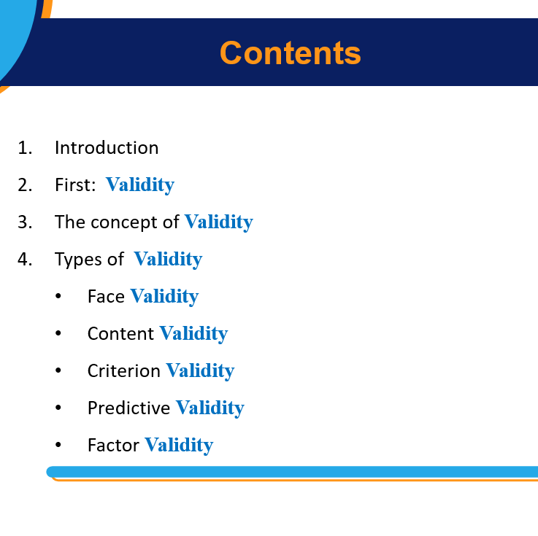

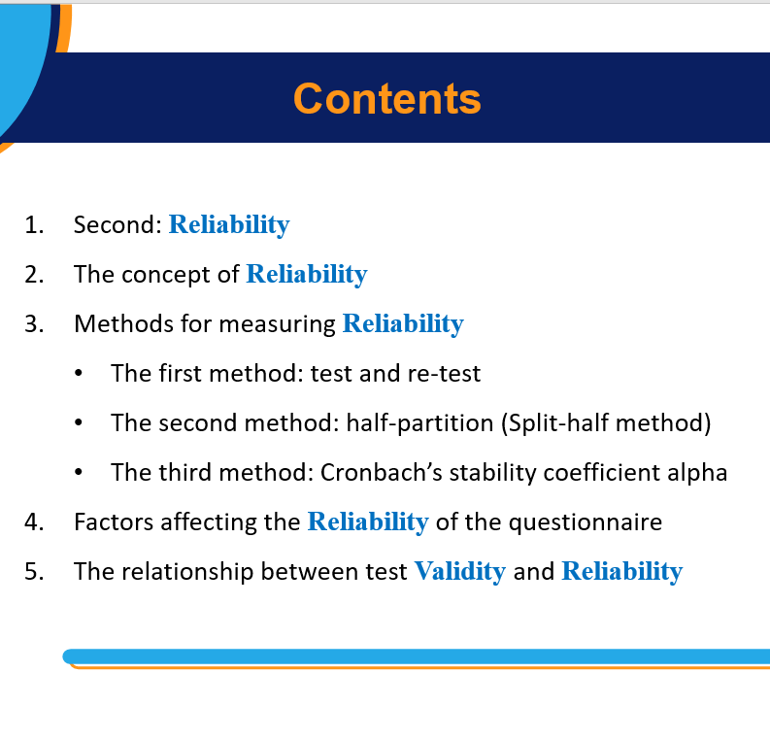

Slide 4
Contents
Data Types: (Quantitative & Qualitative)
The first stage: Presentation and analysis of data using the SPSS program
The second stage: Describing the data using statistical measures.
The third stage: Data analysis using SPSS software

Slide 5
Contents
Learn about qualitative and quantitative data types.
Learn how to display and analyze data using SPSS, including displaying data using different graphic formats
Analyze the data by comparing the means of two different groups.
Analyze the data by one-way analysis of variance
Analyze the data by measuring the correlation coefficient between the variables.
Analyze the data through regression analysis between variables.

Slide 6
Contents
By the end of this chapter, you will possess the following Skills:
The ability to distinguish between different types of data and the appropriate statistical measures for each.
Data presentation skills using the SPSS program using appropriate graphic figures.
Data analysis skills on the SPSS program, which includes a comparison between averages, one-way analysis of variance, measurement and interpretation of the correlation coefficient between variables, regression analysis, and interpretation of results.

Slide 7
SPSS Program
"SPSS is the most used statistical program by researchers to analyze information in the field of human, administrative and economic sciences, and helps the researcher to obtain accurate results while saving time and effort."
(Bhandari, P , 2022)

Slide 8
Data Types
DATA
Qualitative
Quantitative
Nominal
Ordinal
Discrete
Continuous

Slide 9
Data types
First: Qualitative Data
a) Nominal data: male-female, marital status, nationality
No calculations can be performed on it
b) Ordinal data: educational level, degrees of agreement or disagreement.
Second: Quantitative Data
a) Discrete data (discontinuous): number of family members or workers.
b) Continuous data: sale price, age, income.
(Bhandari, P, 2022)

Slide 10
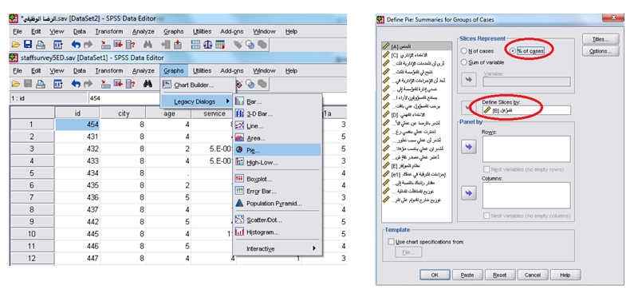
View and analyze data using SPSS Software
The first stage is data presentation.
a) Circle: The proportions of distribution or structural composition of a variable

Slide 11
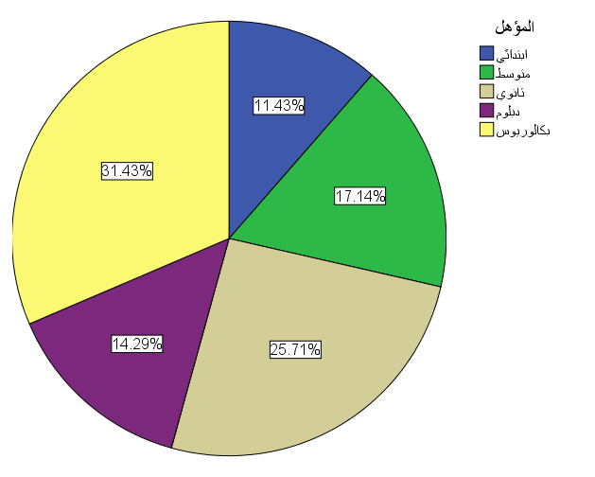
View and analyze data using SPSS Software
The first stage is data presentation. (Sample of 35 employees)
a) Circle: The proportions of distribution or structural composition of a variable

Slide 12
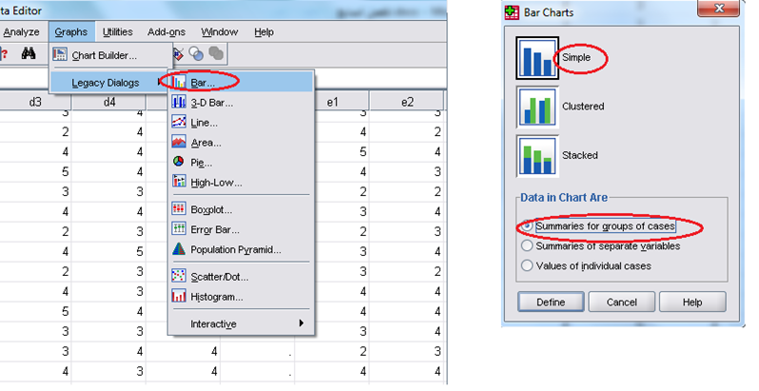
View and analyze data using SPSS software
The first stage is data presentation (Sample of 35 employees).
b) Bar graphs: discrete ordinal and quantitative data.

Slide 13
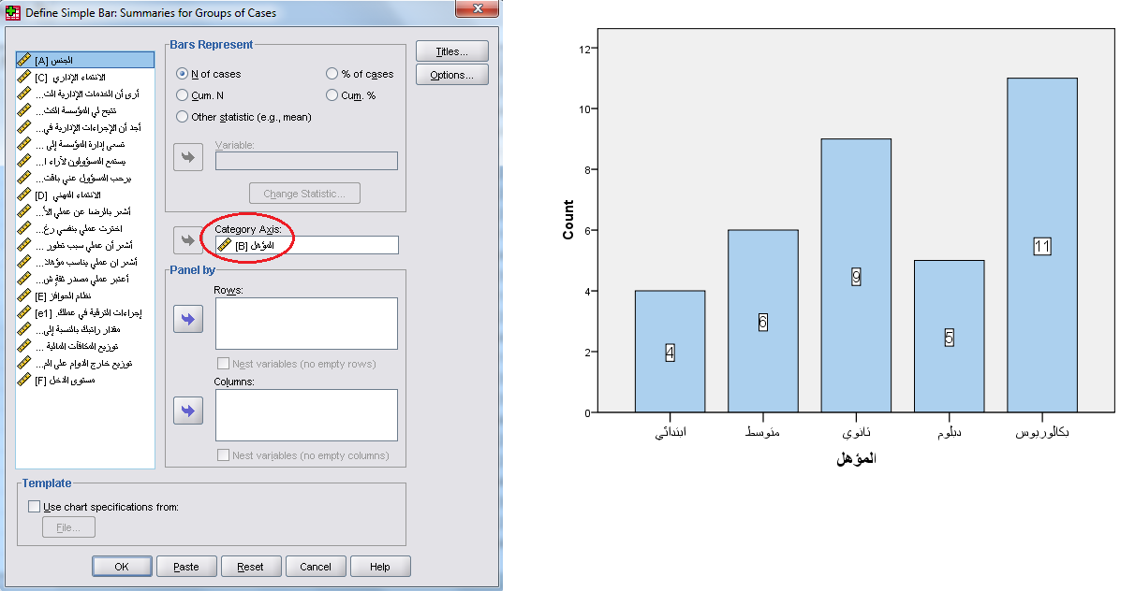
View and analyze data using SPSS software
The first stage is data presentation.
b) Bar graphs: discrete ordinal and quantitative data.

Slide 14
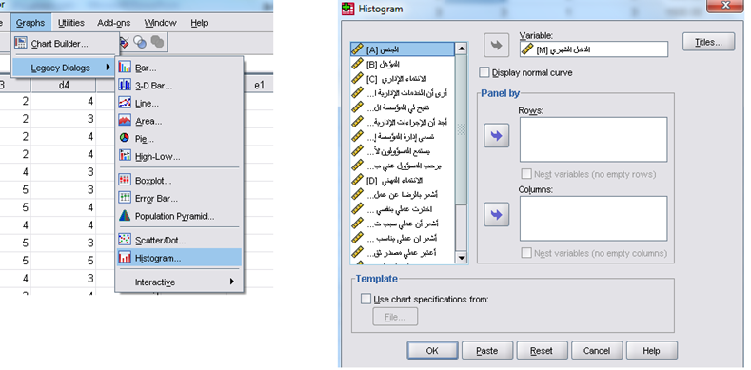
View and analyze data using SPSS Software
The first stage is data presentation.
c) Histogram and Interpolation line: connected quantitative data.

Slide 15
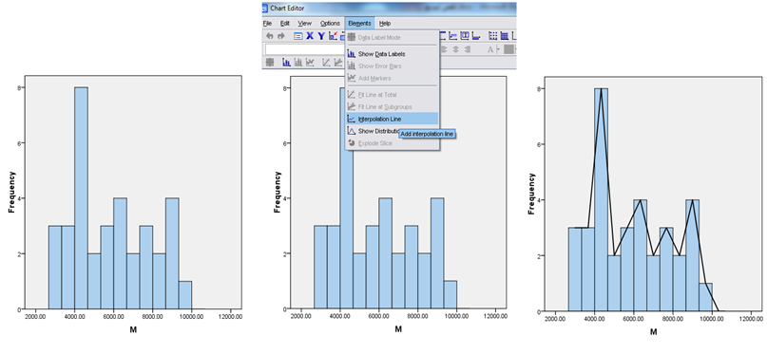
View and analyze data using SPSS software
The first stage is data presentation.
c) Histogram and Interpolation line: connected quantitative data.
We chose the Chart editor, and then we chose the Interpolation line from the list of elements.

Slide 16
View and analyze data using SPSS Software
The second stage: describing the data using statistical measures
A good scale:
Its exact value should be determined and not left to objectivity.
To enter all data or observations in his account.
Easy to understand and calculate.
His ability to coercive dealing.
Not affected by outliers (extremes).

Slide 17
View and analyze data using SPSS Software
The second stage: describing the data using statistical measures
(descriptive statistical measures)
Definition of central tendency
It is the tendency of the data to center around a specific value in the middle of the data.
The measure of central tendency:
  Mean
  Median
  Mod

Slide 18
View and analyze data using SPSS software
Mean
It is the most common and used measure in all scientific and practical fields, and the process of measuring the arithmetic mean is a very simple process, as in the first step, all the values are collected, and in the second step, the sum of the values is divided by their number to obtain the arithmetic mean for a group of values
Median
It is the value that lies in the middle of the data distribution

Slide 19
View and analyze data using SPSS Software
Mod
The measure determines the value or variable that occurs frequently in the data distribution. The mode can be calculated for any quantitative or descriptive data.

Slide 20
View and analyze data using SPSS Software
Frequency Table:
It is a table that organizes and summarizes statistical data, whether descriptive or quantitative and distributes them to categories that determine the number of individuals who belong to each category.

Slide 21
View and analyze data using SPSS Software
Measures of Dispersion:
To determine the extent of convergence, homogeneity, or divergence of the given data, we need measures other than measures of central tendency. These measures are called measures of dispersion.
The dispersion of the data (i.e., the divergence around the mean value of the data) can be measured by several measures:
Variance
Standard Deviation
RANGE

Slide 22
View and analyze data using SPSS Software
Variance
To calculate it, the arithmetic mean must be found first, then, subtract each value given in the data from the arithmetic mean, square it, add all the results from the squaring process, and divide the result by the number of values.
Standard deviation
It is a measure of dispersion, which measures how far away or close the data are from their arithmetic mean
is the positive square root of the variance

Slide 23
View and analyze data using SPSS Software
Range
It is the difference between the most significant and lowest values of the data, symbolized by the symbol (R).

Slide 24
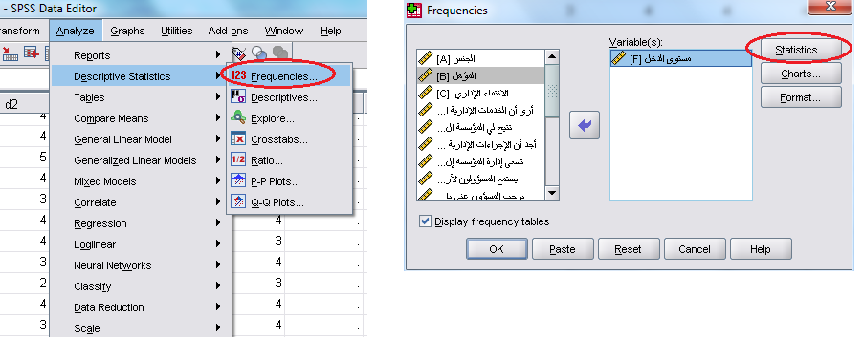
View and analyze data using SPSS Software
The second stage: describing the data using statistical measures

Slide 25
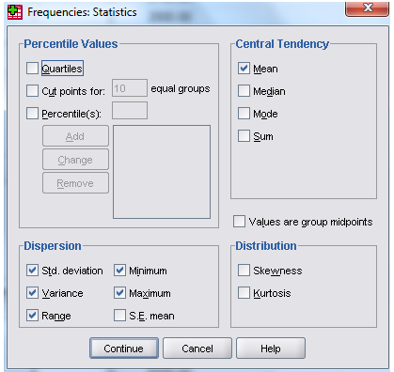
View and analyze data using SPSS Software

Slide 26
View and analyze data using SPSS Software
The second stage: describing the data using statistical measures
Monthly income variable
Statistics | Value
Mean | 5897.1
Std. Deviation | 2026.6
Variance | 4107000
Range | 6700
Minimum | 2800
Maximum | 9500

Slide 27
View and analyze data using SPSS Software
The Second Stage: describing the data using statistical measures
Frequency
The Degree | Frequency | Percent
Primary | 4 | 11.4
Middle School | 6 | 17.1
High School | 9 | 25.7
Diploma | 5 | 14.3
BSC | 11 | 31.4
Total | 35 | 100.0

Slide 28
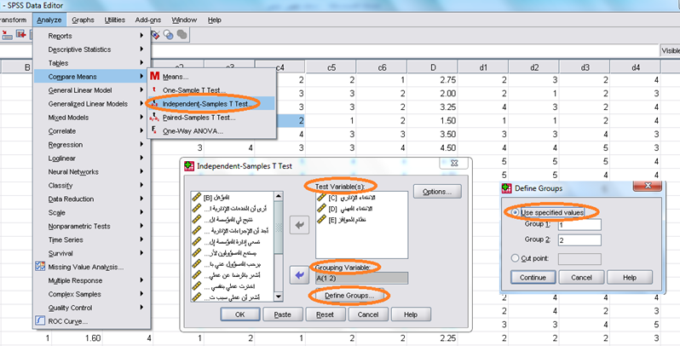
View and analyze data using SPSS Software
The third stage:
a) Comparing the mean of two different groups:
Example: In our previous example, we will test the difference or equality between the averages of the three variables (administrative affiliation, professional affiliation, and incentive system) according to each gender (male, female).

Slide 29
View and analyze data using SPSS Software
The third stage:
Comparison of the mean of two different groups:
Variable | M&F | N | Mean | Std. Deviation
administrative affiliation | M | 23 | 3.087 | .92013
 | F | 12 | 3.200 | .82682
professional affiliation | M | 23 | 3.511 | 1.04305
 | F | 12 | 3.583 | .57735
Incentive System | M | 23 | 3.250 | .90139
 | F | 12 | 3.500 | .48850

Slide 30
View and analyze data using SPSS Software
The third stage: a) Comparing the mean of two different groups:
Independent Samples Test
Variable |  | Levene's Test for Equality of Variances |  | t-test for Equality of Means
 |  | F | Sig. | t | df | Sig.
administrative affiliation | Equal variances assumed | .142 | .709 | -.357 | 33 | .724
 | Equal variances not assumed |  |  | -.369 | 24.66 | .715
professional affiliation | Equal variances assumed | 10.628 | .003 | -.223 | 33 | .825
 | Equal variances not assumed |  |  | -.264 | 32.80 | .793
Incentive System | Equal variances assumed | 8.049 | .008 | -.891 | 33 | .380
 | Equal variances not assumed |  |  | -1.064 | 32.89 | .295

Slide 31
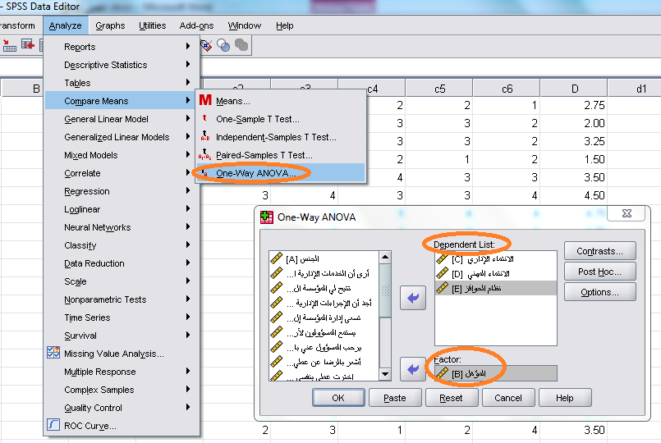
View and analyze data using SPSS Software
The third stage: b) One-way ANOVA:

Slide 32
View and analyze data using SPSS Software
The third stage: b) One-way ANOVA:
Sum of Squares:
  - Between Groups
  - Within Groups
  df
  Mean Square
  F ratio
Null hypothesis: The means of the sampled populations are equal.
Alternative hypothesis: There are at least two sampled populations with different means.

Slide 33
View and analyze data using SPSS Software
b) One-way ANOVA The analysis of the variance test indicates that the value of F for the three variables is significant at 1%, which means that there is a significant difference in the averages of these variables according to qualification
ANOVA
Variable |  | Sum of Squares | Df | Mean Square | F | Sig.
administrative affiliation | Between Groups | 20.858 | 4 | 5.215 | 29.031 | .000
 | Within Groups | 5.389 | 30 | .180
 | Total | 26.247 | 34
professional affiliation | Between Groups | 24.294 | 4 | 6.073 | 54.407 | .000
 | Within Groups | 3.349 | 30 | .112
 | Total | 27.643 | 34
Incentive System | Between Groups | 18.177 | 4 | 4.544 | 48.408 | .000
 | Within Groups | 2.816 | 30 | .094
 | Total | 20.993 | 34

Slide 34
View and analyze data using SPSS Software
C) Measuring the correlation between variables: Correlation
- Correlation coefficient between +1 and -1
- Correlation coefficient between two variables between ± 0.01, ± 0.3 (weak correlation)
- Correlation coefficient ranged from ±0.3, with ±0.6
- The correlation coefficient is between ±0.6 and ±0.99 (strong correlation)
- Correlation coefficient = 1, perfect correlation
- Pearson Correlation

Slide 35
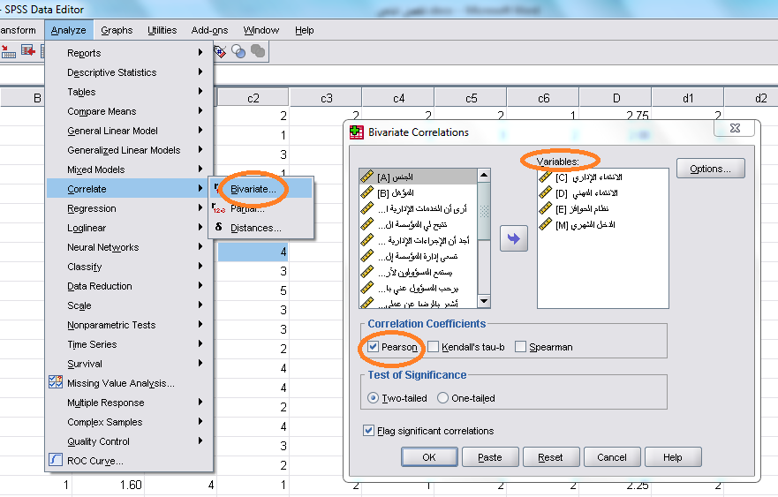
View and analyze data using SPSS Software
D) Correlation

Slide 36
View and analyze data using SPSS Software
D) Correlation
Variables |  | administrative affiliation | professional affiliation | Incentive System | Monthly Income
administrative affiliation | Pearson Correlation | 1
 | Sig. (2-tailed)
professional affiliation | Pearson Correlation | .841** | 1
 | Sig. (2-tailed) | .000
Incentive System | Pearson Correlation | .840** | .901** | 1
 | Sig. (2-tailed) | .000 | .000
Monthly Income | Pearson Correlation | .781** | .846** | .789** | 1
 | Sig. (2-tailed) | .000 | .000 | .000

Slide 37
View and analyze data using SPSS Software
E) Linear Regression analysis
The causal relationship between the variables
The dependent variable and the dependent variable (or variables).
Simple linear regression: Y = a + b X + u
Multiple linear regression:
Y = a + b1X1 + b2X2 + b3X3 + .... + bnXn + u

Slide 38


Thank You

