Slide 1


Human Resources
Management
HRM 611
Introductory Lecture
Prepared by Dr. Sahar Ahmed

Slide 2

Self Introduction
EDUCATION
EXPERIENCE
Cairo University
Head of HR Dep.
2010-2015
Ph.D. Business Administration
Major: HRM
Egyptian Nuclear & Radiological Regulatory Authority
2020-2024
2009-2012
AOTIC- AlFuttaim Group
2009-2006
CHUBB Insurance
Cairo University
Dr. Sahar Ahmed
Assistant Professor
2006-2008
Assistant Professor
2012-2020
Master of Business Administration
Major: HRM
- Arab Open University
- British University in Egypt

Slide 3

Week
01
About the Course
This course provides students with critical understanding of the nature of human resource management (HRM) and the conditions which enables the applications of HRM concepts, values, practices, and its varying contexts of application.
You will appreciate the challenges associated with the transferability of management practices across organizations, sectors, and cultures.
Credit Hours: 3 credit hours
www.midocean.ae

Slide 4
Week
01
Learning Outcome
Critical understanding of the nature of HRM in terms of its emergence, philosophy, and values.
Knowledge of various theories and models of managing people.
Critical understanding of the applicability of theories and models in different organizational, cultural, and institutional contexts.
Ability to provide line managers with advice regarding the implications of theories and models.
Ability to provide line managers on how to modify HR practices to fit organization’s contexts.
www.midocean.ae

Slide 5
Course Plan
Week1: Module Outline
Week7 : Ch.8- Training & Development
Core Curriculum
Week2 : Ch.1- Introduction to HRM
Week 8 : Ch.09 Performance MGMT
Week3 : Ch.3- HRM Strategy
Week 9 : Ch.10- Employee Retention, Engagement, and Careers
Week4 : Ch.4-Job Analysis
Week 10 : Ch.11- Establishing a strategic
pay plan
Week5 : Ch.5- Personnel Planning & Recruiting
Week 11 : Ch.16- Employee Safety & Health
Week6 : Ch.6- Employee testing & Selection
Week 12: General Revision
www.midocean.ae

Slide 6
Week
01
Learning Outcome
The main material and reference for this course will be mainly based on:
Dessler, G. (2011). Human resource management. Thirteenth edition. Pearson International Edition.
www.midocean.ae

Slide 7
Week
Course Content
Weekly Lecture
- Weekly Lecture: Theoretical discussion for each chapter to build student learning (Pdf. + Recorded lecture)
- Weekly Live Meeting: Providing the opportunity for students to apply the material or skills before moving to the next section (Attendance is optional but recommended)
Weekly Quizes (80%)
8 questions for each weekly quiz
1 mark for each question
Exam Type: True/False+MCQ+Verbal Audio
Exam time: 24 minutes
Final Assessment (20%)
End of semster (Week 13)
Exam time: 60 minutes
Exam Type: True/False+MCQ+Verbal Audio
01
www.midocean.ae

Slide 8
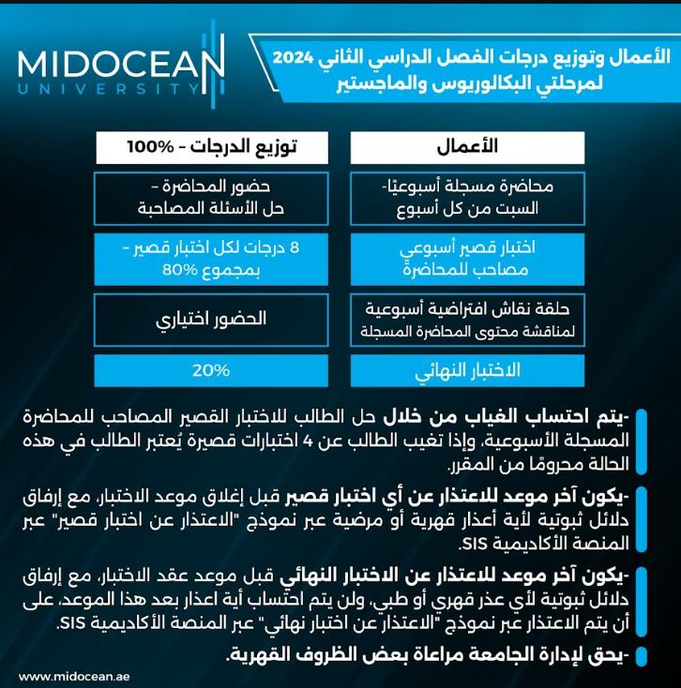
Week
01
Learning Outcome
www.midocean.ae

Slide 9
Week
01
References
Main Reference
Dessler, G. (2011). Human resource management. Thirteenth edition. Pearson International Edition.
Additional Resources for extra reading.
Armstrong, M. (2023). Armstrong's Handbook of Human Resource Management Practice (16th Ed.). Kogan Page.
Noe, R. A., Hollenbeck, J. R., Gerhart, B., & Wright, P. M. (2023). Human Resource Management in Canada (10th Ed.). McGraw-Hill Ryerson.
www.midocean.ae

Slide 10





Thank You

