Slide 1


Entrepreneurial
New Ventures
Prepared by Dr. Sarah Chahine
ENT 634
Writing a Business Plan
Lecture 6

Slide 2


Entrepreneurial
New Ventures
Lecture 6
ENT 634
Writing a Business Plan
Prepared by
Dr. Sarah Chahine
www.midocean.ae

Slide 3

Chapter
Introduction
06
A business plan is a written narrative, typically 25 to 35 pages long, that describes what a new business intends to accomplish and how it intends to accomplish it.
www.midocean.ae

Slide 4

Chapter
Introduction
06
For most new ventures, the business plan is a dual-purpose document that is used both inside and outside the firm. Inside the firm, the plan helps the company develop a “road map” to follow to execute its strategies and plans. Outside the firm, it introduces potential investors and other stakeholders to the business opportunity the firm is pursuing and how it plans to pursue it.
www.midocean.ae

Slide 5
Chapter
The Business Plan
06
The business plan must be substantive enough and have sufficient details about the merits of the new venture in order to convince the reader that the new business is exciting and should receive support. Much of this detail is accumulated in the feasibility analysis stage of investigating the merits of a potential new venture.
A relatively large percentage of entrepreneurs do not write business plans for their new ventures.
www.midocean.ae

Slide 6
Chapter
The Business Plan
06
Ample evidence supports the notion that writing a business plan is an extremely good investment of an entrepreneur’s time and money.
Businesses with a business plan are more likely to increase employment, grow revenues, increase capital spending, and apply for new credit than companies without a business plan.
www.midocean.ae

Slide 7
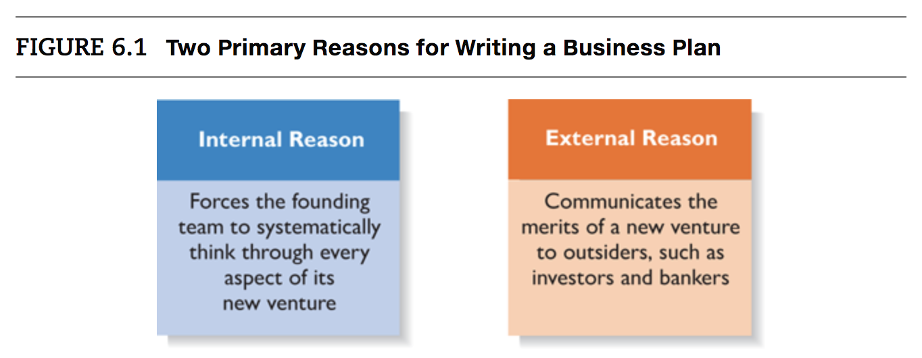
Chapter
Reasons for Writing a Business Plan
06
First, writing a business plan forces a firm’s founders to systematically think through each aspect of their new venture. It usually takes several meetings for days or weeks to complete a well-developed business plan.
www.midocean.ae

Slide 8
Who Reads the Business Plan—and What Are They Looking For?
Chapter
06
There are two primary audiences for a firm’s business plan:
A Firm’s Employees:
A clearly written business plan, one that articulates a firm’s vision and future, is important for both the management team and the rank-and-file employees.
The existence of a business plan is particularly useful for the functional department heads of a young firm.
www.midocean.ae

Slide 9
Who Reads the Business Plan—and What Are They Looking For?
Chapter
06
There are two primary audiences for a firm’s business plan:
Investors and Other External Stakeholders:
To appeal to this group, the business plan must be realistic and not reflective of overconfidence on the firm’s part. Overly optimistic statements undermine a business plan’s credibility. At the same time, the plan must clearly demonstrate that the business idea is viable and offers potential investors financial returns.
A firm must validate the feasibility of its business idea and properly understand their competitive environment prior to presenting its plan to others.
The most compelling facts a company can provide here are the results of its feasibility analysis and a distinctive and competitive business model.
www.midocean.ae

Slide 10
Chapter
Guidelines for Writing a Business Plan
06
It is important to remember that a firm’s business plan is typically the first aspect of a proposed venture that an investor will see. If the plan is incomplete or looks sloppy, it is easy for an investor to infer that the venture itself is incomplete and sloppy.
Along with facts and figures, a business plan needs to project a sense of anticipation and excitement about the possibilities that surround a new venture
www.midocean.ae

Slide 11
Chapter
Style or Format of the Business Plan
06
When writing the plan, avoid getting carried away with the design elements included in word-processing programs. Overuse of these tools makes a business plan look amateurish rather than professional.
One of the most common questions the writers of business plans ask is, “How long and detailed should it be?” The answer to this question depends on the type of business plan that is being written. There are three types of business plans, each of which has a different rule of thumb regarding length and level of detail.
www.midocean.ae

Slide 12
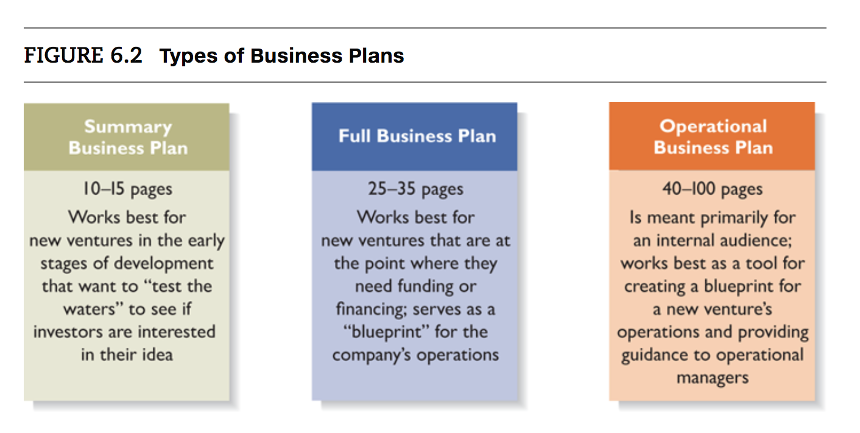
Chapter
Style or Format of the Business Plan
06
www.midocean.ae

Slide 13
Chapter
Style or Format of the Business Plan
06
Summary plan: A summary business plan is 10 to 15 pages and works best for companies that are very early in their development and are not prepared to write a full plan. The authors may be asking for funding to conduct the analysis needed to write a full plan.
Full business plan: A full business plan is typically 25 to 35 pages long. This type of plan spells out a company’s operations and plans in much more detail than a summary business plan, and it is the format that is usually used to prepare a business plan for an investor.
www.midocean.ae

Slide 14
Chapter
Style or Format of the Business Plan
06
Operational business plan: Some established businesses will write an operational business plan, which is intended primarily for an internal audience. An operational business plan is a blueprint for a company’s operations. Commonly running between 40 and 100 pages in length, these plans can obviously feature a great amount of detail that provides guidance to operational managers.
www.midocean.ae

Slide 15
Chapter
Style or Format of the Business Plan
06
If an investor asks you for a PowerPoint deck or the executive summary of your business plan rather than the complete plan, don’t be alarmed—this is a common occurrence. If the investor’s interest is piqued, he or she will ask for more information.
A cover letter should accompany a business plan that is sent to an investor or other stakeholders. The cover letter should briefly introduce the entrepreneur and clearly state why the business plan is being sent to the individual receiving it.
If a new venture is looking for funding, a poor strategy is to obtain a list of investors and blindly send the plan to everyone on the list. Instead, each person who receives a copy of the plan should be a viable investor candidate.
www.midocean.ae

Slide 16
Chapter
Recognizing the Elements of the Plan May Change
06
New insights invariably emerge when entrepreneurs immerse themselves in writing the plan and start receiving feedback from others.
Those developing a business plan should understand that it is not intended to be a static document written in isolation at a desk.
  Instead, it is anticipated that to complete the plan, founders must contact potential customers, suppliers, business partners, and others.
  Additionally, the feedback obtained from these key people will cause the plan to change as it is being written.
  It’s also anticipated that the business itself will iterate and change after it is launched, based on additional feedback.
www.midocean.ae

Slide 17
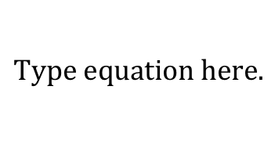
Chapter
Outline of the Business Plan
06
Cover Page and Table of Contents
The cover page should include the company’s name, address, and phone number; the date; the contact information for the lead entrepreneur; and the company’s website address if it has one. The company’s Facebook page and Twitter and Instagram names can also be included. The contact information should include an e-mail address, a smartphone number, and a landline number if you have one.
www.midocean.ae

Slide 18
Chapter
Outline of the Business Plan
06
Executive Summary
The executive summary is a short overview of the entire business plan; it provides a busy reader with everything she needs to know about the new venture’s distinctive nature. In many instances an investor will first ask for executive summary and will request a copy of the full business plan only if the executive summary is sufficiently convincing.
An executive summary shouldn’t exceed two single-spaced pages. The cleanest format for an executive summary is to provide an overview of the business plan on a section-by-section basis.
www.midocean.ae

Slide 19
Chapter
Outline of the Business Plan
06
Industry Analysis
The main body of the business plan begins by describing the industry in which the firm intends to compete. This description should include data and information about various characteristics of the industry, such as its size, growth rate, and sales projections.
It is important to focus strictly on the business’s industry and not its industry and target market simultaneously. Before a business selects a target market, it should have a good grasp of its industry—including where its industry’s promising areas are and its points of vulnerability.
www.midocean.ae

Slide 20
Chapter
Outline of the Business Plan
06
Industry Analysis
Issues such as whether the major participants in the industry are innovative or conservative and are quick or slow to react to environmental changes are the types of characteristics to convey.
The key success factors in an industry are also important to know and convey. Most industries have 6 to 10 key factors in which all participants must establish competence as a foundation for competing successfully. Most participants try to then differentiate themselves by excelling in two or three areas.
Industry trends should be discussed, including both environmental and business trends.
www.midocean.ae

Slide 21
Chapter
Outline of the Business Plan
06
Company Description
This section begins with a general description of the company.
The company history section should be brief, but should explain the origin of the idea for the company and the driving force behind its inception. If the idea for the company is heartfelt, tell it.
A mission statement defines why a company exists and what it aspires to become.
www.midocean.ae

Slide 22
Chapter
Outline of the Business Plan
06
Company Description
The products and services section should include an explanation of your product or service. Include a description of how your product or service is unique and how you plan to position it in the marketplace. A product or service’s position is how it is situated relative to its rivals.
The current status section should reveal how far along your company is in its development. A good way to frame this discussion is to think in terms of milestones. A milestone is a noteworthy or significant event, example: registering your company’s name, completing a feasibility analysis, etc.
www.midocean.ae

Slide 23
Chapter
Outline of the Business Plan
06
Market Analysis
Whereas the industry analysis focuses on the industry in which a firm intends to compete (e.g., toy industry, fitness center industry, men’s clothing industry), the market analysis breaks the industry into segments to which the firm will try to appeal.
The first task is to segment the industry the business will be entering and then identify the specific target market on which it will focus. This is done through market segmentation, which is the process of dividing the market into distinct segments. Markets can be segmented in many ways, such as by geography, demographic variables (age, gender), and so forth.
www.midocean.ae

Slide 24
Chapter
Outline of the Business Plan
06
Market Analysis
It’s important to include a section in the market analysis that deals directly with the behavior of the consumers in a firm’s target market. The more a start-up knows about the consumers in its target market, the more it can gear products or services to accommodate their needs.
A competitor analysis, which is a detailed analysis of a firm’s competitors, should be included.
The final section of the market analysis estimates a firm’s annual sales and market share. The most important outcome is to develop an estimate that is based on sound assumptions and seems both realistic and attainable.
www.midocean.ae

Slide 25
Chapter
Outline of the Business Plan
06
The Economics of the Business
This section begins the financial analysis of a business, which is further fleshed out in the financial projections. It addresses the basic logic of how profits are earned in the business and how many units of a business’s product or service must be sold for the business to “break even” and then start earning a profit.
The major revenue drivers, which are the ways a business earns money, should be identified. If a business sells a single product and nothing else, it has one revenue driver. If it sells a product plus a service guarantee, it has two revenue drivers, and so on.
www.midocean.ae

Slide 26
Chapter
Outline of the Business Plan
06
The Economics of the Business
The next section should provide an analysis of the business’s fixed and variable costs. A firm’s variable costs vary by sales, while its fixed costs are costs a company incurs whether it sells something or not.
The business’s one-time start-up costs should be estimated and placed into a table. These costs include legal expenses, fees for business licenses and permits, website design, business logo design.
This section should conclude with a break-even analysis, which is an analysis of how many units of its product a business must sell before it breaks even and starts earning a profit.
www.midocean.ae

Slide 27
Chapter
Outline of the Business Plan
06
Marketing Plan
The marketing plan focuses on how the business will market and sell its product or service. It deals with price, promotion, distribution, and sales.
The best way to describe a company’s marketing plan is to start by articulating its marketing strategy, positioning, and points of differentiation, and then talk about how these overall aspects of the plan will be supported by price, promotional mix and sales process, and distribution strategy.
A firm’s marketing strategy refers to its overall approach for marketing its products and services. A firm’s overall approach typically boils down to how it positions itself in its market and how it differentiates itself from competitors.
www.midocean.ae

Slide 28
Chapter
Outline of the Business Plan
06
Product (or Service) Design and Development Plan
If you are developing a completely new product or service, you need to include a section highlighting the status of your development efforts.
The first issue to address is to describe the present stage of the development of your product or service. You should describe specifically the point that your product or service is at and provide a timeline that describes the remaining steps.
  A product prototype is the first physical manifestation of a new product, often in a crude or preliminary form.
  A virtual prototype is a computer-generated 3D image of a product or service idea. It displays the idea as a 3D model that can be viewed from all sides and rotated 360 degrees.
www.midocean.ae

Slide 29
Chapter
Outline of the Business Plan
06
Product (or Service) Design and Development Plan
A section labeled “Challenges and Risks” should be included and disclose any major anticipated design and development challenges and risks that will be involved in bringing the product or service to market.
A final section should describe any patents, trademarks, or copyrights that you have secured or plan to secure relative to the products or services you are developing.
www.midocean.ae

Slide 30
Chapter
Outline of the Business Plan
06
Operations Plan
The operations plan section of the business plan outlines how your business will be run and how your product or service will be produced. It is best to keep this section short and crisp.
A useful way to illustrate how your business will be run is to include a general approach to operations which articulates your general approach to operations in terms of what’s most important and what the make-or-break issues are. You can then frame the discussion in terms of “back stage,” or behind-the-scenes activities, and “front stage,” or what the customer sees and experiences.
www.midocean.ae

Slide 31
Chapter
Outline of the Business Plan
06
Operations Plan
The next section of the operations plan should describe the geographic location of your business.
This section should also describe a firm’s facilities and equipment. You should list your most important facilities and equipment and briefly describe how they will be (or have been) acquired, in terms of whether they will be purchased, leased, or acquired through some other means.
www.midocean.ae

Slide 32
Chapter
Outline of the Business Plan
06
Management Team and Company Structure
The management team of a new firm typically consists of the founder or founders and a handful of key management personnel. A brief profile of each member of the management team should be provided, starting with the firm’s founder or founders. Each profile should include the following information:
  Title of the position
  Duties and responsibilities of the position
  Previous industry and related experience
  Previous successes
  Educational background
www.midocean.ae

Slide 33
Chapter
Outline of the Business Plan
06
Management Team and Company Structure
A board of directors is a panel of individuals elected by a corporation’s shareholders to oversee the management of the firm. A board of advisors is a panel of experts asked by a firm’s management to provide counsel and advice on an ongoing basis.
Unlike a board of directors, a board of advisors possesses no legal responsibility for the firm and gives nonbinding advice.
www.midocean.ae

Slide 34
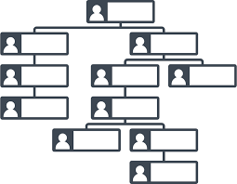
Chapter
Outline of the Business Plan
06
Management Team and Company Structure
The final portion of this section of your business plan focuses on how the company structure. Even if you are a start-up, you should outline how the company is currently structured and how it will be structured as it grows.
The most effective way to illustrate how a company will be structured and the lines of authority and accountability that will be in place is to include an organizational chart in the plan.
www.midocean.ae

Slide 35
Chapter
Outline of the Business Plan
06
Overall Schedule
A schedule should be prepared that shows the major events required to launch the business. The schedule should be in the format of milestones critical to the business’s success, such as incorporating the venture, completion of prototypes, rental of facilities, obtaining critical financing, starting the production of operations, obtaining the first sale, and so forth.
www.midocean.ae

Slide 36
Chapter
Outline of the Business Plan
06
Financial Projections
The first thing to include is a sources and uses of funds statement, which is a document that lays out specifically how much money a firm needs, where the money will come from, and how the money will be used.
The next item to include is an assumptions sheet, which is an explanation of the most critical assumptions on which the financial statements are based.
www.midocean.ae

Slide 37
Chapter
Outline of the Business Plan
06
Financial Projections
The pro forma (or projected) financial statements are the heart of the financial section of a business plan.
  A firm’s pro forma financial statements are similar to the historical statements an established firm prepares, except they look forward rather than track the past. Pro forma financial statements include the pro forma income statement, the pro forma balance sheet, and the pro forma cash flow statement.
  Most experts recommend three to five years of pro forma statements. If the company you are writing your plan for already exists, you should also include three years of historical financial statements.
www.midocean.ae

Slide 38
Chapter
Outline of the Business Plan
06
Appendix
Any material that does not easily fit into the body of a business plan should appear in an appendix—résumés of the top management team, photos or diagrams of product or product prototypes, certain financial data, and market research projections.
www.midocean.ae

Slide 39
Chapter
Presenting the Business Plan to Investors
06
If the business plan successfully elicits the interest of a potential investor, the next step is to meet with the investor and present the plan in person.
The founders of a new venture should prepare a set of PowerPoint slides.
  The presentation shouldn’t last more than 20 minutes. The presentation should be smooth and well-rehearsed. The slides should be sharp and not cluttered with material.
  The presentation should consist of plain talk and should avoid technical jargon.
  This presentation format calls for the use of 12 slides.
www.midocean.ae

Slide 40


Thank You

