Slide 1


Marketing Management
MGM612
Dr. Ayman Hassan
  Lecture –1-Introduction to Marketing Management

Slide 2

Introduction to Marketing Management
Lecture 1
Dr. Ayman Hassan

Slide 3

Learning Outcomes
Marketing Management Tasks
What is Marketing?
Marketing Management

Slide 4


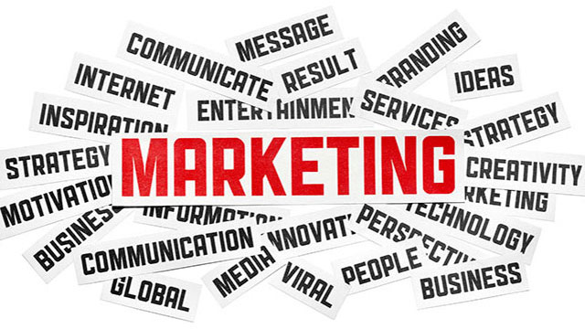
Chapter
1
  Lecture - 1-Introduction to Marketing Management

Slide 5
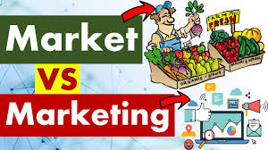
Chapter
1
The difference between market and marketing

Slide 6
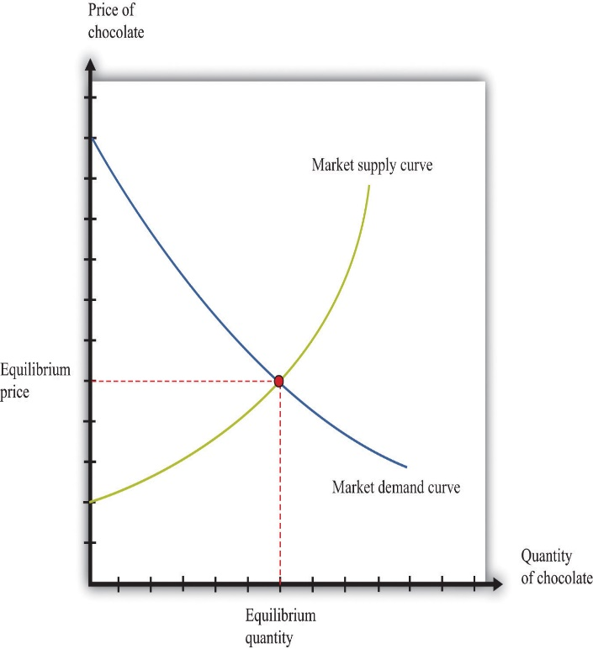
Chapter
1
What is a Market?
A 'market' is traditionally defined as a physical or virtual space where buyers and sellers interact to exchange goods and services.
This interaction is typically governed by the laws of supply and demand.
The market is classified based on various factors:
Geographic Size: Local, regional, national, or international markets.
Type of Customers: Consumer, industrial, or reseller markets.
Type of Goods: Commodities, financial, or real estate markets.
Understanding the nature and dynamics of your market is a crucial step in creating an effective business strategy.

Slide 7
Chapter
1
What is Marketing?
Marketing is an integral business function that involves identifying customer needs, and developing and delivering products or services to satisfy those needs.
It is a broad and dynamic concept, encompassing:
Product: Creating a product or service that meets customer needs.
Price: Setting a price that customers are willing to pay, and that offers a good return on investment.
Place: Choosing the best channels to sell the product or service.
Promotion: Communicating with potential customers about the product or service

Slide 8
Chapter
1
What is Marketing?, 1
Marketing is about identifying and meeting human and social needs.
One of the shortest good definitions of marketing is
“Meeting Needs Profitably.”
The American Marketing Association offers the following formal definition:
Marketing is the activity, set of institutions, and processes for creating, communicating, delivering, and exchanging offerings that have value for customers, clients, partners, and society at large.

Slide 9
Chapter
1
What is Marketing?, 2
SO
Marketing is the delivery of customer satisfaction at a profit.
Marketing is an organizational function and a set of processes for creating, communicating, and delivering value to customers and for managing customer relationships in ways that benefit the organization and its stakeholders.
Marketing is a social and managerial process by which individuals and groups obtain what they need and want through creating and exchanging products and value with others.

Slide 10
Chapter
1
Pay Attention
Social Definition of Marketing.
The social definition explains the role that marketing plays in society.
Some see marketing as "providing a higher standard of living."
Others see marketing as a societal process through which individuals and groups get what they need and want by creating, offering, and freely exchanging products and services of value with others.
So pay attention....
Creating value between consumers and businesses and the importance of creating and sharing value have become important topics in the development of modern marketing thought.

Slide 11
Chapter
1
Pay Attention, 2
We can distinguish between
A managerial definition of marketing.
A social definition of marketing.

Slide 12
Chapter
1
What Is Marketed?
Marketers market 10 main types of entities:
Goods
services
events
experiences
persons
places
properties
Organizations
Information
Ideas

Slide 13
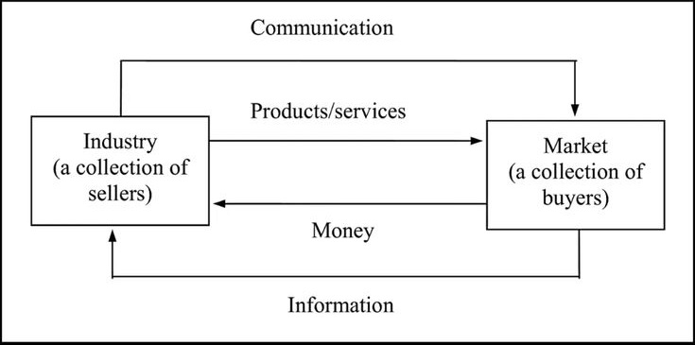
Chapter
1
Markets
The set of all actual and potential buyers of a product or service
Originally a “market” was a place where buyers and sellers gathered to exchange goods (such as a village square).
A simple marketing system

Slide 14

Chapter
1
Who Markets?
Marketers and Prospects A marketer is someone who seeks a response—attention, a purchase, a vote, a donation—from another party, called the prospect.
If two parties are seeking to sell something to each other, we call them both marketers.
Just as production and logistics professionals are responsible for managing supply, marketers are responsible for managing demand.
They seek to influence the level, timing, and composition of demand to meet the organization’s goals.
There are eight possible demand scenarios, which are shown in the next slide:

Slide 15
Chapter
1
Eight demand states
1.Negative demand:
Consumers dislike the product and may even pay to avoid it.
2. Non-existent demand:
Consumers may be unaware of or uninterested in the product.
3. Latent demand:
Consumers may share a strong need that cannot be satisfied by an existing product.
4. Declining demand:
Consumers begin to buy the product less frequently or not at all.

Slide 16
Chapter
1
Eight demand states
5. Irregular demand:
Consumer purchases vary on a seasonal, monthly, weekly, daily, or even hourly basis.
6. Full demand:
Consumers are adequately buying all products put into the marketplace.
7. Overfull demand:
More consumers would like to buy the product than can be satisfied.
8. Unwholesome demand:
Consumers may be attracted to products that have undesirable social consequences.
In each case, marketers must identify the underlying cause(s) of the demand state and determine a plan of action to shift demand to a more desired state.

Slide 17
Chapter
1
The Goal of Marketing
General objectives
To attract new customer by promising superior value, and to keep current customers by delivering satisfaction.
Success dependent upon marketing functions
7 SMART goals for marketing

Slide 18
Chapter
1
7 SMART goals for marketing
SMART goals are specific, measurable, attainable, relevant and time-bound.
2. Increase conversion and engagement
1. Promote new products and services
2. Increase conversion and engagement
3. Find new marketing leads
4. Leverage social media marketing
5. Improve customer satisfaction
6. Establish a new brand identity
7. Become a market leader

Slide 19
Chapter
1
Why Study Marketing?
Plays an important role in society
Vital to business survival, profits and growth
Offers career opportunities
Affects your life every day
Better-informed consumers
Demand for customer satisfaction

Slide 20
Chapter
1
Marketing Defined
Marketing is the process by which companies create value for customers and build strong customer relationships to capture value from customers in return.
‘Marketing is the management process that identifies, anticipate and satisfies customer requirements profitably’
‘The right product, in the right place, at the right time, and at the right price’

Slide 21
Chapter
1
Marketing Defined
Marketers act as the customers’ voice within the firm and marketers are responsible for many more decisions than just advertising or sales:
  Analyze industries to identify emerging trends.
  Determine which national and international markets to enter or exit.
  Conduct research to understand consumer behavior.
  Design integrated marketing mixes – products, prices, channels of distribution, and promotion programs.

Slide 22
Chapter
1
Marketing Defined cont. ….
To explain marketing definition, we examine the following important terms :
  Needs, wants, and demands
  Products and services
  Value, satisfaction and quality
  Exchange, transactions, and relationships
  Markets

Slide 23
Chapter
1
Needs, Wants, and Demands
Needs
The most basic concept underlying marketing is that of human needs.
Human needs are states of felt deprivation.
Human have many complex needs:
  Physical needs for food, clothing, warmth, and safety
  Social needs or belonging and affection
  Individual needs for knowledge and self – expression

Slide 24
Chapter
1
Needs, Wants, and Demands
Wants
Want are the form taken by human needs as they are shaped by culture and individual personality.
People have almost unlimited wants but limited resources.
They want to choose products that provide the most value and satisfaction for their money.
Demands
When backed by buying power, wants become demands.
Consumers view products as bundles of benefits and choose products that give them the best bundle for their money.

Slide 25
Chapter
1
Products and Services
Product
Anything that can be offered to a market to satisfy a need or want.
The concept of product is not limited to physical objects – anything capable of satisfying a need can be called a product.
Services
In addition to tangible goods, products also include services, which are activities or benefits offered for sale that are essentially intangible and do not result in the ownership of anything.

Slide 26
Chapter
1
Values, Satisfaction, and Quality
Values
Customer value is the difference between the values the customer gains from owning and using a product and the costs of obtaining the products.
Customers often do not judge product value and costs accurately or objectively. They act on perceived value.
Satisfaction
Customer satisfaction depends on a product’s perceived performance in delivering value relative to a buyer’s expectation.
If the product’s performance falls short of the customer’s expectations, the buyer is dissatisfied.

Slide 27
Chapter
1
Values, Satisfaction, and Quality
Quality
Customer satisfaction is closely linked to quality.
Quality has a direct impact on product performance.
Quality can be defined as “freedom from defects”.
TQM programs designed to constantly improve the quality of products, services, and marketing processes.

Slide 28
Chapter
1
Exchange, Transactions, and Relationships
Exchange
The act of obtaining a desired object from someone by offering something in return
Transaction
A trade between two parties that involves at least two things of value, agreed – upon conditions a time of agreement, and a place of agreement.
Relationship marketing
The process of creating, maintaining, and enhancing strong, value – laden relationships with customers and other stakeholders

Slide 29
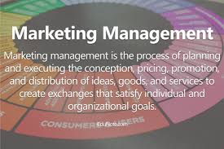
Chapter
1
Marketing Management
The analysis, planning, implementation, and control of programs designed to create, build, and maintain beneficial exchanges with target buyers for the purpose of achieving organizational objectives.

Slide 30
Chapter
1
What is Marketing Management?
Marketing management is the art and science of choosing target markets and getting, keeping, and growing customers through creating, delivering, and communicating superior customer value.

Slide 31
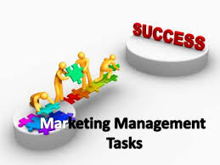
Chapter
1
Marketing Management Tasks
Developing marketing strategies
Capturing marketing insights
Connecting with customers
Building strong brands
Shaping market offerings
Delivering value
Communicating value
Creating long-term growth

Slide 32
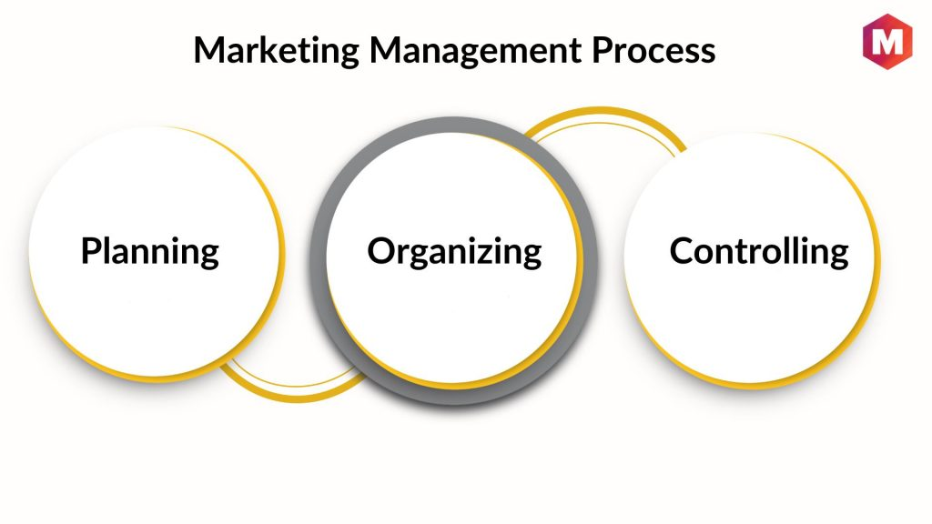
Chapter
1
Marketing management process
Analysis/Audit - where are we now?
Objectives - where do we want to be?
Strategies - which way is best?
Tactics - how do we get there?
Implementation - Getting there
Control - Ensuring arrival

Slide 33
Chapter
1
Marketing Management Involves
Demand Management
The organization has a desired level of demand for its products. At any point in time, There may be no demand, adequate demand, irregular demand, or too much demand, and marketing management must find ways to deal with these different demand states.
Building Profitable Customer Relationships
Beyond designing strategies to attract new customers and create transactions with them, companies now are striving to retain current customers and build lasting customer relationships.

Slide 34
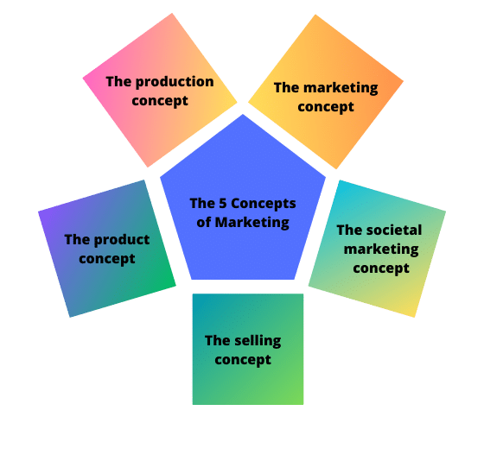

Chapter
1
What are the 5 main marketing concepts?

Slide 35
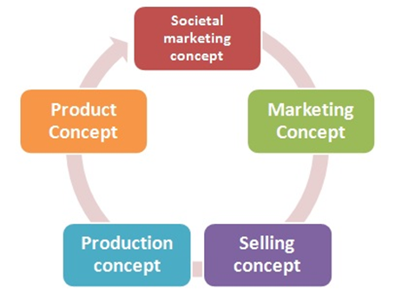
Chapter
1
Marketing management philosophies
The role that marketing plays within a company varies according to the overall strategy and philosophy of each firm.
There are five alternative concepts under which organizations conduct their marketing activities:
  Production concept
  Product concept
  Selling concept
  Marketing concept
  Societal marketing concepts

Slide 36
Chapter
1
1- Production Concept
The philosophy that consumers will favor products that are available and highly affordable and that management should therefore focus on improving production and distribution efficiency.
Production Concept was originated in early mid-50s of the 20th century when capitalization was started and soon after origination of this concept, production oriented business dominated the market.
During this era Businesses and industries were majorly focusing on the efficiency of production and manufacturing methods.
The reason that Production was given major importance was because of “Says Law” which stated that, “Supply will creates its own Demand”(from the French economist Jean — Baptiste Say.)
It was the time where channels of communications were very limited and traveling was the major issue. That’s why salesmen were the main source of advertising and marketing. The distribution of goods was also the problem during that period and there were less competition in the market. Therefore, the sale of goods wasn’t an issue!

Slide 37
Chapter
1
2- Product Concept
The philosophy that consumers will favour products that offer the most quality, performance, and innovative features.
Advantages of product concepts
There are many benefits to using product concepts:
Quality over quantity
Develop curiosity.
Increase margins
Disadvantages of product concepts
The disadvantages of product concepts include:
Irrelevant and impractical features
Price concerns
Product Concept Examples
Samsung Foldable Displays In 2021, Samsung introduced a foldable display - the S Foldable Display - with a bi-fold design that opens to 7.2 inches., Now, Samsung is a leader in the communications market.

Slide 38
Chapter
1
3- Selling Concept
The idea that consumers will not buy enough of the organization’s products unless the organization undertakes a large – scale selling and promotion effort.
This concept assumes that customers tend to be resistant and need to be convinced to make a purchase. Marketing strategies rooted in the selling concept involve pervasive and continuous advertising efforts.
This approach is commonly utilized by companies that have excess inventory and need to sell it in order to create space for new products.
Examples of employing the selling concept include:
Brands that aggressively promote Black Friday (and Cyber Monday), such as Amazon, although many big brands also use very similar tactics.
Brands that heavily rely on email marketing — think of those that flood your inbox with daily emails that advertise discounts, sales, and special offers. These brands constantly strive to capture your attention with their latest deals.

Slide 39
Chapter
1
4- The Marketing Concept
While the selling concept is all about what the company wants or needs, the marketing concept focuses on the customer.
Brands that utilize the marketing concept spend time getting to know their customer’s likes and dislikes. They understand what problems keep their customers awake at night and develop products and services to solve those issues.
This is the approach you’ll see small businesses take. While they can’t compete on scale or price with more prominent brands, they can, through a deep understanding of their customer, fill the gaps in the market and meet a niche demand.
www.midocean.ae

Slide 40
Chapter
1
The selling and Marketing Concepts Contrasted
Starting point
Focus
Means
Ends
Existing products
Selling
and promoting
Profits through sales volume
Factory
The selling concept
Customer
needs
Integrated marketing
Profits through customer satisfaction
Market
The marketing concept

Slide 41
Chapter
1
5- The Societal Marketing Concept
The societal marketing concept takes the marketing concept further and is increasingly becoming the concept of choice when devising a marketing strategy.
This concept emphasizes focusing on meeting customers’ needs to solve their problems while ensuring no harm comes to them.
You should also provide this solution as ethically as you can.
Examples of brands and products that focus on this marketing concept include:
Herbivore and other beauty brands use organic ingredients and claim that their products are ethically produced and do not harm the environment
Reformation is a clothing brand that focuses on ethically made clothing produced without harm to nature.

Slide 42
Chapter
1
Three Considerations Underlying The Societal Marketing
Society
(Human welfare)
Societal marketing concept
Consumers, (Want satisfaction)
Company, (Profits)

Slide 43
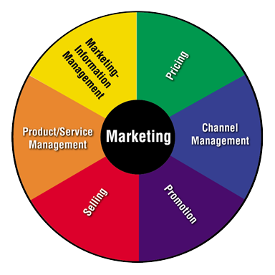
Chapter
1
What Are the Marketing Functions?
Interrelated activities working together to get products from producers to customers
  Product/Service management
  Marketing information management
  Pricing
  Channel management
  Promotion
  Selling

Slide 44
Chapter
1
We will continue in our next lecture Introduction to Marketing Management

Slide 45
Chapter
1
Resources and References
7 SMART Marketing Goals with Benefits (2024) | Indeed.com Australia
Marketing Management Process: A 5-Step Guide | Marketing91
Production Concept in Marketing Management. | by Digital Vinay | Medium
Product Concept: Definition, Types, Examples – Qualtrics
Marketing 101 - The Five Marketing Concepts - Rock Content
www.midocean.ae

Slide 46

Thanks for listening.
01
Best wishes
Dr. Ayman Hassan

