Slide 1


System Administration 1
Prepared by Dr. Ahmed Omar
IT391
System Administration 1
Lecture 7

Slide 2



Installing and Configuring Linux
Lecture 7
IT391
System Administration 1
Prepared by
Dr. Ahmed Omar

Slide 3

Agenda
Comparing User Interfaces: CLI vs. GUI
Introduction to the Linux Operating System
The Linux Command Line Environment
Installing Linux in a Virtual Machine
Fundamental Linux Commands

Slide 4
CLI vs GUI
    CLI: Command Line Interface allows users to interact with the computer using text commands.
    GUI: Graphical User Interface enables interaction through graphical elements like windows, icons, and menus.
  Both have their use cases in modern computing.

Slide 5
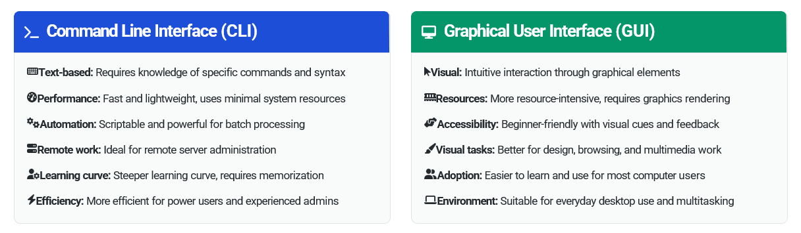
CLI vs GUI

Slide 6
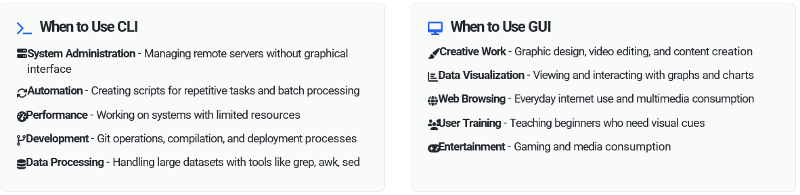
When to Use CLI vs GUI

Slide 7

What is Linux?
Linux is an open-source operating system kernel that serves as the foundation for many different operating system distributions. Created by Linus Torvalds in 1991, Linux is based on Unix principles and has become one of the most widely used operating systems in the world.
open-source software meaning anyone can view, modify, and distribute its source code.

Slide 8
What is Linux?
Linux is a "Unix-like" operating system that was created from scratch to be a free and open-source alternative to the proprietary Unix systems.
Linux is the modern, open-source re-implementation of those ideas, which made the power of a Unix-like system accessible to everyone.

Slide 9
What is kernel?
The kernel is the core component of an operating system that acts as a bridge between applications and the computer's hardware. It's the most fundamental part of the OS that manages system resources and provides essential services.

Slide 10
What is kernel?
A good way to understand the kernel is to think of it as the brain of the operating system. It manages all the essential, low-level operations that you rarely see but that are critical for the computer to function.
Just as your brain coordinates all your body's functions without you consciously thinking about it, the kernel manages the computer's resources behind the scenes.

Slide 11
What is kernel?
Key Functions of the Kernel:
Hardware Management
Resource Allocation
Process Management
Memory Management
Security and Access Control
System Calls

Slide 12
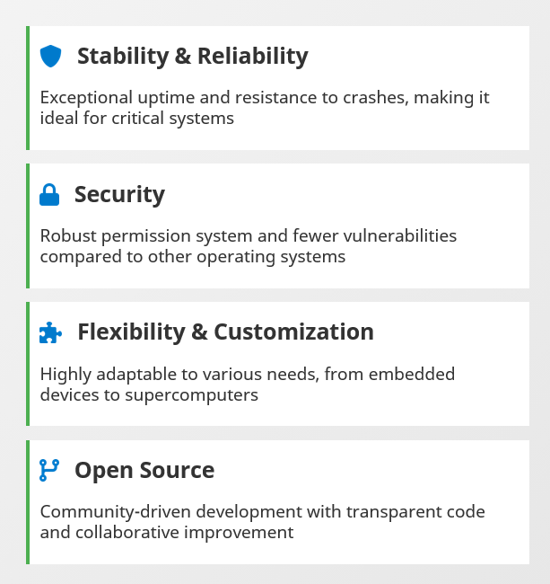
Linux Key Features

Slide 13
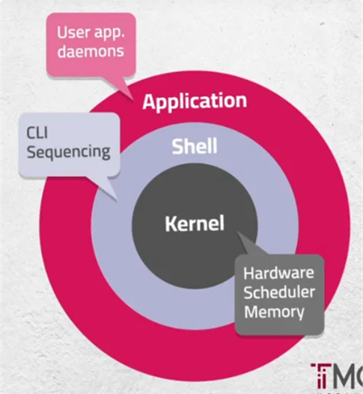
Linux Architecture
Linux follows a layered architecture design where each layer provides specific services to the layers above it.

Slide 14
Linux Architecture
Kernel
The core of Linux that interfaces directly with hardware. Manages memory, processes, devices, and system calls.
Shell
Command interpreter that provides an interface between the user and the kernel. Executes commands and scripts.
Application Layer
User applications, system utilities, and daemons (background services) that run on top of the shell and kernel.
Hardware Interaction
The kernel manages hardware resources through schedulers, memory management, and device drivers.

Slide 15
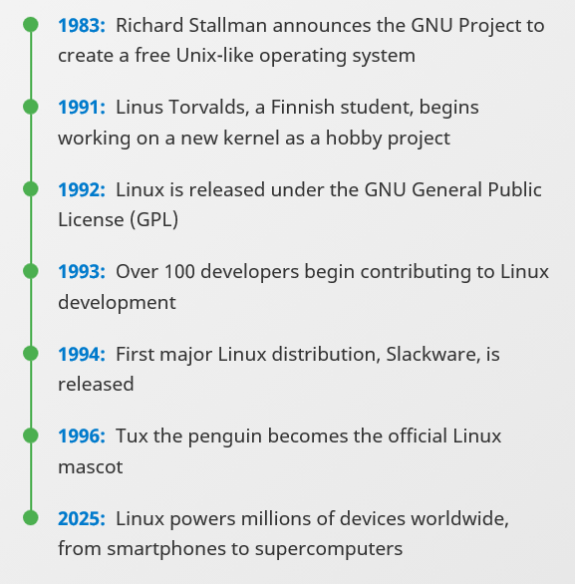
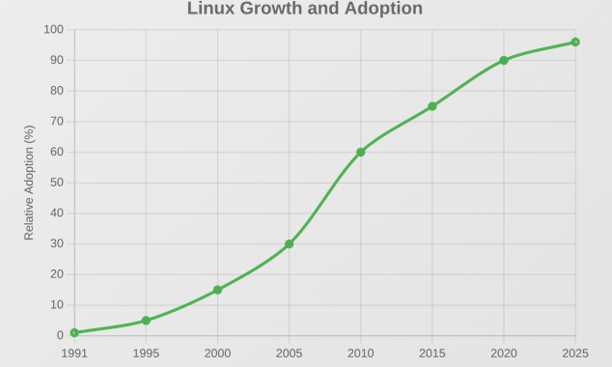
A Brief History

Slide 16
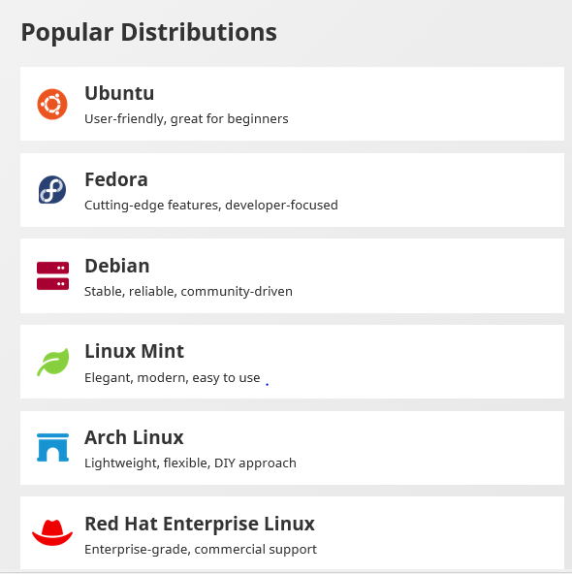
Linux Distributions
A Linux distribution is an operating system built from the Linux kernel and a collection of software.
Over 600 active Linux distributions exist today

Slide 17
Linux Terminology
The terminal is the program that provides a text-based interface window where you can type commands. It's essentially a text input/output environment that displays a command prompt and shows the results of commands you run. Think of it as the "window" or "screen" where you interact with the system through text.

Slide 18
Linux Terminology
The shell is the command interpreter program that actually processes the commands you type in the terminal. When you type a command, the shell reads it, interprets what you want to do, executes the appropriate programs, and returns the results. The shell acts as an intermediary between you and the operating system kernel. It handles things like command parsing, variable expansion, and running programs.

Slide 19
Linux Terminology
Bash (Bourne Again Shell) is a specific type of shell - arguably the most popular and widely-used shell in Linux systems. It's the default shell on most Linux distributions. Bash includes features like command history, tab completion, scripting capabilities, and various built-in commands. Other shells include zsh, fish, dash, and the original Bourne shell (sh).

Slide 20
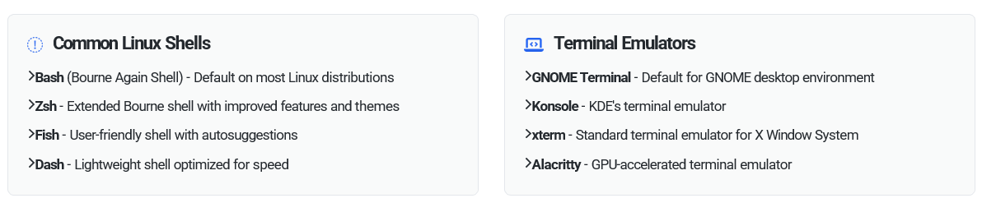
Linux Terminology

Slide 21
Linux Terminology
How They Work Together:
You open a terminal application.
The terminal starts a shell program, which is usually Bash by default
You type a command into the terminal.
The shell (Bash) interprets the command and tells the operating system what to do.
The output of the command is then displayed back to you in the terminal window.

Slide 22
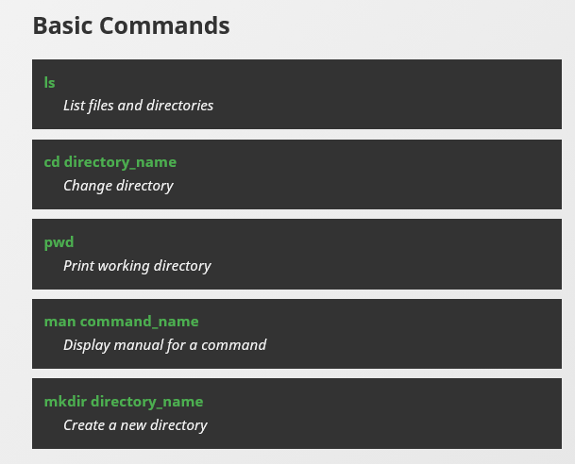
Linux Terminology

Slide 23
Linux Account
Root Account
Superuser: Has complete administrative control over the system
User ID (UID): Always 0
Privileges: Can access all files, modify system configurations, install/remove software, manage other users, and perform any system operation
Prompt: Typically shows # symbol
Home directory: Usually /root
Risk: Commands run as root can potentially damage or compromise the entire system

Slide 24
Linux Account
Regular User Account
Limited privileges: Can only access their own files and perform non-administrative tasks
User ID (UID): Typically 1000 and above for regular users
Restrictions: Cannot modify system files, install system-wide software, or access other users' private files without permission
Prompt: Typically shows $ symbol
Home directory: Usually /home/username
Safety: Mistakes are generally contained to the user's own files and space

Slide 25
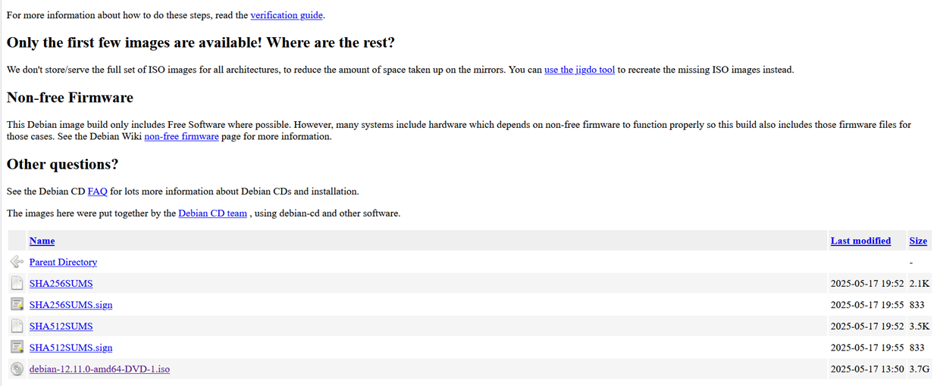
Download ISO
    https://cdimage.debian.org/debian-cd/current/amd64/iso-dvd/

Slide 26
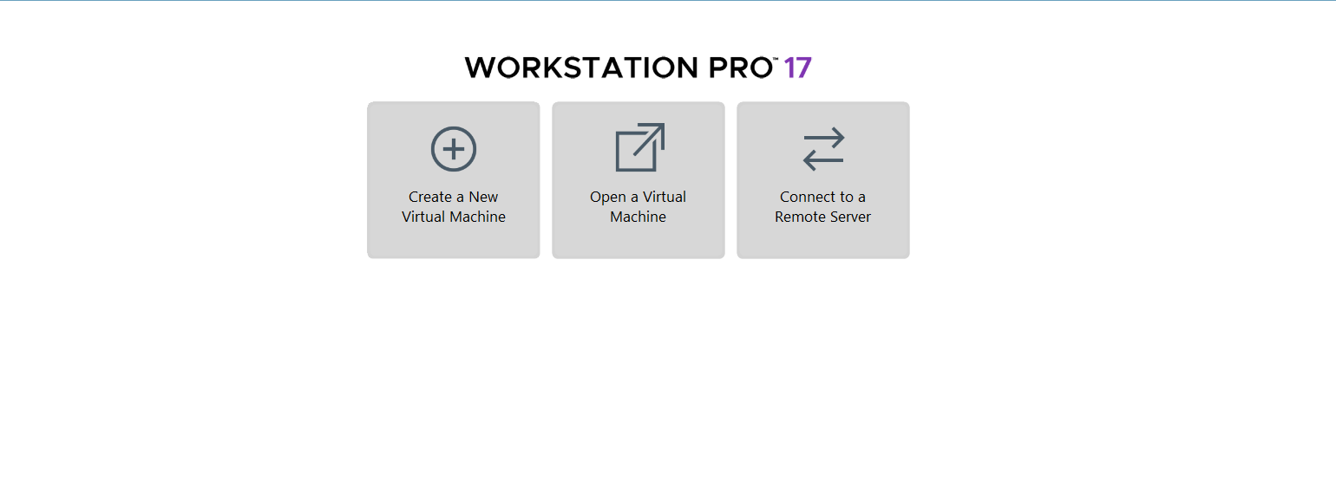
Creating a new virtual machine

Slide 27
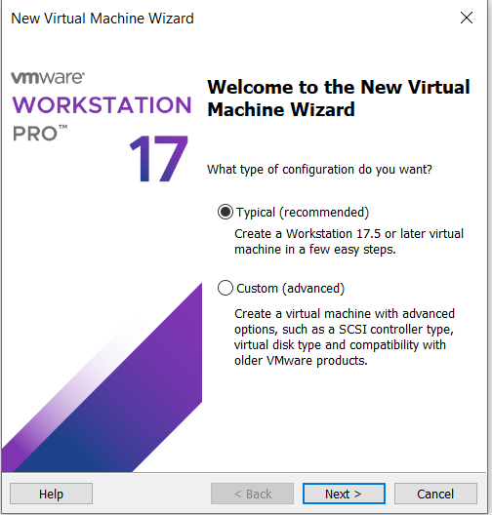
Creating a new virtual machine
Select Typical

Slide 28
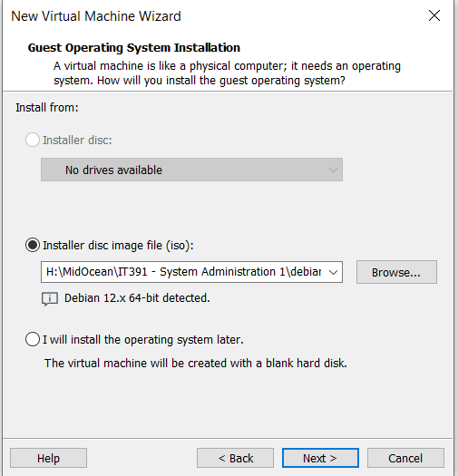
Creating a new virtual machine
Selecting the Linux ISO file

Slide 29
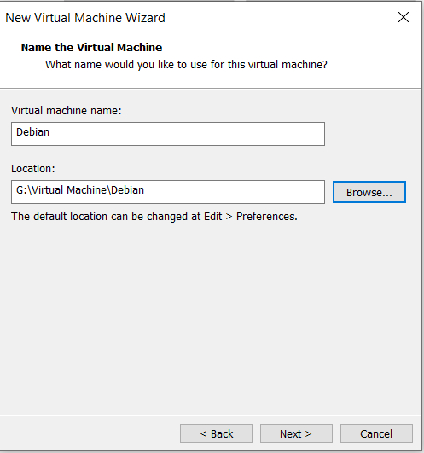
Creating a new virtual machine
Type Name
Select Location

Slide 30
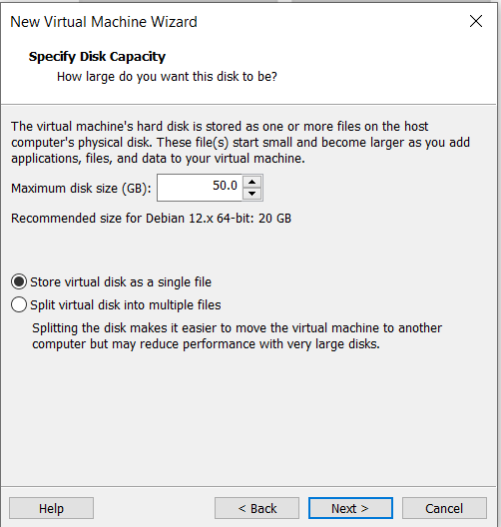
Creating a new virtual machine
Chose Disk size (20 GB minimum)
Select Single File installation

Slide 31
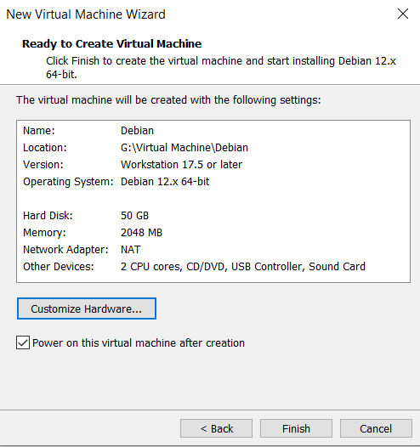
Creating a new virtual machine
You can customize hardware

Slide 32
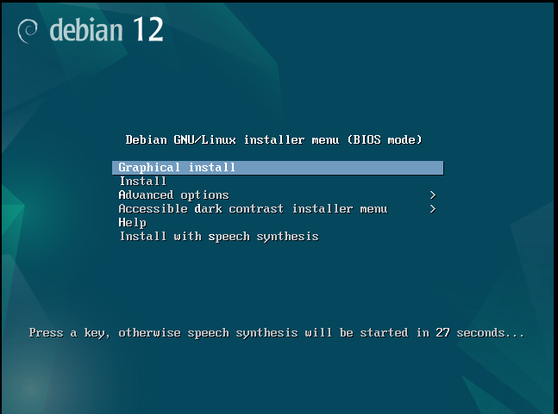
Install Linux
Click Graphical Install

Slide 33
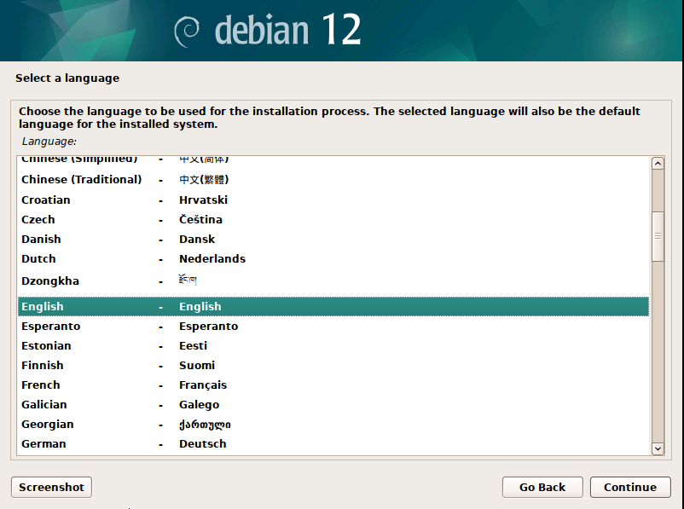
Install Linux
Select Language

Slide 34
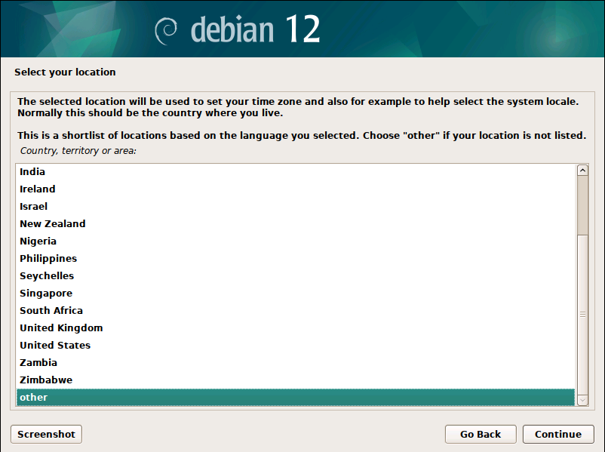
Install Linux
Select Country

Slide 35
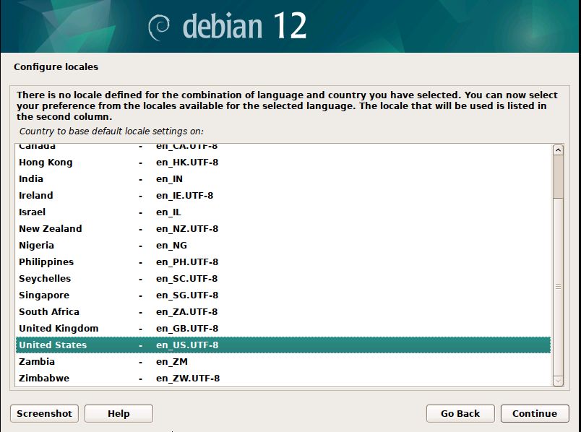
Install Linux
Select keyboard Language

Slide 36
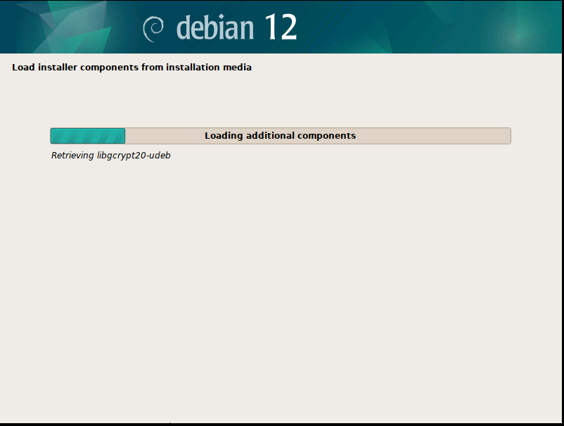
Install Linux
Load installer

Slide 37
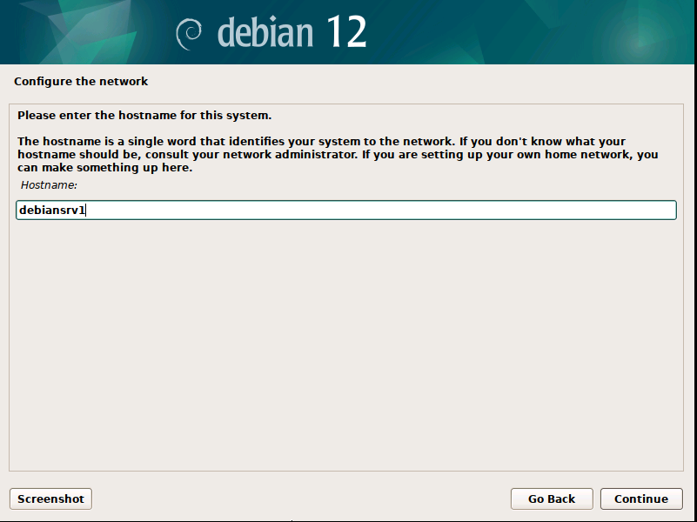
Install Linux
Write the server's name

Slide 38
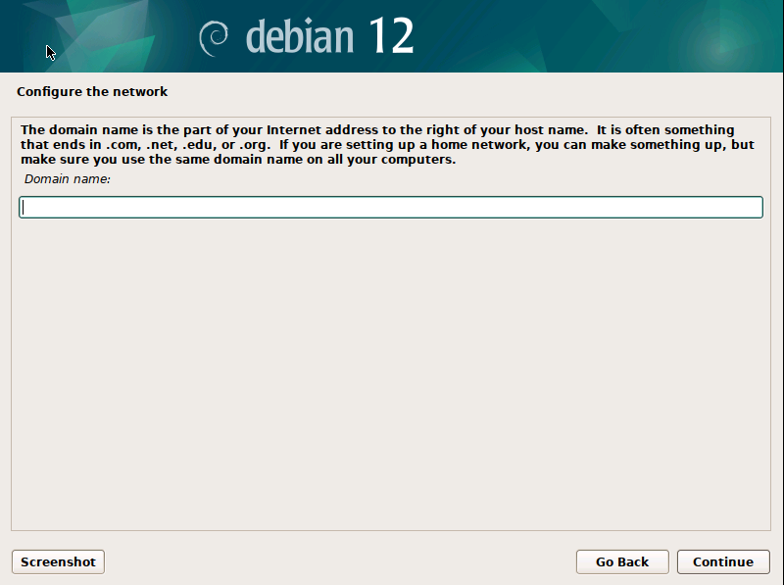
Install Linux
If you want to join Domain, write its name or leave it blank

Slide 39
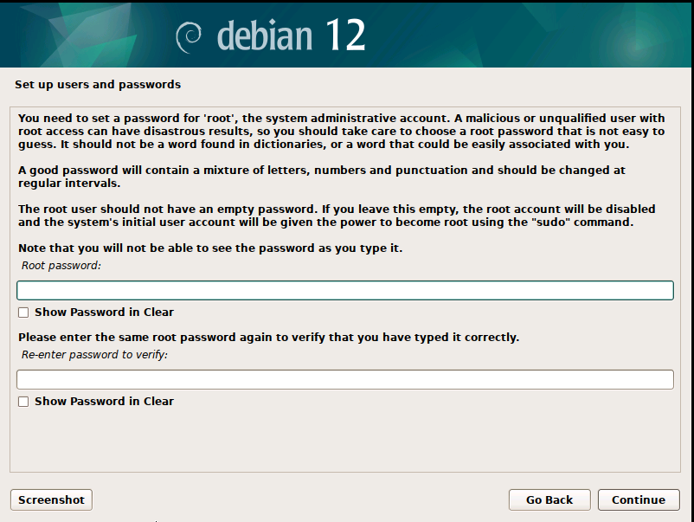
Install Linux
The root password
Pw=root

Slide 40
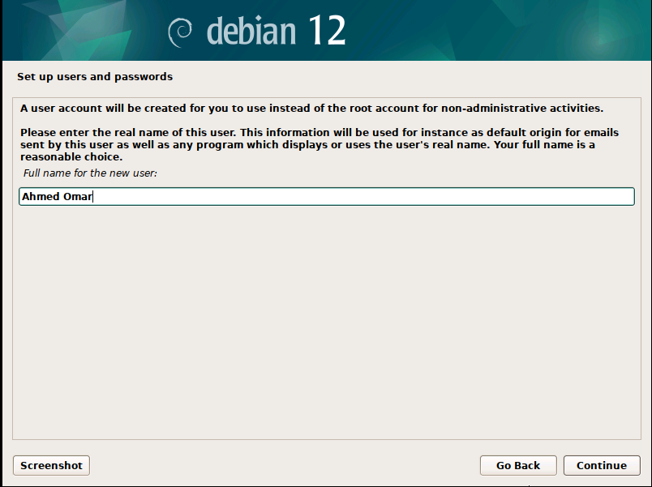
Install Linux
Write user full name

Slide 41
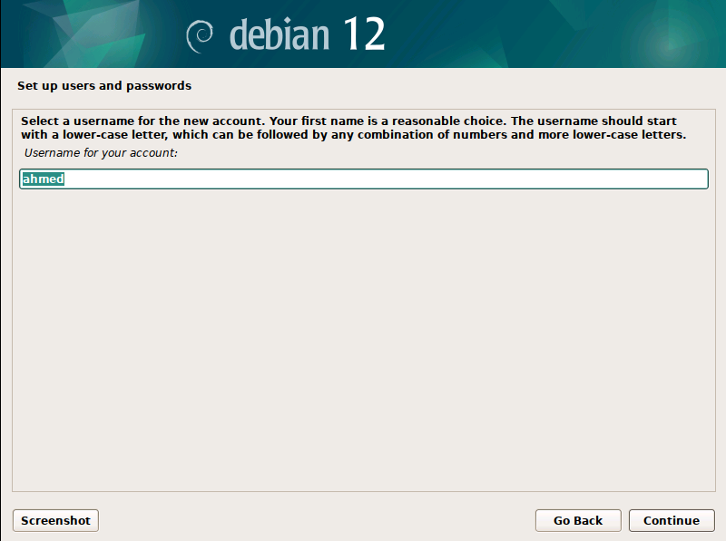
Install Linux
Write user name used to login

Slide 42
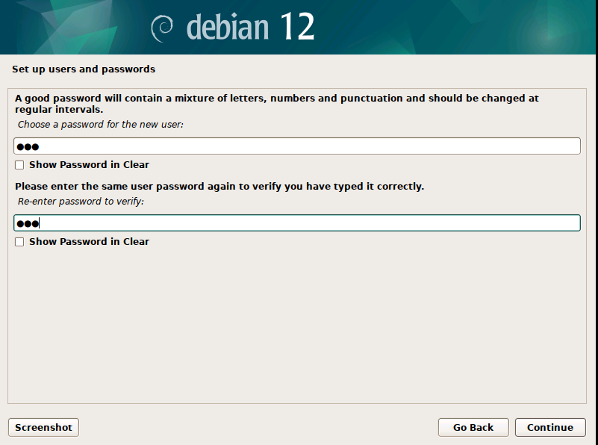
Install Linux
Write password for the user

Slide 43
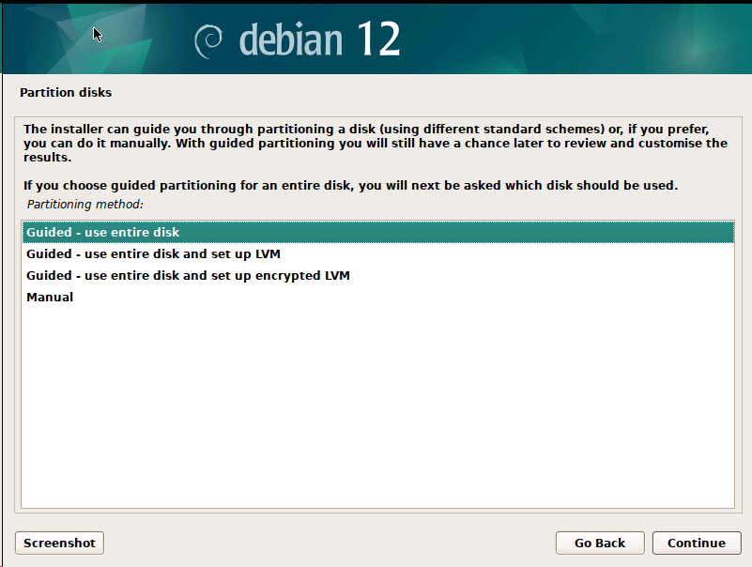
Install Linux
Chose the Partition disks :
how the hard drive will be organized to store the operating system files
Guided - use entire disk

Slide 44
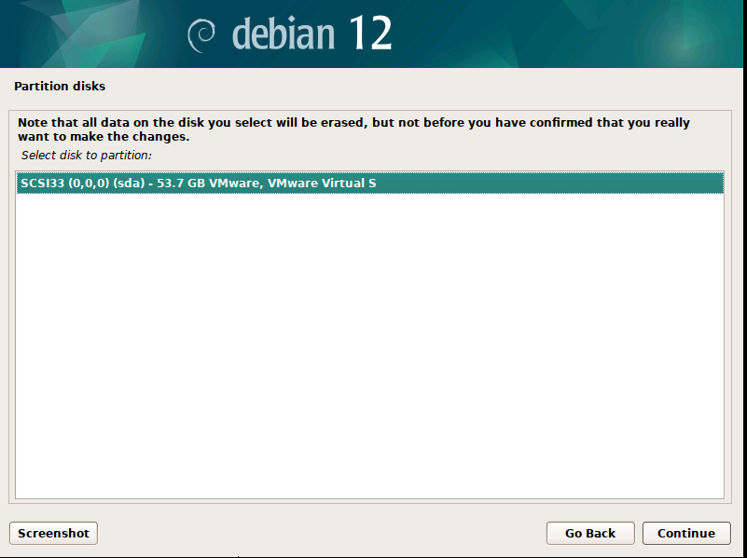
Install Linux
select the hard drive

Slide 45
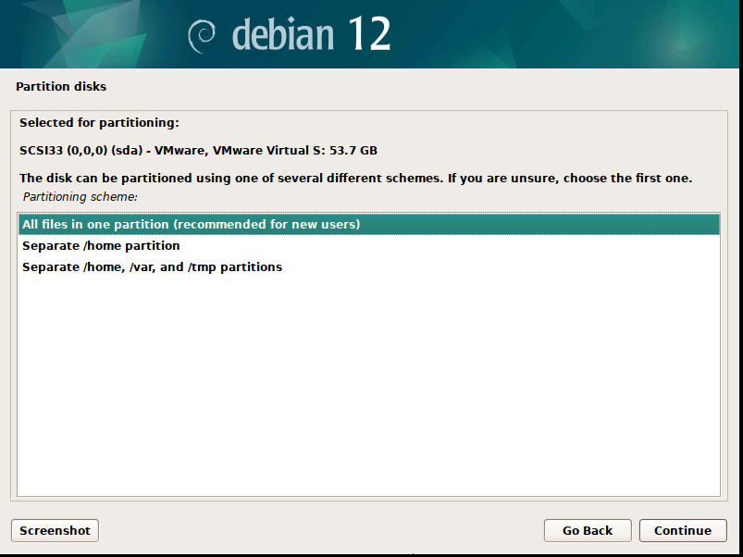
Install Linux
choose the partitioning scheme

Slide 46
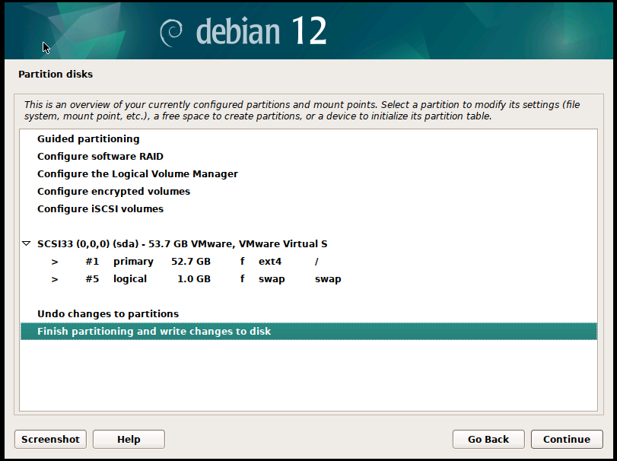
Install Linux
Partitioning Plan overview

Slide 47
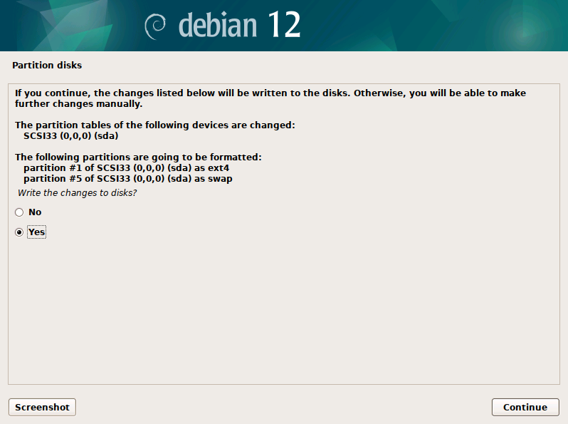
Install Linux
Confirm (Yes)

Slide 48
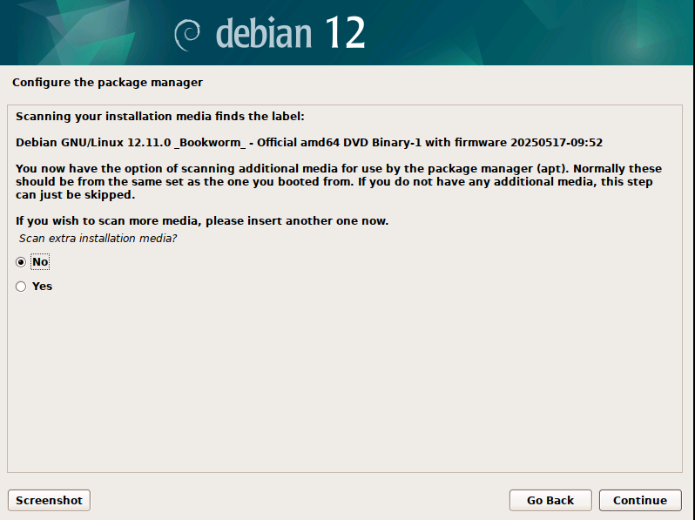
Install Linux
no

Slide 49
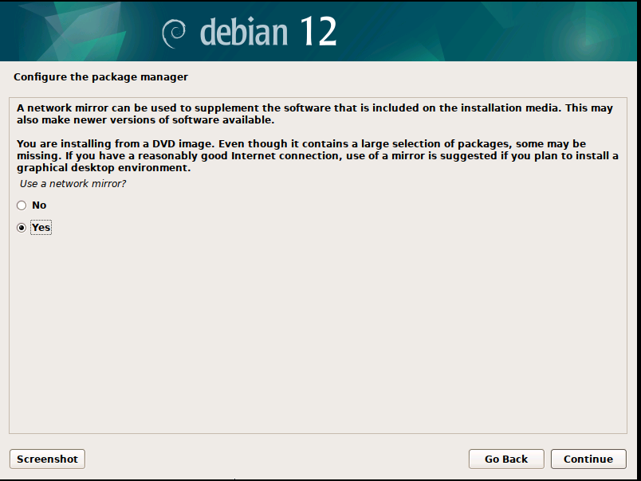
Install Linux
Use network mirror : yes

Slide 50
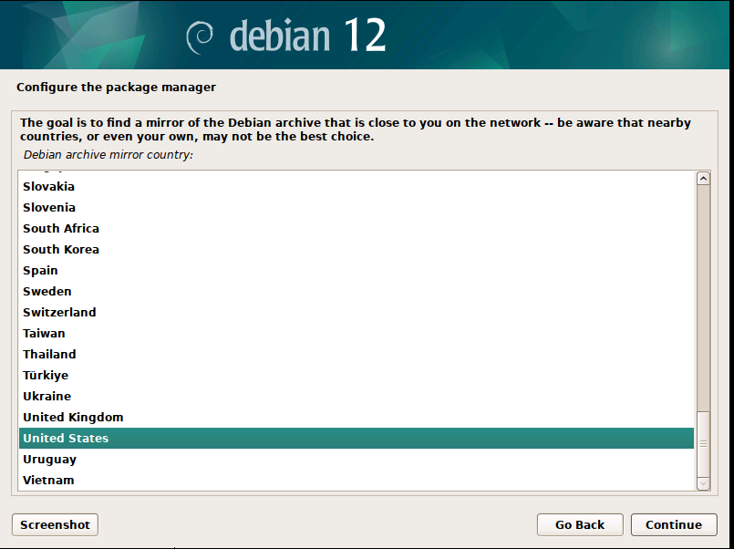
Install Linux
Server country

Slide 51
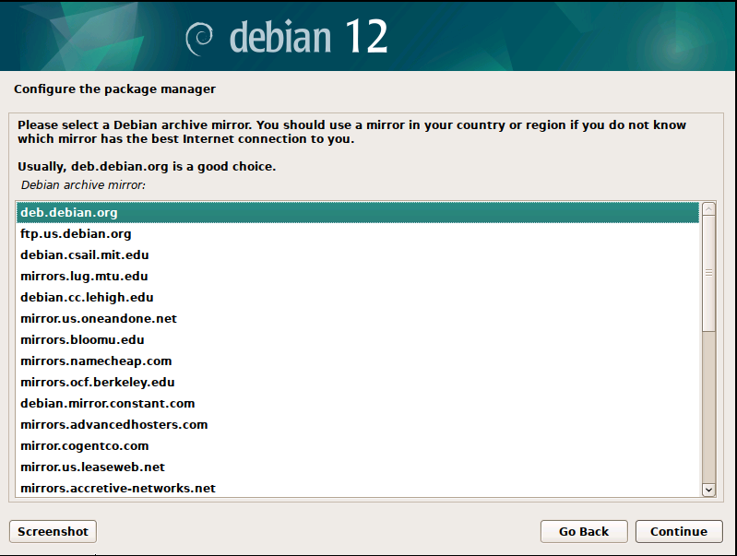
Install Linux
Server name

Slide 52
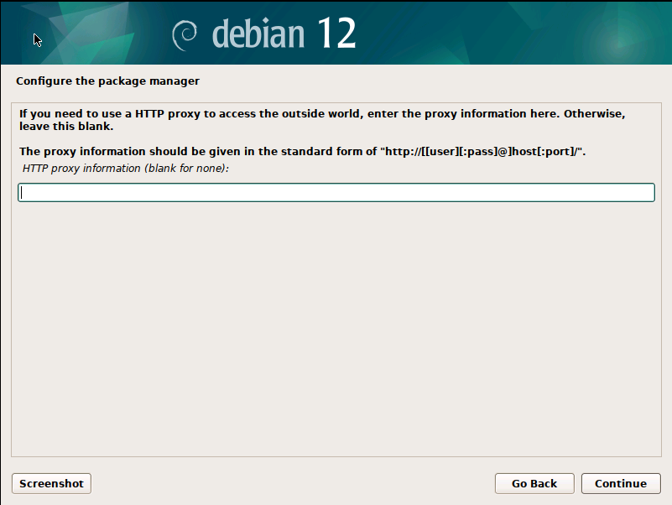
Install Linux
Proxy : blank

Slide 53
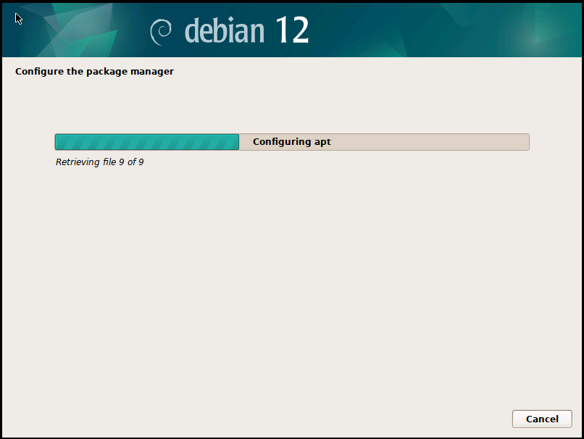
Install Linux

Slide 54
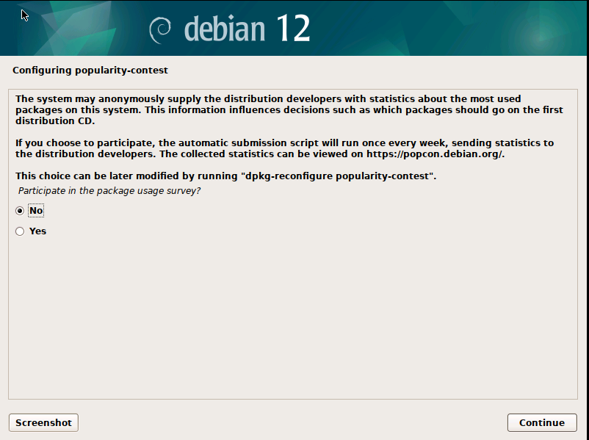
Install Linux
No

Slide 55
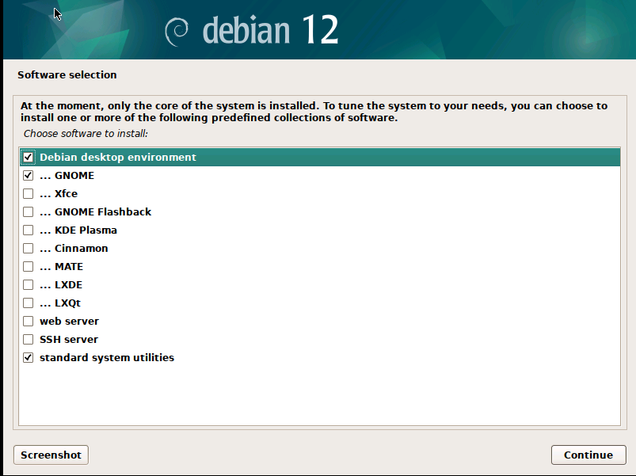
Install Linux
Software selection
Continue

Slide 56
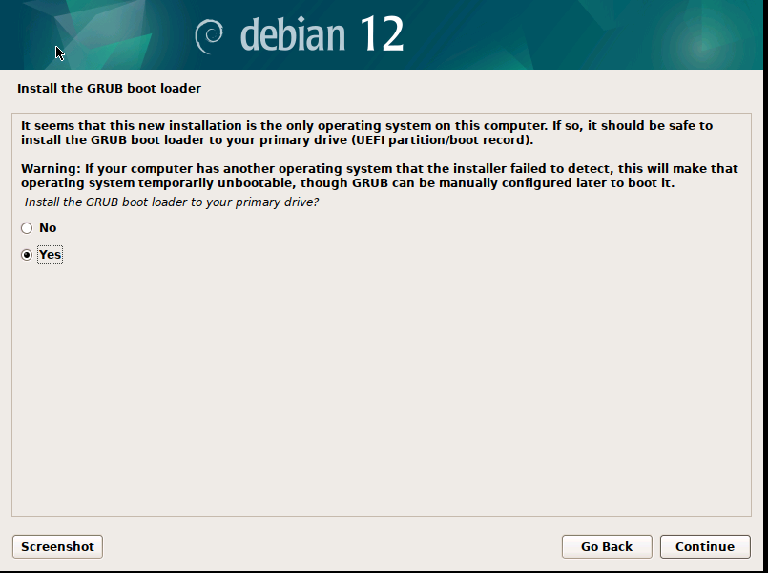
Install Linux
A boot loader is the first program that runs when you turn on your computer
Install GRUB boot loader (yes)

Slide 57
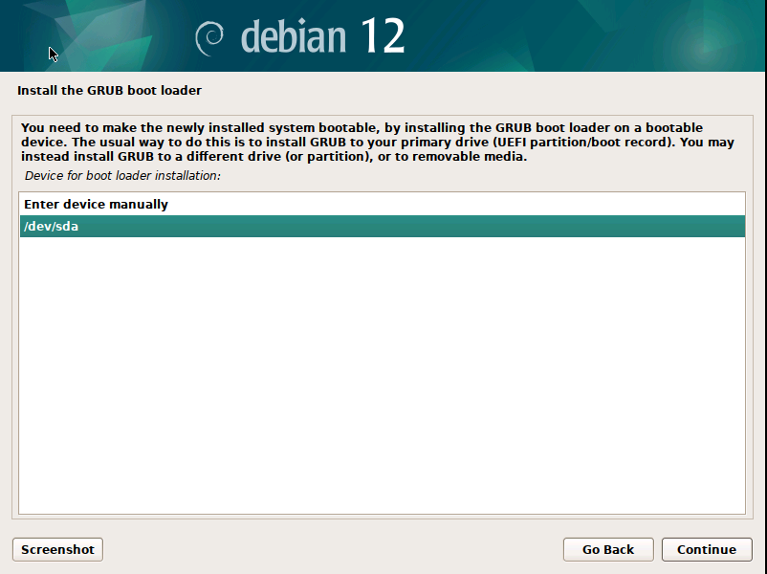
Install Linux
Select disk /dev/sda

Slide 58
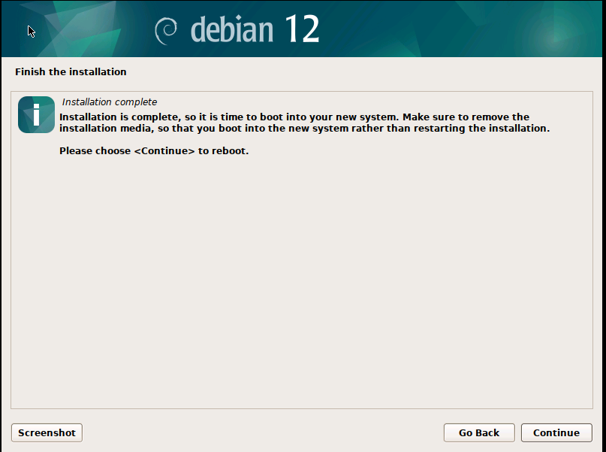
Install Linux
continue

Slide 59
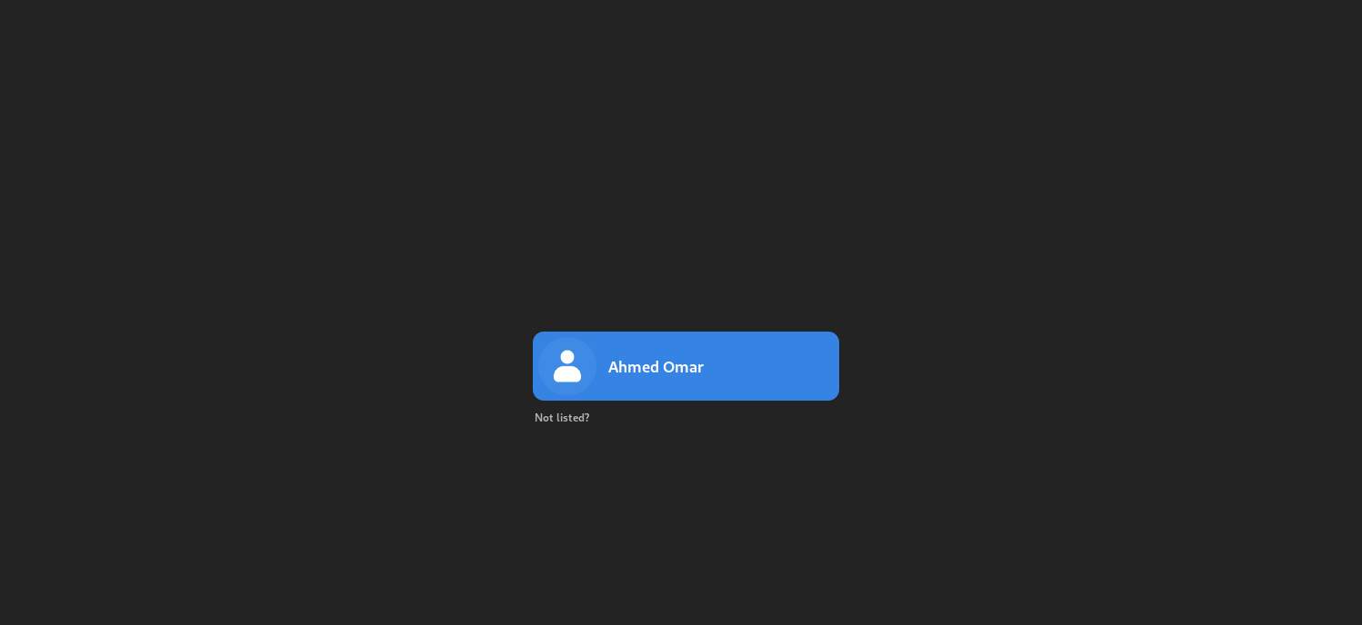
Open Linux
Write user password

Slide 60
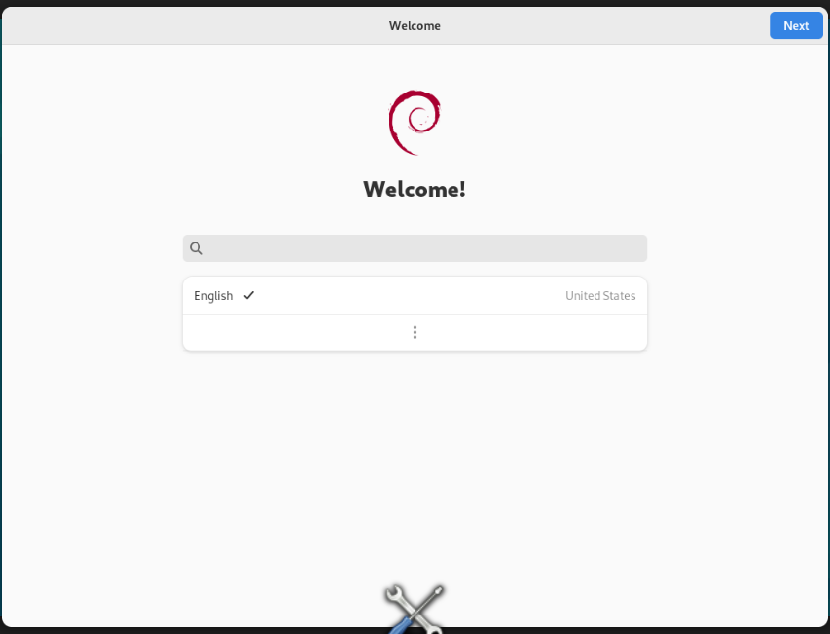
Install Linux
Next

Slide 61
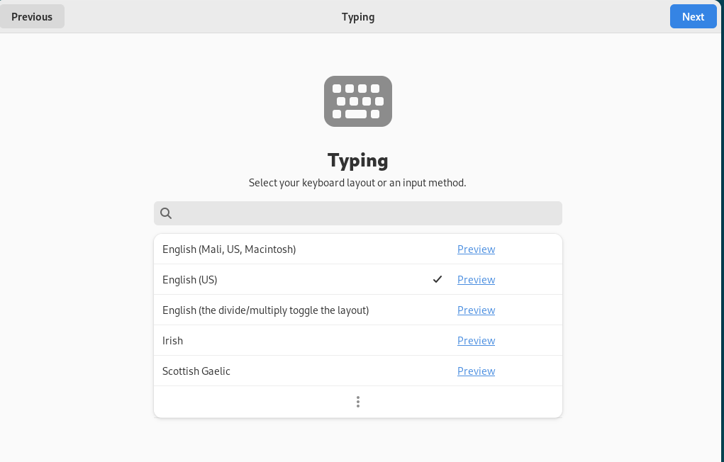
Install Linux
Next

Slide 62
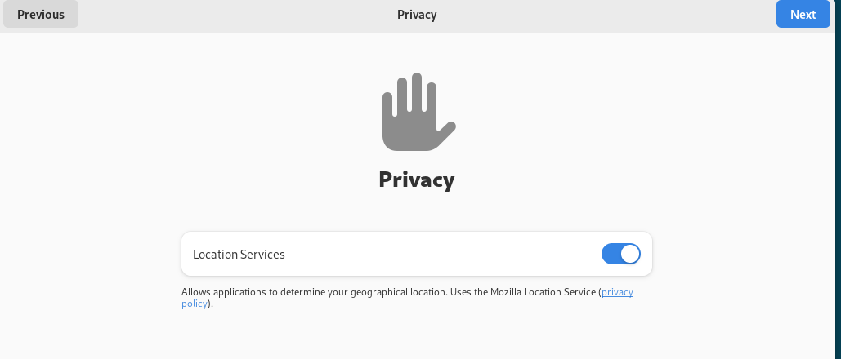
Install Linux
Next

Slide 63
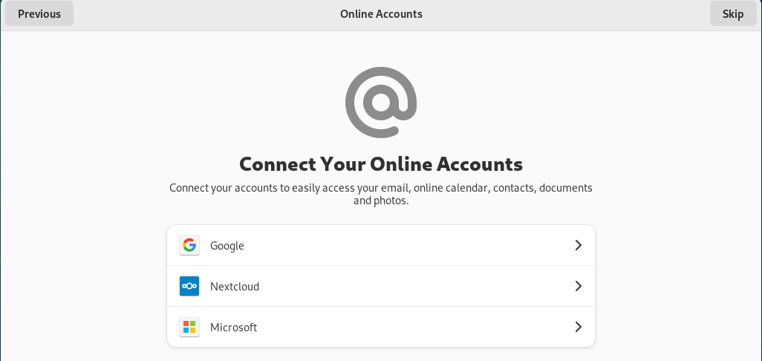
Install Linux
Skip

Slide 64
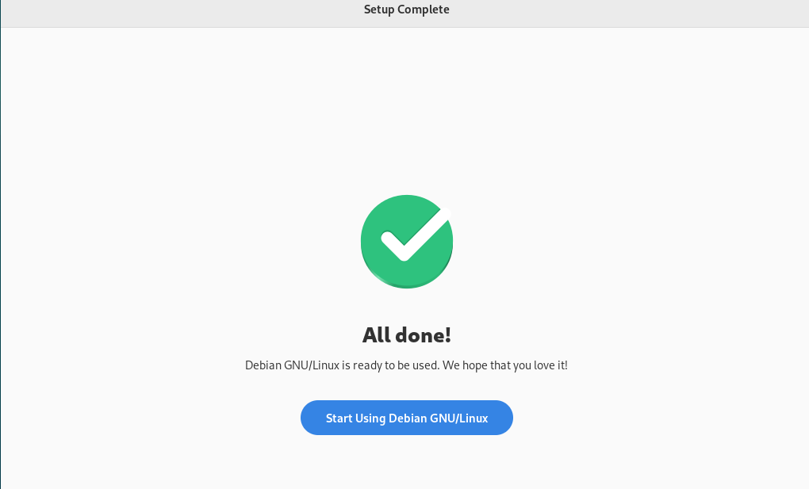
Install Linux
Start using Debian

Slide 65
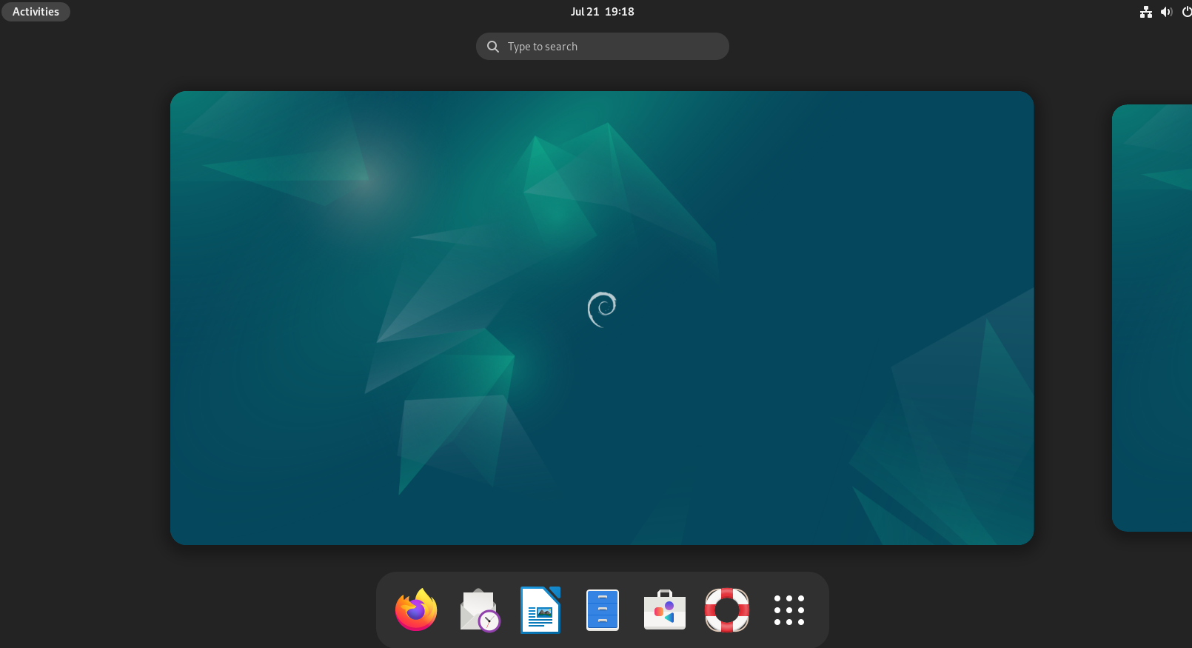
Works with Linux
Click Activities

Slide 66


Works with Linux
Double click

Slide 67

Creating a new virtual machine

Slide 68

Open Terminal
Click Activities
Type terminal in search box

Slide 69

Linux Terminal
The Shell Prompt
When you open a terminal, you'll see a line of text where you can start typing. This is called the shell prompt. It tells you that the system is ready for your commands.

Slide 70
Linux Terminal
ahmed@debiansrv1:~$
Let's break it down:
user: The username of the currently logged-in user.
hostname: The name of the computer you are working on.
~/directory: The current working directory. The tilde (~) is a shortcut for your home directory.
$: This symbol indicates that the shell is waiting for a command from a regular user. # for root user

Slide 71

Linux Commands
date:
Displays the current system date and time.

Slide 72

Linux Terminal
Linux commands are case-sensitive
That means:
Date and date are not the same:

Slide 73

Linux Commands
cal:
Displays a simple calendar in the terminal.

Slide 74

Linux Commands
Cal 2025:
Shows the calendar for the year 2025

Slide 75

Linux Commands
Clear:
clears the terminal screen and moves the cursor to the top-left corner.
You can also use: Ctrl + L

Slide 76

Linux Commands
whoami:
Prints the username of the account you are currently using.

Slide 77

Linux Commands
su:
Stands for "Switch User" It allows you to temporarily become another user. If you just type su, it will try to switch to the superuser (root).

Slide 78

Linux Commands
Switch to root user:
Su -
Su - root
Note the password will never appears

Slide 79

Linux Commands
🆔 ID (User ID)
It is a unique number assigned by the system to each user.

Slide 80


Linux Commands
pwd
Print Working Directory
It shows the full (absolute) path of the current directory you are in.

Slide 81
Summary
CLI vs. GUI
Linux Fundamentals
Practical Installation of Debian Linux
Basic Linux Commands

Slide 82



Thank You

