Slide 1



Software Engineering
Prepared by Dr. Yasser Abdelhamid
IT 382
Software Engineering
Lecture 3

Slide 2

Lecture Outline
Software process models
Waterfall model
Incremental model
Reuse model
www.midocean.ae

Slide 3
The software process
A structured set of activities required to develop a
software system.
  Specification – defining what the system should do;
  Design and implementation – defining the organization of the system and implementing the system;
  Validation – checking that it does what the customer wants;
  Evolution – changing the system in response to changing customer needs.

Slide 4
Software process descriptions
When we describe and discuss processes, we usually talk about the activities in these processes such as specifying a data model, designing a user interface, etc. and the ordering of these activities.

Slide 5
Software process descriptions
Process descriptions may also include:
  Products, which are the outcomes of a process activity;
  Roles, which reflect the responsibilities of the people involved in the process;
  Pre- and post-conditions, which are statements that are true before and after a process activity has been enacted or a product produced.

Slide 6
software process model
A software process model is an abstract representation of a process. It presents a description of a process from some particular perspective.

Slide 7
Plan-driven processes
Plan-driven processes are processes where all of the process activities are planned in advance.
Progress is measured against this plan.

Slide 8
agile processes
In agile processes, planning is incremental.
It is easier to change the process to reflect changing customer requirements.

Slide 9
Real life practice
In practice, most practical processes include elements of both plan-driven and agile approaches.
There are no right or wrong software processes.

Slide 10
Software process models
The waterfall model
  Plan-driven model. Separate and distinct phases of specification and development.
Incremental development
  Specification, development and validation are interleaved. May be plan-driven or agile.
Reuse-oriented software engineering
  The system is assembled from existing components. May be plan-driven or agile.
In practice, most large systems are developed using a process that incorporates elements from all of these models.

Slide 11
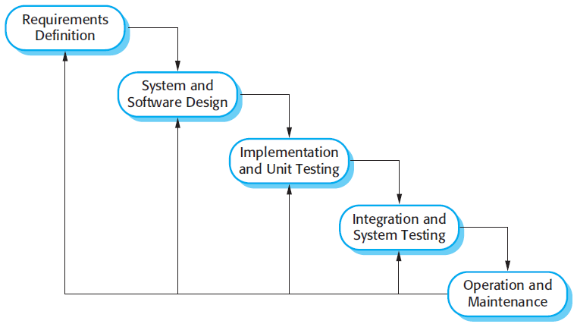
The waterfall model

Slide 12
Waterfall model phases
There are separate identified phases in the waterfall model:
  Requirements analysis and definition
  System and software design
  Implementation and unit testing
  Integration and system testing
  Operation and maintenance

Slide 13
Drawbacks of waterfall model
The main drawback of the waterfall model is the difficulty of accommodating change after the process is underway.
In principle, a phase has to be complete before moving onto the next phase.

Slide 14
Waterfall model problems
Difficult to respond to changing customer requirements.
  Therefore, this model is only appropriate when:
    The requirements are well-understood
    Changes will be fairly limited during the design process. .

Slide 15
Waterfall model problems
The waterfall model is mostly used for large systems engineering projects where a system is developed at several sites.
  In those circumstances, the plan-driven nature of the waterfall model helps coordinate the work.

Slide 16
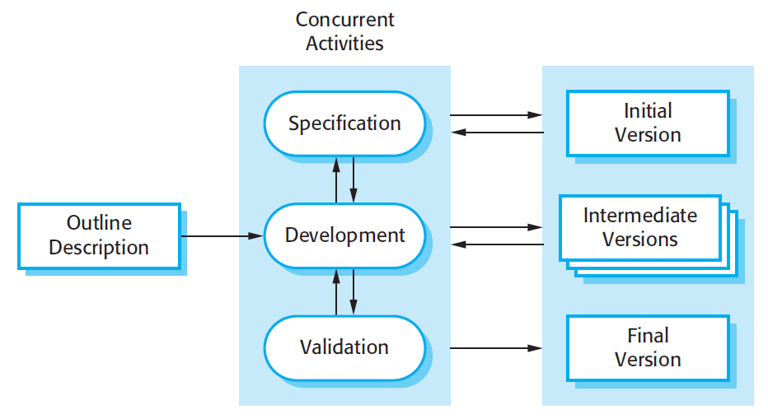
Incremental development

Slide 17
Incremental development benefits
The cost of accommodating changing customer requirements is reduced.
  The amount of analysis and documentation that has to be redone is much less than is required with the waterfall model.

Slide 18
Incremental development benefits
It is easier to get customer feedback on the development work that has been done.
  Customers can comment on demonstrations of the software and see how much has been implemented.

Slide 19
Incremental development benefits
More rapid delivery and deployment of useful software to the customer is possible.
  Customers are able to use and gain value from the software earlier than is possible with a waterfall process.

Slide 20
Incremental development problems
The process is not visible.
  Managers need regular deliverables to measure progress.
  If systems are developed quickly, it is not cost-effective to produce documents that reflect every version of the system.

Slide 21
Incremental development problems
System structure tends to degrade as new increments are added.
  Unless time and money is spent on refactoring to improve the software, regular change tends to corrupt its structure.

Slide 22
Reuse-oriented software engineering
Reuse-oriented software engineering is based on systematic reuse where systems are integrated from existing components or COTS (Commercial-off-the-shelf) systems.

Slide 23
Reuse-oriented software engineering
Process stages
  Requirements specification
  Component analysis;
  Requirements modification;
  System design with reuse;
  Development and integration.
Reuse is now the standard approach for building many types of business systems.

Slide 24
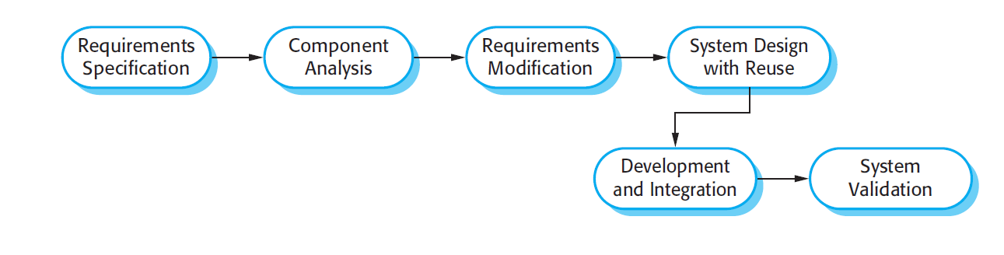
Reuse-oriented software engineering

Slide 25
Types of software component
Web services that are developed according to service standards and which are available for remote invocation.

Slide 26
Web services
Social Media Platforms:
  Social media platforms like Facebook, Twitter, and Instagram provide web services that allow users to create profiles, post content, interact with others, and access various features through web APIs.

Slide 27
Web services
E-commerce Websites:
  E-commerce platforms like Amazon and eBay offer web services for product listings, shopping carts, payment processing, and order management. These services enable businesses to sell products online.

Slide 28
Web services
Weather Services:
  Websites and applications that provide weather information, such as AccuWeather or OpenWeatherMap, offer web services that allow developers to access real-time weather data, forecasts, and weather-related functionalities.

Slide 29
Web services
Mapping and Geolocation Services:
  Services like Google Maps and MapQuest provide web APIs that allow developers to integrate mapping and geolocation features into their applications, such as displaying maps, finding routes, and geocoding addresses.

Slide 30
Web services
Payment Gateways:
  Payment gateways like PayPal and Stripe offer web services for securely processing online payments. These services enable businesses to accept credit card payments, handle transactions, and manage billing processes.

Slide 31
Web services
Messaging and Communication Services:
  Applications like WhatsApp, Slack, and Twilio provide web services for sending and receiving messages, making voice or video calls, and integrating communication functionalities into other applications.

Slide 32
Web services
Travel and Booking Services:
  Websites and applications like Expedia and Airbnb offer web services for searching and booking flights, hotels, and other travel-related services. These services allow developers to access travel information and facilitate bookings.

Slide 33
Web services
Financial Services:
  Financial institutions and fintech companies provide web services for banking operations, account management, transaction processing, and accessing financial data. Examples include banking APIs, stock market data APIs, and payment processing APIs.

Slide 34
Web services
News and Content Aggregators:
  Services like Feedly and Flipboard offer web APIs for aggregating and delivering news articles, blog posts, and other content from various sources. Developers can integrate these services to provide personalized content experiences.

Slide 35
Web services
Cloud Storage and File Sharing:
  Cloud storage providers like Dropbox and Google Drive offer web services that allow users to store, share, and access files and documents securely over the internet. These services provide APIs for integrating cloud storage functionalities into applications.

Slide 36
Types of software component
Collections of objects that are developed as a package to be integrated with a component framework such as .NET or J2EE.

Slide 37
Types of software component
Stand-alone software systems (COTS) that are configured for use in a particular environment.

Slide 38
Summary
Software processes are the activities involved in producing a software system.
Software process models are abstract representations of these processes.
General process models describe the organization of software processes. Examples of these general models include the ‘waterfall’ model, incremental development, and reuse-oriented development.
www.midocean.ae

Slide 39
Summary(cont.)
Types of components that can be used in the reuse process model.
  Web services
  Reusable Objects
  Stand-alone software components
www.midocean.ae

Slide 40


Thank You

