Slide 1


Introduction
Prepared by Dr. Ahmed Alqarni
MGM 115
Critical Thinking
Introduction

Slide 2
Introduction
About the course:
This course is designed to improve a student's ability to analyze and evaluate the kinds of arguments and theories commonly met with in everyday life. The course also helps students improve their own arguments and presentations by showing them how to draw sound conclusions from available evidence and how to construct well-reasoned cases to support these conclusions.
www.midocean.ae

Slide 3
Introduction
Course Objectives:
Demonstrate an understanding of the nature of critical and analytical thinking
Create well-written answers and opinions about a variety of topics using critical thinking skills and models
Detect errors in reasoning and explain how the reasoning is in error
Evaluate evidence and make appropriate inferences from that evidence
Experience group dynamics through collaborative learning activities during the semester.
Analyze and interpret data.
www.midocean.ae

Slide 4
Introduction
Topics:
▪Introduction: critical thinking and argument
Basic logical concepts
The language
Logical fallacies
Analyzing argument
Evaluating arguments and truth claims
Categorical and propositional logics
Inductive reasoning
Finding, evaluating, and using sources
Writing argumentative essay
www.midocean.ae

Slide 5
Introduction
Lecture 1: Introduction: critical thinking and argument
The nature of critical thinking
Key critical thinking standards
Some major impediments to critical thinking
Characteristics of a critical thinker
What is an argument
How to differentiate between argument and nonargument
www.midocean.ae

Slide 6
Introduction
Lecture 2: Basic logical concepts
Deduction and induction
Indicator words
Common patterns of deductive reasoning
Common patterns of inductive reasoning
Deductive validity
Inductive strength
www.midocean.ae

Slide 7
Introduction
Lecture 3: The language
Finding the right words
The importance of precise definitions
Types of Definitions
Strategies for Defining
Rules for Constructing Good Lexical Definitions
www.midocean.ae

Slide 8
Introduction
Lecture 4: Logical fallacies
Fallacies of relevance
Fallacies of insufficient evidence
www.midocean.ae

Slide 9
Introduction
Lecture 5: Analyzing argument
Analyzing short arguments
Analyzing longer arguments
www.midocean.ae

Slide 10
Introduction
Lecture 6: Evaluating arguments and truth claims
What “Good Argument” Does Not Mean
What “Good Argument” Does Mean
When is it reasonable to accept a premise?
Refuting arguments
www.midocean.ae

Slide 11
Introduction
Lecture 7: Categorical and propositional logics
Categorical statements
Propositional logic
www.midocean.ae

Slide 12
Introduction
Lecture 8: Inductive Reasoning
Evaluating Inductive Generalizations
Opinion Polls and Inductive Generalizations
Statistical arguments
Reference Class
Induction and Analogy
Causal Arguments
www.midocean.ae

Slide 13
Introduction
Lecture 9: Finding, evaluating, and using sources
Finding sources
Evaluating sources
Using sources
www.midocean.ae

Slide 14
Introduction
Lecture 10: Writing argumentative essay
Before you write
Writing the first draft
After writing the first draft
www.midocean.ae

Slide 15
Introduction
Textbook:
The main material and reference for this course will be mainly based on:
Textbook: Critical Thinking, Fourth Edition, Gregory Bassham; William Irwin; Henry Nardone; & James M. Wallace
www.midocean.ae

Slide 16
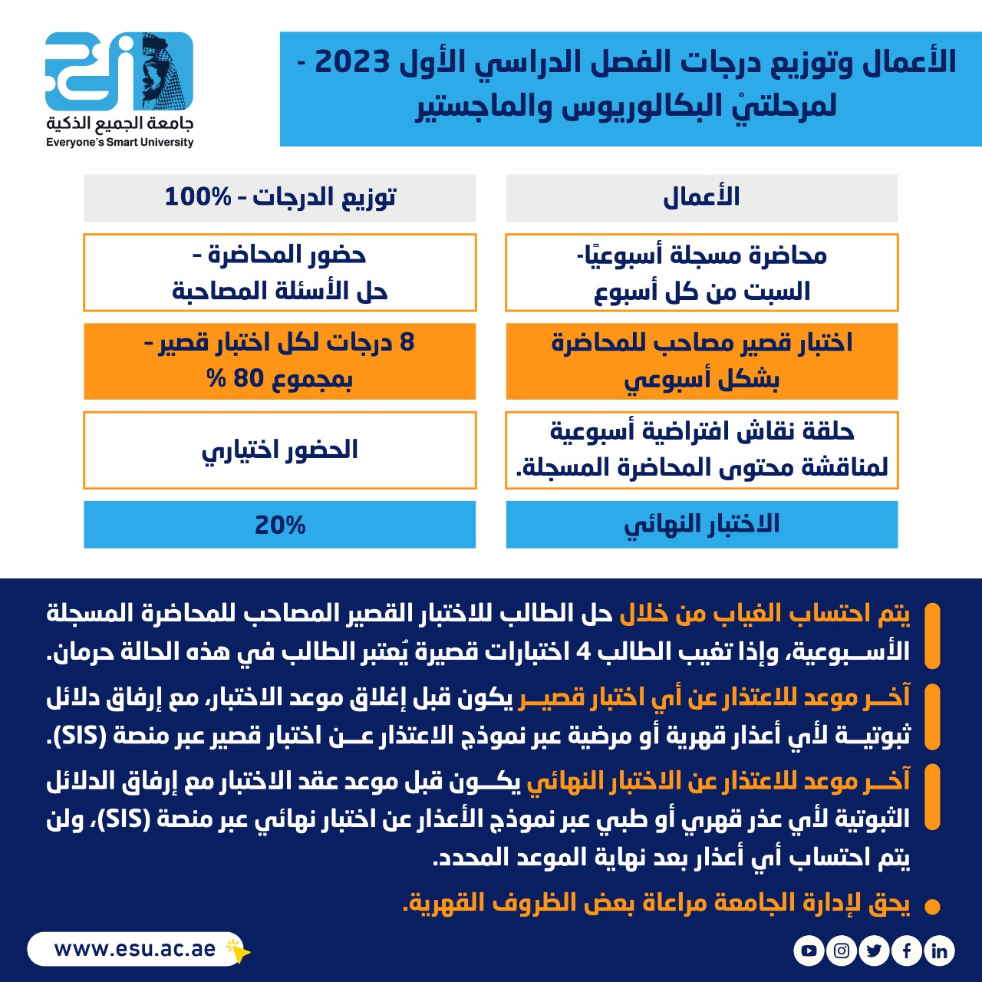
Introduction
www.midocean.ae

Slide 17



Thank You

