Slide 1

Global Project Management
Lecture 8
Everyone’s Smart
University
PMG 661
Global Collaborative Networks

Slide 2

Global Collaborative Networks
Many organisations form strategic alliances and partnerships to access specific markets, to obtain capital resources or sponsorship, or to share R&D and manufacturing skills. Very often, the relationship is sealed around a group of programs or projects. A seamless exchange of information is essential for these initiatives to be successful. This lecture describes the characteristics that define these collaborative networks, discusses the main challenges presented by these forms of relationship, suggests a strategy to achieve effective collaboration and makes recommendations to kick-off the partnership and to concentrate on the interfaces during the project execution.

Slide 3

Collaborative networks: a project-centred approach
Castells (2000) suggests that organisations are evolving from multinational enterprises to international networks, which include large corporations and a series of small and medium business, each in a different country and organizational culture, all with a shared mission to be achieved within a limited timeframe.

Slide 4

Collaborative networks: a project-centred approach
These networks can aggregate the main suppliers, producers and customers with their sub-contractors and service providers, and are strongly reliant on the cooperation among different individuals and on the communication between the computer networks. Program and project managers have the responsibility of driving these networks towards their common mission, by coordinating the collaboration and communication activities, and managing the sharing of interests between the common objective and the goals of the individual companies.

Slide 5

Collaborative networks: a project-centred approach
Figure below exemplifies this concept, by showing a ‘new product development’ project coordinated by a producer company, including team members from the customer, one outsourcing company and one offshore services provider (represented by the dark-grey circle). These team members will collaborate during the product development and liaise with stakeholders from suppliers, R&D, distributors and the end-users (represented by the light-grey circle).

Slide 6
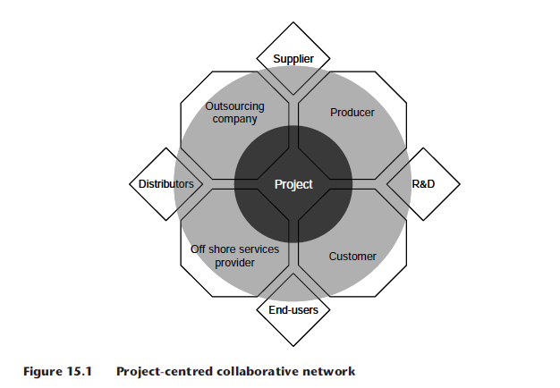
Collaborative networks: a project-centred approach

Slide 7

Understand the challenges
When managing a program or project that is part of a project-centred collaborative network, you must understand the main challenges that may exist in such a relationship. You can organize a brainstorming session to gather ideas from more experienced program or project managers, from senior executives that had previous experiences with the companies and individuals participating in the network and from consultants that are specialized in outsourcing and offshoring initiatives in your domain of expertise. Some examples of these challenges are:

Slide 8

Understand the challenges
Different interests – each company can be joining the network with hidden interests, forcing their views during project meetings or working implicitly towards them. The program and project managers need to evaluate these interests in advance of every conflicting situation and be prepared to negotiate at every occasion.

Slide 9
Understand the challenges
Different corporate cultures – each company has a different view on risk awareness, decision making, motivation, rewards, conflict management, leadership styles and hierarchical structures. The project manager must consider these differences when preparing the stakeholder analysis and defining the project communication strategy.

Slide 10
Understand the challenges
Different maturity levels on project management – while some companies value project management and have established solid methodologies on how to manage and work on projects, other organisations still ‘improvise’ and compensate the lack of competencies on project management with hard work. The project manager must investigate which companies in the network have the higher levels of maturity, by evaluating lessons-learned databases and involving project managers from all companies in the project initiation and planning.

Slide 11
Understand the challenges
Different maturity levels on processes and procedures – some companies can be process-oriented, with clear procedures that allow effective communication across different teams executing complementary tasks. The team members from these companies might adapt quickly to working within a global project team when all components agree to use the same processes and procedures. Other companies can run in a more informal environment, requiring face-to-face discussions to synchronize different work packages.

Slide 12

Understand the challenges
Different collaborative tools and communication techniques – the various companies in the network can have their own set of collaborative systems, using different software providers, and choosing to implement and customize the tools in diverse ways. Some companies may not even have a good knowledge level of these systems, employing only e-mails and audio conferencing for cooperation across borders.

Slide 13
Understand the challenges
The challenges of global projects – all challenges from global projects apply to the collaborative networks, requiring the application of the Global Project Management Framework©. The project manager can use the framework to obtain agreement from the different companies that a set of good practices is required, and apply the learning from the different modules during the whole project, from initiation to completion.

Slide 14
Define a collaboration strategy
After evaluating the challenges that are applicable to your situation and considering how to address each of them, you need to define an inter-organizational collaboration strategy, by:
Defining the mission in specific and clear terms that can be accepted by all parties.
Identifying the need for standardization of organizational practices and policies, taking into account the capability of the different organisations to adapt to the new standard.

Slide 15
Define a collaboration strategy
Defining the desired maturity on project management and the required level of details of process definition, conciliating the project requirements and the abilities of different organisations.

Slide 16
Define a collaboration strategy
Defining the collaborative tools and the modules of the Global Project Management Framework© that are essential for effective cooperation, and fixing a target date for the development and implementation of the tools, methods and good practices across all teams working on the project.

Slide 17
Initiate the collaboration
You can organize a ‘collaboration kick-off session’ to put the strategy in place. This session can include the program managers and project managers coordinating different initiatives in the same collaborative network, sharing the main outcomes with key stakeholders from the companies in the network.
The items in the kick-off session need to address the challenges you identified, and cover all topics you specified in the collaboration strategy. The agenda can include the following
points:

Slide 18
Initiate the collaboration
establish the purpose of the programs and projects;
prepare a team charter;
define roles and responsibilities;
agree on common and flexible systems, structures, policies, tools and methods;
define a shared goal for the different companies to work as a team, reducing the influences and differences from organizational and country borders;

Slide 19
Initiate the collaboration
understand the different organisations’ values and styles;
identify the need for different training and coaching sessions on the new techniques,
processes, tools, methods and good practices;
Have lunch breaks, team dinner events and other social activities that allow relationship building and the creation of informal networks.

Slide 20
Monitor the interfaces
Once you have defined a core set of practices, tools and directions together with the representatives from the other companies, you need to define the group of people who will make sure that the agreements are respected by all parties. When deviations are found, the group must get together and analyse the reasons and potential alternatives.

Slide 21
Monitor the interfaces
This group must concentrate on the interfaces, which are the communications between people across organizational borders and the data exchange between different corporate information systems. The roles assigned to this group must be part of a charter assigning clear responsibilities. Some examples of activities under the responsibility of the ‘monitoring team’ are:

Slide 22

Monitor the interfaces
track progress towards the program and project missions, and identify activities and behaviors that go against these directions;
make sure that the collaborative tools are being employed according to the communication strategy;
monitor the use of the shared processes and practices as agreed during the kick-off session;

Slide 23
Monitor the interfaces
monitor the effectiveness of the training and coaching sessions, and recommend additional educational sessions or guidelines;
fine tune business processes that involve different companies.

Slide 24
Monitor the interfaces
Companies can opt for selecting local agents (persons or partnership firms) to perform a link between the foreign and local cultures, and optimizing the network processing, by applying the following criteria (adapted from Sennara and Hartman, 2002):

Slide 25
Monitor the interfaces
experience on project environments;
a proven track record of experience in the project’s knowledge area;
respect and trust from at least one organization in the project;
openness for understanding of the foreign cultures;
existence of a strong network in the local country, helping to identify and analyse the project stakeholders;
alignment with foreign corporate values.

Slide 26

Resources:
Global Project Management
Communication, Collaboration and Management Across Borders
© Jean Binder 2007
Chapter 15

