Slide 1


Prepared by Dr. Weam Nasan Agha
REA619
Property and Facilities Management
Orientation Lecture

Slide 2



Real Estate Management
Orientation Lecture
REA619
Property and Facilities Management
Prepared by
Dr. Weam Nasan Agha

Slide 3

Contents
The Concept of Property Management
The Concept of Facility Management
Property Management vs. Facility Management
Course Description
Course Objectives
Topics to be covered
Learning Outcomes

Slide 4

The Concept of Property Management
Property management is the operation, control, and oversight of real estate, including residential, commercial, and industrial properties. It involves activities such as leasing, rent collection, maintenance, and tenant relations.
The concept of property management first emerged in the late 19th and early 20th centuries as cities expanded rapidly due to industrialization. As urban populations grew and real estate holdings became more complex, property owners required professional assistance to manage properties.

Slide 5
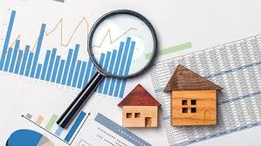
The Concept of Facility Management
Facility management is the integration of people, place, process, and technology to ensure the functionality, comfort, safety, and efficiency of the built environment.
The concept of Facility Management emerged in the late 1970s in the United States, driven by the growing complexity of workplaces and the increasing need to integrate administrative and technical services.

Slide 6
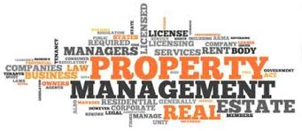
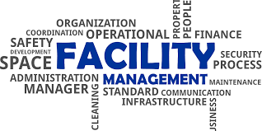
Property vs Facility Management
focuses on financial performance, leasing, and tenant relations.
focuses on service delivery, maintenance, and operational efficiency.
Property = Asset-driven | Facilities = Service-driven
Both functions are complementary in real estate operations.
Property and Facilities Management are vital for the long-term success and performance of real estate assets.

Slide 7

Course Description
Property and Facilities Management (PFM) is a critical discipline that ensures the effective and efficient operation of buildings, physical assets, and real estate.
This course provides students with a thorough understanding of the principles, practices, and tools required to manage residential, commercial, and institutional properties throughout their lifecycle.
It emphasizes strategic planning, operational maintenance, sustainability, and compliance, while highlighting the role of technology and innovation in modern facilities management.
Total Hours
3

Slide 8
Course Objectives
Understand the fundamental concepts and scope of property and facilities management.
Analyze the roles and responsibilities of facility and property managers in various sectors.
Evaluate different management strategies for maintaining, operating, and improving property assets.
Apply sustainable practices and smart technologies in managing facilities.
Develop management plans that align with organizational goals, user needs, and legal requirements.

Slide 9
Topics to be covered
Introduction to Property and Facilities Management
Maintenance Strategies: Preventive, Corrective, and Predictive
Space Planning and Utilization
Health, Safety, and Environmental Compliance
Energy Management and Sustainability in Facilities
Financial Aspects: Budgeting, Cost Control, and Contracting
Outsourcing and Vendor Management
Risk Management and Emergency Planning
Technology in Facilities Management (e.g., CAFM, IoT)
Performance Measurement and Continuous Improvement

Slide 10
Learning Outcomes:
Describe the key principles and scope of property and facilities management.
Identify and assess the physical and operational needs of different types of facilities.
Design and evaluate management strategies for space use, maintenance, and cost efficiency.
Incorporate sustainability and environmental considerations in facility operations.
Use tools and systems (like CAFM software) to support facility and property decisions.
Managing urban real estate complexes according to the concepts of efficiency and integration.
Critically analyze real-life case studies and propose effective solutions to management challenges.

Slide 11
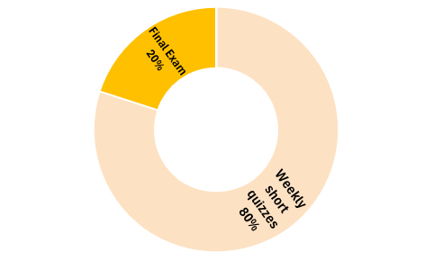
Final Exam 20%
Weekly short quizzes 80%
Total questions
8

Slide 12
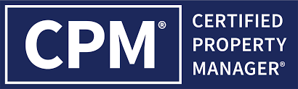
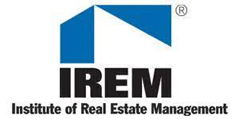

Credited Certificates for Property Management

Slide 13
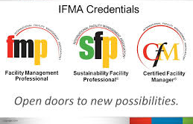

Credited Certificates for Facility Management

Slide 14



Thank You

