Slide 1


System Administration (2)
IT401
Prepared by
Dr. Ahmed El-Douh
Lecture 1

Slide 2



System Administration 2
Lecture 1
IT401
Core Concepts in System Administration
Prepared by
Dr. Ahmed El-Douh

Slide 3
Objectives
Upon completion of this lecture, you will be able to:
  Define systems, components, and services within the context of system administration.
  Explain the importance of system administration in enterprise environments.
  Identify the core responsibilities and daily tasks of a system administrator.
  Recognize essential tools and technologies used in system administration.
  Discuss common challenges faced in managing systems and services.
  Apply guiding rules, best practices, and ethical considerations in system administration.
www.midocean.ae

Slide 4
Chapter
Outlines
01
Defining Systems, Components, and Services
The Importance of System Administration
System Administration Challenges
System Administration Rules and Best Practices
System Administrator Responsibilities
Ethical Considerations in System Administration
www.midocean.ae

Slide 5


Chapter
01
Defining Systems, Components, and Services
www.midocean.ae

Slide 6
What is an IT System?
A system is an organized collection of interconnected components that work together to achieve specific objectives.
Key Characteristics:
  Integration: Components work as unified whole
  Purpose: Designed to accomplish specific goals
  Interaction: Elements communicate and depend on each other
  Boundaries: Clear definition of what's inside vs outside
  Environment: Operates within specific context
www.midocean.ae

Slide 7
Types of Systems
Operating Systems (Windows, Linux, macOS): Software that manages hardware resources and provides a platform for applications to run.
Network Systems: Systems that enable communication, data exchange, and resource sharing between multiple devices.
Database Systems: Systems designed to store, organize, and manage data efficiently for easy access and retrieval.
Application Systems: Software systems built to perform specific tasks or functions for end-users or organizations.
Security Systems: Systems that protect information and resources from unauthorized access, misuse, or attacks.
www.midocean.ae

Slide 8
Core Components of IT Systems
  The core building blocks of IT infrastructure:
    Hardware: Physical devices (servers, storage, PCs).
    Software: Programs and operating systems that run on hardware.
    Networks: Connections that enable communication and data exchange.
    Services: Functionalities provided (email, web, cloud, etc.).
Together, they form the foundation of any organization’s technology ecosystem.
www.midocean.ae

Slide 9
Core Components of IT Systems: Hardware
Processors (CPU): Execute instructions, run programs, and perform calculations.
Memory (RAM): Temporary data storage and fast processing for active tasks.
Storage: Long-term data retention (HDDs for capacity, SSDs for speed).
Network Interfaces (NICs): Enable communication across networks.
Input/Output Devices (I/O): Interaction points for users (keyboard, mouse, monitor, etc.).
www.midocean.ae

Slide 10
Core Components of IT Systems: Software
Operating System (OS): Manages hardware, resources, and system operations.
Applications: Programs designed for end-users (e.g., browsers, office tools).
Drivers: Allow hardware and OS to communicate properly.
Utilities: Specialized tools for system optimization and maintenance.
Firmware: Embedded software controlling hardware at a low level.
www.midocean.ae

Slide 11
Core Components of IT Systems: Networks
Function: Connect devices and enable communication & data exchange.
Types:
  LAN (Local Area Network): Small-scale networks (e.g., office, home).
  WAN (Wide Area Network): Large-scale networks (e.g., the Internet).
  Wireless Networks: Wi-Fi, mobile networks.
Importance: Foundation for collaboration, resource sharing, and Internet access.
www.midocean.ae

Slide 12
Core Components of IT Systems: Services
Definition: Services provided by IT components to support organizational operations and meet user needs.
Core System Services:
  Process Management: Running and scheduling programs.
  Memory Management: Efficient allocation and use of RAM.
  File System: Organizing, storing, and accessing data.
  Security Services: Authentication, authorization, and protection.
  Network Services: Protocols enabling communication (e.g., TCP/IP, DNS).
www.midocean.ae

Slide 13
Core Components of IT Systems: Services
  Infrastructure Services:
    DNS (Domain Name System): Translates domain names into IP addresses.
    DHCP (Dynamic Host Configuration Protocol): Assigns IP addresses automatically.
    Web Services: Enable communication over HTTP/HTTPS protocols.
    Email Services: Handle email transmission and access (SMTP, POP3, IMAP).
    Database Services: Provide structured data storage and retrieval.
www.midocean.ae

Slide 14
Core Components of IT Systems: Services
  Application Services:
    Directory Services: Manage users, devices, and network resources.
    Backup Services: Ensure data protection and disaster recovery.
    Monitoring Services: Track system performance and availability.
    Update Services: Maintain and patch software regularly.
    Remote Access: Enable secure connections via SSH, RDP, VPN.
www.midocean.ae

Slide 15
Chapter
01
The Importance of System Administration
www.midocean.ae

Slide 16
What is System Administration?
System Administration refers to managing computer systems in a multi-user environment, including maintaining, monitoring, and supporting their operation.
The discipline of managing and operating computer systems in a multi-user environment.
Ensures systems are secure, stable, and available for users.
Covers tasks such as installation, configuration, maintenance, and troubleshooting.
Involves monitoring performance, applying updates, and responding to incidents.
Provides user support and aligns IT systems with organizational needs.
www.midocean.ae

Slide 17
Core Areas of System Administration
System Management
Hardware/Software Installation
OS Management & Updates
Performance Monitoring
System Configuration
User Administration
Account Creation & Management
Access Control & Permissions
Authentication Systems
Security Policies
Security & Backup
Security Protocol Implementation
Firewall Management
Backup & Disaster Recovery
Threat Detection
Network Administration
Network Configuration
Device Management
Connectivity Maintenance
Network Troubleshooting
www.midocean.ae

Slide 18
System Administrator
A system administrator (sysadmin) is an IT professional who manages and supports a multi-user computing environment, ensuring the reliable and efficient operation of IT services and systems.
The sysadmin is responsible for maintaining uptime, performance, resources, and security, making sure systems meet user needs while staying within budget limits.
www.midocean.ae

Slide 19
Importance of System Administration
Business Continuity:
  Ensures systems remain operational 24/7
  Minimizes downtime and service interruptions
  Maintains productivity and revenue flow
  Supports business growth and scalability
Data Protection:
  Safeguards critical business information
  Implements backup and disaster recovery
  Ensures data integrity and availability
  Complies with regulatory requirements
www.midocean.ae

Slide 20
Importance of System Administration
Security Assurance:
  Protects against cyber threats and attacks
  Maintains system and network security
  Manages user access and permissions
  Monitors for suspicious activities
Performance Optimization::
  Ensures systems run efficiently
  Manages resource allocation
  Optimizes network performance
  Plans for capacity requirements
www.midocean.ae

Slide 21
Importance of System Administration
Cost Management:
    Reduces operational expenses
    Prevents costly system failures
    Optimizes resource utilization
    Plans strategic technology investments
  Together, these aspects of system administration ensure that IT infrastructure remains reliable, secure, efficient, and cost-effective, directly supporting organizational goals and long-term success.
www.midocean.ae

Slide 22
Chapter
01
System Administration Challenges
www.midocean.ae

Slide 23
System Administration Challenges
Technical Challenges:
    Complexity: Managing diverse, interconnected systems
    Scale: Handling growing data and user volumes
    Integration: Connecting different technologies
    Legacy Systems: Maintaining older infrastructure
    Rapid Change: Keeping up with technology evolution
www.midocean.ae

Slide 24
System Administration Challenges
Security Challenges:
    Cyber Threats: Evolving attack methods
    Compliance: Meeting regulatory requirements
    Access Management: Controlling user permissions
    Data Privacy: Protecting sensitive information
    Incident Response: Handling security breaches
www.midocean.ae

Slide 25
System Administration Challenges
  Operational Challenges:
    24/7 Availability: Ensuring continuous operation
    Resource Constraints: Limited budget and staff
    Skills Gap: Finding qualified personnel
    Documentation: Maintaining accurate records
    Change Management: Implementing updates safely
www.midocean.ae

Slide 26
Chapter
01
System Administration Rules and Best Practices
www.midocean.ae

Slide 27
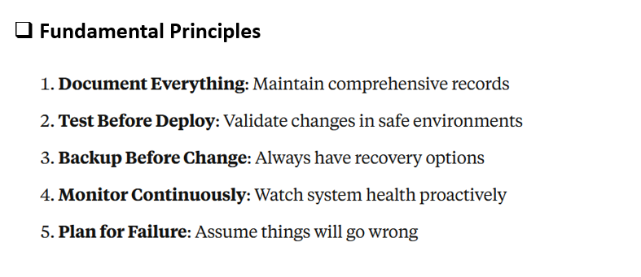
System Administration Rules and Best Practices
www.midocean.ae

Slide 28
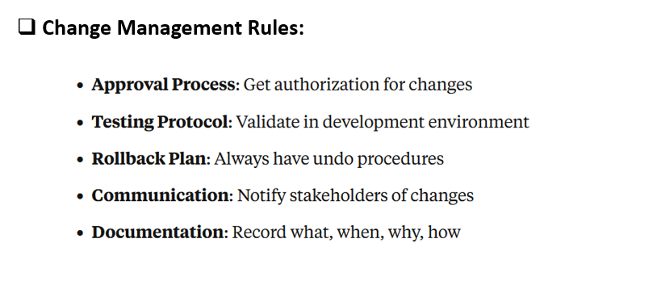
System Administration Rules and Best Practices
www.midocean.ae

Slide 29
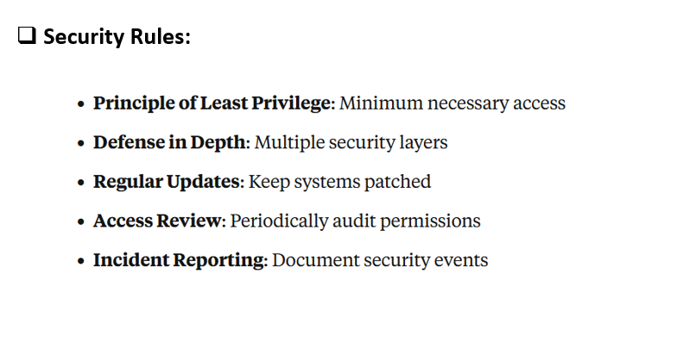
System Administration Rules and Best Practices
www.midocean.ae

Slide 30
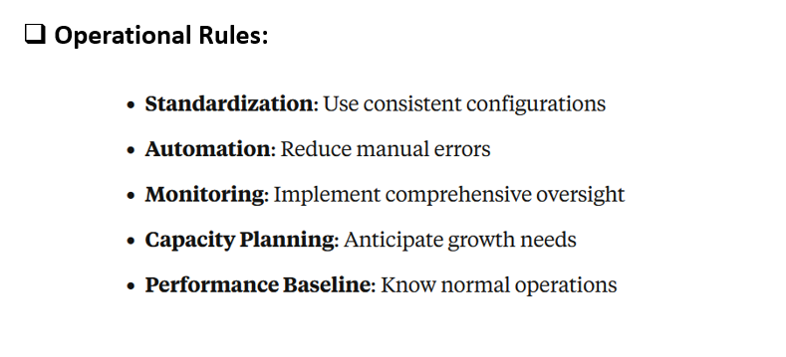
System Administration Rules and Best Practices
www.midocean.ae

Slide 31
Chapter
01
System Administrator Responsibilities
www.midocean.ae

Slide 32
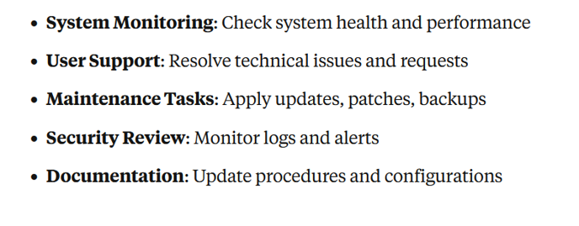
System Administrator Responsibilities: Daily Operations
www.midocean.ae

Slide 33
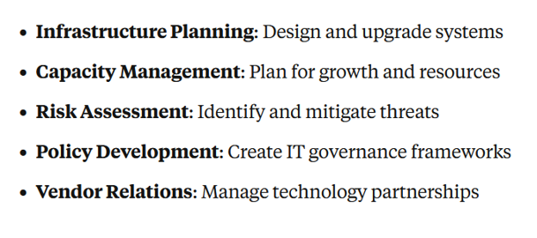
System Administrator Responsibilities: Strategic Responsibilities
www.midocean.ae

Slide 34
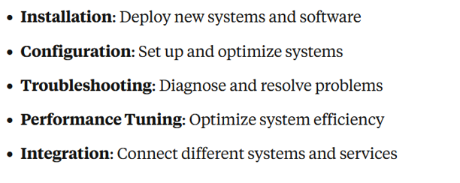
System Administrator Responsibilities: Technical Responsibilities
www.midocean.ae

Slide 35
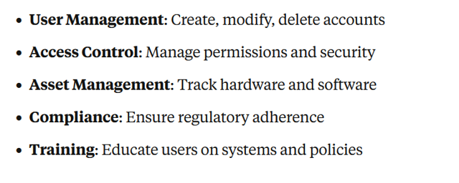
System Administrator Responsibilities: Administrative Responsibilities
www.midocean.ae

Slide 36
Chapter
01
System Administration Ethics
www.midocean.ae

Slide 37
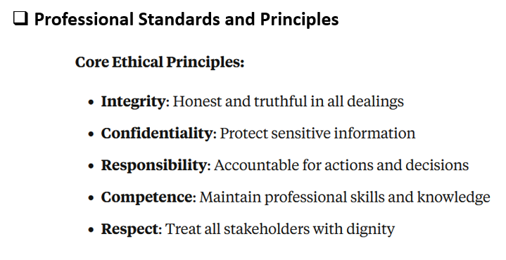
System Administration Ethics
www.midocean.ae

Slide 38
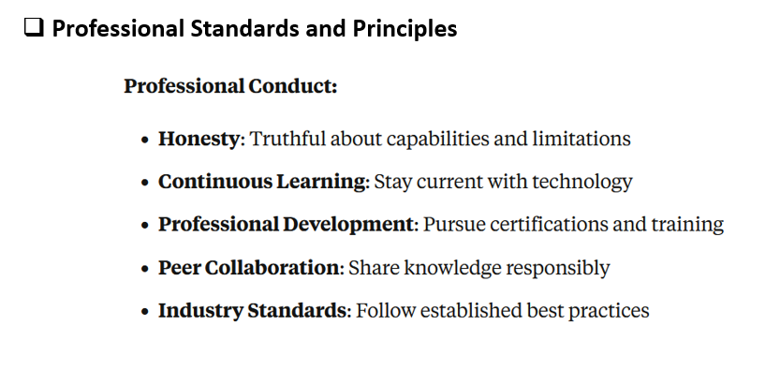
System Administration Ethics
www.midocean.ae

Slide 39
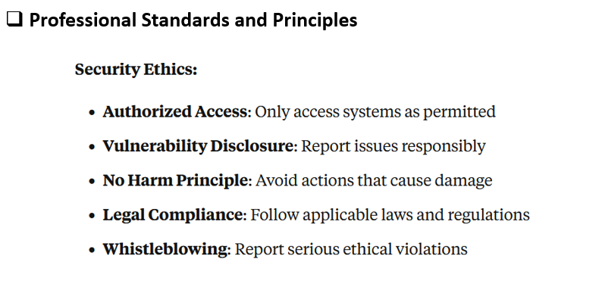
System Administration Ethics
www.midocean.ae

Slide 40
Summary
  Defining Systems, Components, and Services: A system consists of interconnected components and services working together to achieve specific goals.
  The Importance of System Administration: System administration ensures stability, security, and efficiency of IT environments.
  System Administration Challenges: Administrators face issues such as downtime, security threats, and resource management.
  System Administration Rules and Best Practices: Following standard procedures, documentation, and automation reduces risks and improves reliability.
  System Administrator Responsibilities: Admins are responsible for installation, configuration, monitoring, troubleshooting, and maintaining security.
  Ethical Considerations in System Administration: Ethics guide professional conduct, confidentiality,
www.midocean.ae

Slide 41



Thank You

