Slide 1

The Cultures of New Media (DGM 715)
Prepared by
Dr. Mohamed Owies
Lecture No. 2
The Cultures of New Media
(DGM 715)

Slide 2
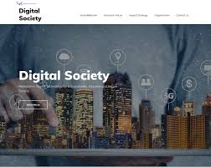

Lecture 2
The content of Lecture 2
The Second lecture sheds light on a number of important topics, including the following:
Social Cooperation and New Media
Social Cooperation and communication
Re-evaluating Gemeinschaft and Gesellschaft with New Media
Social Cooperation and Twitter
Social Presence
Self-Presentation
The Rise of Networked Publics
What are memes?
How do you succeed in Instagram marketing?
Cyber Debates
Digital Revolution

Slide 3
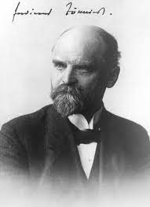
Lecture 2
Social Cooperation and New Media
Tönnies, with his notion of Gemeinschaft, speaking of ‘co-operation’ as fundamental for human existence, contribute to an understanding of the social in terms of collaboration.
For Tönnies, Gemeinschaft is what holds society (‘Gesellschaft’) together. Society is merely people coexisting, but community (‘Gemeinschaft’) is the language, the ways, the mores, and the beliefs that bring about social coherence and unity.
Ferdinand Tönnies

Slide 4
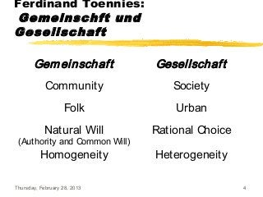
Lecture 2
Social Cooperation and New Media
Understanding Gemeinschaft and Gesellschaft
During the 19th century, a great transformation happened in Europe. The rise of nationalism and the industrial revolution affected all spheres of life and a transition from rural, peasant societies to modern, industrial societies emerged.
To analyze this transition and differences between societies German sociologist Ferdinand Tönnies theorized two concepts to categorize two different social groups: Gemeinschaft (community) and Gesellschaft (society).

Slide 5
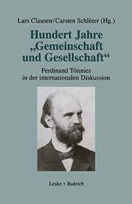
Lecture 2
Social Cooperation and New Media
According to Tönnies, Gemeinschaft indicates pre-industrial, peasant societies. Gemeinschaft is composed of conventional social roles. Kinship, tradition, and religion play an important part in social life. A sense of belonging to the community, firm communal relations, a narrow division of labor are essential for gemeinschaft.
On the other hand, Gesellschaft is composed of ideas of rationality and efficiency. Social ties are determined on a contractual base, a strong division of labor is visible in gesellschaft (Tönnies, 1887).

Slide 6
Lecture 2
Social Cooperation and New Media
Social Cooperation
Ferdinand Tönnies
Gemeinschaft
Community
Gesellschaft
Society

Slide 7
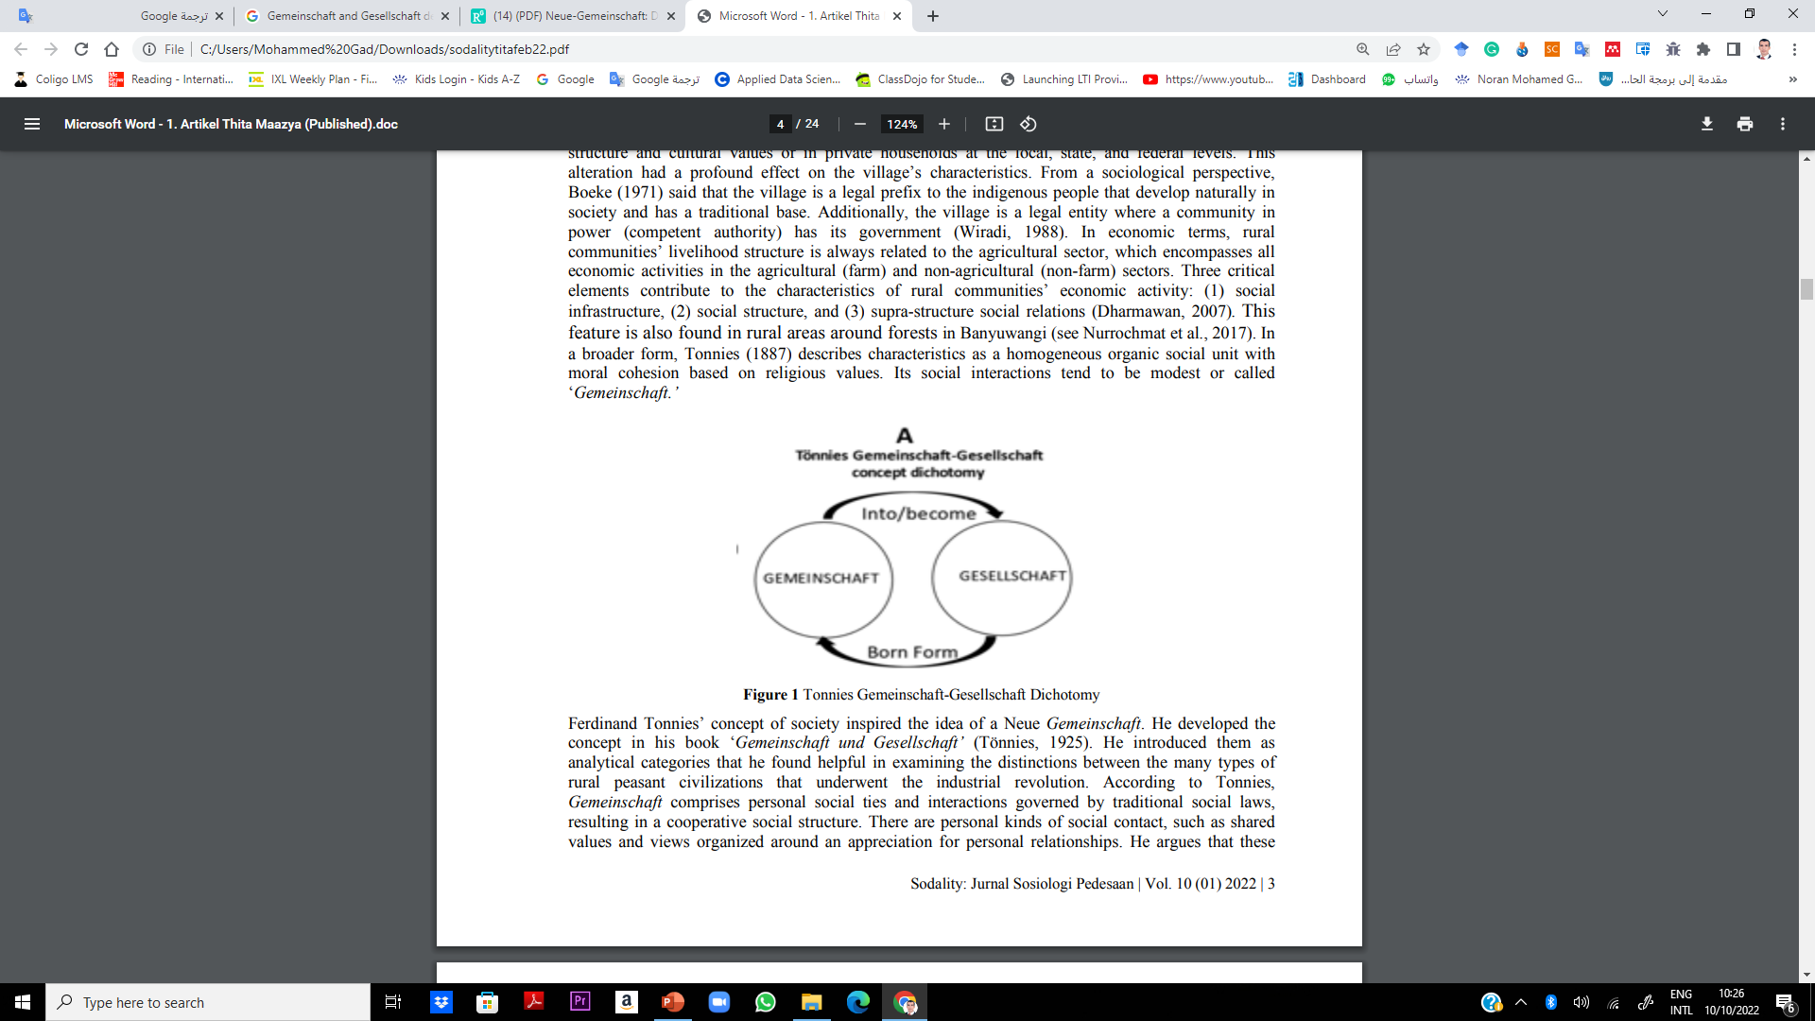
Lecture 2
Social Cooperation and New Media
Ferdinand Tönnies

Slide 8
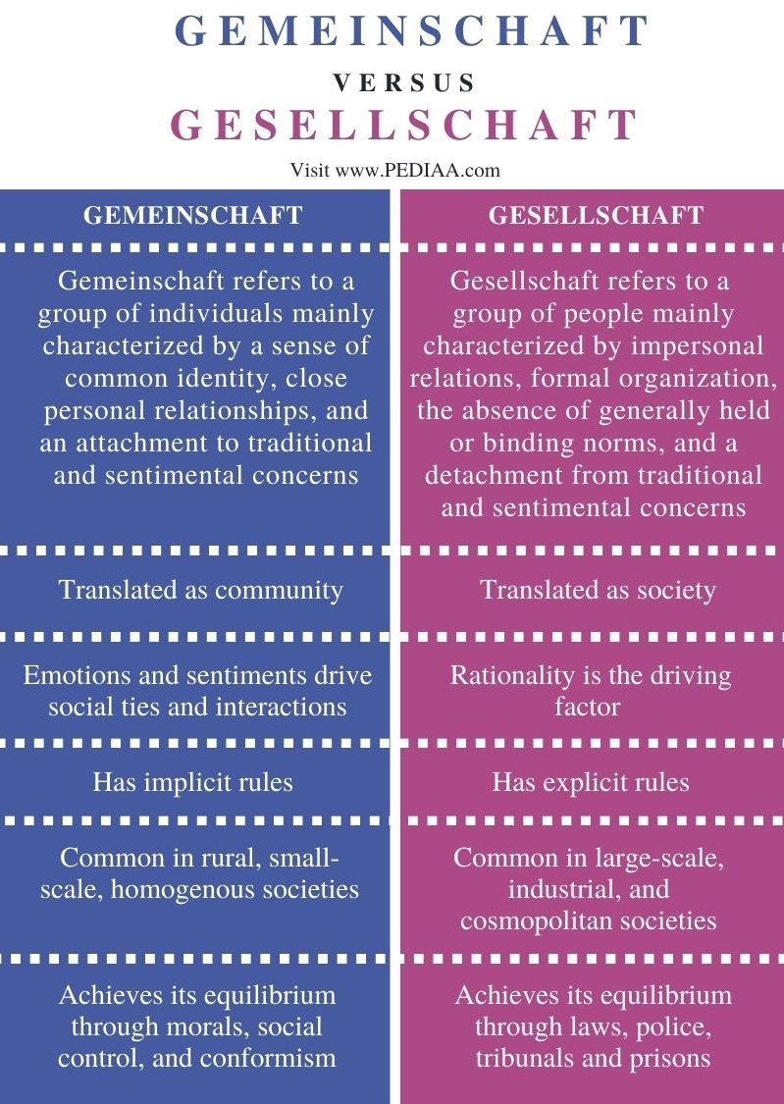
Lecture 2
Social Cooperation and New Media
Ferdinand Tönnies

Slide 9
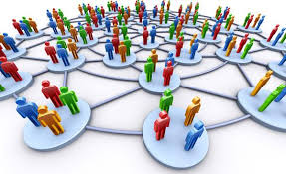
Lecture 2
Social Cooperation and communication
There is also a clear difference between gemeinschaft and gesellschaft in modes of communication. Gemeinschaft is an isolated community in a sense. Interpersonal, face-to-face communication is the most dominant mode in the community.
However, gesellschaft is more related to the creation of nation-states. Telegram, telephone systems, national newspapers made available a more centralized administration and this gave a sense of nationhood to the individuals who live in urban areas and have the opportunity to use these more comprehensive modes of communication.

Slide 10
Lecture 2
Re-evaluating Gemeinschaft and Gesellschaft with New Media
Paul Lazarsfeld’s two-step flow of communication model is worth to mention for this subject. Opinion leaders, which influenced by mass media have a quite important position for opinion-forming processes of individuals. (Lazarsfeld, 1944)
In this process, as a first step media content creates an effect on opinion leaders and as second step, opinion leaders transmit the content, which reinterpreted by opinion leaders, to the individuals by social persuasion. Individuals tend to choose opinion leaders which are similar to their interests, values, demographics.

Slide 11
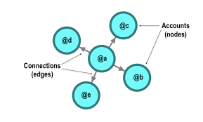
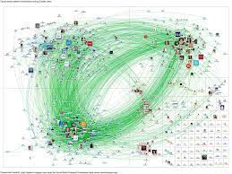
Lecture 2
Re-evaluating Gemeinschaft and Gesellschaft with New Media
As strong examples of social media platforms, Facebook and Twitter started as “gemeinschaft platforms” but as they grow, they became “gesellschaft platforms”.
Twitter will be analyzed in that regard.
Small Network
Big Network

Slide 12
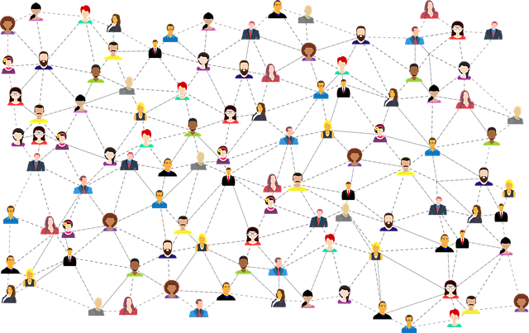
Lecture 2
Re-evaluating Gemeinschaft and Gesellschaft with New Media
Lazarsfeld’s study shows that the media’s direct influence on masses is limited and interpersonal communication, the similarity between individuals play an important role in the decision-making process.
By re-evaluating the definitions of gemeinschaft and gesellschaft, one can create several analogies between Tönnies’s definitions of these concepts and new media platforms. It is possible to analyze social media platforms by gemeinschaft and gesellschaft.

Slide 13
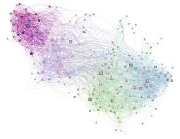
Lecture 2
Re-evaluating Gemeinschaft and Gesellschaft with New Media
Face-to-face communication, in general, oral culture is prominent in gemeinschaft and in one sense, a gemeinschaft community is isolated from other groups. When Twitter was created in 2006, it had a small user base, similarly to all social media platforms in their first year but monthly active users of Twitter increased sequentially over years and in 2018, number of monthly active users reached to 335 million (Twitter, 2018).
In the early years of Twitter, the mentality of users was gemeinschaft oriented, social media influencers were rare, the user base of Twitter was smaller social groups were communicating among themselves and were isolated from other social groups in Twitter.

Slide 14
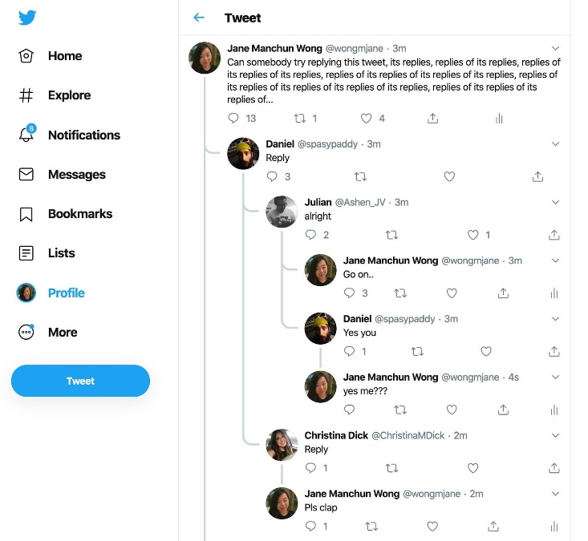
Lecture 2
Social Cooperation and Twitter
Public conversations between persons were the most prominent feature of Twitter. However, the increase in number of active users of Twitter also extended the possible “communication range” of Twitter users.
In the early years, Twitter was another communication service with novel features but it became a prominent information platform for millions of people. According to a study, 71% of Twitter users are getting news on the network (Matsa & Shearer, 2018).

Slide 15
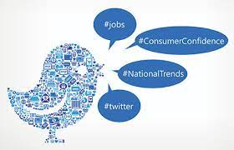
Lecture 2
Social Cooperation and Twitter
Consequently, Twitter became a service to reach the news, to track what is trending nowadays. Public opinion in gemeinschaft is affected by traditional beliefs and information is transmitted through generations. However, public opinion in gesellschaft is much more rational and is created from rational discussion.

Slide 16


Lecture 2
Social Cooperation and Twitter
In that regard, one can claim that information gradually democratized, the range of communication expands, a basic conversation tool becomes a news platform via evolution from gemeinschaft to gesellschaft.
However, according to a study, millennials rely on social media as their news source but in comparison with previous two generations, they are less familiar with a variety of news sources (Gottfried & Barthel, 2015).

Slide 17
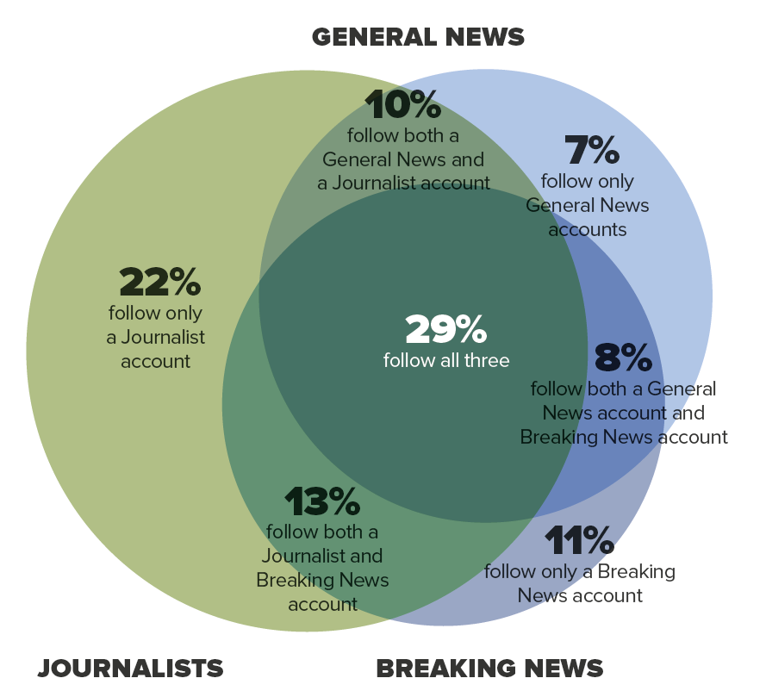
Lecture 2
Social Cooperation and Twitter
How News and Stories are Followed on Twitter?
Source: Digital News Report2014, Available at: https://www.digitalnewsreport.org/essays/2014/how-news-and-stories-are-followed-on-twitter/

Slide 18

Lecture 2
Social Cooperation and Twitter
Gemeinschaft–Gesellschaft is not a simple division, both can coexist in social groups. Twitter became gesellschaft-oriented.
In Twitter, users can reach unrestricted news, viewpoints and sources of this information flow can be quite diverse, it can come from political figures, from conventional news sources, or from their acquaintances. Sources can be subjectively chosen by individuals, they can easily filter their sources and in a sense, can create filter bubbles and the network can evolve to a gemeinschaft-oriented social group.

Slide 19
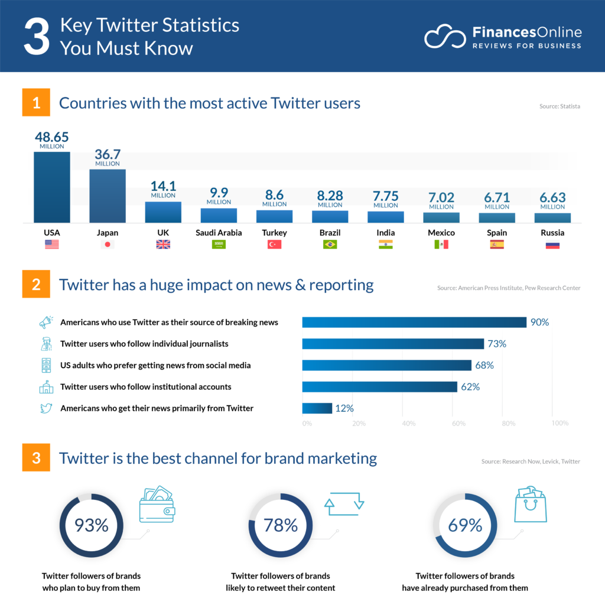
Lecture 2
Countries with the most active Users

Slide 20
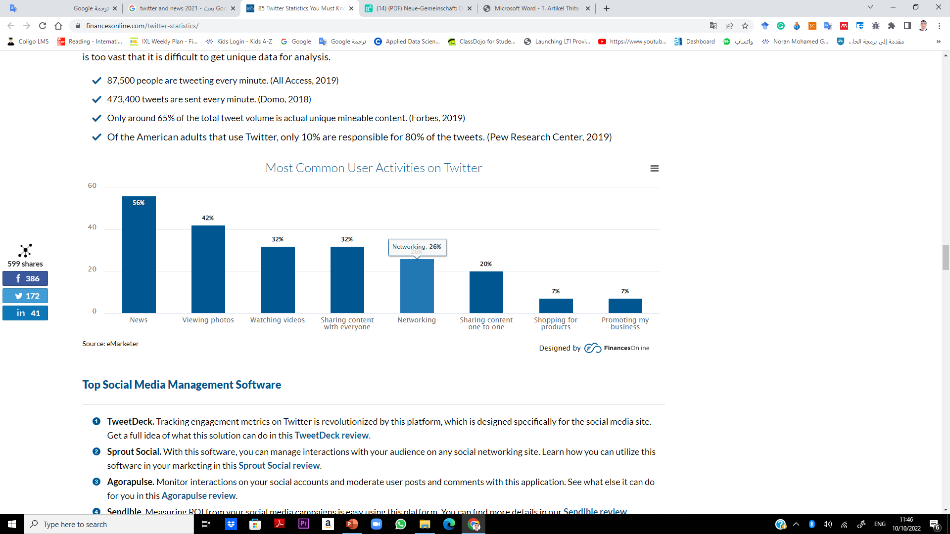

Lecture 2
Countries with the most active Users

Slide 21
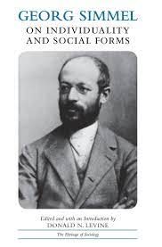
Lecture 2
Social Presence
Social media communication relies to a large extent on small bits of communication — tweets, status updates, Instagram images, snapchats — and in Simmel’s terms we can see these bits and pieces as fragments of individuality that make up increasingly important parts of the social selves of many people in the world.
Even though the tools and platforms that we have at hand to express and represent ourselves may be powerful in many ways, Simmel also warned about a form of isolation following from the fact that a human being’s move towards society can never be complete.

Slide 22
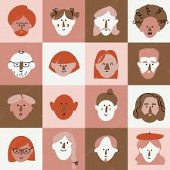
Lecture 2
Social Presence
There might be a risk with social media and web 2.0 technologies, which rely so heavily on certain templates and styles, that ‘the abstract person’ mediated through our profiles and the content we create and circulate prevents ‘the real person (Lanier 2010: 70).

Slide 23
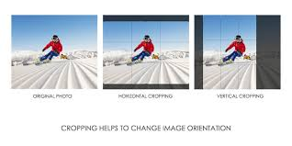
Lecture 2
Self-Presentation
On a digital and social photo-sharing platform like Instagram, for example, users prepare their performance (snapping the photo, deleting it, snapping a new one, cropping it, filtering it, captioning it, tagging it, etc.) in a back region which is not visible to the audience.
Once edited and composed, the performance that is the Instagram photo is presented in the front region.

Slide 24
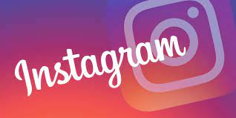
Lecture 2
Self-Presentation
But access to the front region is also controlled as regards who is supposed to take part of the performance as all performances do not address all thinkable people in society.
In the case of Instagram, these things will be decided by things like whether the user has a public or private account, who is a follower, who has been blocked, whether users follow a hashtag that has been used as part of the performance, and so on.

Slide 25
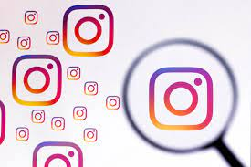
Lecture 2
How do you succeed in Instagram marketing?
Define your goals clearly.
Define your target audience.
Improve your profile.
Write a great description for your posts.
Use hashtags.
Interact with your followers.
Make the most of your Instagram Stories.
Create saveable content.

Slide 26
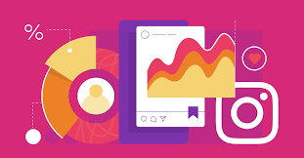
Lecture 2
How do you succeed in Instagram marketing?
Test and analyze your content.
Choose the best time to post.
Try partnering with influencers.
You have to set up an Instagram store.
Start expanding your audience with Instagram ads.
Pin your best stories in highlights.
Improve your strategy with analytics.

Slide 27
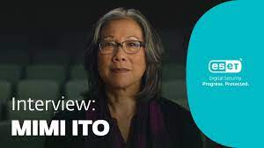
Lecture 2
The Rise of Networked Publics
Today, as our online connections with old and new friends and strangers merge together through networked technologies, the social landscape is restructured.
This leads to the emergence of what cultural anthropologist Mimi Ito (2008) calls networked publics. She discusses how, during the 1990s and early 2000s, the dominant metaphors that had been used previously to describe the digitization of the media landscape and the internet changed from being about things like artificial intelligence, virtual reality, and cyberspace, to being about networking and communication between real and actual people.

Slide 28
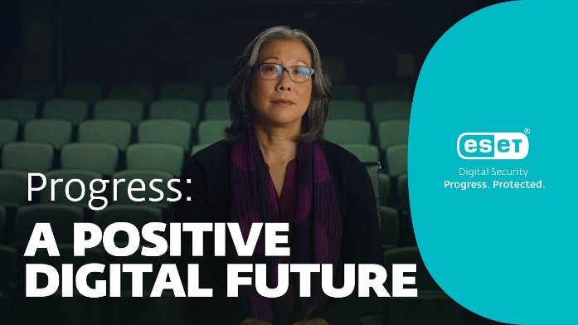
Lecture 2
The Rise of Networked Publics
Networked publics, therefore, is a term that refers to a set of social, cultural, and technological transformations that have followed from the transition to a society where digitally networked media are central to communication. Ito notes that the media as such, as well as patterns of media use and consumption, have not changed completely.
There are still lots of quite passive — noncreative — ways of taking in media, and the mass media communication model where one, or a few, speak to many is still predominant in many areas of social and cultural life. What surely has changed, however, is the way in which people today are ‘networked and mobilized with and through media’ (Ito 2008: 2).

Slide 29
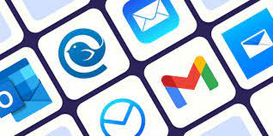
Lecture 2
The Rise of Networked Publics
By using the word ‘public’, rather than ‘audience’ or ‘consumers’, Ito wants to put the more engaged stance of people interacting with media in digital society in the foreground. In talking about the publics as ‘networked’, she emphasizes how we — in the age of social network apps and portable gadgets connected to the internet — communicate increasingly through large and elaborate networks that may go in any thinkable direction, such as bottom-up, top-down, or side-to-side.
A key component of the networked media ecology is personal media (Lüders 2008). While it is hard to maintain a strict division between mass media on the one hand and personal media on the other, an
important difference is that the latter — such as email, discussion forums, and social network sites — are more symmetrical.

Slide 30
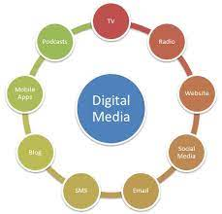
Lecture 2
The Rise of Networked Publics
In contrast to news, TV series, or films, personal media don’t only enable but in fact require that participants, at least to some degree, are active as both receivers and producers of the content in question.
This shifting of roles, where the reader is also the writer, the student is also the teacher, the citizen is also the politician, and the beginner is also the expert, is maybe the most fundamental point made by those who believe that digitally networked media has made — and will continue to make — the world a better place.

Slide 31

Lecture 2
The Rise of Networked Publics
McLuhan and Barrington Nevitt (1972: 27) wrote that ‘we live in an age of simultaneity rather than of sequence. We start with the effects before the product. The consumer becomes producer
Toffler (1980: 266) wrote about ‘what might be called “prosumers”’, people that are ‘neither producers nor consumers in the usual sense’, and about ‘the rapid spread of the market or exchange network — that maze of channels through which goods or services, produced by you, reach me and vice versa’.

Slide 32
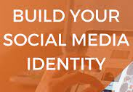
Lecture 2
The Rise of Networked Publics
The networked publics are groups of people who may be located in different physical places but who are connected to each other. They can also be seen as examples of what theorist Benedict Anderson (1983) called imagined communities.
These connections and feelings of community in networked publics are built with the help of social media, and other emerging technologies, both as platforms and tools. The best way to see of networked publics is to see them as spaces. They are spaces where people using digital social platforms express, perform, manage, or create identities

Slide 33
Lecture 2
What are memes?
What are memes?
The word ‘meme’, put forward by biologist Richard Dawkins in the 1970s, derives from the Greek mimema, which means ‘something which is imitated’. But while the term has existed since before internet culture, it has risen in popularity as a word to refer to a certain type of product of online user creativity. Internet memes are images, videos, pictures, concepts, formats, or catchphrases that are passed along to the point where they evolve bit by bit into becoming a social phenomenon which is shared by large numbers of people (Shifman 2014).

Slide 34
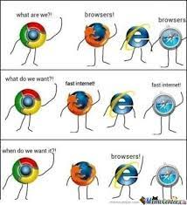
Lecture 2
What are memes?
Social media platforms offer express paths by which memes can be spread. Internet memes also tend to reproduce as people often repackage them by mimicking or remixing them in various ways.
Communications researcher Limor Shifman (2014) argues that while ‘viral’ phenomena — things that spread exponentially and fast online — tend to be single units (one photo, one video, etc.), memes are always a group of digital items that have certain characteristics of content, form, or stance in common. These items were also created in relation to, and with a certain awareness of, each other.

Slide 35
Lecture 2
What are memes?
This very entanglement is at the centre of a social transformation where digital social platforms connect people, through their interaction, giving way to the emergence of networked publics that challenge the entire ‘social operating system’ This is why there has been increasing talk in digital social research and media studies about how the dimensions that we previously talked about as online and offline, digital and material, are coming together in hybrid forms (Lindgren 2014).

Slide 36
Lecture 2
Cyber Debates
In the 1984 book Neuromancer, science-fiction author William Gibson popularised the term ‘cyberspace’. This was his name for a ‘non-space’. It can be defined as ‘the notional environment in which communication over computer networks occurs’.
In other words, things that are ‘cyber’ relate to the imaginary and non-physical (sometimes called virtual) place where digital media communication and interaction happens.
It is the non-space where the message is when it passes from sender to receiver. Such views contribute to a mystification of digital media. Having been ‘understood’ in science fiction before its breakthrough in the real world, the internet and its related social activities have often evoked people’s imagination. This means that both hopes and fears have been connected to it

Slide 37
Lecture 2
Digital Revolution
The internet was claimed by many to be set to revolutionize most areas of social life as we knew it. The digitally networked social reality instigated by the internet would lead to a new economic system where everyone could take part.
It offered new and efficient ways of putting suppliers, producers, and consumers in contact with each other. Innovation would be democratised, while the playing field between big corporations and small startups would be leveled.

Slide 38
Lecture 2
Digital Revolution
McLuhan’s (1962: 8) vision that ‘[t]he new electronic interdependence recreates the world in the image of a global village’ where the ‘entire human family’ is sealed ‘into a single global tribe’.
This would, the internet optimists thought, make people more knowledgeable about, and therefore more tolerant towards, one another.
As media researcher James Curran (2012a: 3) puts it: ‘the internet would be an unstoppable force: like the invention of print and gunpowder, it would change society permanently.
But today, many people, including some of those who were previously more optimistic, have become increasingly sceptical and pessimistic about the effects of the internet on society.

Slide 39
Lecture 2
Digital Revolution
Furthermore, when the public internet began to be commercialised from 1991 onwards, its technical aspects were simplified and made increasingly user-friendly. This is the development discussed in relation to the notions of web 1.0 and 2.0 in the previous Lecture.
So around the year 2000, everything about digital society seemed to be fantastic and transformative.

Slide 40
Lecture 2
Digital Revolution
At the same time, wealth was concentrated in the hands of huge corporations like Apple, Microsoft, Google, and, later, Facebook. The internet was progressively commercialised as big media companies with fast-growing fortunes established websites which looked and functioned better than anything non-commercial actors could yet
create, and as search engine companies started to harvest data for advertising purposes, they also ushered new forms of commercial surveillance technologies into the mix. Around the same time, legislation strengthening intellectual property rights on the internet was passed in several countries.

Slide 41
Lecture 2
End
Thank You

