Slide 1


Change Management
Prepared by Dr. Amira Elfekky
MGM323
Lecture 5

Slide 2


Change Management
Lecture 5
MGM323
Prepared by
Dr. Amira Elfekky
www.midocean.ae

Slide 3
Agenda The change agent
Introduction
Models of change agency;
The consulting process and the role of the change agent within it;
Change agent tools and frameworks;
The competencies of the change agent;
Deeper aspects of being a change agent.

Slide 4
Agenda The change agent
Introduction
Models of change agency;
The consulting process and the role of the change agent within it;
Change agent tools and frameworks;
The competencies of the change agent;
Deeper aspects of being a change agent.

Slide 5


Change Management
This subject is about making sense of change management. The world we live in continues to change at an intense rate. Not a day goes by, it seems, without another important discovery or boundary-pushing invention in the scientific fields. The economics of globalization seems to dominate much of our political and corporate thinking, while the shadow side of globalization– develops at an equally alarming pace.
www.midocean.ae

Slide 6

Content
1 Individual change
Learning and the process of change
2 Team change
What is a group and when is it a team?
3 Organizational change
How organizations really work
4 Leading change
Roles that leaders play
5 The change agent
Models of change agency

Slide 7
Content
6 Mergers and acquisitions
The purpose of merger and acquisition activity
7 Cultural change
Guidelines for achieving successful cultural change
8 IT-based process change
The role of IT management
9 Complex change
When is change complex?
10 Leading change in uncertain times
The impact of uncertainty on our working lives

Slide 8
Agenda The change agent
Introduction
Models of change agency;
The consulting process and the role of the change agent within it;
Change agent tools and frameworks;
The competencies of the change agent;
Deeper aspects of being a change agent.

Slide 9
Chapter
05
MODELS OF CHANGE AGENCY
The objective of this chapter is to look at the role of the change agent in supporting the management of change. It looks at the change agent, rather than the leader, in terms of the nature of the role – whether it is internal or external to the organization, the focus, the competencies needed, and some of the deeper psychological aspects. The next points shows the key strengths of the models and some of the areas of potential concern.
www.midocean.ae

Slide 10

Chapter
MODELS OF CHANGE AGENCY
05
1- Leadership Models
Change agents are identified as leaders or senior executives at the very top of the organization who envision, initiate or sponsor strategic change of a far-reaching or transformational nature.
www.midocean.ae

Slide 11
Chapter
MODELS OF CHANGE AGENCY
05
1- Leadership Models
Key strengths
Leadership models Clear sponsorship and clear direction Power and authority to ‘make change happen’
Things to watch out for
Potential for the change to be too top-down and have too directive an
approach
www.midocean.ae

Slide 12

Chapter
MODELS OF CHANGE AGENCY
05
2- Management Models
Change agents are conceived as middle level managers and functional specialists who adapt, carry forward or build support for strategic change within business units or key functions.
www.midocean.ae

Slide 13
Chapter
MODELS OF CHANGE AGENCY
05
2- Management Models
Key strengths
The ability to translate strategic vision so greater knowledge of what works
Things to watch out for
Capacity and capability issues for middle managers given their necessary attention on business as usual as well as the changes.
www.midocean.ae

Slide 14

Chapter
MODELS OF CHANGE AGENCY
05
3- Consultancy Models
Change agents are conceived as external or internal consultants who operate at a strategic, operational, task, or process level within an organization, providing advice, expertise, project management, change programme coordination, or process skills in facilitating change.
www.midocean.ae

Slide 15
Chapter
MODELS OF CHANGE AGENCY
05
3- Consultancy Models
Key strengths
Ability to coach advise and work in partnership with the organization Change management expertise and experience in a multitude of settings
Things to watch out for
Can be detached with no demonstrable commitment to the area undergoing change Staff might feel ‘done to’
www.midocean.ae

Slide 16
Agenda The change agent
Introduction
Models of change agency;
The consulting process and the role of the change agent within it;
Change agent tools and frameworks;
The competencies of the change agent;
Deeper aspects of being a change agent.

Slide 17
Chapter
05
The consulting process and the role of the change agent within it;
The consulting process suggests that different sets of knowledge, cognitive skills and behaviours are needed at different stages in the consulting process. The next points summarize the work of a number of researchers who suggest what is required of the change agent at each stage.
www.midocean.ae

Slide 18

Differences between internal
and external consultants
Chapter
05
Entry
Internal change agent
Ready access to clients, Ready relationships, Knows company jargon, Understands root causes
External change agent
Source (find) clients, Build relationships, Learn company jargon
www.midocean.ae

Slide 19

Differences between internal
and external consultants
Chapter
05
Contracting
Internal change agent
Informal agreements, Must complete projects, assigned
External change agent
Formal documents, Can terminate project at will, Guard against out of pocket expenses
www.midocean.ae

Slide 20

Differences between internal
and external consultants
Chapter
05
Diagnosing
Internal change agent
Has a relationship with many organization members Prestige determined by job rank
External change agent
Meet most organization members for the first time
www.midocean.ae

Slide 21

Differences between internal
and external consultants
Chapter
05
Evaluating
Internal change agent
Rely on repeat business, pay rise, and promotion as key measures of success
External change agent
Rely on repeat business and customer referral as key measures of project success
www.midocean.ae

Slide 22
Agenda The change agent
Introduction
Models of change agency;
The consulting process and the role of the change agent within it;
Change agent tools and frameworks;
The competencies of the change agent;
Deeper aspects of being a change agent.

Slide 23
Choices of intervention based on the nature of
the cultural change
Chapter
05
1- Organization change required
Change within current culture norms (local restructure, geographic
expansion, etc)
Change agent stance
Role modelling based on current ways of doing things including management style, degree of consultation, decision-making processes, etc
www.midocean.ae

Slide 24
Choices of intervention based on the nature of
the cultural change
Chapter
05
2- Organization change required
Change outside current culture norms (diversification requiring new way of working, partnership working, etc)
Change agent stance
Role modelling based on new ways of doing things including management style, degree of consultation, decision-making processes, etc
www.midocean.ae

Slide 25
Choices of intervention based on the nature of
the cultural change
Chapter
05
3- Organization change required
Culture change itself (eg new ways of doing things to meet external or internal drivers for change)
Change agent stance
Role modelling based on effective change management practices including management style, degree of consultation, decision making processes, etc
www.midocean.ae

Slide 26
Agenda The change agent
Introduction
Models of change agency;
The consulting process and the role of the change agent within it;
Change agent tools and frameworks;
The competencies of the change agent;
Deeper aspects of being a change agent.

Slide 27
Chapter
The competencies of the change agent;
05
The change agent will need to have a good understanding of how business works, together with knowledge (or a knowledgeable partner) in the field of Human Resources. The final aspect referred to by Cummings and Worley is the skills set acquired through management
www.midocean.ae

Slide 28
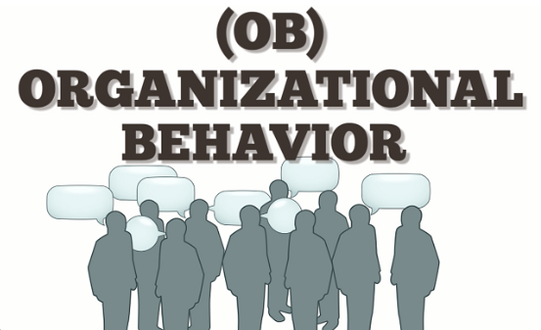
Knowledge and skill requirements of
the organization development practitioner
Chapter
05
Existing system − Knowledge
Organization behavior
A. Organization culture
B. Work design
C. Interpersonal relations
D. Power and politics
E. Leadership
F. Goal setting
www.midocean.ae

Slide 29
Knowledge and skill requirements of
the organization development practitioner
Chapter
05
How systems change over time − Knowledge
Organization design Decision making process associated with formulating and aligning HR systems; information systems; reward systems; work design; political systems; culture; etc.
A. The concept of fit and alignment
B. Diagnostic and design model for sub-systems
C. Key thought leaders in organization design
www.midocean.ae

Slide 30

Knowledge and skill requirements of
the organization development practitioner
Chapter
05
How systems change over time − Skills
Managing the consulting process
A. Entry
B. Contracting
C. Diagnosing
D. Designing interventions
E. Implementation
F. Managing emergent issues
G. Evaluation
www.midocean.ae

Slide 31
Agenda The change agent
Introduction
Models of change agency;
The consulting process and the role of the change agent within it;
Change agent tools and frameworks;
The competencies of the change agent;
Deeper aspects of being a change agent.

Slide 32
Chapter
Deeper aspects of being a change agent
05
One of Freud’s definitions of psychoanalysis was the procedure for the investigation of mental processes that are almost inaccessible in any other way – that is the unconscious phenomena in human interaction. As such it is one way of being able to understand the more irrational aspects of human behaviour. The next points list a number of psychoanalytic terms which describe phenomena.
www.midocean.ae

Slide 33

Chapter
Psychoanalytic terms useful in the change agent’s practice
05
Psychoanalytic term
Transference
The process by which emotions and desires originally associated with one person, such as a parent or sibling, are unconsciously shifted to another person, especially to the analyst.
www.midocean.ae

Slide 34

Chapter
Psychoanalytic terms useful in the change agent’s practice
05
Psychoanalytic term
Projection
The attribution of one’s own attitudes, feelings, or suppositions to others
www.midocean.ae

Slide 35
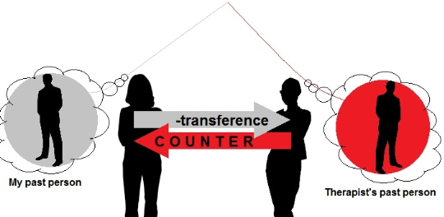
Chapter
Psychoanalytic terms useful in the change agent’s practice
05
Psychoanalytic term
Counter-transference
The psychoanalyst’s displacement of emotion onto the patient or more generally the psychoanalyst’s emotional involvement in the therapeutic
interaction
www.midocean.ae

Slide 36

Chapter
Principles of presence
05
www.midocean.ae

Slide 37
Chapter
Principles of presence
05
Be Honourable
Align personal assumptions, values, beliefs, behaviour Stand for something; take a position Dare to be different (or similar) State the obvious Speak the unspeakable
www.midocean.ae

Slide 38
Chapter
Principles of presence
05
Be an Effective Agent of Change
Be an awareness expert Facilitate enhanced interaction among members of the client system and with self Teach basic behavioural skills
www.midocean.ae

Slide 39
Chapter
Principles of presence
05
Be Curious
Stay in a space of perpetual wonderment Show genuine interest in the client Be interested in self Explore the nature of relationships between self and client and among individuals in the client system
www.midocean.ae

Slide 40

www.midocean.ae

Slide 41


Thank You

