Slide 1


Principles of Accounting
Lecture 6
Prepared by:
Dr. Rasha B. AL Jerd
Subject code: MGM 227

Slide 2



Principles of
Accounting
MGM 227
Chapter 3:
The Adjusting Process
Prepared by:
Dr. Rasha B. AL Jerd

Slide 3
Learning objectives:
1 Differentiate between cash basis accounting and accrual basis accounting
2 Define and apply the time period concept, revenue recognition, and matching principles
3 Explain the purpose of and journalize and post adjusting entries
4 Explain the purpose of and prepare an adjusted trial balance
5 Identify the impact of adjusting entries on the financial statements

Slide 4
3
Explain the purpose of and journalize and post adjusting entries
“exercises”

Slide 7

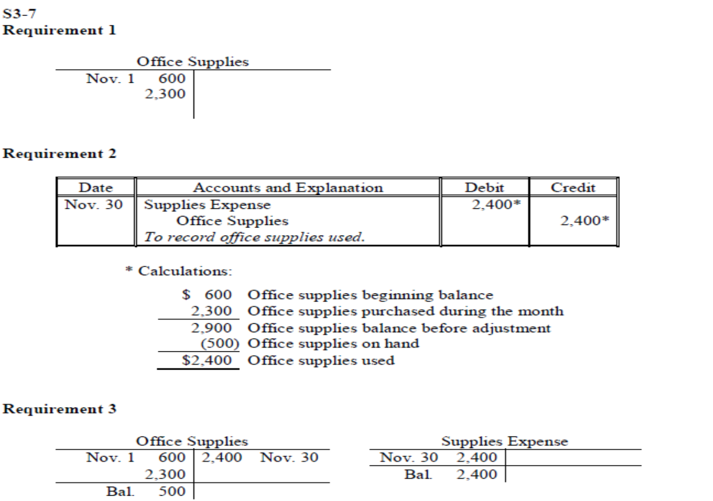

Slide 13


Slide 16
4
Explain the purpose of and prepare
an adjusted trial balance

Slide 17

This chapter began with the unadjusted trial balance. After the adjustments have been journalized and posted, the account balances are updated and an adjusted trial balance can be prepared by listing all the accounts with their adjusted balances. Remember, the purpose of a trial balance is to ensure that total debits equal total credits. Even if the trial balance balances, it does not guarantee that a mistake has not been made. For example, an adjusting entry could have been recorded for the incorrect amount or could have been omitted entirely. The equality of the trial balance ensures only that each posted transaction had an equal debit and credit amount.
The adjusted trial balance for Smart Touch Learning is shown in Exhibit 3-5.

Slide 18
5
Identify the impact of adjusting
entries on the financial statements

Slide 19
The adjusted trial balance is used to prepare the financial statements. If adjusting entries are not recorded, the ledger accounts will not reflect the correct balances and the adjusted trial balance will be incorrect. Remember, adjusting entries are completed to ensure that all Revenues and expenses for the accounting period examined have been recorded. In addition, adjusting entries update the balance sheet accounts so that all accounts are properly valued.
Exhibit 3-6 summarizes the impact on the financial statements had the adjusting entries not been recorded.

Slide 22

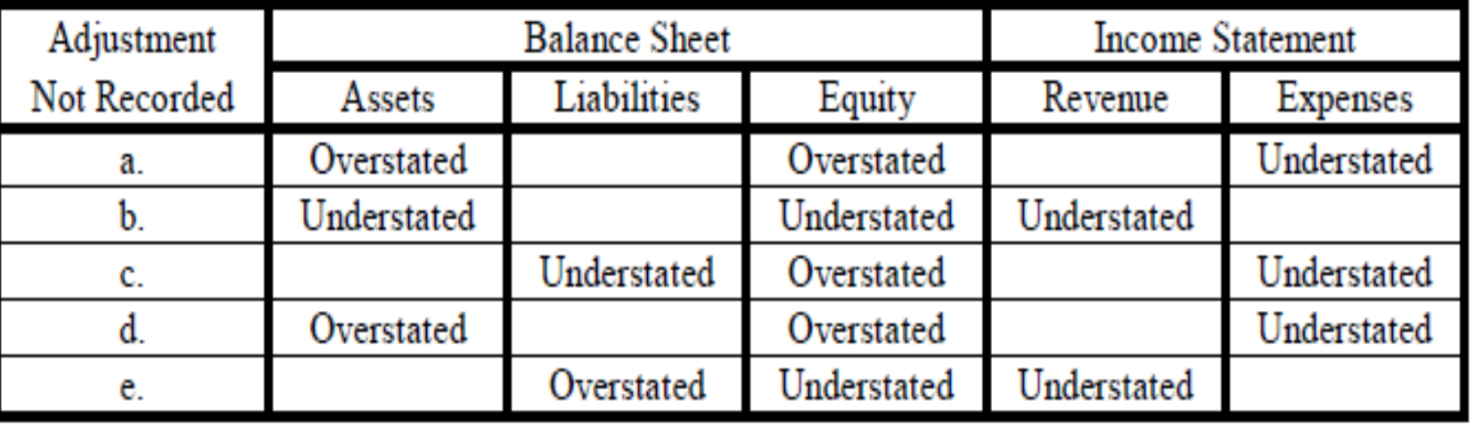

Slide 26


Slide 29


Slide 31

Demonstration of E3-19
Popular Advertising Agency completed the following selected transactions during July 2018:
Jul. 1 | Prepaid rent for three months, $6,000
4 | Received and paid electricity bill, $1,000
10 | Received cash for service rendered to customers, $5,000
15 | Paid cash for computer equipment, $20,000
20 | Service rendered on account, $10,000
31 | Made the adjusting entry for rent (from July 1).
31 | Accrued salary expense, $3,000
31 | Recorded depreciation for July on computer equipment, $170
Requirements
1. | Show whether each transaction would be handled as a revenue or an expense using both the cash basis and accrual basis accounting systems.
2. | Calculate the amount of net income or net loss for Popular Advertising Agency under the accrual basis and cash basis accounting systems for July.
3. | Considering your results from Requirement 2, which method gives the best picture of the true earnings of Popular Advertising Agency? Why?

Slide 32

Demonstration of E3-19-Req. 1
Amount of Revenue (Expense) for July
Date | Cash Basis Amount of Revenue (Expense) | Accrual Basis Amount of Revenue (Expense)
Jul. 1 | ($6,000) | ($0)
Jul. 4 | (1,000) | (1,000)
Jul. 10 | 5,000 | 5,000
Jul. 15 | (20,000) | 0
Jul. 20 | 0 | 10,000
Jul. 31 | 0 | (2,000)*
Jul. 31 | 0 | (3,000)
Jul. 31 | 0 | (170)
*Rent prepaid on July 1 for 3 months | $6,000
Months | ÷3
Rent expense for July | $2,000

Slide 33
Demonstration of E3-19-Req. 3
Net income (loss) under cash basis is ($22,000)
Calculation:
Net Income (Loss) | ═ | Total Revenues – Total Expenses
 | ═ | $5,000 − ($6,000 + $1,000 + $20,000)
 | ═ | $5,000 − $27,000
 | ═ | ($22,000)
Net income (loss) under accrual basis is $8,830
Calculation:
Net Income (Loss) | ═ | Total Revenues – Total Expenses
 | ═ | $5,000 + $10,000 − ($1,000 + $2,000 + $3,000 + $170)
 | ═ | $15,000 − $6,170
 | ═ | $8,830
Accrual basis accounting gives the best picture of the true earnings of Popular Advertising, because revenues are recorded when earned and expenses are recorded when incurred, as dictated by the revenue recognition principle and the matching principle

Slide 34
Demonstration of E3-25 & E3-26
The unadjusted trial balance for Bright Solutions Company, a tutoring service, is as follows:
 | BRIGHT SOLUTIONS COMPANY
 | Unadjusted Trial Balance
 | December 31, 2018
 | Account Title | Balance
 |  | Debit | credit
 | Cash | $1,500
 | Office Supplies | 4,000
 | Prepaid Insurance | 1,200
 | Equipment | 35,000
 | Accumulated Depreciation—Equipment |  | $14,000
 | Accounts Payable |  | 3,700
 | Salaries Payable
 | Unearned Revenue |  | 2,000
 | Common Stock |  | 10,000
 | Dividends | 5,000
 | Service Revenue |  | 27,000
 | Salaries Expense | 10,000
 | Supplies Expense
 | Depreciation Expense—Equipment
 | Insurance Expense
 | Total | $56,700 | $56,700

Slide 35
Demonstration of E3-25 & E3-26
During the 12 months ended December 31, 2018, Bright Solutions:
a. | used office supplies of $2,500.
b. | used prepaid insurance of $600.
c. | depreciated equipment, $700.
d. | accrued salaries expense of $500 that hasn’t been paid yet.
e. | earned $1,000 of unearned revenue.
Requirements
E3-25 | 1. | Open a T-account for each account using the unadjusted balances.
 | 2. | Journalize the adjusting entries using the letter and December 31 date in the date column.
 | 3. | Post the adjustments to the T-accounts, entering each adjustment by letter. Show each account’s adjusted balance.
E3-26 |  | Prepare an adjusted trial balance.

Slide 36
Demonstration of E3-25-Req. 1
Cash
Bal. | 1,500
Office Supplies
Bal. | 4,000
Insurance Expense
Prepaid Insurance
Bal. | 1,200
Equipment
Bal. | 35,000
Supplies Expense
Accumulated Depreciation -Equipment
 |  | 14,000 | Bal.
Accounts Payable
 |  | 3,700 | Bal.
Depreciation Expense—Equipment

Slide 37
Demonstration of E3-25-Req. 1
Common Stock
 |  | 10,000 | Bal.
Dividends
Bal. | 5,000
Service Revenue
 |  | 27,000 | Bal.
Salaries Expense
Bal. | 10,000
Salaries Payable
Unearned Revenue
 |  | 2,000 | Bal.

Slide 38
Demonstration of E3-25-Req. 2 & 3
a. Used office supplies of $2,500.
Date | Accounts and Explanation | Debit | Credit
a. Dec. 31 | Supplies Expense | 2,500
 | Office Supplies |  | 2,500
 | To record office supplies used.
Office Supplies
Bal. | 4,000 | 2,500 | a.
Supplies Expense
a. | 2,500

Slide 39
Demonstration of E3-25-Req. 2 & 3
b. Used prepaid insurance of $600
Date | Accounts and Explanation | Debit | Credit
b. Dec. 31 | Insurance Expense | 600
 | Prepaid Insurance |  | 600
 | To record insurance expense.
Insurance Expense
b. | 600
Prepaid Insurance
Bal. | 1,200 | 600 | b.

Slide 40
Demonstration of E3-25-Req. 2 & 3
c. Depreciated equipment, $700
Date | Accounts and Explanation | Debit | Credit
c. Dec. 31 | Depreciation Expense—Equipment | 700
 | Accumulated Depreciation—Equipment |  | 700
 | To record depreciation on equipment.
Depreciation Expense—Equipment
c. | 700
Accumulated Depreciation -Equipment
 |  | 14,000 | Bal.
 |  | 700 | c.

Slide 41
Demonstration of E3-25-Req. 2 & 3
d. Accrued salaries expense of $500 that hasn’t been paid yet.
Date | Accounts and Explanation | Debit | Credit
d. Dec. 31 | Salaries Expense | 500
 | Salaries Payable |  | 500
 | To accrue salaries expense.
Salaries Expense
Bal. | 10,000
d. | 500
Salaries Payable
 |  | 500 | d.

Slide 42
Demonstration of E3-25-Req. 2 & 3
e. Earned $1,000 of unearned revenue.
Date | Accounts and Explanation | Debit | Credit
e. Dec. 31 | Unearned Revenue | 1,000
 | Service Revenue |  | 1,000
 | To record service revenue earned that was collected in advance.
Unearned Revenue
e. | 1,000 | 2,000 | Bal.
Service Revenue
 |  | 27,000 | Bal.
 |  | 1,000 | e.

Slide 43
Demonstration of E3-25-Req. 3
Cash
Bal. | 1,500
Bal. | 1,500
Office Supplies
Bal. | 4,000 | 2,500 | a.
Bal. | 1,500
Salaries Expense
Bal. | 10,000
d. | 500
Bal. | 10,500
Prepaid Insurance
Bal. | 1,200 | 600 | b.
Bal. | 600
Equipment
Bal. | 35,000
Bal. | 35,000
Depreciation Expense—Equipment
c. | 700
Bal. | 700
Insurance Expense
b. | 600
Bal. | 600
Supplies Expense
a. | 2,500
Bal. | 2,500
Common Stock
 |  | 10,000 | Bal.
 |  | 10,000 | Bal.

Slide 44
Demonstration of E3-25-Req. 3
Accumulated Depreciation -Equipment
 |  | 14,000 | Bal.
 |  | 700 | c.
 |  | 14,700 | Bal.
Accounts Payable
 |  | 3,700 | Bal.
 |  | 3,700 | Bal.
Salaries Payable
 |  | 500 | d.
 |  | 500 | Bal.
Unearned Revenue
e. | 1,000 | 2,000 | Bal.
 |  | 1,000 | Bal.
Dividends
Bal. | 5,000
Bal. | 5,000

Slide 45
Demonstration of E3-26
BRIGHT SOLUTIONS COMPANY
Adjusted Trial Balance
December 31, 2018
Account Title | Balance
 | Debit | Credit
Cash | $1,500
Office Supplies | 1,500
Prepaid Insurance | 600
Equipment | 35,000
Accumulated Depreciation—Equipment |  | $14,700
Accounts Payable |  | 3,700
Salaries Payable |  | 500
Unearned Revenue |  | 1,000
Common Stock |  | 10,000
Dividends | 5,000
Service Revenue |  | 28,000
Salaries Expense | 10,500
Supplies Expense | 2,500
Depreciation Expense—Equipment | 700
Insurance Expense | 600
Total | $57,900 | $57,900

Slide 46



Thank You

