Slide 1


Overview of the Clinical Governance ( Part 1 )
Prepared by Dr. Abdulaziz Alsaedi
MHA611
Healthcare Systems
Lecture 09

Slide 2

Outlines:
Introduction to governance.
Definitions and concepts of governance.
Benefits and importance of governance.
Levels of governance.
Clinical governance and corporate governance.
Principles of clinical governance.
Clinical effectiveness and research.
Clinical audit.

Slide 3

Chapter
09
Understanding the concepts of governance and clinical governance.
Understanding the different levels of governance in the healthcare industry.
Understanding the importance of clinical governance in healthcare delivery.
Understanding the 7 pillars of clinical governance.
Understanding the clinical effectiveness and clinical audit principles.

Slide 4

Chapter
09
The emergence of Governance:
Global financial and economic crisis.
Negative impact on even big companies.
1976 was the beginning in USA.
Ownership & Management.

Slide 5
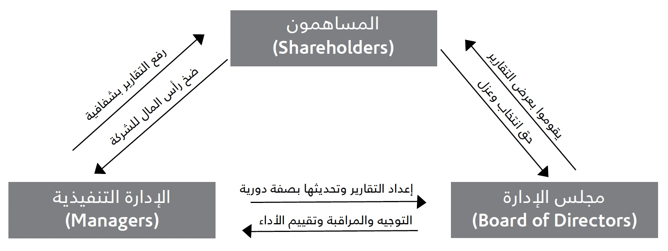
Chapter
09
Corporate Governance definitions:
It is defined as “A set of relationships between a company's management, its board, its shareholders and other stakeholders”.
Organization for Economic Cooperation and Development (OECD)
منظمة التعاون الاقتصادي والتنمية

Slide 6
Chapter
09
Corporate Governance definitions:
It is defined as ”the system by which companies are directed and controlled”.
International Finance Corporation (IFC)
مؤسسية التمويل الدولية
It is a framework that determines the rights and responsibilities among the various parties, such as the managers, board of directors, shareholders and other stakeholders in the company.
Capital Market Authority
هيئة السوق المالية السعودية

Slide 7

Chapter
09
Corporate Governance definitions:
Corporate Governance is a set of activities/ Processes that guide, direct, and control an organization to ensure the rights and responsibilities of all stakeholders:
Dr. Abdulaziz Alsaedi
Shareholders
Board
of Directors
Executive Management
Staff
Suppliers
Clients
Investors

Slide 8

Chapter
09
Purpose of Corporate Governance:
The purpose of corporate governance: “helps to build an environment of trust, transparency and accountability necessary for fostering long-term investment, financial stability and business integrity, thereby supporting stronger growth and more inclusive societies”.
Organization for Economic Cooperation and Development (OECD)
منظمة التعاون الاقتصادي والتنمية

Slide 9


Chapter
09
Purpose of Corporate Governance:
Corporate Governance
Efficiency
Effectiveness
Principles
Enablers
Tools
Systems/ Strategies
Monitor
Reporting

Slide 10

Chapter
09
Benefits of Corporate Governance:
6. Building a participation culture.
7. Building a loyalty culture.
8. Responding to the stakeholders needs.
9. Fighting corruption and its practices.
10. Encourage external investments.
1. Best utilization of resources.
2. Increase in Productivity.
3. Performance measurement.
4. Documenting procedures.
5. Identify clear responsibilities.

Slide 11

Chapter
09
Levels of Governance:
Corporate Level
Process Level
Activity Level
Individual Level

Slide 12
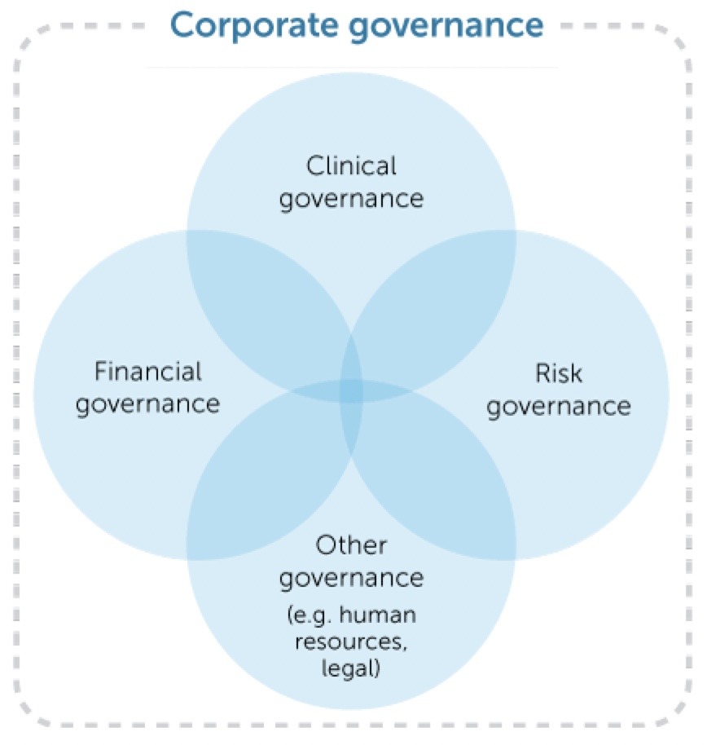
Chapter
09
Clinical Governance as an Integrated component of the Organizational Governance
The responsibility of a governing body such as a board for clinical governance is an integrated element of its overall responsibility and accountability to govern the organization. As a component of broader systems for corporate governance, clinical governance involves a complex set of leadership behaviours, policies, procedures, and monitoring and improvement mechanisms that are directed towards ensuring good clinical outcomes.
The clinical governance system of a health service organization therefore needs to be conceptualized as a system within a system – a clinical governance system within a corporate governance system.
ReferenceNational Model Clinical Governance Framework, ACSQHC (2017)

Slide 13
Chapter
09
Clinical Governance as an Integrated component of the Organizational Governance
Under this model, it is important to recognize the following:
Clinical governance is of equivalent importance to financial, risk and other business governance.
Decisions about other aspects of corporate governance can have a direct effect on the safety and quality of care, and decisions about clinical care can have a direct effect on other aspects of corporate governance, such as financial performance and risk management.
Governing bodies are ultimately responsible for good corporate (including clinical) governance.
ReferenceNational Model Clinical Governance Framework, ACSQHC (2017)

Slide 14

Chapter
09
Can we implement Governance at home?

Slide 15

Chapter
09
What is Clinical Governance?

Slide 16

Chapter
Clinical Governance
09
History of Clinical Governance:
When: 1990s
Whom: National Health Services (NHS)
Where: Britain (UK)
Why: To tackle the wide differences in quality of care throughout Britain. It is also a response to recent and major failures in NHS standards. These include the high mortality rate in children undergoing heart surgery at a leading British hospital.

Slide 17

Chapter
Clinical Governance
09
The National Health Service (NHS):
The National Health Service (NHS) refers to the Government-funded medical and health care services that everyone living in the UK can use without being asked to pay the full cost of the service.

Slide 18
Chapter
Clinical Governance
09
Definitions & Concepts:
The United Kingdom (UK) Department of Health (1998) defined Clinical Governance as “a system through which NHS organizations are accountable for continuously improving the quality of their services and safeguarding high standards of care by creating an environment in which excellence in clinical care will flourish”
A First Class Service: Quality in the New NHS 1998
Focus:
High Standards of care
Transparent Responsibility & Accountability
Continual Improvement

Slide 19
Chapter
Clinical Governance
09
Definitions & Concepts:
Clinical Governance is defined as:
“A systematic and integrated approach to assurance and review of clinical responsibility and accountability that improves quality and safety resulting in optimal patient outcomes”.
The Office of Strategy and Quality in Health Care in Western Australia
Clinical Governance is simply defined as:
“Patients are receiving the right care at the right time from the right person in a safe, honest, open and caring environment”.
McSherry and Pearce (2011).

Slide 20
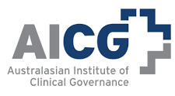
Chapter
Clinical Governance
09
Definitions & Concepts:
Clinical Governance is defined as:
“a concept by which all staff (clinical and non-clinical) share responsibility and accountability for safe and quality care, not just within the acute care setting, but across all sectors of healthcare delivery, including primary care, aged care, disability and mental health”.
The Australasian Institute of Clinical Governance (AICG)
Source: https://www.achs.org.au/news/powerful-partnership-quality-improvement-clinical-governance

Slide 21
Chapter
Clinical Governance
09
What is Clinical Governance really about?
Clinical governance is about every member of the health facility staff recognizing their role in providing high-quality care.
Clinical governance is about improving care using whatever method is the most suitable – for example, by identifying aspects of care that need improvement, making plans to improve them, and monitoring your success.
Clinical governance puts patients’ experience at the heart of clinical care and involves patients and the public in defining quality and in efforts to improve it.
Clinical governance is not only about identifying what is wrong – it is also about identifying good practice and what is working well.

Slide 22
Chapter
Clinical Governance
09
What is Clinical Governance really about?
Clinical governance is about changing organizational culture – away from a culture of blame to one of learning.
Clinical governance is about nurturing a sense of accountability.
Clinical governance is about developing true partnerships – between managers and clinical staff and between clinical staff and patients.

Slide 23
Chapter
Clinical Governance
09
The Scope of Clinical Governance:
It covers many activities that help to support, improve and advance the standards of care delivery, such as clinical audit and risk management.
It works by trying to link all of these activities together to make them more effective.
It covers both the direct and indirect clinical care given to patients.

Slide 24
Chapter
Clinical Governance
09
Key Benefits of Effective Clinical Governance:
A commitment to quality.
Minimizing inequalities in the health of different subgroups of the population.
Reducing variation in healthcare services.
Defining standards.
Routine engagement with the public.
Working as a multidisciplinary team.
Regular Board-level discussion on quality issues.
Strong leadership from the top.
Good use of information for planning and monitoring clinical governance.
Sustaining quality improvements.
Article: Clinical Governance in the UK NHS, DFID’s Health System Resource Center, 2001

Slide 25
Chapter
Clinical Governance
09
Who is responsible for implementing the Clinical Governance?
At Regional Level
At Organizational Level
At Department Level
Reference: https://onlinelibrary.wiley.com/doi/full/10.1046/j.1365-2141.2001.02515.x

Slide 26
Chapter
Clinical Governance
09
What does Clinical Governance mean in practice?
Demonstrate that we are doing the right thing
Demonstrate that we are up to date and fit to practice
Demonstrate continuous improvement in the quality of clinical services
Reference: https://onlinelibrary.wiley.com/doi/full/10.1046/j.1365-2141.2001.02515.x

Slide 27
Chapter
09
Linkage to the Corporate Governance:
Corporate governance is concerned with running organizations and businesses efficiently, and within legal constraints.
Clinical governance is closely related to patient care and managing activities to ensure quality of care and patient safety.
Corporate governance is focused on the board room and the executive suite, while clinical governance is associated more closely with the ward, unit, department, health center and clinic.

Slide 28
Chapter
09
The Clinical Governance VS Corporate Governance:
Clinical Governance shares some parallels with the wider corporate governance of healthcare organizations.
Both address the structure, system and processes that assure the quality, accountability and proper management of an organization’s operation and delivery of service.
Clinical Governance applies only to healthcare organizations, and only those aspects of such organizations that are related to the delivery of care to patients.
Clinical Governance is not concerned with the other business processes of the organization except insofar as they affect the delivery of care.

Slide 29
Chapter
09
The Clinical Governance VS Hospital Governance:
﻿Good hospital governance is the application of hospital management functions based on the principles of transparency, accountability, independence and responsibility, equality and fairness. Good clinical governance is the application of clinical management functions that include clinical leadership, clinical audits, clinical data, evidence-based clinical risk, performance improvement, complaint management, monitoring mechanisms for service outcomes, professional development, and hospital accreditation (Law Number 44 of 2009).

Slide 30
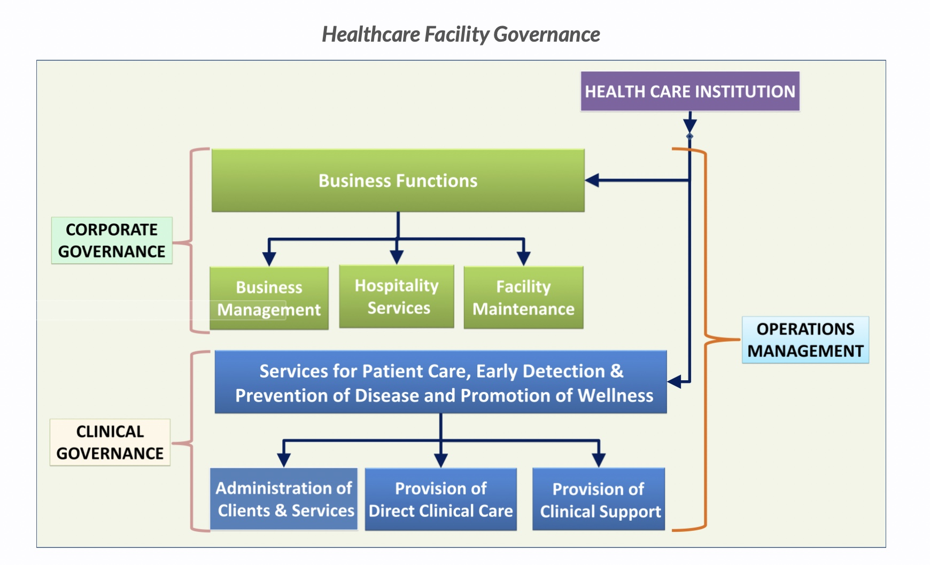
Chapter
09
The Clinical Governance VS Corporate Governance:

Slide 31
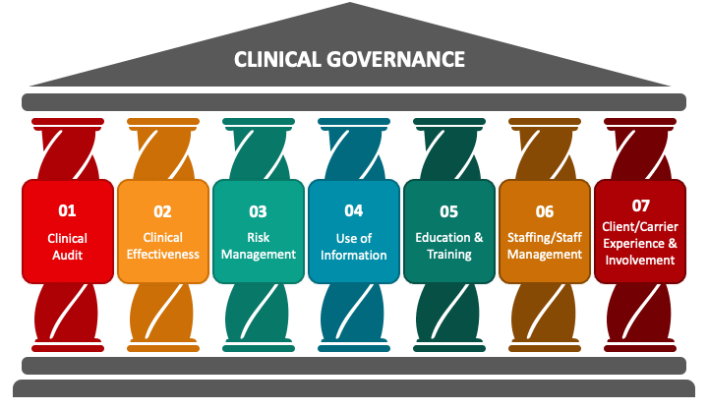
Chapter
Clinical Governance
09
The 7 Clinical Governance Pillars:
Clinical Effectiveness & Research.
Clinical Audit.
Risk Management.
Education & Training.
Patient & Public Involvement.
Using Information & IT.
Staffing & Staff Management.

Slide 32
Chapter
09
Pillar 1: Clinical Effectiveness and Research

Slide 33
Chapter
09
Pillar 1: Clinical Effectiveness and Research
This is ensuring that we use the best available evidence and research to provide the best possible outcomes for patients. We should always work in the best interests of the patient and this aspect ensures we provide the best care. Examples of this include:
Carrying out evidence-based practice when deciding treatments and decision-making
Using standards and guidelines to help inform care e.g. FGDP radiograph guidelines, and NICE guidelines on wisdom tooth extraction. These are all backed by evidence.
Conducting new research to inform new guidelines, papers and standards to continually improve care
Implementation of new standards and guidelines as they are developed (this also links into clinicians’ requirements to carry out Continuing Professional Development (CPD).

Slide 34

Chapter
09
Pillar 1: Clinical Effectiveness and Research
Clinical Governance can be described by 5Rs:
Right care
Right patient
Right time
Right clinician
Righ way
Reference: Book: A Clinical Governance Handbook for district clinical specialist teams

Slide 35
Chapter
09
Pillar 1: Clinical Effectiveness and Research
In practice, it means:
1. Adopting an evidence-based approach in the management of patients.
2. Changing your practice and developing new protocols or guidelines based on experience and evidence if current practice is shown inadequate.
3. Implementing national service frameworks and other national standards to ensure optimal care.
4. Conducting research to develop the body of evidence available and therefore enhancing the level of care provided to patients in future.
Reference: https://alison.com/topic/learn/133628/the-pillars-of-clinical-governance

Slide 36
Chapter
09
Pillar 1: Clinical Effectiveness and Research
The Key Components of Clinical Effectiveness includes:
Evidence-informed practice.
Clinical guidelines
Clinical audit.
Reference: Book: A Clinical Governance Handbook for district clinical specialist teams

Slide 37
Chapter
09
Pillar 2: Clinical Audit

Slide 38
Chapter
09
Pillar 2: Clinical Audit
Auditing evaluates existing practice against the gold standard of practice. Through this, we try to identify any shortcomings and develop methods to improve our outcomes. Ultimately, this aims to improve the quality of care we provide.
Carrying out an audit involves identifying a particular area of interest/concern; researching a standard to compare it to; collecting the data to compare; analyzing the data and identifying shortcomings; implementing methods of change and, finally, re-auditing after a time period to close the loop and assess improvements.
Reference: https://www.dentalnotebook.com/7-pillars-clinical-governance/

Slide 39
Chapter
09
Pillar 2: Clinical Audit
Clinical audit is an essential tool to help health professionals assess the quality of care they offer in an objective manner, whether best practices are being followed, and whether the patient outcomes are the desired ones.
Clinical audit is a quality improvement process that seeks to improve patient care and outcomes through a systematic review of care against explicit criteria ….. Where indicated, changes and implemented … and further monitoring is used to confirm improvement in health care delivery. (Principles for Best Practices in Clinical Audit)
Reference: A CLINICAL GOVERNANCE HANDBOOK FOR DISTRICT CLINICAL SPECIALIST TEAMS

Slide 40
Chapter
09
Pillar 2: Clinical Audit
Clinical audit is not just a single data collection activity. Rather it is a quality improvement process or cycle that includes the following steps:
Measuring procedures for diagnosis, care and treatment against explicit criteria of the gold standard and investigating what impact these have on patient outcomes.
Identifying opportunities for improvement and planning and implementing changes, if necessary.
Following up by further audit to see if the changes have been successfully implemented and are yielding the expected outcome.
Reference: A CLINICAL GOVERNANCE HANDBOOK FOR DISTRICT CLINICAL SPECIALIST TEAMS

Slide 41
Chapter
09
Pillar 2: Clinical Audit
What aspects of clinical practice can be audited?
Inputs: the availability and organization of resources and personnel.
Examples of clinical audits evaluating inputs include:
Checking the contents and placement of resuscitation trolleys.
Direct observation of the appropriateness of labour and infrastructure.
Evaluating staff complement against staff norms.
Reference: A CLINICAL GOVERNANCE HANDBOOK FOR DISTRICT CLINICAL SPECIALIST TEAMS

Slide 42
Chapter
09
Pillar 2: Clinical Audit
What aspects of clinical practice can be audited?
Process: the activities undertaken with these recourses. Most clinical audits look at processes.
Examples of clinical audits evaluating processes include:
Reviews of antenatal cards for completeness of information and/ or accuracy of plots of gestational age and fundal height.
Audit of the portogram.
Review of inpatient files to assess whether vital signs in post-Caesarean section women are being assessed according to protocol in the recovery and postnatal ward.
Reviews of Child Health Booklets for completeness of information on growth, vaccination history and development progress.
Reference: A CLINICAL GOVERNANCE HANDBOOK FOR DISTRICT CLINICAL SPECIALIST TEAMS

Slide 43
Chapter
09
Pillar 2: Clinical Audit
What aspects of clinical practice can be audited?
Outcomes: the effect of the activities on the health and well-being of the individual.
Examples of clinical audits evaluating outcomes include:
The annual maternal, neonatal and child mortality audits done in health facilities.
Reference: A CLINICAL GOVERNANCE HANDBOOK FOR DISTRICT CLINICAL SPECIALIST TEAMS

Slide 44
Chapter
09
Pillar 2: Clinical Audit
The Key Stages of Clinical Audit:
Implementing agreed changes
Allowing time for changes to embed, before re-auditing
Collecting a second set of data
Feeding back the re-audit results
Discussing whether practice has improved
Considering how to sustain positive changes.
Selecting a topic
Agreeing on standards of best practice (audit criteria)
Collecting data
Analyzing data against standards
Feeding back results to all stakeholders
Discussing possible changes
Reference: A CLINICAL GOVERNANCE HANDBOOK FOR DISTRICT CLINICAL SPECIALIST TEAMS

Slide 45
Chapter
09
Pillar 2: Clinical Audit
Finding a Topic for Audit:
Because Clinical Audit projects take time and resources that the topic you choose to investigate should be a priority and the information gained should be of potential benefit to the services.
Certain conditions or practices may be a priority because they are extremely common, have a high morbidity or mortality, or are very expensive to manage.
Ideas for audit topics may also arise from patients’ views or complaints, adverse event reporting, critical event review meetings, or research.

Slide 46
Chapter
09
Pillar 2: Clinical Audit
Who should be involved in a clinical audit?
Service providers – clinical and non-clinical.
Services users (patients, community members).
People who will be required to implement change (such as operational managers, HR).
Identify a team to undertake the clinical audit. It is best that this is a multi-disciplinary team because a patient’s care is never provided by one discipline only. Remember to include non-clinical staff too – for example, ward clerks, data capturers, equipment depot staff and security personnel, as appropriate.
Reference: A CLINICAL GOVERNANCE HANDBOOK FOR DISTRICT CLINICAL SPECIALIST TEAMS

Slide 47
Chapter
09
Pillar 2: Clinical Audit
The relationship between Clinical Audit and other components of the clinical governance:
Evidence-based practice (Effectiveness):
Clinical audit standards describe What should be done in a particular clinical situation. They should therefore be based on the best available evidence to ensure that practice is up to date and, where possible, based on sound research.
Patient involvement:
Clinicians and patients may differ in their opinion about what constitutes best practice and a good outcome. It is therefore important to involve patients in identifying priority topics for clinical audit, setting audit standards, monitoring practice and identifying areas which need to be improved.
Reference: A CLINICAL GOVERNANCE HANDBOOK FOR DISTRICT CLINICAL SPECIALIST TEAMS

Slide 48
Chapter
09
Pillar 2: Clinical Audit
The relationship between Clinical Audit and other components of the clinical governance:
Risk Management:
Clinical audit can be used to implement and monitor risk management standards and identify areas for improvement.
Patient complaints:
Complaints can provide a valuable means of identifying areas within which patients are dissatisfied, and which are therefore priority areas for standard-setting and clinical audit.
Reference: A CLINICAL GOVERNANCE HANDBOOK FOR DISTRICT CLINICAL SPECIALIST TEAMS

Slide 49
Chapter
09
Pillar 2: Clinical Audit
The relationship between Clinical Audit and other components of the clinical governance:
Research and Development:
Clinical audit will often generate questions for research, e.g. an audit of antipsychotic medication may find that a high percentage of patients stop taking their medication without consulting their psychiatrist or general practitioner. Why? Conversely, clinical audit can be used to implement and monitor the take-up of research findings.
Reference: A CLINICAL GOVERNANCE HANDBOOK FOR DISTRICT CLINICAL SPECIALIST TEAMS

Slide 50
Chapter
09
Pillar 2: Clinical Audit
Clinical Audit | Research
Aim: How close is current practice to best practice? | Aim: What is best practice?
Improves healthcare service | Improves knowledge
Carried out by members of the multidisciplinary team | Usually carried out by specific researchers
Practice-based | Theory-driven
An ongoing process | A one-off project
Never involve an experimental treatment of placebo | May involve an experimental treatment or placebo
What is the difference between Clinical Audit and Research:
Reference: How to conduct a Clinical Audit, Dr. Adam Hexter, 2013

Slide 51
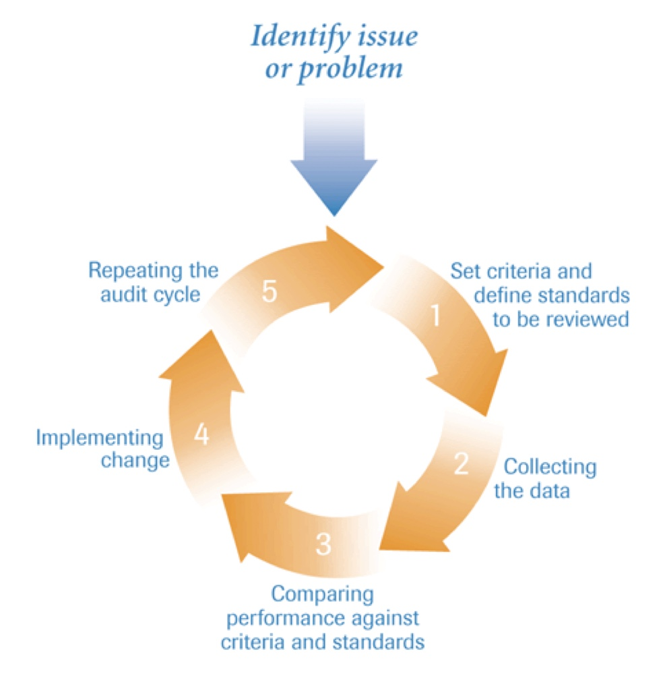
Chapter
09
Pillar 2: Clinical Audit
What is the Clinical Audit Cycle?
The audit process is divided into 5 official steps and the cycle is only considered complete if all steps are performed. The five steps are as follows:
Define the standards.
Collect the data.
Compare current practice with the standard.
Implement a change to improve the service.
Close the audit cycle loop.
Reference: How to conduct a Clinical Audit, Dr. Adam Hexter, 2013

Slide 52
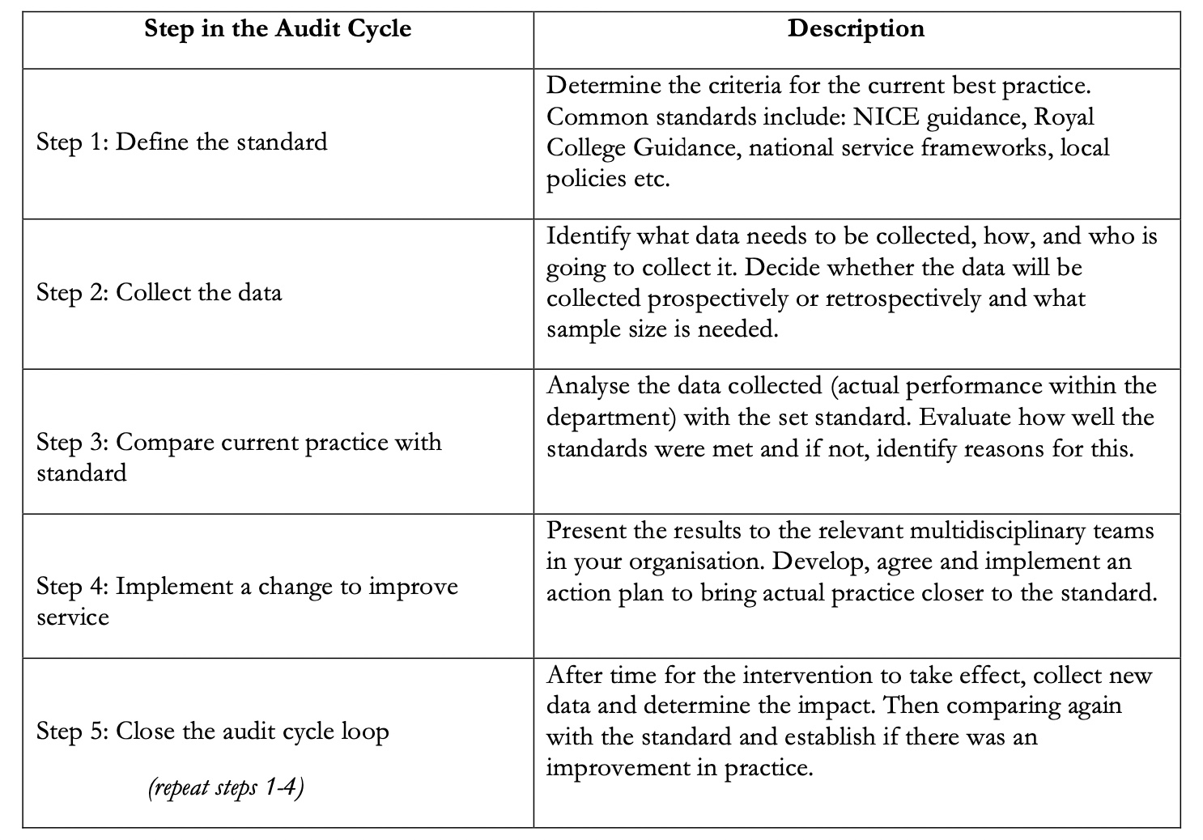
Chapter
09
Pillar 2: Clinical Audit
What is the Clinical Audit Cycle?
Reference: How to conduct a Clinical Audit, Dr. Adam Hexter, 2013

Slide 53
Chapter
09
Pillar 2: Clinical Audit
What are the different types of audits?
Structure of care: refers to the resources required.
Process of care: refers to the actions and decisions taken by practitioners together with users.
Outcome of care: measures the physical or behavioural response to an intervention.
Reference: How to conduct a Clinical Audit, Dr. Adam Hexter, 2013

Slide 54
Chapter
Summary
09
Governance aims to improve efficiency and effectiveness.
The clinical governance is one level at the organization pyramid.
The clinical governance aims to improve the quality and patient safety.
The clinical governance was first introduced by the National Health Services, UK.
The clinical governance has 7 pillars.
Reference: How to conduct a Clinical Audit, Dr. Adam Hexter, 2013

Slide 55



Thank You

Slide 56
Chapter
References:
09
Wang, H. (2016). Comparative Health Systems: A Global Perspective. In International Encyclopedia of Public Health. Jones & Bartlett Learning. https://doi.org/10.1016/B978-0-12-803678-5.00085-0
Rivki, M., Bachtiar, A. M., Informatika, T., Teknik, F., & Indonesia, U. K. (2013). healthcare Systems Around The World (Issue 112).
Will, K. K., Mutyala, J., & Essary, A. C. (2023). Health Systems Science. Jaapa, 36(6), 45–46. https://doi.org/10.1097/01.jaa.0000931464.13332.f1
https://www.mdclarity.com/glossary/social-insurance-bismarck-model
https://www.ahaap.org/out-of-pocket-model

