Slide 1



Slide 2



Academic Staff Orientation
PhD. M.SC. BSc.
PMP. PMI-ACP. PMI - PBA.
P3O. 6Sigma, Scrum master, TOT
د. صفوة العجب

Slide 3


Project Cost Manegement
6
Introduction to estimating
safwa@esu.ac.ae
Dr.Safwa Abdalbagi

Slide 4
Chapter 04
Introduction to estimating
Introduction
Cost is one of the most critical project attributes that must be controlled by the project manager (PM), superintendent, and cost engineering team. Project costs are estimated to develop a construction budget within which the project team must build the project.
Cost estimating is the process of collecting, analyzing, and summarizing data in order to prepare an educated projection of the anticipated cost of a project. All project costs are estimated in preparing bids for lump sum or unit-price contracts and negotiating the guaranteed maximum price (GMP) on cost-plus contracts. This project budget is the first step and becomes the basis for the cost control system that will be discussed in Chapters 8.

Slide 5
Chapter 04
Introduction to estimating
When possible, the PM, cost engineer, and superintendent should be responsible for developing the estimate or at a minimum, work as integral members of the estimating team. Their individual inputs regarding constructability and their personal commitments to the final estimate are essential to assure not only the success of the estimate, but also the ultimate success of the project. One of the first assignments for the estimating team is to develop a responsibility list and to schedule the estimate. The estimating process should be scheduled for each project beginning with the dates for the pre-bid or pre-proposal conference and finishing when the bid or proposal is due. With these milestones established, a short bar-chart schedule should be developed which shows each step and assigns due dates to the estimating tasks depicted in the Estimating Process Figure 4.1.

Slide 6
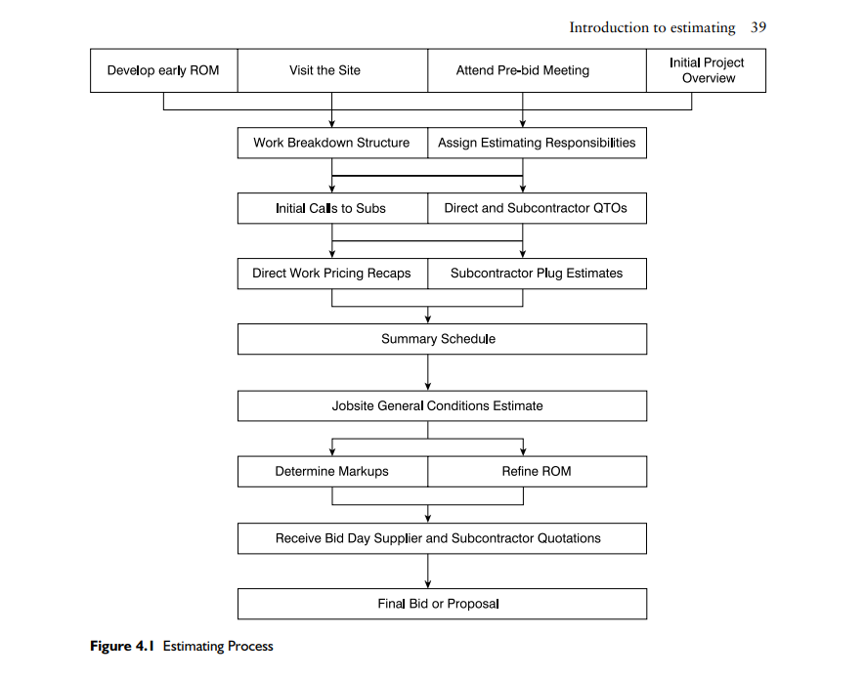
Chapter 04
Introduction to estimating

Slide 7
Chapter 04
Introduction to estimating
Types of cost estimates
Many outside of the construction industry view all contractors’ estimates the same, in that they are all ‘firm bids’ and all contractor-produced estimates are completely detailed and accurate. This of course is a misconception and largely dependent upon document completion. There are several different types of cost estimates. Conceptual cost estimates are developed using incomplete project documentation, while detailed cost estimates are prepared using complete drawings and specifications. Semi-detailed cost estimates are used for guaranteed maximum price contracts and have elements of both conceptual and detailed estimates as discussed further later. The estimating strategy or approach is different with each of the three main types of estimates and the level of detail will differ as well. The accuracy of an estimate is directly proportional to the accuracy of the documents and the time spent on preparing an estimate also follows those same lines. All estimates have major elements or cost categories, some
of which require a more detailed effort by

Slide 8
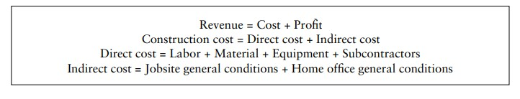
Chapter 04
Introduction to estimating
The revenue equation, and subsets of this equation, is shown here and will be referred
to throughout this study on construction cost accounting.
Early estimates may be developed by contractors or architects on limited information and produced quite quickly. These estimates are not expected to be ‘firm’ nor are they necessarily accurate. They should be referred to as budgets, schematic estimates, or conceptual estimates.

Slide 9
Chapter 04
Introduction to estimating
Budgets are the least accurate estimate type and should carry substantial contingencies, such as 10–20%. Budgets are also developed only by seasoned estimators, whereas the junior estimator or cost engineer will assist with quantity take- offs (QTOs) associated with detailed lump sum bid estimates. A contractor will also develop an early and quick budget from even a detailed set of drawings as soon as they come through the door. This estimate is referred to as a ROM estimate and is utilized to determine if the project is the right size for the contractor to pursue and which of its estimating or management staff would be best suited to work on the subsequent detailed estimate. Another early estimate prepared by the project owner, which is often a real estate developer, is a pro forma, which is the topic of the last chapter in this book. A detailed estimate takes the longest time to prepare, costs the contractor the most in personnel resources to complete, and produces the most accurate final figure. Usually drawings and specifications which are 90–95% complete are associated with detailed estimates. This would be consistent with completion of the construction document (CD) design phase.

Slide 10
Chapter 04
Introduction to estimating
Detailed estimates are required for projects which are lump sum bid, such as for a public waste water treatment plant.
Although lump sum bids are customarily associated with public works projects, clients on privately financed projects may also solicit lump sum bids during a slow economy. In a busy economy though, project owners may only interest contractors with negotiated requests for proposals.
Clients soliciting lump sum bids are primarily interested in just the bottom-line price and assume all contractors can deliver the project with comparable levels of quality, schedule, and safety.
the detailed estimate process includes quantity take-offs, pricing recaps, early subcontractor plug estimates, jobsite general conditions, competitive subcontractor and supplier quotations, and markup choices.

Slide 11
Chapter 04
Introduction to estimating
Guaranteed maximum price estimates and resultant guaranteed maximum price (GMP) contracts are a hybrid of budgets and detailed estimates.
GMPs are often prepared on negotiated projects after completion of the design development (DD) phase. Detailed estimates are produced Revenue = Cost + Profit Construction cost = Direct cost + Indirect cost Direct cost = Labor + Material + Equipment + Subcontractors Indirect cost
= Jobsite general conditions + Home office general conditions for scopes which have been adequately designed and specified, such as structural concrete and steel, utilizing measured quantities and unit prices. Subcontractor plugs or allowances are included for areas not yet designed.

Slide 12
Chapter 04
Introduction to estimating
Work breakdown structure
The process of developing an estimate was illustrated in Figure 4.1. The first step of gathering information is the foundation for the process. As the estimator proceeds through the process, information continues to be analyzed and summarized and refined, until eventually there is only one price left, the final estimate or bid. The work breakdown structure (WBS) for the project is an early outline of the significant work items that will have associated cost or schedule considerations. This includes scopes of work such as concrete walls, exterior paving, ceramic tile, electrical, etc. Before detailed take-offs and pricing are prepared, the estimator should develop this general picture of all of the work that will be included on the WBS. One of the first steps in the estimating process is to perform a brief document overview. The estimator should slowly leaf through the drawings and specifications and develop a good understanding of the type of project and the building systems that are included. The estimator should
not start quantifying or pricing any work items until this overview is complete.

Slide 13
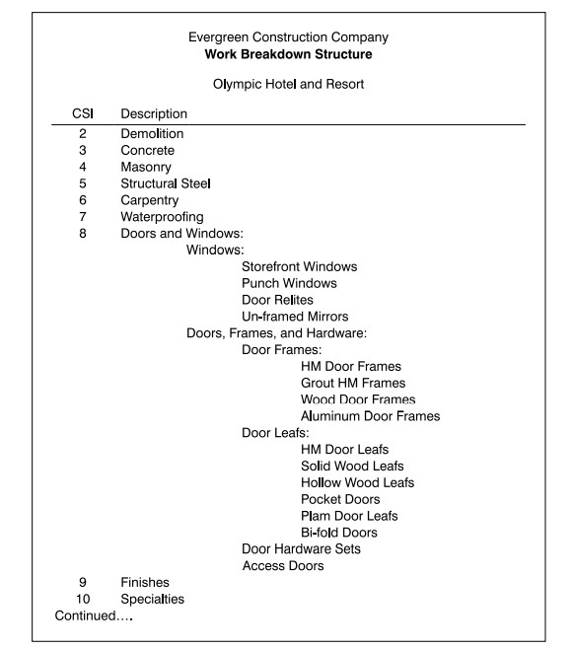
Chapter 04
Introduction to estimating

Slide 14
Chapter 04
Introduction to estimating
general contractors may perform with their own direct crews include: concrete formwork, structural steel erection, rough carpentry, finish carpentry, doors, specialties, and accessories. These are scopes of work often installed direct by the GC’s carpenters, laborers, and ironworkers. Decisions regarding which scopes of work to self-perform and which to subcontract are based on several criteria:
Subcontractors will be used if the specialized tradesmen needed are not employed
by the GC.
The reason subcontractors are also known as specialty contractors is that they specialize in a specific scope of work, such as windows, and should be expected to know that work better than would other contractors.
If there are problems with the quality of installation, a subcontractor is required to
repair the work without increase in cost to the GC.

Slide 15

Chapter 04
Introduction to estimating
* The subcontractor may have estimated a fixed price which is less than what the GC has estimated therefore the subcontractor would be absorbing the pricing risk.
*Subcontractors may have craftsmen and equipment available and the GC does not.
*There are risk mitigation arguments on both sides as to which, the subcontractor or the GC, can perform the work faster, safer, cheaper, and with better quality than the other.
Another tool the construction team might utilize at this stage is a project item list, which is essentially a work breakdown structure with columns indicting direct labor and material from that of subcontractors. A live Excel version of the project item list is included on the resource. After the estimator, project manager, and superintendent have decided which scopes of work to subcontract, subcontractors should be notified
about the project. .

Slide 16
Chapter 04
Introduction to estimating
Today this is likely done electronically with an invitation to bid and an access code to drawing files. It is a good idea to have the subcontractors working to assist with the estimate in parallel with the general contractor developing its own estimates for self- performed work. When subcontractors are notified they will ask the estimator questions regarding specifications, quantities, and materials.
The cost engineer or estimator should be informed at that time about specific subcontractor scopes but should be cautious about providing too much detail to the subcontractor. General contractors do not want to place themselves in the position that subcontractors have based their prices solely on information the GC estimators have given them. Each subcontractor should develop a completely independent estimate. The work breakdown structure, if properly developed including sufficient detail and cost codes, can also function as a preliminary ‘bill-of-materials’ from which the superintendent and cost engineer can issue short-form purchase orders and place material orders.

Slide 17
Chapter 04
Introduction to estimating
Quantity take-off
After the work breakdown structure is developed, the estimator takes material quantities directly off the drawings. The estimator prepares quantity take-offs by conducting detailed measurements and counts of each item of work that the team selected to be self-performed. The take-off process is a time-consuming step in the estimating process as shown in Figure 4.1, and is a crucial step in preparing any detailed construction estimate. The quantity take-off process starts with the work items that will be constructed first, the foundations. This is typical for commercial or civil or residential projects. This order will accomplish several tasks. First, it will force the estimator to think like the builder – the foundations are built before the floor systems. This is also why it is important to have the superintendent involved early in
the estimate creation.

Slide 18
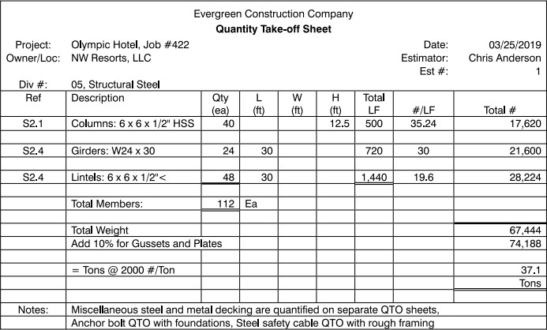
Chapter 04
Introduction to estimating
Organization of the estimate in this fashion will later assist with the schedule development and will aid with the development of the project cost control systems. All the work items should be taken off prior to pricing, but some estimators perform both QTO and pricing simultaneously – another advantage offered by computer estimating tools. Material quantities are recorded on QTO sheets similar to the one for the Olympic Hotel as

Slide 19
Chapter 04
Introduction to estimating
Counted and measured quantities of materials must be mathematically converted to purchasable units that match up with standard unit pricing. For example, concrete is measured in length multiplied times width multiplied times height or thickness or depth which produces cubic feet, but it must be divided by 27 to produce cubic yards. Likewise structural steel is purchased by the ton, wood framing by the thousand board feet, and plywood floor and wall sheeting by individual sheets.

Slide 20
Chapter 04
Introduction to estimating
Quantity take-off sheets for subcontracted work are prepared similarly, but by system or assembly and need not be as detailed as that of the general contractor’s direct work. For example, the GC will take-off sheetrock walls, including metal studs and taping, by the square foot or linear foot of wall system, and not independently quantify sheets of drywall, metal studs, and taping mud. Order-of-magnitude (OM) estimates will be developed for subcontracted work to be replaced later when competitive quotes are provided by the subcontractors
.

Slide 21
Chapter 04
Introduction to estimating
Pricing
There is no one exact estimate for any project but some estimates are more correct than others. Adjustments in pricing, subcontractor and direct labor strategies, jobsite overhead structures, and fee calculations are individual contractor decisions that will determine the most correct estimate for those conditions at that time. Pricing recapitulation sheets (recaps) are developed for each system, or CSI division, that is utilized. The estimator should not start pricing until all of the materials have been taken off and recorded on the quantity sheets. After all of the quantity take-off has been completed, the estimator should begin pricing labor and direct materials. All of the recapped material quantities are circled or highlighted and brought forward from the QTOs and entered onto the pricing recap sheets. An example of a pricing recap
sheet is shown in Figure 4.4.

Slide 22
Chapter 04
Introduction to estimating
Contractors can only guestimate how many hours it will take to perform a task; there are no rules and they can only manage, not control, actual field productivity as will be discussed in Chapter 8. Often a general contractor will review the amount of direct labor in an estimate and use this figure as some basis for determining overall project risk and therefore the appropriate fee to apply. Labor productivity is estimated as man- hours (MH) per unit of work, such as 10 MHs per door. This is referred to as unit man- hours or UMH. This system allows for fluctuation of labor rates, union versus open shop choices, geographic variations, and time. If it takes 8 MHs per ton to install foundation reinforcement steel in Atlanta, it probably takes the same in Aberdeen.
Appropriate wage rates can be applied for the specific project.
The best source of labor productivity is from the estimator’s in-house database.

Slide 23
Chapter 04
Introduction to estimating
Each estimator or contractor should develop their own database from previous estimates and as-built labor history. Other sources of labor productivity rates include published databases or reference guides, such as RS Means’ Building Construction Cost Data. It is important to round calculated man-hours off on the pricing recap sheets.

Slide 24
Chapter 04
Introduction to estimating
The wage rates that get applied are determined by the company, location, union agreements (if applicable), and the type of work to be performed. Public construction project wage rate values may also be governed by Davis-Bacon or prevailing wage rates which are established by the Department of Labor

Slide 25
Chapter 04
Introduction to estimating
Some estimators will use crew wage rates which combine journeymen with foremen with apprentices. This often averages out at the journeyman’s wage and is a common and acceptable practice. Some will use blended wage rates which factor carpenters and laborers and cement masons and ironworkers all together. Others will use loaded wage rates which combine bare wages (that which the craftsman receives) with labor burden.

Slide 26
Chapter 04
Introduction to estimating
Price quotations should be received in writing on the supplier’s letterhead. A live example of a telephone bid proposal form is available on the resource. If telephone quotations are received, company-consistent forms should be used for recording material pricing, although pricing on the vendor’s letterhead is always preferred. Many material quotes are received electronically. Other sources of material prices include in- house historical costs or previous estimates. Historical prices are not as reliable as current quotes, but it is better than leaving an item blank. The third choice for material prices are databases or reference guides. These sources suffice for unusual items for which local quotes cannot be obtained or as allowances or subcontractor plugs or order-of-magnitude estimates in early budget development until competitive prices are received.

Slide 27
Chapter 04
Introduction to estimating
Pricing subcontracted work
The best source of subcontractor pricing is from subcontractors. They are the ones who will ultimately be required to sign a contract and guarantee performance of an established scope of work for a fixed amount of compensation. Subcontractors are invited to bid on a project as one of the early steps in the estimating process. Just as general contractors market to project owners, they should also treat past, current, and future subcontractors with respect so that they receive complete and competitive future bids

Slide 28
Chapter 04
Introduction to estimating
.
Some subcontractors may also provide GCs with early budgets for their scopes as place-holders until bid day quotes are refined. Additional ways to treat subcontractors fairly are to assure timely monthly payments and release of final
retention after close-out as will be discussed in Chapters 14 and 16 respectively.

Slide 29

Chapter 01

Slide 30

Chapter 01
Introduction

