Slide 1


Training Course
Fundamentals of Accounting
for Non-Professionals
Prepared by Dr. Mohamed Hussein
Lecture 3

Slide 2

www.midocean.ae
Lecture Outlines
The History of Accounting.
Definition and Importance of Accounting
Users of accounting
Types of Accounting: Financial and Managerial
Principles and Assumptions of Accounting
Lecture
01
Introduction to Accounting

Slide 3

www.midocean.ae
Lecture Outlines
Understanding the Basic Equation
Understanding the Expanded Accounting Equation
Adjusting the accounting errors
Lecture
02
Basic and Expanded Accounting Equations

Slide 4
www.midocean.ae
Lecture Outlines
Recording pross (journaling and posting ledgers, trial balance)
How to Inspect Accounts and Verify the Accuracy of Financial Records
Lecture
03
Accounts and recording pross

Slide 5

LEC
Learning Objectives
03
  describe the accounting cycle used to record, classify and summarize transactions
  Define debits and credits and explain their use in recording business transactions.
  Identify the basic steps in the recording process.
  Explain what a journal is and how it helps in the recording process.
  Explain what a ledger is and how it helps in the recording process.
  Explain what posting is and how it helps in the recording process.
  Discuss the purpose of a trial balance and how to prepare one..
www.midocean.ae

Slide 6
The Account
Lecture
03
Record of increases and decreases in a specific asset, liability, owners’ equity, revenue, or expense item.
Debit = “Left”
Credit = “Right”
The
Account
An account can be illustrated in a T-account form.
www.midocean.ae

Slide 7
The Account
Lecture
03
DEBIT AND CREDIT PROCEDURES
Double-entry system
  Each transaction must affect two or more accounts to keep the basic accounting equation in balance.
  Recording done by debiting at least one account and crediting at least one other account.
  DEBITS must equal CREDITS.
www.midocean.ae

Slide 8
Debits and Credits
Lecture
03
If the sum of Debit entries are greater than the sum of Credit entries, the account will have a debit balance.
Transaction #1
$10,000
$3,000
Transaction #2
Transaction #3
8,000
Balance
$15,000
www.midocean.ae

Slide 9
Debits and Credits
Lecture
03
If the sum of Credit entries are greater than the sum of Debit entries, the account will have a credit balance.
Transaction #1
$10,000
$3,000
Transaction #2
8,000
Transaction #3
Balance
$1,000
www.midocean.ae

Slide 10
Debits and Credits
Lecture
03
Assets - Debits should exceed credits.
Liabilities – Credits should exceed debits.
Normal balance is on the increase side.
www.midocean.ae

Slide 11
Debits and Credits
Lecture
03
Owner’s investments and revenues increase owner’s equity (credit).
Owner’s drawings and expenses decrease owner’s equity (debit).
www.midocean.ae

Slide 12

Debits and Credits
Lecture
03
The purpose of earning revenues is to benefit the owner(s).
The effect of debits and credits on revenue accounts is the same as their effect on Owner’s Capital.
Expenses have the opposite effect: expenses decrease owner’s equity.
www.midocean.ae

Slide 13
Debits and Credits
Lecture
03
Normal Balance Debit
Normal Balance Credit
www.midocean.ae

Slide 14


Debits and Credits
Lecture
03
Balance Sheet Income Statement
Asset
Liability
+
-
=
Equity
Revenue
Expense
Debit
Credit
www.midocean.ae

Slide 15
Debits/Credits Rules
Lecture
03
Question
Debits:
  increase both assets and liabilities.
  decrease both assets and liabilities.
  increase assets and decrease liabilities.
  decrease assets and increase liabilities.
www.midocean.ae

Slide 16
Debits/Credits Rules
Lecture
03
Question
Accounts that normally have debit balances are:
  assets, expenses, and revenues.
  assets, expenses, and equity.
  assets, liabilities, and owner’s drawing.
  assets, owner’s drawing, and expenses.
www.midocean.ae

Slide 17
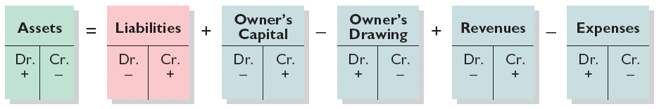
Summary of Debit/Credit Rules
Lecture
03
Relationship among the assets, liabilities and owner’s equity of a business:
Basic Equation
Assets = Liabilities +
Owner’s Equity
Expanded Equation
Debit/Credit Effects
The equation must be in balance after every transaction. Total Debits must equal total Credits.
www.midocean.ae

Slide 18
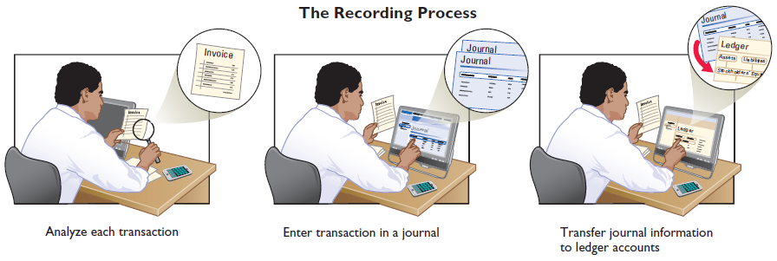
Steps in the Recording Process
Lecture
03
Business documents, such as a sales slip, a check, or a bill, provide evidence of the transaction.
www.midocean.ae

Slide 19
Steps in the Recording Process
Lecture
03
The Journal
Book of original entry.
Transactions recorded in chronological order.
Contributions to the recording process:
  Discloses the complete effects of a transaction.
  Provides a chronological record of transactions.
  Helps to prevent or locate errors because the debit and credit amounts can be easily compared.
www.midocean.ae

Slide 20
Steps in the Recording Process
Lecture
03
JOURNALIZING - Entering transaction data in the journal.
Illustration: On September 1, Ray Neal invested $15,000 cash in the business, and Softbyte purchased computer equipment for $7,000 cash.
GENERAL JOURNAL
Sept. 1
Cash
15,000
  Owner’s Capital
15,000
Equipment
7,000
  Cash
7,000

Slide 21
Steps in the Recording Process
Lecture
03
SIMPLE AND COMPOUND ENTRIES
Illustration: On July 1, Butler Company purchases a delivery truck costing $14,000. It pays $8,000 cash now and agrees to pay the remaining $6,000 on account.
GENERAL JOURNAL
July 1
Equipment
14,000
  Cash
8,000
  Accounts payable
6,000
www.midocean.ae

Slide 22
Steps in the Recording Process
Lecture
03
Yasmin engaged in the following activities in establishing her salon, Hair It Is:
Opened a bank account in the name of Hair It Is and deposited $20,000 of her own money in this account as her initial investment.
Purchased equipment on account (to be paid in 30 days) for a total cost of $4,800.
Interviewed three persons for the position of hair stylist.
Prepare the entries to record the transactions.
www.midocean.ae

Slide 23
Steps in the Recording Process
Lecture
03
Prepare the entries to record the transactions.
Opened a bank account and deposited $20,000.
Purchased equipment on account (to be paid in 30 days) for a total cost of $4,800.
Interviewed three persons for the position of hair stylist.
Cash 20,000
Owner’s Capital 20,000
Equipment 4,800
Accounts Payable 4,800
www.midocean.ae

Slide 24
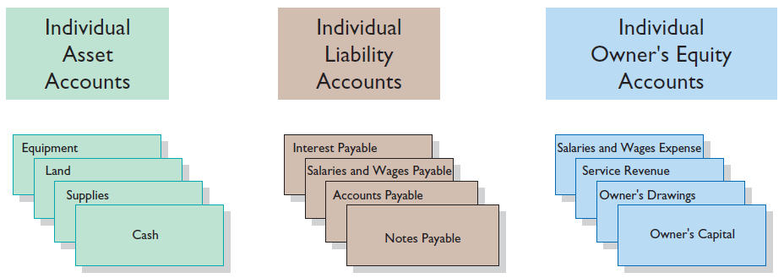
Steps in the Recording Process
Lecture
03
The Ledger
General Ledger contains all the asset, liability, and owner’s equity accounts.
www.midocean.ae

Slide 25
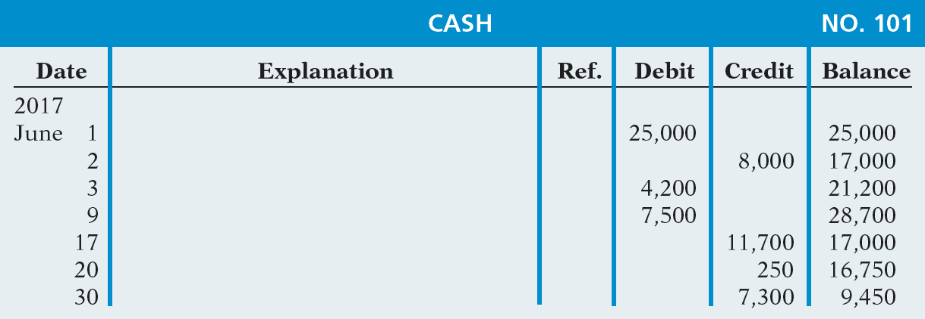
The Ledger
Lecture
03
STANDARD FORM OF ACCOUNT
www.midocean.ae

Slide 26
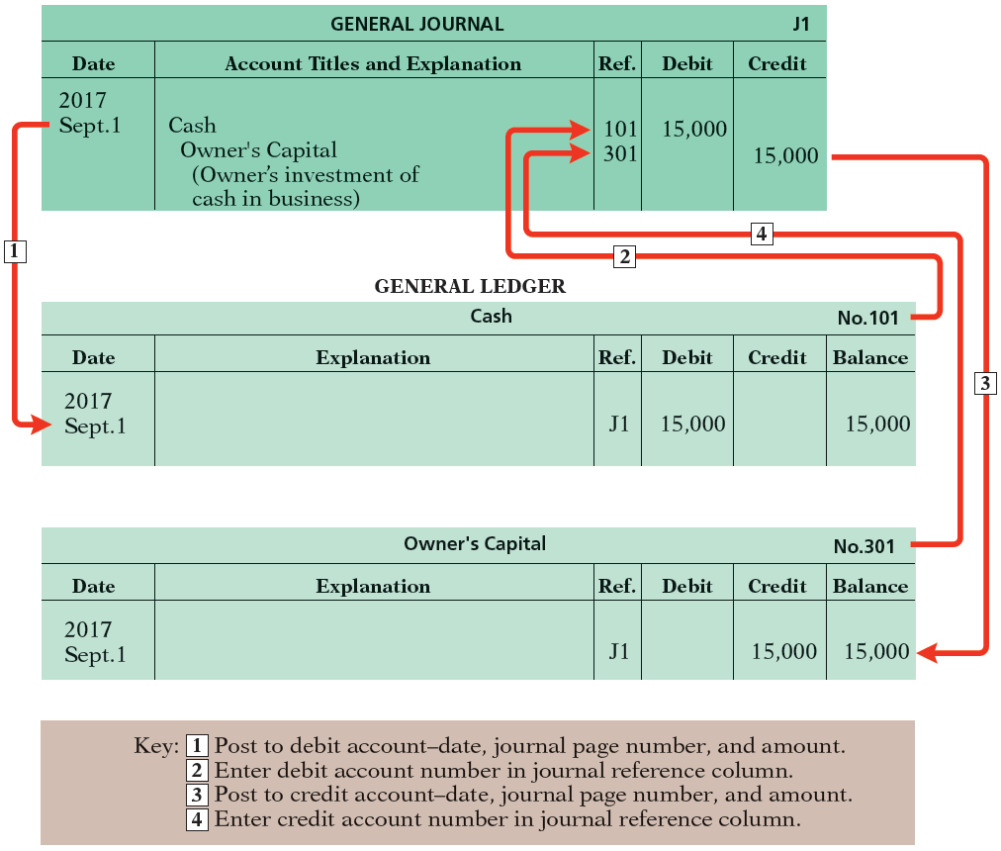
Ledger
Lecture
03
POSTING Transferring journal entries to the ledger accounts.
www.midocean.ae

Slide 27
Ledger
Lecture
03
Question
Posting:
  normally occurs before journalizing.
  transfers ledger transaction data to the journal.
  is an optional step in the recording process.
  transfers journal entries to ledger accounts.
www.midocean.ae

Slide 28
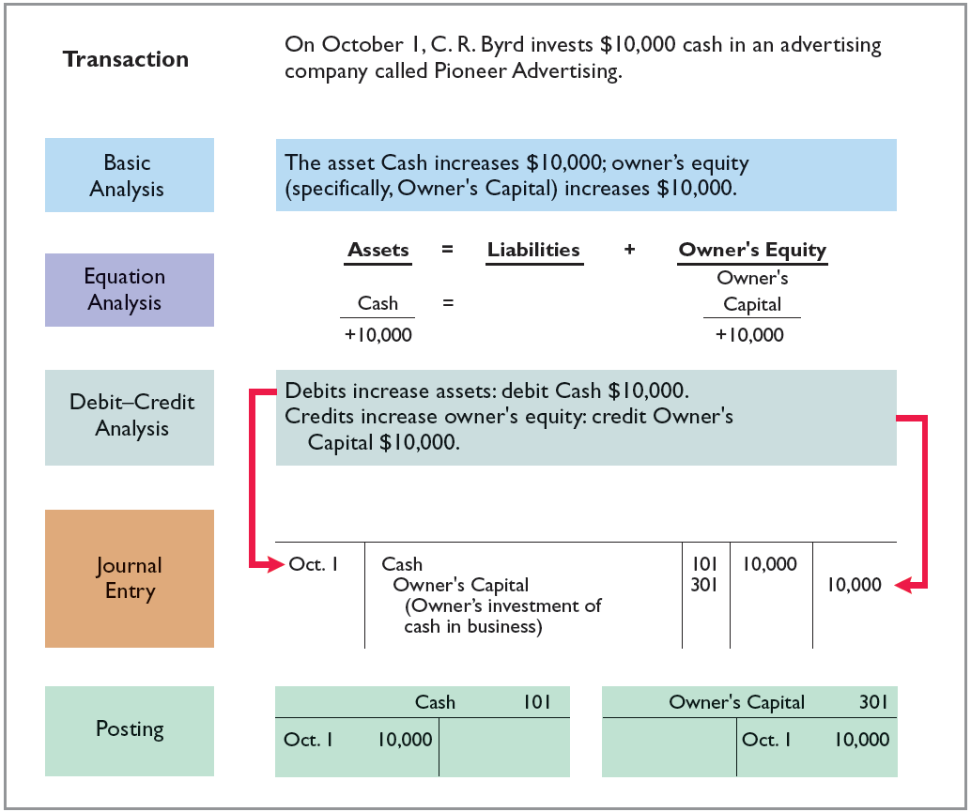
The Recording Process Illustrated
Lecture
03
Follow these steps:
1. Determine what type of account is involved.
2. Determine what items increased or decreased and by how much.
3. Translate the increases and decreases into debits and credits.

Slide 29
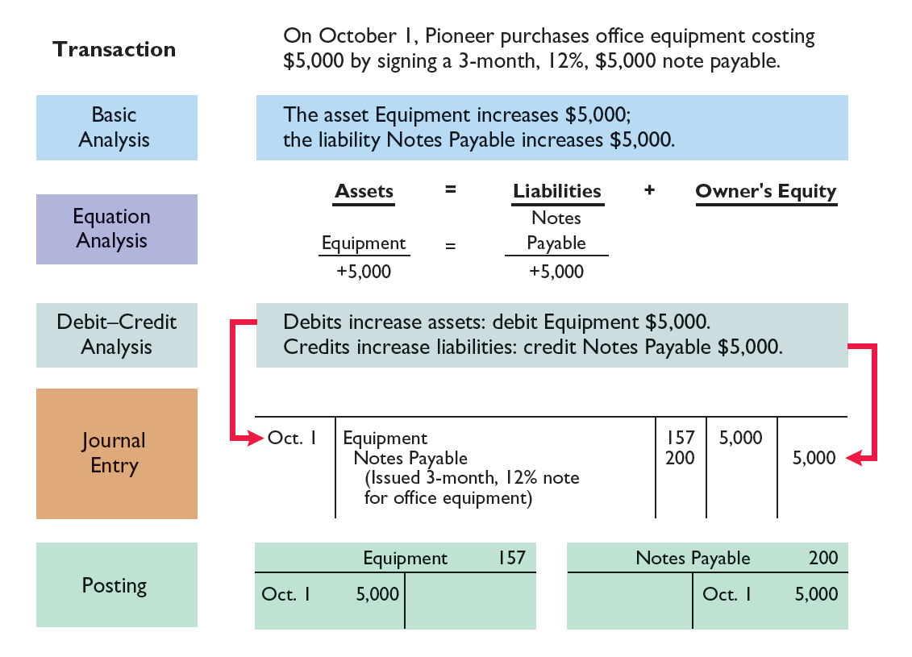
The Recording Process Illustrated
Lecture
03

Slide 30
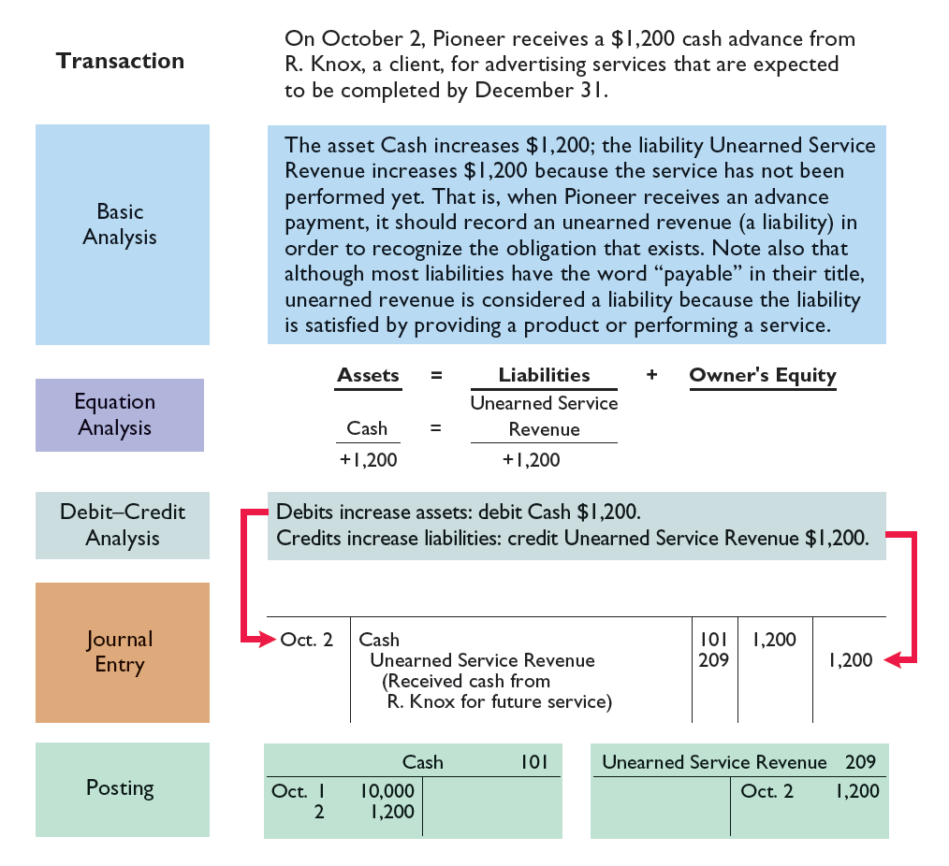
The Recording Process Illustrated
Lecture
03

Slide 31
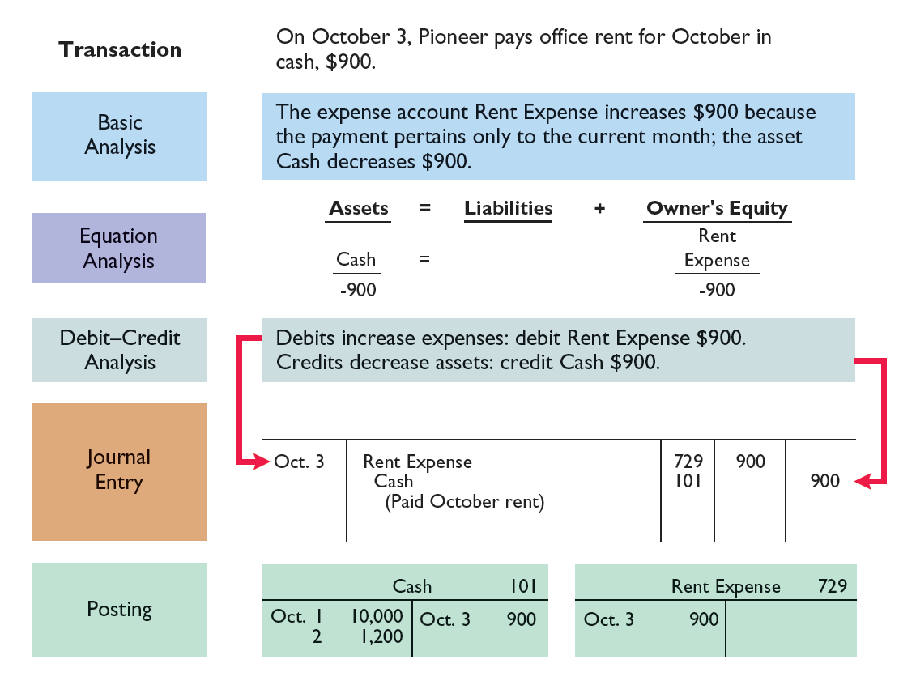
The Recording Process Illustrated
Lecture
03

Slide 32
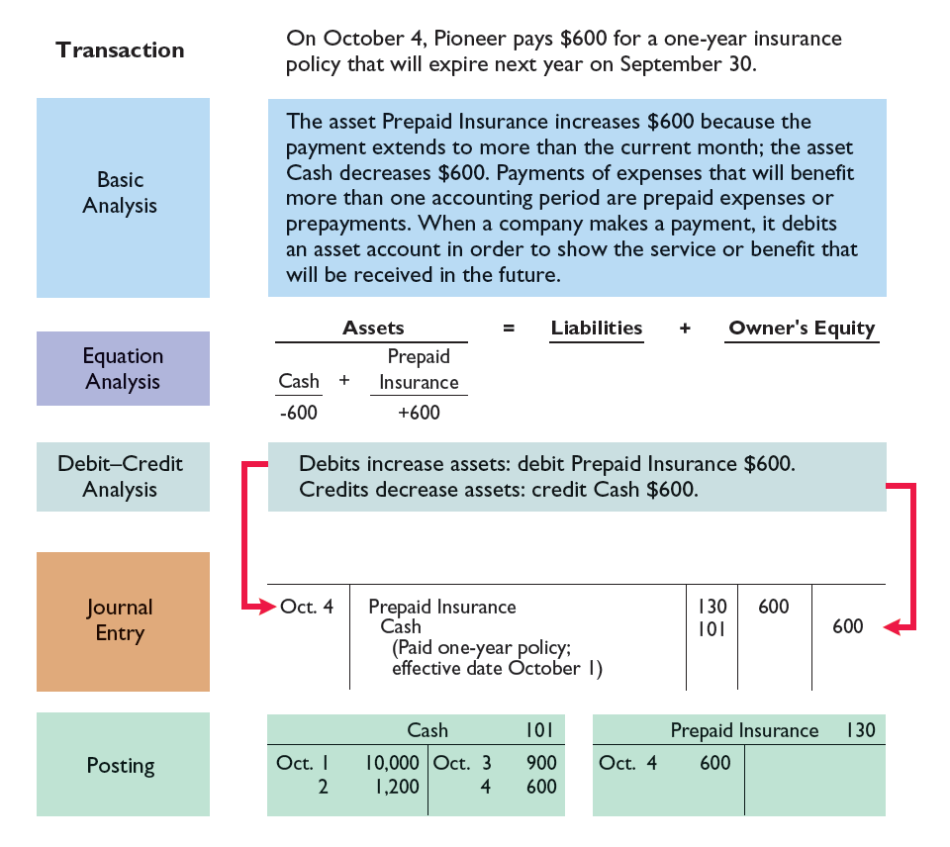
The Recording Process Illustrated
Lecture
03

Slide 33
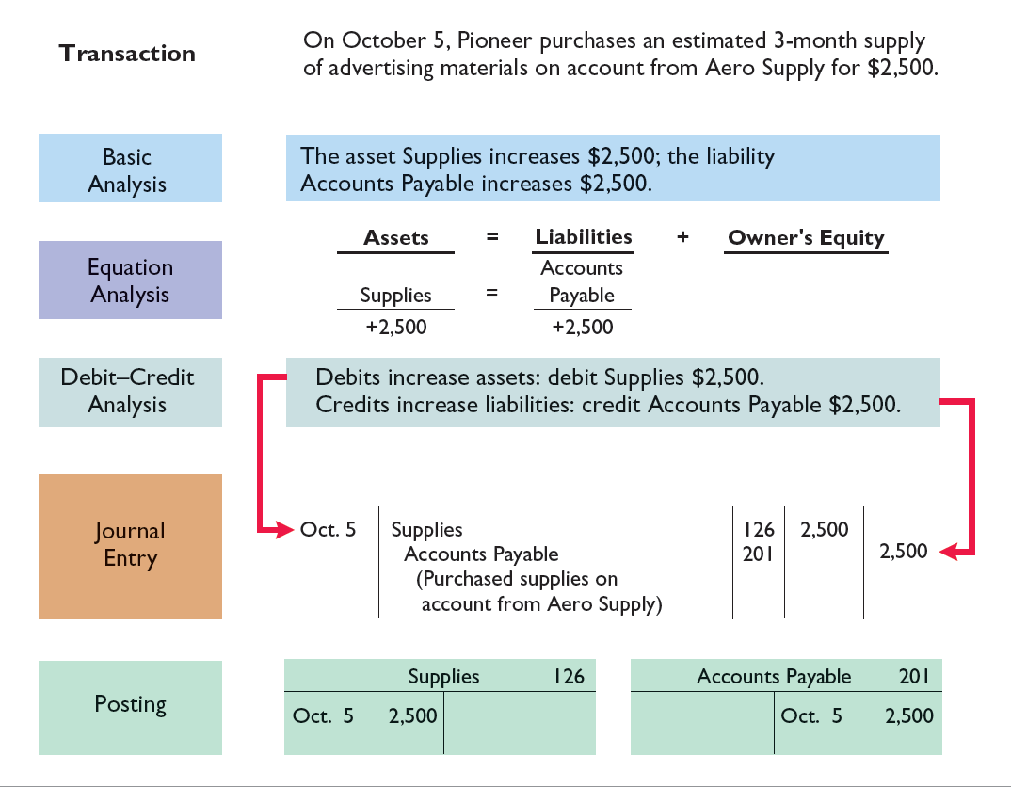
The Recording Process Illustrated
Lecture
03

Slide 34
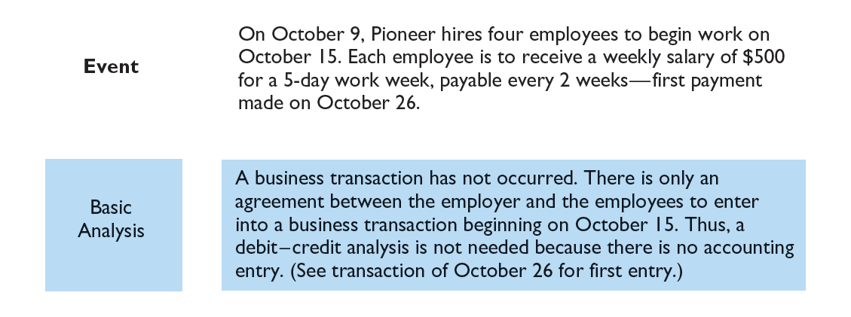
The Recording Process Illustrated
Lecture
03

Slide 35
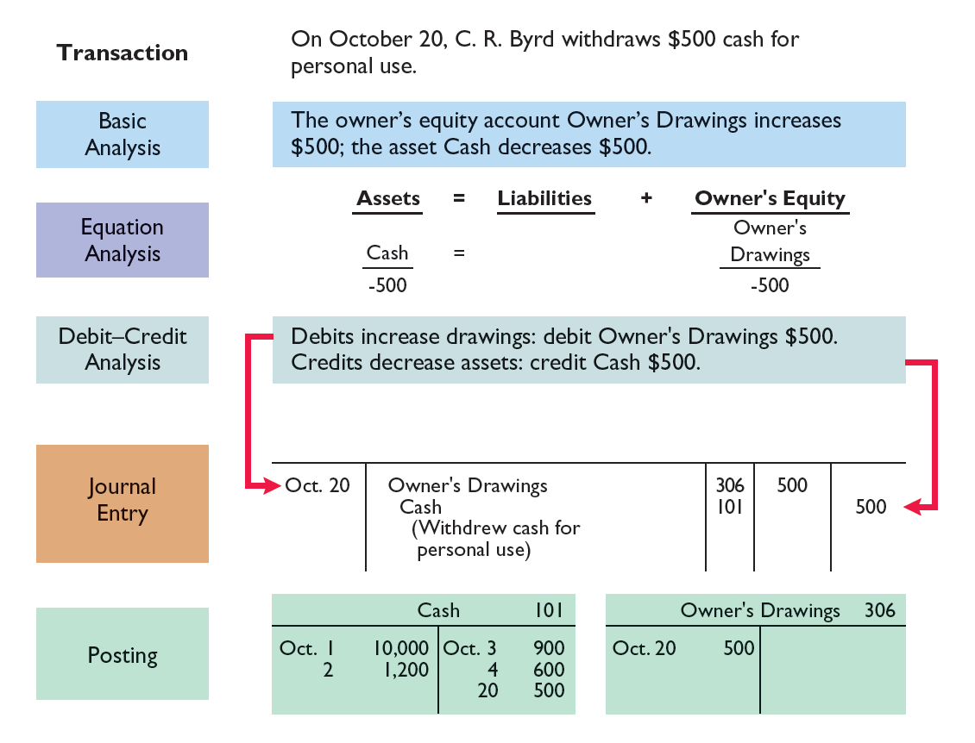
The Recording Process Illustrated
Lecture
03

Slide 36
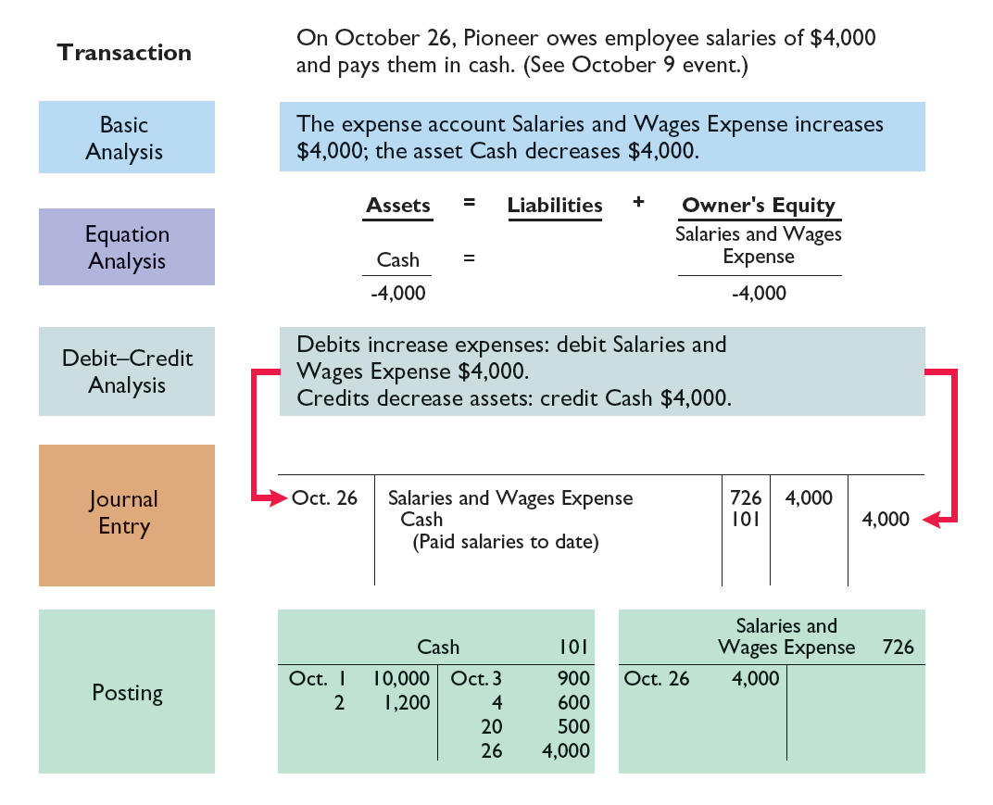
The Recording Process Illustrated
Lecture
03

Slide 37
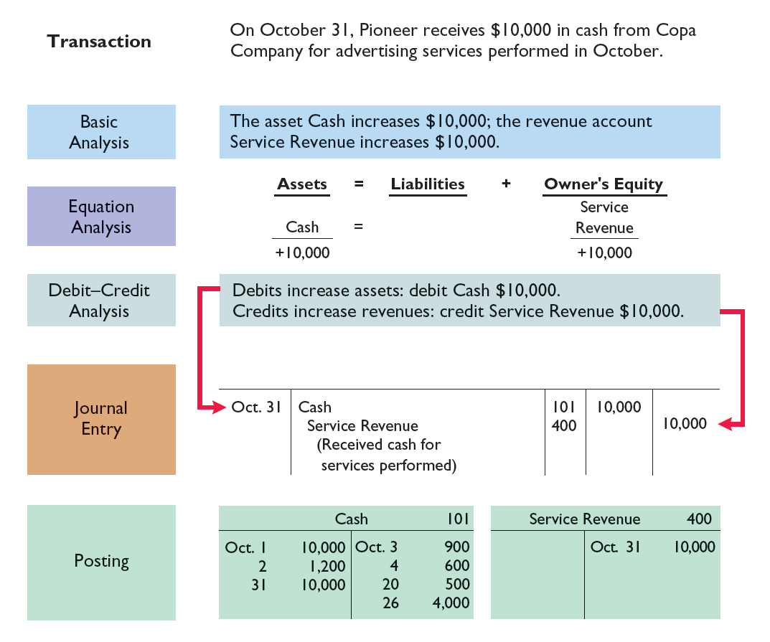
The Recording Process Illustrated
Lecture
03

Slide 38
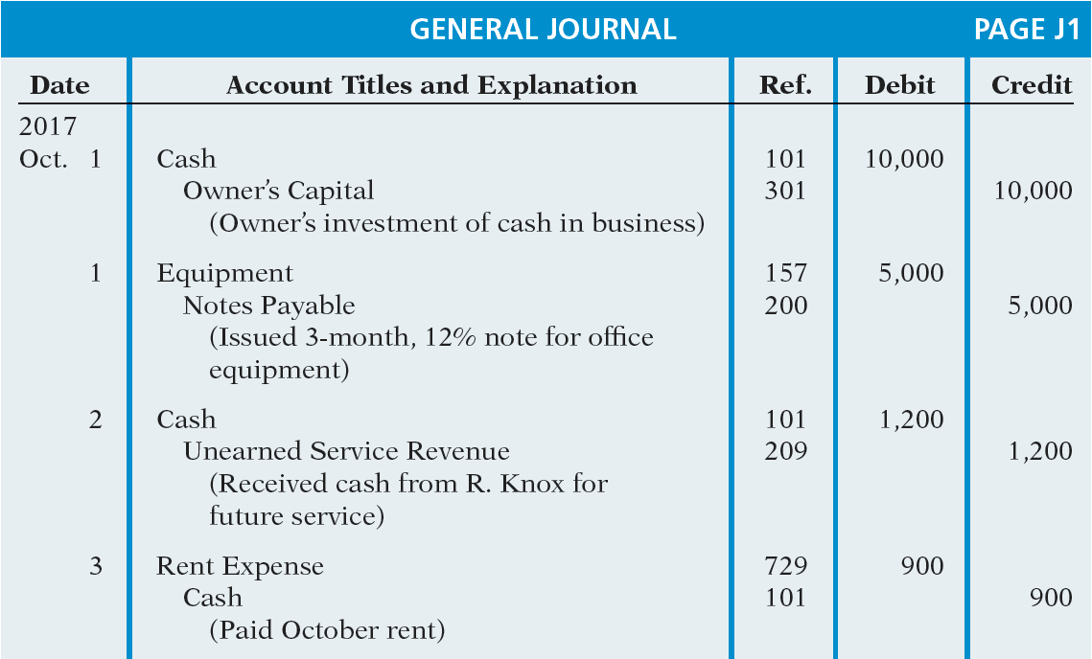
The Recording Process Illustrated
Lecture
03

Slide 39
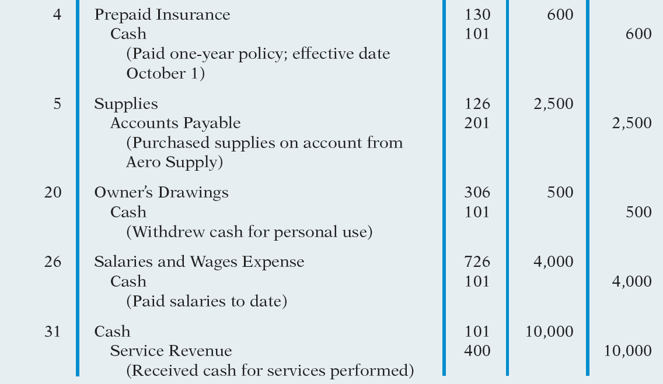
The Recording Process Illustrated
Lecture
03

Slide 40
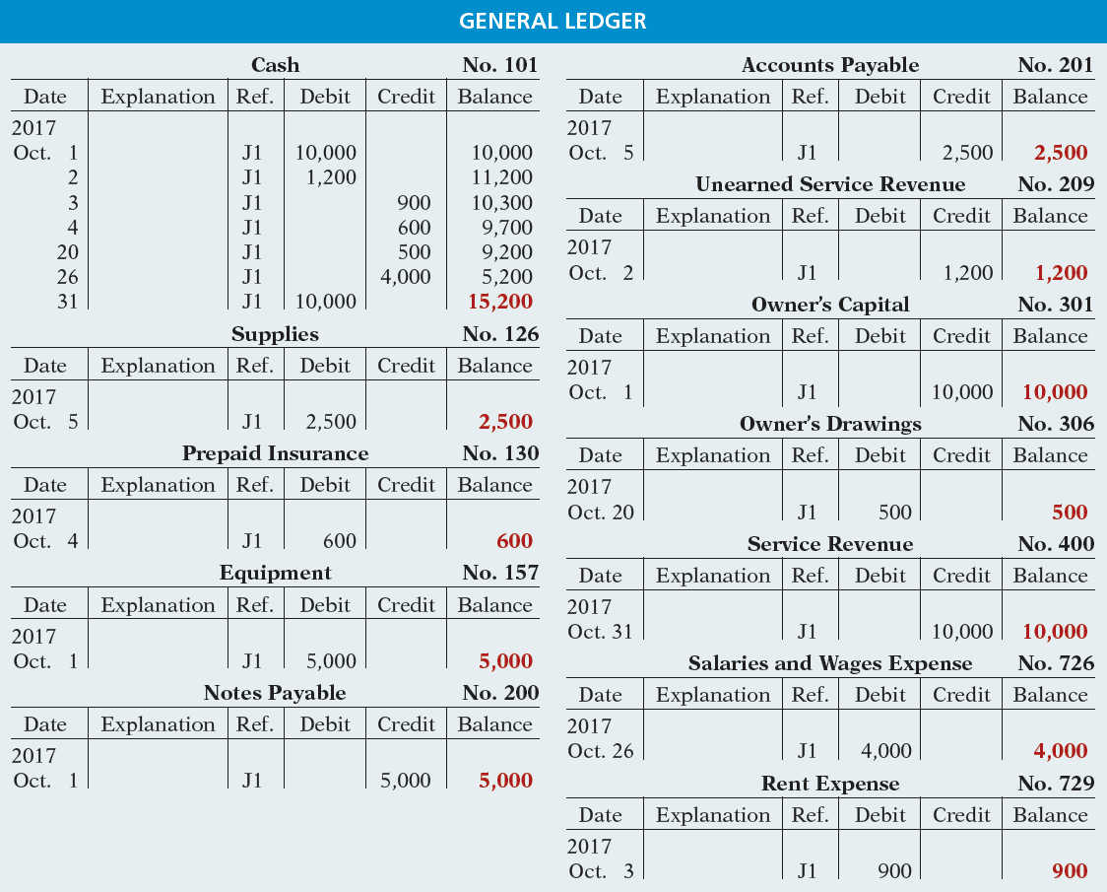
Lecture
03

Slide 41
Ledger
Lecture
03
Kate Brown recorded the following transactions in a general journal during the month of March. Post these entries to the Cash account.
Mar. 4 Cash 2,280
Service Revenue 2,280
Mar. 15 Salaries and Wages Expense 400
Cash 400
Mar. 19 Utilities Expense 92
Cash 92
www.midocean.ae

Slide 42
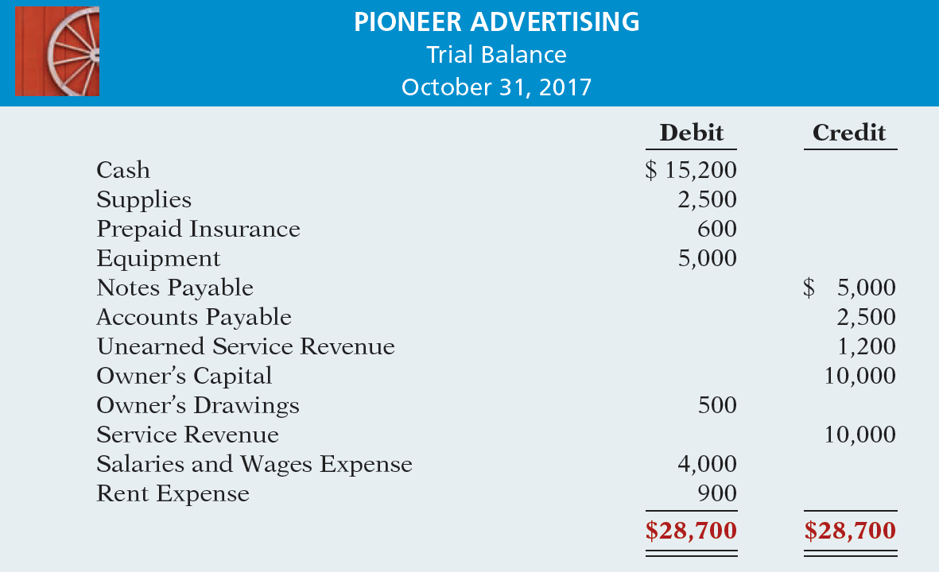
Prepare a trial balance.
Lecture
03
www.midocean.ae

Slide 43
Ledger
Lecture
03
Question
A trial balance will not balance if:
  a correct journal entry is posted twice.
  the purchase of supplies on account is debited to Supplies and credited to Cash.
  a $100 cash drawing by the owner is debited to Owner’s Drawing for $1,000 and credited to Cash for $100.
  a $450 payment on account is debited to Accounts Payable for $45 and credited to Cash for $45.
www.midocean.ae

Slide 44
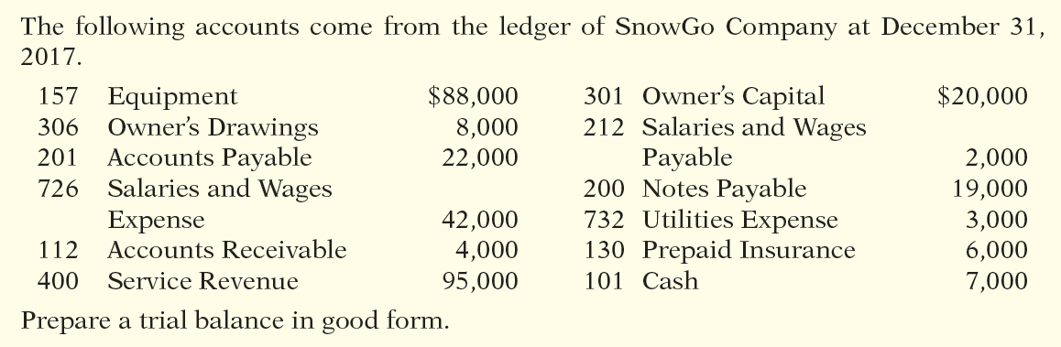
Steps in the Recording Process
Lecture
03
www.midocean.ae

Slide 45
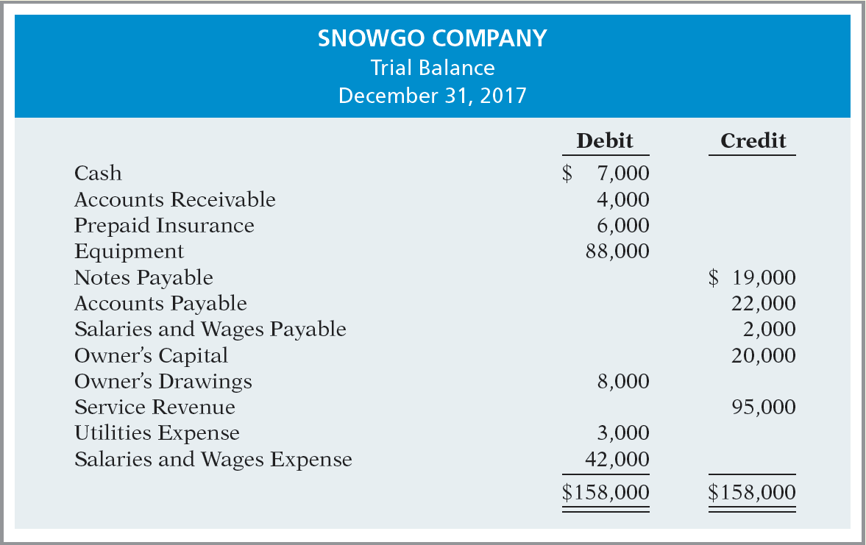

Lecture
03

Slide 46



Thank You

