Slide 1


1
SENTIMENT ANALYSIS OF CUSTOMER FEEDBACK
USING MACHINE LEARNING AND DEEP LEARNING
Name: Nouf Alotaibi
ID: 243001489
Supervisor: Dr. Hagar Saleh
Midocean University

Slide 2
Customer Experience: Journey Disruption Forecasting
1
Sentiment Analysis of Customer Feedback Using Machine Learning and Transformer
Name: Nouf Alotaibi
ID: 243001489
Supervisor: Dr. Hagar Saleh
Midocean University

Slide 3
Presentation RoadMap
01
05
Introduction
Methodology
02
06
Problem Statement
Results
03
07
Contribution and Objective
Conclusion
04
08
Related Work
Future Work

Slide 4


Introduction
Our company occasionally receives negative customer feedback that reflects dissatisfaction with certain services. However, these opinions are often unstructured, making it difficult to identify the exact reasons behind customer dissatisfaction. This lack of clarity limits the company’s ability to make informed decisions and implement targeted service improvements. Therefore, analyzing customer feedback is essential to understand the drivers of negative opinions and support decisions that enhance service quality and customer satisfaction. This challenge is the main motivation for selecting this research.
Sentiment analysis supports organizations in understanding customer's feedback in complaints.
Customer complaints are often long, unstructured, and difficult to analyze
Automated sentiment classification improves service quality and decision-making.

Slide 5
01
02
03
04
05
06
Problem Statement
Our company occasionally receives negative customer feedback that reflects dissatisfaction with certain services. However, these opinions are often unstructured, making it difficult to identify the exact reasons behind customer dissatisfaction. This lack of clarity limits the company’s ability to make informed decisions and implement targeted service improvements. Therefore, analyzing customer feedback is essential to understand the drivers of negative opinions and support decisions that enhance service quality and customer satisfaction. This challenge is the main motivation for selecting this research.
Applying advanced deep neural network models to enhance customer feedback based on the sentiment analysis.
Using benchmark dataset
Evaluate model using different evaluation matrix
Applying different preprocessing step to improve text quality
Develop AI framework to enhance customer feedback
conducted transformer model is achieve the best performance we compare it with different machine learning models

Slide 6
02
04
Conversion of all textual entries into a standardized string format
The dataset was split into training and testing subsets to evaluate model generalization performance.
The split was conducted in a stratified manner to preserve class distribution across subsets, ensuring unbiased evaluation.
Research Contribution and objective
01
02
03
04
05
06
Applying advanced deep neural network models to enhance customer feedback based on the sentiment analysis.
Using benchmark dataset
Evaluate model using different evaluation matrix
Applying different preprocessing step to improve text quality
Develop AI framework to enhance customer feedback
conducted transformer model is achieve the best performance we compare it with different machine learning models
The study 1
01
03
The study [30] investigated sentiment analysis of customer responses related to a telecommunication operator using Twitter data. The dataset consisted of customer tweets expressing opinions and reactions toward telecommunication services. The preprocessing phase included text normalization to handle informal language, abbreviations, and noise commonly found in social media content. The proposed approach combined a Deep Convolutional Neural Network (DCNN) for feature extraction with a Support Vector Machine (SVM) classifier. The experimental results on the test data reported 63% accuracy, 63% precision, and only 50% recall, indicating limited ability to correctly retrieve sentiment instances. The authors highlighted that the short length of tweets and linguistic variability negatively affected recall performance, particularly for minority sentiment classes.
Removal of records with missing or null complaint text
Preservation of original textual structure without aggressive text cleaning to maintain semantic integrity
The study 2
In the study [31], sentiment classification was performed on highly noisy customer feedback data collected from Global Support Services surveys and Knowledge Base surveys. The dataset included more than 40,000 customer feedback records, each associated with satisfaction scores ranging from “not satisfied” to “very satisfied.” The preprocessing stage involved lemmatization, stop-word removal, and feature reduction. A linear Support Vector Machine (SVM) was employed using surface-level n-gram features alongside linguistic features. The results demonstrated moderate performance, reporting an F1-score of 74.62% for extreme satisfaction classes, while performance dropped substantially to 58.14% F1-score when closely related sentiment classes were grouped. These findings indicate the difficulty of achieving high recall when sentiment boundaries are ambiguous in real customer feedback.
The study 3
The study [32] was conducted as part of the IJCNLP-2017 Shared Task on Customer Feedback Analysis and focused on classifying multilingual customer feedback obtained from Microsoft Office users. The dataset covered four languages—English, French, Spanish, and Japanese—and included six predefined feedback categories such as complaint, request, and comment. Several machine learning and neural network models were evaluated, including Support Vector Machines (SVM), Naïve Bayes classifiers, and bidirectional LSTM models with pre-trained word embeddings. The reported results showed exact-match accuracy values of approximately 65% for English and as low as 56% for Japanese, reflecting challenges in capturing sentiment-related feedback across languages. The authors emphasized that multilingual variability and class imbalance significantly limited recall performance.

Slide 7
02
04
Conversion of all textual entries into a standardized string format
The dataset was split into training and testing subsets to evaluate model generalization performance.
The split was conducted in a stratified manner to preserve class distribution across subsets, ensuring unbiased evaluation.
Related work
Study: Sentiment analysis of customer response of telecommunication operator in Twitter
Study: Sentiment classification on customer feedback data. noisy data large feature
Study: IIIT-H at IJCNLP-2017 Task 4 Customer Feedback Analysis using
The study investigated sentiment analysis of customer responses related to a telecommunication operator using Twitter data. The dataset consisted of customer tweets expressing opinions and reactions toward telecommunication services. The preprocessing phase included text normalization to handle informal language, abbreviations, and noise commonly found in social media content. The proposed approach combined a Deep Convolutional Neural Network (DCNN) for feature extraction with a Support Vector Machine (SVM) classifier. The experimental results on the test data reported 63% accuracy, 63% precision, and only 50% recall, indicating limited ability to correctly retrieve sentiment instances. The authors highlighted that the short length of tweets and linguistic variability negatively affected recall performance, particularly for minority sentiment classes.
In the study sentiment classification was performed on highly noisy customer feedback data collected from Global Support Services surveys and Knowledge Base surveys. The dataset included more than 40,000 customer feedback records, each associated with satisfaction scores ranging from “not satisfied” to “very satisfied.” The preprocessing stage involved lemmatization, stop-word removal, and feature reduction. A linear Support Vector Machine (SVM) was employed using surface-level n-gram features alongside linguistic features. The results demonstrated moderate performance, reporting an F1-score of 74.62% for extreme satisfaction classes, while performance dropped substantially to 58.14% F1-score when closely related sentiment classes were grouped. These findings indicate the difficulty of achieving high recall when sentiment boundaries are ambiguous in real customer feedback.
The study was conducted as part of the IJCNLP-2017 Shared Task on Customer Feedback Analysis and focused on classifying multilingual customer feedback obtained from Microsoft Office users. The dataset covered four languages—English, French, Spanish, and Japanese—and included six predefined feedback categories such as complaint, request, and comment. Several machine learning and neural network models were evaluated, including Support Vector Machines (SVM), Naïve Bayes classifiers, and bidirectional LSTM models with pre-trained word embeddings. The reported results showed exact-match accuracy values of approximately 65% for English and as low as 56% for Japanese, reflecting challenges in capturing sentiment-related feedback across languages. The authors emphasized that multilingual variability and class imbalance significantly limited recall performance.
01
03
Removal of records with missing or null complaint text
Preservation of original textual structure without aggressive text cleaning to maintain semantic integrity

Slide 8







02
04
Methodology
Data Collection
Data Preprocessing
Feature Representation
Performance Evaluation
Model Training
01
03
Removal of records with missing or null complaint text
Preservation of original textual structure without aggressive text cleaning to maintain semantic integrity

Slide 9

Methodology – Data Collection
The experiments were conducted using Jupyter Notebook on a machine running Microsoft Windows 10, equipped with an Intel Core i7 CPU and 16 GB of RAM.
Dataset
Dataset Characteristics
All models shared consistent preprocessing steps, including text cleaning, tokenization, normalization, and numerical feature representation.
The study utilizes the Customer Complaints Sentiment and Priority Dataset, which contains real-world customer complaint texts collected from financial service platforms.
Data type: Structured textual data
Language: English
Task: Binary sentiment classification
Domain: Customer complaints
Class distribution: Imbalanced
Classical machine learning models—including Logistic Regression (LR), Decision Tree (DT), K-Nearest Neighbors (KNN), and Linear SVC—were implemented using the scikit-learn framework.
TF–IDF vectorization was applied to all classical ML models, enabling the extraction of sparse, high-dimensional term-weighted features.
Dataset Structure
Feature Representation Techniques
In contrast, the BERT classifier leveraged contextual embeddings derived from its transformer architecture, allowing deeper semantic representation of complaint narratives.
The transformer-based model (BERT) was implemented using the Hugging Face Transformers library built on PyTorch.
Complaint Text
Free-text customer complaint descriptions expressing dissatisfaction and service-related issues.
Class Distribution:
Total samples: 1,750
Positive complaints: 1,295 (74%)
Negative complaints: 455 (26%)
Sentiment Label
  0 – Negative
  1 – Positive

Slide 10
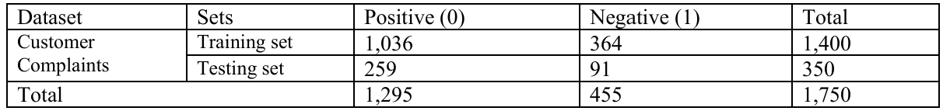




Data Preparation
The dataset consists of customer complaint texts labeled with binary sentiment classes. The data preprocessing steps included:
Removal of missing values from text and label columns
Conversion of text data to lowercase strings
Stratified splitting of the dataset into:
01
02
03
04
Methodology - Data Preprocessing / Preparation
Data Preprocessing
Data Preparation
All experiments were implemented using Jupyter Notebook on a machine running Microsoft Windows 10, equipped with an Intel Core i7 CPU and 16 GB of RAM.
Python and standard data science libraries, including scikit-learn, pandas.
01
02
03
Text normalization
Stop Word Removal & Stemming Applied to Word Count & TF-IDF only
Text cleaning
Label formatting
01
02
Imbalanced class distribution
Negative: 1,295 (74%)
Positive: 455 (26%)
train/test split
70%
training set
15%
validation set
15%
test set
Accuracy
Precision
Recall
F1-score
Measures overall correctness of predictions
Measures Correctness of predicted positive class
Measures ability to detect all actual positive cases
Harmonic mean of precision and recall

Slide 11
Methodology - Feature Representation
Feature Representation Techniques
Word Count
TF-IDF
Transform complaint texts into numerical vectors based on raw term frequency
Weight words according to their importance across the corpus

Slide 12
Methodology – Model Training (Machine Learning)
The following machine learning classifiers were implemented and evaluated using both word count and TF-IDF representations:
01
02
03
04
05
06
Logistic Regression (LR)
Random Forest (RF)
Decision Tree (DT)
Naïve Bayes (NB)
K-Nearest Neighbors (KNN)
Extreme Gradient Boosting (XGBoost)
These models were selected due to their robustness, interpretability, and widespread use in text classification research.

Slide 13
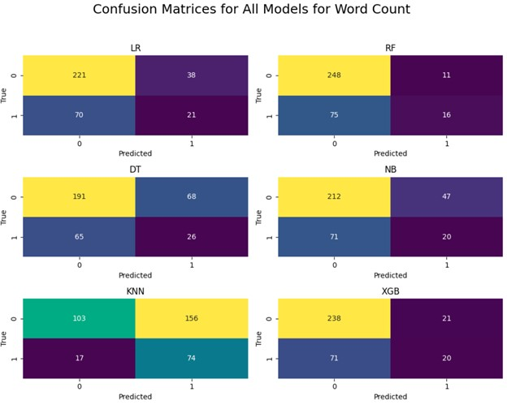
Methodology – Model Training (Transformer Based Models)
Model | Accuracy | Precision | Recall | F1-score
Logistic Regression (LR) | 0.6914 | 0.6545 | 0.6914 | 0.6675
Random Forest (RF) | 0.7543 | 0.7222 | 0.7543 | 0.7012
Decision Tree (DT) | 0.6200 | 0.6240 | 0.6200 | 0.6220
Naïve Bayes (NB) | 0.6629 | 0.6320 | 0.6629 | 0.6447
K-Nearest Neighbors (KNN) | 0.5057 | 0.7188 | 0.5057 | 0.5221
XGBoost (XGB) | 0.7371 | 0.6968 | 0.7371 | 0.6989
To capture deeper semantic and contextual information, two transformer-based models were fine-tuned:
01
BERT (Bidirectional Encoder Representations from Transformers)
02
DistilBERT, a compressed version of BERT designed to reduce computational complexity while maintaining performance
Both models were initialized using pretrained weights and fine-tuned on the complaint dataset using supervised learning.

Slide 14
Methodology - Evaluation Metrics
Evaluation Metrics
01
02
03
04
05
Accuracy
Precision
Recall
F1-score
Confusion matrix
Measures overall correctness of predictions
Measures correctness of predicted positive class
Measure ability to detect all actual positive cases
Harmonic mean of precision and recall
compares predicted labels with true labels to assess classification performance
 | Predicted Positive | Predicted Negative
Actual Positive | TP | FN
Actual Negative | FP | TN

Slide 15
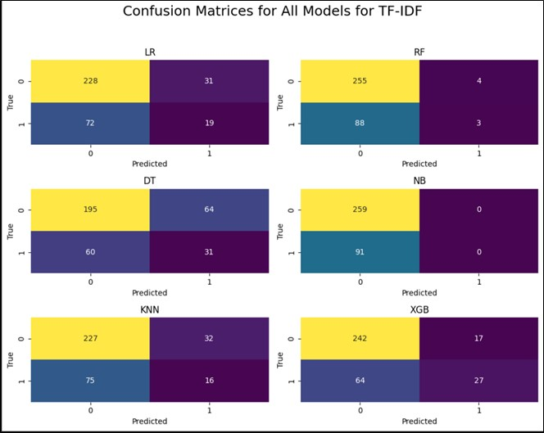
Results - Machine Learning Models Using Word Count
Model | Accuracy | Precision | Recall | F1-score
Logistic Regression (LR) | 0.6914 | 0.6545 | 0.6914 | 0.6675
Random Forest (RF) | 0.7543 | 0.7222 | 0.7543 | 0.7012
Decision Tree (DT) | 0.6200 | 0.6240 | 0.6200 | 0.6220
Naïve Bayes (NB) | 0.6629 | 0.6320 | 0.6629 | 0.6447
K-Nearest Neighbors (KNN) | 0.5057 | 0.7188 | 0.5057 | 0.5221
XGBoost (XGB) | 0.7371 | 0.6968 | 0.7371 | 0.6989

Slide 16
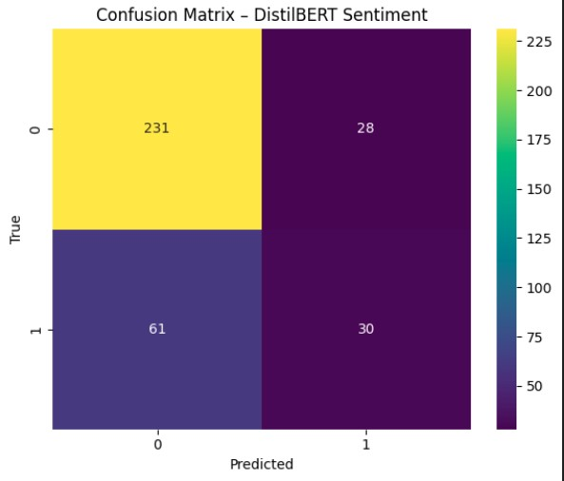
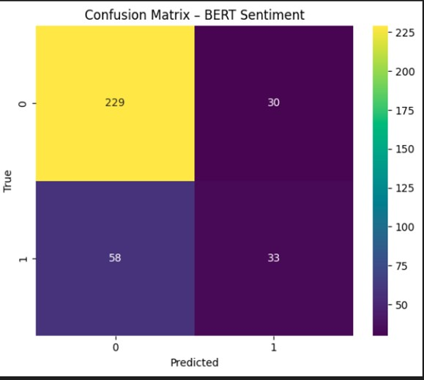
Model | Accuracy | Precision | Recall | F1-score
BERT | 0.7486 | 0.7266 | 0.7486 | 0.7322
DistilBERT | 0.7457 | 0.7199 | 0.7457 | 0.7252
Results - Machine Learning Models Using TF-IDF
Model | Accuracy | Precision | Recall | F1-score
Logistic Regression (LR) | 0.7057 | 0.6612 | 0.7057 | 0.6737
Random Forest (RF) | 0.7371 | 0.6615 | 0.7371 | 0.6428
Decision Tree (DT) | 0.6457 | 0.6507 | 0.6457 | 0.6481
Naïve Bayes (NB) | 0.7400 | 0.5476 | 0.7400 | 0.6294
K-Nearest Neighbors (KNN) | 0.6942 | 0.6428 | 0.6942 | 0.6587
XGBoost (XGB) | 0.7685 | 0.7447 | 0.7685 | 0.7379

Slide 17
Results - Transformer-Based Models
Model | Accuracy | Precision | Recall | F1-score
BERT | 0.7486 | 0.7266 | 0.7486 | 0.7322
DistilBERT | 0.7457 | 0.7199 | 0.7457 | 0.7252
01
TF-IDF features improve the performance of classical machine learning models compared to Word Count
02
XGBoost achieves the best performance among machine learning models.
03
Transformer-based models provide stable and competitive results, particularly in recall and F1-score, demonstrating their effectiveness in capturing contextual sentiment in
customer complaints

Slide 18
Conclusion
The study evaluated multiple machine learning and transformer-based models for customer complaint sentiment classification:
Transformer models achieved noticeable performance improvements over classical approaches:
01
02
03
THANK YOU
1
Transformer-based models provide stable and competitive results, particularly in recall and F1-score, demonstrating their effectiveness in capturing contextual sentiment in
customer complaints
TF-IDF features improve the performance of classical machine learning models compared to Word Count
XGBoost achieves the best performance among machine learning models.

Slide 19
Future Work
Early Sentiment Detection
Real-Time CX Monitoring
Broader Data Coverage
Complaint Severity Prediction
Continuous CX Improvement
Improving transformer models to identify negative customer sentiment early and prevent complaint escalation
Integrating sentiment analysis into live dashboards to support faster, data-driven operational decisions
Expanding data sources to capture more diverse customer feedback and improve service understanding
Extending the model to predict complaint urgency, enabling smarter routing and escalation
Deploying sentiment models to support ongoing service improvement and measurable business outcomes
THANK YOU
1

Slide 20
THANK YOU
1

