Slide 1
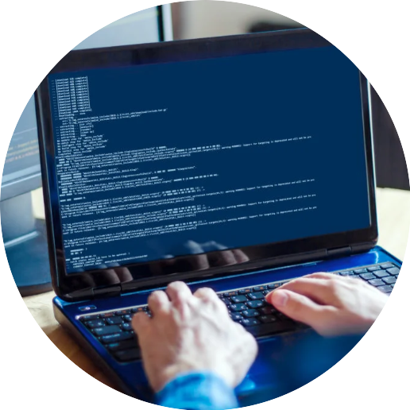


Network
Programming
in Python
Prepared by Dr. Hamada I. AbdulWakel
Lecture 4

Slide 2



Socket Programming
Using Python – Part I
Lecture 4
Prepared by
Dr. Hamada I. AbdulWakel
www.midocean.ae

Slide 3
Lecture
RECAP: LECTURE 3
04
BeautifulSoup and web scraping.
Socket Programming in Python.
www.midocean.ae

Slide 4
Lecture
LECTURE MAIN POINTS
04
The Client/Server Programming.
The Communication Protocols.
TCP and UDP Programming in Python.
www.midocean.ae

Slide 5
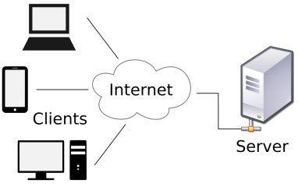
THE CLIENT/SERVER PROGRAMMING MODEL
Lecture
04
Every network application is based on the client-server model.
An application consists of a server process and
one or more client processes.
A server manages some resource, and it provides
some service for its clients by manipulating that
resource.
www.midocean.ae

Slide 6
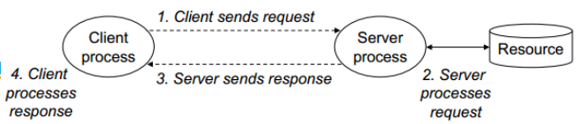
THE CLIENT/SERVER PROGRAMMING MODEL
Lecture
04
Cont'd
www.midocean.ae

Slide 7
THE CLIENT/SERVER PROGRAMMING MODEL
Lecture
04
Cont'd
A client-server transaction consists of four steps.
  When a client needs service, it initiates a transaction by sending a request to the server.
  The server receives the request, interprets it, and manipulates its resources in the appropriate way.
  The server sends a response to the client, and then waits for the next request.
  The client receives the response and manipulates it.
www.midocean.ae

Slide 8
Lecture
04
THE COOMUNICATION PROTOCOLS
Any computer usually has:
  A single physical connection to the network.
  Data could be sent by different applications through the use of ports configured on the same physical network connection.
A computer's address is a 32-bit IP address.
The port number is a 16-bit number ranging from 0 to 65,535, with ports 0-1023 restricted by well-known applications like HTTP and FTP.
www.midocean.ae

Slide 9
Lecture
04
THE COOMUNICATION PROTOCOLS
Cont'd
Every packet of data has:
  Source IP, Source Port, Destination IP, and Destination Port.
  Allow computing devices and applications to send data via a network and verify its delivery.
There are two types of client-server application communication protocol:
  Transmission Control Protocol (TCP).
  User Datagram Protocol (UDP).
www.midocean.ae

Slide 10
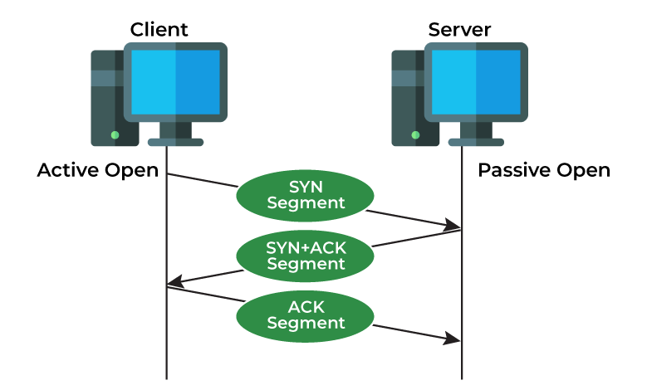
THE TRANSMISSION CONTROL PROTOCOL (TCP)
Lecture
04
A connection-oriented protocol that provides a reliable flow of data between end-to-end connection.
  Three-way handshake. "Wanna connect?" "Sure!" "Alright then!".
www.midocean.ae

Slide 11
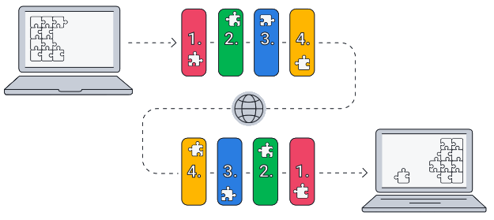
THE TRANSMISSION CONTROL PROTOCOL (TCP)
Lecture
04
Cont'd
www.midocean.ae

Slide 12
THE TRANSMISSION CONTROL PROTOCOL (TCP)
Lecture
04
Cont'd
TCP features:
  Slow overhead time of setting up.
  Retransmission.
    Bigger overhead.
  In-order delivery.
  Congestion control.
    Delays transmission when network is congested.
    Data doesn't always get sent out immediately (i.e., voice chat).
www.midocean.ae

Slide 13
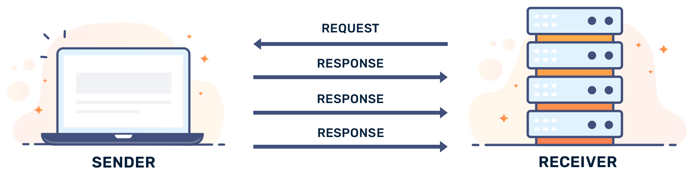
THE USER DATAGRAM PROTOCOL (UDP)
Lecture
04
A Connection-less protocol that sends independent packets of data (datagrams), from one computer to another.
  No connection to create and maintain.
www.midocean.ae

Slide 14
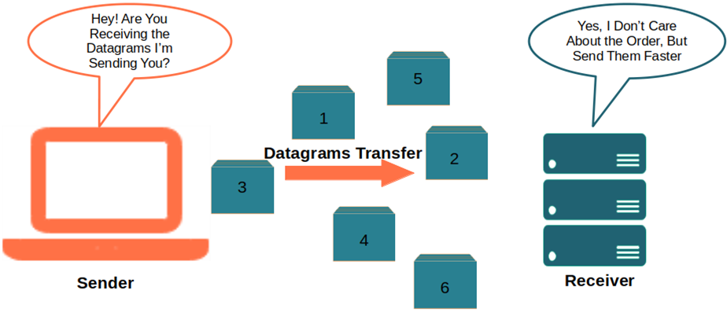
THE USER DATAGRAM PROTOCOL (UDP)
Lecture
04
Cont'd
www.midocean.ae

Slide 15
THE USER DATAGRAM PROTOCOL (UDP)
Lecture
04
Cont'd
UDP features:
  Faster since no overhead of setting up a connection.
  Small packet sizes.
  No compensation for lost packets.
  Packets can arrive out of order.
  No error recovery.
  No congestion control.
www.midocean.ae

Slide 16
THE TCP AND UDP IN SOCKET MODULE
Lecture
04
Both protocols (TCP and UDP) are supported by socket module.
  A socket is a file-like object.
  Allows data to be sent and received across the network like a file.
  But it also includes functions to accept and establish connections.
  Before two machines can establish a connection, both must create a socket object.
www.midocean.ae

Slide 17
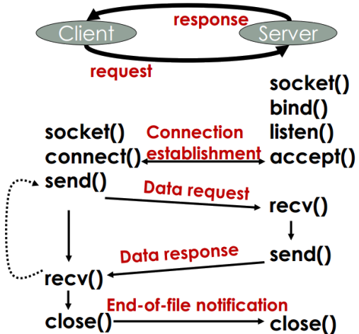
Lecture
04
THE SYSTEM CALLS IN TCP
www.midocean.ae

Slide 18
THE SERVER SOCKET CREATION STEPS
Lecture
04
To create a socket server, follow the following steps:
  Create a socket object.
  Get the current machine name and the port number for connection.
  Bind the socket object with the address.
  Listen for any connections.
  Accept requests from clients.
  Send & receive messages.
  Close the connection.
www.midocean.ae

Slide 19
THE CLIENT SOCKET CREATION STEPS
Lecture
04
To create a socket client, follow the following steps:
  Create a socket object.
  Identify the server machine name (i.e., hostname) and the port number where the client can find the server.
  Connect to the server.
  Send & receive messages.
  Close the connection.
www.midocean.ae

Slide 20
Lecture
04
SOME SOCKET METHODS
gethostname(): returns the host name of the current system under which the Python interpreter is executed.
print( socket.gethostname() )
gethostbyname(): returns the IP address of the host.
print( socket.gethostbyname("www.github.com") )
www.midocean.ae

Slide 21
Lecture
04
SOME SOCKET METHODS
Cont'd
gethostbyaddr(): returns a tuple containing (Host Name, Alias list for the IP address if any, IP address of the host)
ipAddress = "192.0.43.8"
hostName = socket.gethostbyaddr(ipAddress)
print( hostName )
getprotobyname(): takes a protocol string like TCP, UDP, or FTP and returns the associated constant for the protocol as defined by the socket module.
print( socket.getprotobyname("TCP") )
www.midocean.ae

Slide 22
Lecture
04
SOME SOCKET METHODS
Cont'd
getservbyname(): takes a network service name and an underlying protocol name and returns the port number on which the service is defined.
print(socket.getservbyname("https", "tcp"))
getservbyport(): returns the name of the service for a given port number.
print(socket.getservbyport(21, "tcp"))
www.midocean.ae

Slide 23
Lecture
04
SOME SOCKET METHODS
Cont'd
recv(bufsize): receives the TCP message from socket. The argument bufsize stands for buffer size and defines the maximum data.
  You should use the decode() method when receiving data from the socket to convert it to a string.
send(bytes): sends data to the socket which is connected to the remote machine. The argument bytes will give the bytes sent to the socket.
  You should use the encode() method to convert the string to bytes.
www.midocean.ae

Slide 24
A SIMPLE CLIENT/SERVER APPLICATION USING TCP
Lecture
04
Code: 1- the server
import socket
soc = socket.socket()
print("socket created")
soc.bind( (socket.gethostname(), 5485) )
soc.listen()
print("Waiting for connections .....")
www.midocean.ae

Slide 25
A SIMPLE CLIENT/SERVER APPLICATION USING TCP
Lecture
04
Cont'd
Code: 1- the server
while True:
#return client socket and address
clientSoc, clientAddre = soc.accept()
name = clientSoc.recv(1024).decode()
print("Connected with", clientAddre, name)
clientSoc.send(("Welcome we are connected :) " + name).encode())
clientSoc.close()
www.midocean.ae

Slide 26
A SIMPLE CLIENT/SERVER APPLICATION USING TCP
Lecture
04
Cont'd
Code: 2- the client
import socket
soc = socket.socket()
# the address is the same as in the server
soc.connect( (socket.gethostname(), 5485) )
name = input("Enter your name? ")
soc.send(name.encode())
print(soc.recv(1024).decode())
soc.close()
www.midocean.ae

Slide 27
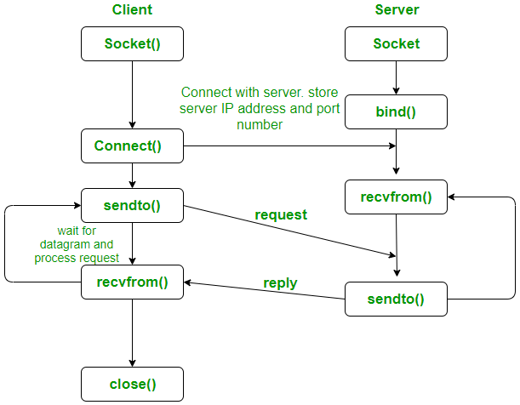
Lecture
04
THE SYSTEM CALLS IN UDP
www.midocean.ae

Slide 28
Lecture
04
SOME SOCKET METHODS
recvfrom(bufsize): receives the maximum data size, bufsize. Two pair (data, address) value is returned by this method.
  Data defines the received data and address specifies the address of socket sending the data..
    You should use the decode() method when receiving data from the socket to convert it to a string.
sendto(message, address): sends message as bytes to the socket specified with the given address.
  You should use the encode() method to convert the string to bytes.
www.midocean.ae

Slide 29
A SIMPLE CLIENT/SERVER APPLICATION USING UDP
Lecture
04
Code: 1- the server
import socket
localIP = "127.0.0.1"
localPort = 20001
UDPsoc = socket.socket(socket.AF_INET, socket.SOCK_DGRAM)
UDPsoc.bind((localIP, localPort))
print("UDP server up and listening")
www.midocean.ae

Slide 30
A SIMPLE CLIENT/SERVER APPLICATION USING UDP
Lecture
04
Cont'd
Code: 1- the server
while True:
bytesAddressPair = UDPServerSocket.recvfrom(1024)
message = bytesAddressPair[0].decode()
address = bytesAddressPair[1]
print("The client IP address:", address)
print("The message from client:", message)
message = message.upper().encode()
UDPsoc.sendto(message, address)
www.midocean.ae

Slide 31
A SIMPLE CLIENT/SERVER APPLICATION USING UDP
Lecture
04
Cont'd
Code: 2- the client
serverAddress = ("127.0.0.1", 20001)
UDPclt = socket.socket(socket.AF_INET, socket.SOCK_DGRAM)
while True:
data = input("Enter a word: ")
data = data.encode()
UDPclt.sendto(data, serverAddress)
msgFromServer = UDPclt.recvfrom(1024)
msg = "Message from Server"+ msgFromServer[0].decode()
print(msg)
www.midocean.ae

Slide 32
Lecture
04
QUESTIONS FOR ONLINE DISCUSSION
Write a program to create a client/server application that pretends to be a calculator. It begins by asking the client about his name and age, then ask him to enter two numbers and the operation he want to perform. The server should calculate the result of the required operation and send it to the client.
Write a program to create a UDP client/server program that calculate and send the factorial (n!) of a given number send by a client.
www.midocean.ae

Slide 33


Thank You

