Slide 1


English Course- Advanced Level
Prepared by
Ahmed Soliman

Slide 2



Lecture 5
www.midocean.ae

Slide 3
Lecture Outline:
Listening: THE FOUR SEASONS
Grammar: Types of Sentences
Reading: Ibn Battuta (Revision)
Speaking: Describe a recent travel experience.
www.midocean.ae

Slide 4
Listening
(THE FOUR SEASONS)
www.midocean.ae

Slide 5
Vocabulary and Sample Sentences
occasionally (adverb): from time to time, now and then, once in a while
– We occasionally go on picnics during the spring and summer seasons.
sledding (noun): the activity or sport of riding on a sled, usually in snow
– I took the kids sledding yesterday down a real fun hill, and we had a great time.
hover (verb): remain somewhat steady
– You should be prepared from cold weather this weekend because temperatures will hover around freezing.
stroll (verb): take a leisurely walk
– During the early spring, you often see couples strolling through the park.
soar (verb): rise quickly
– The weather forecast predicts that temperatures will soar into the 100s by the middle of the week.
humidity (noun): wetness in the air
– Because I live in a dry climate, I’m not used to the humidity when I travel.
www.midocean.ae

Slide 6
Listen to the recording and answer the questions.
https://www.esl-lab.com/academic-english/four-seasons/
1- This presentation seems to be ______.
an informal discussion between friends
a TV debate
an academic speech at school
2- How does the man describe the winter season?
January receives about 30 inches in snow.
Some winter activities are sledding and skiing.
Winter temperatures hover below freezing.
www.midocean.ae

Slide 7
3- In spring, people enjoy ______.
hiking in the mountains
fishing in the park
flying kites
4- What is the summer season like in this area?
not mentioned
mild and breezy
warm and humid
www.midocean.ae

Slide 8
5-People often ______ in the fall.
go and see the fall colors
clean their houses
have a fall picnic
www.midocean.ae

Slide 9
Listening Script
Hello everyone. Have you ever wondered what the weather is like in other places around the world? Today, I’d like to talk to you about the changing seasons in my city which was the assigned topic for this class.
First of all, the winter season usually begins in December and ends in early March. The coldest month is January, and the temperatures can drop below freezing for most of this month. The city usually averages about 30 inches of snow during this entire, 3-month period. Occasionally, we have snow storms that can drop a foot of snow in a very short period of time. Winter activities during this season include sledding, skiing, and snowshoeing.
Spring usually arrives in late March, and the temperatures hover around 50 degrees during the day. It is a beautiful season because the flowers start to bloom. It is also sometimes windy, and this is great for flying kites. People in my city often like to go on picnics, stroll through the parks, and play outdoor games.
www.midocean.ae

Slide 10
Next, summer starts in June, as temperatures slowly rise to around 80 degrees. The summer in my city is very dry with little rain throughout the season, and temperatures can soar above 100 degrees in August. Fortunately, the weather is very dry with low humidity, so it is pleasant even on hot days. Popular activities during this season include hiking, fishing, camping, water skiing, and outdoor sports including football and soccer.
And finally, summer changes to fall in late September when the weather cools off, and the trees begin to change colors. A lot of people enjoy driving into the mountains and viewing the fall colors. It is also a time when people clean up their yards and gardens in preparation for the winter season.
So, as you can see, my city has a lot to offer no matter when you visit this area.
www.midocean.ae

Slide 11
Grammar
Clauses
www.midocean.ae

Slide 12
What is a clause
A group of words which includes a subject and a verb.
www.midocean.ae

Slide 13
All cars stop when they see a red flag.
This sentence has two clauses:
(1) "All cars stop“
independent clause
(2) "when they see a red flag“
dependent clause.
www.midocean.ae

Slide 14
Clauses vs Phrases
A clause contrasts with a phrase, which does not contain a subject and a verb.
Anna sings... | when she wakes up. This is a clause. It has a subject ("she") and a verb ("wakes up").
 | in the morning. This is a phrase. There is no subject and no verb.
www.midocean.ae

Slide 15
Grammar
Types of Sentences
www.midocean.ae

Slide 16
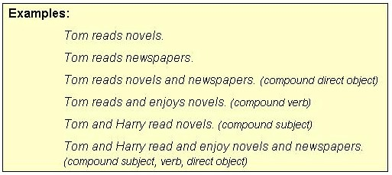
1- A SIMPLE SENTENCE has one independent clause.
www.midocean.ae

Slide 17
Punctuation note: NO commas separate two compound elements (subject, verb, direct object, indirect object, subjective complement, etc.) in a simple sentence.
www.midocean.ae

Slide 18
2. A COMPOUND SENTENCE has two independent clauses joined by
A. a coordinating conjunction (for, and, nor, but, or, yet, so),
B. a conjunctive adverb (e.g. however, therefore), or
C. a semicolon alone.
www.midocean.ae

Slide 19
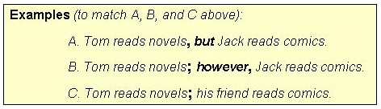
www.midocean.ae

Slide 20
Punctuation patterns (to match A, B, and C above):
A. Independent clause, coordinating conjunction independent clause.
B. Independent clause; conjunctive adverb, independent clause.
C. Independent clause; independent clause.
www.midocean.ae

Slide 21
3. A COMPLEX SENTENCE has one dependent clause (headed by a subordinating conjunction or a relative pronoun ) joined to an independent clause.
www.midocean.ae

Slide 22
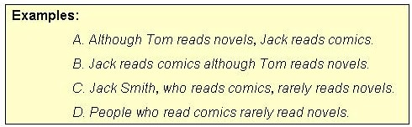
www.midocean.ae

Slide 23
4. A COMPOUND-COMPLEX SENTENCE has two independent clauses joined to one or more dependent clauses.
www.midocean.ae

Slide 24
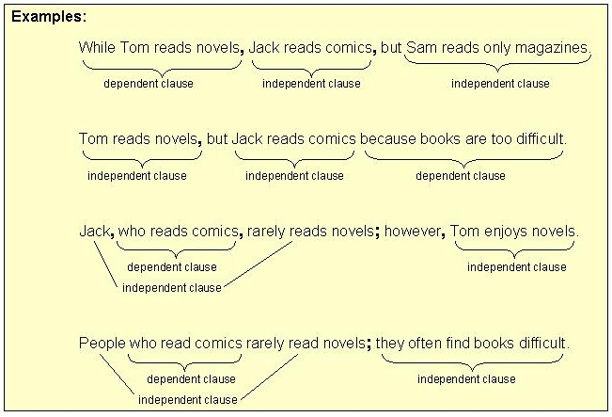
www.midocean.ae

Slide 25
Reading
(Ibn Battuta)
www.midocean.ae

Slide 26
Read the following passage, and then choose the best answer
1. Abu Abdullah Muhammad Ibn Battuta, was a Moroccan Muslim scholar and traveler. He is known for his traveling and going on tours called the Rihla. His journeys lasted for a period of almost thirty years. This covered nearly the whole of the known Islamic world and beyond, extending from North Africa, West Africa, Southern Europe and Eastern Europe in the West, to the Middle East, Indian subcontinent, Central Asia, Southeast Asia and China in the East, a distance readily surpassing that of his predecessors. After his travel, he returned to Morocco and gave his account of the experience to Ibn Juzay.
2. Ibn Battuta, was born in Tangier, Morocco, on the 24th of February 1304 C.E. (703 Hijra). He was commonly known as Shams ad-Din. His family was of Berber origin and had a tradition of service as judges. After receiving an education in Islamic law, he
www.midocean.ae

Slide 27
chose to travel. He left his house in June 1325, and set off from his hometown on a hajj (pilgrimage) to Mecca, a journey that took him 16 months. He did not come back to Morocco for at least 24 years after that. His journey was mostly by land. To reduce the risk of being attacked, he usually chose to join a caravan. In the town of Sfax, he got married.
3. He first began his voyage by exploring the lands of the Middle East. Thereafter he sailed down the Red Sea to Mecca. He crossed the huge Arabian Desert and traveled to Iraq and Iran. In 1330, he set off again, down the Red Sea to Aden and then to Tanzania. Then in 1332, Ibn Battuta decided to go to India. He was greeted open heartedly by the Sultan of Delhi. There he was given the job of a judge. He stayed in India for a period of 8 years and then left for China.
www.midocean.ae

Slide 28
Ibn Battuta left for another adventure in 1352. He then went south, crossed the Sahara desert, and visited the African kingdom of Mali. Finally, he returned home at Tangier in 1355
4. After the completion of the Rihla in 1355, little is known about Ibn Battuta’s life. He was appointed a judge in Morocco and died in 1368.
www.midocean.ae

Slide 29
The main idea of paragraph 1 is-----------------
a. Ibn Battuta was Moroccan Muslim.
b. Talking mainly about the places Ibn Battuta traveled to
c. How Ibn Battuta returned to Morocco
d. Ibn Battuta's education
2. Ibn Battuta was ---------------years old when he set off from his hometown on a hajj (pilgrimage) to Mecca.
a. 21
b. 20
c. 30
d. 42
www.midocean.ae

Slide 30
3. . Ibn Battuta's family were famous for their services as ------------------------
a. travelers
b. judges
c. kings
d. traders
4. How old was Ibn Battuta when he died?
a. 60 years
b. 51 years
c. 35 years
d. 64 years
www.midocean.ae

Slide 31
5. Where did Ibn Battuta work as a judge?
a. In China and Mecca
b. In India and Morocco
c. In India and China
d. In Mecca and Morocco
6. The underlined pronoun He in paragraph 3 refers to---------------
a. Ibn Battuta
b. Sultan of India
c. King of Mali
d. Sultan of China
www.midocean.ae

Slide 32
Speaking
(Describe a recent travel experience)
www.midocean.ae

Slide 33
Describe a recent travel experience.
You should say:
Where did you go?
Who did you travel with?
What did you do there?
What did you enjoy the most about the trip?
www.midocean.ae

Slide 34




Thank You

