Slide 1


Human Resources Management
Robert L. Mathis ⏐ John H. Jackson
Prepared by Dr. Samah Abdelfatah
MGM 243
Lecture 01

Slide 2



Changing Nature of Human
Resource Management
Chapter
01
Lecture 01
MGM 243
Prepared by
Dr. Samah Abdelfatah

Slide 3

Chapter
Learning Objectives
01
After you read this chapter, you should be able to:
Define human capital and explain its strategic importance in modern organizations.
Identify and describe the seven categories of HR activities.
Describe how the major roles of HR management are being transformed by technology and strategic imperatives.
Discuss four contemporary challenges facing HR today, including AI disruption and workforce diversity.
Identify the purposes and uses of HR technology, including AI-powered HRMS platforms.
Discuss why ethical issues that affect HR management.
Explain the key competencies needed by HR professionals in the digital age.

Slide 4
Chapter
Nature of Human Resource Management
01
All these assets are crucial in varying degrees in different organizations. But the human assets are the “glue” that holds all the other assets together and guides their use to achieve results
Human Resource Management
The design of formal systems in an organization to ensure effective and efficient use of human talent to accomplish organizational goals.
This definition extends to encompass a strategic, data-driven, and human-centric orientation.
Recently, HR's fundamental purpose has shifted from administrative efficiency toward creating sustainable competitive advantage through people.

Slide 5
Chapter
Who is an HR Manager?
01
All these assets are crucial in varying degrees in different organizations. But the human assets are the “glue” that holds all the other assets together and guides their use to achieve results
All managers at every level must concern themselves with HR management.
HR specialists design processes that operating managers help implement.
The rise of self-service HR technologies and AI-enabled advisory tools has redistributed many traditional HR tasks directly to employees and managers, freeing HR professionals to focus on higher-value strategic work.

Slide 6
Chapter
Human Capital in Organizations
01
All these assets are crucial in varying degrees in different organizations. But the human assets are the “glue” that holds all the other assets together and guides their use to achieve results
Organizations must manage four types of assets: Physical (buildings, equipment), Financial (cash, securities), Intangible (patents, information systems), and Human (individuals with talents, capabilities, expertise, and relationships).
Human assets are the "glue" that holds all other assets together and guides their use toward results.
In the knowledge economy of the 2020s, human capital has become the primary source of sustainable value creation, particularly as physical and financial assets grow increasingly commoditized.

Slide 7
Chapter
Human Capital and HR
01
For example, f rms with high intellectual capital may have technical and research employees who create new biomedical devices, formulate pharmaceuticals that can be patented, and develop new software for specialized uses. All these organizational contributions illustrate the potential value of human capital
What is the difference between HR & HC?
Human Resources (HR) refers to the people themselves — the employees an organization hires and employs.
Human Capital(HC)refers to the collective value of the capabilities, knowledge, skills, life experiences, and motivation of an organizational workforce — sometimes called intellectual capital to reflect the thinking, creativity, and decision-making people contribute. For example, a researcher who formulates a patentable pharmaceutical compound or a software engineer who builds a platform used by millions illustrates the enormous potential value embedded in human capital.

Slide 8


Chapter
Human Resources As A Core Competency
01
For example, f rms with high intellectual capital may have technical and research employees who create new biomedical devices, formulate pharmaceuticals that can be patented, and develop new software for specialized uses. All these organizational contributions illustrate the potential value of human capital
A core competency is A unique and difficult-to-imitate organizational capability that creates exceptional value and differentiates the firm from competitors
Google (renowned for its engineering culture and data-driven talent management) and IKEA (celebrated for its values-driven employment model) demonstrate that how a firm manages human capital can be as strategically significant as what it offers.

Slide 9
Chapter
HR Activities
01
HR management can be thought of as seven interlinked activities taking place within organizations, as depicted in Figure 1-1.
Strategic HR Management
Equal Employment Opportunity
Staffing
Talent Management and Development
Total Rewards
Risk Management and Worker Protection
Employee and Labor Relations

Slide 10
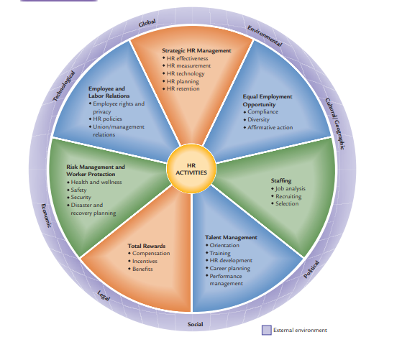
HR Management Activities
Figure 1-1

Slide 11
HR Management Roles
Administrative
Role
Operational and Employee Advocate Role for HR
Strategic Role for HR
Focusing on HR clerical administration and recordkeeping
Managing most HR activities in keeping with the strategy that has been identified by management and serving as employee “champion”
Helping to define the strategy relative to human capital and its contributing to organizational results
Figure1-2

Slide 12
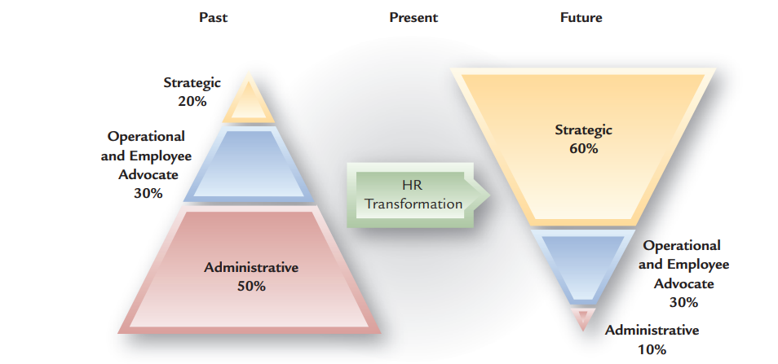
Changing Roles of HR Management
Figure 1-3

Slide 13
Chapter
Administrative Role
01
Two major shifts driving the transformation of the administrative role : are greater use of technology and outsourcing.
Technology Transforming HR Cloud-based HRMS platforms have dramatically reduced time and cost of routine administrative tasks. By 2025, AI-powered chatbots handle significant proportions of employee queries, automated workflows process leave requests, and robotic process automation (RPA) executes high-volume transactions with near-zero error rates .
Outsourcing of HR Increasingly, many HR administrative functions are being outsourced to vendors. Outsourcing of HR administrative activities has grown dramatically with the value of outsourcing contracts tripling recently, and there are projections of large increases occurring over the next several years.

Slide 14
Chapter
Operational And Employee Advocate Role for HR
01
Operational Role
  Identification and implementation of HR programs and policies—EEO, hiring, training, and other activities that support the organization.
Advocate Role
“Champion” for employee concerns
    Employee crisis management
    Responding to employee complaints
    protecting employee mental health in hybrid work environments,
    advocating for fair treatment in AI-assisted HR decisions,
    managing the evolving psychological contract — the set of implicit expectations between employer and employee — which shifted significantly following the COVID-19 pandemic.

Slide 15
Chapter
Strategic Role for HR
01
HR becomes a strategic business partner by:
  Focusing on developing HR programs that enhance organizational performance .
  Involving HR in strategic planning at the onset.
  Participating in decision making on mergers, acquisitions, and downsizing.
  Redesigning organizations and work processes
  Accounting and documenting the financial results of HR activities.

Slide 16
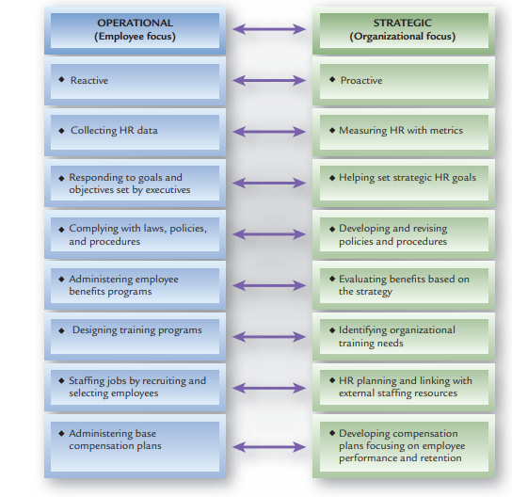
Operational to Strategic Transformation of HR
Figure 1-4

Slide 17
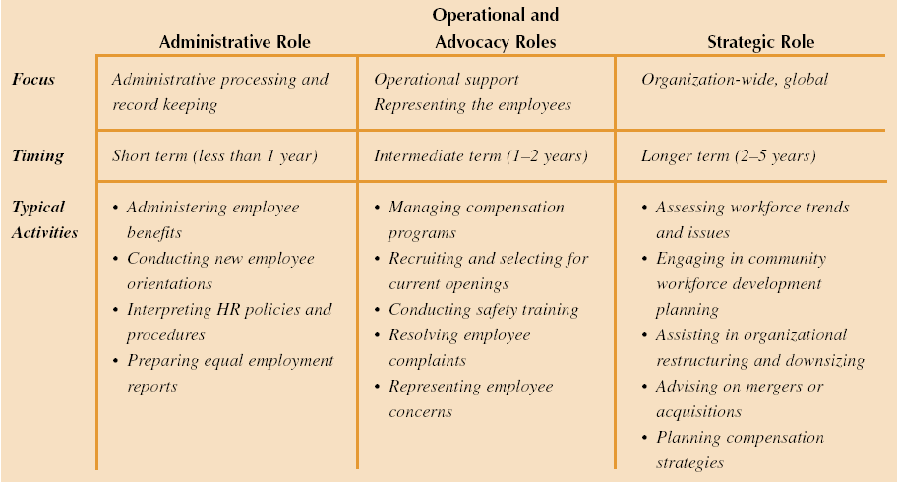
Overview of HR Management Roles
Figure 1-5

Slide 18
Chapter
HR Management Challenges
01
Globalization of Business
Economic and Technological Changes
Workforce Demographics and Diversity
Organizational Cost Pressures and Restructuring
Figure 1-6

Slide 19
Chapter
Globalization oF Business
01
Off-shoring U.S. businesses contracting out activities to unaffi liated companies or their affi liates in another country.
Business globalization has shifted from trade and investment to the integration of global operations, management, and strategic alliances. This produces off-shoring (contracting to foreign affiliates), in-shoring (foreign firms shifting activities to the home country), and outsourcing (contracting to unaffiliated companies at home or abroad).
Geopolitical realignments have prompted multinationals to pursue "friendshoring" — relocating operations to geopolitically allied nations. This creates new HR challenges around managing culturally diverse, geographically dispersed teams while maintaining consistent organizational culture and navigating multi-jurisdictional compliance

Slide 20
Chapter
Economic and Technological Changes
01
Off-shoring U.S. businesses contracting out activities to unaffi liated companies or their affi liates in another country.
Occupational Shifts: Employment continues migrating from manufacturing and agriculture toward service, technology, and knowledge work. Generative AI is disrupting this further by automating cognitive tasks previously considered immune to automation.
Workforce Availability and Quality Concerns Many parts of the world face significant workforce shortages that exist due to an inadequate supply of workers with the skills needed to perform the jobs being added. Significant shortages persist in healthcare, technology, skilled trades, and renewable energy

Slide 21
Economic and Technological Changes(cont.)
Growth in Contingent Workforce Contingent workers (temporary workers, independent contractors, leased employees, and part-timers). caused by:
    Need for flexibility in staffing levels
    Increased difficulty in firing regular employees.
    younger workers' preference for non-traditional employment.
    Reduced legal liability from contract employees.
Technological Shifts and AI: The World Economic Forum's Future of Jobs Report 2023 estimates approximately 85 million jobs may be displaced by automation by 2025, while 97 million new roles may emerge requiring new competencies. HR's role in managing this transition — through reskilling, upskilling, and workforce redesign — is paramount.

Slide 22
Chapter
Jobs of The Future
01
As part of organizational changes, many organizations have “rightsized” by: (1) eliminating layers of managers, (2) closing facilities, (3) merging with other organizations, and (4) outplacing workers. To improve productivity, quality, and service while also reducing costs, they are redesigning jobs and affecting people.
Roles projected to see strong growth include:
AI and machine learning specialists,
Cybersecurity experts,
Data scientists and analysts,
Healthcare professionals,
Renewable energy technicians,
Agricultural innovators,
Software developers,
And HR analytics specialists.

Slide 23
Chapter
Workforce Demographics and Diversity
01
Racial/Ethnic Diversity: Minorities account for a growing labor force percentage, necessitating more inclusive HR practices and equitable opportunity structures.
Balancing Work and Family: Flexible work models — hybrid, remote, compressed schedules — have become critical for talent attraction and retention. This includes managing dual-career couples, single-parent households, and working caregivers.
Aging Workforce: Dual challenges arise from retaining older workers' institutional knowledge while attracting younger talent with fundamentally different expectations regarding technology, purpose, and flexibility.

Slide 24
Chapter
Organizational Cost Pressures and Restructuring
01
As part of organizational changes, many organizations have “rightsized” by: (1) eliminating layers of managers, (2) closing facilities, (3) merging with other organizations, and (4) outplacing workers. To improve productivity, quality, and service while also reducing costs, they are redesigning jobs and affecting people.
An overriding theme facing managers and organizations is to operate in a “cost-less” mode, which means continually looking for ways to reduce costs of all types— financial, operations, equipment, and labor.
As part of organizational changes, many organizations have “rightsized” by:
(1) eliminating layers of managers,
(2) closing facilities,
(3) merging with other organizations, and
(4) outplacing workers.

Slide 25
Organizational Cost Pressures and Restructuring (Cont.)
  HR managers must work toward ensuring cultural compatibility in mergers.
  The widespread technology-sector layoffs of 2022–2024 demonstrated the reputational risks of poorly managed restructuring. Organizations that invested in transparent communication, generous severance, and redeployment support maintained stronger employer brand equity and workforce resilience

Slide 26

Chapter
HR Technology
01
As part of organizational changes, many organizations have “rightsized” by: (1) eliminating layers of managers, (2) closing facilities, (3) merging with other organizations, and (4) outplacing workers. To improve productivity, quality, and service while also reducing costs, they are redesigning jobs and affecting people.
Human Resource Management Systems (HRMS)
An HRMS is an integrated system providing information used by HR management in decision-making.
Contemporary platforms now incorporate:
Natural Language Processing (NLP) for automated candidate screening and chatbot-based employee support.
Predictive analytics for turnover risk identification and workforce demand forecasting.
Machine learning for compensation benchmarking and pay equity analysis.
Sentiment analysis tools that continuously monitor employee engagement signals.

Slide 27
Chapter
Purposes Of an HRMs
01
As part of organizational changes, many organizations have “rightsized” by: (1) eliminating layers of managers, (2) closing facilities, (3) merging with other organizations, and (4) outplacing workers. To improve productivity, quality, and service while also reducing costs, they are redesigning jobs and affecting people.
Administrative Efficiency: Improving the speed and accuracy with which employee data and HR activities are compiled, reducing paperwork and minimizing error.
Strategic Planning and Decision Support: Enabling HR planning to be grounded in data rather than managerial intuition. Real-time workforce analytics allow organizations to identify talent gaps, model workforce scenarios, and evaluate HR investment ROI.
People Analytics: Google's People Operations team pioneered the use of people analytics to identify attributes of effective managers, transforming its leadership development program. This evidence-based approach to HR decision-making is now a global best practice.

Slide 28
Chapter
Ethics and HR Management
01
What is Ethical Behavior?
  What “ought” to be done.
  Organizations that are seen as operating with integrity are viewed more positively by individuals in the community and industry, as well as by consumers and employees.
  Examples for Unethical Practices(Enron, WorldCom, Tyco, numerous financial and investment firms, and other organizations).

Slide 29
Chapter
Ethics and Global Differences
01
    Differences in legal, political, and cultural values and practices in different countries often raise ethical issues for global employers. Those employers also must comply with their home-country laws.
    Algorithmic Accountability: When an AI system denies a candidate an interview or flags an employee for termination, the question of who is legally and ethically responsible — the algorithm, the vendor, or the HR professional who deployed it — remains unresolved in many jurisdictions. This represents a new frontier of HR ethical responsibility.

Slide 30
Ethical Behavior and Organizational Culture
Organizational culture The shared values and beliefs in an organization.
Basically, organizational culture is “how things are done here.”
HR plays a key role in ensuring ethical behavior in organizations.

Slide 31
Ethical Behavior and Organizational Culture (Cont’d)
When the following four elements of ethics programs exist, ethical behavior is likely to occur:
A written code of ethics and standards of conduct
Training on ethical behavior for all executives, managers, and employees
Means for employees to obtain advice on ethical situations they face, often provided by HR
Systems for confidential reporting of ethical misconduct or questionable behavior

Slide 32
Chapter
HR’s Role in Organizational Ethics
01
Responding to Ethical Situations
  Guided by values and personal behavior “codes” that include:
    Does response meet all applicable laws, regulations, and government codes?
    Does response comply with all organizational standards of ethical behavior?
    Does response pass the test of professional standards for ethical behavior?

Slide 33
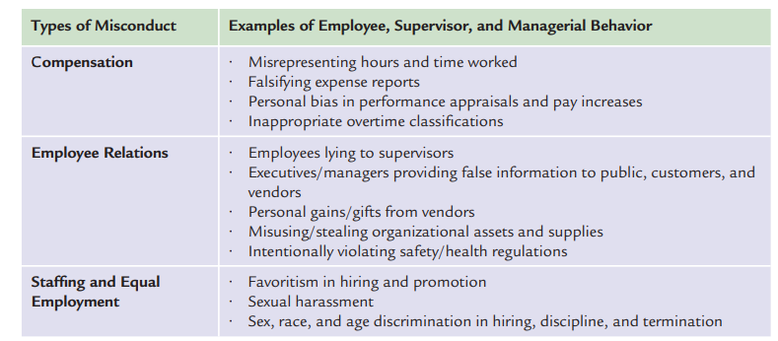
Examples of Ethical Misconduct in HR Activities
Figure 1-7

Slide 34
Chapter
HR Management Competencies and Careers
01
The five areas of HR competencies are described briefly as follows
Strategic contribution: key competency that HR needs to fulfill its strategic role
Business knowledge: They must understand the financial, technological, and other facets of the industry and the organization.

Slide 35
Chapter
HR Management Competencies and Careers (Cont)
01
HR delivery: HR activities must be delivered effectively and efficiently
in ways that meet the needs of both the organization and its employees.
HR technology: information systems and Web based resources, have become a significant part of HR management today.
Personal credibility: HR professionals must have credibility personally and professionally manage internal and external relationships

Slide 36
Chapter
HR Management as a Career Field
01
HR Generalist
  A person with responsibility for performing a variety of HR activities.
HR Specialist
  A person with in-depth knowledge and expertise in a limited area of HR.

Slide 37
Chapter
HR Professionalism and Certification
01
Professional Involvement and Development The most well-known certification programs for HR generalists are administered by the Human Resource Certification Institute (HRCI), which is affiliated with Society for Human Resource Management (SHRM)
PHR/SPHR Certification The most widely known HR certifications are the Professional in Human Resources (PHR) and the Senior Professional in Human Resources (SPHR), both sponsored by HRCI.

Slide 38
Chapter
SUMMARY
01
Human Capital
HR Activities
HR Roles
HR Challenges
HR Technology
HR Ethics
Professional HR

Slide 39
Chapter
REFERENCES
01
Cappelli, P., & Nehmeh, R. (2024). HR's new role. Harvard Business Review, 102(1), 64–73.
Deloitte. (2024). Global Human Capital Trends 2024: Thriving beyond boundaries. Deloitte Insights.
Mathis, R. L., & Jackson, J. H. (2011). Human resource management (13th ed.). South-Western Cengage Learning.
Mercer. (2024). Global Talent Trends 2024–2025: The rise of the relatable organization. Mercer.
Prahalad, C. K., & Hamel, G. (1990). The core competence of the corporation. Harvard Business Review, 68(3), 79–91.
SAP SuccessFactors. (2025). HR trends shaping the future of work 2025. SAP.
SHRM. (2024). HR trends and predictions: People strategy in the age of AI. Society for Human Resource Management.
Ulrich, D., Kryscynski, D., Ulrich, M., & Brockbank, W. (2021). Victory through organization: Why the war for talent is failing your company and what you can do about it. McGraw-Hill Education.
World Economic Forum. (2023). The future of jobs report 2023. WEF.

Slide 40


Thank You

