Slide 1

Project Risk &Supply Chain Risk
Prepared by Dr. Dalia Hosni
Lecture 9
PMG 663
Project Risk &Supply Chain Risk

Slide 2

Logistics Management
Chapter
08
Integrates all materials functions
  Purchasing
  Inventory management
  Production control
  Inbound traffic
  Warehousing and stores
  Incoming quality control
Objective: Efficient, low cost operations
Notes:
In addition to framing the materials management function, this slide raises the issue of “how does one begin assigning responsibilities for each of the facets of supply-chain management?”

Slide 3
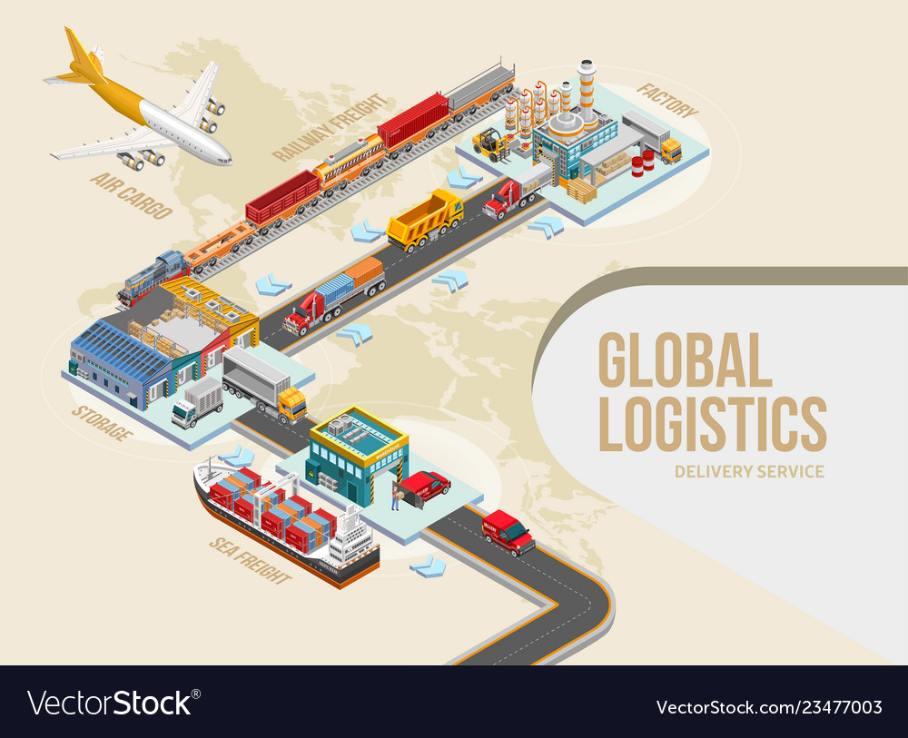
Goods Movement Options
Chapter
09
Trucking
Railways
Airfreight
Waterways
Pipelines
Notes:
Here you might simply discuss some of the options available under each of the categories listed.

Slide 4
Transportation
Chapter
09
Air
Truck
Rail
Ship
Pipeline
Electronic

Slide 5
Facilities
Chapter
09
Production
  Flexible vs. Dedicated
  Flexibility costs
    Production: Remember BMW: “a sports car disguised as a sedan”
    Service: Can your instructor teach music as well as SCM?
    Sports: A playmaker who shoots well is rare.
Inventory-like operations: Receiving, Prepackaging, Storing, Picking, Packaging, Sorting, Accumulating, Shipping
  Job Lot Storage: Need more space. Reticle storage in fabs.

Slide 6
Information
Chapter
09
Role in the supply chain
  The connection between the various stages in the supply chain
  Crucial to daily operation of each stage in a supply chain
    E.g., production scheduling, inventory levels
Role in the competitive strategy
  Allows supply chain to become more efficient and more responsive at the same time (reduces the need for a trade-off)
  Information technology
    Andersen Windows
      Wood window manufacturer, whose customers can choose from a library of 50,000 designs or create their own. Customer orders automatically sent to the factory.

Slide 7
Characteristics of the Good Information
Chapter
09
Strategy
Analytical Models
$$$
Information
Accurate?
Accessible?
Up-to-date?
In the Correct form?
    If not, database restricted ability. How difficult is it to import data into SAP?

Slide 8
Quality of Information
Chapter
09
Information drives the decisions:
  Good information means good decisions
IT helps: MRP, ERP, SAP, EDI
Relevant information?
How to use information?

Slide 9
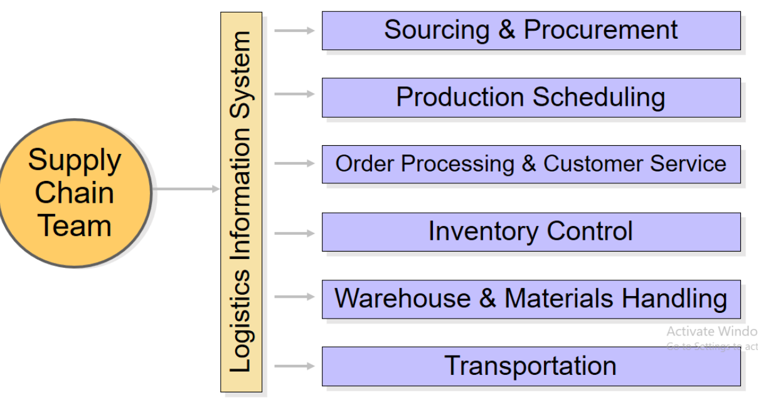
Chapter
09
Integrated Logistical Components of the Supply Chain

Slide 10

Chapter
09
Logistics activities or Functions of Logistics
1- Order processing
The Logistics activities start from the order processing which might be the work of the commercial department in an organization. The commercial department is the one who ensures that the payment terms and the delivery terms have been met and then processes the order from within the company.

Slide 11
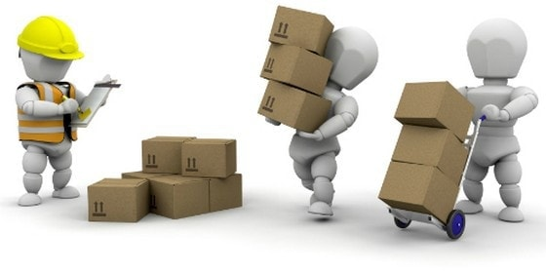
Chapter
09
Logistics activities or Functions of Logistics
2) Materials handling
Material handling is the movement of goods within the warehouse. It involves handling the material in such a way that the warehouse is able to process orders efficiently. Although it may sound a mundane task, it is an important one and an ongoing activity in any warehouse.

Slide 12
Chapter
09
Logistics activities or Functions of Logistics
3) Warehousing :If we take the example of LG or Samsung, these are consumer durable companies which are present in multiple countries. Their manufacturing might be at one point, but the distribution is all across the world. Thus, warehousing plays a huge role and is one of the important Logistics activities.
The important point in warehousing is that the warehouse should be nearby to the dealer or the distributors’ place and it should facilitate the easy delivery of goods. If there was a product which was from a branded company, but which takes 1 week to deliver, then this product might not move as much in the market as another product which is taking 2 days to deliver even though it is unbranded.

Slide 13
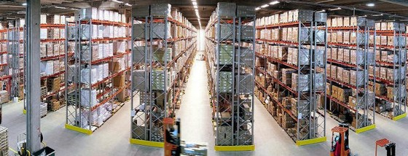
Chapter
09
Logistics activities or Functions of Logistics
The location of warehouses also reduces the pressure on mother warehouse (large warehouses which stock most of the products). When there is a peak in demand or if there is a drop in production, these warehouses can take the pressure of deliveries and they can become interdependent to ensure delivery of goods to consumers.

Slide 14
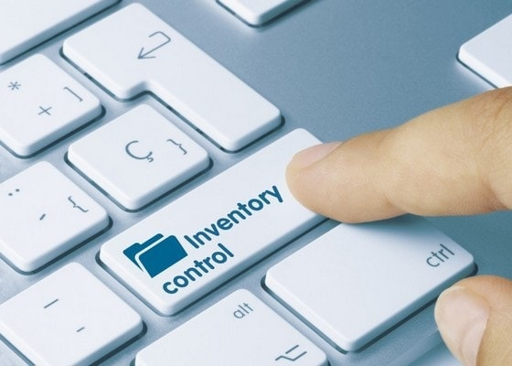
Chapter
09
Logistics activities or Functions of Logistics
Inventory control
If a firm has 100 units of a product in stock, but the demand is only of 10 units, then the company has uselessly invested in 90 units. This is money which can be used as a working capital and it is money on which banks are applying interest.

Slide 15
Chapter
09
Logistics activities or Functions of Logistics
On the other hand, another firm had a demand of 500 units, but they have manufactured only 200 units thinking that demand will be less. Now they have lost the orders which is an opportunity cost. The perfect firm will be one, which has manufactured 100 units, knows there will be 50 units of demand and is ready even if demand doubles. But they are continuously monitoring the demand and are ready for it without investing much in manufacturing.
With the above example, you understood the importance of Inventory control in Logistics activities. Inventory management is one of the most important functions of logistics especially after the adoption of various production techniques such as Just in time manufacturing, lean manufacturing or other manufacturing processes where the cost of inventory management is brought down.

Slide 16
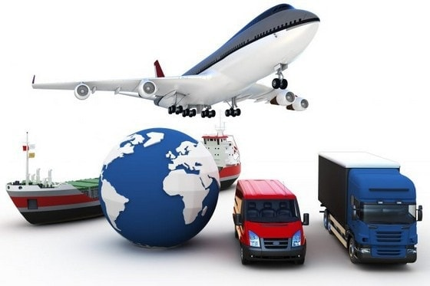
Chapter
09
Logistics activities or Functions of Logistics
5- Transportation
Now we come to one of the major logistics activities which is one of the most resources heavy and revenue heavy segment of logistics. There is a single reason that transportation is costly – Fuel. Be it petrol, Diesel or gas, fuel is costly, and it is mostly consumed in transportation activities.

Slide 17
Chapter
09
Logistics activities or Functions of Logistics
Transportation involves the physical delivery of goods from the company to the distributor or dealer and from the dealer to the end customer. Generally, companies are involved only till the point delivery happens to the distributor or the dealer. The distributor is then responsible for the delivery to the end customer. However, transportation is a cost to the dealer as well and reduces his profit – due to which the company has to give higher profits to the dealer – to negate his costs.
The better the warehousing and the inventory management of a company, the lower is the transportation cost for the company.

Slide 18

Chapter
09
Logistics activities or Functions of Logistics
6) Packaging : There are two types of packaging – One which the customer sees on the shelf of supermarkets or hypermarkets where the package appears attractive and makes the customer buy the packages. The other is transport packaging where the products are packed in bulk so as to avoid any breakage or spillage and yet allow them to transfer huge volumes of the product safely from one place to another.

Slide 19
Chapter
09
Logistics activities or Functions of Logistics
Packaging the product is a responsibility of the logistics team because otherwise the product will reach damaged to the end customer and this is a huge cost to the company.

Slide 20
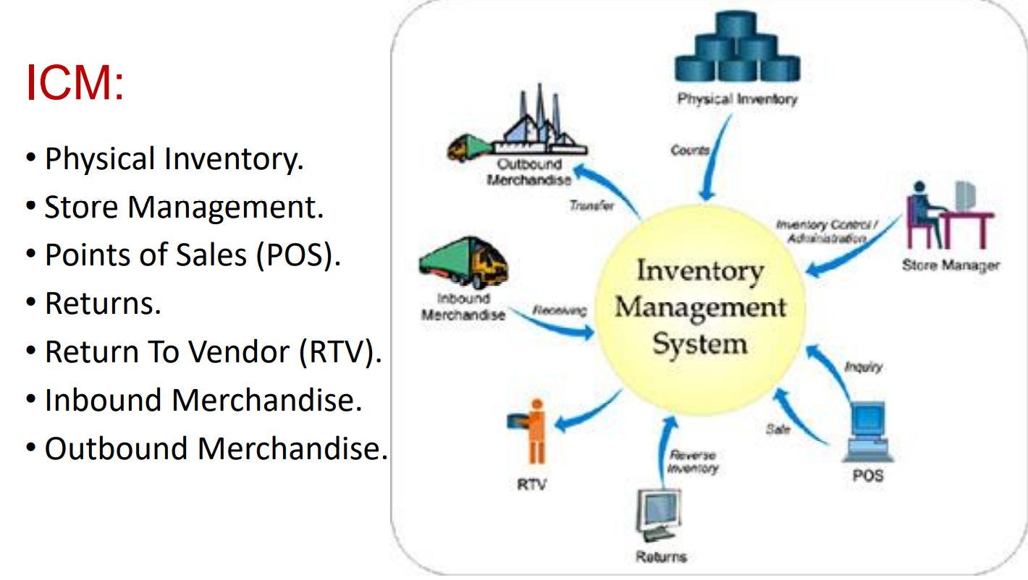
Chapter
09
Inventory Management system

Slide 21
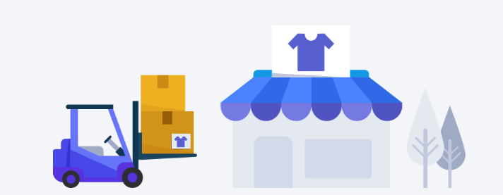
Chapter
09
Inventory Management system
What is inventory?
Inventory is: Those stocks or items used to support production (raw materials and work-in-process items), supporting activities (maintenance, repair, and operating supplies), and customer service (finished goods and spare parts)

Slide 22
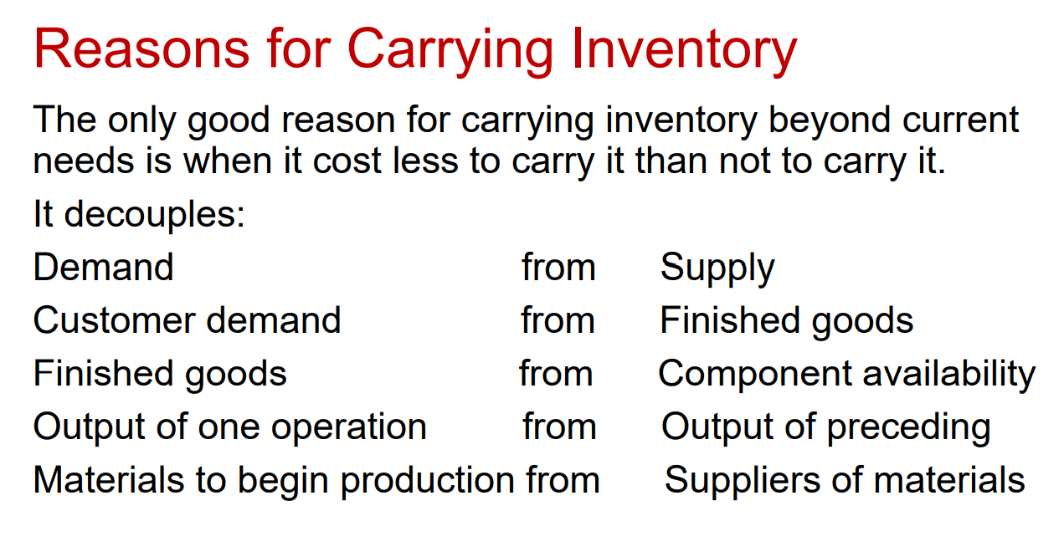
Chapter
09
Inventory Management system

Slide 23
Chapter
09
Inventory Management system
Management Challenges:
Maximize inventory value.
Optimize your warehouse.
Streamline order fulfillment.
Link people, processes, and information.
Gain insight to enhance operational and management decision-making.
Empower your people with tools that fuel productivity.

Slide 24
Chapter
09
Inventory Management
Why does inventory exist ?
1- Raw materials and bought-out parts inventory will allow the organization to:
Cater for the variability of supply.
Take advantage of quantity discounts or market prices.
Provide strategic stocks of items which could be in short supply due, for instance, to strikes or other supply problems.
Guard against inflation.
Form of investment when price increases are anticipated

Slide 25
Chapter
09
Inventory Management
Why does inventory exist ?
2- Work-in-progress inventory helps maintain the independence of stages in the process by decoupling the production steps involved. This leads to:
Greater flexibility in production scheduling especially at times of machine breakdown;
Stabilizing the different output rates at each part in the process
Improving the utilization of plant, processes and labour

Slide 26
Chapter
09
Inventory Management
Why does inventory exist ?
3. Finished goods inventory with which the organization can:
Provide off-the-shelf customer service.
Achieve a steady supply of goods in the face of intermittent production or supply
Cope with fluctuations in demand, particularly in the case of seasonal products
Provide an insurance against plant or equipment breakdowns and, in some instances, against internal or suppliers' strikes

Slide 27
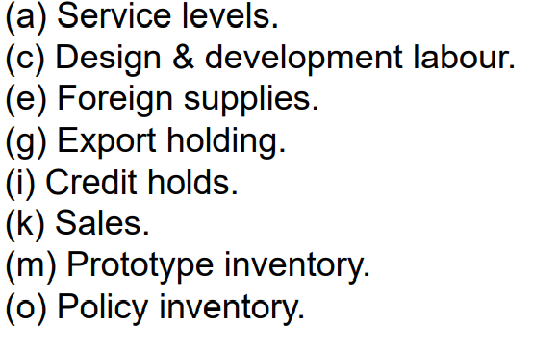
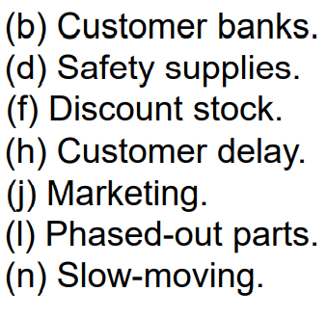
Chapter
09
Inventory Management
Inventory that is not production / operations related needs to be segregated and separately accounted for and controlled. This category of stock is known as corporate inventory. Some of these categories are:

Slide 28
Chapter
09
Inventory Control
A company should ensure the following steps are taken to improve its inventory control :
Protect your company against theft.
Establish an approved stock list for each warehouse
Assign and use bin locations
Record all material leaving your warehouse

Slide 29
Chapter
09
Inventory Control
A company should ensure the following steps are taken to improve its inventory control :
5- Process paperwork in a timely manner
6- Set appropriate objectives for your buyers
7- Make sure every employee is aware of the cost of bad inventory management
8- Ensure that stock balances are accurate and will remain accurate

Slide 30
Chapter
09
Inventory Control
A company should ensure the following steps are taken to improve its inventory control :
9- Determine the most advantageous replenishment path for each item in each warehouse.
10- Specify guidelines for setting the reorder method an other purchasing parameters to maximize inventory turns and minimize stock-outs.
11- Document replenishment procedures

Slide 31
Forms of inventories
Chapter
09
There are many types of inventory. The form of inventories depends upon the type of concern. All types of inventory do not require same treatment and therefore policy with regard to each may also differ.

Slide 32
Raw material inventories:
Chapter
09
Forms of inventories
There are raw materials and other supplies, parts and components, which enter into the product during the production process and generally form part of the product.

Slide 33
Chapter
09
Forms of inventories
Work in process inventories:
These are semi finished, work in progress and partly finished products formed at the various stages of production.

Slide 34
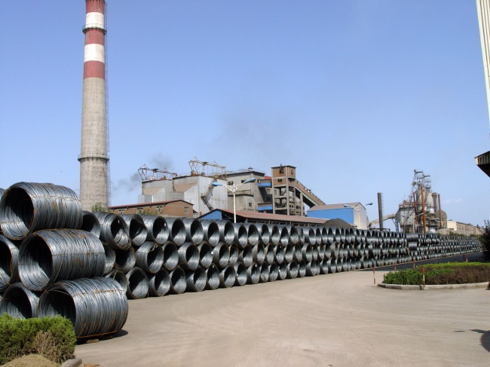
Chapter
09
Forms of inventories
m.r.o inventories/ Spare part inventories:
Maintenance, repairs and operating supplies which are consumed during the production process and generally do not form part of the product itself are referred to as spare part inventories.

Slide 35
Chapter
09
Forms of inventories
Finished inventories:
These are complete finished products ready for sales. In a manufacturing unit, they are the
final output of the production process.
They can also be classified as:-
Movement inventories
Lot size inventories
Anticipation inventories
Fluctuation inventories

