Slide 1


Slide 2


Slide 3

Learning Objectives:

Slide 4

Graphs Terminology

Slide 5

WHAT ARE GRAPHS?

Slide 6
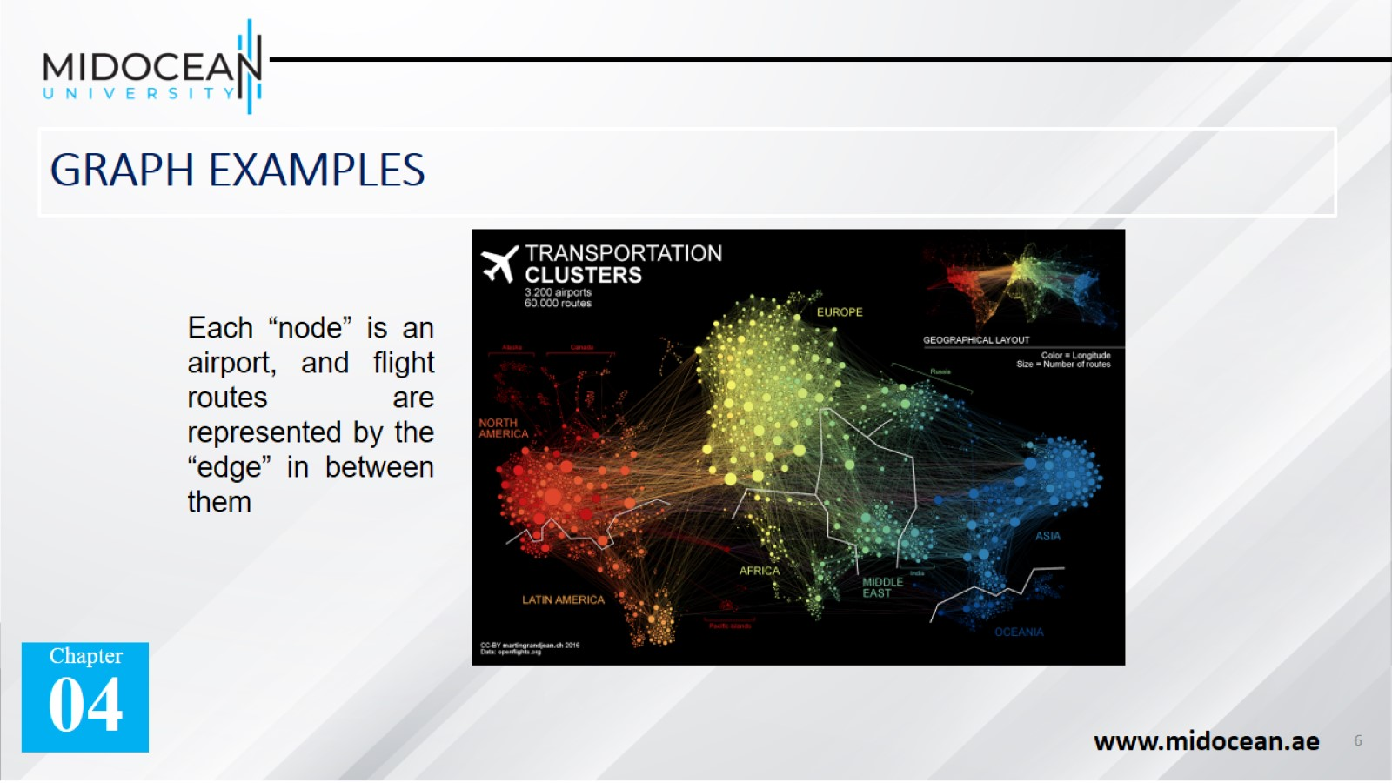
GRAPH EXAMPLES

Slide 7
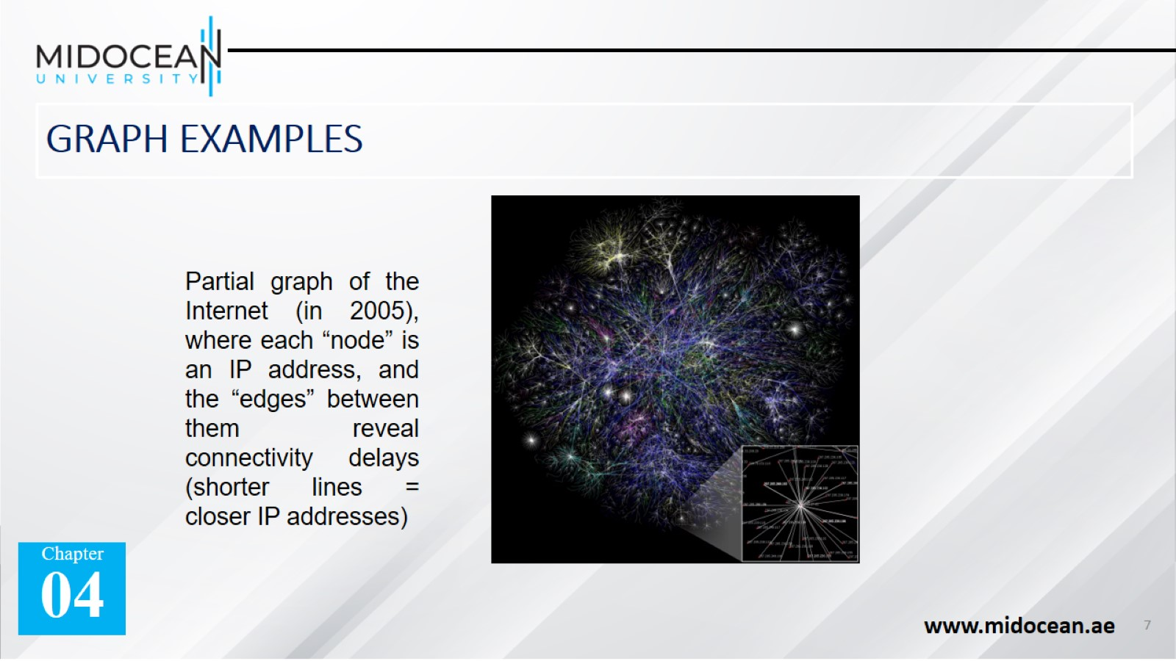
GRAPH EXAMPLES

Slide 8
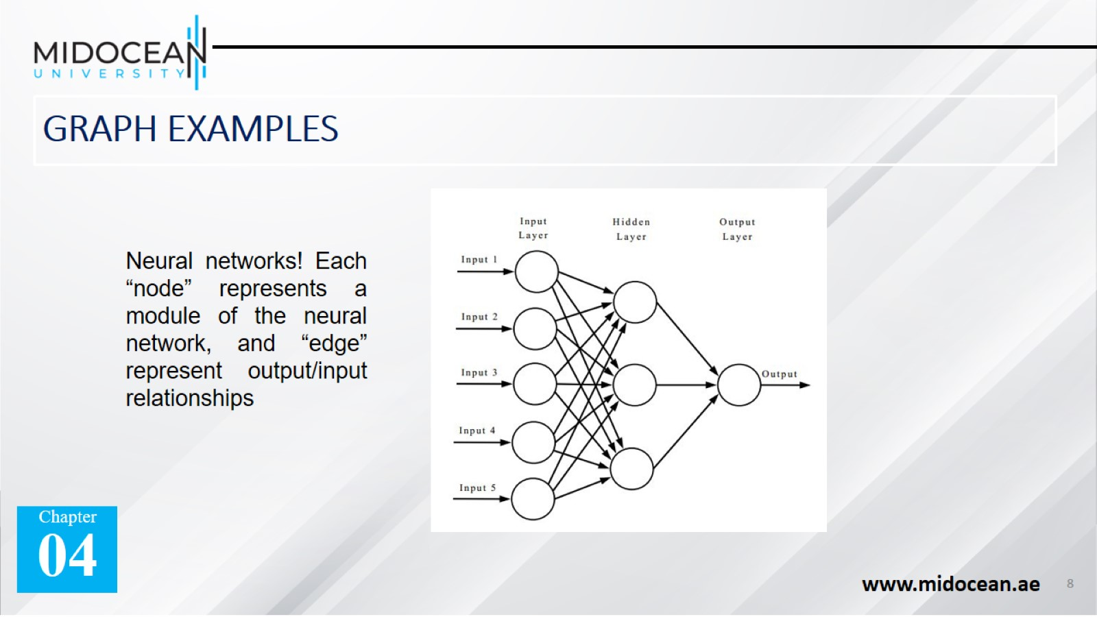
GRAPH EXAMPLES

Slide 9
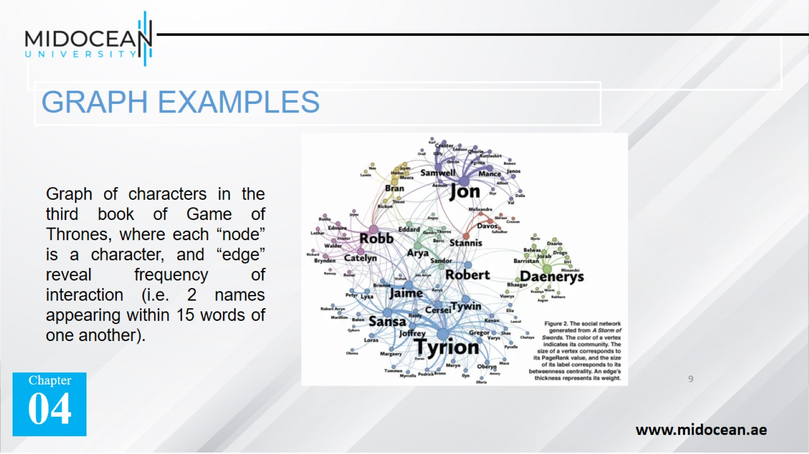
GRAPH EXAMPLES

Slide 10
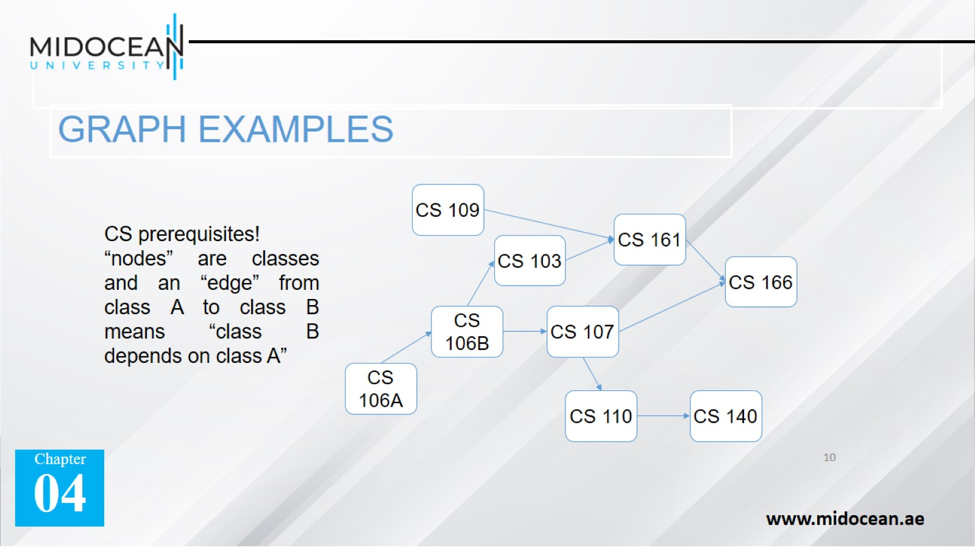
GRAPH EXAMPLES

Slide 11
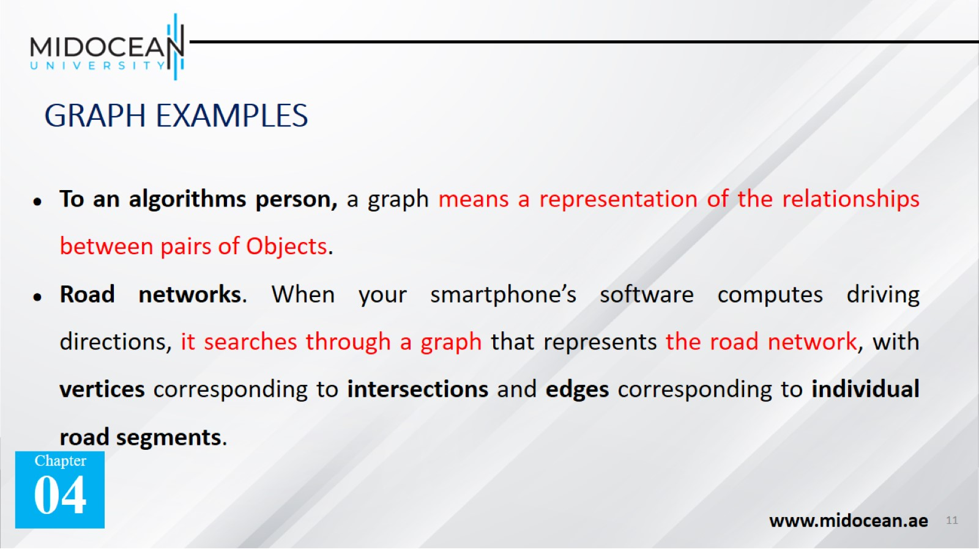
GRAPH EXAMPLES

Slide 12
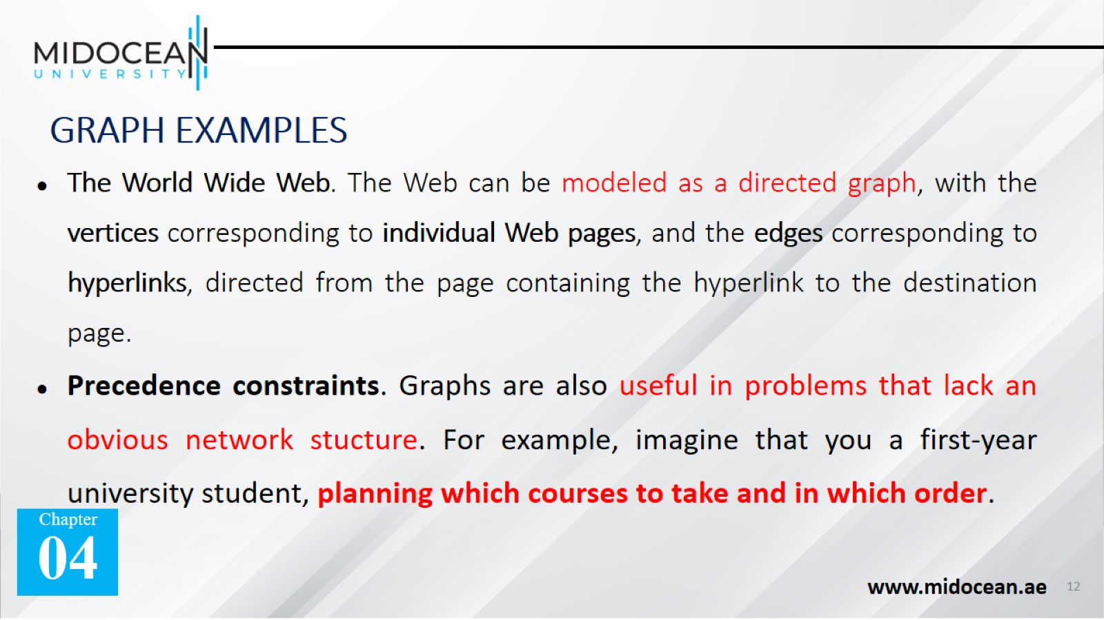
GRAPH EXAMPLES

Slide 13
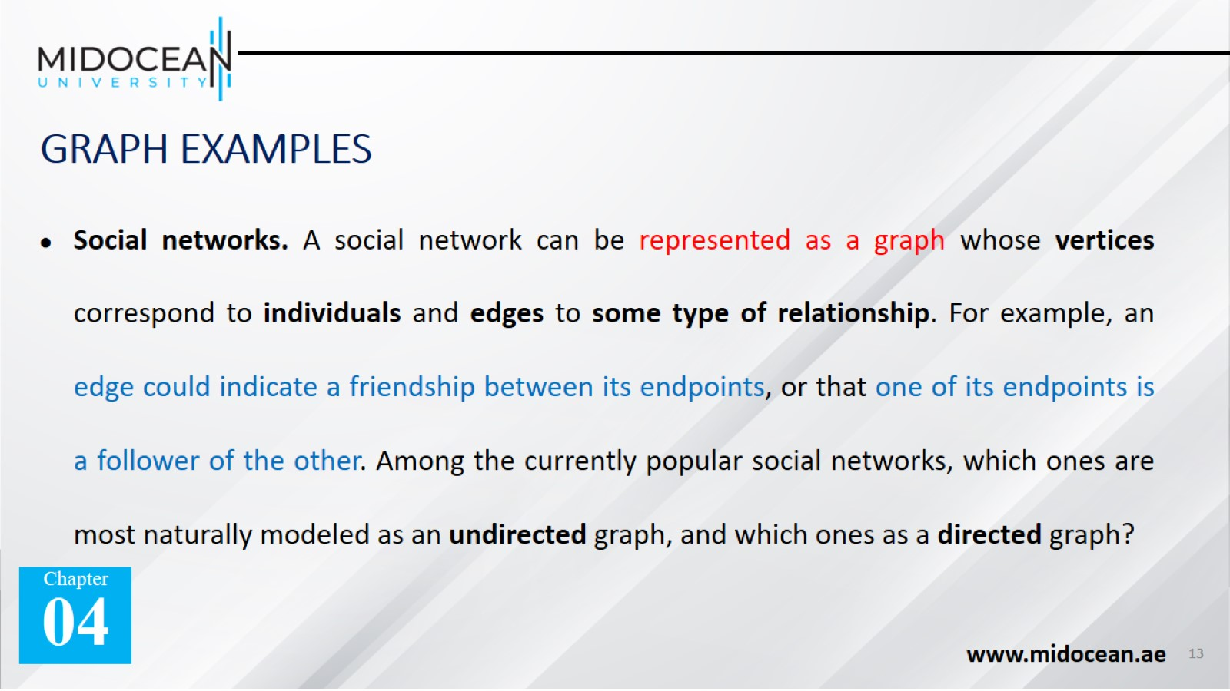
GRAPH EXAMPLES

Slide 14
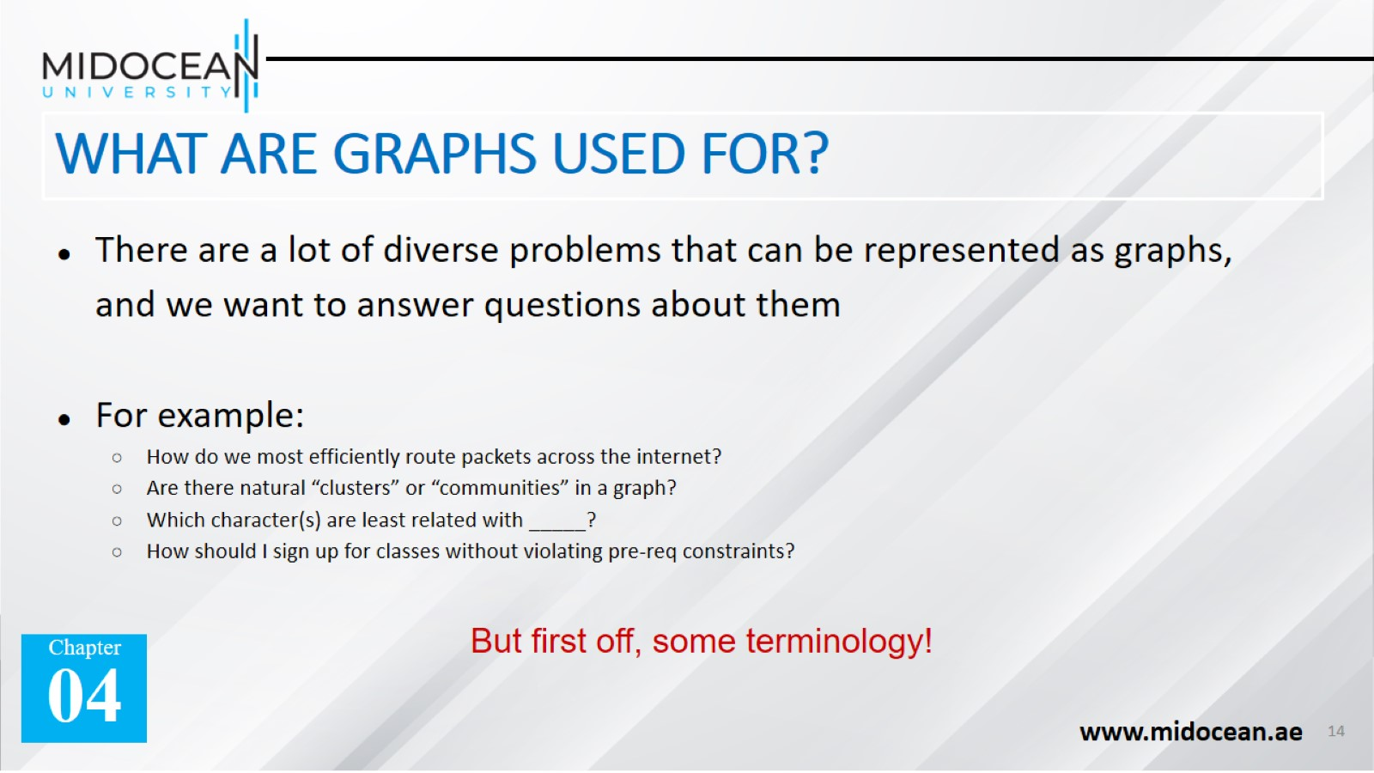
WHAT ARE GRAPHS USED FOR?

Slide 15


Slide 16
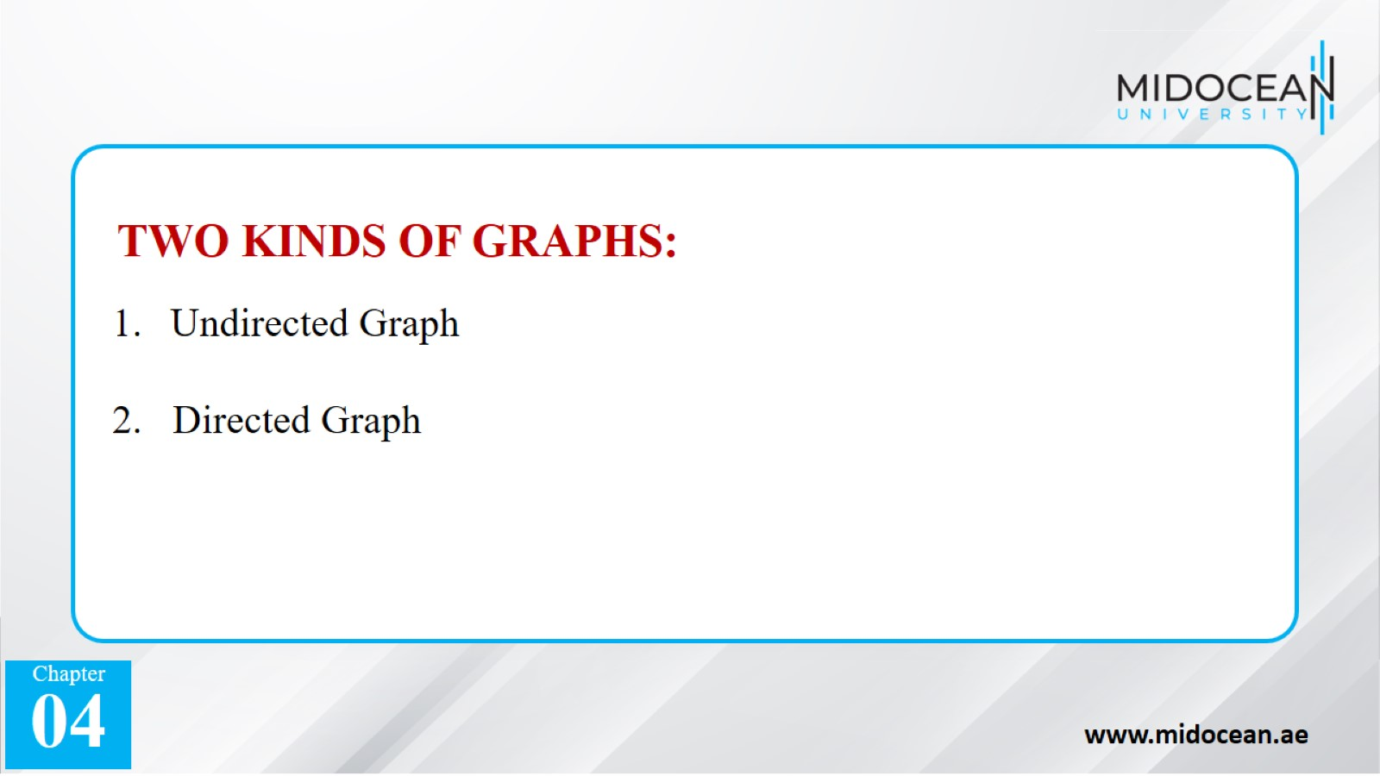

Slide 17
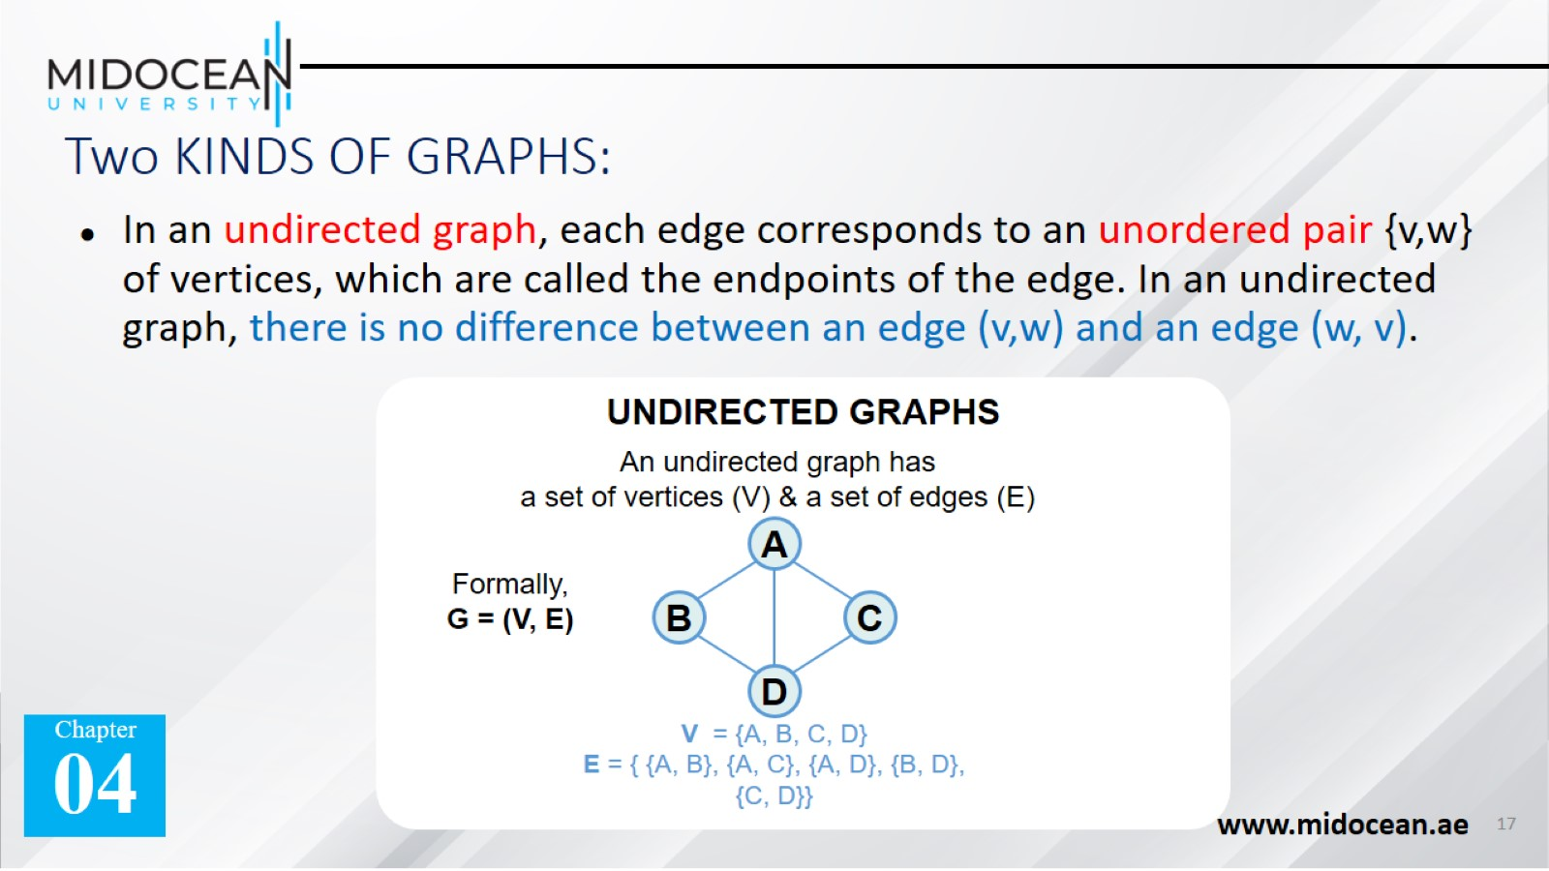
Two KINDS OF GRAPHS:

Slide 18
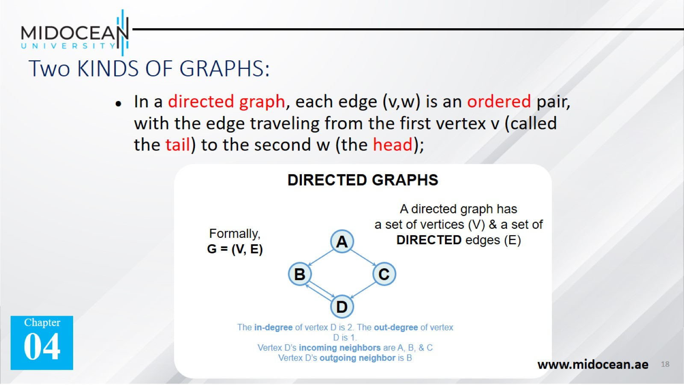
Two KINDS OF GRAPHS:

Slide 19


Slide 20


Slide 21
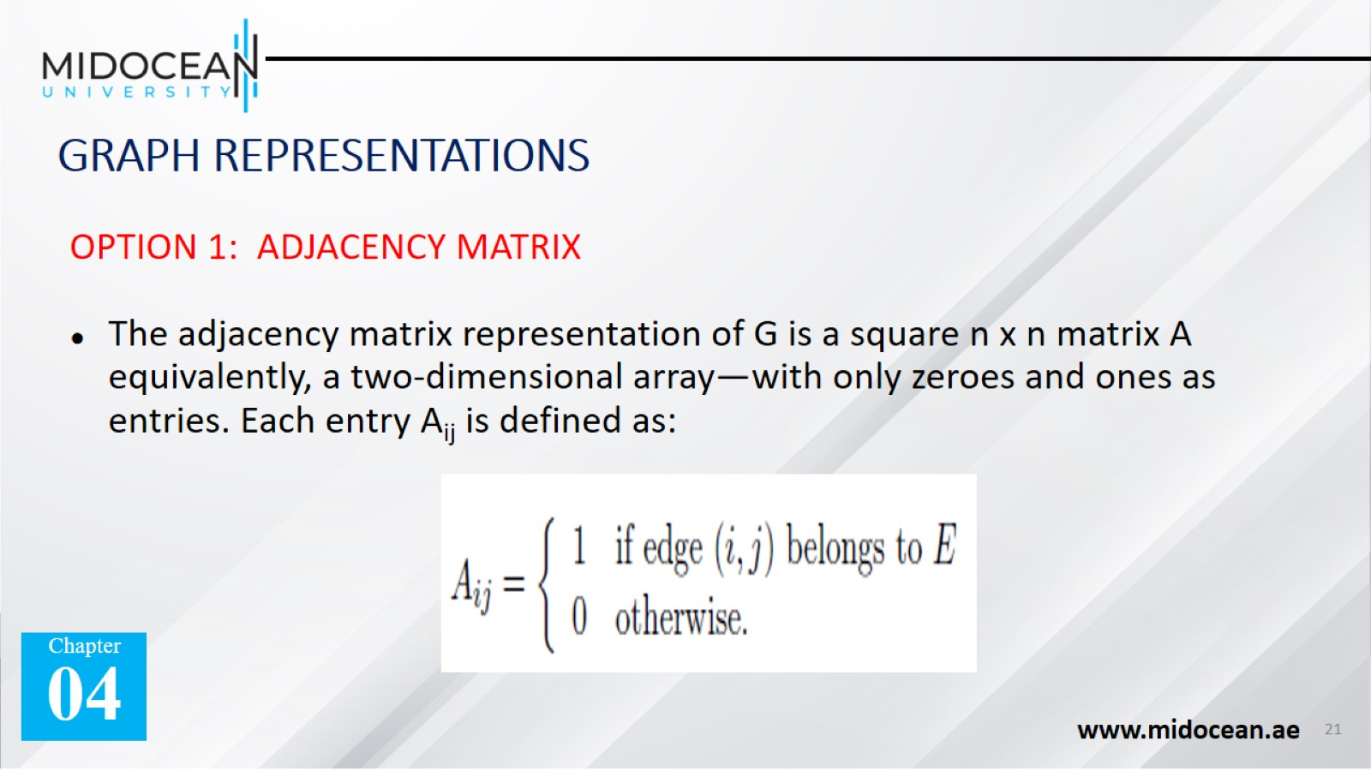
GRAPH REPRESENTATIONS

Slide 22
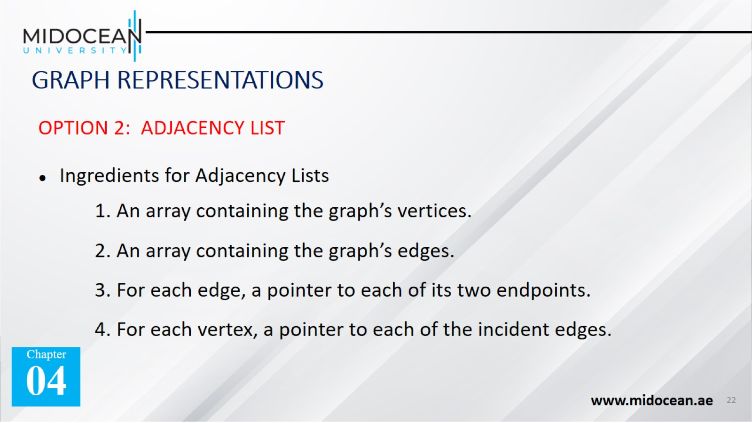
GRAPH REPRESENTATIONS

Slide 23
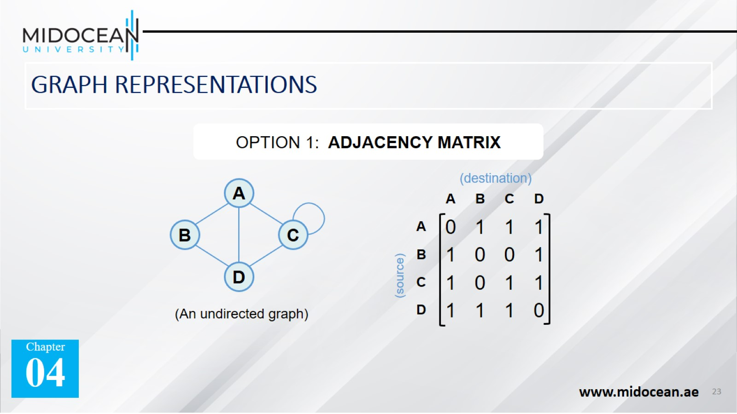
GRAPH REPRESENTATIONS

Slide 24
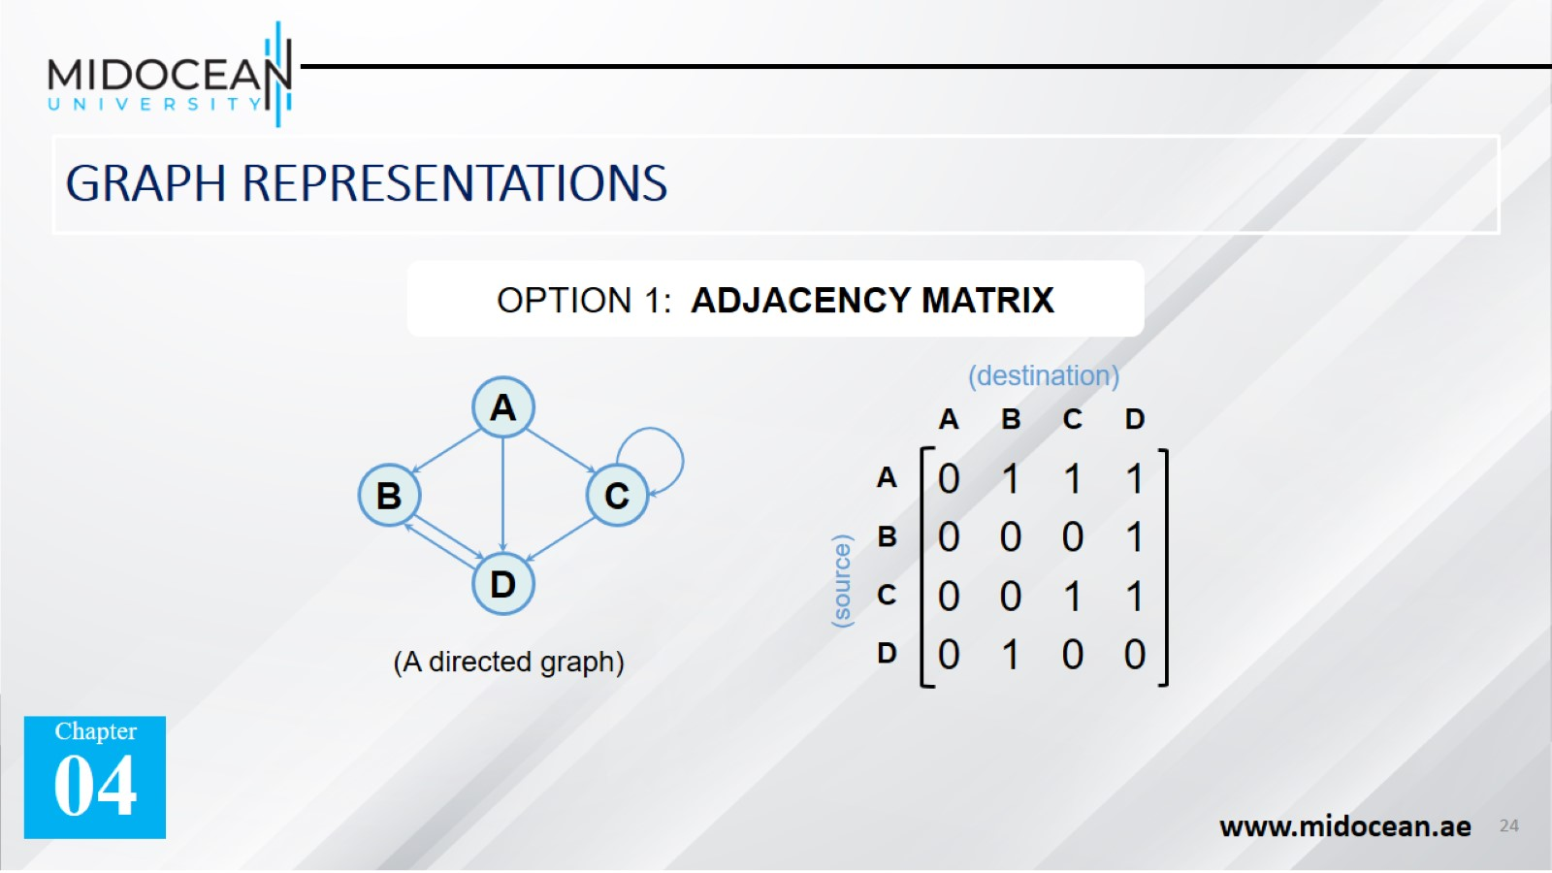
GRAPH REPRESENTATIONS

Slide 25
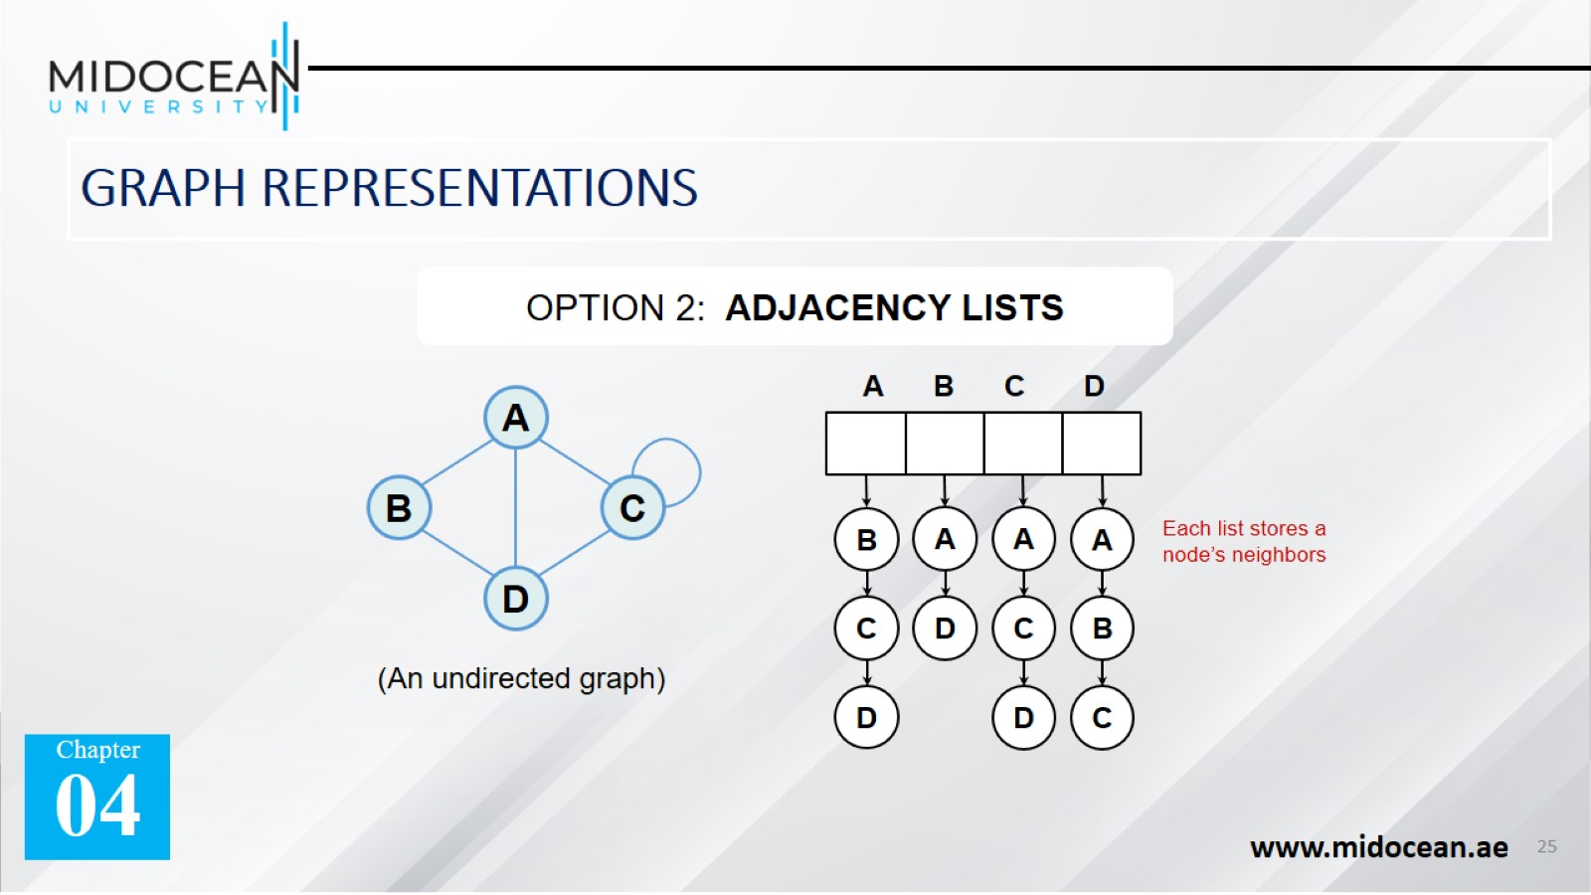
GRAPH REPRESENTATIONS

Slide 26
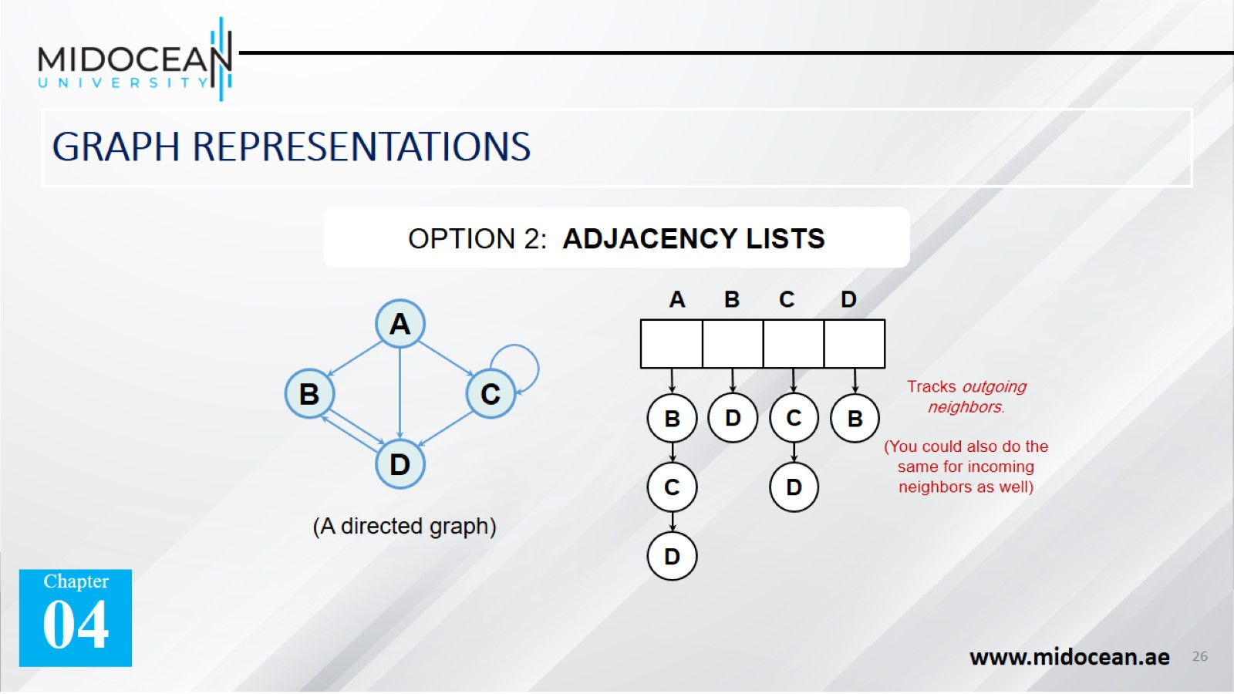
GRAPH REPRESENTATIONS

Slide 27
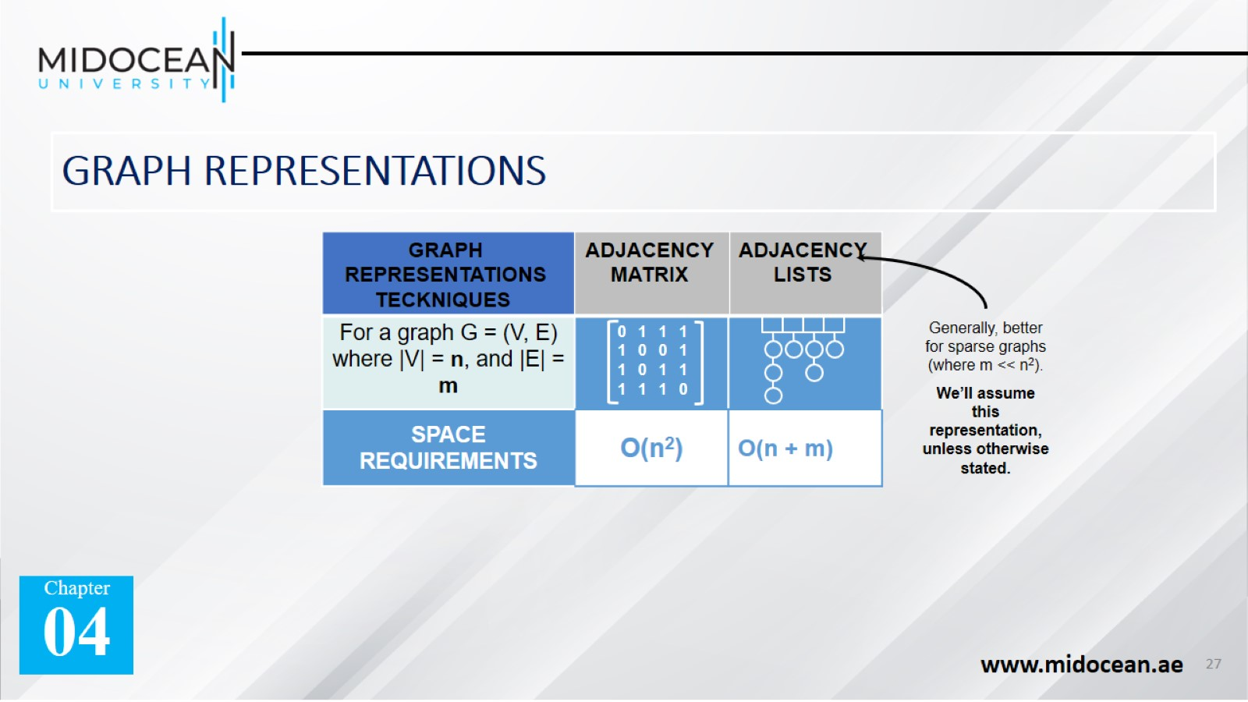
GRAPH REPRESENTATIONS

Slide 28
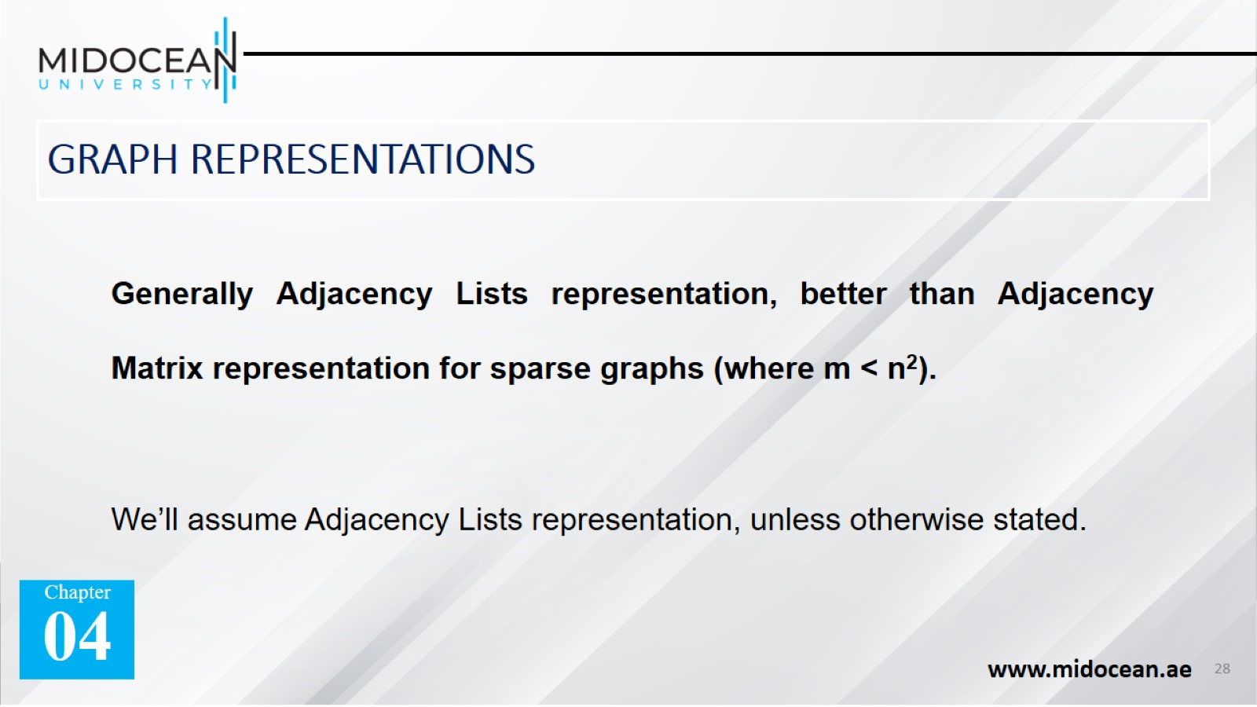
GRAPH REPRESENTATIONS

Slide 29


Slide 30
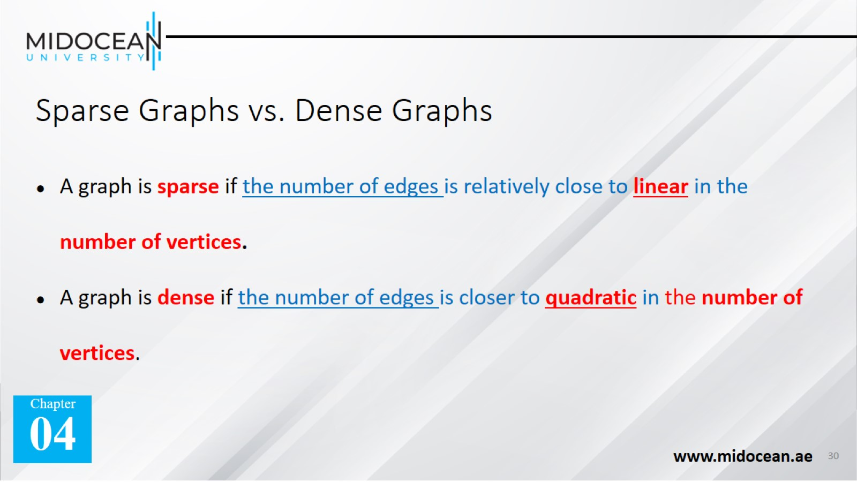
Sparse Graphs vs. Dense Graphs

Slide 31


Slide 32
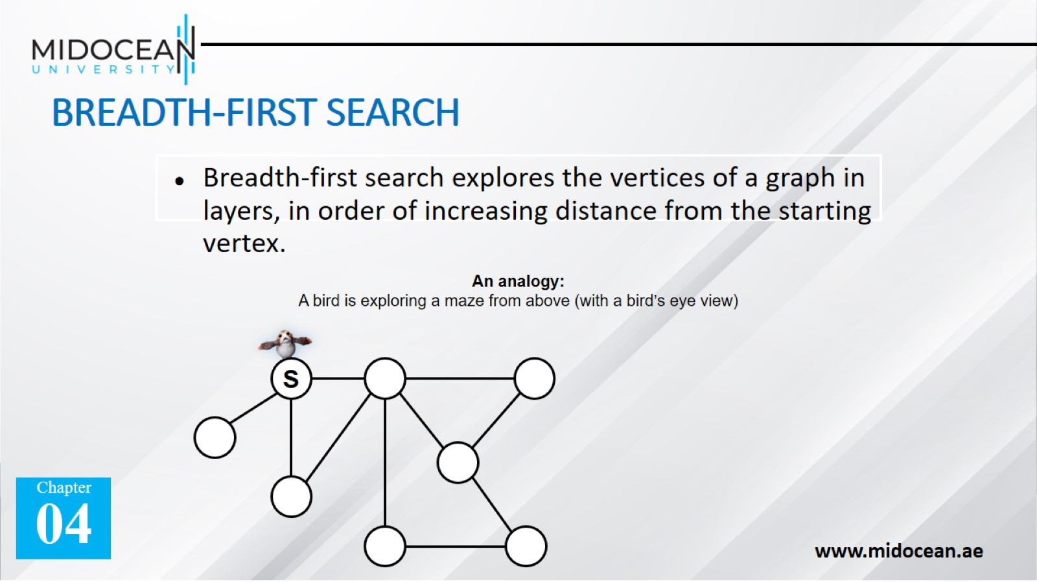
BREADTH-FIRST SEARCH

Slide 33
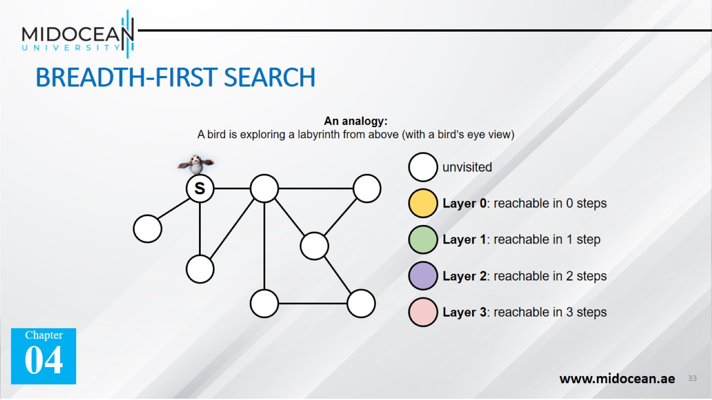
BREADTH-FIRST SEARCH

Slide 34
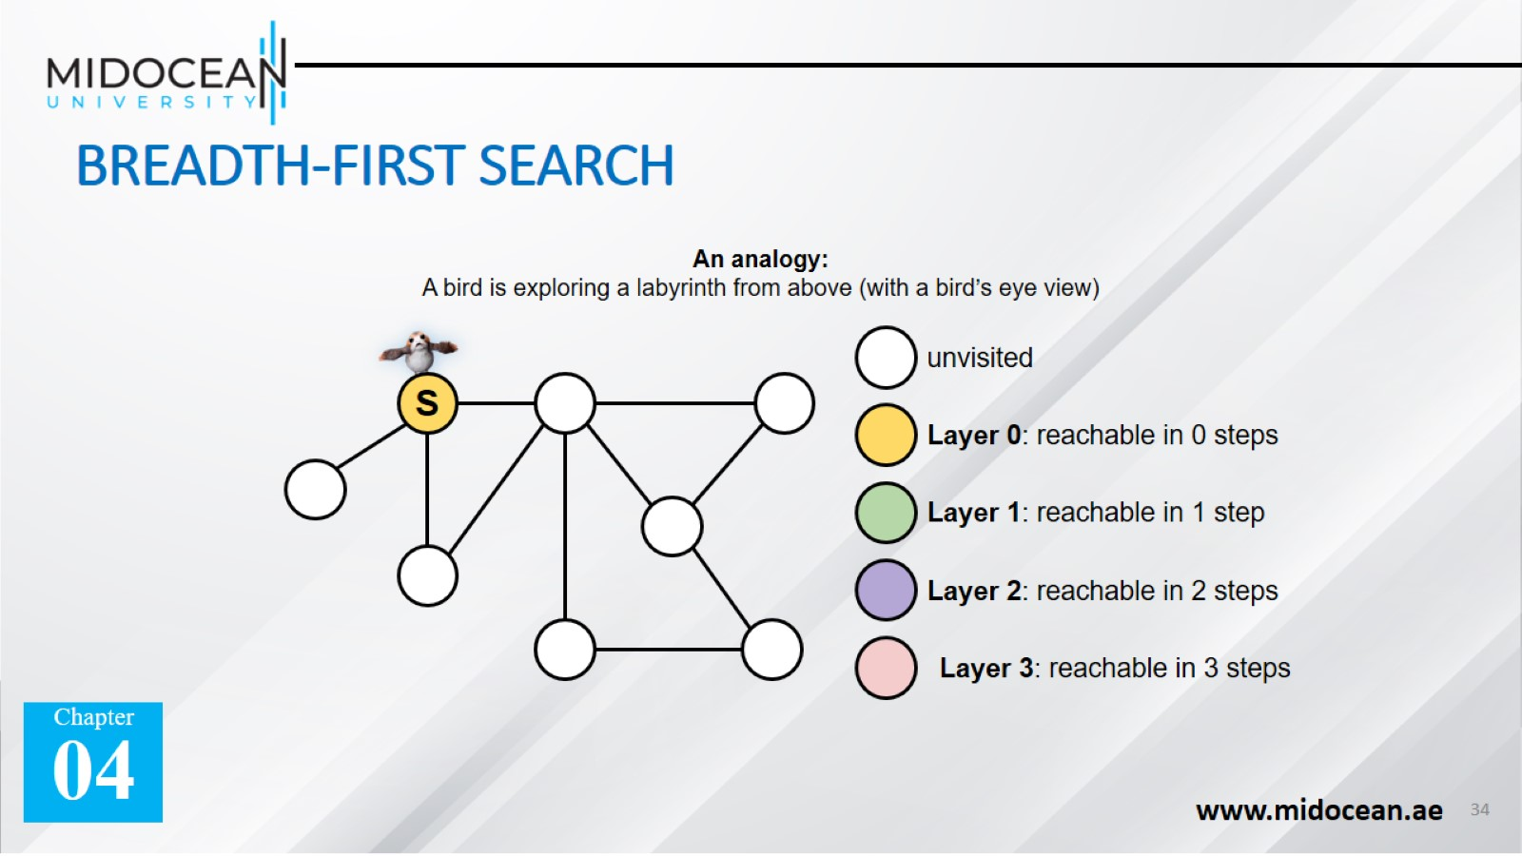
BREADTH-FIRST SEARCH

Slide 35

BREADTH-FIRST SEARCH

Slide 36

BREADTH-FIRST SEARCH

Slide 37
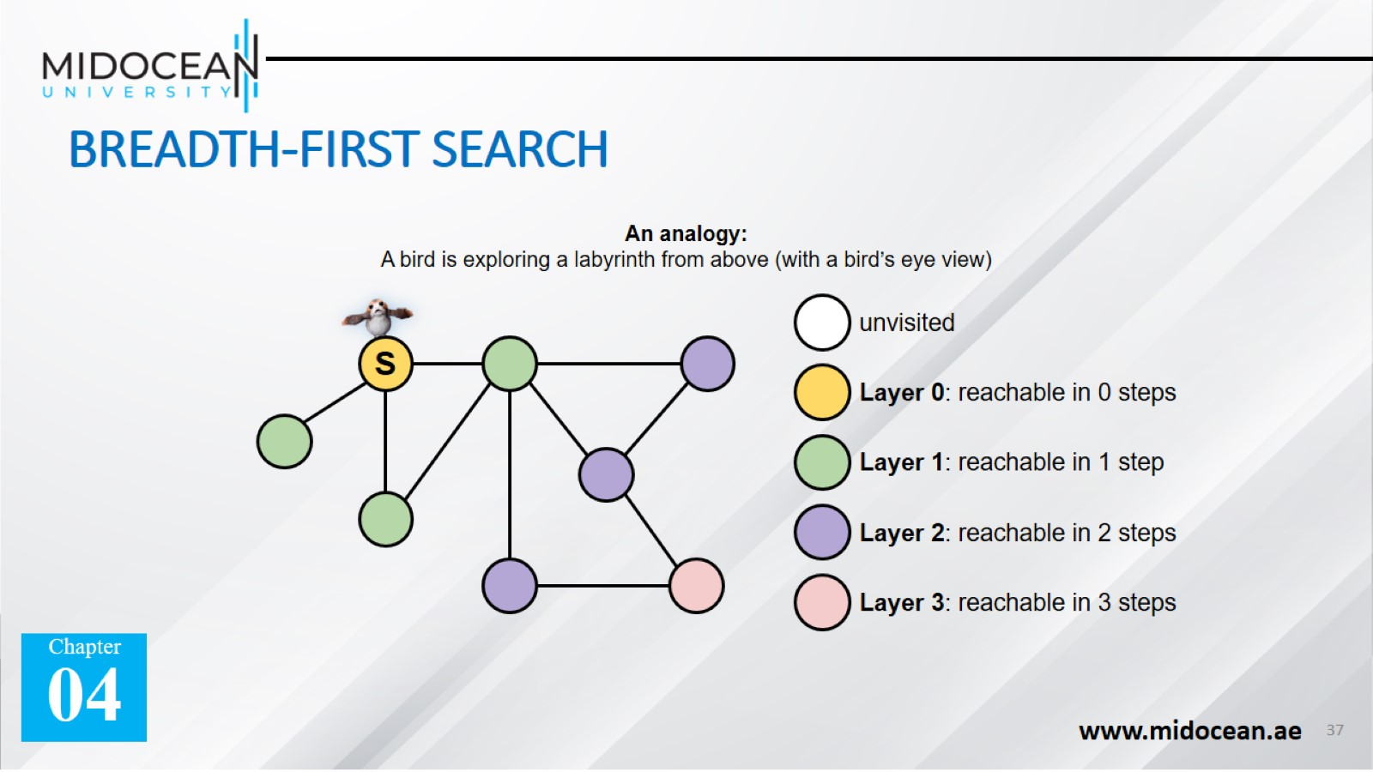
BREADTH-FIRST SEARCH

Slide 38
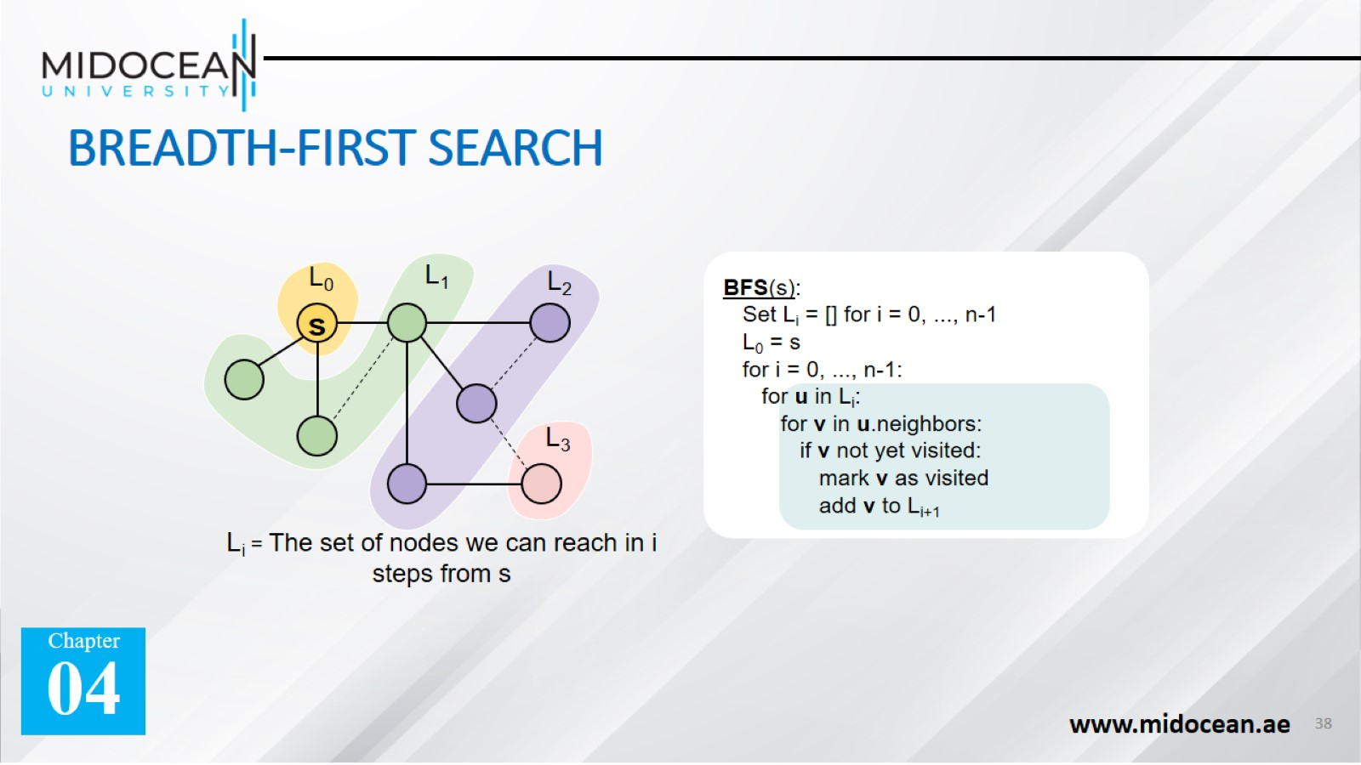
BREADTH-FIRST SEARCH

Slide 39
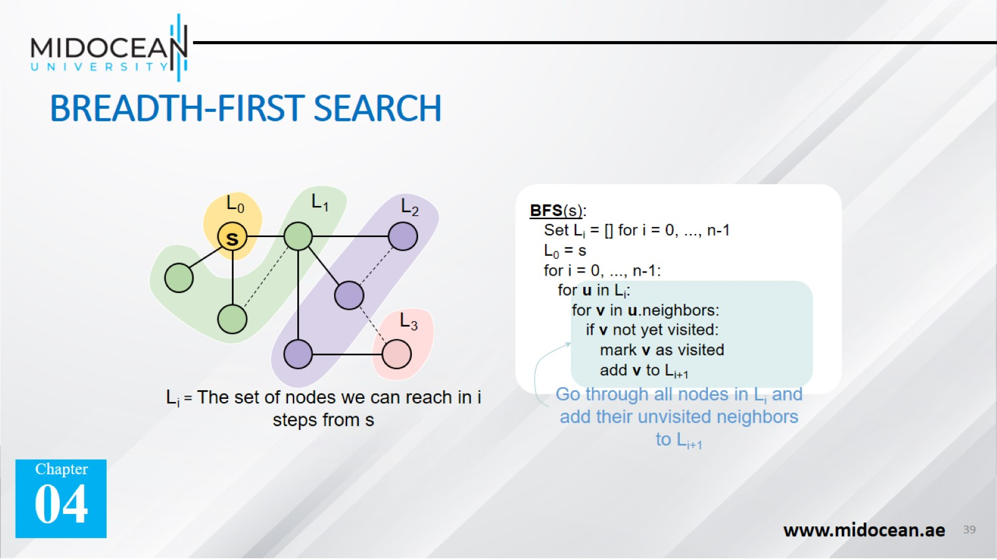
BREADTH-FIRST SEARCH

Slide 40


