Slide 1




Fundamentals of
Risk Management
Lecture 1
PMG510
Prepared by
Dr. Usama Al-Fendi

Slide 2
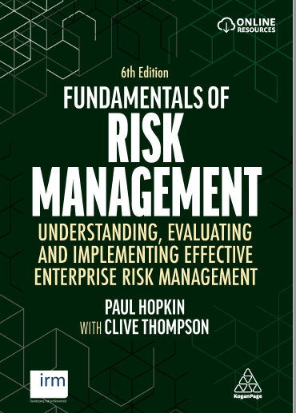
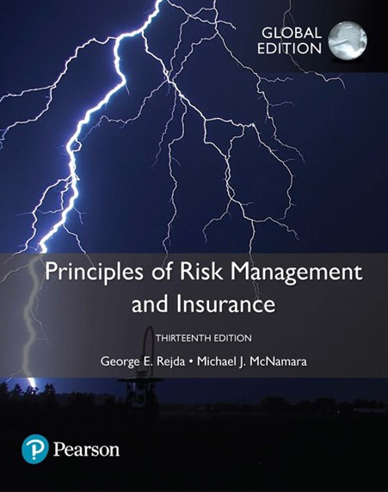

Lecture 1
Main References

Slide 3
Lecture 1
Course Outlines
Approaches to defining risk | Risk management standards
Impact of risk on organizations | establishing the context
Types of risks | enterprise risk management
Scope of risk management | Alternative approaches
Principles and aims of risk management | Risk assessment considerations

Slide 4
Lecture 1
Course Outlines
Importance of Risk Management Different Definitions of Risk Chance of Loss (Probability of Occurrence) Impact of Loss (Severity of Loss) Peril and Hazard Classification of Risk Major Personal Risks and Commercial Risks Burden of Risk on Society Techniques for Managing Risk

Slide 5

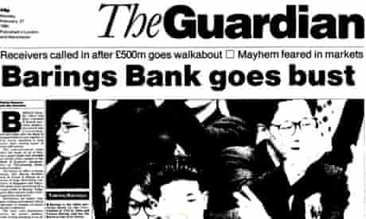


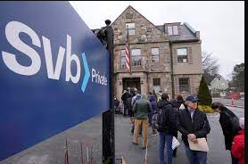

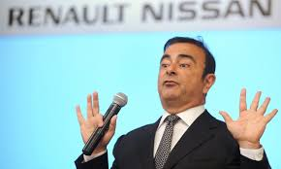



Lecture 1
Why Risk Management

Slide 6
Lecture 1
Different definitions of Risk
Risk: Uncertainty concerning the occurrence of a loss Loss Exposure: Any situation or circumstance in which a loss is possible, regardless of whether a loss occurs. Probability that that the actual outcome will deviate from expected. Volatility of returns above and below average expected level.

Slide 7
Lecture 1
Different definitions of Risk
Objective Risk vs. Subjective Risk Objective risk is defined as the relative variation of actual loss from expected loss It can be statistically calculated using a measure of dispersion, such as the standard deviation. We can quantify and measure it quantitatively and without personal biased.

Slide 8
Lecture 1
Different definitions of Risk
Objective Risk vs. Subjective Risk Subjective risk is defined as uncertainty based on a person’s mental condition or state of mind Two persons in the same situation may have different perceptions of risk High subjective risk often results in conservative behavior Have personal biased.

Slide 9
Lecture 1
Chance of Loss
Chance of loss: The probability that an event will occur. Probability of Occurrence. Likelihood of happening. It can be quantified as a number between zero and one. Best way to measure it objectively is through historical actual frequency data.

Slide 10
Lecture 1
Impact of Loss
Impact of loss: The dollar value of loss that will result if the probable event occur. Loss severity. It can be quantified through the size of loss exposure. Example: for car insurance companies, loss exposures are the dollar value of the insured car ($10,000, $50,000, $100,000)

Slide 11
Lecture 1
Peril and Hazard
A peril is defined as the cause of the loss In an auto accident, the collision is the peril, earth quick the damage is the peril. A hazard is a condition that increases the chance of loss. Example: during winter icy roads can increase the frequency of car accident occurrence.

Slide 12
Lecture 1
Types of Hazard
Physical hazards are physical conditions that increase the chance of loss (icy roads, defective wiring, unstable areas) Moral hazard is dishonesty or character defects in an individual, that increase the chance of loss (faking accidents, inflating claim amounts)

Slide 13
Lecture 1
Types of Hazard
Attitudinal Hazard (Morale Hazard) is carelessness or indifference to a loss, which increases the frequency or severity of a loss (leaving keys in an unlocked car) Legal Hazard refers to characteristics of the legal system or regulatory environment that increase the chance of loss (large damage awards in liability lawsuits)

Slide 14
Lecture 1
Classification of Risk
Pure and Speculative Risk A pure risk is one in which there are only the possibilities of loss or no loss (earthquake, car accident, fire in the warehouse) A speculative risk is one in which both profit or loss are possible (gambling, investing in stocks)

Slide 15
Lecture 1
Classification of Risk
Diversifiable Risk and Nondiversifiable Risk A diversifiable risk affects only individuals or small groups, or a company alone or one sector in the economy (car theft, resign of a CEO, increase the price of raw material). It is also called nonsystematic or particular risk.

Slide 16
Lecture 1
Classification of Risk
Diversifiable Risk and Nondiversifiable Risk A nondiversifiable risk affects the entire economy or large numbers of persons or groups within the economy (hurricane, interest rate change by central bank, wars, pandemics like COVID19). It is also called systematic risk or fundamental risk. Government assistance may be necessary to insure nondiversifiable risks.

Slide 17
Lecture 1
Classification of Risk
Enterprise risk encompasses all major risks faced by a business firm, which include: pure risk, speculative risk, strategic risk, operational risk, and financial risk Financial Risk refers to the uncertainty of loss because of adverse changes in commodity prices, interest rates, foreign exchange rates, and the value of money.

Slide 18
Lecture 1
Classification of Risk
Enterprise Risk Management combines into a single unified treatment program all major risks faced by the firm: Pure risk Speculative risk Strategic risk Operational risk Financial risk

Slide 19
Lecture 1
Common Types of Risk
Credit Risk: the risk that the borrower will not be able to payback his obligation on a timely manner. Market risk: the risk that occur due to changes in market variables. Operational risk: the risk of loss resulting from inadequate or failed internal processes, people and systems or from external events

Slide 20
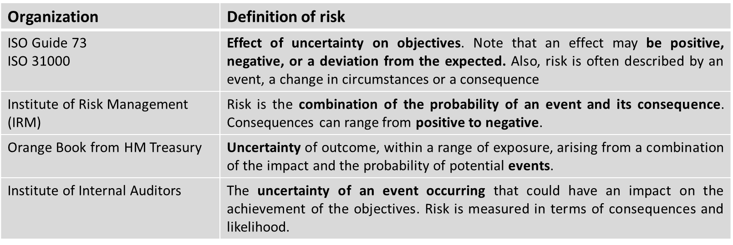
Lecture 1
Organizational definitions of Risk

Slide 21
Lecture 1
Major Personal Risks and Commercial Risks
Personal risks involve the possibility of a loss or reduction in income, extra expenses or depletion of financial assets: Premature death of family head Insufficient income during retirement Most workers are not saving enough for a comfortable retirement

Slide 22
Lecture 1
Major Personal Risks and Commercial Risks
Personal risks Poor health (catastrophic medical bills and loss of earned income) Involuntary unemployment

Slide 23
Lecture 1
Major Personal Risks and Commercial Risks
Personal risks Property risks involve the possibility of losses associated with the destruction or theft of property: Physical damage to home and personal property from fire, tornado, vandalism, or other causes

Slide 24
Lecture 1
Major Personal Risks and Commercial Risks
Personal risks Direct loss vs. indirect loss A direct loss is a financial loss that results from the physical damage, destruction, or theft of the property, such as fire damage to a home

Slide 25
Lecture 1
Major Personal Risks and Commercial Risks
Personal risks Direct loss vs. indirect loss An indirect loss results indirectly from the occurrence of a direct physical damage or theft loss, such as the additional living expenses after a fire to a home. These additional expenses would be a consequential loss

Slide 26
Lecture 1
Major Personal Risks and Commercial Risks
Personal risks Liability risks involve the possibility of being held liable for bodily injury or property damage to someone else There is no maximum upper limit with respect to the amount of the loss A lien can be placed on your income and financial assets Defense costs can be enormous

Slide 27
Lecture 1
Major Personal Risks and Commercial Risks
Commercial Risks Firms face a variety of pure risks that can have serious financial consequences if a loss occurs: Property risks, such as damage to buildings, furniture and office equipment Liability risks, such as suits for defective products, pollution of the environment, and sexual harassment

Slide 28
Lecture 1
Major Personal Risks and Commercial Risks
Commercial Risks Loss of business income, when the firm must shut down for some time after a physical damage loss Other risks to firms include crime exposures, human resource exposures, foreign loss exposures, intangible property exposures, and government exposures

Slide 29
Lecture 1
Burden of Risk on Society
The presence of risk results in three major burdens on society: In the absence of insurance, individuals would have to maintain large emergency funds The risk of a liability lawsuit may discourage innovation, depriving society of certain goods and services Risk causes worry and fear

Slide 30
Lecture 1
Techniques for Managing Risk
There are Four major methods for managing risk Avoidance Acceptance or Retention Loss control or Mitigate Transfers

Slide 31
Lecture 1
Techniques for Managing Risk
Risk Avoidance: Prevents the organization from entering into a risk-rich situation or environment. For example, when choosing a vendor for a service, the organization could choose to accept a vendor with a higher-priced bid if the lower-cost vendor does not have adequate references. Example: A company decided not to invest in X country due to the high political instability.

Slide 32
Lecture 1
Techniques for Managing Risk
Risk acceptance or Retention Based on the comparison of the risk to the cost of control, management could accept the risk and move forward with the risky choice. (An individual or firm retains all or part of a given risk)

Slide 33
Lecture 1
Techniques for Managing Risk
Example: There is the risk an employees will burn themselves if the company installs new coffee makers in the break room. The benefit of employee satisfaction from new coffee makers outweighs the risk of an employee accidentally burning themselves on a hot cup of coffee, so management accepts the risk and installs the new appliance.

Slide 34
Lecture 1
Techniques for Managing Risk
Risk acceptance or Retention Active retention means that an individual is consciously aware of the risk and deliberately plans to retain all or part of it Passive retention means risks may be unknowingly retained because of ignorance, indifference, or laziness Self Insurance is a special form of planned retention by which part or all of a given loss exposure is retained by the firm

Slide 35
Lecture 1
Techniques for Managing Risk
Risk control or mitigate Mitigating risks involves implementing action plans and controls that reduce the likelihood of the risk and/or the impact it would have if the risk were realized.

Slide 36
Lecture 1
Techniques for Managing Risk
Risk control or mitigate For example, if an organization allows employees to work from home, there is a risk of data leakage due to the transmission of data across the public internet. To mitigate this risk, management might implement a VPN service and have remote users access the business network through VPN only. This would reduce the likelihood of data leakage, thereby mitigating the risk.

Slide 37
Lecture 1
Techniques for Managing Risk
Risk control or mitigate An other example, when the bank impose a segregation of duties to the operations deliver and prevent one single employee form having more than one process in the transactions. This technique will be the most important one in the risk mitigation stage.

Slide 38
Lecture 1
Techniques for Managing Risk
Risk or Loss control Loss prevention refers to activities to reduce the frequency of losses Loss reduction refers to activities to reduce the severity of losses

Slide 39
Lecture 1
Techniques for Managing Risk
Loss prevention refers to activities to reduce the frequency of losses Example: speed cameral controls, strict regulations for not smoking in the gas stations, segregations of duties, applying good fundamental analysis before investments in foreign currencies.

Slide 40
Lecture 1
Techniques for Managing Risk
Loss reduction refers to activities to reduce the severity of losses Example: seat belt, placing fire extinguishers along the building, emergency exits in the buildings, concentration limit for investments in foreign currencies.

Slide 41
Lecture 1
Techniques for Managing Risk
Risk Transfer Transferring the risk means shifting the risk to another organization. The three most common means for transferring are outsourcing, warrantees and insuring.

Slide 42
Lecture 1
Techniques for Managing Risk
Risk Transfer When outsourcing, management cannot completely transfer the responsibility for controlling risk. Insuring against the risk ultimately transfers some of the financial impacts of the risk to the insurance company.

Slide 43
Lecture 1
Conclusion

Slide 44


Thank You

