Slide 1



ORG 123
Organizational Behavior
Lecture 5
Prepared by
Dr. Walid K. El Leithy
www.midocean.ae

Slide 2
Foundation of Group Behavior
This chapter will enable you to:
  1. Define groups, and differentiate between different types of groups.
  2. Identify the five stages of group development.
  3. Show how role requirements change in different situations.
  4. Demonstrate how norms and status exert influence on an individual’s behavior.
  5. Show how group size affects group performance.

Slide 3
Foundation of Group Behavior
This chapter will enable you to:
  6. Contrast the benefits and disadvantages of cohesive groups.
  7. Contrast the strengths and weaknesses of group decision making.
  8. Compare the effectiveness of interacting, brainstorming, nominal, and electronic meeting groups.
  9. Evaluate evidence for cultural differences in group status and social loafing, and the effects of diversity in groups.

Slide 4
Defining and Classifying Groups
Group:
  Two or more individuals interacting and interdependent, who have come together to achieve particular objectives
Formal Group:
  Defined by the organization’s structure with designated work assignments establishing tasks
Informal Group:
  Alliances that are neither formally structured nor organizationally determined
  Appear naturally in response to the need for social contact
  Deeply affect behavior and performance

Slide 5
Sub Classifications of Groups
Formal Groups
Informal Groups
Command Group
  A group composed of the individuals who report directly to a given manager
Task Group
  Those working together to complete a job or task in an organization but not limited by hierarchical boundaries.
  It is a unit or formation established to work on a single defined task or activity. Committee formed for a specific task or objective, and dissolved after the completion of the task or achievement of the objective.
Interest Group
  Members work together to attain a specific objective with which each is concerned
Friendship Group
  Those brought together because they share one or more common characteristics

Slide 6
Why people Join Groups?
Security
Status
Self-esteem
Affiliation
Power
Goal Achievement

Slide 7
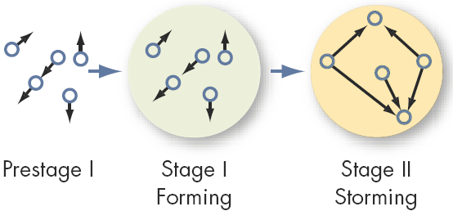
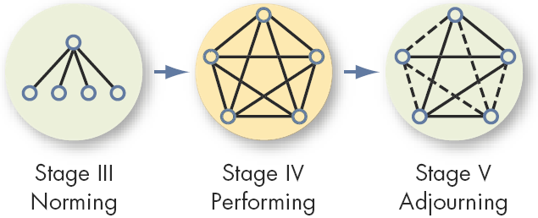
Five Stages of Group Development Model

Slide 8
The Five Stages of Group Behavior
In 1965, psychologist Bruce Tuckman proposed his original model of group development. This model suggests that groups and teams move through a series of stages in order to achieve their peak level of performance. The first five stages of the model are:
Forming
  Members feel much uncertainty. At this stage, the group witnesses orientation and ice-breaking.
Storming
  Lots of conflict between members of the group. At this stage, the group is addressing its conflicts and disagreements.

Slide 9
The Five Stages of Group Behavior
3.Norming Stage
  Members have developed close relationships and cohesiveness. They resolved their conflicts and reached a consensus on how the group will function
4. Performing Stage
  The group is finally fully functional.
5. Adjourning Stage
  In temporary groups, the group wraps up its work and then dissolves.

Slide 10
What Do Effect Groups’ Performance? Group Properties
Group
Performance
Norms
Status
Size
Roles
Cohesiveness

Slide 11
Group Property 1: Roles
Role
  A set of expected behavior patterns attributed to someone occupying a given position in a social unit
Role Identity
  Certain attitudes and behaviors consistent ثابتة with a role
Role Perception
  An individual’s view of how he or she is supposed to act in a given situation – received by external stimuli
Role Expectations
  How others believe a person should act in a given situation
  Psychological Contract: an unwritten agreement that sets out mutual expectations of management and employees

Slide 12
Group Property 2 : Norms
Norms
  Acceptable standards of behavior within a group that are shared by the group’s members
Classes of Norms
  Performance norms - level of acceptable work
  Appearance norms - what to wear
  Social arrangement norms - friendships and the like
  Allocation of resources norms - distribution and assignments of jobs and material

Slide 13
Group Property 3: Status
A socially defined position or rank given to groups or group members by others – it differentiates group members
  Important factor in understanding behavior
  Significant motivator
Status Characteristics Theory
  Status derived from one of three sources:
    Power a person has over others
    Ability to contribute to group goals
    Personal characteristics

Slide 14
Status Effects
On Norms and Conformity
  High-status members are less restrained by norms and pressure to conform
  Some level of deviance is allowed to high-status members so long as it doesn’t affect group goal achievement
On Group Interaction
  High-status members are more assertive
  Large status differences limit diversity of ideas and creativity
On Equity
  If status is perceived to be inequitable, it will result in various forms of corrective behavior.

Slide 15
Group Property 4: Size
Group size affects behavior
Size:
  Twelve or more members is a “large” group
  Seven or fewer is a “small” group
Best use of a group:
Attribute | Small | Large
Speed | X
Individual Performance | X
Problem Solving |  | X
Diverse Input |  | X
Fact-finding Goals |  | X
Overall Performance | X

Slide 16
Issues with Group Size
Social Loafing
  The tendency for individuals to expend less effort when working collectively than when working individually
  Caused by either equity concerns or a diffusion of responsibility (free riders)
Managerial Implications
  Build in individual accountability
  Prevent social loafing by:
    Setting group goals
    Increase intergroup competition
    Use peer evaluation
    Distribute group rewards based on individual effort

Slide 17
Group Property 5: Cohesiveness
Degree to which group members are attracted to each other and are motivated to stay in the group
Managerial Implication
  To increase cohesiveness:
    Make the group smaller.
    Encourage agreement with group goals.
    Increase time members spend together.
    Stimulate competition with other groups.
    Give rewards to the group, not individuals.

Slide 18
Group Decision Making Vs Individual Choice
Group Strengths:
  Generate more complete information and knowledge
  Offer increased diversity of views and greater creativity
  Increased acceptance of decisions
  Generally more accurate (but not as accurate as the most accurate group member)
Group Weaknesses:
  Time-consuming activity
  Conformity pressures in the group
  Discussions can be dominated by a few members
  A situation of ambiguous responsibility

Slide 19
Group Decision Making Phenomena
Group think : Groupthink is a psychological phenomenon that occurs within a group of people, in which the desire for harmony or conformity in the group results in an irrational or dysfunctional decision-making outcome. Group members try to minimize conflict and reach a consensus decision without critical evaluation of alternative viewpoints, by actively suppressing dissenting viewpoints, and by isolating themselves from outside influences.

Slide 20
Group Decision Making Phenomena
Group shift : is a phenomenon in which the initial positions of individual members of a group are exaggerated toward a more extreme position. When people are in groups, they make decisions about risk differently from when they are alone. In the group, they are likely to make riskier decisions, as the shared risk makes the individual risk less.

Slide 21
Group Decision Making Technique
Made in interacting groups where members meet face-to-face and rely on verbal and nonverbal communication.
Brainstorming
- It is a group creativity technique by which efforts are made to find a conclusion for a specific problem by gathering a list of ideas spontaneously contributed by its members.
Nominal Group Technique (NGT)
  Works by restricting discussion during the decision-making process. Participants are asked to write their ideas anonymously. Then the facilitator collects the ideas and the group votes on each idea.
Electronic Meeting
  It is a type of computer software that facilitates creative problem solving and decision-making of groups within or across organizations.

Slide 22
Global Implications
Status and Culture
  The importance of status varies with culture
  Managers must understand who and what holds status when interacting with people from another culture
Social Loafing
  Most often in Western (individualistic) cultures
Group Diversity
  Increased diversity leads to increased conflict
  May cause early withdrawal and lowered morale
  If the initial difficulties are overcome, diverse groups may perform better
  Surface diversity may increase openness

Slide 23
ا
Summary & Managerial Implications
Performance
  Typically, clear role perception, appropriate norms, low status differences and smaller, more cohesive groups lead to higher performance
Satisfaction
  Increases with:
    High congruence لتطابق between boss and employee’s perceptions about the job
    Not being forced to communicate with lower-status employees
    Smaller group size

Slide 24
Understanding Work Teams
After studying this chapter, you should be able to:
  1.Analyze the growing popularity of teams in organizations.
  2.Contrast groups and teams.
  3.Compare and contrast four types of teams.
  4.Identify the characteristics of effective teams.
  5.Show how organizations can create team players.
  6.Decide when to use individuals istead of teams.
  7.Show how our understanding of teams differs in a global context.

Slide 25
Differences Between Groups and Teams
Work Group
  A group that interacts primarily to share information and to make decisions to help each group member perform within his or her area of responsibility
  No joint effort required
Work Team
  Generates positive synergy through coordinated effort. The individual efforts result in a performance that is greater than the sum of the individual inputs

Slide 26
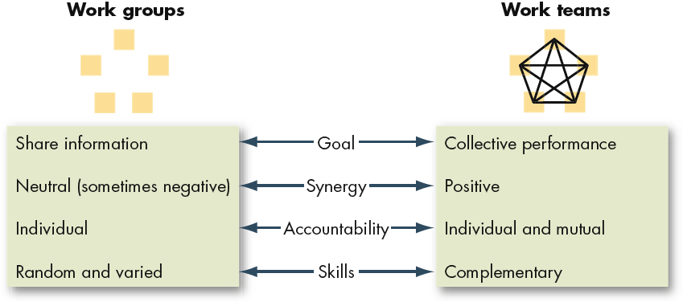
Comparing Work Groups & Work Teams

Slide 27
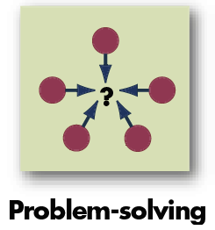
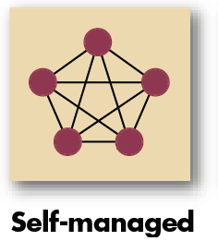
Types of Teams
Problem-Solving Teams
  Groups of 5 to 12 employees from the same department who meet for a few hours each week to discuss ways of improving quality, efficiency, and the work environment
Self-Managed Work Teams
  Groups of 10 to 15 people who take on the responsibilities of their former supervisors

Slide 28
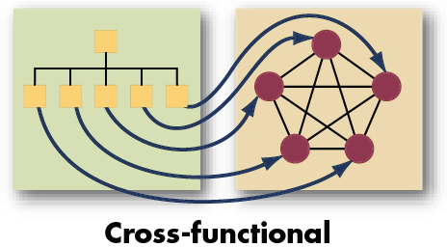
More Types of Teams
Cross-Functional Teams
  Employees from about the same hierarchical level, but from different work areas, who come together to accomplish a task
  Very common
  Task forces
  Committees

Slide 29
A Final Type of Team
Virtual Teams
  Teams that use computer technology to tie together physically dispersed members in order to achieve a common goal
Characteristics
  Limited socializing
  The ability to overcome time and space constraints
To be effective, needs:
  Trust among members
  Close monitoring
  To be publicized

Slide 30
Why Have Teams Become So Popular?
1.Great way to use employee talents.
2.Teams are more flexible and responsive to changes in the environment.
3.Can quickly assemble, deploy, refocus, and disband.
4.Facilitate employee involvement.
5.Increase employee participation in decision making.
6.Democratize an organization and increase motivation.

Slide 31
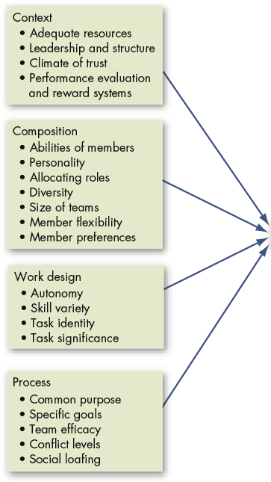

A Team Effectiveness Model
Caveat 1: This is a general guide only.
Caveat 2: The model assumes that teamwork is preferable to individual work.

Slide 32
Key Components of Effective Teams
1.Context
2.Composition
3.Work Design
4.Process Variables

Slide 33
Creating Effective Teams: Context
Team Adequate Resources
  Need the tools to complete the job
Team Effective Leadership and Structure
  Agreeing to the specifics of work and how the team fits together to integrate individual skills
  Even “self-managed” teams need leaders
  Leadership especially important in multi-team systems
Team Climate of Trust
  Members must trust each other and the leader
Team Performance and Rewards Systems that Reflect Team Contributions
  Cannot just be based on individual effort

Slide 34
Creating Effective Teams: Composition
Abilities of Members
  Need technical expertise, problem-solving, decision-making, and good interpersonal skills
Personality of Members
  Openness to experience, and relate any achieved success to team performance
Allocating Roles and Diversity
  Many necessary roles must be filled
  Diversity can lead to lower or high performance
Size of Team
  The smaller the better: 5 to 9 is optimal
Member’s Preference for Teamwork
  Do the members want to be on teams?

Slide 35
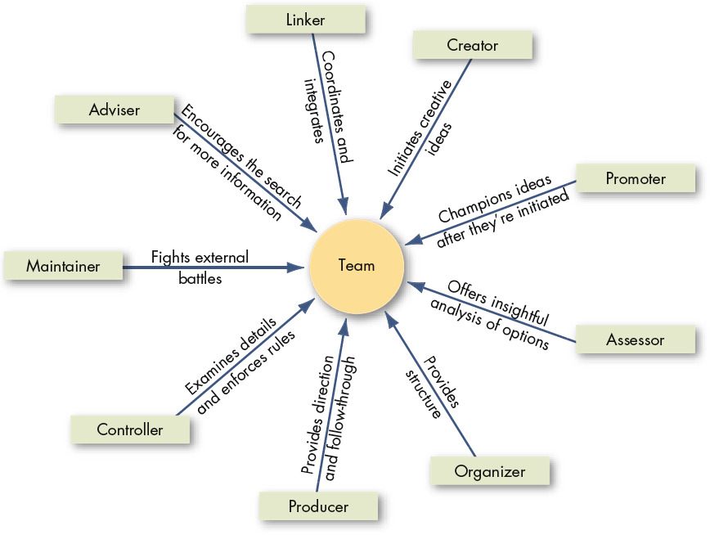
Key Roles on Teams

Slide 36
Key Roles on Teams
Linker: Coordinates and integrates
Creator: Indicates creative ideas
Promoter: Champions ideas after they are created
Assessor: Offers insightful analysis of options
Organizer: Provides structure
Producer: Provides direction
Controller: Examines details and enforces rules
Maintainer: Fights external battles
Advisor: Encourages the search for more information

Slide 37
Creating Effective Teams: Work Design
Team Freedom and Autonomy
  Ability to work independently
Team Skill Variety
  Ability to use different skills and talents
Team Task Identity
  Ability to complete a whole and identifiable task or product
Team Task Significance
  Working on a task or project that has a substantial impact on others

Slide 38
Creating Effective Teams: Process
Commitment to a Common Purpose
  Create a common purpose that provides direction
  Willing to adjust plan if necessary
Establishment of Specific Team Goals
  Must be specific, measurable, realistic, and challenging
Team Efficacy
  Team believes in its ability to succeed
Mental Models
  Have an accurate and common mental map of how the work gets done
A Managed Level of Conflict
  Task conflicts are helpful; interpersonal conflicts are not
Minimized Social Loafing
  Team holds itself accountable both individually and as a team

Slide 39
Turning Individuals into Team Players
Selection
  Make team skills one of the interpersonal skills in the hiring process.
Training
  Individualistic people can learn
Rewards
  Rework the reward system to encourage cooperative efforts rather than competitive (individual) ones
  Continue to recognize individual contributions while still emphasizing the importance of teamwork

Slide 40
Beware ,Teams are not always the answer
Teams take more time and resources than does individual work.
Three tests to see if a team fits the situation:
  Is the work complex and is there a need for different perspectives: will it be better with the insights of more than one person?
  Does the work create a common purpose or set of goals for the group that is larger than the aggregate of the goals for individuals?
  Are members of the group involved in interdependent
  ( depending on each other) tasks?

Slide 41
Global Implications
Extent of Teamwork
  Other countries use teams more often than does the U.S.
Self-Managed Teams
  Do not work well in countries with low tolerance for ambiguity and uncertainty and a high power distance
Team Cultural Diversity and Team Performance
  Diversity caused by national differences interferes with team efficiency, at least in the short run
  After about three months the differences between diverse and non-diverse team performance disappear

Slide 42
Summary and Managerial Implications
Effective teams have common characteristics:
  Adequate resources
  Effective leadership
  A climate of trust
  Appropriate reward and evaluation systems
  Composed of members with correct skills and roles
  Are smaller
  Do work that provides freedom, autonomy, and the chance to contribute
  The tasks are whole and significant
  Has members who believe in the team’s capabilities
Managers should modify the environment and select team-oriented individuals to increase the chance of developing effective teams.

