Slide 1

Accounting Principles
Prepared by Dr. Mohamed Hamouda
Lecture 9
Completing the Accounting Cycle

Slide 2
Accounting Principles
Prepared by Dr. Mohamed Hamouda
Lecture 9
Completing the Accounting Cycle

Slide 3
Accounting Principles
Prepared by Dr. Mohamed Hamouda
Lecture 9
Completing the Accounting Cycle

Slide 4
Accounting Principles
Prepared by Dr. Mohamed Hamouda
Lecture 9
RECAP

Slide 5
Building Blocks of Analysis
Ability to meet short-term obligations and to efficiently generate revenues
Liquidity and Efficiency
Ability to generate future revenues and meet long-term obligations
Solvency
Ability to provide financial rewards sufficient to attract and retain financing
Ability to generate positive market expectations
Profitability
Market

Slide 6
Inventories
Classifying Inventory
Determining Inventory Quantities
Inventory Costing
Inventory Errors
Statement Presentation and Analysis
Finished goods
Work in process
Raw materials
Taking a physical inventory
Determining ownership of goods
Specific identification
Cost flow assumptions
Financial statement and tax effects
Consistent use
Lower-of-cost-or-net realizable value
Income statement effects
Statement of financial position effects
Presentation
Analysis using inventory turnover

Slide 7

Allowance Method
P1
At the end of each period, estimate total bad debts expected to be realized from that period’s sales.
Two advantages to the allowance method:
It records estimated bad debts expense in the period when the related sales are recorded.
It reports accounts receivable on the balance sheet at the estimated amount of cash to be collected.
Notes:
The allowance method of accounting for bad debts matches the estimated loss from uncollectible accounts receivable against the sales they helped produce. We must use estimated losses because when sales occur, management does not know which customers will not pay their bills. This means that at the end of each period, the allowance method requires an estimate of the total bad debts expected to result from that period’s sales. This method has two advantages over the direct write-off method:
it records estimated bad debts expense in the period when the related sales are recorded and
it reports accounts receivable on the balance sheet at the estimated amount of cash to be collected.

Slide 8
Estimating Bad Debts Expense
P2
Two Methods
Percent of Sales Method
Accounts Receivable Methods
  Percent of Accounts Receivable
  Aging of Accounts Receivable
Notes:
The allowance method requires an estimate of bad debts expense to prepare an adjusting entry at the end of each accounting period. There are two common methods. The Percent of Sales Method is based on the income statement relation between bad debts expense and sales. The Accounts Receivable Methods are based on the balance sheet relation between accounts receivable and the allowance for doubtful accounts.

Slide 9
Plant Assets
C 1
Tangible in Nature
Actively Used in Operations
Expected to Benefit Future Periods
Called Property, Plant, & Equipment
Notes:
Plant assets are tangible assets that are actively used in the operations of the entity. We fully expect these assets, sometimes referred to as property, plant, and equipment, to benefit more than one accounting period.

Slide 10
Statement of Cash Flows
The Statement of Cash Flows: Usefulness and Format
Preparing the Statement of Cash Flows—Indirect Method
Using Cash Flows to Evaluate a Company
Usefulness
Classifications
Significant noncash activities
Format
Corporate life cycle
Preparation
Indirect and direct methods
Step 1: Operating activities
Step 2: Investing and financing activities
Step 3: Net change in cash
Free cash flow
Assessing liquidity and solvency

Slide 11
Capital Structure and Dividend Policy Decisions

Slide 12
Capital Structure
The combination of debt and equity used to finance a firm
Equity
Debt
Equity
Equity
Debt
Equity
Equity
Debt
Equity
Equity
Debt
Debt
Equity
Equity
Debt
Debt
Equity

Slide 13
Target Capital Structure
The optimal mix of debt, preferred stock, and common equity with which the firm plans to finance its investments May change over time
Trade-off between risk and return to achieve goal of maximizing the price of the stock
Preferred Stock
Common Stock
Debt

Slide 14
Factors Influence Capital Structure Decisions
1. Firm’s business risk
2. Firm’s tax position
3. Financial flexibility
4. Managerial attitude

Slide 15
Completing the Accounting Cycle

Slide 16
Completing the Accounting Cycle
Using a Worksheet
Closing the Books
Summary of Accounting Cycle
Classified Statement of Financial Position
Steps in preparation
Preparing financial statements
Preparing adjusting entries
Preparing closing entries
Posting closing entries
Preparing a post-closing trial balance
Reversing entries—An optional step
Correcting entries—An avoidable step
Intangible assets
Property, plant, and equipment
Long-term investments
Current assets
Equity
Non-current liabilities
Current liabilities

Slide 17
Using A Worksheet
Worksheet
  A multiple-column form used in preparing financial statements.
  Not a permanent accounting record.
  Five step process.
  Use of worksheet is optional.
SO 1 Prepare a worksheet.

Slide 18
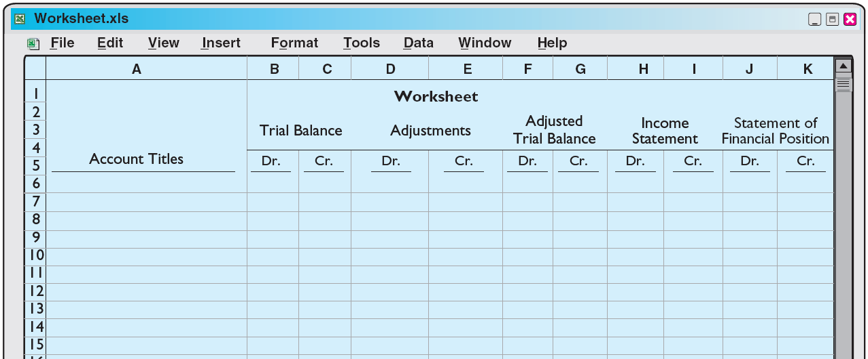
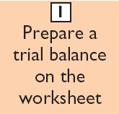
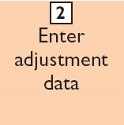
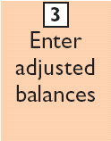
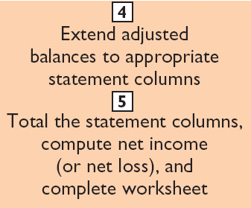
Steps in Preparing a Worksheet
Illustration 4-1
SO 1 Prepare a worksheet.

Slide 19
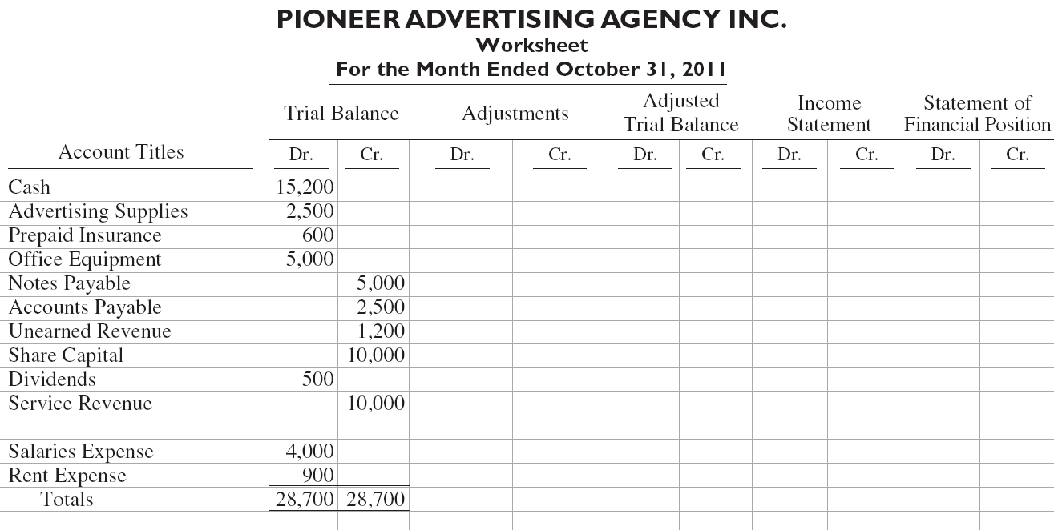
Steps in Preparing a Worksheet
Illustration:
Illustration 4-2
Preparing a trial balance
SO 1 Prepare a worksheet.

Slide 20
Steps in Preparing a Worksheet
1. Prepare a Trial Balance on the Worksheet
Trial balance amounts come directly from ledger accounts.
Include all accounts with balances.
SO 1 Prepare a worksheet.

Slide 21
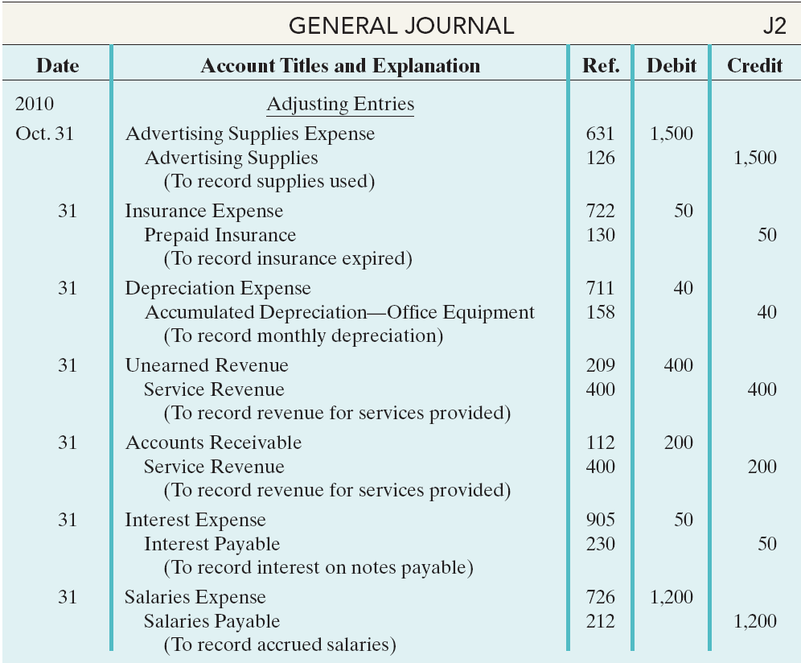
Steps in Preparing a Worksheet
Illustration 3-22
General journal showing adjusting entries
Adjusting Journal Entries (Chapter 3)
SO 1 Prepare a worksheet.

Slide 22
Steps in Preparing a Worksheet
2. Enter the Adjustments in the Adjustments Columns
(a)
(b)
Adjustments Key:
(a) Supplies Used.
(b) Insurance Expired.
(c) Depreciation Expensed.
(d) Service Revenue Earned.
(e) Service Revenue Accrued.
(f) Interest Accrued.
(g) Salaries Accrued.
(d)
(d)
(g)
(e)
(a)
(b)
(c)
(c)
(e)
Enter adjustment amounts, total adjustments columns,
and check for equality.
(f)
(f)
(g)
Add additional accounts as needed.
SO 1 Prepare a worksheet.

Slide 23
Steps in Preparing a Worksheet
3. Complete the Adjusted Trial Balance Columns
(a)
(b)
(d)
(d)
(g)
(e)
(a)
(b)
(c)
(c)
(e)
(f)
(f)
(g)
Total the adjusted trial balance columns and check for equality.
SO 1 Prepare a worksheet.

Slide 24
Steps in Preparing a Worksheet
4. Extend Amounts to Financial Statement Columns
(a)
(b)
(d)
(d)
(g)
(e)
(a)
(b)
(c)
(c)
(e)
(f)
(f)
(g)
Extend all revenue and expense account balances to the income statement columns.
SO 1 Prepare a worksheet.

Slide 25
Steps in Preparing a Worksheet
4. Extend Amounts to Financial Statement Columns
(a)
(b)
(d)
(d)
(g)
(e)
(a)
(b)
(c)
(c)
(e)
(f)
(f)
(g)
Extend all asset, liability, and equity account balances to the statement of financial position columns.
SO 1 Prepare a worksheet.

Slide 26
Steps in Preparing a Worksheet
5. Total Columns, Compute Net Income (Loss)
(a)
(b)
(d)
(d)
(g)
(e)
(a)
(b)
(c)
(c)
(e)
(f)
(f)
(g)
Compute Net Income or Net Loss.
SO 1 Prepare a worksheet.

Slide 27
Steps in Preparing a Worksheet
Review Question
Net income is shown on a worksheet in the:
  income statement debit column only.
  statement of financial position debit column only.
  income statement credit column and statement of financial position debit column.
  income statement debit column and statement of financial position credit column.
SO 1 Prepare a worksheet.

Slide 28
Preparing Financial Statements from a Worksheet
Worksheet
  Income statement is prepared from the income statement columns.
  Statement of financial position and retained earnings statement are prepared from the statement of financial position columns.
Companies journalize and post adjusting entries.
SO 1 Prepare a worksheet.

Slide 29
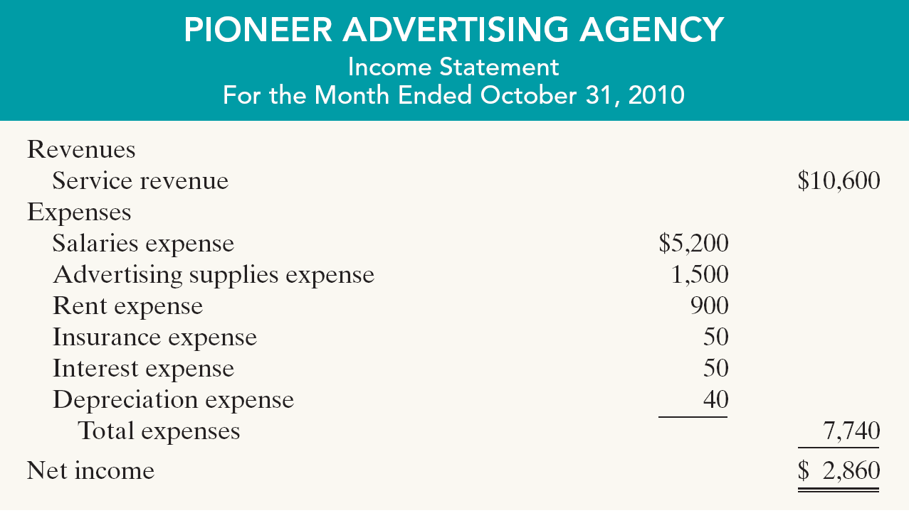

Preparing Financial Statements from a Worksheet
Illustration 4-4
SO 1 Prepare a worksheet.

Slide 30
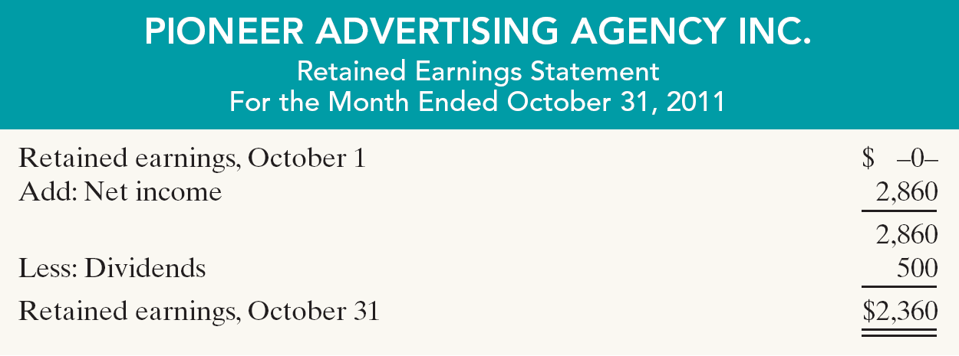
Preparing Financial Statements from a Worksheet
Illustration 4-4
SO 1 Prepare a worksheet.

Slide 31
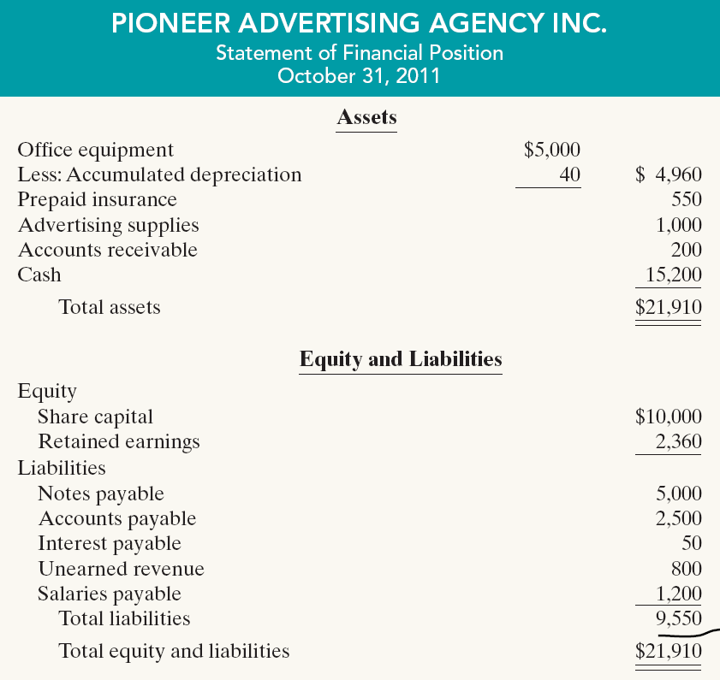
Preparing Financial Statements from a Worksheet
Illustration 4-4

Slide 32
Preparing Adjusting Entries from a Worksheet
Adjusting Entries
  The adjusting entries are prepared from the adjustments columns of the worksheet.
  Journalizing and posting of adjusting entries follows the preparation of financial statements when a worksheet is used.
SO 1 Prepare a worksheet.

Slide 33
Preparing Adjusting Entries from a Worksheet
Illustration 3-22
General journal showing adjusting entries
Adjusting Journal Entries (Chapter 3)
SO 1 Prepare a worksheet.

Slide 34
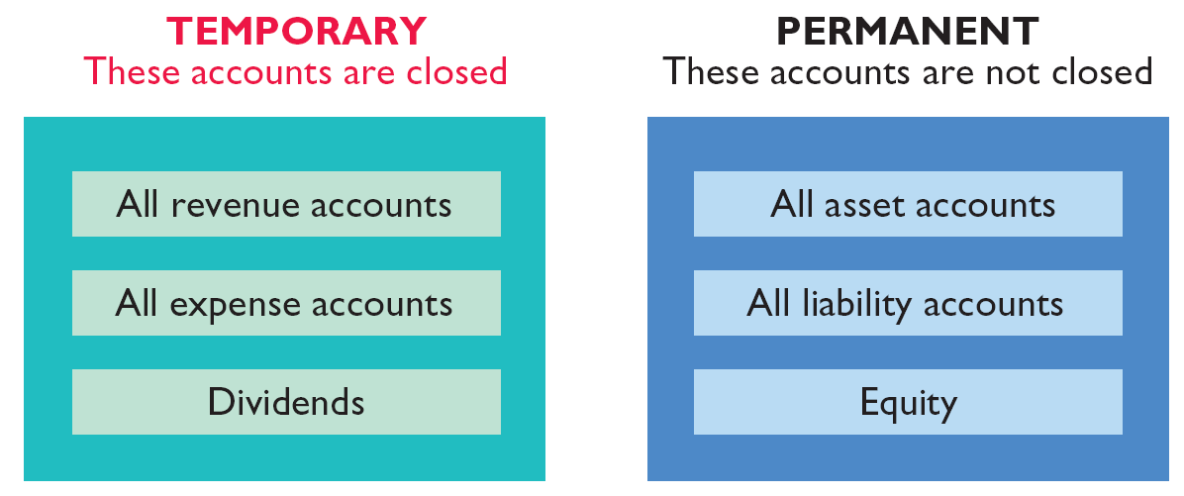
Closing the Books
At the end of the accounting period, the company makes the accounts ready for the next period.
Illustration 4-5
SO 2 Explain the process of closing the books.

