Slide 1


Overview of management
Chapter- 1 lecture-2
Everyone’s Smart
University
MGM111
Principle of Management

Slide 2
Learning Outcomes
Describe function or process of management and function of project
Discuss some major changes in management
Discuss the principal challenges managers face

Slide 3
Functions of Management
planning
organizing
leading
controlling

Slide 4
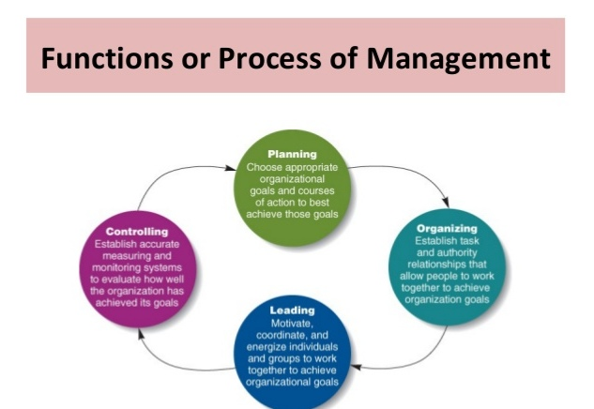

Slide 5
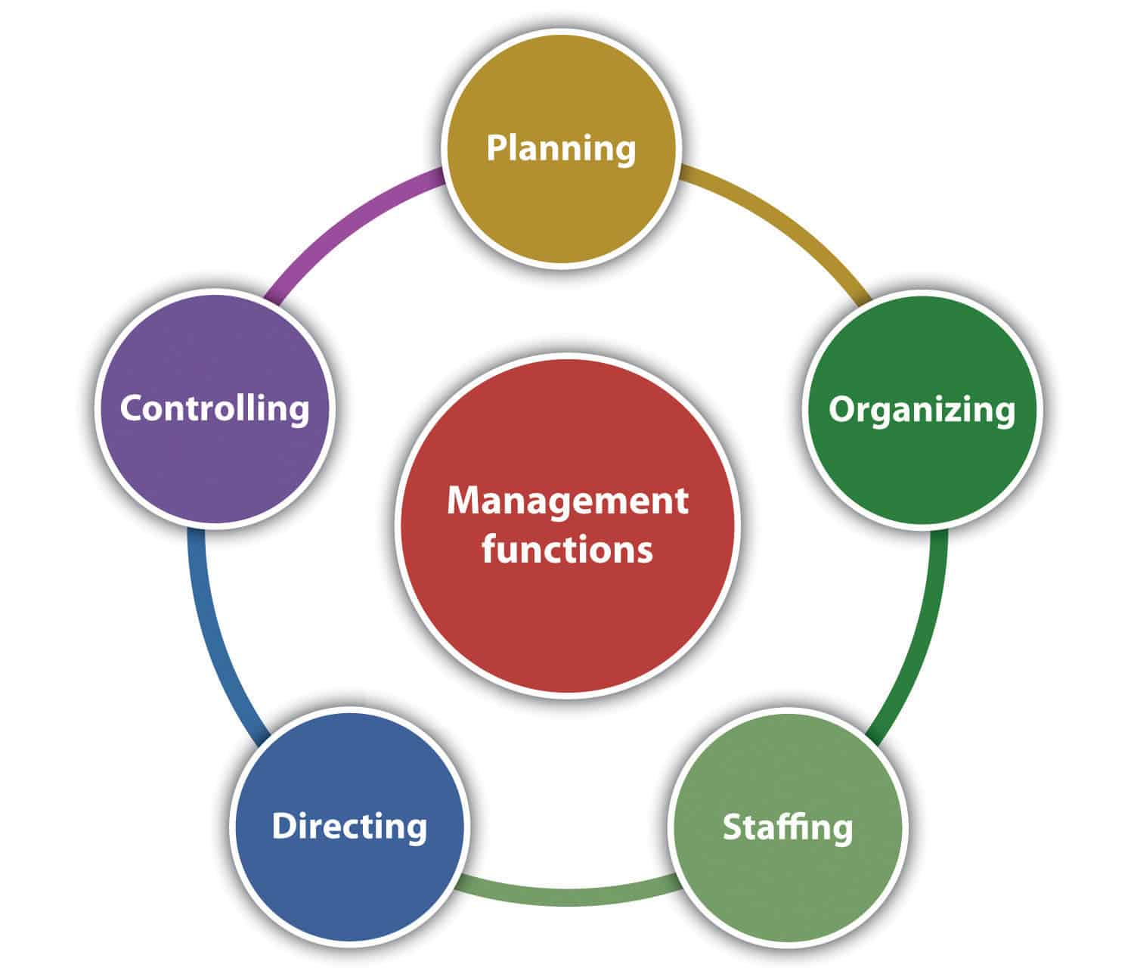
Function or process of management

Slide 6
Functions of project
product
marketing
Human resource
finance

Slide 7
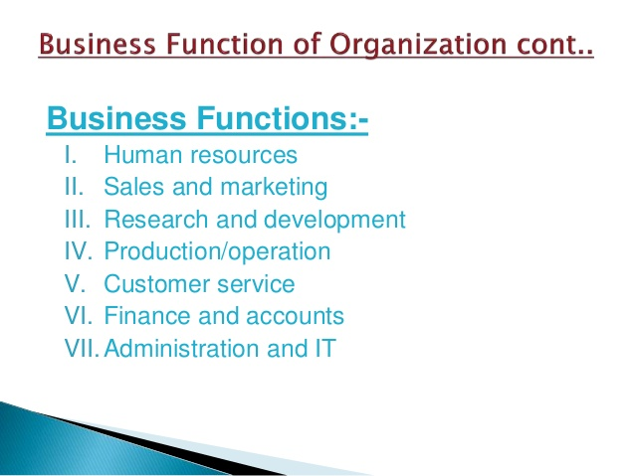

Slide 8
Planning
• Process of identifying and selecting appropriate organizational goals and courses of action.
• Planning is determining the objectives and formulating the methods to achieve them. It is more simply said than done.

Slide 9
A job well planned is half done

Slide 10
PLANNING
Planning is determining the objectives and formulating the methods to achieve them. It is more simply said than done. A job well planned is half done. During planning one needs to ask oneself the following:
What am I trying to accomplish i.e. what is my objective?
What resources do I have and do I need to accomplish the same?
What are the methods and means to achieve the objectives?
Is this the optimal path?

Slide 11
Type of planning
Purposes or missions.
Objectives-It is the ultimate goal towards which the activities of the organization are directed .
Strategies-general program of action and deployment of resources
Policies-general statement or understanding which guide or channel thinking in decision making.
Procedures-states a series of related steps or tasks to be performed in a sequential way.
Rules-prescribes a course of action and explicitly states what is to be done.
Programs-comprehensive plan that includes future use of different resources.
Budgets-statement of expected results expressed in numerical terms.

Slide 12
Principles of Planning
Take Time to Plan
Planning can be Top to Down or Bottom to Top
Involve and Communicate with all those Concerned
Plans must be Flexible and Dynamic
Evaluate and Revise

Slide 13
Steps in Planning
Determining the goals or objectives for the entire organization.
Making assumptions on various elements of the environment.
To decide the planning period.
Examine alternative courses of actions.
Evaluating the alternatives.
Real point of decision making
To make derivative plans.

Slide 14
Steps in the Planning Process
• Deciding which goals the organization will pursue
• Deciding what courses of action to adopt to attain those goals
• Deciding how to allocate organizational resources

Slide 15
planning cont
• Complex, difficult activity
• Strategy to adopt is not always immediately clear
• Done under uncertainty

Slide 16
Types of Managerial Decisions
Programmed
Non programmed.
Mechanistic-It is one that is routine and repetitive in nature
Analytical-It involves a problem with a larger number of decision variables
Judgmental-It involves a problem with a limited number of decision variables, but the outcomes of decision alternatives are unknown
Adaptive-It involves a problem with a large number of decision variables, where outcomes are not predictable

Slide 17
Organizing
Organizing is assembling and coordinating the human, financial, physical, informational, and other resources needed to achieve goals

Slide 18
Process of Organizing
Determine what is to be done/ Division of Work:
Assign Tasks: Departmentalization
Link Departments: Hierarchy Development
Decide how much Authority to Designate/ Authority, Responsibility and Delegation
Decide the Levels at which Decisions are to be made / Centralization vs. Decentralization
Decide how to Achieve Coordination

Slide 19
Organizing cont
• Involves grouping people into departments according to the kinds of job-specific tasks they perform
• Managers lay out lines of authority and responsibility
• Decide how to coordinate organizational resources

Slide 20
Functional Departmentalization
manager
Product meager
Marketing manager
Human resource manager

Slide 21
Leading
• Leading is stimulating people to be high performers. It is directing, motivating and communicating with employees.
• Articulating a clear organizational vision for its members to accomplish, and energize and enable employees so that everyone understands the part they play in achieving organizational goals

Slide 22
Leading cont..
Provides positive and dynamic leadership
• Provides maximum opportunities
• Provides proper motivation of personnel
• Ability to command people Directing/Leading

Slide 23
Controlling
• Controlling is the management function of monitoring progress and making changes.
• Steps in the Control Process
Establish Standards of Performance
2) Measure Actual Performance
3) Compare Performance to Standard
4) Take Corrective Action

Slide 24
CONTROLLING CONCEPTS
Feed Forward Control-Control that attempts to identify and prevent deviations before they occur is called feed forward control, sometimes called preliminary or preventive control.
Concurrent Control-Control that monitors ongoing employee activities during their progress, to ensure they are consistent with quality standards, is called concurrent control.
Feedback Control-In this case, the control takes place after the action. Sometimes called post-action or output control

Slide 25
Challenges for Management in a Global Environment
• Rise of Global Organizations.
• Building a Competitive Advantage
• Maintaining Ethical Standards
• Managing a Diverse Workforce
• Utilizing Information Technology and Technologies
• Global Crisis Management

Slide 26
Building Competitive Advantage
• Competitive Advantage – ability of one organization to outperform other organizations because it produces desired goods or services more efficiently and effectively than its competitors

Slide 27
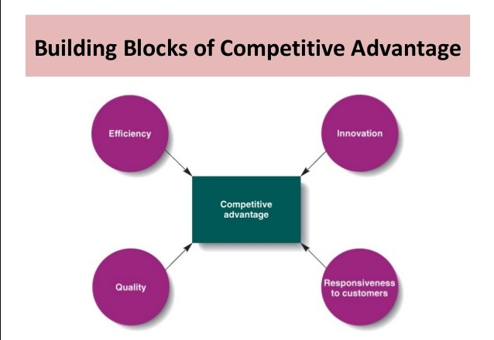

Slide 28
Building Competitive Advantage
* Increasing efficiency
– Reduce the quantity of resources used to produce goods or services
* Increasing Quality
– Improve the skills and abilities of the workforce – Introduce total quality management.

Slide 29
Building Competitive Advantage
• Increasing speed, flexibility, and innovation
– How fast a firm can bring new products to market
– How easily a firm can change or alter the way they perform their activities
• Innovation
– Process of creating new or improved goods and services that customers want
– Developing better ways to produce or provide goods and services

Slide 30
Maintaining Ethical and Socially Responsible Standards
Managers are under considerable pressure to make the best use of resources
Too much pressure may induce managers to behave unethically, and even illegally

Slide 31
Managing a Diverse Workforce
• To create a highly trained and motivated workforce managers must establish HRM procedures that are legal, fair and do not discriminate against organizational members

Slide 32
Global Crisis Management
May be the result of:
• Natural causes
• Manmade causes
• International terrorism
• Geopolitical conflicts

Slide 33
Some Management Aspects
• Core Competency: Specific set of departmental skills, abilities, knowledge and experience that allows one organization to outperform its competitors
• Restructuring: Involves simplifying, shrinking, or downsizing an organization’s operations to lower operating costs
• Outsourcing: Contracting with another company, to perform a work activity the company previously performed itself
• Empowerment: Involves giving employees more authority and responsibility over the way they perform their work activities

Slide 34
Thanks

