Slide 1


Computer Vision,
and Digital Image
Processing
Prepared by Dr. Mohamed Mostafa
AI 612
Lecture 3

Slide 2



Intensity Transformations and Spatial Filtering
Lecture 3
AI 612
Prepared by
Dr. Mohamed Mostafa
www.midocean.ae

Slide 3

Intensity Transformations and
Spatial Filtering
Chapter
02
www.midocean.ae

Slide 4
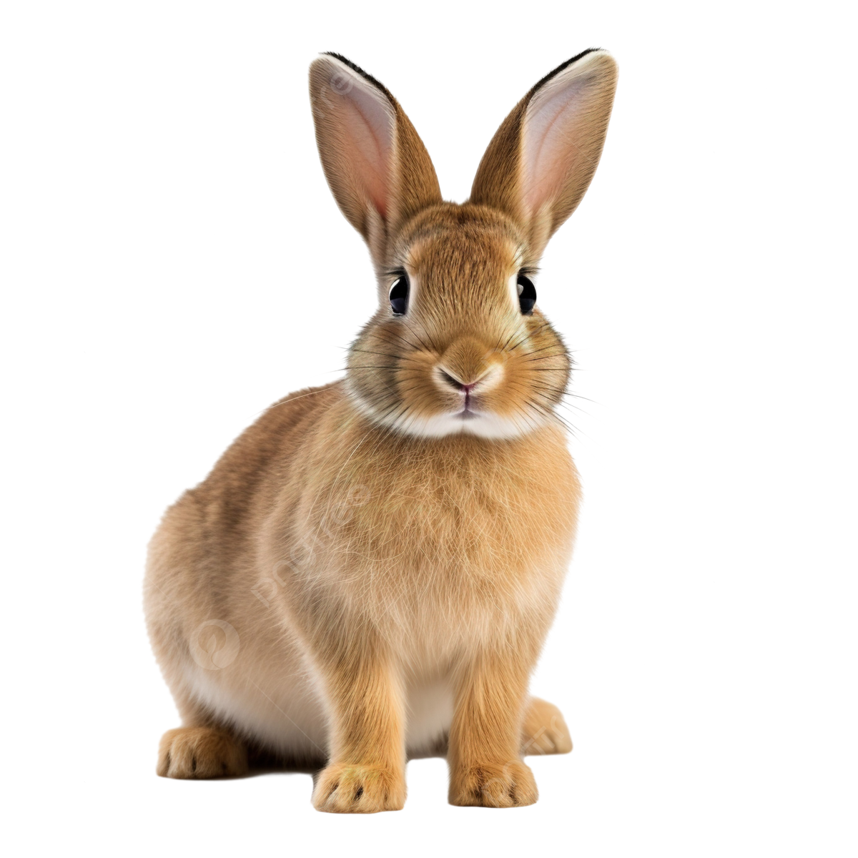

What is Spatial Domain?
The term spatial domain refers to the image plane itself.
Image processing methods in this category are based on direct manipulation of pixels in an image.
Two principal categories of spatial processing :
Intensity transformations : operate on single pixels of an image for tasks such as contrast manipulation and image thresholding.
Spatial filtering: performs operations on the neighborhood of every pixel in an image. include image smoothing and sharpening
f (x, y): is an input image,
g(x, y) is the output image,
T is an operator on f defined over a neighborhood of point (x, y).

Slide 5
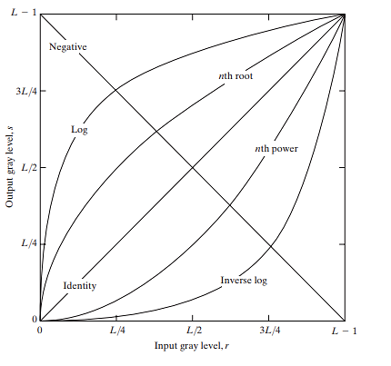
Number of Basic Intensity Transformation Functions?
IMAGE NEGATIVES
LOG TRANSFORMATIONS
POWER-LAW (GAMMA) TRANSFORMATIONS

Slide 6

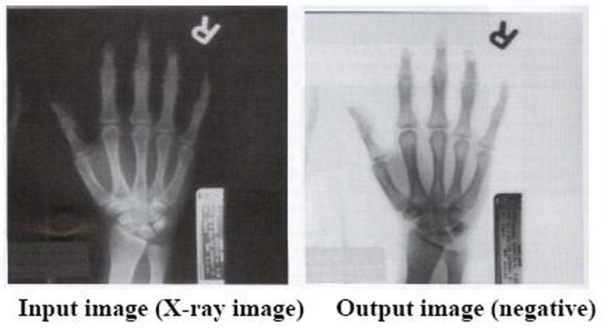
Image Negatives
The negative of an image (monochrome image) with intensity levels in the range [0,L - 1] is obtained by using the negative transformation function
Let us take an 8-bit image with intensity range of 0–255.
then if the pixel is Black (0) to inverse it (255-0 = 255, which means White color)
The White to opposite (255-255= 0 then goes to Black)

Slide 7
Image Negatives
Find the negative of the current image with 255 gray levels
Gray_image = [[100, 150, 200],
[50, 75, 100],
[25, 0, 255]]
Negative Image= [[155, 105, 55],
[205, 180, 155],
[230, 255, 0]]

Slide 8
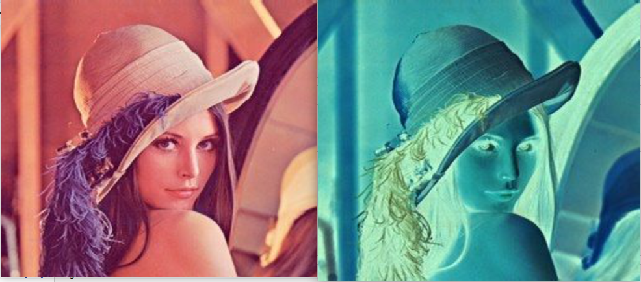
Image Negatives
For color image, we can convert it into its negative form by simply subtracting the RGB intensity value from 255.
Mathematically,
R = 255-R
G = 255 -G
B = 255 -B

Slide 9
Image Negatives
Problem:
Consider a colored image with RGB channels represented as matrices. The pixel values range from 0 to 255, where 0 represents black and 255 represents white.
Calculate the negative values for a pixel with RGB values (100, 150, 200).

Slide 10
Image Negatives
Answer:
Given RGB values: R = 100, G = 150, B = 200
Negative_R = 255 - R = 255 - 100 = 155
Negative_G = 255 - G = 255 - 150 = 105
Negative_B = 255 - B = 255 - 200 = 55
So, the negative values for the pixel are (155, 105, 55).

Slide 11
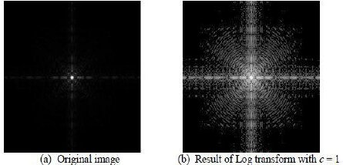
Log Transformations
s=c⋅log(1+r)
where:
s is the output pixel value,
r is the input pixel value,
c is a scaling factor.
www.midocean.ae

Slide 12
If > 1.0, then the result is logarithmic curves that brighten an image. RGB monitors have gamma values of 1.4 to 2.8.
Power-law (Gamma) Transformations
The brightness of an image can be adjusted with a gamma correction transformation.
by applying a power-law function to its pixel values. The general form of a power-law transformation is given by:
s=c⋅r^{γ}
where:
s is the output pixel value,
r is the input pixel value,
c is a scaling factor,
γ is the gamma parameter.
If γ > 1.0, then the result is logarithmic curves that darken an image.
RGB monitors have gamma values of 1.4 to 2.8.

Slide 13
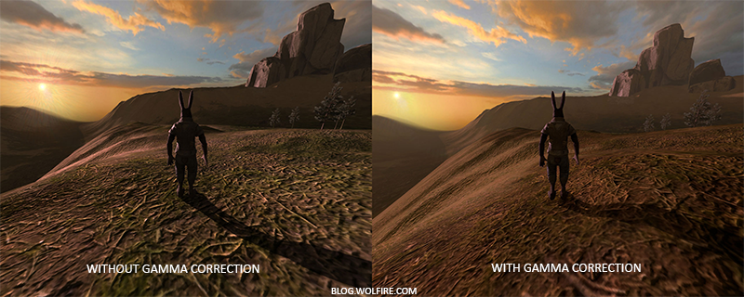
Power-law (Gamma) Transformations

Slide 14
Problem:
Suppose we have a grayscale image with 256 gray levels and we want to perform a power-law (gamma) transformation on it.
Let's consider the following parameters for the transformation:
Input intensity level (r) = 100
Constant scaling factor (c) = 1.5
Gamma value (γ) = 0.5
Power-law (Gamma) Transformations

Slide 15

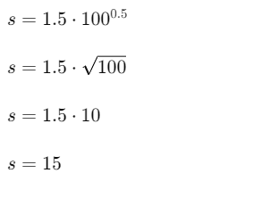
Power-law (Gamma) Transformations
Answer:
Given intensity level (r) = 100
Then using the transformation Function
So, the new value for the pixel is (15).

Slide 16
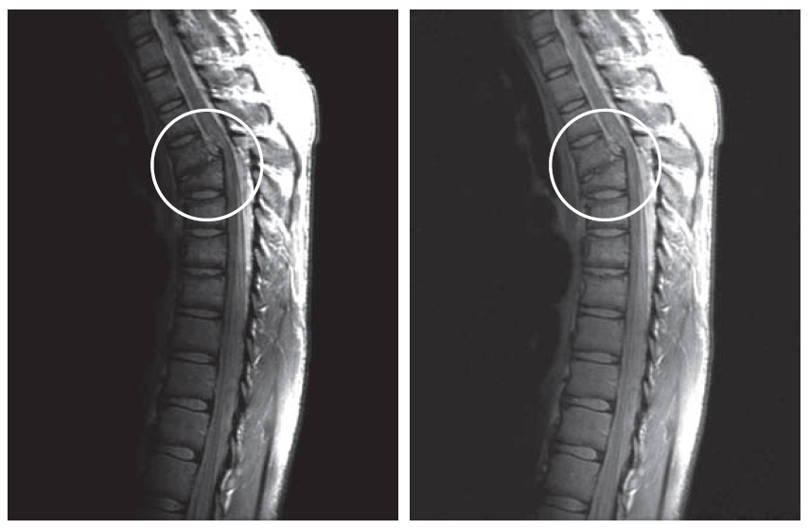
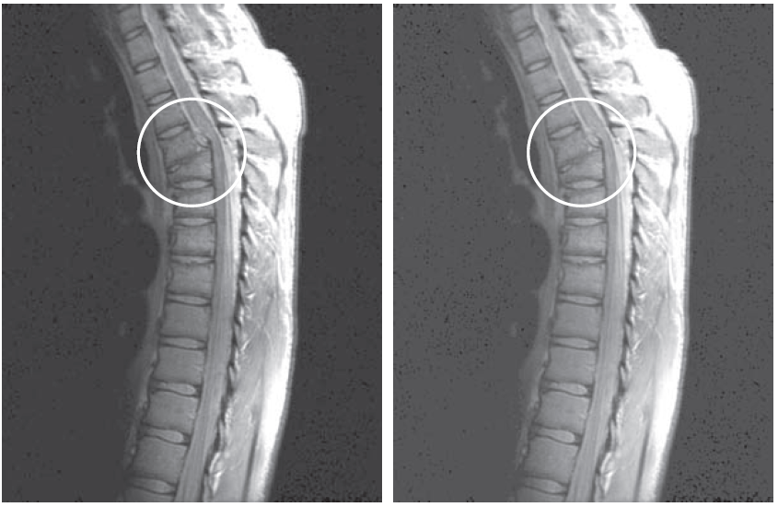
Power-law (Gamma) Transformations
γ = 0.6
γ = 0.4
γ = 0.3
Notes:
where c = 1

Slide 17
Piecewise Transformations
Instead of applying a single transformation function to the entire image, different regions of the image are subjected to different transformations. This approach allows for more flexibility in adjusting pixel values and enhancing specific features in different parts of the image.
Types:
Contrast stretching,
Gray level slicing and
Bit-Plane slicing
www.midocean.ae

Slide 18
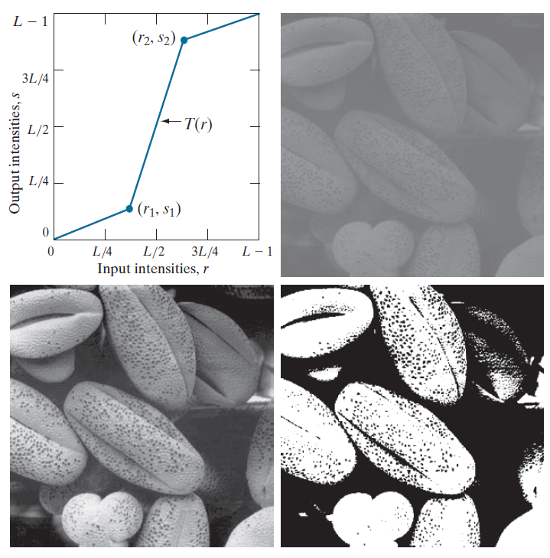
Contrast Stretching Transformations
Contrast stretching, also known as intensity stretching or normalization, is an image processing technique used to enhance the contrast of an image by expanding the range of pixel values. The goal is to improve the visibility of details and features within the image.

Slide 19
Contrast Stretching Transformations
Problem:
Consider a gray image with 256 gray-levels represented by pixel values ranging from 0 to 255. Apply contrast stretching transformation to enhance the contrast of the image with the following parameters:
Original pixel values: [100, 150, 200, 50, 75, 225, 175, 125]
New pixel values after contrast stretching transformation: ?

Slide 20
Contrast Stretching Transformations
Answer:
Determine the minimum and maximum pixel values in the original image:
Minimum pixel value (Min): 50 Maximum pixel value (Max): 225
Compute the range of pixel values in the original image:
Range = Max - Min = 225 - 50 = 175
Define the desired minimum and maximum pixel values for the stretched image (commonly 0 and 255, respectively).
Apply the contrast stretching transformation to each pixel in the original image using the formula:
NewPixelValue = (OriginalPixelValue - Min) * (NewMax / Range)
Substitute the values into the formula:
NewMin = 0 (desired minimum pixel value)
NewMax = 255 (desired maximum pixel value)

Slide 21
Contrast Stretching Transformations
Answer:
For each original pixel value:
For pixel value 50: NewPixelValue = (50 - 50) * (255 / 175) = 0 * 1.457 = 0
For pixel value 75: NewPixelValue = (75 - 50) * (255 / 175) = 25 * 1.457 = 36.425 ≈ 36
For pixel value 100: NewPixelValue = (100 - 50) * (255 / 175) = 50 * 1.457 = 72.85 ≈ 73
For pixel value 125: NewPixelValue = (125 - 50) * (255 / 175) = 75 * 1.457 = 109.275 ≈ 109
For pixel value 150: NewPixelValue = (150 - 50) * (255 / 175) = 100 * 1.457 = 145.7 ≈ 146
For pixel value 175: NewPixelValue = (175 - 50) * (255 / 175) = 125 * 1.457 = 182.125 ≈ 182
For pixel value 200: NewPixelValue = (200 - 50) * (255 / 175) = 150 * 1.457 = 218.55 ≈ 219
For pixel value 225: NewPixelValue = (225 - 50) * (255 / 175) = 175 * 1.457 = 255.475 ≈ 255
The new pixel values after contrast stretching transformation are approximately: [0, 36, 73, 109, 146, 182, 219, 255]

Slide 22
Intensity Level Slicing Transformations
Intensity level slicing, also known as thresholding or binary slicing, is an image processing technique that involves dividing an image into regions based on the intensity levels of its pixels. The goal of intensity level slicing is often to highlight specific features or regions within an image by isolating pixels with intensity values falling within a certain range.
Thresholding:
  Intensity level slicing is essentially a form of thresholding where a threshold or range of intensity values is defined, and pixels with intensities within that range are treated differently from those outside the range.
Binary Image Creation:
  The result of intensity level slicing is often a binary image, where pixels within the specified intensity range are assigned one value (usually white), and pixels outside the range are assigned another value (usually black). This creates a high-contrast representation of the selected features.

Slide 23
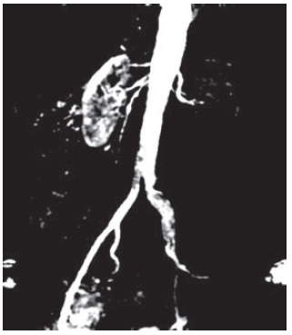
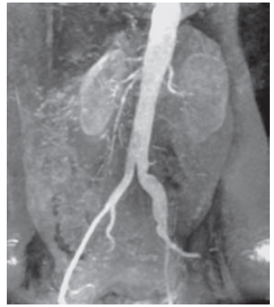
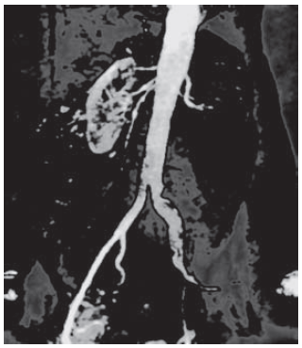
Intensity Level Slicing Transformations
Binary Image Creation
Thresholding

Slide 24
Intensity Level Slicing Transformations
Thresholding Example:
Let's consider a grayscale image represented by the following pixel values (ranging from 0 to 255)
[25, 50, 75, 100, 125, 150, 175, 200, 225, 250]
Now, let's apply intensity level slicing transformation using thresholding to highlight pixels with intensity values between 100 and 200.
Define the threshold range:
  - Lower threshold (T1): 100
  - Upper threshold (T2): 200
Apply thresholding to create a binary mask:
For pixels with intensity values between T1 and T2, set the corresponding pixel value in the mask to 1 (white).
For pixels with intensity values outside the threshold range, set the corresponding pixel value in the mask to 0 (black).

Slide 25
Intensity Level Slicing Transformations
Thresholding Example:
Original Image: [25, 50, 75, 100, 125, 150, 175, 200, 225, 250]
Mask: [ 0, 0, 0, 1, 1, 1, 1, 1, 0, 0]
Resulting Image: [ 0, 0, 0, 100, 125, 150, 175, 200, 0, 0]

Slide 26
Intensity Level Slicing Transformations
Binary Image Creation Example:
Let's consider a grayscale image represented by the following pixel values (ranging from 0 to 255)
[25, 50, 75, 100, 125, 150, 175, 200, 225, 250]
Now, let's apply intensity level slicing transformation using thresholding to highlight pixels with intensity values between 100 and 200.
Define the threshold range:
  - Lower threshold (T1): 100
  - Upper threshold (T2): 200
Apply thresholding to create a binary mask:
For pixels with intensity values between T1 and T2, set the corresponding pixel value in the mask to 1 (white).
For pixels with intensity values outside the threshold range, set the corresponding pixel value in the mask to 0 (black).

Slide 27
Intensity Level Slicing Transformations
Binary Image Creation Example :
Original Image: [25, 50, 75, 100, 125, 150, 175, 200, 225, 250]
Binary Image : [ 0, 0, 0, 1, 1, 1, 1, 1, 0, 0]

Slide 28
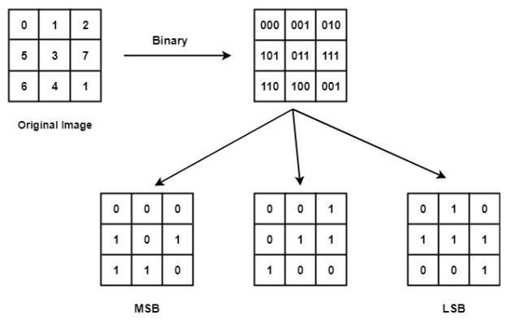
Bit-Plane Slicing Transformations
In Bit-plane slicing, we divide the image into bit planes. This is done by first converting the pixel values in the binary form and then dividing it into bit planes.
The higher-order bits (especially the top four) contain the majority of the visually significant data.
www.midocean.ae

Slide 29
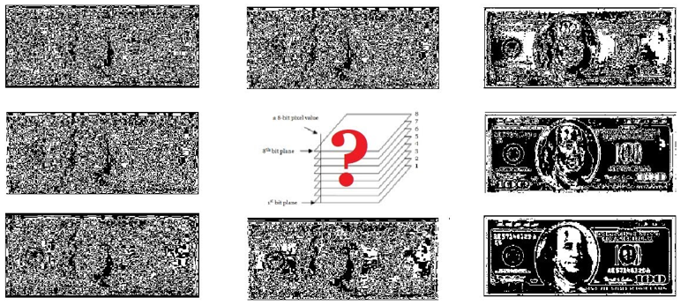
Bit-Plane Slicing Transformations
www.midocean.ae

Slide 30
Bit-Plane Slicing Transformations
Practice:
Consider a grayscale image represented by the following gray values (each value is an 8-bit binary number):
4 | 5 | 7
0 | 2 | 3
2 | 3 | 1
Visualize the bit-planes for the given image
www.midocean.ae

Slide 31
Bit-Plane Slicing Transformations
100 | 101 | 111
000 | 010 | 011
010 | 011 | 001
Practice:
Consider a grayscale image represented by the following gray values (each value is an 8-bit binary number):
Step 1: Converted to Binary digits
www.midocean.ae

Slide 32
Bit-Plane Slicing Transformations
100 | 101 | 111
000 | 010 | 011
010 | 011 | 001
Practice:
Consider a grayscale image represented by the following gray values (each value is an 8-bit binary number):
MSB
Mid
LSB
1 | 1 | 1
0 | 0 | 0
0 | 0 | 0
0 | 0 | 1
0 | 1 | 1
1 | 1 | 0
0 | 1 | 1
0 | 0 | 1
0 | 1 | 1
Step 2: Bit-wise slicing
www.midocean.ae

Slide 33
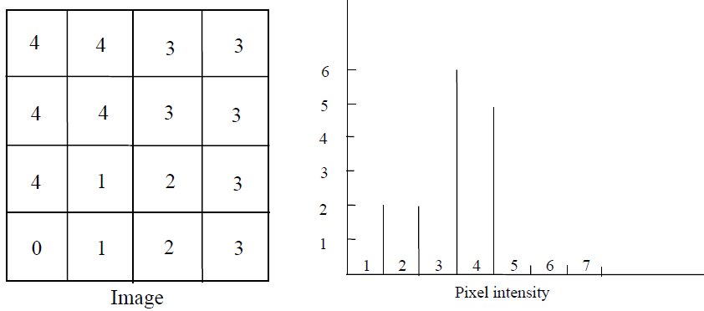
Histogram Processing
The image histogram is a valuable tool used to view the intensity profile of an image.
The histogram provides information about the contrast and overall intensity distribution of an image.
The image histogram is simply a bar graph of the pixel intensities. The pixel intensities are plotted along the x-axis and the number of occurrences for each intensity represents the y-axis.
Let’s try:
https://www.dcode.fr/image-histogram
www.midocean.ae

Slide 34
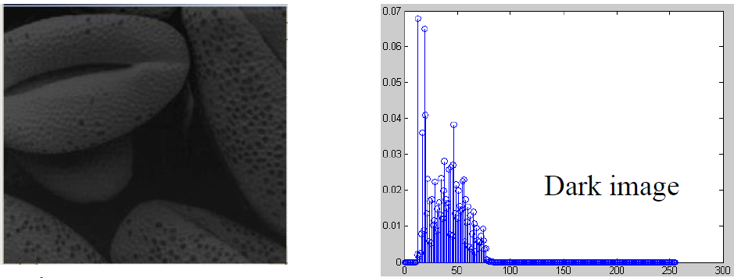
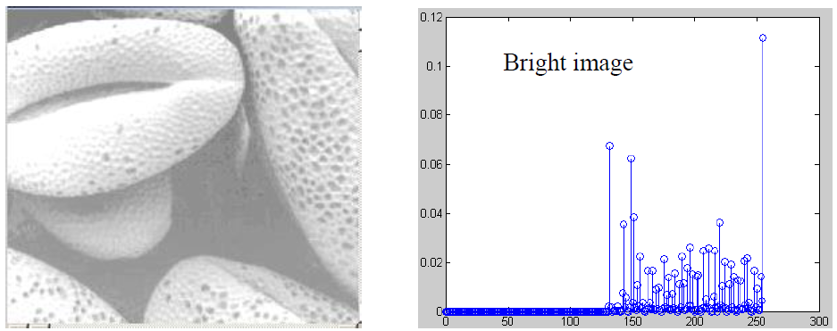
Histogram Processing
www.midocean.ae

Slide 35
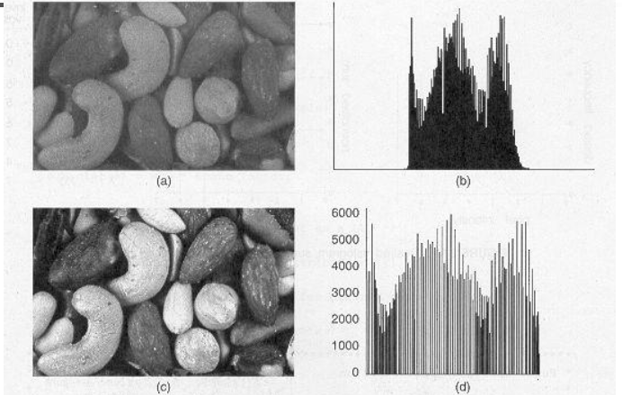



Histogram Equalization
–To improve the contrast of an image
– To transform an image in such a way that the transformed image has a nearly uniform distribution of pixel values
The intensity levels in an image may be viewed as random variables in the interval [0, L-1].
The probability of occurrence of intensity level r_{k}
Normalized image histogram
www.midocean.ae

Slide 36
Histogram Equalization
The process involves the following steps:
Compute the Histogram: Calculate the histogram of the input image. The histogram is a plot or graph that shows the frequency of each pixel intensity value in the image. It provides a visual representation of the distribution of pixel values.
Normalize the Histogram: Normalize the histogram so that it represents the probability density function (PDF) of the image. This is done by dividing each bin (intensity value) in the histogram by the total number of pixels in the image.
Cumulative Distribution Function (CDF): Compute the cumulative distribution function (CDF) of the normalized histogram. The CDF represents the cumulative sum of the probabilities of each intensity value and ranges from 0 to 1.

Slide 37
Histogram Equalization
The process involves the following steps:
Histogram Equalization: For each pixel in the original image, replace its intensity value with a new value obtained by mapping the original intensity to
its corresponding CDF value. This mapping can be done using the following formula:
new_intensity = CDF(original_intensity) * (L-1)
Create the Equalized Image: Replace each pixel's intensity in the original image with the new intensity calculated in the previous step.

Slide 38
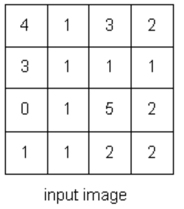
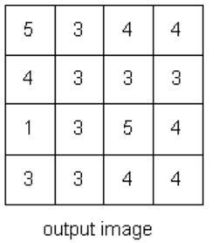
Histogram Equalization
Gray Level | freq | PDF | CDF | CDF * (Levels-1) | New Gray Level Value
0 | 1 | 1/16=0.06 | 0.06 | 0.06*5= 0.3 | 1
1 | 7 | 7/16=0.44 | 0.5 | 0.5*5= 2.5 | 3
2 | 4 | 4/16=0.25 | 0.75 | 0.75*5= 3.75 | 4
3 | 2 | 2/16=0.13 | 0.88 | 0.88*5= 4.4 | 4
4 | 1 | 1/16=0.06 | 0.94 | 0.94*5= 4.7 | 5
5 | 1 | 1/16=0.06 | 1 | 1*5= 5 | 5
Total | 16

Slide 39
Histogram Equalization
Assignment
10 | 2 | 11 | 13 | 14
11 | 13 | 14 | 13 | 13
10 | 11 | 13 | 11 | 14
13 | 11 | 14 | 12 | 10
10 | 14 | 12 | 14 | 14
Normalize the following gray level image

Slide 40


Thank You

