Slide 1




Master of Science in Artificial intelligent
Lecture 2
AI511
Foundations of Artificial Intelligence
Prepared by
Prof. Lamiaa Fattouh Ibrahim
www.midocean.ae

Slide 2
Intelligent “Rational” Agents?
Outline
AI as the Study & Design of Intelligent Agents
  Intelligent Agents in the World
  Example: Vacuum _ Agent
  Type of Agents
Specifying the task environment
  Environment types
2

Slide 3
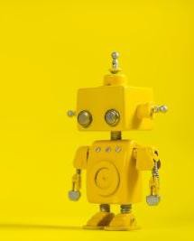
Acting Rationally
Intelligent Agents

Slide 4
This lecture covers mainly the following chapter(s):
MainResources forthisSection
Chapter Agents) Russell
2 (Intelligent
from Stuart J.
and Peter Norvig,
"Artificial Intelligence: A
Modern Approach," Third
Edition (2010), by Pearson Education Inc.

Slide 5
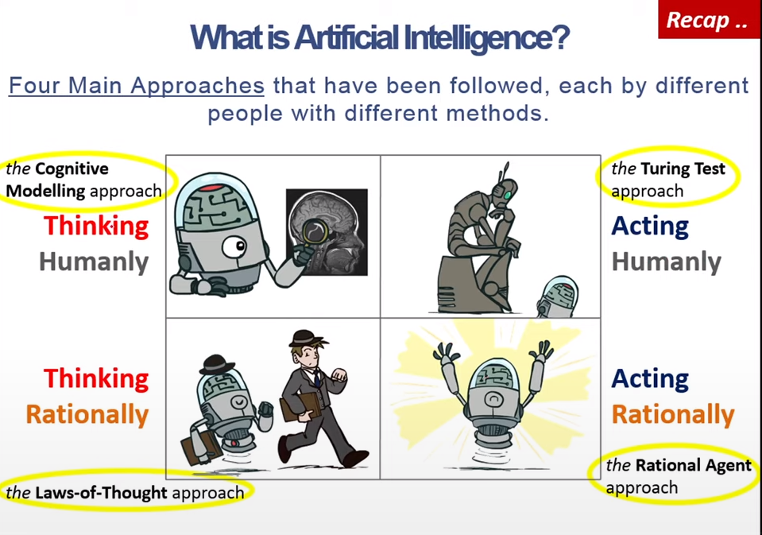


What is Artificial Inte ligence?
Acting Rationally

Slide 6
Recap: What is Artificial Intelligence?
Systems that act like humans | Systems that think rationally
“The study of how to make computers do things at which, at the moment, people are better” (Rich and Knight, 1991) “The art of creating machines that perform functions that require intelligence when performed by people.” (Kurzweil, 1990) | “The study of mental faculties through the use of computational models” (Charniack and McDermott, 1985). “The study of the computations that make it possible to perceive, reason, and act.” (Winston, 1992)
Systems that think like humans | Systems that act rationally
“The automation of activities that we associate with human thinking, such as decision making, problem solving, learning” (Bellman, 1978) “The exciting new effort to make computers think … machines with minds, in the full and literal sense.” (Haugeland, 1985) | “AI .. is concerned with intelligent behavior in artifacts (Nilsson, 1998) “Computational Intelligence is the study of the design of intelligent agents.” (Poole et al., 1998)

Slide 7
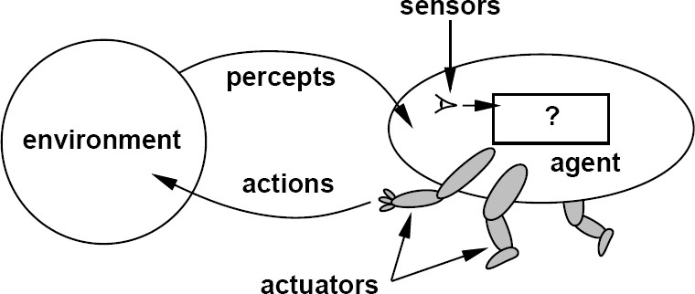
BB-8 “the Star Wars franchise”
Intelligent “Rational” Agents
Agent Smith in The Matrix (1999)
An agent is anything that can be viewed as perceiving its environment through sensors and acting upon that environment through actuators
Arthur, an android bartender on the Avalon, Passengers

Slide 8
Recap: AI as the Study & Design of Intelligent Agents
(Poole and Mackworth, 1999)
An intelligent agent is such that:
  Its actions are appropriate for its goals and circumstances.
  It is flexible to changing environments and goals.
  It learns from experience.
  It makes appropriate choices given perceptual limitations and
limited resources (bounded rationality or bounded optimality).

Slide 9
Thus, a rational agent acts to optimally achieve its goals (does the right thing). The right thing: that which is expected to maximize goal achievement, given the available information

Slide 10





Intelligent Agent
Environment
Agent
?
It’s all about how the control policy function of this agent takes the decision

Slide 11
Agent | Sensors (inputs) | Actuators
Human Agent | eyes, ears, and other organs | hands, legs, …..
robotic agent | cameras and infrared range finders | various motors
software agent | keystrokes, file contents, and network packets | displaying on the screen, writing files, and sending network packets.

Slide 12
THE STRUCTURE OF AGENTS
The job of AI is to design an agent program that implements the agent function— the mapping from percepts to actions.
We assume this program will run on some sort of computing device with physical sensors and actuators—we call this the architecture:
Structure of Agent = architecture + agent program

Slide 13



Slide 14





AI in Finance
Stock or Bond Market
Trading Agent
Decision

Slide 15

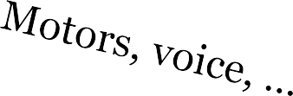
AI in Robotics
Environment
Robot
Decision
Notes:
Presenter
2015-10-12 03:30:12
--------------------------------------------
* Robotics and AI usually studied as one discipline. However robotics is a special discipline deals with physical environment.
* Actually, early web crawlers are called robots. And in every website, there is a file named robot.txt allows you to deny web crawlers.

Slide 16


AI in Games
Game Agent
You
Decision
You
Notes:
Presenter
2015-10-12 03:30:12
--------------------------------------------
For example Chess. The agent task is to won and to make you feel it’s natural (believable )

Slide 17


AI in Medicine
You
Diagnostic agent
Decision
and your Doctor
Notes:
Presenter
2015-10-12 03:30:13
--------------------------------------------
In intensive care devices, or life long medicine

Slide 18






AI in the WEB
Search text
Search
Feeling lucky
You and World Wide Web
Crawler DB
Decision

Slide 19
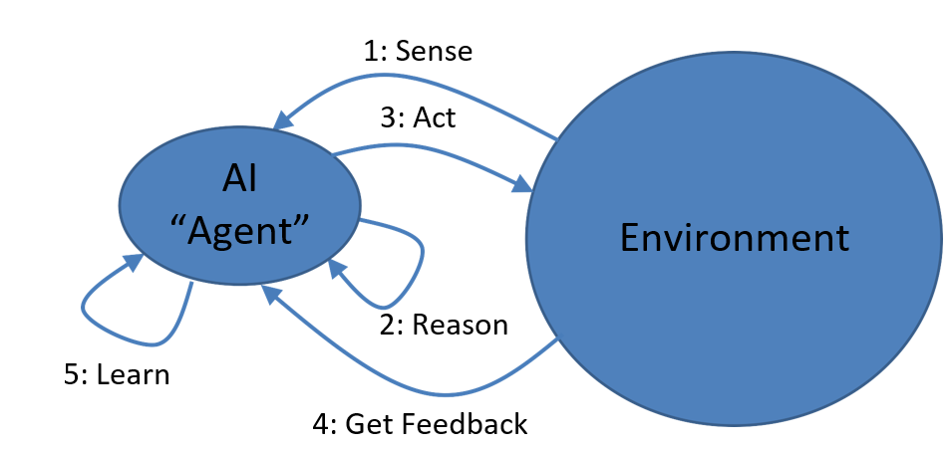
Intelligent Agents in the World ..
.. Learning? .. Feedback?
1: Sense
3: Act
AI
“Agent”
Environment
2: Reason

Slide 20
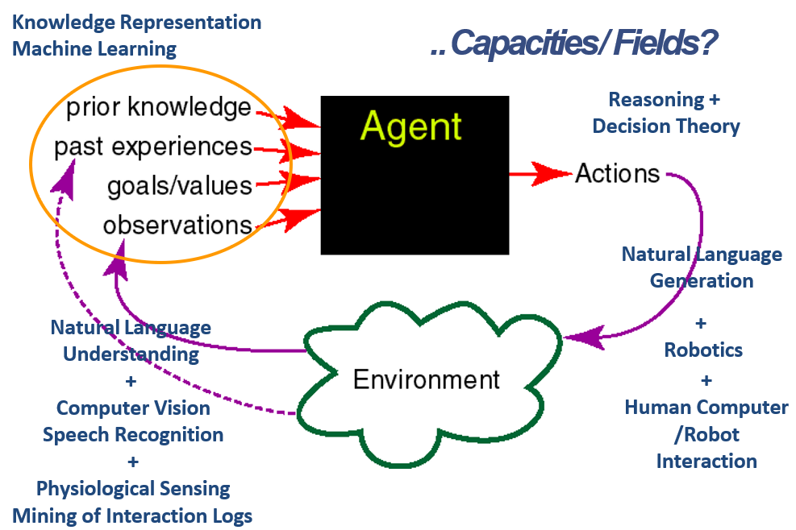
Intelligent Agents in the World ..

Slide 21
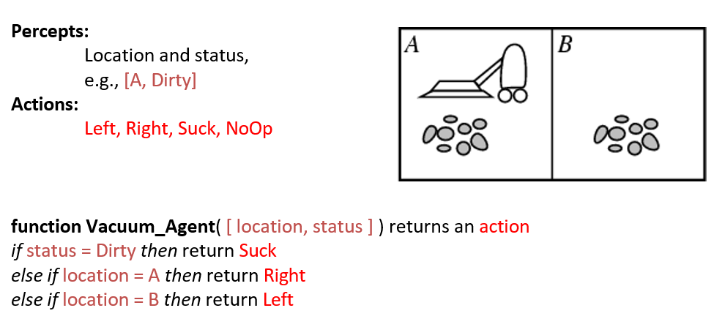
Example:Vacuum –Agent

Slide 22
Rational Agents
For each possible percept sequence, a rational agent should select an action that is expected to maximize its performance measure, given the evidence provided by the percept sequence and the agent’s built-in knowledge
Performance measure (utility function):
An objective criterion for success of an agent's behavior.

Slide 23
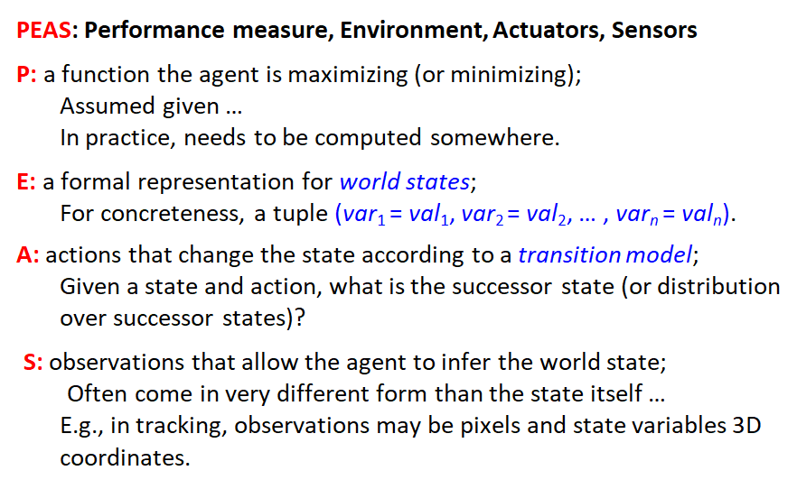
Specifying the task environment

Slide 24
PEAS Example: Autonomous taxi
Performance measure
Safe, fast, legal, comfortable trip, maximize profits
Environment
Roads, other traffic, pedestrians, customers
Actuators
Steering wheel, accelerator, brake, signal, horn
Sensors
Cameras, LIDAR, speedometer, GPS, odometer, engine sensors, keyboard

Slide 25
Another PEAS example: Spam filter
Performance measure
Minimizing false positives, false negatives
Environment
A user’s email account, email server
Actuators
Mark as spam, delete, etc.
Sensors
Incoming messages, other information about user’s account

Slide 26
Agent types
FIVE basic types in order of increasing generality:
Simple reflex agents
Model-based reflex agents
Goal-based agents
Utility-based agents
Learning agents

Slide 27
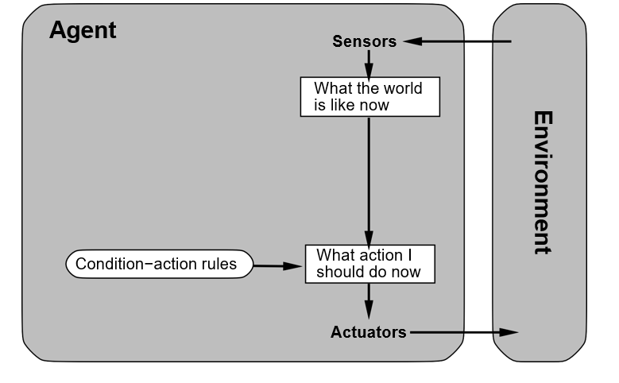
Simple reflex agents
- Selects action based on current perception of the environment.
- Simple but has a limited intelligence.

Slide 28
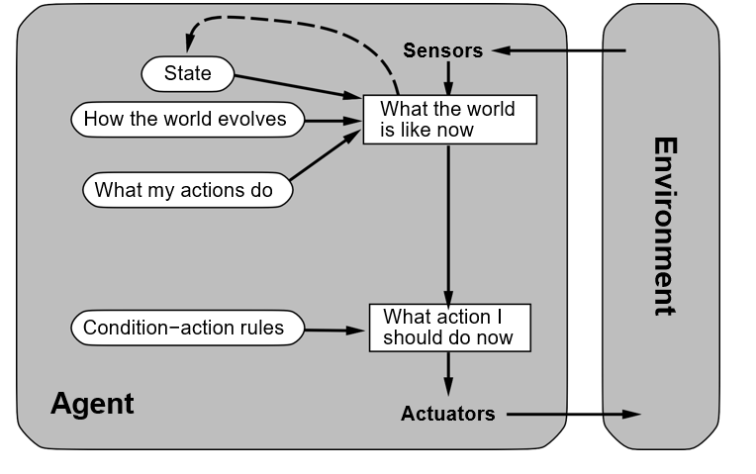
Reflex agents with state
Model-based reflex agents
Keeps track of perception history in the form of internal state (reflecting unobserved aspects of the current state of the World).
State
How the world evolves
What my actions do
Condition−action rules
Agent

Slide 29
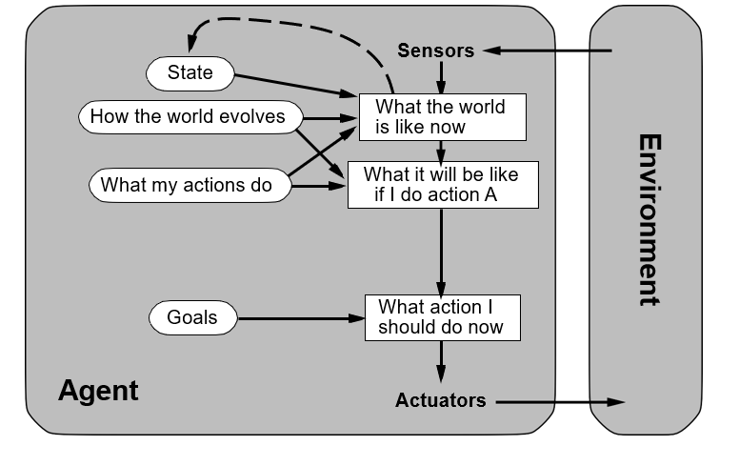
Goal-based agents

Slide 30
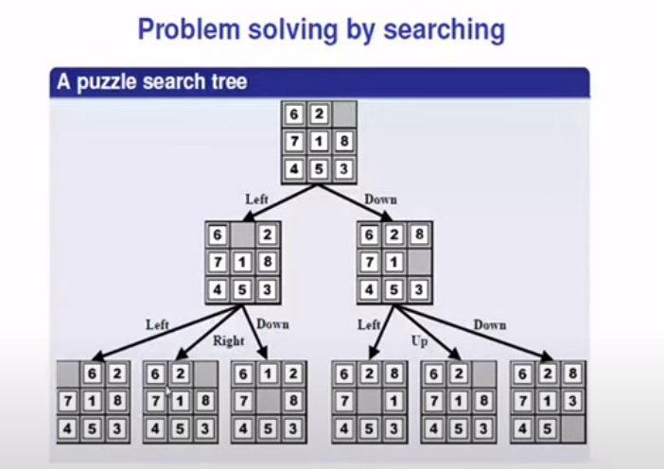

Slide 31
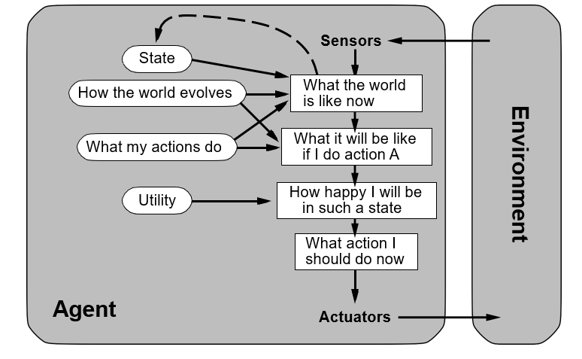
Utility-based agents
Agent

Slide 32
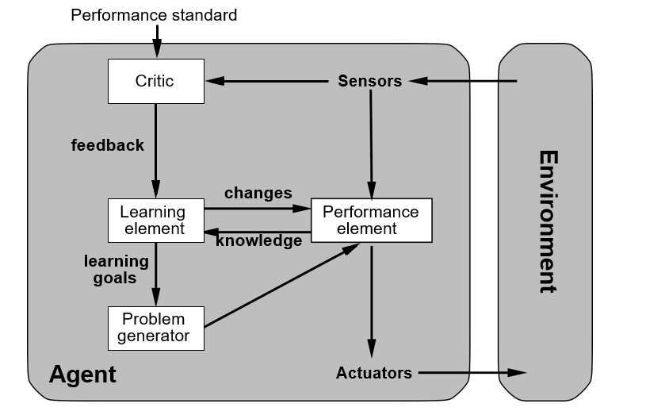
Learning agents
Agent

Slide 33
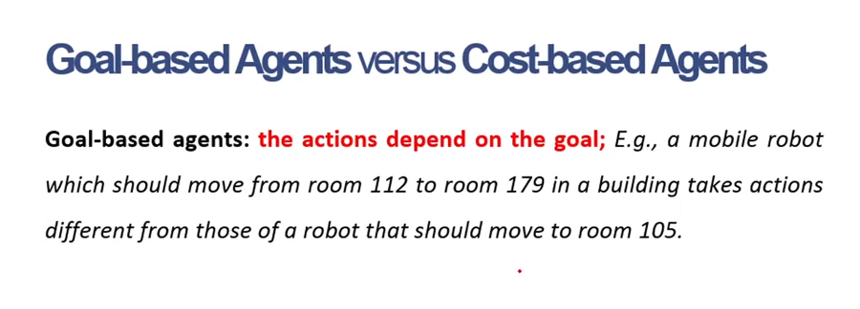

Slide 34
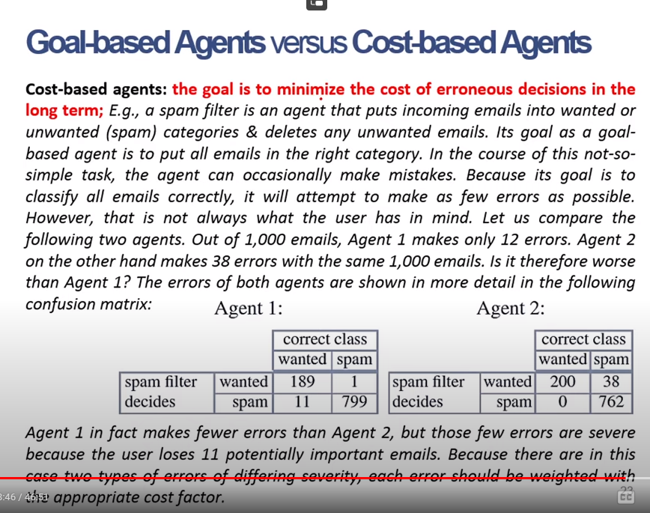

Slide 35
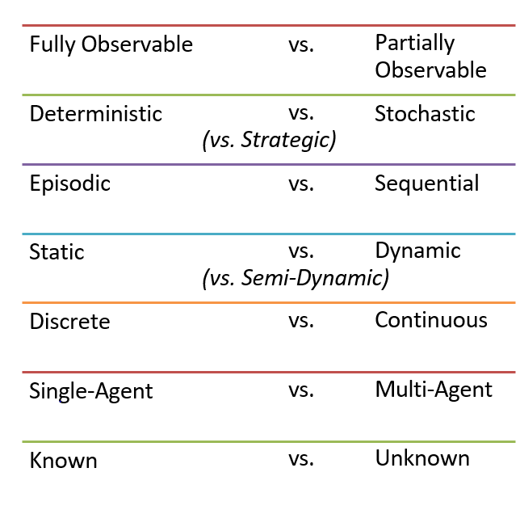
Environment Types

Slide 36
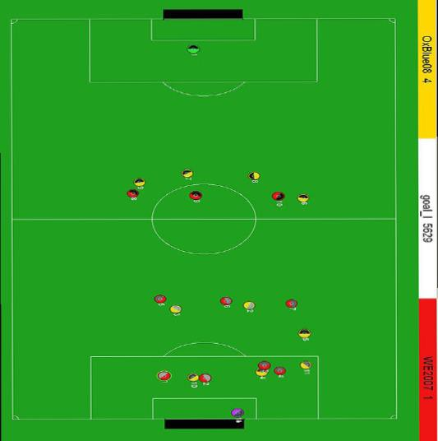
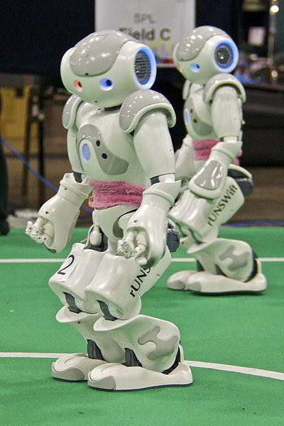
Fully Observable vs. Partia ly Observable
Do the agent's sensors give it access to the complete state of the environment?
For any given world state, are the values of all the variables known to the agent?
vs.
Source: L. Zettlemoyer

Slide 37
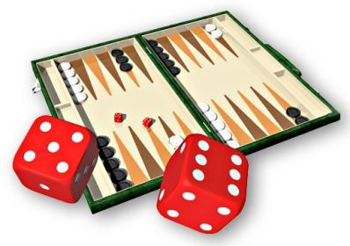
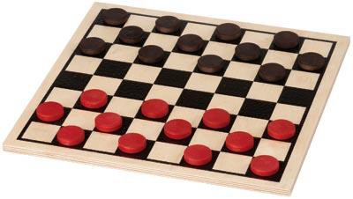
Deterministic vs. Stochastic
Is the next state of the environment completely determined by the current state and the agent’s action?
Is the transition model deterministic (unique successor state given current state and action) or stochastic (distribution over successor states given current state and action)?
Strategic: the environment is deterministic except for the actions of other agents.
vs.

Slide 38
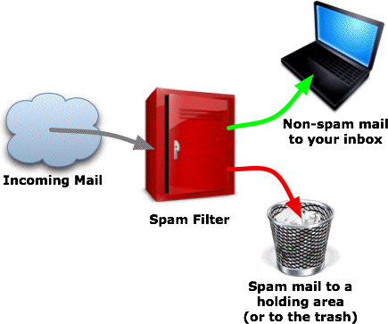
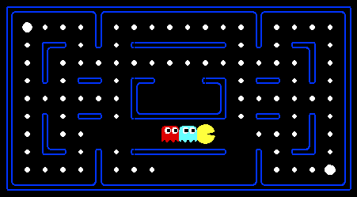
Episodic vs. Sequential
Is the agent’s experience divided into unconnected single decisions/actions, or is it a coherent sequence of observations and actions in which the world evolves according to the transition model?
vs.

Slide 39
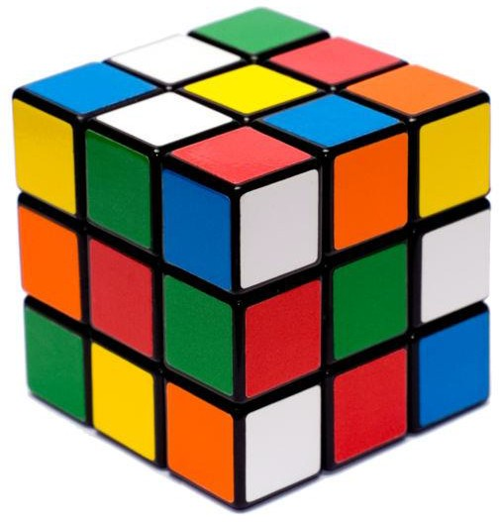
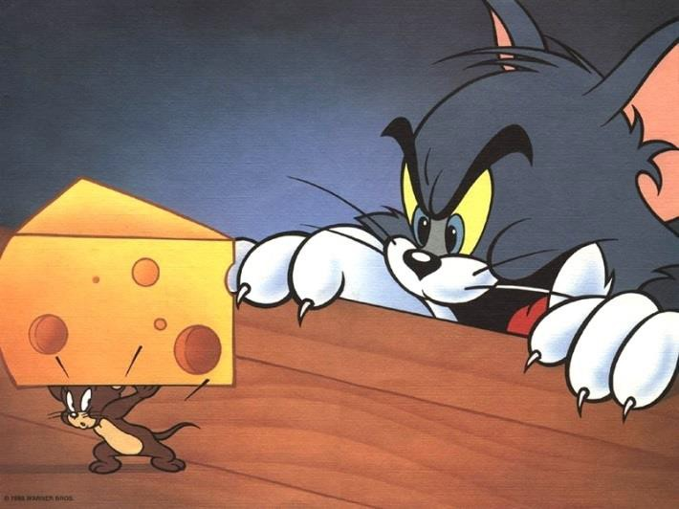
Static vs. Dynamic
Is the world changing while the agent is thinking?
Semidynamic: the environment does not change with the passage of time, but the agent's performance score does.
vs.

Slide 40
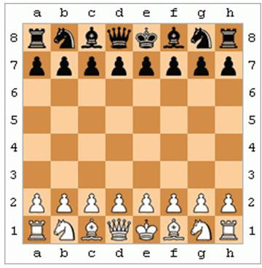
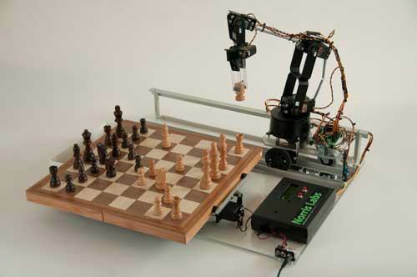
Discrete vs. Continuous
Does the environment provide a fixed number of distinct percepts, actions, and environment states?
Are the values of the state variables discrete or continuous? Time can also evolve in a discrete or continuous fashion
vs.

Slide 41
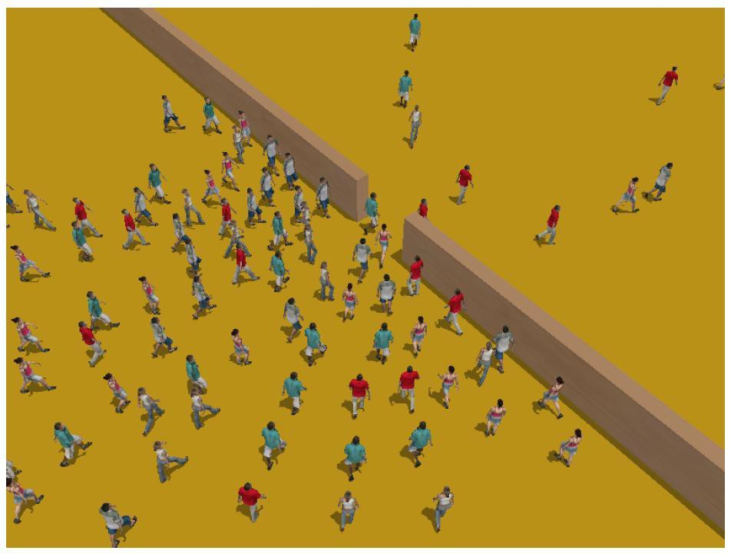
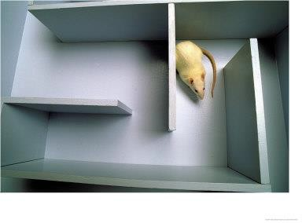
Single–Agent vs. Multi–Agent
Is an agent operating by itself in the environment?
vs.

Slide 42
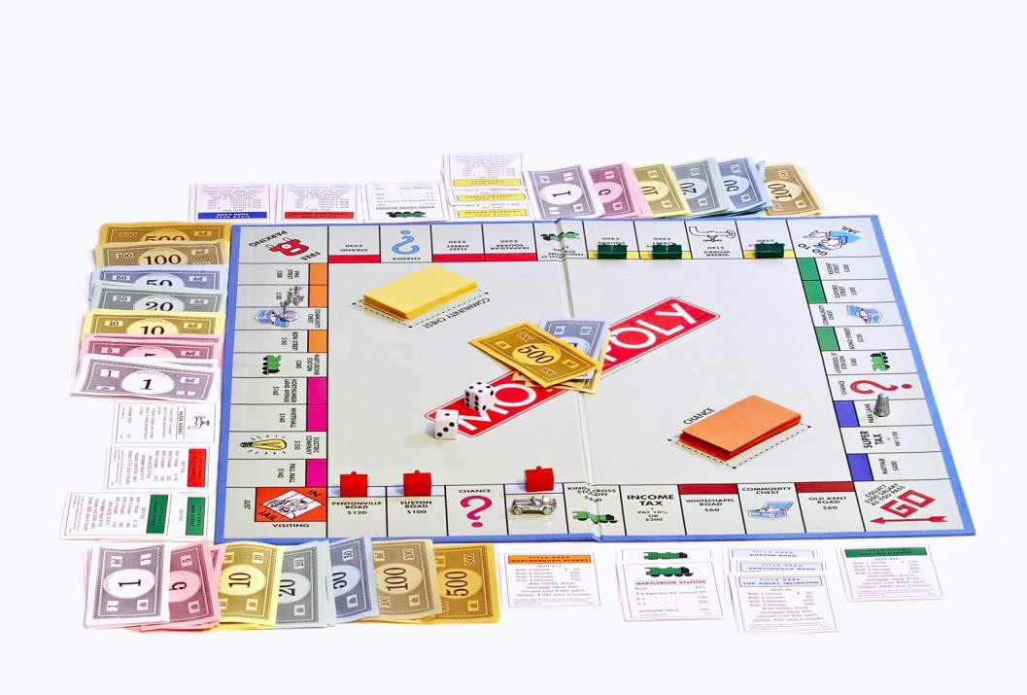
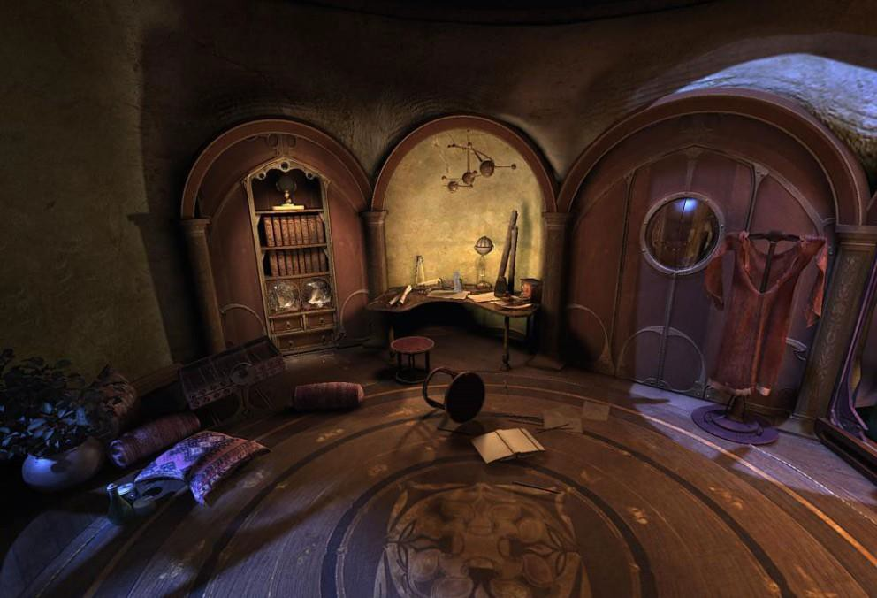
Known vs. Unknown
Are the rules of the environment (transition model and rewards associated
with states) known to the agent?
Strictly speaking, not a property of the environment, but of the agent’s state of knowledge.
vs.

Slide 43
Terminology
Deterministic: Deterministic environment is one where your agent's actions uniquely determine the outcome.
Stochastic: In stochastic environment, there is certain amount of randomness.
Notes:
Presenter
2015-10-12 03:30:14
--------------------------------------------
Chess and dice

Slide 44
Terminology
Discrete v.s. continues: A discrete environment is one where you have finitely many action choices, and finitely many things you can sense. For example, in chess there's finitely many board positions, and finitely many things you can do.
Notes:
Presenter
2015-10-12 03:30:14
--------------------------------------------
Chess vs darts

Slide 45

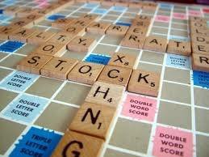
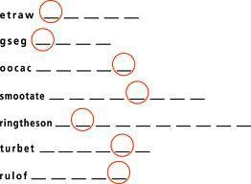

Examples of the different environments
 | Word jumble solver | Chess with a clock | Scrabble | Autonomous driving
Observable | Fully | Fully | Partially | Partially
Deterministic | Deterministic | Strategic | Stochastic | Stochastic
Episodic | Episodic | Sequential | Sequential | Sequential
Static | Static | Semi-dynamic | Static | Dynamic
Discrete | Discrete | Discrete | Discrete | Continuous
Single agent | Single | Multi | Multi | Multi

Slide 46
Summary
AI as the Study & Design of Intelligent Agents
  Intelligent Agents in the World
  Example: Vacuum _ Agent
  Type of Agents
Specifying the task environment
  Environment types

Slide 47


Thank You
Thank you

