Slide 1



Cover Letter Writing
Lecture 6
Prepared by
Ahmed Soliman
www.midocean.ae

Slide 2

What is a Cover Letter? (and Why It’s Important)
A cover letter is a one-page document that you submit as part of your job application (alongside your CV or Resume).
Its purpose is to introduce you and briefly summarize your professional background. On average, your cover letter should be from 250 to 400 words long.
www.midocean.ae

Slide 3
A good cover letter can spark the HR manager’s interest and get them to read your resume.
A bad cover letter, on the other hand, might mean that your application is going directly to the paper shredder. So, to make sure this doesn’t happen, it’s essential to know how to write a convincing cover letter.
www.midocean.ae

Slide 4
Cover letter format
Header with date and contact information
Salutation or greeting
Opening paragraph
Middle paragraph(s)
Closing paragraph
Letter ending and signature
www.midocean.ae

Slide 5
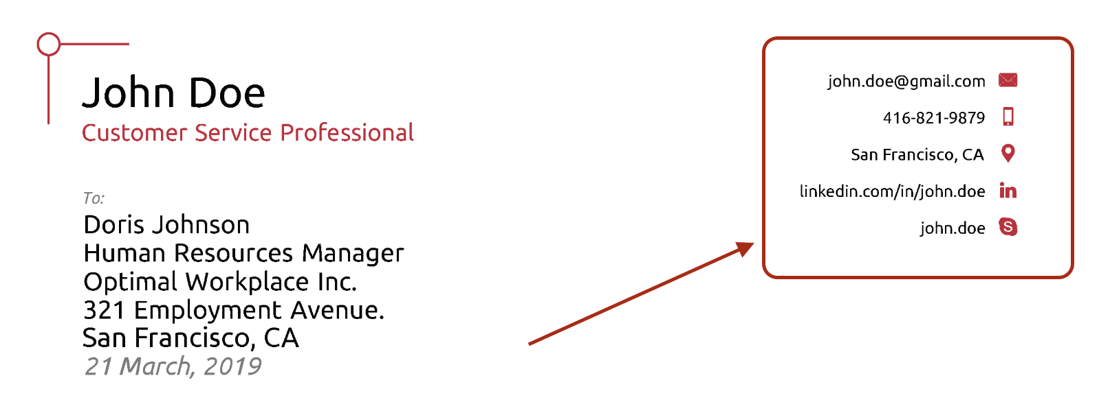
How to Write the Perfect Cover Letter (And Get Hired!)
1- Start the Cover Letter with a Header
www.midocean.ae

Slide 6
Here, you want to include all essential information, including:
Full Name
Phone Number
Email
Date
Name of the hiring manager / their professional title
Name of the company you’re applying to
www.midocean.ae

Slide 7
2. Include a greeting
Example greetings:
Dear Hiring Manager,
Dear Tyler Wallace,
www.midocean.ae

Slide 8
3- Write an Attention-Grabbing Introduction
So, it’s essential to catch their attention from the very first paragraph.
www.midocean.ae

Slide 9
4- Explain why you’re the perfect person for the job
This is where you show off your professional skills and convince the HR manager that you’re a better fit for the job than all the other applicants.
But first things first - before you even write anything, you need to learn what the most important requirements for the role are. So, open up the job ad and identify which of the responsibilities are the most critical.
www.midocean.ae

Slide 10
5- Explain why you’re a good fit for the company
Once you’ve written the last paragraph, you might be thinking - I’m a shoo-in for the job! What else do I need to write? I’ll just wrap up the cover letter and hit that sweet SEND button.
Well, no. You’re not quite there yet.
www.midocean.ae

Slide 11
The HR manager doesn’t only look at whether you’ll be good at the job or not. They’re looking for someone that’s also a good fit for the company culture.
After all, employees that don’t fit in are bound to quit, sooner or later. This ends up costing the company a ton of money, up to 50% of the employee’s annual salary.
Meaning, you also need to convince the HR manager that you’re really passionate about working with them.
www.midocean.ae

Slide 12
6- Wrap up with a call to action
Finally, it’s time to finish up your cover letter and write the conclusion.
In the final paragraph, you want to:
Wrap up any points you couldn't in the previous paragraphs. Do you have anything left to say? Any other information that could help the hiring manager make their decision? Mention it here.
Thank the hiring manager for their time. It never hurts to be courteous, as long as you don’t come off as too needy.
Finish the cover letter with a call to action. The very last sentence in your cover letter should be a call to action. You should ask the hiring manager to take some sort of action.
www.midocean.ae

Slide 13
Good Example:
So to wrap it all up, thanks for looking into my application. I hope I can help Company X make the most out of their Facebook marketing initiatives. I'd love to further discuss how my previous success at XYZ Inc. can help you achieve your Facebook marketing goals.
www.midocean.ae

Slide 14
7- Use the right formal closing
Once you’re done with the final paragraph, all you have to do is write down a formal “goodbye” and you’re good to go.
Feel free to use one of the most popular conclusions to a cover letter:
Best Regards,
Kind Regards,
Sincerely,
Thank you,
www.midocean.ae

Slide 15
8- End with your signature at the bottom.
www.midocean.ae

Slide 16
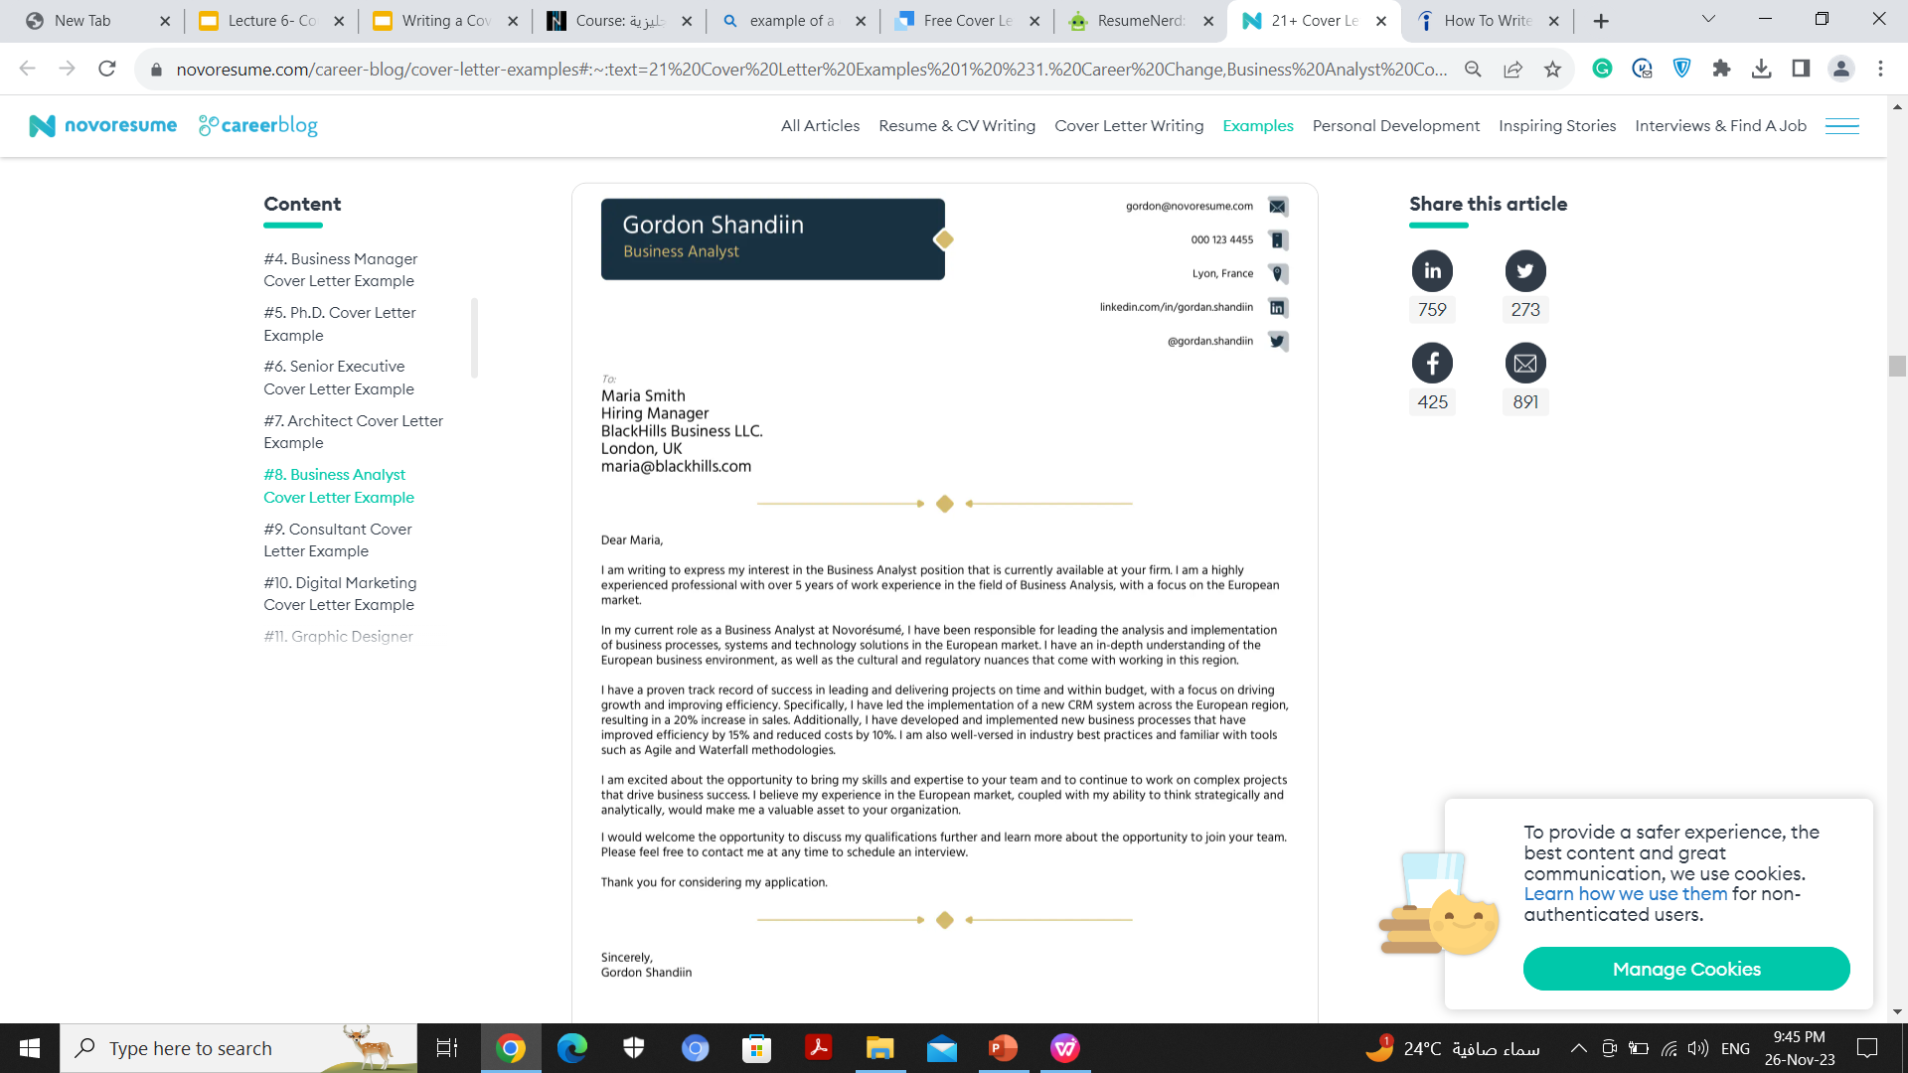
www.midocean.ae

Slide 17


Thank You

