Slide 1

Prepared by
Dr. Hamada I. AbdulWakel
Lecture 8
CYB615
Network Programming

Slide 2
Module8: Email Composition and Decoding

Slide 3


Lecture 8
Agenda
Email Messages.
E-mail Module in Python.
The Multipurpose Internet Mail Extensions.

Slide 4
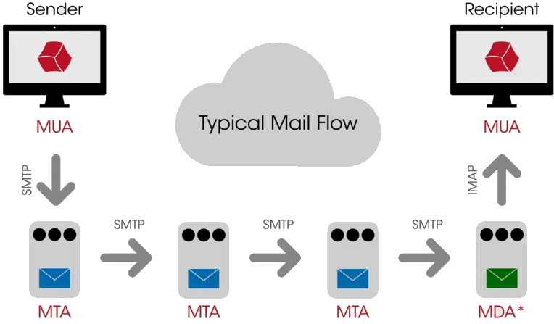
Lecture 8
E-mail Definition & Its Basic Flow
Sending and receiving of information through internet is known as an E-mail. Sharing an email is done through the use of email address.

Slide 5
Lecture 8
E-mail Definition & Its Basic Flow
Cont'd
A Mail User Agent (MUA): client app. Running on a computer that is used to send and receive mail.
  Examples: Apple Mail and Microsoft Outlook.
A Mail Transfer Agent (MTA): Accepts messages from a sender and routes them along to their destinations.
  Examples: Sendmail, Postfix, and Microsoft Exchange

Slide 6
Lecture 8
E-mail Definition & Its Basic Flow
Cont'd
Sender Policy Framework (SPF): defines a mechanism by which an organization can specify server(s) that are allowed to send email on behalf of that domain.
  If an email fails an SPF check, it can be an easy mechanism we can use to detect spam.
DomainKeys Identified Mail (DKIM): provides a cryptographic method of verifying a received email actually originated from the sending domain

Slide 7
Lecture 8
E-mail Protocols
The Simple Mail Transfer Protocol (SMTP): a widely used TCP protocol for email sending.
  Mainly used by the clients to send emails to the servers or for the email communications between servers.
The Internet Message Access Protocol (IMAP): a protocol for receiving emails from a server.
  Allows access to emails from multiple locations simultaneously, it keeps the email on the server after being delivered.

Slide 8
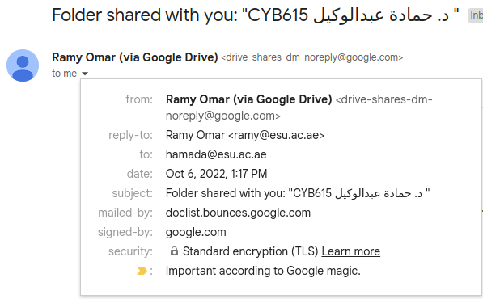
Lecture 8
E-mail Header Information

Slide 9
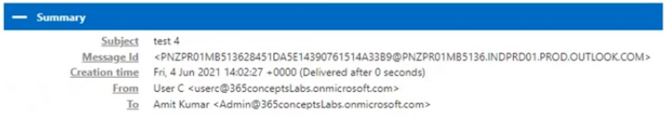
Lecture 8
E-mail Header Information
Cont'd

Slide 10
Lecture 8
The Email Module
The email module is an email message management library.
import email
It has three major components:
  The central component of the package is an “object model” that represents email messages.
  The other two components are:
    The parser takes the serialized version of an email message (a stream of bytes) and converts it into a EmailMessage object.
    The generator takes a EmailMessage object and turns it back into a serialized byte stream.

Slide 11
Lecture 8
The Email Module
Cont'd
Using the EmailMessage object, we can add or remove email subcomponents.
We can not send an email message using the email module alone.
The email module also provides support for parsing e-mail messages. Re-constructing the EmailMessage object.
  Any e-mail has:
    The standard format.
    Headers look like the dictionary key-values of the EmailMessage object.

Slide 12
Lecture 8
The Email Module
Cont'd
The email method:
  EmailMessage(): create a message object.
The email.message methods:
  set_payload(): set the body of a message object.
  as_string(): returns the message object as string.
  is_multipart(): check if the message object includes a list of sub-EmailMessage objects.
  message_from_file(): read and parse the content of a text file to a EmailMessage object.
  keys(): return a list of all the message’s header field names.

Slide 13
Lecture 8
The Email Module
Cont'd
The email.utils methods:
  make_msgid(): returns a string appropriate for a Message-ID header.
  formatdate(): returns a date time as string.
    The localtime argument used to return time related to the local timezone.
  parsedate_tz(): returns either None or a 10-tuple datetime.
  mktime_tz(): create a Universal Time Coordinated (UTC) timestamp from a 10-tuple datetime.
    Unix time: the number of seconds that have elapsed since 00:00:00 UTC on 1 January 1970.

Slide 14
Lecture 8
Creating Email Headers Example
import email.utils
from email.message import EmailMessage
text = " Hello, This is a test message. I hope you enjoy it! "
msg = EmailMessage()
msg['To'] = 'recipient@example.com'
msg['From'] = 'sender@example.com'
msg['Subject'] = 'Test Message'
msg['Date'] = email.utils.formatdate(localtime = 1)
msg['Message-ID'] = email.utils.make_msgid()
msg.set_payload(text)
print(msg.as_string())

Slide 15
Lecture 8
Parsing Email Headers Example
import email
popular_headers = ('From', 'To', 'Subject', 'Date')
msg = email.message_from_file(open('/path/to/message.txt'))
headers = sorted(msg.keys())
for header in headers:
if header not in popular_headers: print(header + ':', msg[header] )
for header in headers:
if header in popular_headers: print(header + ':', msg[header] )
if msg.is_multipart():
print("This program cannot handle MIME multipart messages.")
else: print(msg.get_payload())

Slide 16
Lecture 8
Parsing Email Date Header Example
from email.utils import parsedate_tz, mktime_tz
timetuple1 = parsedate_tz('Sun, 27 May 2007 11:34:43 +1000')
print(timetuple1)
timestamp1 = mktime_tz(timetuple1)
print(timestamp1)

Slide 17
Lecture 8
The Multipurpose Internet Mail Extensions
MIME is a set of rules for encoding data, rather than simple plain text, inside e-mails.
MIME message can include several different parts (e.g., a plain-text message, an image file attachment, a PDF attachment) into the message body.
MIME operates by adding headers to an e-mail message and then giving it content that looks like plain text to the machine.

Slide 18
Lecture 8
Common MIME Types
Two primary MIME types:
  text/plain: the default value for textual files.
    A textual file should be human-readable and must not contain binary data.
  application/octet-stream: the default value for all other cases.
    An unknown file type should use this type.
    Browsers pay a particular care when manipulating these files, to protect users from software vulnerabilities and possible dangerous behavior.

Slide 19
Lecture 8
Common MIME Types
Cont'd
import mimetypes, os
print(os.getcwd())
print(os.listdir())
print(mimetypes.guess_type('test.py'))
mtype = mimetypes.guess_type('test.py')[0]
print(mtype)
print(mimetypes.guess_all_extensions('image/jpeg'))
print(mimetypes.types_map)

Slide 20
Lecture 8
Creating a MIME Message
To compose a message with attachments, you will generally follow these steps:
  Create a MIMEMultipart object and set its message headers.
  Create a MIMEText object with the message body text and attach it to the MIMEMultipart object.
  Create appropriate MIME objects for each attachment and attach them to the MIMEMultipart object.
  Finally, call as_string() on the MIMEMultipart object to write out the resulting message.

Slide 21
Lecture 8
Parsing Email Date Header Example
import email.mime.application, email.mime.text, email.mime.multipart, email.utils, os
def attachment(email_message, filename):
with open(filename, 'rb') as f:
file_attachment = email.mime.application.MIMEApplication(f.read())
file_attachment.add_header("Content-Disposition", f"attachments; filename={filename}")
email_message.attach(file_attachment)

Slide 22
Lecture 8
Parsing Email Date Header Example
message = """Hello, This is a test message. I hope you enjoy it!"""
msg = email.mime.multipart.MIMEMultipart()
msg['To'] = 'recipient@example.com'
msg['From'] = 'sender@example.com'
msg['Subject'] = 'Test Message'
msg['Date'] = email.utils.formatdate(localtime = 1)
msg['Message-ID'] = email.utils.make_msgid()
body = email.mime.text.MIMEText(message, 'plain')
msg.attach(body)
attachment(msg, 'Document2.pdf')
print(msg.as_string())

Slide 23
THANK YOU

