Slide 1



Project Financial
Management
Lecture Three: Working with Lenders
PMG 615
Prepared by
Dr. Walaa Mohamed
www.midocean.ae

Slide 2

Objective of this lecture
This chapter covers the procedures for raising project finance from private-sector lenders, in particular commercial banks and bondholders, with a comparison between the two.

Slide 3
Commercial banks
Organizational Structure:
Most commercial banks in the project-finance field have specialist departments that work on putting project-finance deals together. There are three main approaches to organizing such departments:
1.1. Project-Finance Department: The longest-standing approach is to have a department purely specializing in project-finance transactions. Larger departments are divided into industry teams, covering sectors such as infrastructure, energy and natural resources. Concentrating all the project-finance expertise in one department ensures an efficient use of resources and good cross-fertilization, using experience of project finance for different industries; however, it may not offer clients the best range of services.

Slide 4
1.2. Structured-Finance Department: The divisions between project finance and other types of structured finance have become increasingly blurred, and therefore project finance often forms part of a larger structured-finance operation. Again, there may be a division into industry teams. This approach may offer a more sophisticated range of products, but there is some danger that project finance may not fit easily into the operation if other business is based on a much shorter time horizon—e.g. if LBOs (see below) are also dealt with in the same department.
1.3. Industry-Based Departments: Another approach is to combine all financing for a particular industry sector (e.g. electricity, natural resources, or infrastructure) in one department; if this industry makes regular use of project finance, project- finance experts form part of the team. This provides one-stop services to the bank’s clients in that particular industry, but obviously may diminish cross-fertilization between project-finance experience and different industries.

Slide 5
1. Organizational Structure
In the end good communication and cooperation within the bank are probably more important than the formal organization.
Projects need to be of a reasonable minimum size to provide banks with enough revenue to make the time spent on them worthwhile. Arranging debt for a project much under, say, $25 million, is unlikely to be economic (unless it is part of a production line of very similar projects for which the same template can be used, or, preferably, if several smaller projects can be bundled together and the financing for all them procured at the same time), and most major banks would prefer to work on projects of, say, $100 million or more.

Slide 6
Examples of other types of structured finance
Receivables financing is when a business receives funding based on issued invoices. Those invoices refer to purchases made, but the payment hasn’t been received yet.
Receivables finance process
To take factoring as an example, the receivables finance process may go like this:
Seller sells goods to buyer
Seller issues an invoice to the buyer
Seller sells the invoice to the factor
Factoring company pays seller a cash advance of 70%-90% of the value of the invoice
Buyer pays the invoice
Factor sends the balance to the seller with fees deducted.

Slide 7
Examples of other types of structured finance
2. Network Development: This would include projects such as development of utility distribution, cable TV, mobile phone, or internet-access networks, where demand cannot normally be established until the system is able to offer the service. These types of project could be said to come halfway between receivables financing and ‘true’ project finance, in that the financing may be used towards construction of a project, but loans are normally not drawn until the initial revenues have been established.
The usual approach to financing such projects is to establish the initial usage, usually by the first stage of development of the project being funded by investors’ equity rather than debt; once an initial level of penetration into the market, and revenues from usage, has been established part of the debt is advanced for further expansion of the network, and releases of debt continue in this way as successive penetration, usage and revenue targets are met. This is known as the ‘borrowing base’ model. A more liberal approach is for lenders to lend based on the progress of similar projects elsewhere, and their rate of growth in usage and revenues.

Slide 8
Examples of other types of structured finance
3. Leveraged Buyout (‘LBO’) or Management Buyout (‘MBO’) Financing: LBO is leveraged buyout which happens when an outsider arranges debts to gain control of a company. MBO is management buyout when the existing management of a business purchase it from its current owners.. It does not normally involve finance for construction of a new project, nor does this type of financing use contracts as security as does project finance. The risks involved in this type of finance are much higher than those for a typical project-finance transaction.
4. Acquisition Finance: Acquisition finance enables company A to acquire company B using highly leveraged debt, but based on the combined business of the two companies.

Slide 9
Examples of other types of structured finance
5. Asset Finance: Asset finance is based on lending against the value of assets easily saleable in the open market, e.g. ships, aircraft or real estate (property), whereas project-finance lending is against the cash flow produced by the asset, which may have little open-market value of itself. (Of course the market value of such assets does assume a capacity to generate revenues.)
6. Leasing: Leasing is a form of asset finance, in which ownership of the asset financed remains
with the lessor (i.e. lender).

Slide 10

Lead arrangers (Lead manager)
A standard approach to arranging a project-finance loan is to appoint a bank, which will ultimately underwrite the debt, as ‘lead arranger’., experience of lending to the type of project and in the country concerned are key factors in selecting a lead arranger; a wider banking relationship with one or more of the Sponsors is often another element in the decision.
Larger loans may require more than one bank to underwrite the financing. This has become more common since 2008 as a result of pressures on bank balance sheets, and the decline in the syndication market, resulting in Sponsors having to appoint several lead arrangers who will underwrite the debt on a ‘club’ basis, which is in effect a pre-syndication of the loan. The result may be the appointment of some or all of these banks as joint lead arrangers.
One of the first questions Sponsors have to consider on the financing side is when the lead arranger should be brought into the transaction. Ideally, to ensure the maximum competition between banks on the financing terms, the whole of the project package should be finalized (including all the Project Contracts) and a number of banks then invited to bid in a competition to underwrite and provide the loan as lead arranger. This implies either that the Sponsors make use of a financial advisor to put this package together , or do it themselves if they have the experience.

Slide 11
Lead arrangers (Lead manager)
An alternative approach is to agree with a bank at an early stage of the project- development process that it will act both as financial advisor and lead arranger. This should reduce the cost of the combined financial advisory and banking underwriting fees, and also ensure that the advice given is based on what the bank itself is willing to do, and therefore that the project should be financeable.
The obvious problem with this approach is that the banks are not in a competitive position (even if there may have originally been some kind of bidding process for the mandate), and therefore the Sponsors will probably not get the most aggressive final terms for the financing. However, this may be a reasonable price to pay for the greater efficiency of the process and greater certainty of obtaining finance that this method affords. Clearly the general relationship between the Sponsors and the banks concerned, and the Sponsors’ own experience in the financial market, may also affect this decision.

Slide 12
Lead arrangers (Lead manager)
It is also possible for the Sponsors to stipulate that they will have the right to ‘market test’ the final financing package by asking for competitive bids from other banks, and if the original lead arranger(s) are found not to be competitive, the financing will be moved to new banks. However, this may hold up conclusion of the financing and therefore not be practical unless the original lead arranger(s) have become so out of line with the market that it is worth the loss of time and extra legal and other costs that are likely to be involved in going elsewhere.
In major projects, both a financial advisor and lead arranger(s) may be appointed separately at an early stage to provide more balanced advice, although obviously this adds to development costs.
The financial advisor (or lead arranger(s) acting as financial advisor) plays an active role in the negotiation of Project Contracts, to ensure that financing implications of these contracts are taken into account. Any changes in the Project Contracts that are good for the Sponsors are generally good for the banks too, and so lead arrangers are also sometimes used by Sponsors to improve their commercial position in these negotiations.

Slide 13
Letters of Intent
Banks commonly provide letters of intent (or letters of interest) to Sponsors early in the development of a project. These are usually short—1–2 pages long—and confirm the banks’ basic interest in getting involved in the project. If the letter requires the Sponsors to deal exclusively with the banks concerned, this may amount to a lead arrangers’ mandate letter. Alternatively, the Sponsors may collect a number of such letters from different banks. Letters of this nature provide the Sponsors with initial reassurance that the financing market is interested in their project, and help to give the Sponsors credibility with other prospective Project Contract counterparts, such as fuel suppliers, product purchasers, Contracting Authorities.
Such letters should not be regarded as a legal commitment on the banks’ part. They are primarily used by banks to ensure they keep their foot in the door of the project, but on the other a bank does not issue such a letter frivolously.

Slide 14
Letters of Intent
A mandate letter is normally signed between the Sponsors and the selected lead arranger(s), which expresses the banks’ intention—subject to due diligence, credit clearance, and agreement on detailed terms—to underwrite the debt required; some indication of pricing and other debt terms may also be given, although this may be difficult at an early stage of the transaction. This mandate letter does not (and realistically cannot) impose a legal obligation on the bank(s) to underwrite or lend money for the project. If the lead arranger(s) are also appointed as financial advisor, the mandate letter will also provide for services similar to those of the financial advisor. The mandate may be combined with a term sheet, depending on how advanced the project development is at the time.

Slide 15
Financial Model
Throughout the due-diligence process, the financial advisor or lead arranger develops a financial model for the project (if it is developed by a financial advisor, it is normally passed on to the banks for their use). A project finance model is a specialized financial model, the purpose of which is to assess the economic feasibility of the project in question.

Slide 16
Term Sheet, Underwriting, and Documentation
As the financing structure develops, a term sheet is drawn up, setting out in summary form the basis on which the finance will be provided. This can develop into quite an elaborate document, especially if the bank lawyers are involved in drawing it up, which can add substantially to the Sponsors’ legal costs. It is preferable for term-sheet discussions to concentrate on commercial rather than legal issues, although the dividing line may be difficult to draw.
The final term sheet should provide the basis for lead arrangers to complete their internal credit proposals and obtain the necessary approvals to go ahead with the loan. The work of a bank’s project-finance team, and the consequent proposal for a loan, is normally reviewed by a separate credit department, and may be presented to a formal credit committee for approval. Banks must have a well-organized interface between the credit team and the project-finance team, especially where a bank is acting as a lead arranger: it may take a long time to develop a project-finance transaction, and if the loan is turned down at the end of that process on credit grounds, this obviously has serious consequences for the Sponsors (and does not help the bank’s project-finance team very much).

Slide 17
Term Sheet, Underwriting, and Documentation
On the other hand, a bank cannot obtain credit approval at the beginning of the development process, because the structure of the transaction will probably not be sufficiently finalized. The Sponsors therefore need to have confidence that a lead arranger has the experience and credibility to manage this internal review process.
After obtaining their credit approval, lead arrangers ‘underwrite’ the debt, usually by signing the agreed term sheet. The term sheet sets out pricing and key terms for the loan, and provides for a final date by which documentation should be signed (i.e. a validity period), as banks usually have to reapply for internal credit approval if their loan is not signed within a reasonable period. This signature of a term sheet is still normally no more than a moral obligation, as the commitment by the banks is usually subject to further detailed due diligence of the Project Contracts and associated documentation, and signature of financing and security documentation. Nonetheless, a term sheet is treated seriously, and banks normally only withdraw from an underwriting if there is a major change of circumstances, either in relation to the project itself, the country in which it is situated, or the market in general.

Slide 18
Term Sheet, Underwriting, and Documentation
Even when the financing documents and the Project Contracts are signed (this should ideally be simultaneous) the Sponsors have not yet finally obtained committed financing for the Project Company. Even at this stage, the bank(s) may not actually provide the finance as there are numerous conditions precedent that have to be fulfilled, before allowing a drawing to be made. When the project has reached this stage—i.e. conditions precedent have been fulfilled, and the Project Company is able to begin drawing funds for construction, the project has finally achieved ‘Financial Close’.

Slide 19
Information Memorandum and Syndication
The lead arrangers (and any sub-underwriters they may bring in) may wish to reduce their own exposure by placing (syndicating) part of the financing with other banks in the market. The lead arrangers prepare a package of information to facilitate this syndication process, at the heart of which is an Information Memorandum. This Final Information Memorandum (FIM) used for syndication may be based on a Preliminary Information Memorandum (PIM) originally prepared by the Sponsors or their financial advisor to present the project to prospective lead arrangers. The bank in charge of the syndication process is generally known as the ‘book runner’.

Slide 20
Information Memorandum and Syndication
The FIM should provide a detailed summary of the transaction, including:
● a summary overview of the project, its general background, and reasons of existence.
● the term sheet.
● the Project Company, its ownership, organization, and management.
● financial and other information on Sponsors and other major project parties, including their experience in similar projects and the nature of their involvement in and support for the current project.
● technical description of the construction and operation of the project;

Slide 21
Information Memorandum and Syndication
The FIM should provide a detailed summary of the transaction, including (continued):
● market situation (the commercial basis for the project), where relevant, covering
aspects such as supply and demand, competition, etc.
● summary of the Project Contracts.
● project costs and financing plan.
● risk analysis.
● financial analysis, including the Base Case financial model and sensitivity analyses.

Slide 22
Information Memorandum and Syndication
The Information Memorandum is accompanied by supplementary reports and information, which may include:
● the legal advisors may provide a summary of legal aspects of the project.
● a technical report from the Lenders’ Engineer summarizing their due diligence review
● a report on insurances from the insurance advisor.
● a copy of the financial model, with the Model Auditor’s report
● advisor’s report on the market in which the project is operating and its revenue projections (if sales of its product or services are not covered by a long term Project Agreement or Offtake Contract—even if they are, background information on the market is useful).
● a similar market report on fuel or raw material input supplies may be relevant.
● the environmental impact assessment.
● annual reports and other financial information on the various parties to the project.

Slide 23
Loan Agency
In cases where the loan is being provided by a syndicate of banks, whether lead arrangers, participating banks or a bank ‘club’, once the financing documentation has been signed one of the lead arrangers acts as agent for the bank syndicate as a whole: this agent bank acts as a channel between the Project Company and the banks, as otherwise the Project Company could find it is spending an excessive amount of time communicating with individual banks. The agent bank performs various tasks:
● collects the funds from the syndicate when drawings are made and passes these on to the Project Company.
● holds the project security on behalf of the lenders however, this function may be carried out by a separate security trustee, acting on the instructions of the agent bank.
● calculates interest rates, interest payments and principal repayments.
● receives these debt-service payments from the Project Company and passes their respective shares on to the individual syndicate banks.

Slide 24
Loan Agency
● gathers information about the progress of the project, in liaison with the banks’ advisors, and distributes this to the syndicate at regular intervals.
● monitors the Project Company’s compliance with the requirements of the financing documentation and provides information on this to the syndicate banks.
● arranges meetings and site visits as necessary for the Project Company and the Sponsors to make more formal presentations to the syndicate banks on the project’s progress.
● organizes discussions with and voting by the syndicate if the Project Company needs to obtain an amendment or waiver of some term of the financing.
● takes enforcement action against the Project Company or the security after a default.

Slide 25
Collateralized Loan Obligations (CLOs):
CLOs are a method of effectively syndicating bank loans to non-bank lenders (e.g. life-insurance companies or pension funds)—the process is also known as securitization. A bank ‘packages’ up a portfolio of its project-finance loans (usually of a similar type, e.g. PPPs) and ‘sells’ these off. There are two types of CLO:
(1) Synthetic CLOs: here the bank just transfers the risk to the new lenders (who thus provide the bank with a guarantee against its portfolio), but continues to fund and manage the portfolio, and keep a share of the credit margin.
(2) Cash CLOs: here the bank (or banks—more than one may be involved) actually sells its portfolio to the new lenders but continues to manage it on their behalf, for which it is paid a fee.

Slide 26
BONDS
As has been seen, bonds have provided an important source of project finance in certain specific markets. The key difference in nature between loans and bonds is that bonds are tradable instruments and therefore have at least a theoretical liquidity, which loans do not. This difference is not as great as it at first appears, because many bonds are sold on a ‘private placement’ basis, to investors who do not intend to trade them in the market, whereas loans are in fact traded on an ad hoc basis between banks.
Bonds are purchased by investors looking for long-term, fixed-rate income— typically life-insurance companies and pension funds, or individual investors (usually investing via bond funds(.

Slide 27
BONDS
The Investment Bank and the Credit Rating Agencies:
Investors in bonds generally do not get directly involved in the due-diligence process to the extent that banks do, and rely more on the project’s investment bank and a credit rating agency to carry out this work.
An investment bank (i.e. a bank that arranges and underwrites financing but does not normally provide the financing itself, except on a temporary basis) is appointed as lead arranger and assists in structuring the project in a similar way to a financial advisor on a bank loan.
The investment bank then makes a presentation on the project to a credit rating agency (the leaders in the field as far as project-finance bonds are concerned are Standard & Poor’s and Moody’s Investors Services), which assigns the bond a credit rating based on its independent review of the risks of the project, including legal documentation and independent advisors’ reports. This review considers the same risk issues that a commercial bank would do.

Slide 28
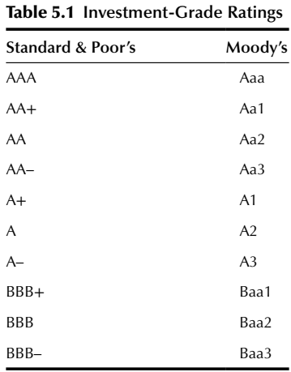
BONDS
The Investment Bank and the Credit Rating Agencies (continued):
Gradations of credit ratings by Standard & Poor’s and Moody’s from the prime credit level of AAA/Aaa down to the minimum ‘investment grade’ rating of BBB–/ Baa3 (below which most major bondholders will not purchase a bond issue) are as listed in Table 5.1. Most project finance ratings are at the lower end of this range. (Below the investment grade level the ratings continue from BB + /Ba1, etc.)

Slide 29
BONDS
The Investment Bank and the Credit Rating Agencies (continued):
Major bondholders, however, do carry out their own review of the project information in the prospectus besides relying on the credit rating, and may even participate in bank loans, or act as sole lenders. After any necessary preliminary testing of the market (which may include a road-show of presentations to investors), the investment bank issues the final bond prospectus and underwrites the bond issue through a subscription agreement. The coupon (interest rate) and other key conditions of the bond are fixed based on the market at the time of underwriting, and the bond proceeds are paid over to the Project Company a few days later (obviously the project must have reached Financial Close by then). The investment bank places (or resells) the bonds with investors, and may also maintain a liquid market by trading in the bond.
A prospectus is an essential disclosure document that a company has to issue at the time of issuing investment securities to the public. It is defined as a legal document describing a company's securities that have been put on sale. The prospectus generally discloses the company's operations along with the purpose of the securities being offered.

Slide 30
The preliminary prospectus is the first offering document provided by a security issuer and includes most of the details of the business and transaction. However, the preliminary prospectus doesn't contain the number of shares to be issued or price information. Typically, the preliminary prospectus is used to gauge interest in the market for the security being proposed.
The final prospectus contains the complete details of the investment offering to the public. The final prospectus includes any finalized background information, as well as the number of shares or certificates to be issued and the offering price.
A prospectus includes some of the following information:
A brief summary of the company’s background and financial information
The name of the company issuing the stock or bond
The number of shares or bond
The type of securities being offered
Whether an offering is public or private
Names of the company’s principals
Names of the banks or financial companies performing the underwriting

Slide 31
BANK LOANS VERSUS BONDS
Assuming that bond finance is one option for a particular project, various factors affect whether a project should use commercial bank loans or bonds (or a combination of the two) for its financing.
In general, bonds are suitable for developed markets and ‘standard’ projects. They are also especially suitable if a project is being refinanced after it has been built and has operated successfully for a period. Conversely, the greater flexibility of bank loans tends to make them more suitable for the construction and early operation phases of a project, projects which require long-term financial flexibility, more complex projects, or projects in more difficult markets.

Slide 32
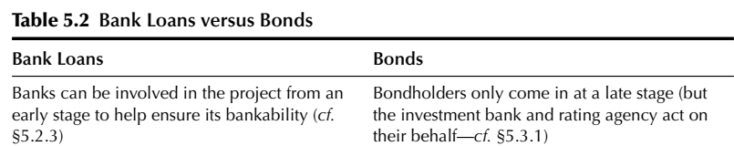
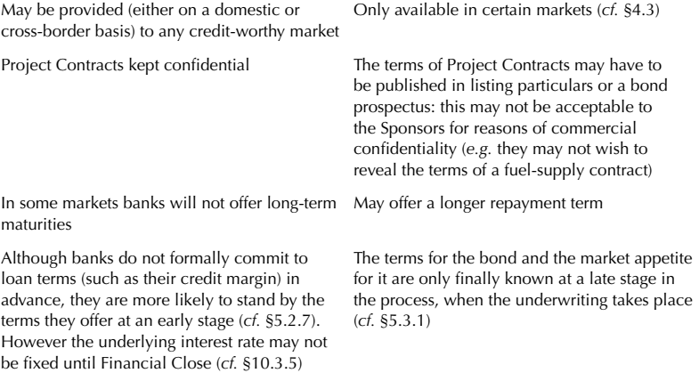
BANK LOANS VERSUS BONDS

Slide 33
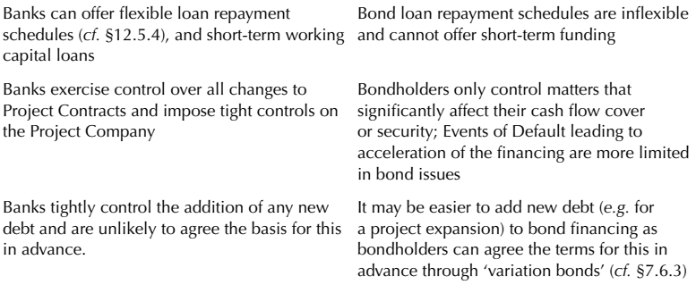
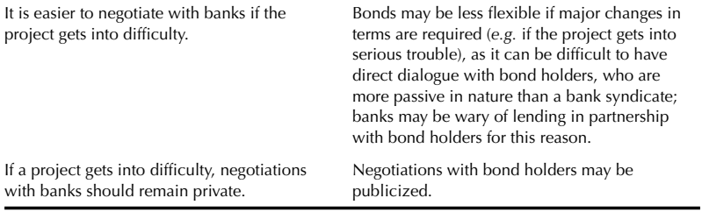
BANK LOANS VERSUS BONDS

Slide 34
Resources:
Principles of Project Finance
By:E.R. Yescombe
Second edition
© YCL Consulting Ltd. 2014
www.yescombe.com
This lecture is taken from chapter5

