Slide 1



Machine Learning
for Finance
Lecture 10
FNT633
Forecasting Part 3
Performance metrics
Prepared by
Dr. Diaa Salama

Slide 2
Week
11
Today
Forecasting
Performance metrics (Confusion Matrix)
www.midocean.ae

Slide 3
Week
What Kind of Problem do I Need to Solve?
How do I Solve it?
11
The Problem to Solve | The Category of Techniques | Covered in this Course
I want to group items by similarity. I want to find structure (commonalities) in the data | Clustering | K-means clustering
I want to discover relationships between actions or items | Association Rules | Apriori
I want to determine the relationship between the outcome and the input variables | Regression | Linear Regression Logistic Regression
I want to assign (known) labels to objects | Classification | Naïve Bayes Decision Trees
I want to find the structure in a temporal process I want to forecast the behavior of a temporal process | Time Series Analysis | ACF, PACF, ARIMA
I want to analyze my text data | Text Analysis | Regular expressions, Document representation (Bag of Words).
www.midocean.ae

Slide 4
Week
11
Agenda
    Forecasting ( Seasonal Variations in Data)
    Confusion Matrxs
    Performance metrics
www.midocean.ae

Slide 5
Week
11
Seasonal Variations in Data
www.midocean.ae

Slide 6
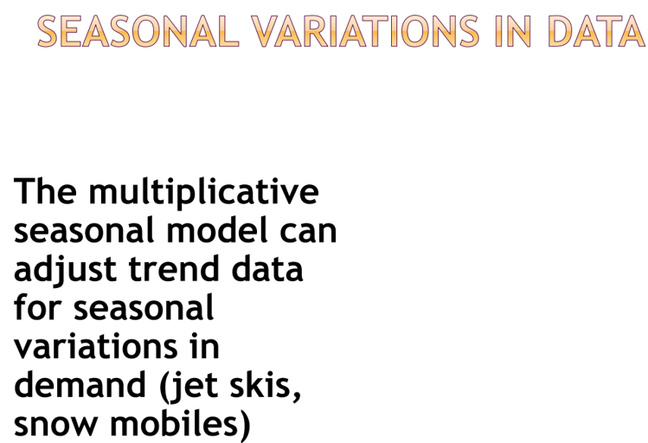
Week
11
Seasonal Variations in Data
www.midocean.ae

Slide 7
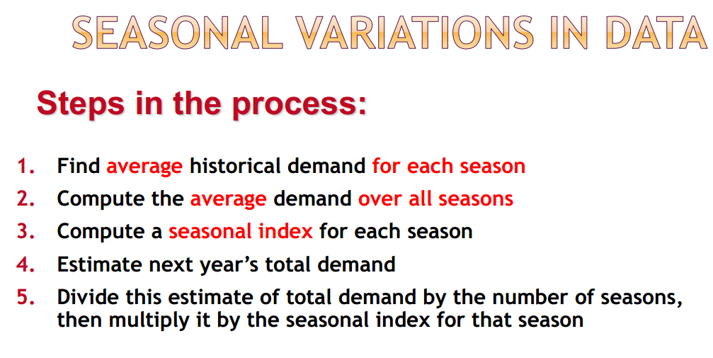
Week
11
Seasonal Variations in Data
www.midocean.ae

Slide 8
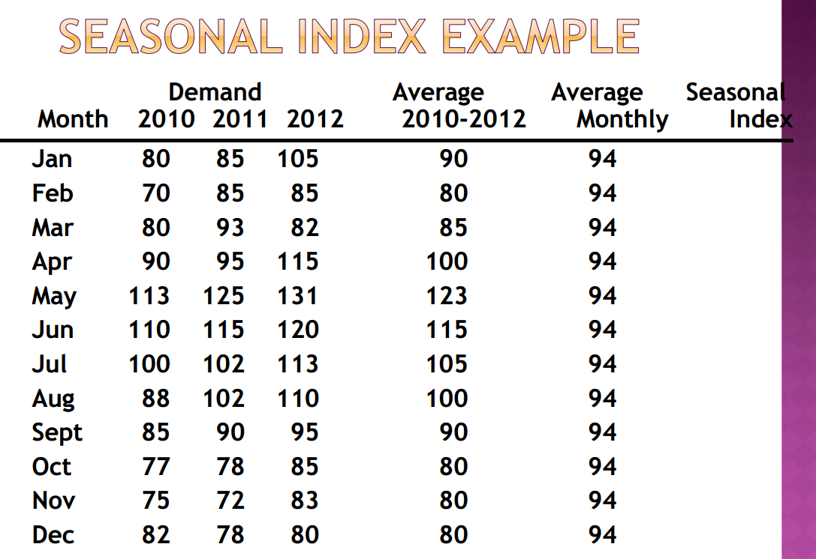
Week
11
Seasonal Variations in Data
www.midocean.ae

Slide 9
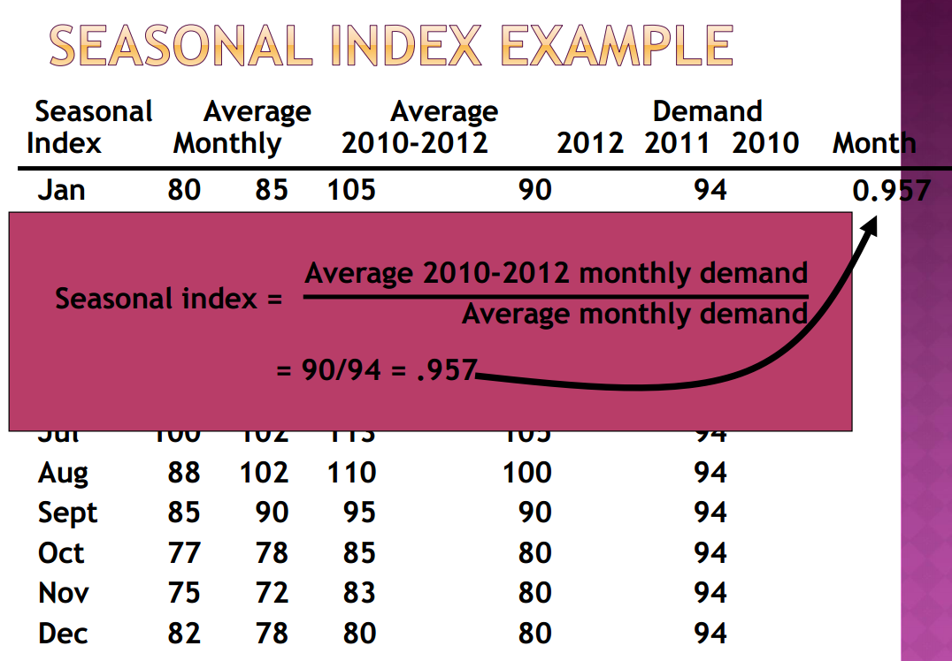
Week
11
Seasonal Variations in Data
www.midocean.ae

Slide 10
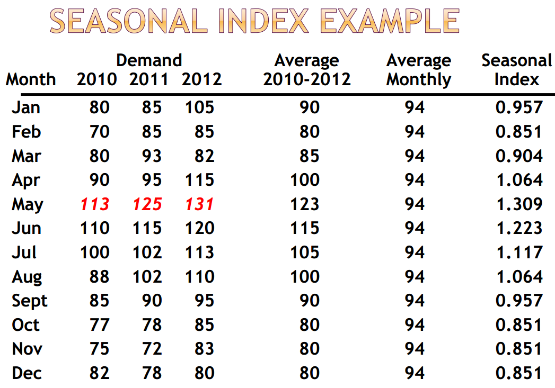
Week
11
Seasonal Variations in Data
www.midocean.ae

Slide 11
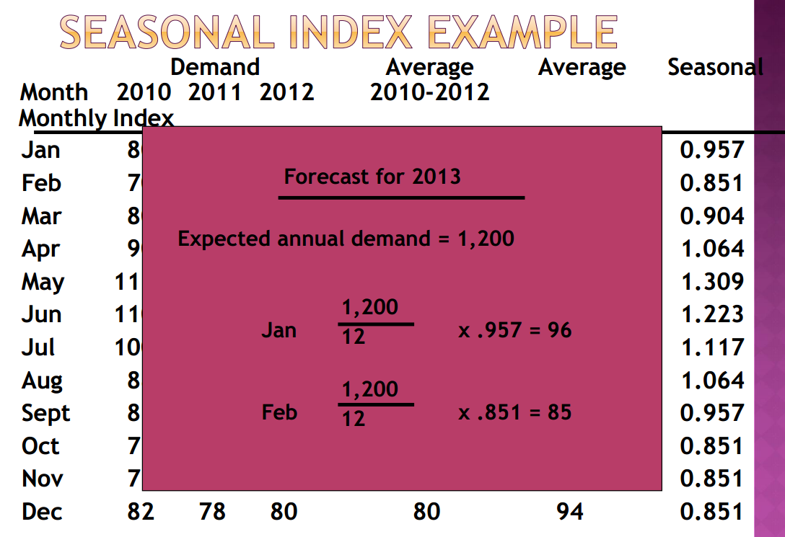
Week
11
Seasonal Variations in Data
www.midocean.ae

Slide 12
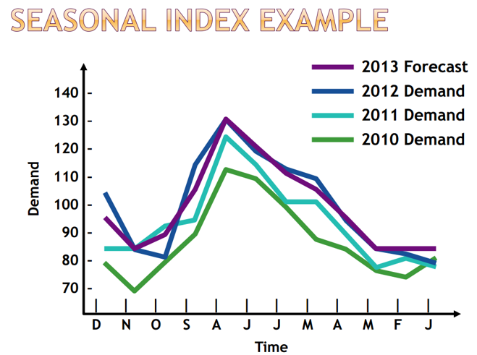
Week
11
Seasonal Variations in Data
www.midocean.ae

Slide 13
Week
11
The Confusion Matrix
www.midocean.ae

Slide 14
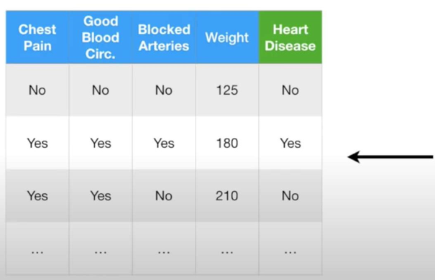
Week
11
The Confusion Matrix
a
    Imagine we have this medical data …….
www.midocean.ae

Slide 15
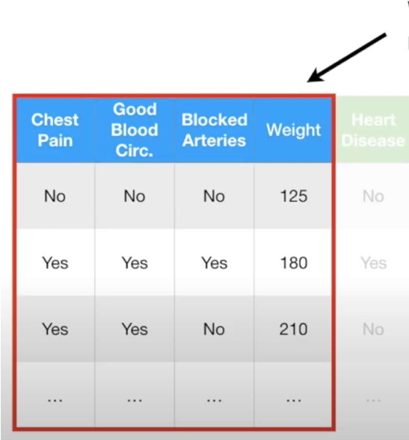
Week
11
The Confusion Matrix
a
    Suppose we ‘ve some clinical measurement
www.midocean.ae

Slide 16
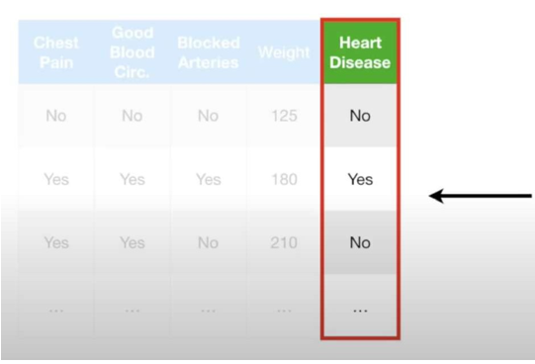
Week
11
The Confusion Matrix
    …..and we want to apply a machine learning method to them to predict whether or not someone will develop heart disease.
www.midocean.ae

Slide 17
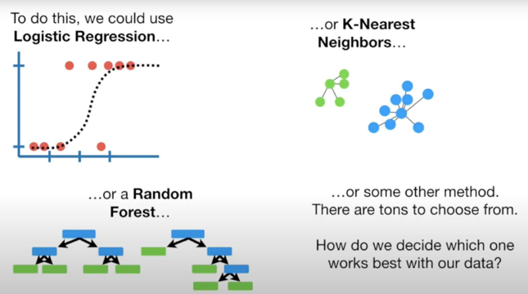
Week
11
The Confusion Matrix
www.midocean.ae

Slide 18
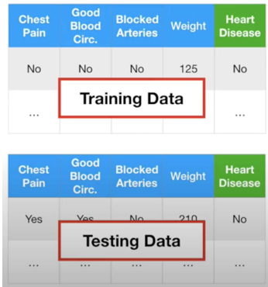
Week
11
The Confusion Matrix
    We start by dividing the data into Training and Testing sets...
www.midocean.ae

Slide 19
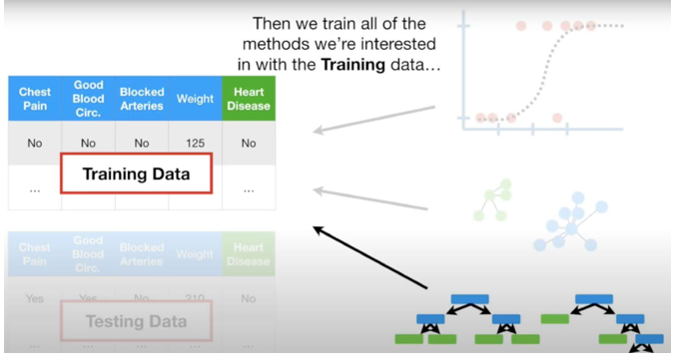
Week
11
The Confusion Matrix
www.midocean.ae

Slide 20
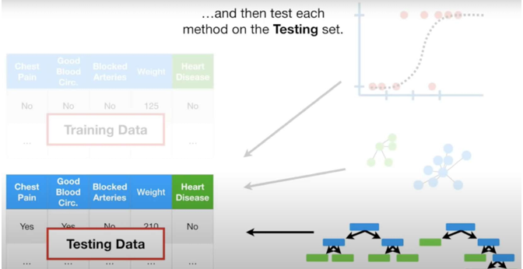
Week
11
The Confusion Matrix
www.midocean.ae

Slide 21
Week
11
The Confusion Matrix
    Now we need to summarize how each method performed on the Testing data
www.midocean.ae

Slide 22
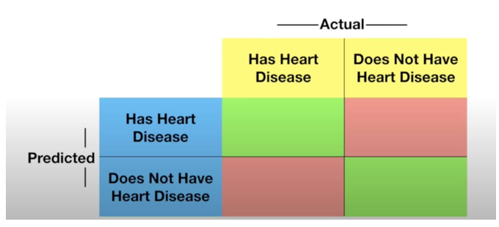
Week
11
The Confusion Matrix
    One way to do this is by creating a Confusion Matrix for each method.
www.midocean.ae

Slide 23
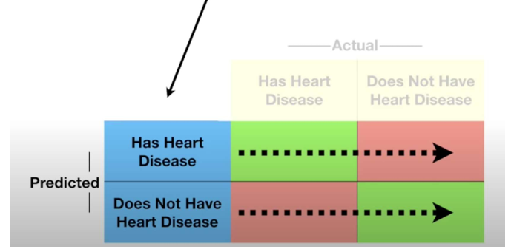
Week
11
The Confusion Matrix
    The rows in a Confusion Matrix correspond to what the machine learning algorithm predicted...
www.midocean.ae

Slide 24
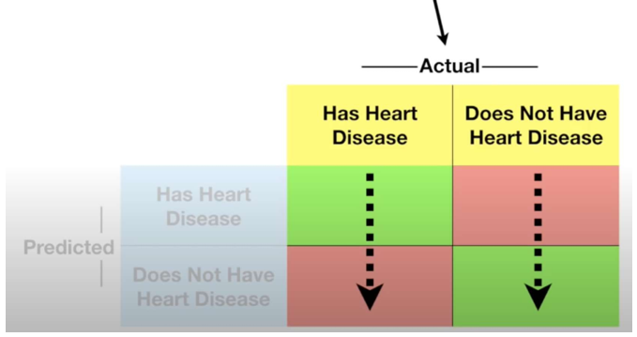
Week
11
The Confusion Matrix
    .and the columns correspond to the known truth.
www.midocean.ae

Slide 25
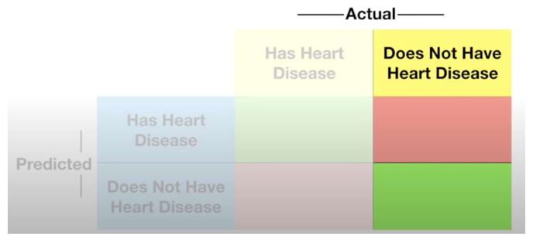
Week
11
The Confusion Matrix
    Since there are only two categories to choose from
        :"Has Heart Disease" or
        "Does Not Have Heart Disease“……….
www.midocean.ae

Slide 26
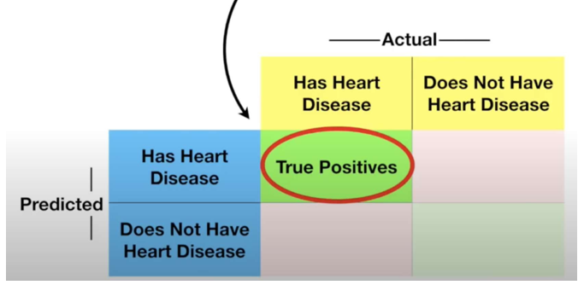
Week
11
The Confusion Matrix
    then the top left corner contains
    True Positives.
www.midocean.ae

Slide 27
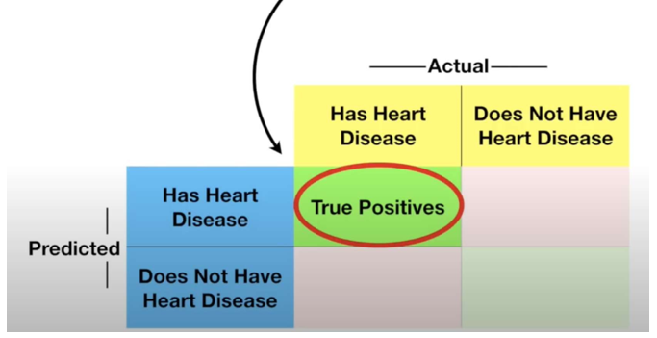
Week
11
The Confusion Matrix
    These are the patients that had heart disease that were correctly identified by the algorithm.
www.midocean.ae

Slide 28
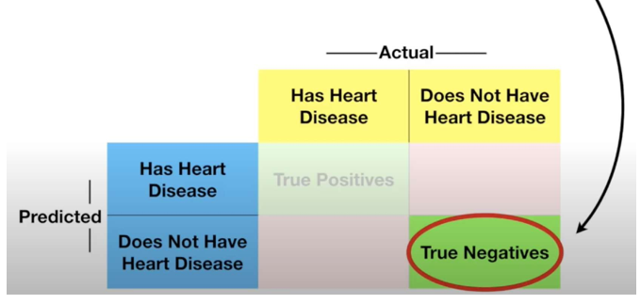
Week
11
The Confusion Matrix
    The True Negatives are in the bottom
    right-hand corner.
www.midocean.ae

Slide 29
Week
11
The Confusion Matrix
    These are the patients that did not have heart disease that were correctly identified by the algorithm.
www.midocean.ae

Slide 30
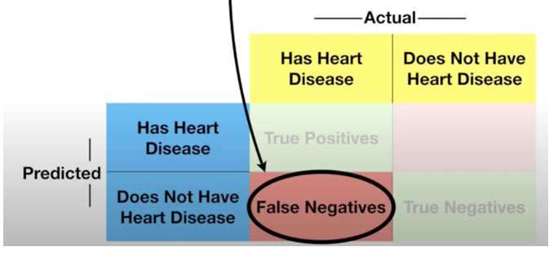
Week
11
The Confusion Matrix
    The bottom left-hand corner contains the False Negatives...
www.midocean.ae

Slide 31
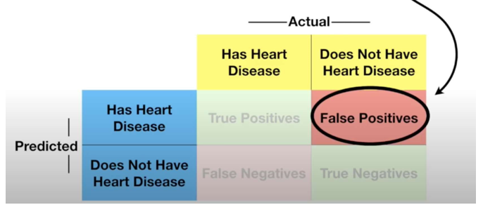
Week
11
The Confusion Matrix
    Lastly, the top right-hand corner contains the False Positives...
www.midocean.ae

Slide 32
Week
11
The Confusion Matrix
    False Positives are patients that do not have heart disease, but the algorithm says they do.
www.midocean.ae

Slide 33
Week
11
Terminologies used
condition positive (P)
the number of real positive cases in the data
condition negative (N)
the number of real negative cases in the data
true positive (TP) eqv. with hit
true negative (TN)
eqv. with correct rejection
false positive (FP)
eqv. with false alarm, type I error or underestimation
false negative (FN)
eqv. with miss, type II error or overestimation
www.midocean.ae

Slide 34
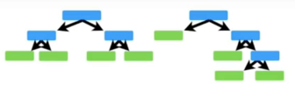
Week
11
The Confusion Matrix
    For example, when we applied the Random Forest to the Testing data..
www.midocean.ae

Slide 35
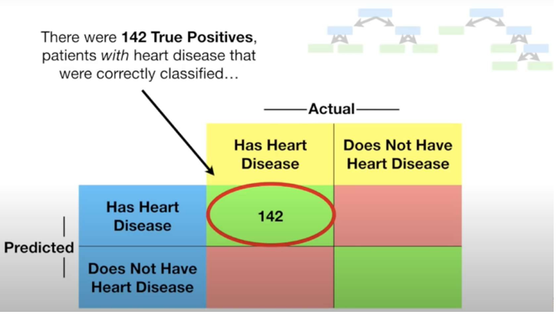
Week
11
The Confusion Matrix
www.midocean.ae

Slide 36
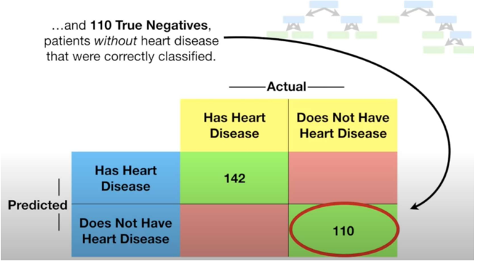
Week
11
The Confusion Matrix
www.midocean.ae

Slide 37
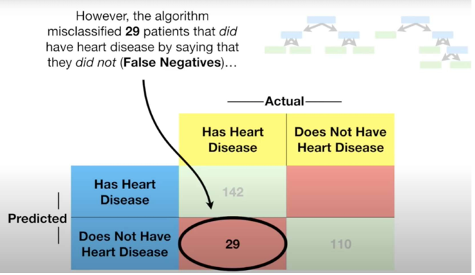
Week
11
The Confusion Matrix
www.midocean.ae

Slide 38
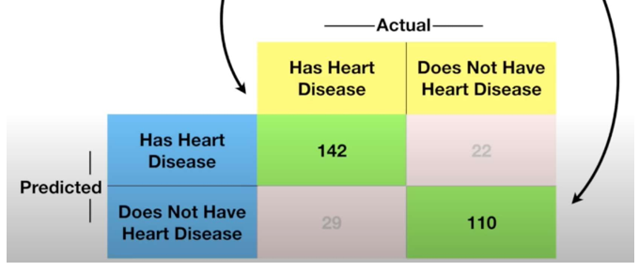
Week
11
The Confusion Matrix
    The numbers along the diagonal (the Green Boxes) tell us how many times the samples were correctly classified.
www.midocean.ae

Slide 39
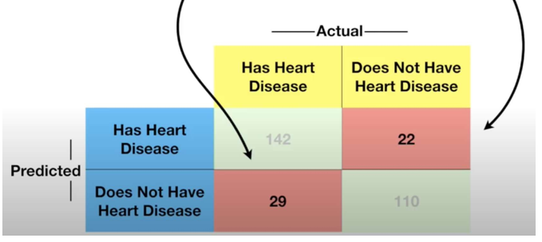
Week
11
The Confusion Matrix
    The numbers not on the diagonal (the Red Boxes) are samples the algorithm messed up.
www.midocean.ae

Slide 40
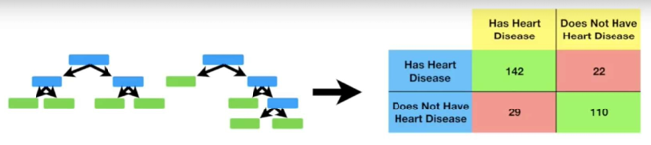
Week
11
The Confusion Matrix
    Now we can compare the Random Forest's
    Confusion Matrix...
www.midocean.ae

Slide 41
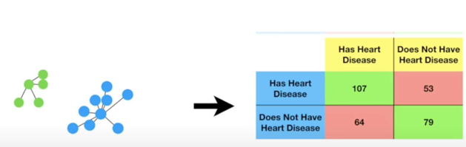
Week
11
The Confusion Matrix
    ………………to the Confusion Matrix we get when we use K-Nearest Neighbors.
www.midocean.ae

Slide 42
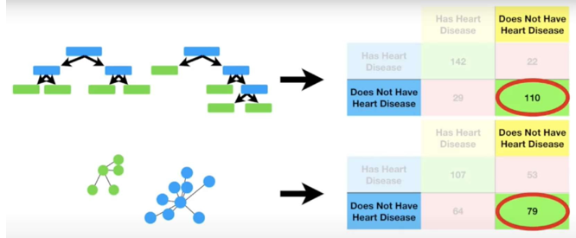
Week
11
The Confusion Matrix
    and worse at predicting patients without Heart Disease (79 vs 110)...
www.midocean.ae

Slide 43
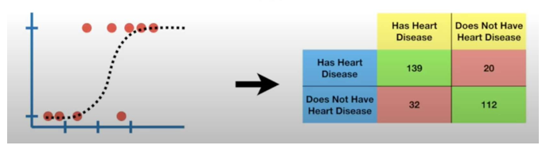
Week
11
The Confusion Matrix
    Lastly, we can apply Logistic Regression to the Testing Dataset and create a Confusion Matrix.
www.midocean.ae

Slide 44
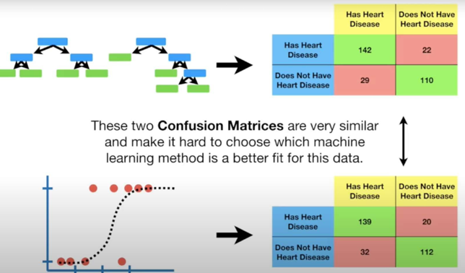
Week
11
The Confusion Matrix
www.midocean.ae

Slide 45
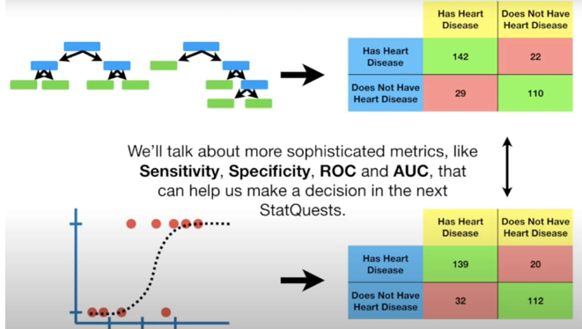
Week
11
The Confusion Matrix
www.midocean.ae

Slide 46
Week
11
The Confusion Matrix
    Now that we have the basic confusion matrix figured out, let's look at a more complicated one.
www.midocean.ae

Slide 47
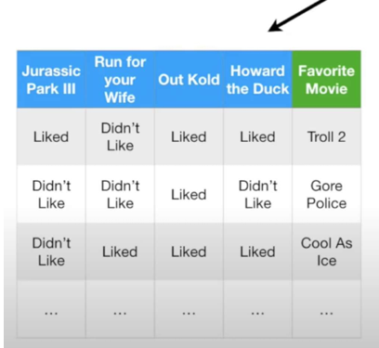
Week
11
The Confusion Matrix
    Here's a new data set...
www.midocean.ae

Slide 48
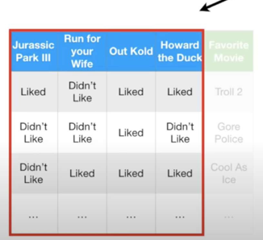
Week
11
The Confusion Matrix
    Now the question is, based on what people think of these movies...
www.midocean.ae

Slide 49
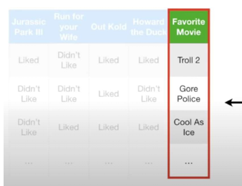
Week
11
The Confusion Matrix
    ...can we use a machine learning method to predict their favorite movie.
www.midocean.ae

Slide 50
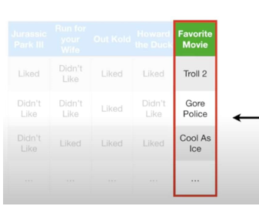
Week
11
The Confusion Matrix
    If the only options for favorite movie were Troll 2, Gore Police or CoolAs Ice
www.midocean.ae

Slide 51
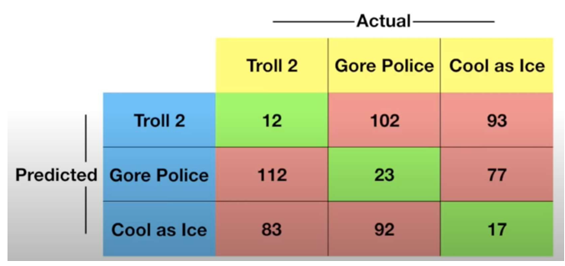
Week
11
The Confusion Matrix
    ...then the confusion matrix would have 3 rows and 3 columns.
www.midocean.ae

Slide 52
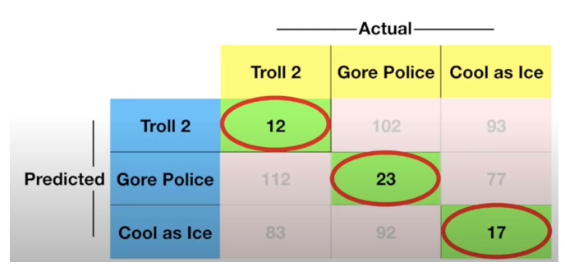
Week
11
The Confusion Matrix
    But just like before, the diagonal (the Green Boxes) are where the machine learning algorithm did the right thing...
www.midocean.ae

Slide 53
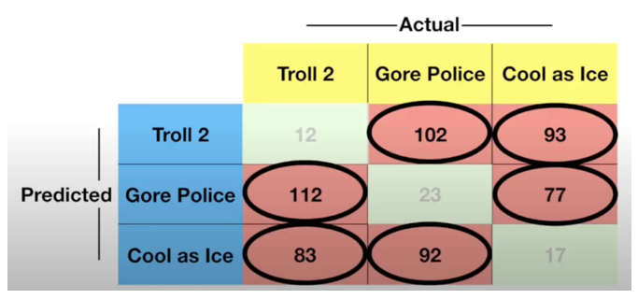
Week
11
The Confusion Matrix
    .and everything else is where
    the algorithm messed up
www.midocean.ae

Slide 54
Week
11
The Confusion Matrix
    Ultimately, the size of the confusion matrix is determined by the number of things we want to predict.
www.midocean.ae

Slide 55
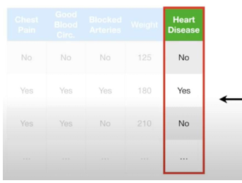
Week
11
The Confusion Matrix
    In the first example, we were only trying to predict two things: if someone had heart disease of if they didn't...
www.midocean.ae

Slide 56
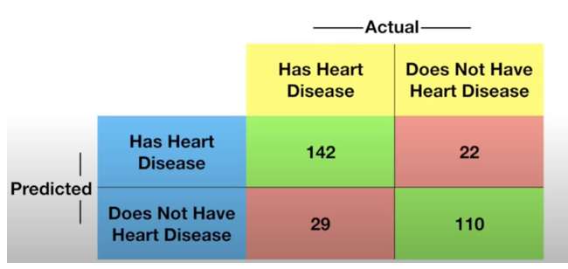
Week
11
The Confusion Matrix
    . ...and that gave us a confusion matrix with 2 rows and 2 columns.
www.midocean.ae

Slide 57
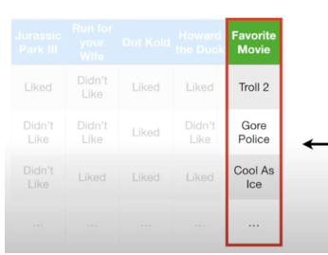
Week
11
The Confusion Matrix
    In the second example, we had three things to choose from.
www.midocean.ae

Slide 58
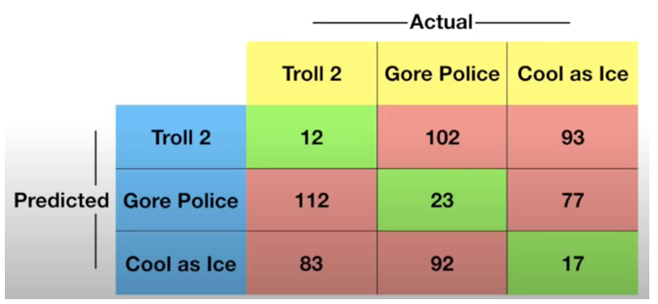
Week
11
The Confusion Matrix
    .and a confusion matrix with 3 rows and 3 columns.
www.midocean.ae

Slide 59
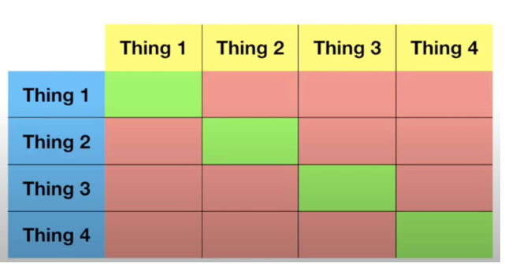
Week
11
The Confusion Matrix
    If we had 4 things to choose from, we get a confusion matrix with 4 rows and 4 columns...
www.midocean.ae

Slide 60
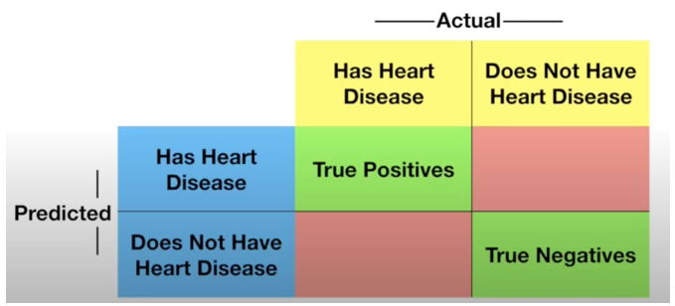
Week
11
The Confusion Matrix
    In summary, a Confusion Matrix tells you what your machine learning algorithm did right...
www.midocean.ae

Slide 61
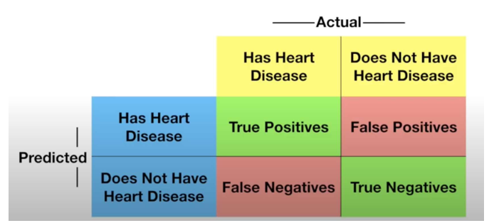
Week
11
The Confusion Matrix
    In summary, a Confusion Matrix tells you what your machine learning algorithm did right... And what it did wrong.
www.midocean.ae

Slide 62
Week
11
Summarized Confusion Matrix
It is a special kind of contingency table, with two dimensions ("actual" and "predicted"), and identical sets of "classes" in both dimensions (each combination of dimension and class is a variable in the contingency table).
www.midocean.ae

Slide 63
Week
11
Summarized Confusion Matrix
Confusion matrix, also known as an error matrix, is a specific table layout that allows visualization of the performance of an algorithm, typically a supervised learning.
Each row of the matrix represents the instances in an actual class while each column represents the instances in a predicted class, or vice versa – both variants are found in the literature.
The name stems from the fact that it makes it easy to see whether the system is confusing two classes (i.e. commonly mislabeling one as another).
www.midocean.ae

Slide 64
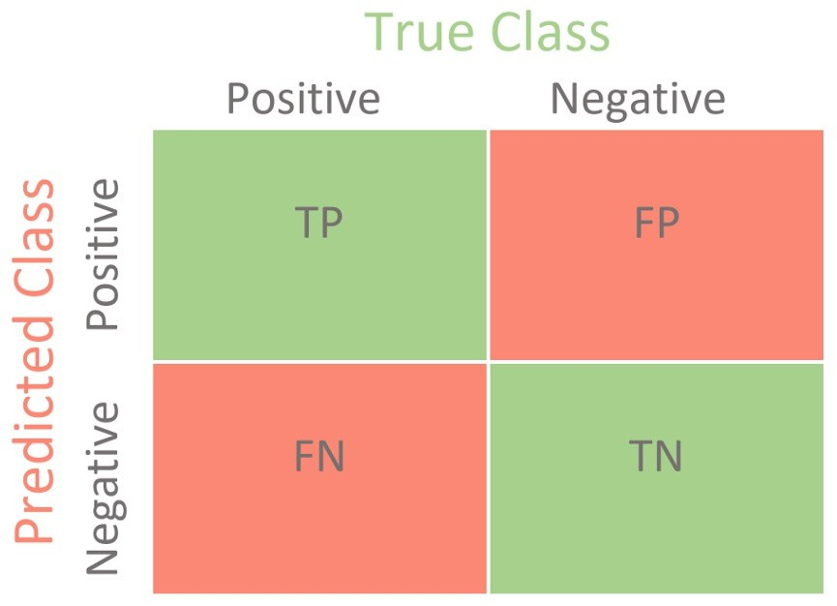
Week
11
Summarized Confusion Matrix
Confusion matrix, also known as an error matrix, is a specific table layout that allows visualization of the performance of an algorithm, typically a supervised learning.
Each row of the matrix represents the instances in an actual class while each column represents the instances in a predicted class, or vice versa – both variants are found in the literature.
The name stems from the fact that it makes it easy to see whether the system is confusing two classes (i.e. commonly mislabeling one as another).
www.midocean.ae

Slide 65
Week
11
Confusion Matrix Example 2
Given a sample of 12 pictures, 8 of cats and 4 of dogs, where cats belong to class 1 and dogs belong to class 0,
actual = [1,1,1,1,1,1,1,1,0,0,0,0],
assume that a classifier that distinguishes between cats and dogs is trained, and we take the 12 pictures and run them through the classifier. The classifier makes 9 accurate predictions and misses 3: 2 cats wrongly predicted as dogs (first 2 predictions) and 1 dog wrongly predicted as a cat (last prediction).
prediction = [0,0,1,1,1,1,1,1,0,0,0,1]
With these two labeled sets (actual and predictions), we can create a confusion matrix that will summarize the results of testing the classifier:
www.midocean.ae

Slide 66

Week
11
Confusion Matrix Example 2
In this confusion matrix, of the 8 cat pictures, the system judged that 2 were dogs, and of the 4 dog pictures, it predicted that 1 were cats.
All correct predictions are located in the diagonal of the table (highlighted in bold), so it is easy to visually inspect the table for prediction errors, as values outside the diagonal will represent them.
www.midocean.ae

Slide 67


Week
11
Confusion Matrix Example 2
www.midocean.ae

Slide 68
Week
11
Performance metrics
www.midocean.ae

Slide 69
Week
11
Outline
1. Metrics
2. Precision , Accuracy , F 1 Score and recall
3. Worked example
www.midocean.ae

Slide 70
Week
11
Outline
1. Metrics
2. Precision , Accuracy , F 1 Score and recall
3. Worked example
www.midocean.ae

Slide 71
Week
11
Metrics
It is extremely important to use quantitative metrics for evaluating a machine learning model
Until now, we relied on the cost function value for regression and classification
Other metrics can be used to better evaluate and understand the model
For classification
  Accuracy/Precision/Recall/F1-score, ROC curves,…
For regression
  Normalized RMSE, Normalized Mean Absolute Error (NMAE),…
www.midocean.ae

Slide 72

Week
11
Accuracy
Accuracy is also used as a statistical measure of how well a binary classification test correctly identifies or excludes a condition.
That is, the accuracy is the proportion of correct predictions (both true positives and true negatives) among the total number of cases examined
www.midocean.ae

Slide 73
Week
11
Accuracy
Accuracy is a measure of how close a given set of guessing from our model are closed to their true value.
_{Accuracy =} # Correct classifications
# All classifications
If a classifier make 10 predictions and 9 of them are correct, the accuracy is 90%.
Accuracy is a measure of how well a binary classifier correctly identifies or excludes a condition.
It’s the proportion of correct predictions among the total number of cases examined.
www.midocean.ae

Slide 74
Week
11
Outline
1. Metrics
2. Precision , Accuracy , F 1 Score and recall
3. Worked example
www.midocean.ae

Slide 75
Week
11
Accuracy
Accuracy is also used as a statistical measure of how well a binary classification test correctly identifies or excludes a condition.
That is, the accuracy is the proportion of correct predictions (both true positives and true negatives) among the total number of cases examined
www.midocean.ae

Slide 76
Week
11
Precision
The positive predictive value (PPV), also called precision, is defined as,
www.midocean.ae

Slide 77
Week
11
Negative Predictive Value
The negative predictive value is defined as:
www.midocean.ae

Slide 78
Week
11
F1-score
In statistical analysis of binary classification, the F-score or F-measure is a measure of a test's accuracy.
It is calculated from the precision and recall of the test, where the precision is the number of true positive results divided by the number of all positive results, including those not identified correctly, and the recall is the number of true positive results divided by the number of all samples that should have been identified as positive.
www.midocean.ae

Slide 79
Week
11
F1 Score
Suppose that 𝑦 = 1 in presence of a rare class that we want to detect
Precision (How much we are precise in the detection)
Confusion matrix
Actual class
Of all patients where we classified 𝑦 = 1, what fraction actually has the disease?
True Positive True Positive
# Estimated Positive ⁼ True Positive + False Positive
 | 1 (p) | 0 (n)
1 (Y) | True positive (TP) | False positive (FP)
0 (N) | False negative (FN) | True negative (TN)
Estiamted class
Recall (How much we are good at detecting)
Of all patients that actually have the disease, what fraction did we correctly detect as having the disease?
True Positive # Actual Positive
True Positive
True Positive + False Negative
=
www.midocean.ae

Slide 80

Week
11
Confusion Matrix for multiple classes
www.midocean.ae

Slide 81

Week
11
Summaries of the confusion matrix
Different metrics can be computed from the confusion matrix, depending on the class of interest (https://en.wikipedia.org/wiki/Precision_and_recall)
www.midocean.ae

Slide 82
Week
11
Outline
1. Metrics
2. Precision , Accuracy , F 1 Score and recall
3. Worked example
www.midocean.ae

Slide 83

Week
11
Example 1
suppose the following data set
www.midocean.ae

Slide 84

Week
11
Example 1
suppose the following data set
www.midocean.ae

Slide 85

Week
11
Consruction Confusion Matrix
www.midocean.ae

Slide 86

Week
Calculate Metrics
11
Suppose the following dataset
www.midocean.ae

Slide 87

Week
11
Example 2 : Pneumonia detection
Suppose to have at disposal X-ray images of lungs: Healthy people - Covid-19 disease patients
This example is ONLY for educational purposes
www.midocean.ae

Slide 88
Week
11
Acknowledgments
The COVID-19 X-ray image is curated by Dr. Joseph Cohen, a postdoctoral fellow at the University of Montreal, see https://josephpcohen.com/w/public-covid19-dataset/
The previous data contain only X-ray images of people with a disease. To collect images of healthy people, we can download another X-ray dataset on the platform Kaggle https://www.kaggle.com/paultimothymooney/chest-xray-pneumonia
The analysis is inspired from a tutorial by Adrian Rosebrock: https://www.pyimagesearch.com/2020/03/16/detecting-covid-19-in-x-ray-images-with-keras- tensorflow-and-deep-learning/
This example is ONLY for educational purposes

Slide 89
Week
11
Acknowledgments
We want to use a classifier to perform classification:
Healthy patients: class 0
Patients with a disease: class 1
The input data are directly the X-ray images
For these computer vision tasks, the state of the art algorithm are the Convolutional Neural Networks:
we can use them to classify the images into healthy and disease
This example is ONLY for educational purposes

Slide 90

Week
11
Example 2 : Pneumonia detection
Estimated covid label Estimated healthy label
True label
Suppose to have at disposal X-ray images of lungs: Healthy people - Covid-19 disease patients
This example is ONLY for educational purposes
www.midocean.ae

Slide 91
Week
11
Pneumonia detection
Classification results on test set
Sensitivity (recall, true positive rate)
Actual class
Estimated class
 | 1 (p) | 0 (n)
1 (Y) | True positive 11 | False positive 0
0 (N) | False negative 1 | True negative 11
True Positive True Positive
=
= 0.92
# Actual Positive True Positive + False Negative
Specificity (true negative rate)
True Negative True Negative
Accuracy: ≈ 96%
=
= 1
# Actual Negative False Positive + True Negative
This example is ONLY for educational purposes
www.midocean.ae

Slide 92
Week
11
Pneumonia detection
Sensitivity (recall, true positive rate)
Specificity (true negative rate)
True Positive True Positive
True Negative True Negative
=
= 0.92
=
= 1
# Actual Positive True Positive + False Negative
# Actual Negative False Positive + True Negative
Sensitivity: of patients that do have COVID-19 (i.e., true positives), we could accurately identify them as “COVID-19 positive” 92% of the time using our model
Specificity: of patients that do not have COVID-19 (i.e., true negatives), we could accurately identify them as “COVID-19 negative” 100% of the time using our model.
This example is ONLY for educational purposes
www.midocean.ae

Slide 93
Week
11
Summary
Balancing sensitivity and specificity is incredibly challenging when it comes to medical applications
The results should always be validated with another pool of people Furthermore, we need to be concerned of what the model is actually learning:
Does the results align with the medical knowledge?
Was the dataset well representative of the population or there was selection bias?
www.midocean.ae

Slide 94
Week
11
Issues Affecting Model Selection
Accuracy
  classifier accuracy: predicting class label
Speed
  time to construct the model (training time)
  time to use the model (classification/prediction time)
Robustness: handling noise and missing values
Scalability: efficiency in disk-resident databases
Interpretability
  understanding and insight provided by the model
Other measures, e.g., goodness of rules, such as decision tree size or compactness of classification rules
www.midocean.ae

Slide 95



Thank You

