Slide 1


Database Management System
IT 261
Bachelor of Information Technology
Prepared by Dr. Khaled Eskaf
Lecture 4

Slide 2

Week | Topic | Objective | MySQL Practical Activities
1 | Introduction to Database Concepts | Understand basic database concepts. | Install MySQL, explore the interface, create a basic database.
2 | Relational Data Model | Learn about the relational data model. | Create relational tables in MySQL.
3 | Relational Integrity Rules | Understand relational integrity constraints. | Implement primary and foreign key constraints in MySQL.
4 | Relational Algebra and Basic SQL | Explore relational algebra and basic SQL commands. | Use basic SQL queries in MySQL.
5 | Advanced SQL Queries | Delve into complex SQL operations. | Execute advanced SQL commands in MySQL.
6 | Introduction to Database Normalization | Begin learning database normalization principles. | Apply the first normal form (1NF) in MySQL.
7 | Advanced Database Normalization | Explore advanced normalization techniques. | Normalize a database in MySQL to 2NF and 3NF.
8 | Data Modeling and ER Diagrams | Understand data modeling and ER diagrams. | Create an ER diagram and implement it in MySQL.
9 | Database Design for Real-World Apps | Apply database design to real-world scenarios. | Develop a database schema based on a real-world example.
10 | Project and Review | Apply all learned concepts in a comprehensive project. | Complete a project in MySQL incorporating all learned skills.
www.midocean.ae

Slide 3

www.midocean.ae

Slide 4

Chapter
Week 3 Outlines
03
www.midocean.ae

Slide 5
Chapter
03
Relational integrity rules are fundamental in relational database design, ensuring data remains accurate and consistent. They include primary keys to uniquely identify records, foreign keys to maintain referential integrity (ensuring relationships between tables are preserved), and unique constraints to prevent duplicate entries. These rules help in maintaining the reliability of data relationships across the database.
www.midocean.ae
Notes:
تعتبر قواعد التكامل العلائقي أساسية في تصميم قواعد البيانات العلائقية، مما يضمن بقاء البيانات دقيقة ومتسقة. وهي تتضمن مفاتيح أساسية لتعريف السجلات بشكل فريد، ومفاتيح خارجية للحفاظ على التكامل المرجعي (ضمان الحفاظ على العلاقات بين الجداول)، وقيود فريدة لمنع الإدخالات المكررة. تساعد هذه القواعد في الحفاظ على موثوقية علاقات البيانات عبر قاعدة البيانات.

Slide 6
Chapter
03
Relational integrity rules include:
Primary Keys: Uniquely identify each record in a table.
Foreign Keys: Establish and enforce relationships between tables.
Unique Constraints: Prevent duplicate entries in specific columns.
Check Constraints: Ensure that column values meet a specified condition.
Not Null Constraints: Ensure that a column cannot have a null value.
These rules ensure data accuracy and consistency within relational databases.
www.midocean.ae
Notes:
المفاتيح الأساسية: لتحديد كل سجل بشكل فريد في جدول.
المفاتيح الخارجية: لإنشاء وفرض العلاقات بين الجداول.
القيود الفريدة: لمنع الإدخالات المكررة في أعمدة محددة.
القيود المحددة: لضمان أن تلبي قيم الأعمدة شرطًا محددًا.
القيود غير الفارغة: لضمان عدم ترك عمود بدون قيمة.
تضمن هذه القواعد دقة واتساق البيانات داخل قواعد البيانات العلاقية

Slide 7
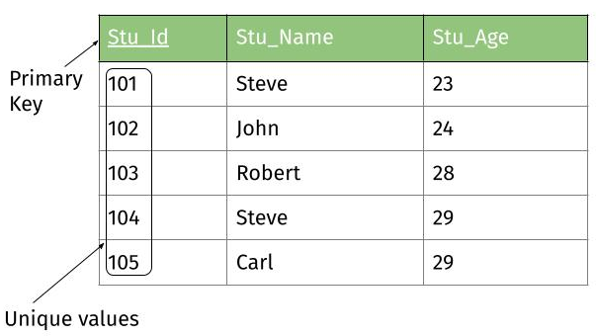
Chapter
03
Primary Keys
Table named Students, where each student has a unique student ID, a name, and an age. The primary key for this table would be the student ID because it uniquely identifies each record. Here's a basic example:
Table: Students
  Columns: StudentID (Primary Key), Name, Age
  Rows:
    Stu_Id: 1, Stu_Name: ali ahmed, Stu_Age:20
    Stu_Id : 2, Stu_Name: hassan ahmed, Stu_Age:21
www.midocean.ae

Slide 8
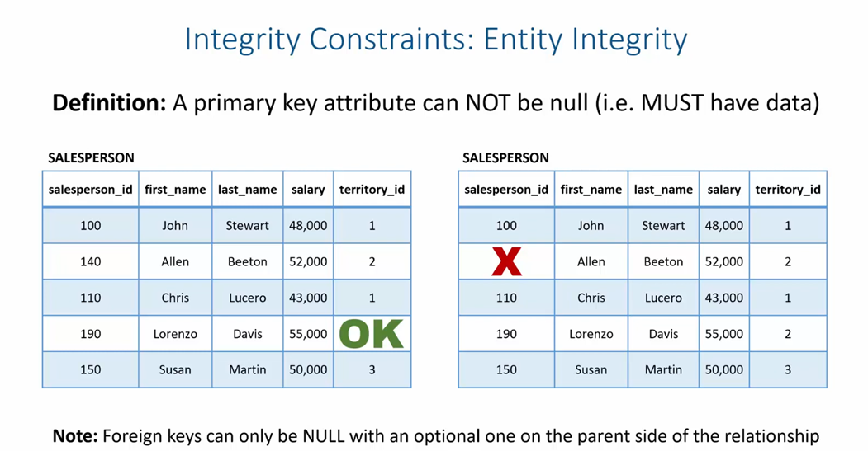
Chapter
03
www.midocean.ae

Slide 9
Chapter
Foreign Keys
03
Foreign keys establish a relationship between two tables in a database, ensuring referential integrity. For example, consider two tables: Students and Courses. Each student enrolls in a course, creating a relationship between students and courses.
Students Table:
  Columns: StudentID (Primary Key), StudentName
Courses Table:
  Columns: CourseID (Primary Key), CourseName, StudentID (Foreign Key)
The StudentID in the Courses table is a foreign key that references the StudentID in the Students table. This setup ensures that each course entry is associated with a valid student, maintaining the integrity of the database.
www.midocean.ae
Notes:
التكامل المرجعي

Slide 10
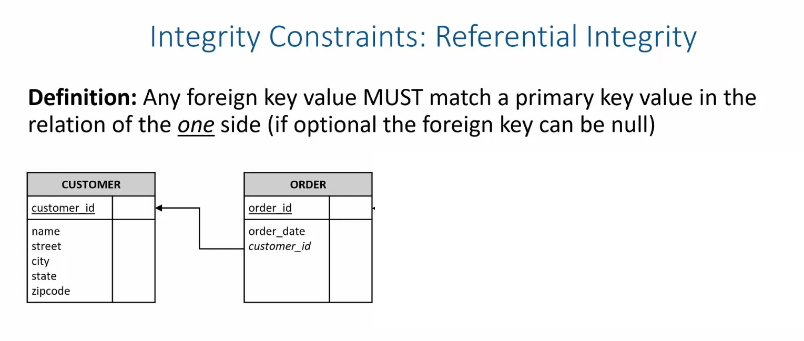
Chapter
03
www.midocean.ae

Slide 11
Chapter
Unique Constraint
03
Unique constraints ensure that all values in a column are different from each other, preventing duplicate entries in a database table. For instance, in a table named Students, a unique constraint on the email column guarantees that no two students can have the same email address. Here's a simplified example of how this might be applied:
Table Name: Students
Columns: StudentID, Name, Email
Unique Constraint: Applied to the Email column.
By setting a unique constraint on the Email column, the database ensures that every student has a distinct email address, thus maintaining the integrity and uniqueness of student contact information.
www.midocean.ae
Notes:
القيد الفريد

Slide 12
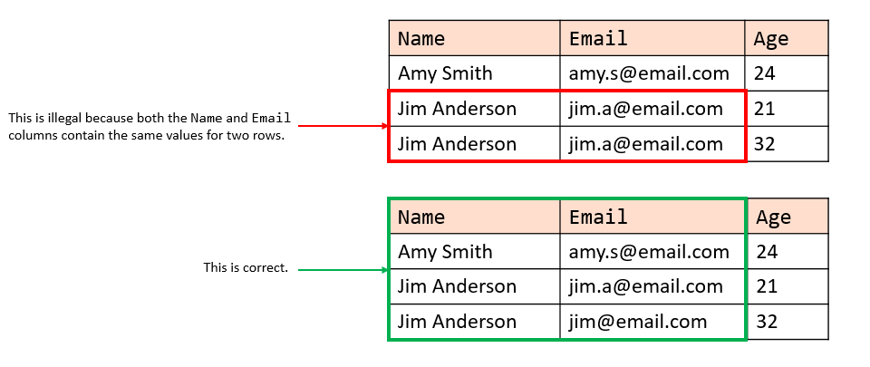
Chapter
03
www.midocean.ae

Slide 13
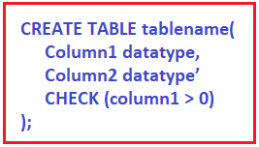
Chapter
03
Check Constraints
Check constraints in a database ensure that all values in a column meet a specific condition. For example, if you have a table named "Employees" and you want to make sure that the age of each employee is greater than 18, you would add a check constraint on the "Age" column.
Example Table: Employees
Columns: EmployeeID, Name, Age
www.midocean.ae

Slide 14
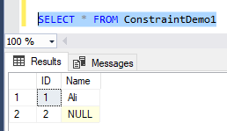
Chapter
03
Not Null Constraints
Not Null Constraints Example:
Imagine we have a table named Students, where each student must have a unique student_id and a name. To ensure every student record has a name, we apply a Not Null constraint on the name column.
Table Name: Students
Columns: student_id (INT), name (VARCHAR)
www.midocean.ae

Slide 15
Chapter
A domain constraint
03
A domain constraint specifies the permissible values for a given attribute in a database table. For example, consider a table named "Students" with an attribute "Grade". If the "Grade" attribute only accepts values from A to F, then the domain constraint for "Grade" would be set to only these letters. This ensures data integrity by restricting the grade values entered into the database to only those that are valid within the specified domain.
www.midocean.ae

Slide 16
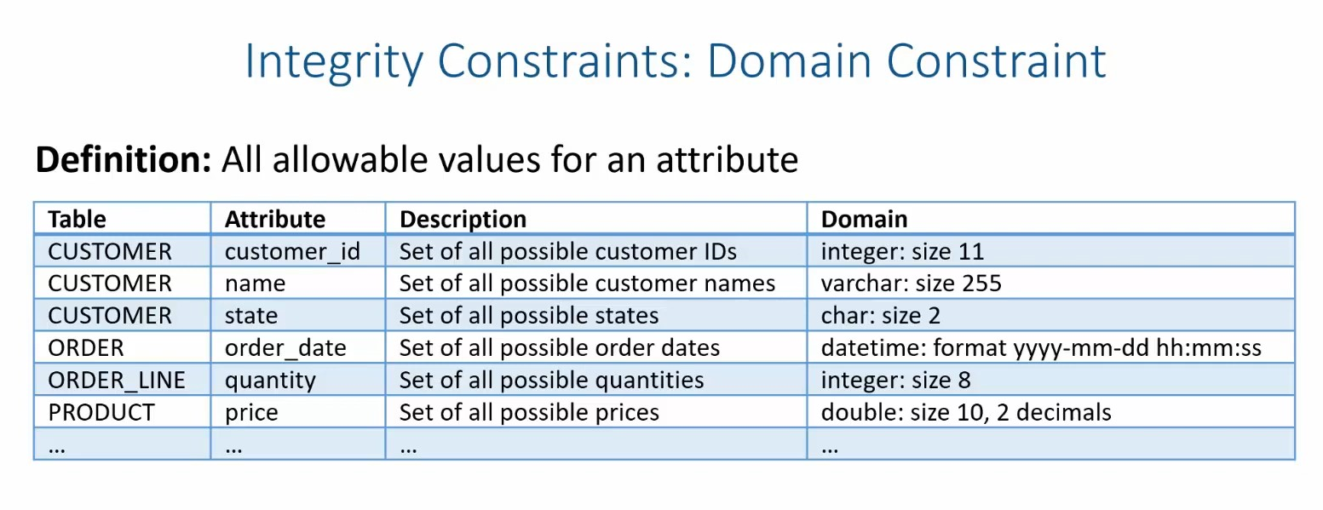
Chapter
03
www.midocean.ae

Slide 17

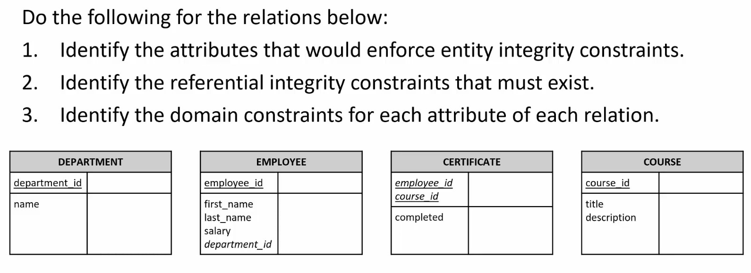
Chapter
03
www.midocean.ae

Slide 18
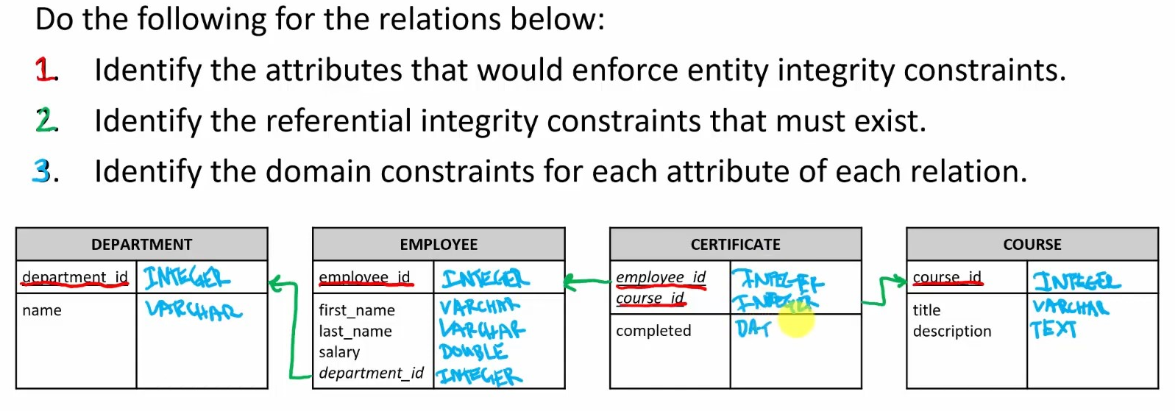
Chapter
03
www.midocean.ae

Slide 19

Chapter
03
www.midocean.ae

Slide 20
Chapter
03
To create a database in MySQL Workbench for students, courses, and teachers, follow these steps:
Open MySQL Workbench and connect to your MySQL server.
Create a New Schema: Click on the "+" icon next to "Schemas" to create a new database. Name it school_db and apply the changes.
Create Tables: Use the toolbar to create new tables for Students, Courses, and Teachers.
  For Students, add fields like student_id, name, email.
  For Courses, include course_id, course_name, teacher_id.
  For Teachers, fields might be teacher_id, name.
Define Primary Keys for each table (e.g., student_id, course_id, teacher_id) and set them to auto-increment.
Establish Relationships: Use foreign keys to link Courses to Teachers by teacher_id.
Insert Data: Use INSERT INTO statements to populate each table with sample data.
www.midocean.ae

Slide 21
Chapter
03
1.Create a Database (Schema):
CREATE DATABASE school_db; USE school_db;
Create a Table for Students:
CREATE TABLE Students ( student_id INT AUTO_INCREMENT, name VARCHAR(100), email VARCHAR(100), PRIMARY KEY(student_id) );
Create a Table for Courses:
CREATE TABLE Courses ( course_id INT AUTO_INCREMENT, course_name VARCHAR(100), teacher_id INT, PRIMARY KEY(course_id), FOREIGN KEY(teacher_id) REFERENCES Teachers(teacher_id) );
Create a Table for Teachers:
CREATE TABLE Teachers ( teacher_id INT AUTO_INCREMENT, name VARCHAR(100), PRIMARY KEY(teacher_id) );
www.midocean.ae

Slide 22
Chapter
03
Hospital ER Model
Hospital.
The entities are represented in rectangular boxes and are Patient, Tests and Doctor.
Each of these entities have their respective attributes which are −
Patients - ID(primary key), name, age,visit_date
Tests- Name(primary key), date, result
Doctor- ID(primary key), name, specialization
www.midocean.ae

Slide 23
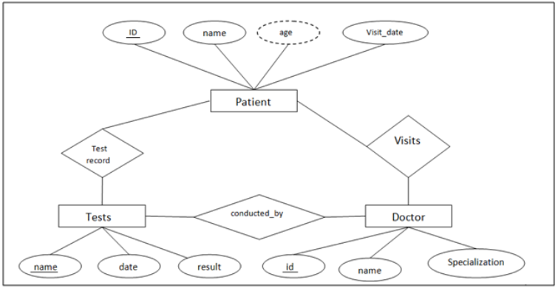
Chapter
03
www.midocean.ae

Slide 24

Chapter
04
www.midocean.ae

Slide 25
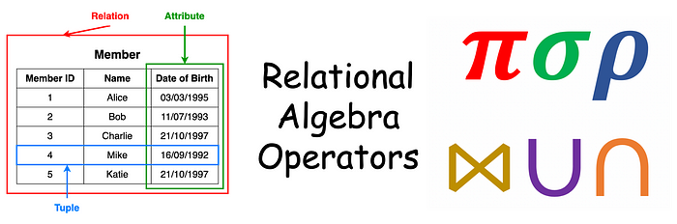
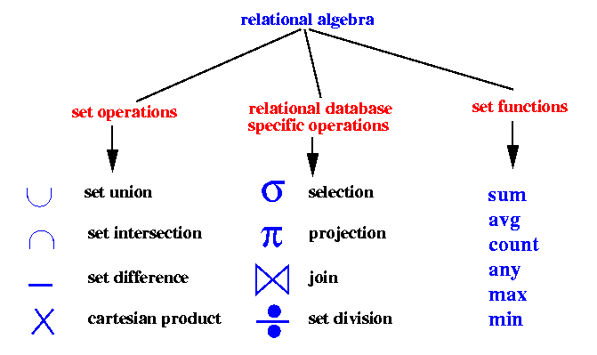
Chapter
04
www.midocean.ae

Slide 26
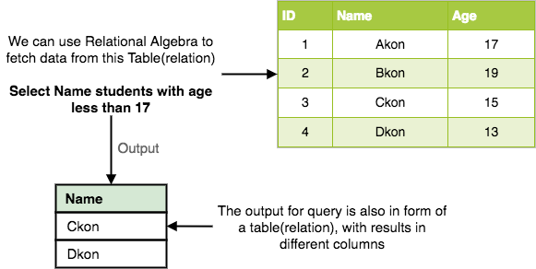
Chapter
04
Every database management system must define a query language to allow users to access the data stored in the database. Relational Algebra is a procedural query language used to query the database tables to access data in different ways.
In relational algebra, input is a relation(table from which data has to be accessed) and output is also a relation(a temporary table holding the data asked for by the user).
www.midocean.ae
Notes:
يجب على كل نظام إدارة قاعدة بيانات تحديد لغة استعلام للسماح للمستخدمين بالوصول إلى البيانات المخزنة في قاعدة البيانات. الجبر العلائقي هو لغة استعلام إجرائية تستخدم للاستعلام عن جداول قاعدة البيانات للوصول إلى البيانات بطرق مختلفة.
في الجبر العلائقي، المدخلات هي علاقة (جدول يجب الوصول إلى البيانات منه) والمخرجات هي أيضًا علاقة (جدول مؤقت يحتوي على البيانات التي يطلبها المستخدم).

Slide 27
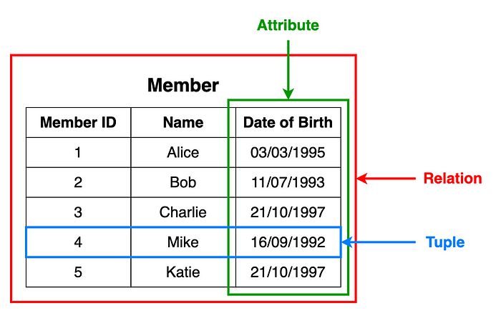
Chapter
04
What is Relational Algebra?
Relational algebra is a family of algebras with a well-founded semantics used for modelling the data stored in relational databases, and defining queries on it.
www.midocean.ae

Slide 28
Chapter
04
Relational Algebra works on the whole table at once, so we do not have to use loops etc to iterate over all the rows(tuples) of data one by one. All we have to do is specify the table name from which we need the data, and in a single line of command, relational algebra will traverse the entire given table to fetch data for you.
The primary operations that we can perform using relational algebra are:
Select
Project
Union
Set Different
Cartesian product
Rename
www.midocean.ae

Slide 29
Chapter
04
Select Operation (σ) Sigma :
This is used to fetch rows(tuples) from table(relation) which satisfies a given condition.
Syntax: σ_{p}(r)
Where, σ represents the Select Predicate, r is the name of relation(table name in which you want to look for data), and p is the prepositional logic, where we specify the conditions that must be satisfied by the data. In prepositional logic, one can use unary and binary operators like =, <, > etc, to specify the conditions.
Let's take an example of the Student table we specified above in the Introduction of relational algebra, and fetch data for students with age more than 17.
σ_{age > 17} (Student)
This will fetch the tuples(rows) from table Student, for which age will be greater than 17.
You can also use, and, or etc operators, to specify two conditions, for example,
σ_{age > 17 and gender = 'Male'} (Student)
This will return tuples(rows) from table Student with information of male students, of age more than 17.(Consider the Student table has an attribute Gender too.)
www.midocean.ae

Slide 30
Chapter
04
A | B | C
1 | 2 | 4
2 | 2 | 3
3 | 2 | 3
4 | 3 | 4
Example:
For the above relation, σ(c>3)R will select the tuples which have c more than 3.
Note: The selection operator only selects the required tuples but does not display them. For display, the data projection operator is used.
A | B | C
1 | 2 | 4
4 | 3 | 4
www.midocean.ae

Slide 31
Chapter
04
Project Operation (∏) PI:
Project operation is used to project only a certain set of attributes of a relation. In simple words, If you want to see only the names all of the students in the Student table, then you can use Project Operation.
It will only project or show the columns or attributes asked for, and will also remove duplicate data from the columns.
Syntax: ∏_{A1, A2...}(r)
where A1, A2 etc are attribute names(column names).
For example,
∏_{Name, Age}(Student)
Above statement will show us only the Name and Age columns for all the rows of data in Student table.
www.midocean.ae

Slide 32
Chapter
04
Projection(π):
It is used to project required column data from a relation.
Example: Consider Table 1. Suppose we want columns B and C from Relation R.
π(B,C)R will show following columns.
Note: By Default, projection removes duplicate data.
A | B | C
1 | 2 | 4
2 | 2 | 3
3 | 2 | 3
4 | 3 | 4
B | C
2 | 4
2 | 3
3 | 4
www.midocean.ae

Slide 33
Chapter
04
Union Operation (∪):
This operation is used to fetch data from two relations(tables) or temporary relation(result of another operation).
For this operation to work, the relations(tables) specified should have same number of attributes(columns) and same attribute domain. Also the duplicate tuples are autamatically eliminated from the result.
Syntax: A ∪ B
where A and B are relations.
For example, if we have two tables RegularClass and ExtraClass, both have a column student to save name of student, then,
∏_{Student}(RegularClass) ∪ ∏_{Student}(ExtraClass)
Above operation will give us name of Students who are attending both regular classes and extra classes, eliminating repetition.
www.midocean.ae

Slide 34
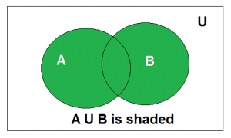
Chapter
04
Union
Union of the sets A and B, denoted by A ∪ B, is the set of distinct elements that belong to set A or set B, or both.
                Venn diagram of A ∪ B
Above is the Venn Diagram of A U B.
Example: Find the union of A = {2, 3, 4} and B = {3, 4, 5}; Solution : A ∪ B = {2, 3, 4, 5}.
www.midocean.ae

Slide 35
Chapter
04
Union(U): Union operation in relational algebra is the same as union operation in set theory.
Example:
Student_Name | Roll_Number
Ram | 01
Mohan | 02
Vivek | 13
Geeta | 17
GERMAN
Student_Name | Roll_Number
Vivek | 13
Geeta | 17
Shyam | 21
Rohan | 25
Consider the following table of Students having different optional subjects in their course.
π(Student_Name)FRENCH U π(Student_Name)GERMAN
www.midocean.ae

Slide 36
Chapter
04
Consider the following table of Students having different optional subjects in their course.
Student_Name
Ram
Mohan
Vivek
Geeta
Shyam
Rohan
Note: The only constraint in the union of two relations is that both relations must have the same set of Attributes.
www.midocean.ae

Slide 37
Chapter
04
Set Difference (-) :
This operation is used to find data present in one relation and not present in the second relation. This operation is also applicable on two relations, just like Union operation.
Syntax: A – B
where A and B are relations.
For example, if we want to find name of students who attend the regular class but not the extra class, then, we can use the below operation:
∏_{Student}(RegularClass) - ∏_{Student}(ExtraClass)
www.midocean.ae

Slide 38
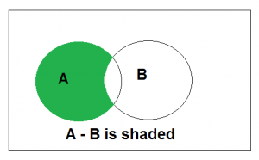
Chapter
04
Set Difference
The difference between sets is denoted by ‘A – B’, which is the set containing elements that are in A but not in B. i.e., all elements of A except the element of B.
Example: If A = {1, 2, 3, 4, 5} and B = { 2, 4, 6, 8}, find A-B Solution: A-B = {1, 3, 5}
www.midocean.ae

Slide 39
Chapter
04
Set Difference(-): Set Difference in relational algebra is the same set difference operation as in set theory.
Example: From the above table of FRENCH and GERMAN, Set Difference is used as follows
GERMAN
π(Student_Name)FRENCH - π(Student_Name)GERMAN
Student_Name | Roll_Number
Vivek | 13
Geeta | 17
Shyam | 21
Rohan | 25
FRENCH
Student_Name
Ram
Mohan
Student_Name | Roll_Number
Ram | 01
Mohan | 02
Vivek | 13
Geeta | 17
Note: The only constraint in the Set Difference between two relations is that both relations must have the same set of Attributes.
www.midocean.ae

Slide 40
Chapter
04
Set Intersection(∩)
Set Intersection(∩): Set Intersection in relational algebra is the same set intersection operation in set theory.
Example: From the above table of FRENCH and GERMAN, the Set Intersection is used as follows
GERMAN
π(Student_Name)FRENCH ∩ π(Student_Name)GERMAN
Student_Name | Roll_Number
Vivek | 13
Geeta | 17
Shyam | 21
Rohan | 25
FRENCH
Student_Name
Vivek
Geeta
Student_Name | Roll_Number
Ram | 01
Mohan | 02
Vivek | 13
Geeta | 17
Note: The only constraint in the Set Difference between two relations is that both relations must have the same set of Attributes.
www.midocean.ae

Slide 41
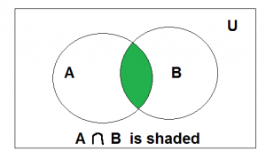
Chapter
04
Intersection
The intersection of the sets A and B, denoted by A ∩ B, is the set of elements that belong to both A and B i.e. set of the common elements in A and B.
Example: Find the intersection of A = {2, 3, 4} and B = {3, 4, 5} Solution : A ∩ B = {3, 4}.
www.midocean.ae

Slide 42
Chapter
04
Rename Operation (ρ) rho :
This operation is used to rename the output relation for any query operation which returns result like Select, Project etc. Or to simply rename a relation(table)
Syntax: ρ(RelationNew, RelationOld)
www.midocean.ae

Slide 43
Chapter
04
Rename(ρ): Rename is a unary operation used for renaming attributes of a relation.
ρ(a/b)R will rename the attribute 'b' of the relation by 'a'.
www.midocean.ae

Slide 44
Chapter
04
Cartesian Product (X) - Cross Product(X):
This is used to combine data from two different relations(tables) into one and fetch data from the combined relation.
Syntax: A X B
For example, if we want to find the information for Regular Class and Extra Class which are conducted during morning, then, we can use the following operation:
σ_{time = 'morning'} (RegularClass X ExtraClass)
For the above query to work, both RegularClass and ExtraClass should have the attribute time.
www.midocean.ae

Slide 45
Chapter
04
Cross Product(X): Cross-product between two relations. Let’s say A and B, so the cross product between A X B will result in all the attributes of A followed by each attribute of B. Each record of A will pair with every record of B.
Example:
A
B
Name | Age | Sex
Ram | 14 | M
Sona | 15 | F
Kim | 20 | M
ID | Course
1 | DS
2 | DBMS
www.midocean.ae

Slide 46
Chapter
A
B
04
Name | Age | Sex
Ram | 14 | M
Sona | 15 | F
Kim | 20 | M
ID | Course
1 | DS
2 | DBMS
A X B
Name | Age | Sex | ID | Course
Ram | 14 | M | 1 | DS
Ram | 14 | M | 2 | DBMS
Sona | 15 | F | 1 | DS
Sona | 15 | F | 2 | DBMS
Kim | 20 | M | 1 | DS
Kim | 20 | M | 2 | DBMS
Note: If A has ‘n’ tuples and B has ‘m’ tuples then A X B will have ‘ n*m ‘ tuples.
www.midocean.ae

Slide 47
Chapter
04
Apart from these common operations Relational Algebra is also used for Join operations like,
Natural Join
Conditional Join
www.midocean.ae

Slide 48



Thank You

