Slide 1

RHSA (Admin 1) Red Hat Enterprise Linux 8 Essentials
Prepared by Eng. Taghreed Elsayed
Lecture 7
CONFIGURING AND SECURING OPENSSH

Slide 2

Chapter
09
CONFIGURING AND SECURING OPENSSH
WHAT IS THE OPENSSH SECURE SHELL (SSH)?
The term OpenSSH refers to the software implementation of the Secure Shell software used in the system.
The OpenSSH Secure Shell, ssh, is used to securely run a shell on a remote system.
If you have a user account on a remote Linux system providing SSH services, ssh is the command normally used to remotely log into that system.
The ssh command can also be used to run an individual command on a remote system.
SECURE SHELL EXAMPLES
Here are some examples of ssh command syntax for remote login and remote execution: • Create a remote interactive shell as the current user, then return to your previous shell when done with the exit command.

Slide 3
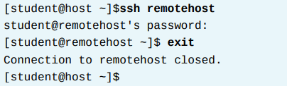

Chapter
09
CONFIGURING AND SECURING OPENSSH
• Connect to a remote shell as a different user (remoteuser) on a selected host (remotehost):

Slide 4

Chapter
09
CONFIGURING AND SECURING OPENSSH
• Execute a single command (hostname) on a remote host (remotehost) and as a remote user (remoteuser) in a way that returns the output to the local display:
The w command displays a list of users currently logged into the computer. This is especially useful to show which users are logged in using ssh from which remote locations, and what they are doing.

Slide 5
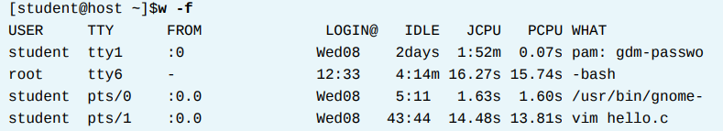
Chapter
09
CONFIGURING AND SECURING OPENSSH
In this example, user student logged in on virtual console 1 (tty1) through the graphical login (:0) at about 08:00 on Wednesday.
User student currently has three pseudo-terminals open (pts/0, pts/1, and pts/3) started by the graphical environment; these are almost certainly terminal windows.
In one window, student is editing hello.c.

Slide 6
Chapter
09
CONFIGURING AND SECURING OPENSSH
User root is logged in on virtual console 6, starting at 12:33 today. User visitor logged in on pseudo-terminal 6 at 09:22 today from the host server2.
example.com (note that the name has been truncated), probably using ssh, and has been sitting idle at a shell prompt for three minutes and 14 seconds.
SSH HOST KEYS
SSH secures communication through public-key encryption.
When an ssh client connects to an SSH server, before the client logs in, the server sends it a copy of its public key.
This is used to set up the secure encryption for the communication channel and to authenticate the server to the client.

Slide 7
Chapter
09
CONFIGURING AND SECURING OPENSSH
The first time a user uses ssh to connect to a particular server, the ssh command stores the server's public key in the user's ~/.ssh/known_hosts file.
Every time the user connects after that, the client makes sure it gets the same public key from the server by comparing the server's entry in the ~/.
ssh/known_hosts file to the public key the server sent.
If the keys do not match, the client assumes that the network traffic is being hijacked or that the server has been compromised, and breaks the connection.
This means that if a server's public key is changed (because the key was lost due to hard drive failure, or replaced for some legitimate reason), users will need to update their ~/.ssh/ known_hosts files and remove the old entry in order to log in.

Slide 8

Chapter
09
CONFIGURING AND SECURING OPENSSH
• Host IDs are stored in ~/.ssh/known_hosts on your local client system:
• Host keys are stored in /etc/ssh/ssh_host_key* on the SSH server.

Slide 9
Chapter
09
CONFIGURING AND SECURING OPENSSH
SSH KEY-BASED AUTHENTICATION
Users can authenticate ssh logins without a password by using public key authentication. ssh allows users to authenticate using a private-public key scheme.
This means that two keys are generated, a private key and a public key.
The private key file is used as the authentication credential, and like a password, must be kept secret and secure.
The public key is copied to systems the user wants to log into, and is used to verify the private key. The public key does not need to be secret.
An SSH server that has the public key can issue a challenge that can only be answered by a system holding your private key.
As a result, you can authenticate using the presence of your key.

Slide 10

Chapter
09
CONFIGURING AND SECURING OPENSSH
This allows you to access systems in a way that doesn't require typing a password every time, but is still secure. Key generation is done using the ssh-keygen command.
This generates the private key ~/.ssh/ id_rsa and the public key ~/.ssh/id_rsa.pub.
Before key-based authentication can be used, the public key needs to be copied to the destination system. This can be done with ssh-copy-id.
When the key is copied to another system using ssh-copy-id, it copies the ~/.ssh/ id_rsa.pub file by default.

Slide 11
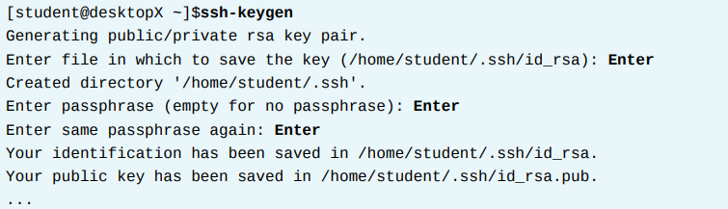
Chapter
09
CONFIGURING AND SECURING OPENSSH
USING SSH KEY-BASED AUTHENTICATION
set up SSH user key-based authentication to initiate SSH connections.
1. Create an SSH key pair as student on desktopX using no passphrase.

Slide 12
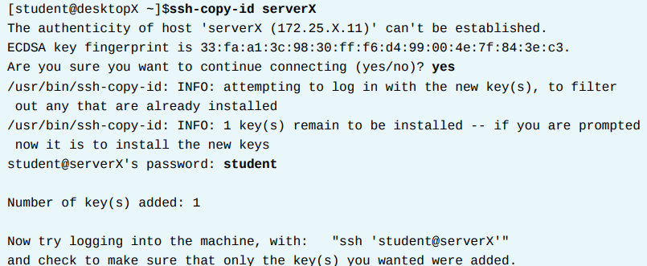
Chapter
09
CONFIGURING AND SECURING OPENSSH
2. Send the SSH public key to the student account on serverX.

Slide 13
Chapter
09
CONFIGURING AND SECURING OPENSSH
3. Run the hostname command by using ssh to display the hostname of the serverX.example.com machine without the need to enter a password.

Slide 14
Chapter
09
CONFIGURING AND SECURING OPENSSH
CUSTOMIZING SSH SERVICE CONFIGURATION
THE OPENSSH SERVER CONFIGURATION FILE While
OpenSSH server configuration usually does not require modification, additional security measures are available.
Various aspects of the OpenSSH server can be modified in the configuration file /etc/ssh/ sshd_config.
PROHIBIT THE ROOT USER FROM LOGGING IN USING SSH
• The username root exists on every Linux system by default, so a potential attacker only has to guess the password, instead of a valid username and password combination.
The root user has unrestricted privileges.

Slide 15
Chapter
09
CONFIGURING AND SECURING OPENSSH
The root user has unrestricted privileges.
The OpenSSH server has an internal configuration file setting to prohibit a system login as user root, which is commented out by default in the /etc/ssh/sshd_config file:
The root user will be unable to log into the system using the ssh command after the sshd service has been restarted:

Slide 16

Chapter
09
CONFIGURING AND SECURING OPENSSH
The sshd service has to be restarted to put the changes into effect:
Another option is to only allow key-based ssh login as root with:

Slide 17
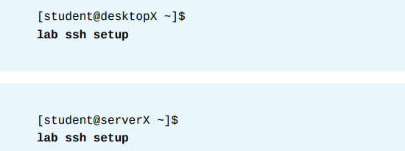
Chapter
09
CONFIGURING AND SECURING OPENSSH
CONFIGURING AND SECURING OPENSSH SERVICE
you will add security measures to the ssh service.
Run lab ssh setup as the student user on both desktopX and serverX.This will create a user account called visitor with a password of password.
Unless specified, all steps are to be performed as user visitor.

Slide 18

Chapter
09
CONFIGURING AND SECURING OPENSSH
1. Generate SSH keys on desktopX for user visitor and copy the public key to the visitor account on serverX.
1.1. Generate a SSH public key on desktopX as user visitor.
1.2. Install the SSH public key generated previously on desktopX to the visitor account on serverX.

Slide 19
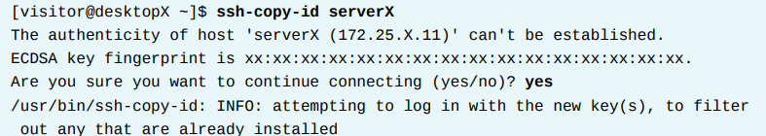
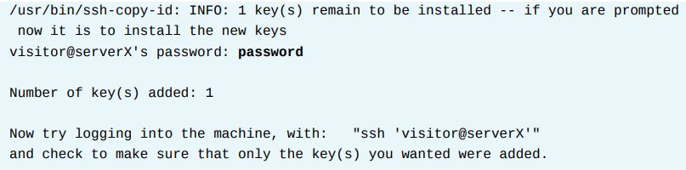
Chapter
09
CONFIGURING AND SECURING OPENSSH

Slide 20

Chapter
09
CONFIGURING AND SECURING OPENSSH
2. Disable ssh login for the root user and password-based SSH authentication on serverX.
2.1. Log into the serverX virtual machine as user root.
2.2. Customize the ssh service on serverX by disabling SSH connections for the user root and only allow key-based login.
Set the necessary config file parameters in /etc/ssh/sshd_config:

Slide 21
Chapter
09
CONFIGURING AND SECURING OPENSSH
2. Disable ssh login for the root user and password-based SSH authentication on serverX.
2.1. Log into the serverX virtual machine as user root.
2.2. Customize the ssh service on serverX by disabling SSH connections for the user root and only allow key-based login.
Set the necessary config file parameters in /etc/ssh/sshd_config:

Slide 22
Chapter
09
CONFIGURING AND SECURING OPENSSH
2. Disable ssh login for the root user and password-based SSH authentication on serverX.
2.1. Log into the serverX virtual machine as user root.
2.2. Customize the ssh service on serverX by disabling SSH connections for the user root and only allow key-based login.
Set the necessary config file parameters in /etc/ssh/sshd_config:

Slide 23

Chapter
09
CONFIGURING AND SECURING OPENSSH
2.3. Restart the sshd service on serverX.
3. Verify that user root is not allowed to login to serverX by using ssh, while user visitor is with the private key.
3.1. On a different terminal window on desktopX, validate that user root cannot connect to serverX with the ssh command. It should fail because we disabled root logins with the ssh service.

Slide 24


Chapter
09
CONFIGURING AND SECURING OPENSSH
3.2. Try logging in as user student to serverX from desktopX by using ssh. It should fail because we did not add the public key from that user to the student account on the serverX machine.
3.3. Verify the ssh service is still accepting key-based authentication by successfully connecting to serverX as user visitor with the ssh command.

