Slide 1



Prepared by Dr. Mohamed Soliman
ENT 632
Entrepreneurial Financing
Lecture 10

Slide 2









The Future of Entrepreneurial Finance
Lecture 10
ENT 632
Entrepreneurial Financing
Prepared by
Dr. Mohamed Soliman

Slide 3




The Future of Entrepreneurial Finance
N ew technolog ies, techniques, and approaches in financing new ventures — from AI- driven capital allocation to D eFi ecosystem s and tokenized assets.
MASTER'S LEVEL

Slide 4

Learning Objectives
1
Analyze Funding Ecosystems
Evaluate traditional and emerging funding sources across the venture lifecycle.
2
Apply Valuation Methods
Use modern valuation techniques including AI-assisted and token-based models.
3
Assess D eFi & Tokenization
Understand decentralized finance instruments and their application to startups.
4
Design Capital Strategies
Build a comprehensive financing roadmap for an early-stage venture.
5
Evaluate Risk & Return
Apply analytical frameworks to assess investor risk profiles and return expectations.
6
Critique Case Studies
Analyze real financing decisions made by Uber, Airbnb, Stripe, and others.

Slide 5




Why Entrepreneurial Finance Is Changing
The globalstartupfinancing landscapehas undergonea seismic shift.
Traditional gatekeepers — banks, institutional VCs, and stock exchanges — no longer hold exclusive power over who getsfundedand how.
Artificial intelligence, blockchain, decentralized protocols, and global crowdfunding platforms have democratized accesstocapital,compressedfunding timelines,and introducedentirelynew assetclasses.
For entrepreneurs, understanding these forcesis no longer optional — it is a core competency.
What Has Changed?
Capitalformation is no longer geographicallyconstrained
AI replacestraditionalcreditworthinessmodels
Retailinvestorsaccessearly-stagedealsvia crowdfunding
Smart contractsautomatetermsheetsand distributions
Tokenization enablesfractionalownershipof assets
SPACs and alternativeIPO routeshave reshapedexits

Slide 6




The Entrepreneurial Funding Lifecycle
Every venture passes through distinct capital stages — each with unique investor profiles, risk tolerances, and financing instruments.
Idea
Bootstrapping initial concept
Seed
Ang els and accelerators
Growth
PE, debt, revenue- based
Pre- Seed
Friends & fam ily support
Series A/B
Venture capital scaling
Understanding where your venture sits in this lifecycle determines which financing instruments are appropriate,
which investors to target, and what terms to expect.

Slide 7
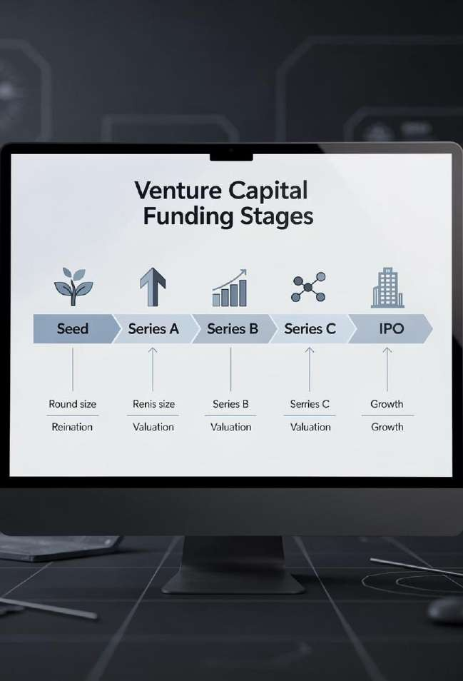


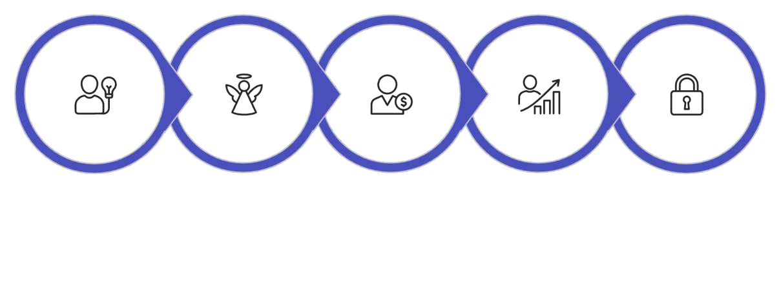




The Venture Funding Lifecycle
Understanding the full arc of venture financing is essential before examining disruptions at each stage.
Pre-Seed
Seed
Series A
Series B/C
Late Stage
Each stage carries distinct risk profiles, investor expectations, dilution mechanics, and governance implications.
Modern financing innovations are reshaping every node of this lifecycle — from AI-powered seed scouts to tokenized secondary markets that allow liquidity before a traditional exit.

Slide 8



1. Traditional Financing — The Foundation
Before exploring frontier finance, we must master the bedrock.
Traditional entrepreneurial finance — bootstrapping, angel investment, venture capital, and bank debt — remains the dominant pathway for most startups globally.

Slide 9





Traditional Financing Instruments
Bootstrapping
Angel Investment
High-net-worth individuals providing early capital, mentorship, and networks. Typical check:
$25K–$500K.
Venture C apital
Institutional funds deploying capital in exchange for equity. Expect board seats, milestones, and high-growth expectations.
Debt Financing
SBA loans, lines of credit, and revenue-based financing.
Non-dilutive but requires cash flow and collateral.
Self-funded
growth savings,
using revenue
personal
reinvestment, and lean operations. Preserves equity but limits speed.

Slide 10
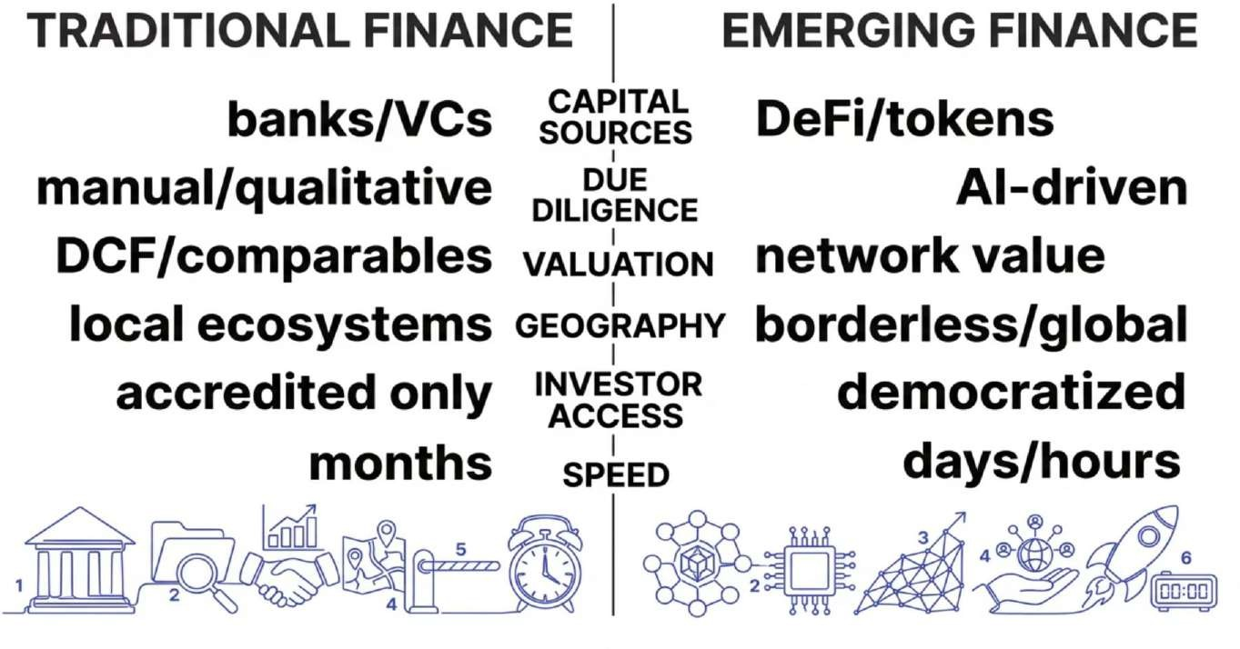
Traditional vs. Emerging Financing: A Paradigm Shift
The shift is not merely technological — it is philosophical.
Emerging finance models prioritize transparency, speed, inclusivity, and programmatic enforcement of agreements, challenging decades of established practice in venture and growth equity.

Slide 11


Venture Capital: Deal Structure Essentials
Key VC Term Sheet C om ponents The VC Power Law
Pre-money valuation: Company value before investment
Liquidation preference: Investor payout priority on exit
Anti-dilution provisions: Protection against down rounds
Pro-rata rights: Right to maintain ownership in future rounds
Board composition: Governance and control allocation
Vesting schedules: Founder equity lock-in (typically 4 years, 1-year cliff)
VCs expect most portfolio
companies to fail.
Returns are driven by 1–2
"unicorn" outcomes per fund.
This shapes their preference
for high-risk, high-upside bets
over steady, moderate-growth businesses.

Slide 12


2. The Rise of Alternative Financing
Alternative financing has exploded over the past decade, giving entrepreneurs access to capital outside traditional institutional channels.
These models are faster, more inclusive, and
increasingly data-driven.

Slide 13



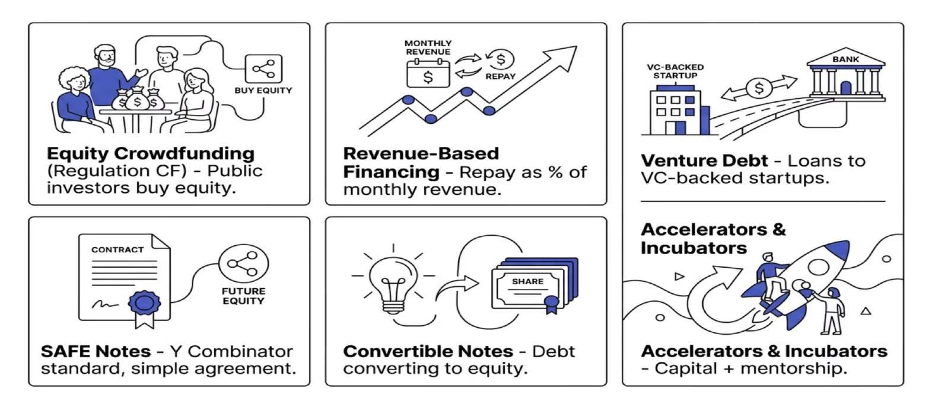
Alternative Financing Landscape
Each instrument carries distinct dilution, repayment, and control implications.
Entrepreneurs must match the instrument to their stage, revenue profile, and growth trajectory.

Slide 14

SAFE Notes: The Y Combinator Standard
What Is a SAFE?
A Simple Agreement for Future Equity (SAFE) is a contract giving investors the right to receive equity in a future priced round. Introduced by Y Combinator in 2013, SAFEs have become the dominant pre-seed instrum ent in Silicon Valley and g lobally.
Key Features
No interest rate or maturity date
Converts at next equity round
Valuation cap + discount rate
Founder-friendly, fast to execute
SAFE vs. Convertible Note
SAFE: N ot debt. No repaym ent oblig ation S im pler leg al structure. Preferred at pre- seed.
C onvertible N ote: Is debt. H as interest and m aturity. More investor- protective. C om m on at seed stag e.
Both convert to equity at a priced round — the key difference is legal structure and investor protection level.

Slide 15


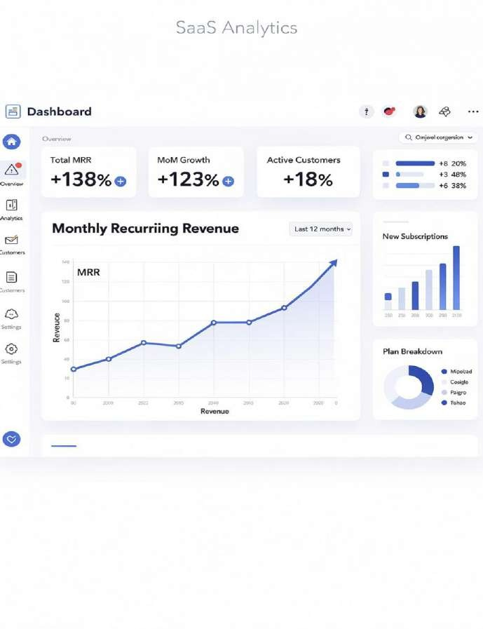
Revenue-Based Financing (RBF)
How It Works
Investors provide capital in exchange for a fixed percentage of monthly revenue until a predetermined repayment cap (typically 1.5x–3x the original investment) is reached.
No equity dilution. No fixed monthly payments.
Non-dilutive financing models have emerged as a compelling alternative to equity rounds for founders
seeking
ownership.
Best For
growth capital without surrendering
Key Players
Advantage
SaaS, e-commerce, subscription-based businesses with predictable MRR
Clearco, Capchase, Arc
Pipe,
Non-dilutive,
flexible repayment tied to
performance

Slide 16
Revenue-Based Financing: Mechanics & Math
RBF vs. Equity vs. Debt
How RBF Works
Equity
Dilutive, no repayment, board governance, long time horizon.
Bank Debt
Fixed payments, collateral required, personal guarantees common.
A company borrows a lump sum and repays through a percentage of monthly gross revenue — typically 2–8% reaching a predetermined repayment cap (usually the principal). Unlike debt, there are no fixed monthly payments; repayments flex with revenue performance.
RBF
Non-dilutive, flexible repayment, revenue-gated, fast deployment.
Example: A SaaS company with $500K ARR receives
$150K at a 1.5x cap. Monthly payments = 5% of
revenue until $225K is repaid.

Slide 17


EmergingAlternative FinancingModels
Venture Debt
Loans from specialized lenders (Silicon Valley Bank, Hercules Capital, Western Technology Investment) structured alongside equity rounds. Typically 25–35% of the last equity round amount, usingwarrants as a sweetener rather than significant equity dilution.
Strategic Partnerships & Corporate Venture
CVC arms of Google, Salesforce, Intel, and others provide capital alongside ecosystem access, customer introductions, and technical resources — often at valuations more favorable than pure financial VCs.
Grants &SBIR/STTR
The U.S. Small Business Innovation Research (SBIR) program awards $3.6B+ annually to early-stage deeptech and biotech ventures. Phase I awards reach
$275K; Phase II can provide $1.83M —fully non-dilutive.
Merchant Cash Advances
For commerce-enabled startups, MCAs provide immediate capital against future card receivables. While expensive (factor rates of 1.2– 1.5x), they offer speed and accessibility for ventures with predictable transaction volume.

Slide 18
Case Study: Uber's Capital Strategy
Uber's Financing Playbook
Financing Milestones
2009: $200K angel round from First Round Capital
2011: $37M Series B led by Benchmark at $60M
valuation
2013: Google Ventures leads $258M at $3.5B
2016: Saudi PIF invests $3.5B — sovereign wealth breakthrough
2017: SoftBank Vision Fund acquires 15% stake (~$8B)
2019: NYSE IPO raises $8.1B at $45/share ($75.5B
Key lesson: Uber used international sovereign wealth funds to finance geographically-bound market expansion — a playbook now widely replicated.
Uber's path from a $200K seed round in 2009 to a $75B+ IPO in 2019 represents one of the most aggressive and innovative venture financingstrategies ever executed.
The company pioneered the use of convertible notes, tranched venture debt, and sovereign wealth fund capital to sustain hyper-growth across global markets simultaneously.
valuation
valuation)

Slide 19



3 . AI in Entrepreneurial Finance
Artificial intelligence is transforming every dimension of entrepreneurial finance — from finance — from how startups are discovered and evaluated, to how capital is deployed deployed and monitored.
AI is not a future trend; it is reshaping deals today.
H ow AI Transform s the Investm ent Process
Venture capital firm s like Sequoia, Andreessen H orowitz, and EQ T Ventures proprietary AI platform s that ing est thousands of data sig nals — founder trajectories, GitH ub com m it frequency, app store rating s, web traffic trends,
— to identify hig h- potential startups before they raise.
EQ T's Motherbrain platform is perhaps the m ost cited: it processes over 10 points weekly to surface investm ent candidates invisible to traditional

Slide 20

How AI Is Reshaping Startup Financing
AI-Powered Deal Sourcing
Platforms like SignalFire and EvenBreak use machine learning to scan millions of data points — GitHub commits, LinkedIn growth, web traffic — to identify high-potential startups before they raise.
Autom ated D ue D ilig ence
N LP tools analyze pitch decks, financial statem ents, and market data in minutes, flag g ing risks and inconsistencies that would take human analysts days to uncover.
Founder Analytics
Pattern recognition identifies founding team traits correlated with high performance.
Predictive Valuation Models
AI models trained on thousands of funding rounds can predict startup valuations, burn rates, and probability of success with greater accuracy than traditional analyst methods.
Alternative Credit Scoring
AI-driven lenders like Kabbage and Brex assess creditworthiness using real-time business data — transactions, payroll, inventory
— rather than traditional credit scores.

Slide 21

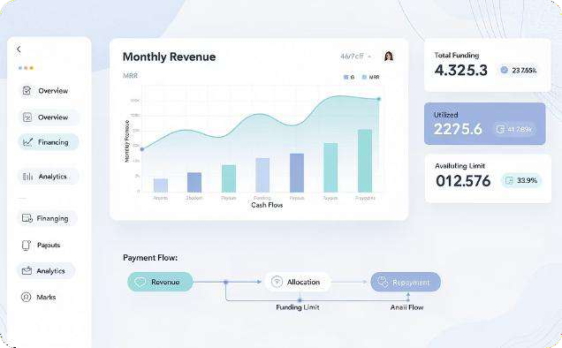

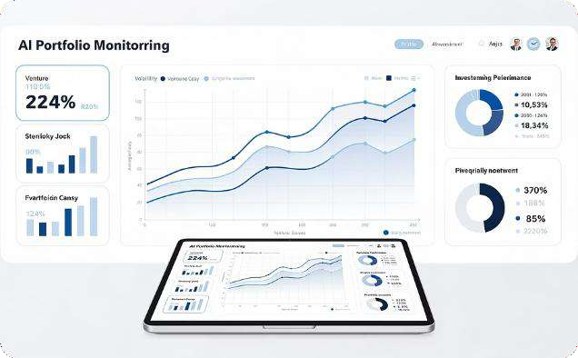
AI-Driven Credit & Revenue-Based Financing
For ventures without traditional collateral or credit history, AI-driven underwriting models create new pathways to capital by analyzing real-time business performance data.
Revenue-Based Financing (RBF)
Platforms like Pipe, Capchase, and
analyze recurring revenue streams,
Alternative Credit Scoring
Fintechs like Kabbage (now American Express) and Fundbox replaced FICO-based models with
Portfolio Intelligence
Post-investment, AI tools like Visible.vc and Allvue monitor KPIs across portfolio companies,
Clearco
cohort
retention, and churn metrics via API to offer non- dilutive capital in 24–48 hours. Repayment scales with monthly revenue, reducing cash flow risk for founders.
live data integrations: QuickBooks, Stripe, Shopify, and bank feeds power real-time creditworthiness assessments for early-stage businesses.
flag anomalies, and generate LP reports automatically — freeing GPs to focus on value- add activities rather than data aggregation.

Slide 22
AI Valuation: Beyond the DCF Model
AI-Enhanced Approaches
Pattern recognition: Match startup profiles to historical outcomes
Sentiment analysis: Parse founder interviews, reviews,
and press
Network analysis: Evaluate team quality via professional graph data
Real-time benchmarking: Dynamic comps updated
continuously
Scenario modeling: Monte Carlo simulations at scale
Traditional Valuation Lim its
D iscounted C ash Flow (D C F) m odels require stable cash flow projections — a poor fit for early- stag e startups with no revenue history.
C om parable com pany analysis is lim ited
by sparse data.

Slide 23




4. Blockchain, Decentralized Finance (DeFi) & Tokenization
Decentralized Finance (DeFi) and blockchain-based tokenization represent the most radical restructuring of capital markets since the invention of the joint-stock company.
For entrepreneurs, these technologies unlock entirely new financing primitives.

Slide 24



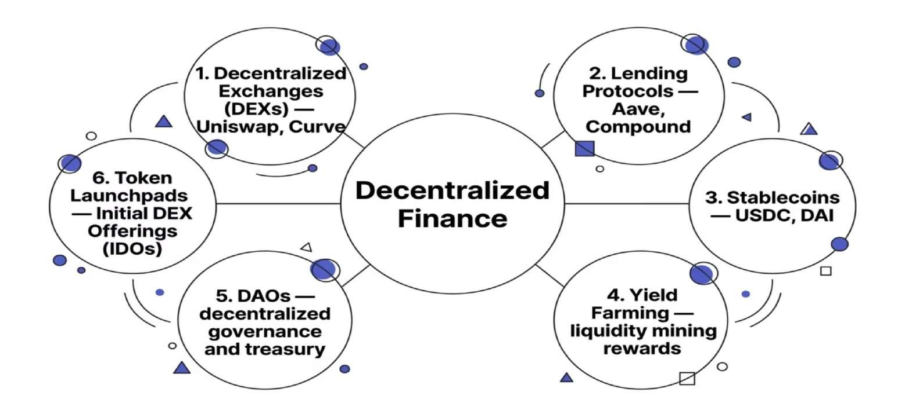
The DeFi Ecosystem for Startups
Each DeFi primitive offers entrepreneurs a new tool: from raising liquidity via token launches, to accessing collateralized loans without a bank, to governing a company through a DAO treasury.

Slide 25
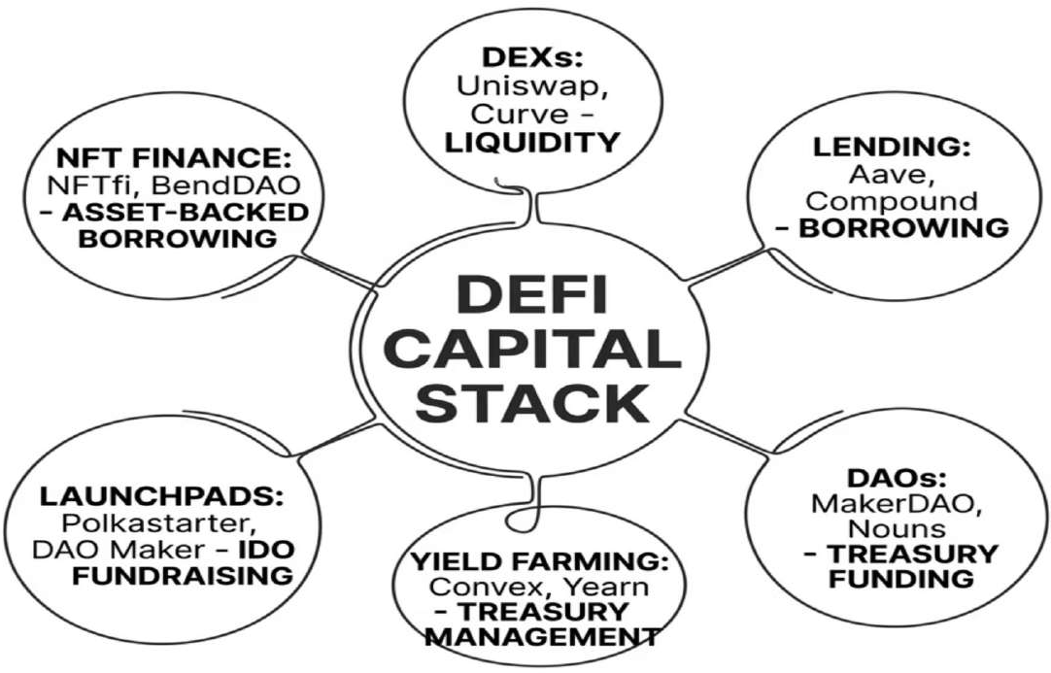
The DeFi Ecosystem for Startups
Each DeFi primitive represents a distinct financing mechanism. Founders can leverage lending protocols for working capital, launch governance tokens via DAOs to raise community capital, or participate in yield strategies to optimize treasury holdings — all without a traditional financial intermediary.

Slide 26

Tokenization of Assets & Equity
Tokenization converts rights to real-world assets — equity, real estate, revenue streams, intellectual property — into blockchain- native digital tokens, enabling fractional ownership, programmable compliance, and global liquidity.
Equity Tokens
Represent fractional startup ownership on-chain. Platforms
like Republic and tZERO enable compliant tokenized equity issuance under Reg CF, Reg A+, or Reg D.
Revenue Tokens
Investors purchase rights to a defined revenue percentage. Eliminates dilution while providing capital — popular in SaaS and media ventures with predictable cash flows.
Real-World Asset (RWA) Tokens
Tokenization of physical assets (real estate, commodities, receivables) unlocks collateral for DeFi lending. BlackRock's BUIDL fund tokenized $500M+ in Treasury bonds in 2024.
NFTs as Capital Tools
NFTs serve as memberships, revenue-sharing instruments, or collateral in protocols like NFTfi, enabling founders to borrow against digital asset holdings without selling.

Slide 27
Tokenization of Assets & Equity
Real- W orld Asset Smart Contract
Property, equity stake, revenue stream, or intellectual propertyLegal rights encoded on
auditable, immutable
blockchain; programmable,
Token Issuance
Fractional digital tokens representing ownership or economic rights
Global Market
24/7 trading, global investor access, automated compliance via smart contracts
Tokenization reduces minimum investment thresholds, increases liquidity for traditionally illiquid assets, and enables programmable governance — fundamentally changing who can invest in startups and on what terms.

Slide 28

Security Tokens vs. Utility Tokens
Security Tokens (STO s)
Represent ownership rights — equity, debt, or revenue share. Subject to SEC/regulatory oversight. Traded on licensed platforms. Examples: tZERO, Securitize.
Investor protections apply
Compliant with securities law
Suitable for equity replacement
Utility Tokens (ICOs/IDOs)
Grant access to a product or service within a protocol. Not classified as securities (in most jurisdictions). Examples: Filecoin, Basic Attention Token.
Fundraising without equity dilution
Regulatory gray area
High speculative risk

Slide 29



DAOs as Financing Vehicles
A Decentralized Autonomous Organization (DAO) is a blockchain-governed entity where token holders through smart contracts vote on capital allocation, strategy, and governance.
Treasuries can hold hundreds of millions in assets, deploying capital to projects approved by community vote — effectively functioning as a distributed venture fund.
For entrepreneurs, DAOs represent a new model for community-owned ventures.
MakerDAO
Uniswap DAO
Constitution DAO
Example: Uniswap DAO controls a treasury exceeding
$3B, funding grants and protocol development through governance votes.
$8B+ treasury governed by MKR token holders
C ontrols protocol fees and
developm ent g rants
Raised $47M in 72
hours via com m unity crowdfunding

Slide 30


DAOFinancingMechanics
Grants: Non-dilutive funding for open-source or ecosystem projects
Token swaps: DAOs exchange governance tokens with partner protocols
Venture arms: Dedicated DAO investment committees (e.g., MakerDAO, Compound Grants)
Retroactive funding: Optimism's RetroPGF rewards proven impact post-delivery
DAOs represent a fundamentally new investor-founder relationship: community ownership, transparent governance, and programmable incentive alignment.

Slide 31




5. Equity Crowdfunding & the Democratization of Capital
The JOBS Act (2012) and Regulation CF (2016) opened equity investment to non-accredited investors in the U.S., triggering a wave of platforms enabling anyone to invest in startups for as little as $100.

Slide 32


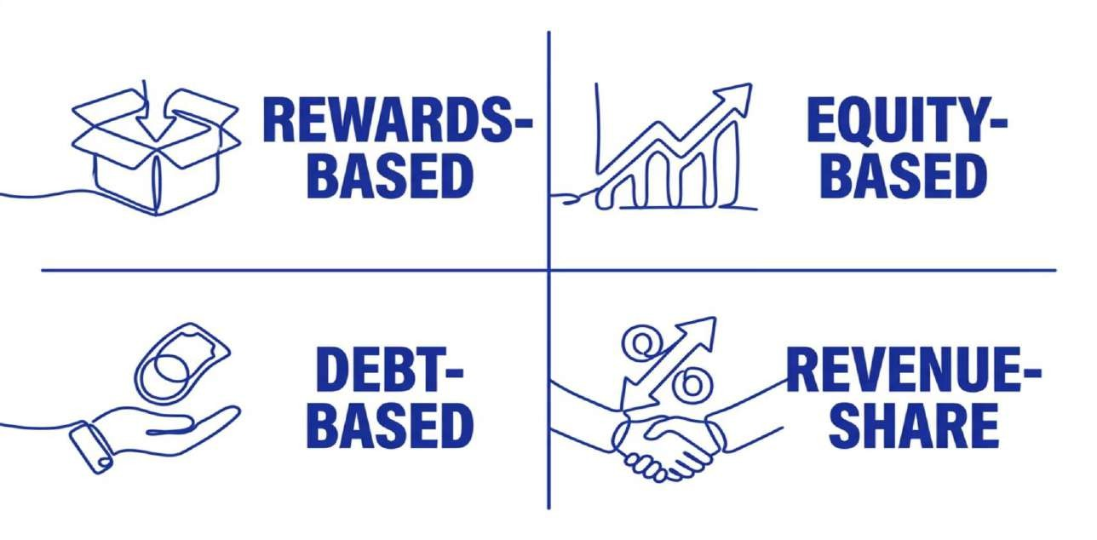
The Crowdfunding Landscape: Four Models
Each model carries distinct legal structures, investor protections, and strategic fit depending on the venture's stage, business model,
and growth trajectory. Equity crowdfunding has grown most significantly, with platforms raising over $1.5B annually in the U.S. alone.

Slide 33

Equity Crowdfunding Platforms & Regulation
Republic
$2B+raised across 600+deals. Focuses on tech, real estate, and gaming. Minimum investment:
$10.
Wefunder
Largest Reg CF platform by volume. Community-driven. Supports SAFEs and equity rounds.
StartEngine
Reg CF +Reg A+offerings. Secondary market available for token trading.
Regulation CF Limits
Companies may raise up to
$5M/year from the public. Investors have tiered limits based on income/net worth.
Regulation A+
Mini-IPO allowing up to $75M/year. Full SEC review. Accessible
to all investors globally.
Regulation D
Private placement to accredited investors only. No cap on raise
size. Most common VC instrument.

Slide 34

Regulation CF, A+, and D: The Legal Architecture
Navigatingthe Regulatory Stack
The SEC's exemption framework determines how much a startup can raise, from whom, and with what disclosure burden. Understanding this stack is a foundational competency for any entrepreneurial finance professional.
Strategic Insight
Savvy founders often combine exemptions: a Reg CF raise builds community and product validation, while a concurrent Reg D round captures institutional capital — a "dual-track" strategy pioneered by platforms like Republic.
Exemption
Annual C ap
Investor Type
Key Disclosure
The 2023 SEC amendments to Reg CF increased the offering limit from $1.07M to $5M, dramatically improving the viability of community rounds for growth-stage startups.
Reg CF
$5 m illion
Any investor
Form C filing
Reg A+
$75 million
Any investor
Offering circular
Reg D (506b)
Unlimited
Accredited only
Form D filing
Reg D (506c)
Unlimited
Verified accredited
Form D + verification

Slide 35



Case Study: Airbnb's Financing Evolution
2008 —FFF &Cereal Hustle
1
Founders Chesky & Gebbia funded initial operations by selling novelty cereals. Classic resourcefulness before
formal capital.
2
2009 — Y Combinator
Accepted into YC's Winter 2009 batch, receiving $20K seed investment for 6% equity — a pivotal moment that validated the model.
2010–2014 —VC Scaling
Sequoia, Greylock, and Andreessen H orowitz led Series A throug h D rounds totaling $ 475M, funding g lobal expansion.
3
4
2020 — COVID Crisis & IPO
Raised emergency debt ($2B) during COVID. IPO in December 2020 valued at
$47B — one of the largest tech IPOs of the decade.

Slide 36

6. Case Study — Uber's Financing Evolution
CASE STUDY
Uber's journey from a $200K angel round to a $75B IPO is one of the most studied financing trajectories in startup history — illustrating how aggressive capital deployment can reshape entire industries.

Slide 37



Uber: Financing Milestones
2009 — Seed
$200K from founders & angels. Travis Kalanick and Garrett Camp self-fund
the prototype.
1
2
2010 — Series A
$1.25M from First Round Capital. Validates the ride-sharing model in San Francisco.
2011 — Series B
$37M led by Benchm ark C apital. Beg ins g eog raphic expansion
across U.S. cities.
3
4
2013–2016 — Growth
$1.2B+ from Google Ventures, Fidelity, Saudi PIF. Global expansion, price wars, driver subsidies.
2019 — IPO
N YSE listing at $45/share. $8.1B raised. $75B m arket cap at open —
one of the larg est tech IPO s in history.
5
Key Lesson: Uber used aggressive VC capital to subsidize growth and eliminate competition — a "blitzscaling" strategy that prioritized market share over profitability for a decade.

Slide 38


Case Study — Airbnb: Surviving to Thrive
C ASE STUD Y
Financing Journey
2008: Rejected by 7 top VC s. Funded operations by selling novelty cereal boxes ("O bam a O 's")
2009: Y C om binator — $20K for 6% equity
2010: Series A — $7.2M (Sequoia C apital)
2011: Series B — $112M at $1.3B valuation (first "unicorn" m ilestone)
2020: C O VID crisis — raised $2B in em erg ency debt at hig h interest
2020: IPO — $3.5B raised; stock doubled on first day
Key Lessons
Resilience: Airbnb's COVID debt raise at
punishing terms preserved the company
through a near-zero-revenue period.
Timing: Their IPO in December 2020 — amid a
pandemic — became one of the most successful
in history, proving market timing is less important than business fundamentals.

Slide 39


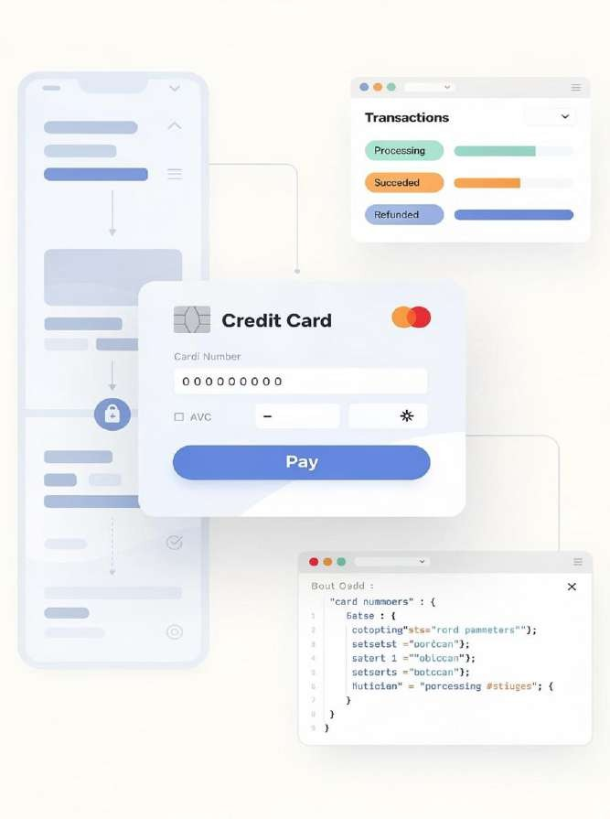
Case Study — Stripe: The Private Unicorn Playbook
C ASE STUD Y
Stripe has raised over $8 .7B across m ultiple rounds while deliberately staying private — reaching a peak valuation of $95B in 2021 before a down round to $50B in 2023.
This m akes Stripe one of the m ost instructive cases in late- stag e private financing .
2011 — Seed
$2M from Peter Thiel, Elon Musk, Sequoia. Y C om binator alum ni
network activated.
2012–2019
Series A–F. Raised
$1.6B. Expanded to 40+ countries.
Launched Stripe Atlas,
Radar, C apital.
2021 — Peak
$600M Series H at $95B valuation. Largest private fintech in U.S. history at the time.
2023 — Down Round
$6.5B raised at $50B valuation. Demonstrates that even elite startups face market corrections.

Slide 40



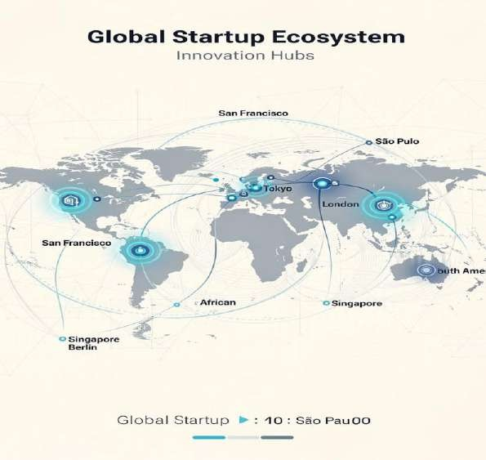
7. Global Venture Capital Trends: The Role of Accelerators, Corporate VCs & Family Offices
Venture capital is no longer a Silicon Valley phenomenon.
Global VC investment reached $415B in 2022 before contracting to approximately $285B in 2023 amid rising interest rates and market corrections — reshaping where and how capital flows.

Slide 41


Emerging Market Venture Trends
H ig h- Growth Reg ional Ecosystem s
Three reg ions are experiencing the m ost dram atic venture ecosystem developm ent, supported by m obile- first infrastructure, dem og raphic tailwinds, and im proving reg ulatory fram eworks:
Africa
Fintech leads with $3B raised in 2022. Flutterwave ($3B valuation), Chipper Cash, and M-Pesa successors dominate. Mobile money infrastructure leapfrogs traditional banking.
Southeast Asia
Grab, Go To (Gojek+ Tokopedia), and Sea Group dem onstrate super- app potential. S ing apore is the reg ion's VC hub with
$8.5B invested in 2022.
MENA & Gulf
Saudi Vision 2030 and UAE's Hub71 accelerate regional ecosystems. Sovereign wealth funds (PIF, Mubadala) deploy billions into tech ventures as diversification strategy.
Cross-Border Financing Considerations
Currency risk: USD-denominated term sheets in local- revenue businesses create FX exposure
Regulatory arbitrage: Cayman Islands structures, Singapore holdcos, and Delaware C-corps serve different investor bases
CFIUS review: National security scrutiny of foreign
investment in U.S. tech startups intensifying
Dual-class structures: Common in Asian markets, increasingly adopted globally to protect founder control

Slide 42


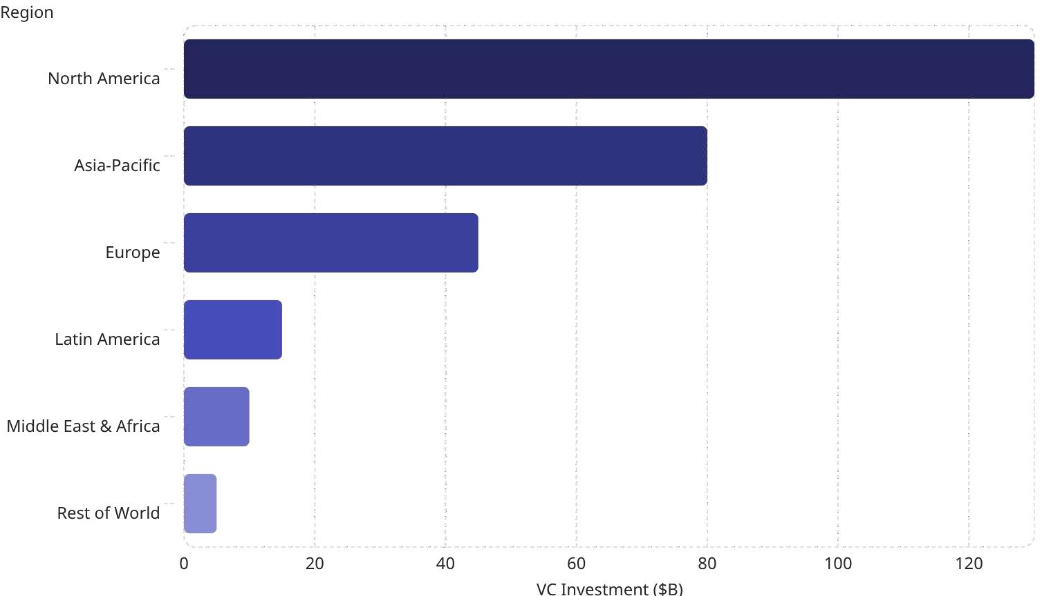
Global VC Investment by Region (2023)
130
80
45
15
10
5
North America retains dominance, but Asia-Pacific — led by India, Southeast Asia, and South Korea — is the fastest-growing VC destination. Emerging markets are attracting capital as valuations in mature markets remain compressed.

Slide 43


The Rise of Corporate Venture Capital (CVC)
What Is CVC?
Corporate Venture Capital involves established companies investing in startups — not just for financial return, but for strategic access to innovation, talent, and emerging markets.
Scale
CVCs participated in 25%+of all VC deals globally in 2023. Major players include Google Ventures (GV), Intel Capital, Salesforce Ventures, and SoftBank Vision Fund.
CVC vs. Traditional VC
Strategic value: Distribution, partnerships, M&A pipeline
Patient capital: Longer time horizons than fund-driven VCs
Risk: Strategic misalignment can harm startups
Trend: CVCs increasingly lead rounds, not
just follow

Slide 44


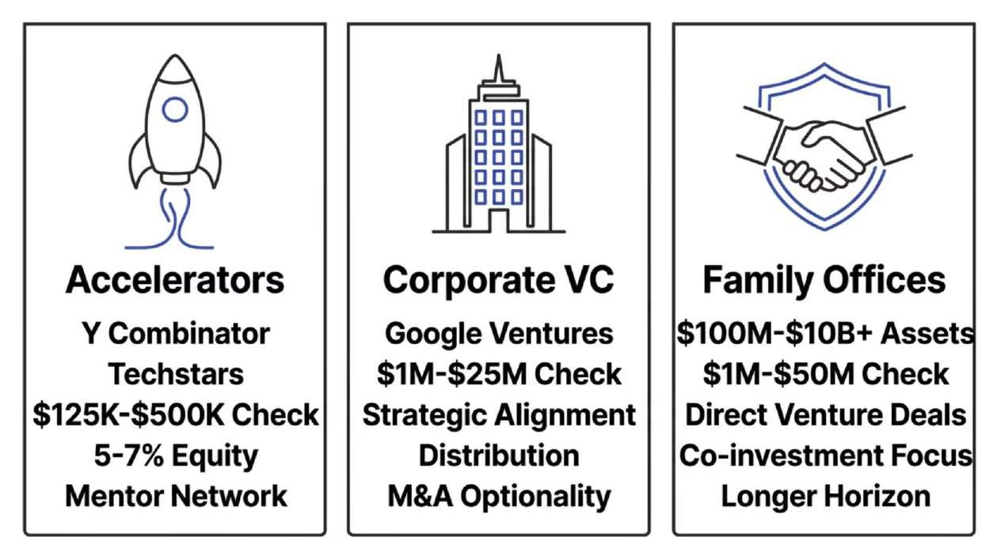
Accelerators, CVCs & Family Offices Compared
Strategic founders often sequence these players intentionally: accelerator credentialing → angel/seed round → CVC strategic partnership → institutional VC growth round. Each stage builds the proof points the next requires while diversifying the support network.

Slide 45
Y Combinator: The Accelerator as Asset Class
YC 's Financial Im pact
Y C om binator has funded over 4 ,000 startups since 2005 , with a com bined valuation exceeding $600B. Its standard deal — $500 K for 7 % equity (post- 2022 standard) —
Why YC Changes a Startup's Financing Trajectory
Signal value: YC acceptance triggers inbound investor interest at Demo Day
SAFE standardization: YC popularized the Simple Agreement for Future Equity, now an industry standard
Network effects: Access to YC alumni network worth more than capital for many founders
Demo Day pricing: Typical post-Demo Day seed rounds of
$1M–$3M at $8M–$15M valuations
Continuity fund: YC's own follow-on fund participates in subsequent rounds
represents investm ent com panies
one of the m ost analyzed
term s in venture history. Top
include Airbnb, Stripe, D ropbox,
C oinbase, and D oorD ash.

Slide 46




8. Emerging Financing Models
Beyond DeFi and AI, a new generation of financing models is emerging — each designed to address specific gaps in the traditional funding ecosystem for entrepreneurs.
Mastery of venture financial modeling is a non-negotiable competency for entrepreneurial finance professionals. The model is not merely a forecast tool — it is a communication instrument that signals founder sophistication, reveals strategic assumptions, and drives investment decisions.

Slide 47



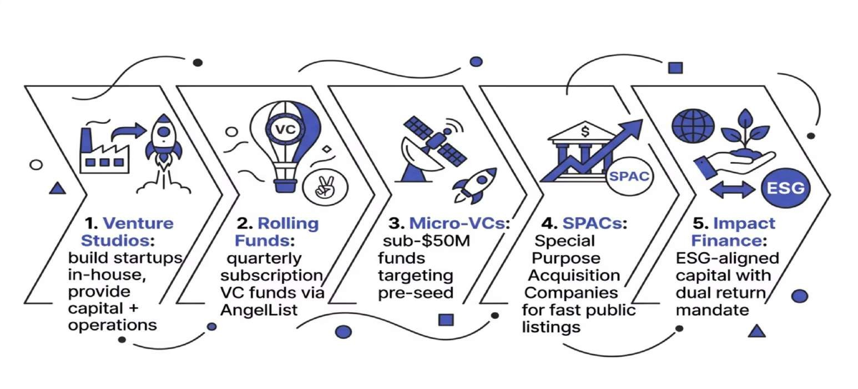
Emerging Models Reshaping Startup Finance
Each model addresses a specific market gap: Rolling Funds democratize VC access; Venture Studios reduce early-
stage risk; SPACs accelerate public market entry; Impact Finance aligns capital with sustainability mandates.

Slide 48




Direct Listings & New Exit Pathways: Tender Offers & Secondary Markets
The exit landscape has been fundamentally transformed. Beyond the traditional IPO, founders and investors now navigate SPACs, direct listings, continuation funds, and secondary markets — each with distinct economics, timelines, and strategic implications.
D irect Listing s
Spotify (2018) and Palantir (2020) pioneered direct listings — allowing existing shareholders to sell directly into public markets without new share issuance or underwriter lock-ups. No dilution, but also no capital raised.
Tender Offers & Secondary Sales
Platforms like Carta, Forge Global, and EquityZen enable employees and
early investors to sell pre-IPO shares to accredited investors, providing liquidity without a public market event. Increasingly common in long- gestation deeptech companies.
C ontinuation Funds
Strategic M&A
Acquisition by a strategic buyer remains the most common exit for venture-backed companies. Increasingly, Big Tech acqui-hires and acqui- mergers involve non-traditional terms including earnouts, retention equity, and milestone payments.
When GPs want to hold portfolio winners longer than fund life allows, continuation funds allow existing LPs to cash out while new capital rolls in. Used extensively post-2021 to manage vintage fund timing mismatches.

Slide 49


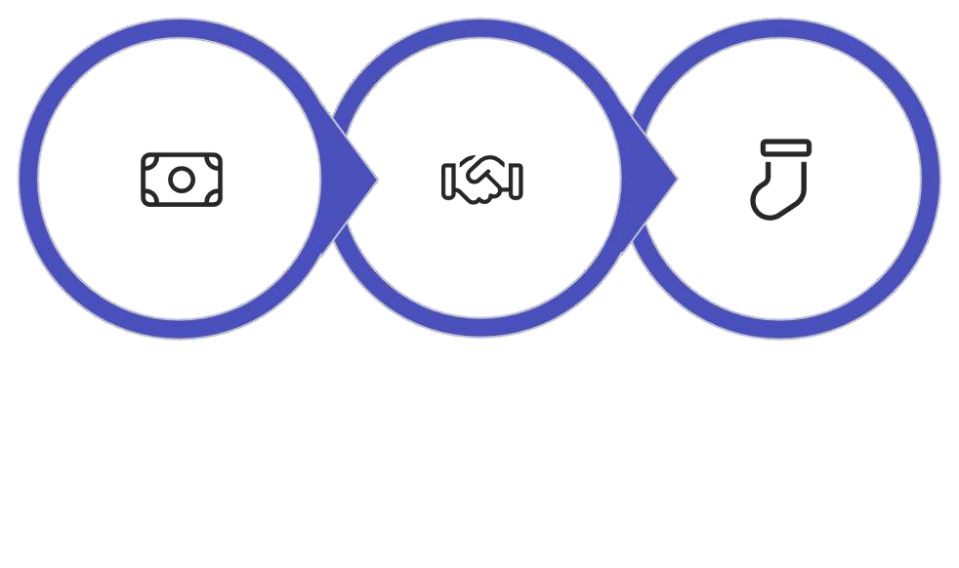
SPACs: Fast Track to Public Markets
How SPACs Work
A Special Purpose Acquisition Company raises capital via IPO as a "blank check" shell company, then merges with a private target — taking it public without a traditional IPO process.
SPAC Boom & Bust
2020–2021: 860 SPACs raised $162B — a
historic frenzy driven by low interest rates and retail investor enthusiasm.
2022–2023: Sharp decline. SEC increased scrutiny. Many SPAC-merged companies underperformed significantly.
Lesson: SPACs are a tool, not a shortcut.
Fundamentals still matter post-merger.
SPAC IPO
Target & Merger
De-SPAC

Slide 50

SPACs: Structure, Mechanics & Strategic Fit
Target Search
Management identifies a merger candidate within 18–
24 months.
D e- SPAC Merg er
Target merges with SPAC, becomes public; PIPE closes.
SPAC Formation
Blank-check company raises IPO capital and places funds in trust.
Post-Merger Trading
Combined company trades publicly; founders retain equity.
SPACs surged from 59 in 2019 to 613 in 2021 before regulatory scrutiny and poor post-merger performance cooled enthusiasm. The key advantage remains speed — a SPAC merger can complete in 3–6 months versus 12–18 for a traditional IPO. However, founder dilution from warrants and founder shares requires careful negotiation.

Slide 51

Impact Investing, ESG & Climate Finance
IMPACT & ESG
Impact investing has evolved from a niche philanthropic vehicle to a mainstream asset class commanding over $1 trillion in AUM globally.
For entrepreneurial finance, this represents both a capital source and a valuation dimension — ESG performance increasingly influences investor appetite and exit multiples.

Slide 52



Impact Finance & ESG-Aligned Capital
Impact investing — deploying capital to generate measurable social or environmental benefit alongside financial return — has grown to over $1.16 trillion AUM globally (GIIN, 2022). For entrepreneurs building in climate tech, health equity, or financial inclusion, impact capital is increasingly accessible and strategically valuable.
Climate Tech
$70B+invested in 2023. Breakthrough Energy Ventures, Lowercarbon Capital leading.
Financial Inclusion
Fintech for the unbanked. Accion Venture Lab, Omidyar Network active investors.
Health Equity
Addressing healthcare access gaps. Social determinants of health as investment thesis.

Slide 53



The Im pact Finance Ecosystem
Green Bonds & Climate Tech Blended Finance Structures
ESG Integration in VC Due
Diligence
Green bond markets exceeded $500B in annual issuance in 2023. Climate tech startups raised $196B globally in 2022, with energy transition, carbon capture, and sustainable agriculture leading sector investment. First Movers Coalition and Breakthrough Energy Ventures anchor institutional commitment.
Blended
concessional developm ent com m ercial
finance
capital finance)
capital to
com bines (g rants,
with de- risk
Top-tier funds now apply ESG screens at investment committee stage. Frameworks including IRIS+, SASB standards, and the EU SFDR (Sustainable Finance Disclosure
investment in emerg ing markets. The
O verseas
C orporation
$60B+ in
Private Investm ent (now D FC ) deploys
Regulation) are becoming baseline requirements for LP reporting across institutional venture funds.
blended structures
targ eting SD G- alig ned ventures in developing econom ies.

Slide 54



The Venture Financial Model: C ore C om ponents
1 2
Revenue Architecture
Bottom-up drivers (unit economics, conversion rates, pricing tiers) are preferred over top-down market share projections. For SaaS: Monthly New ARR = New Logos × ACV. Model cohorts separately to capture churn-adjusted growth accurately.
Cash Runway & Burn Rate
Gross burn (total cash out) vs. net burn (burn minus revenue). Runway = Cash Balance ÷ Net Monthly Burn. Target: 18–24 months runway post-raise. Sensitivity analysis on burn rate is critical for investor presentations.
3
Unit Econom ics: C AC & LTV
Customer Acquisition Cost (CAC) and Lifetime Value (LTV) are the bedrock metrics. LTV/CAC ratio ≥3x is a VC benchmark; CAC payback period under 12 months signals capital efficiency. These metrics determine whether growth investment creates or destroys value.
4
Scenario & Sensitivity Analysis
Professional models include Base, Bull, and Bear cases with key variable sensitivities. Investors assess how the business performs under stress — churn increases, sales cycle elongation, gross margin compression. Founders who present this signal analytical maturity.

Slide 55


Key SaaS & Platform Metrics Reference
3x
Minim um LTV/C AC
The venture benchmark for customer unit economics viability in subscription businesses.
110%
N et Revenue Retention
NRR above 100% means existingcustomers expand faster than they churn —
the gold standard for SaaS.
<12mo
CAC Payback Target
Best-in-class SaaS companies recover customer acquisition cost within 12 months.
40%
Rule of 40
Revenue growth % + profit margin % ≥ 40% defines a healthy, fundable SaaS business at scale.

Slide 56
The EvolvingInvestor-Founder Relationship
From Capital Provider to Value Partner
The best VCs have evolved beyond capital deployment into active operational partners. Modern VCs differentiate through portfolio support networks, operational expertise, talent acquisition support, and customer introductions — creating "franchise value" that justifies higher ownership demands.
The rise of founder-friendly terms (no participating preferred, 1x non-participating liquidation preferences, founder-controlled dual-class structures) reflects a decade of power shifting toward elite founders who can choose their investors.
Governance & Control Architecture
Board composition: Founders should maintain control until Series B or later
Protective provisions: Investor veto rights on liquidation, new issuance, debt
Information rights: Monthly financials, quarterly board meetings are standard
Drag-along rights: Majority can force minority shareholders to approve M&A exits
Right of first refusal: Investors can match any secondary share sale offer

Slide 57



9. Startup Valuation in the Modern Era
Valuation is both art and science — and the tools available to entrepreneurs and investors have never been more sophisticated.
Understanding modern valuation methods is essential for negotiating funding rounds effectively.
From Berkus and Scorecard methods for pre-revenue companies to network value models for Web3 protocols, modern entrepreneurial finance demands fluency across multiple valuation frameworks.

Slide 58
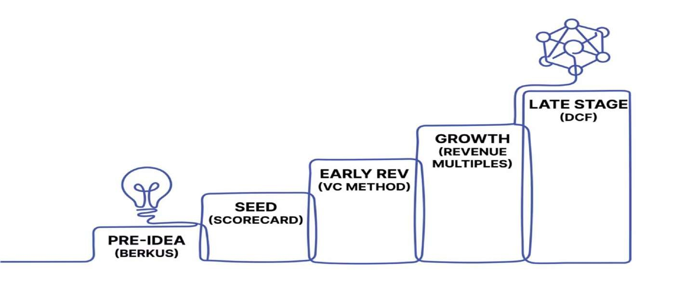
Valuation Frameworks Across Stages
No single method dominates. Sophisticated investors triangulate across 2–3 approaches, using the range to frame negotiation rather than assert a single precise number. The choice of method signals the investor's philosophy as much as the startup's value.

Slide 59


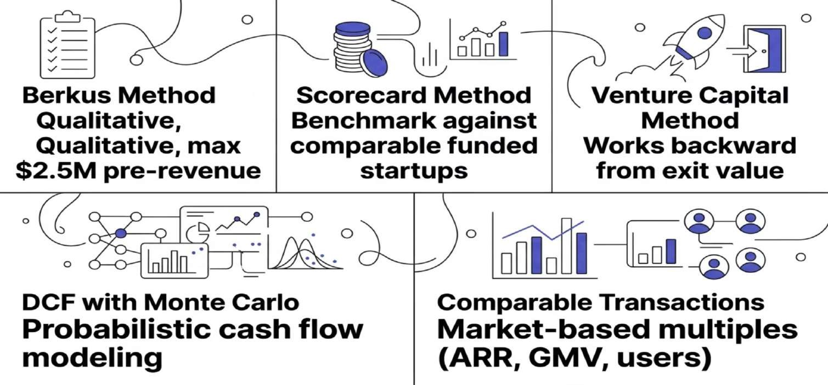
Modern Valuation Methods Compared
No single method is definitive. Sophisticated investors triangulate across multiple approaches, weighting each based on the
startup's stage, sector, and data availability.
Pre-revenue companies rely on qualitative methods; growth-stage companies shift to revenue multiples.

Slide 60



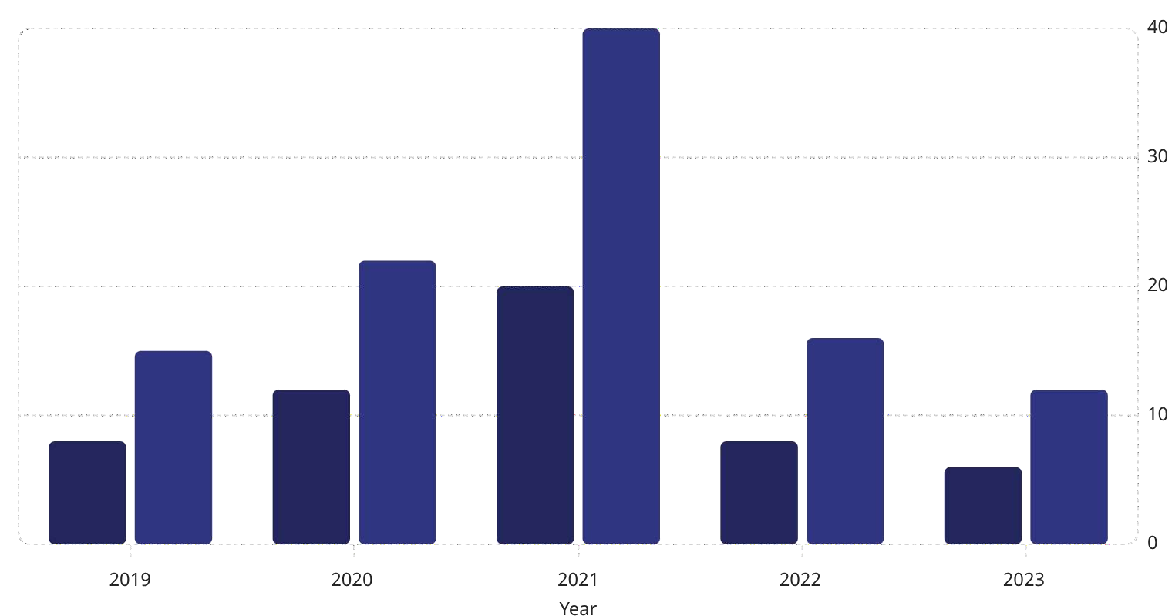
The ARR Multiple: SaaS Valuation Benchmark
Median ARR Multiple (x)
Top Quartile ARR Multiple (x)
40
22
20
15
16
12
12
8
8
6
SaaS valuations peaked dramatically in 2021 before contracting sharply.
The normalization of ARR multiples reflects rising interest rates and a return to fundamentals-based investing. High-growth companies still command premium multiples, but the bar for "high growth" has risen.

Slide 61


Cap Table Architecture & Dilution Dynamics
Understanding Cap Table Evolution
A capitalization table records every equity holder's stake. As ventures raise successive rounds, early holders experience dilution — their percentage ownership as absolute value may increase. Managing this dynamic is to founder wealth preservation.
Option Pool Shuffle: Investors require pre-money pools, diluting founders before new investors
Anti-dilution provisions: Full ratchet vs. broad-based weighted average
Pro-rata rights: Allow existing investors to maintain
percentage in future rounds
SAFEs vs. convertible notes: Debt-like instruments at future priced rounds
Founder Dilution: A Realistic Path
A typical venture-backed founder may own 60– 70% at incorporation and arrive at IPO with 12– 18% after multiple rounds, option grants, and ESOP expansion. Understanding this trajectory is essential for financial planning and equity negotiation at each stage.
Benchmark: Airbnb co-founders owned approximately 13.5% combined at IPO — still representing billions in value, but the dilution journey is real and requires proactive management.

Slide 62

Case Study: Stripe's Financing Architecture
01
2010 — Y Combinator ($20K)
Patrick and John C ollison join YC S 10 batch. Early capital from PayPal m afia ang els including Peter Thiel. Valuation: ~ $1M.
02
2011–2016 —VC Acceleration
Series A through D raised $280M from Sequoia, Andreessen Horowitz, Thrive Capital. Strategic rounds with Visa and American Express signal financial industry validation.
03
2019–2021 —Unicorn to Decacorn
Series G at $36B valuation (2019), followed by pandem ic- era e- com m erce surg e.
March 2021 Series H raises $600M at $95B valuation — larg est private fintech g lobally.
04
2023 — Down Round & Discipline
Valuation reset to $50B in March 2023 tender offer as rate environment shifted. Stripe delays IPO, prioritizes profitability — a masterclass in private market discipline.

Slide 63



10. The Future — What's Next in Entrepreneurial Finance
The convergence of AI, blockchain, regulatory evolution, and global capital flows is creating a fundamentally new financing landscape.
The entrepreneurs who thrive will be those who understand and leverage these forces strategically.

Slide 64


10 Trends Definingthe Future of Entrepreneurial Finance
01
02
AI-Native Investment Platforms Real-World Asset Tokenization
Fully autom ated deal sourcing , dilig ence, and portfolio m onitoring a$t1s6cTa+lein. assets projected to be tokenized on-chain by 2030 (BCG estimate).
03 04
Embedded Finance for Startups
Regulatory Clarity on Crypto
Banking , lending , and insurance natively integ rated into startup operating SpElCa,tMfoiCrmA (sE.U), and global frameworks will unlock institutional DeFi participation.
05 06
Decentralized Credit Markets
On- chain credit scoring and undercollateralized D eFi lending for businesses.
Climate Finance Acceleration
Carbon markets, green bonds, and blended finance scaling to trillions.
07
08
Global Retail Investor Access
Founder-Friendly Instruments
Reg C F, tokenization, and cross- border platforms enabling truly g lobal capEvtoalbutlieosn. of SAFEs, rolling funds, and non-dilutive structures favoring founders.
09 10
Sovereign Wealth Fund Participation Quantum Computing in Finance
SWFs from UAE, S ing apore, and Saudi Arabia increasing ly leading g rowth Nroeuxtn-gdesn. eration risk modeling and portfolio optimization emerging from research
labs.

Slide 65





Building Your Venture Financing Strategy
A financing strategy is not a single decision — it is a dynamic roadmap that evolves with your venture. The best
founders think several rounds ahead, optimizing for dilution, control, and strategic value at every stage.
Idea Stage
Bootstrap + SAFE from ang els
Pre-Seed
Accelerator + Micro-VC + Crowdfunding
Seed
Lead VC + Strategic Angels + Convertible Notes
Series A+
Institutional VC + CVC + Venture Debt
Growth & Exit
PE + RBF + IPO / M&A / Token Launch

Slide 66


Key Questions & Answers
Summary
Test your mastery of core concepts with these applied Q&A pairs:
Q: What is the primary advantage of a SAFE over a convertible note?
A: A SAFE is not debt — it has no interest rate or maturity date, making it simpler and more founder- friendly. It converts to equity at the next priced round without creating repayment pressure.
Q: How does AI improve startup due diligence?
A: AI tools use NLP to analyze pitch decks, financial statements, and market data in minutes — flagging risks, benchmarking against comparable companies, and identifying patterns predictive of success or failure.
Q: What distinguishes a Security Token from a Utility Token?
Q: Why did Airbnb's COVID debt raise matter strategically?
A: It preserved the company through near-zero
revenue, enabling a historic IPO just months later. It
A: Security tokens represent ownership rights (equity, debt, revenue share) and are subject to securities regulation. Utility tokens grant access to a product/service and generally fall outside securities law — though this is jurisdiction-dependent.
demonstrates that survival capital — even at
punishing terms — can be the right strategic choice when the alternative is insolvency.

Slide 67


Key Questions & Answers
Summary
Q: What is the primary advantage of Revenue-Based Financing over traditional equity rounds?
Answer: RBF is non- dilutive — founders retain full ownership.
Repaym ent scales with revenue perform ance rather than fixed
schedules, reducing cash flow risk. Best suited for businesses with predictable, recurring revenues (SaaS, e- com m erce subscriptions).
Q: How do DAOs function as venture funding vehicles?
Answer: DAOs are blockchain-governed entities whose token holders vote on capital deployment. They fund projects through grants, token swaps, and venture arms. Uniswap DAO's $3B+ treasury and Optimism's retroactive public goods funding illustrate the scale and diversity of DAO-mediated entrepreneurial finance.
Q: What distinguishes Regulation CF from Regulation D offerings?
Answer: Reg C F perm its raises up to $ 5M annually from any investor (accredited or retail), requiring a Form C SEC filing . Reg D is uncapped but restricted to accredited investors only, with fewer disclosure
requirem ents. Reg C F dem ocratizes access; Reg D preserves institutional confidentiality and scale.
Q: What is the "Rule of 40" and why do VCs use it?
Answer: The Rule of 40 states that a SaaS company's revenue growth rate plus profit margin should equal or exceed 40%. It provides a single metric balancing growth and profitability — useful for benchmarking companies across growth stages where neither metric alone tells the full story.

Slide 68


Key Questions & Answers
Summary
Q: What is Revenue-Based Financing best suited for?
A: RBF is ideal for SaaS, e- com m erce, and subscription
businesses with predictable m onthly recurring revenue. It is
non- dilutive and repaym ent scales with perform ance — m aking it a powerful alternative to equity for capital- efficient
businesses.
Q: How did Stripe use private financing strategically?
A: Stripe raised $8.7B+ while staying private, using capital to expand globally and build adjacent products. Its 2023 down round from $95B to
$50B illustrates that even elite startups face valuation corrections — and that late-stage private financing carries mark-to-market risk.
Q: What is a DAO and how can it function as a
financingvehicle?
A: A D AO is a blockchain- g overned entity where token holders vote on capital allocation and strateg y. Entrepreneurs can raise capital by issuing g overnance tokens, enabling com m unity
ownership and decentralized treasury m anag em ent — as
dem onstrated by C onstitutionD AO raising $47M in 72 hours.
Q: What macro trend most significantly
impacts startup valuations in 2023–2024?
A: Rising interest rates compressed ARR multiples from a peak of 20x (median) in 2021 to approximately 6x in 2023. Higher rates increase the discount rate applied to future cash flows, reducing the present value of high-growth, unprofitable startups — forcing a return to fundamentals- based investing.

Slide 69
Key Questions & Answers
Summary
Q: How does AI change the due diligence process in venture
capital?
Answer: AI platform s like EQ T's Motherbrain ing est m illions of sig nals (web traffic, GitH ub activity, app reviews, founder backg rounds) to
surface and score investm ent targ ets alg orithm ically. N LP tools
autom ate docum ent review, reducing due dilig ence from weeks to
hours while enabling analysis at scale previously im possible for hum an
team s.
Q: What are the key risks of SPAC mergers for target
companies?
Answer: SPAC risks include: warrant dilution to SPAC sponsors (typically 20% founder shares), redemption risk if too many SPAC shareholders redeem before close, compressed due diligence relative to traditional IPO, SEC regulatory scrutiny of forward-looking projections, and post-merger underperformance in public markets — statistically, most SPAC targets trade below NAV within 12 months.
Q: How does Stripe's 2023 "down round" illustrate venture market dynamics?
Answer: Stripe's reset from $95B to $50B valuation reflects the im pact
of rising interest rates on g rowth stock m ultiples. It illustrates that
private valuations lag public m arket corrections, down rounds trig g er anti- dilution protections (diluting founders), and disciplined founders prioritize business fundam entals and delay exits rather than accept
unfavorable IPO conditions during m arket dislocations.
Q: What is tokenization and how does it expand entrepreneurial financing options?
Answer: Tokenization converts ownership rights into blockchain-native digital tokens, enabling fractional ownership, programmable compliance, and global liquidity. For startups, it unlocks equity tokens (compliant fractional ownership), revenue tokens (non-dilutive capital against future revenue), and RWA tokens (collateral for DeFi borrowing) — creating financing pathways that bypass traditional intermediaries entirely.

Slide 70
Summary
Future Horizons: What's Next in Entrepreneurial Finance?
Looking beyond current trends, five emerging forces will define the next decade of venture and entrepreneurial finance — demanding that founders and investors develop entirely new competencies and mental models.
Generative AI as CFO
AI financial co-pilots (Harvey, Pilot AI, Brex's AI) will automate financial planning, investor reporting, and compliance — compressing the finance function for early-stage teams.
On-Chain Capital Markets
Fully tokenized equity cap tables with programmable compliance, automated distributions, and on-chain secondary markets will normalize for tech-native startups within 5– 10 years.
Sovereign AI Funds
Nation-states are deploying sovereign wealth into AI infrastructure as strategic national interest — creating a new class of patient, politically-motivated capital for deeptech ventures.
Micro-VC Proliferation
Sub-$50M funds with hyper-specialized focus (climate infrastructure, femtech, AI safety) are capturing early-stage deal flow through domain expertise that generalist VCs cannot match.
Community-Led Finance
Creator economy and community-first startups are raising from their user bases first — embedding financial alignment into product communities before approaching institutional capital.

Slide 71


Key Takeaways: The Future of Entrepreneurial Finance
Summary
Technology Is Restructuring Capital Access AI, blockchain, and digital platforms have permanently democratized and accelerated capital formation — founders and investors who understandthese tools hold structural advantages. | Diversify the Financing Stack The most resilient ventures combine dilutive and non-dilutive capital, strategic and financial investors, and institutional and community funding—buildingoptionality across market conditions.
Global Is the Default Capital, talent, and customers are globally distributed. Founders who design for cross-border capital structures and emerging ecosystem opportunities will dramatically expand their addressable financing universe. | Metrics Drive Conviction In an increasingly data-driven investment environment, mastery of unit economics, cohort analysis, and financial modeling is the most reliable signal of founder competence that investors can evaluate efficiently.

Slide 72



Key Takeaways
Master the Fundamentals
Traditional VC , ang els, and debt rem ain the backbone of startup
finance — understand them deeply before exploring alternatives.
Embrace Emerging Tools
AI, D eFi, tokenization, and RBF are not hype — they are reshaping
how capital flows to entrepreneurs g lobally.
Think Strategically
The best financing decisions optim ize for dilution, control, and
strateg ic value — not just the larg est check.
Go Global
Capital is increasingly borderless. The next great financing opportunity may
come from a sovereign wealth fund, a DAO, or a global crowdfunding
platform.

Slide 73

Summary of Lecture Objectives
Analyze Funding Ecosystems
This objective focuses on developing a deep understanding of the complete funding ecosystem for startups. Students will evaluate traditional funding sources such as bootstrapping, angel investment, venture capital, and bank debt, alongside emerging sources including AI-powered platforms, decentralized finance (DeFi), tokenization, equity crowdfunding, and revenue-based financing. The analysis covers how these funding options evolve across the entire venture lifecycle — from the idea and pre-seed stages through seed, Series A/B, growth, and eventual exit.
Apply Valuation Methods
This objective equips students with practical skills to apply modern valuation techniques suitable for startups. It covers traditional approaches as well as advanced methods, including AI-assisted valuation models that use pattern recognition, sentiment analysis, network analysis, and real-time benchmarking. Students will also explore token-based valuation models and learn how to triangulate multiple methods (such as ARR multiples for SaaS companies) to determine accurate valuations at different stages of a venture’s development.

Slide 74
Summary of Lecture Objectives
Assess DeFi & Tokenization
Students will gain a comprehensive understanding of decentralized finance (DeFi) instruments and blockchain-based asset tokenization and their revolutionary applications to startup financing. The objective covers key concepts such as security tokens versus utility tokens, smart contracts, fractional ownership, DAOs as financing and governance vehicles, and how tokenization enables global 24/7 trading, lower investment thresholds, and programmable equity. Real examples like MakerDAO and ConstitutionDAO illustrate practical implementation.
Design Capital Strategies
This objective emphasizes building a strategic and dynamic financing roadmap tailored to an early-stage venture. Students will learn how to match appropriate financing instruments (SAFE notes, convertible notes, VC, RBF, crowdfunding, etc.) to each stage of the company’s lifecycle while optimizing for minimal dilution, founder control, and long-term strategic value. The focus is on creating a forward-looking capital strategy that evolves as the venture progresses from idea stage through growth and exit.

Slide 75
Summary of Lecture Objectives
Evaluate Risk & Return
Students will learn to apply analytical frameworks to assess investor risk profiles, return expectations, and the risk-return tradeoff across different financing instruments. This includes understanding the VC power law (where returns are driven by a few unicorn outcomes), the non-dilutive nature of revenue-based financing, the higher risk in DeFi and tokenization, and how market conditions such as rising interest rates affect valuations and investor behavior. Special attention is given to evaluating risk in traditional, alternative, and emerging financing models.
Critique Case Studies
This objective develops critical thinking by requiring students to analyze real financing decisions from prominent companies such as Uber, Airbnb, and Stripe. Students will examine Uber’s aggressive blitzscaling strategy through multiple VC rounds, Airbnb’s resilience during the COVID-19 crisis with emergency debt financing, and Stripe’s deliberate choice to remain private while raising over $8.7 billion. Through these cases, students extract key lessons on capital strategy, timing, market conditions, survival tactics, and the balance between growth and profitability.

Slide 76

Recommended Resources & Further Reading
Essential Texts
Venture D eals — Brad Feld & Jason Mendelson (term sheet m echanics)
The Business of Venture C apital — Mahendra Ram sing hani
(LP/GP dynam ics)
Z ero to O ne — Peter Thiel (venture philosophy)
The Lean Startup — Eric Ries (capital- efficient g rowth)
D eFi and the Future of Finance — H arvey, Ram achandran, Santoro
Data & Research Sources
  PitchBook & CB Insights — venture data and analytics
  SEC EDGAR — regulatory filings and exemption data
  Crunchbase — funding rounds and ecosystem mapping
  a16z Future, NFX Signal — thought leadership from active VCs
Practitioners to Follow
Marc Andreessen — a16z, software eating the world thesis
C ham ath Palihapitiya — Social C apital, SPAC m echanics
N aval Ravikant — Ang elList, rolling funds, dem ocratization
Renata Q uintini — Reneg ade Partners, LP relations
H aje Jan Kam ps — TechC runch, pitch deck analysis
Platforms to Explore
Republic.com — equity crowdfunding mechanics
Aave.com — DeFi lending protocols
Carta.com — cap table management
Pipe.com — revenue-based financing

Slide 77




Thank You

