Slide 1
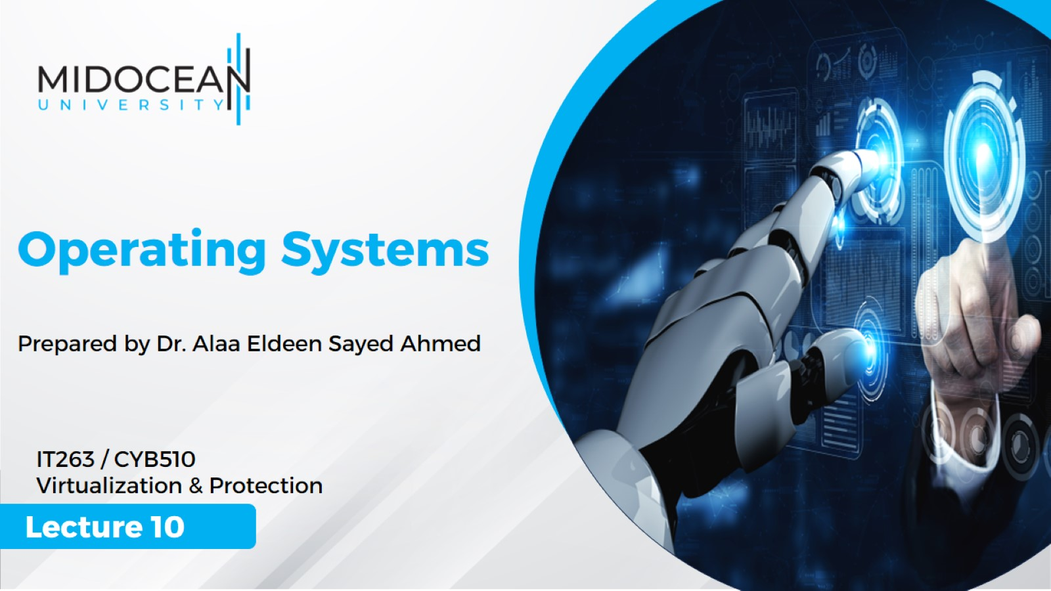

Slide 2
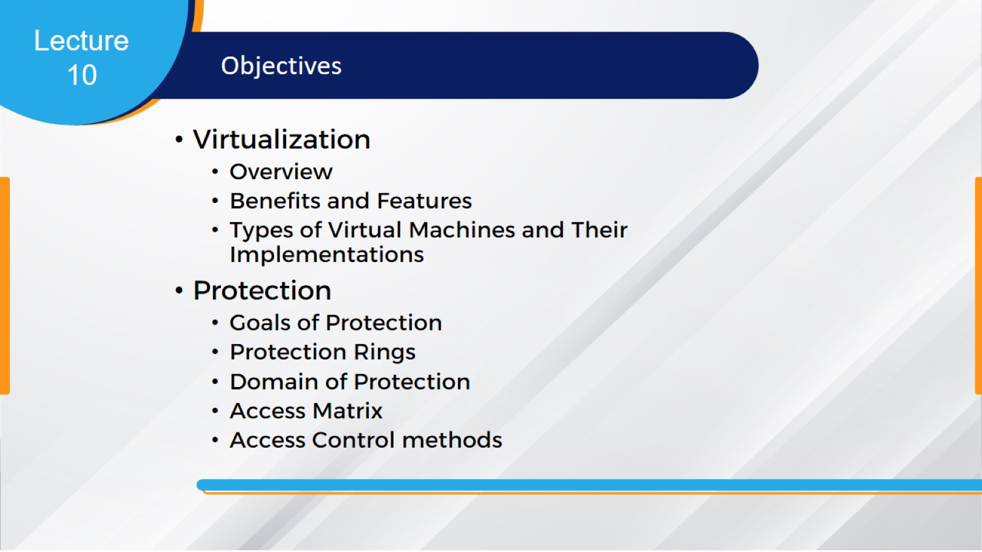

Slide 3
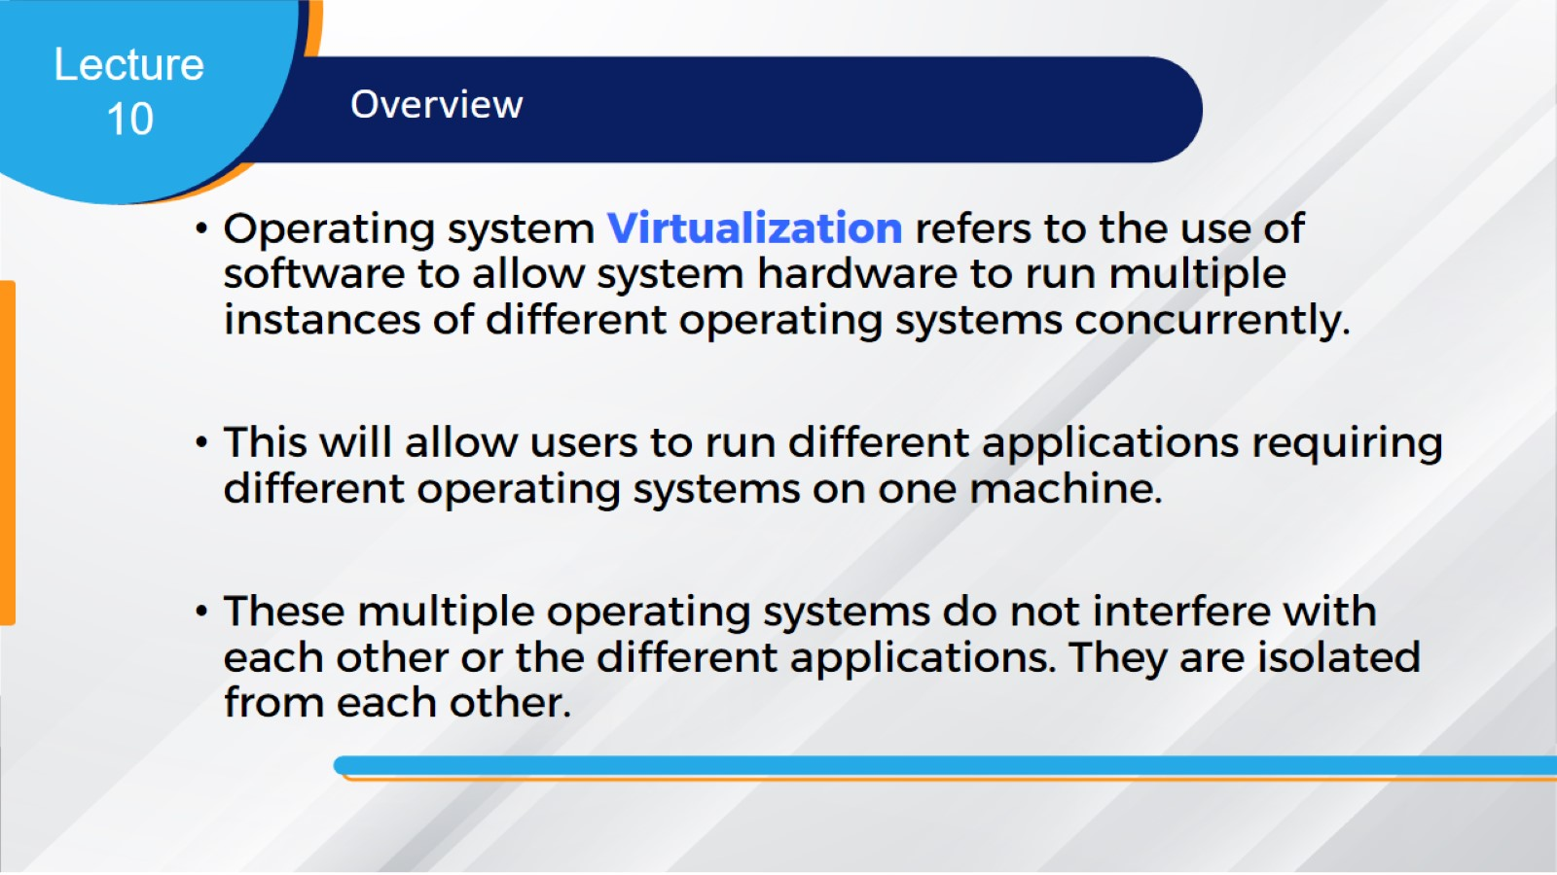

Slide 4
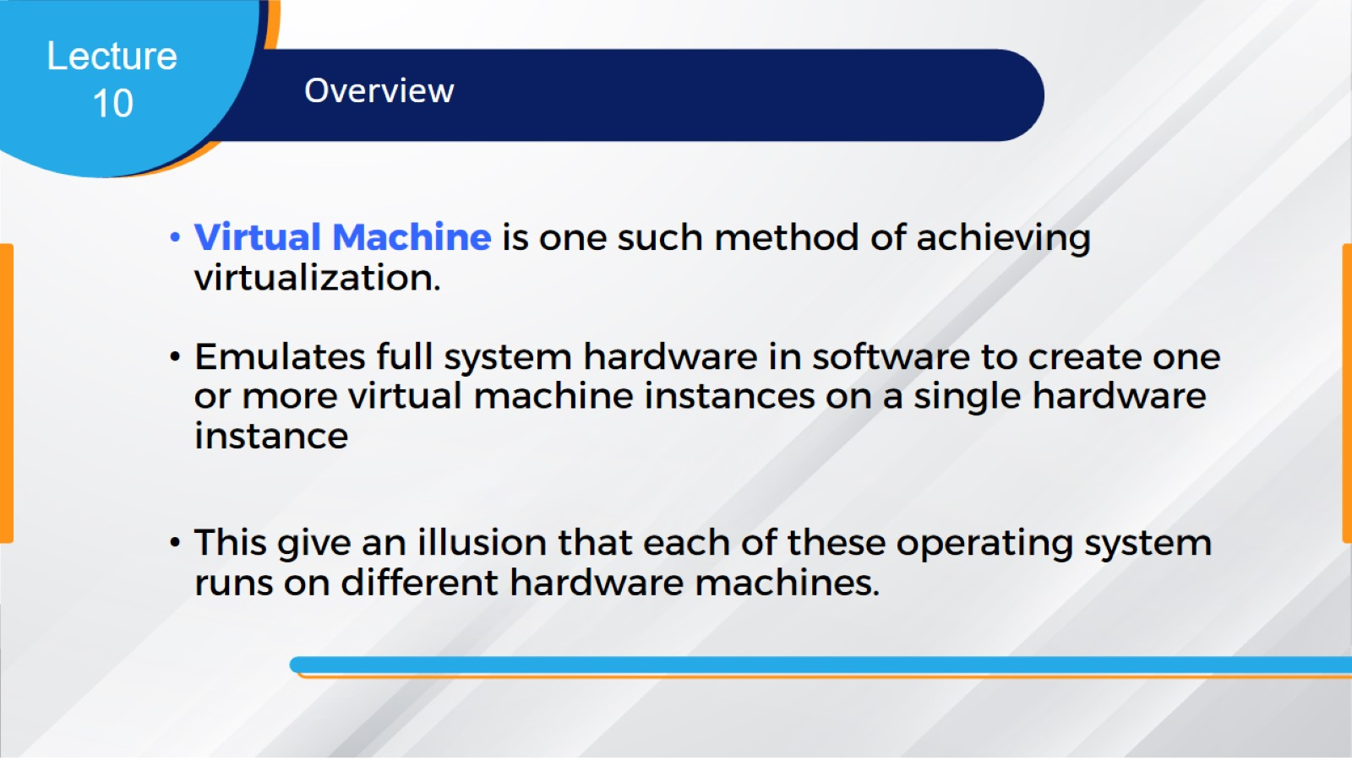

Slide 5
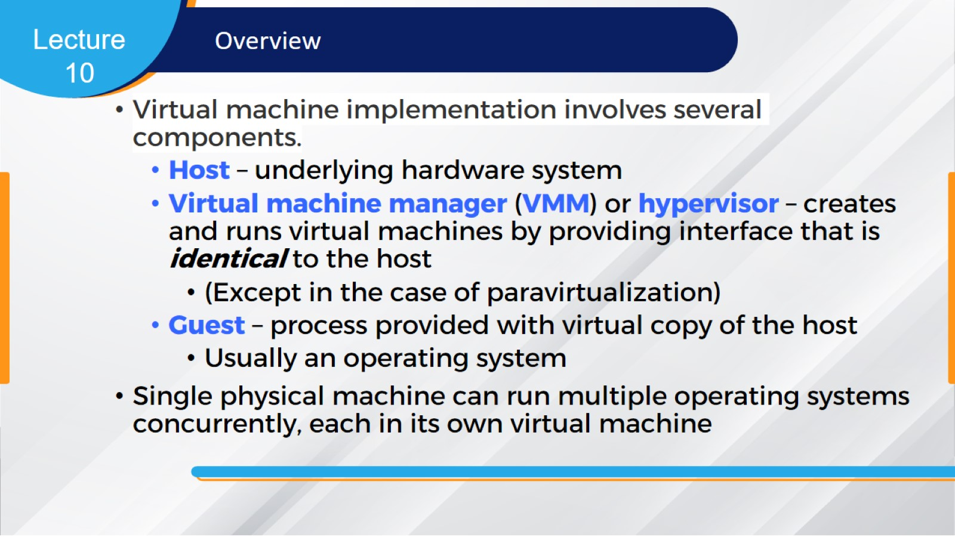

Slide 6
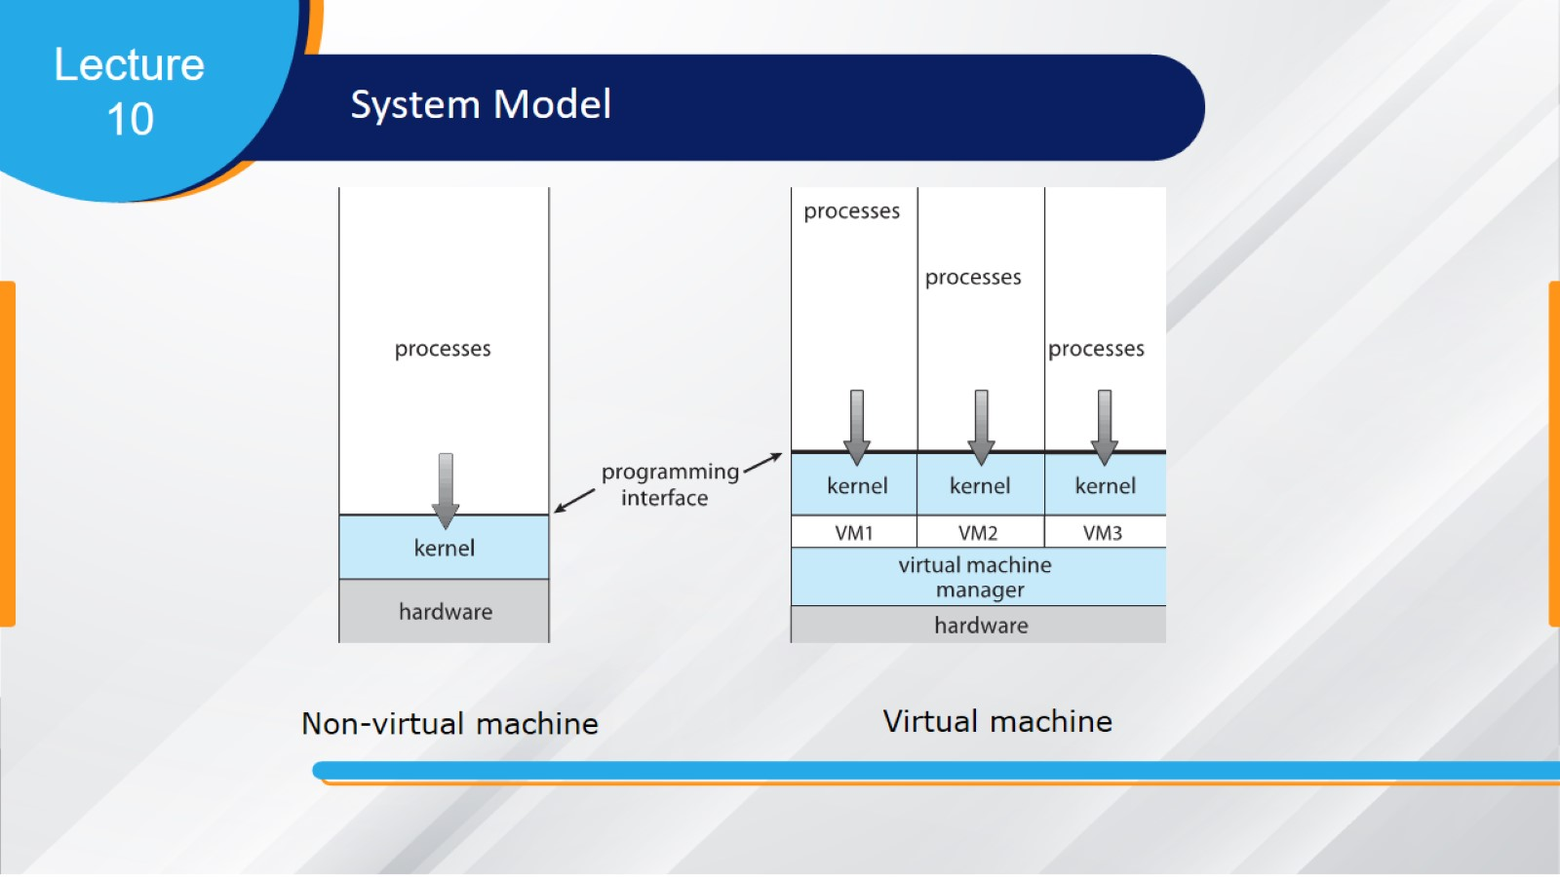

Slide 7
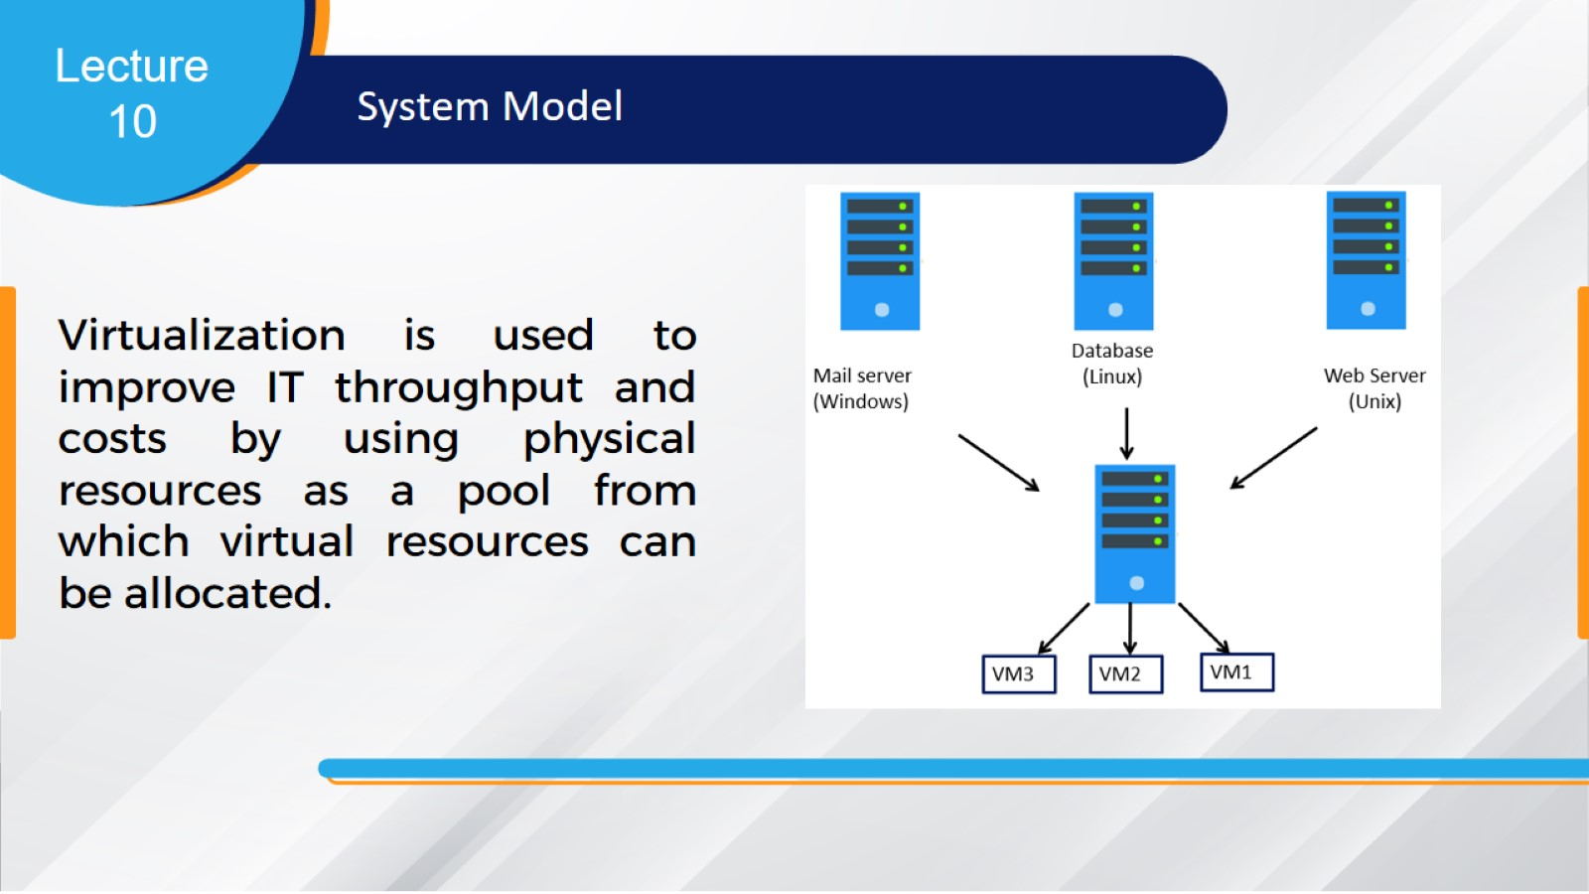

Slide 8
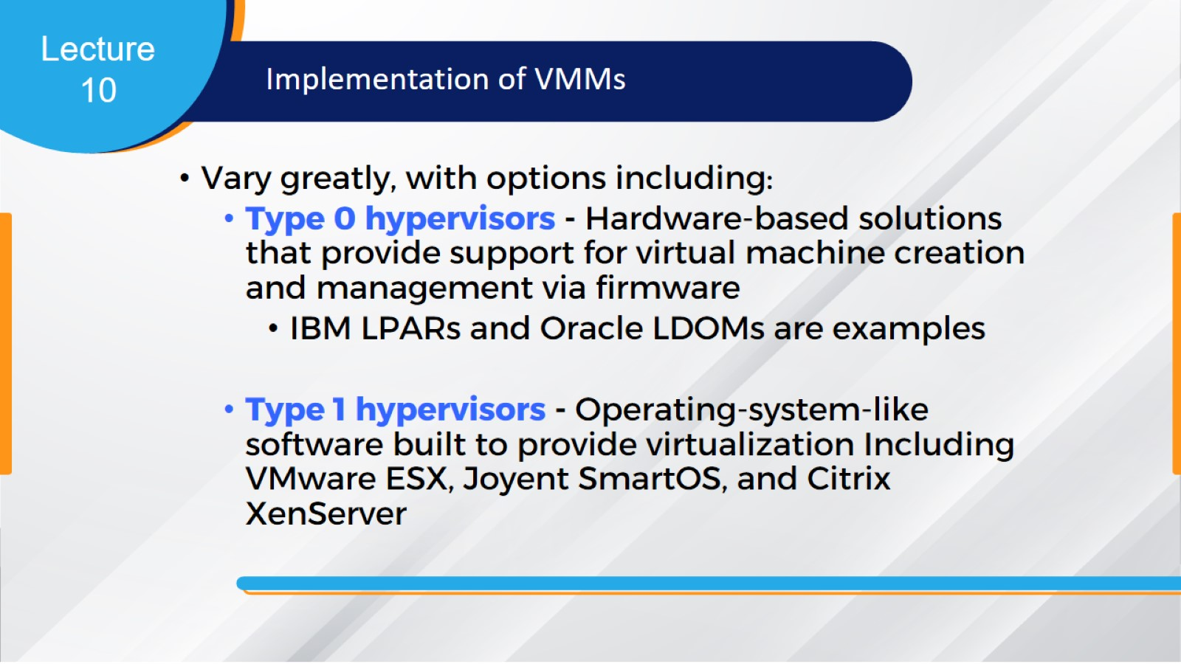

Slide 9
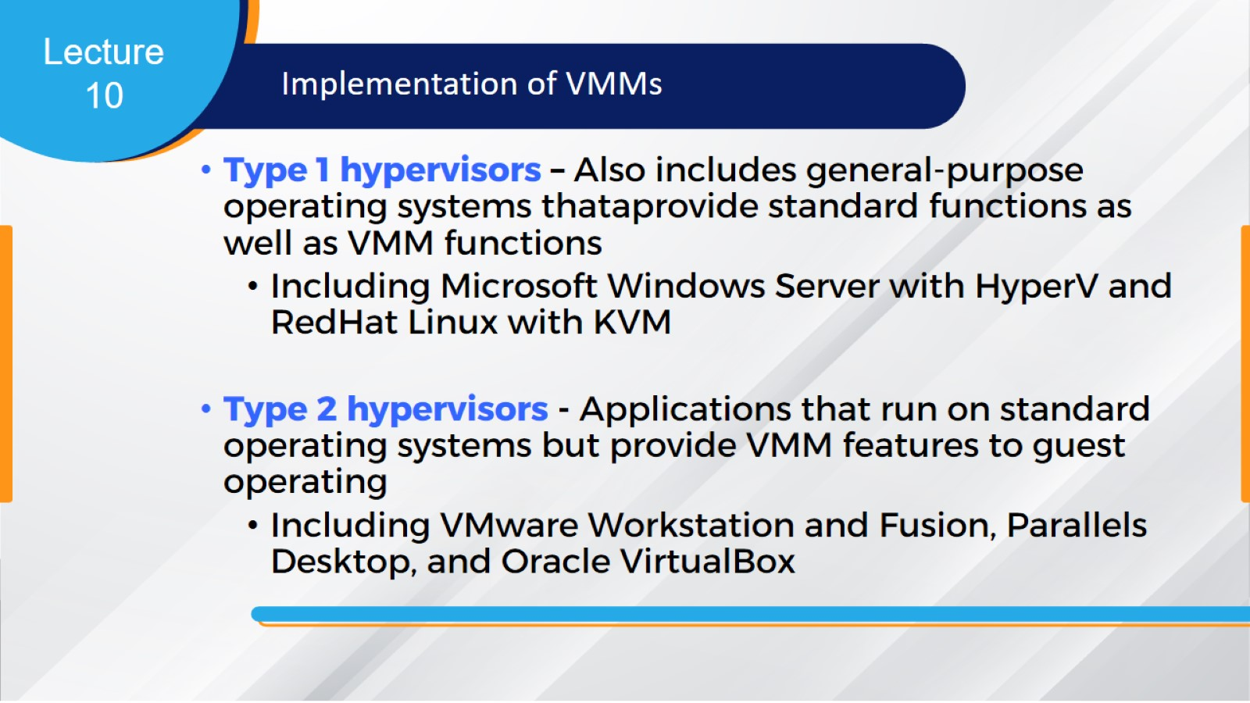

Slide 10
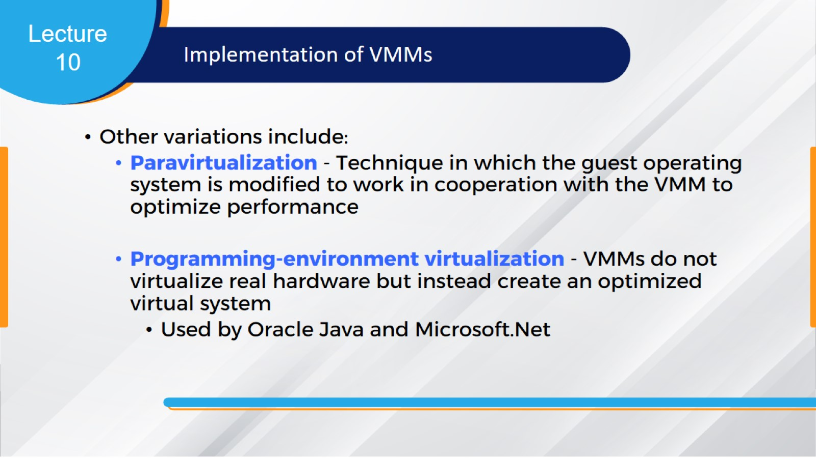

Slide 11
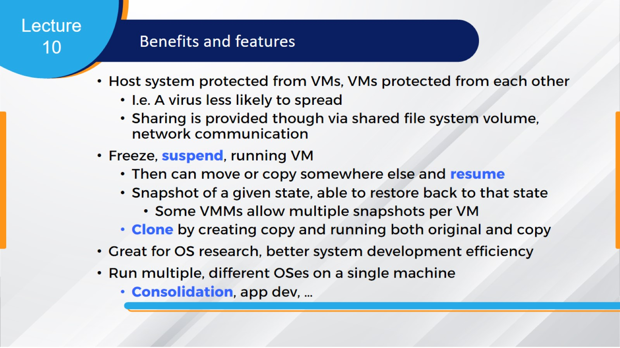

Slide 12
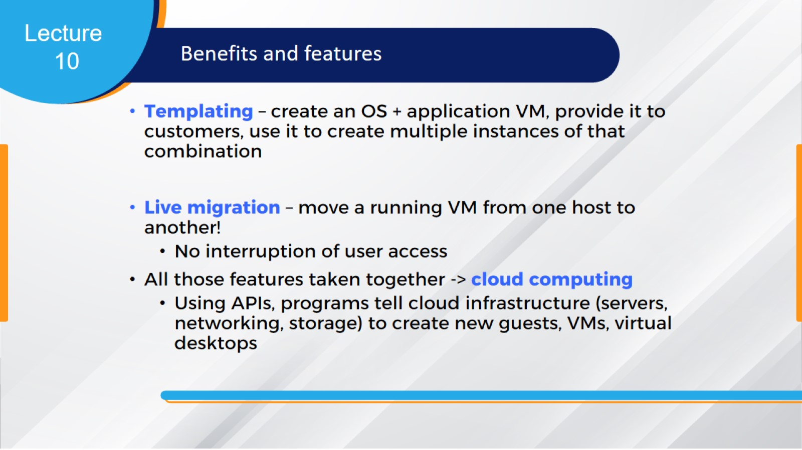

Slide 13
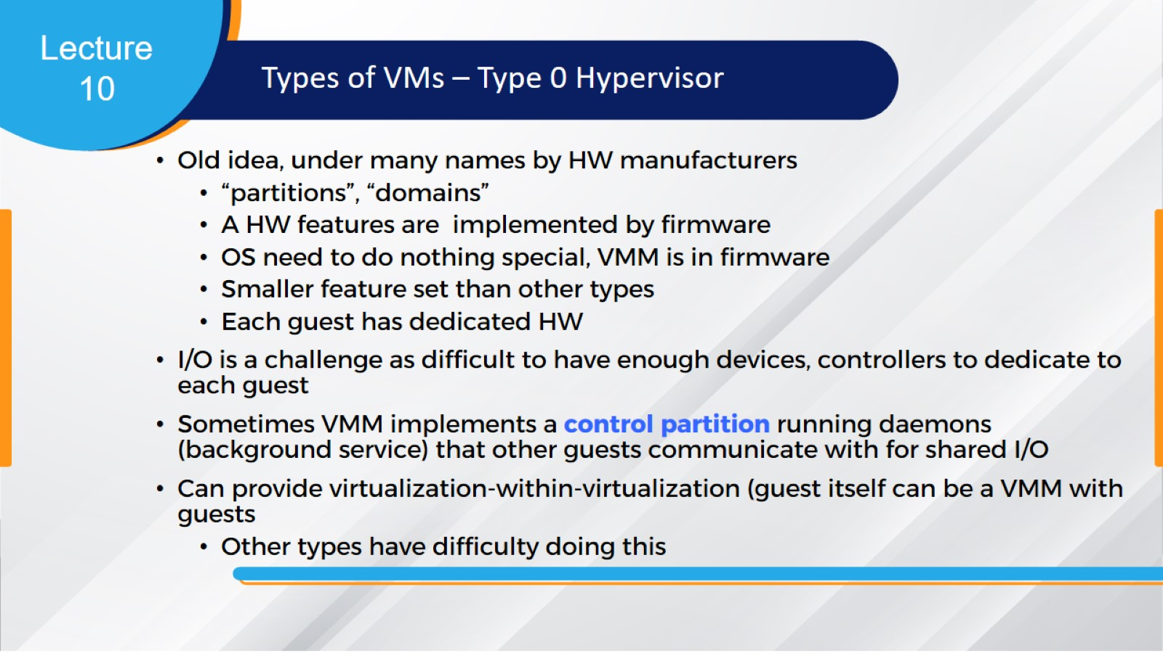

Slide 14
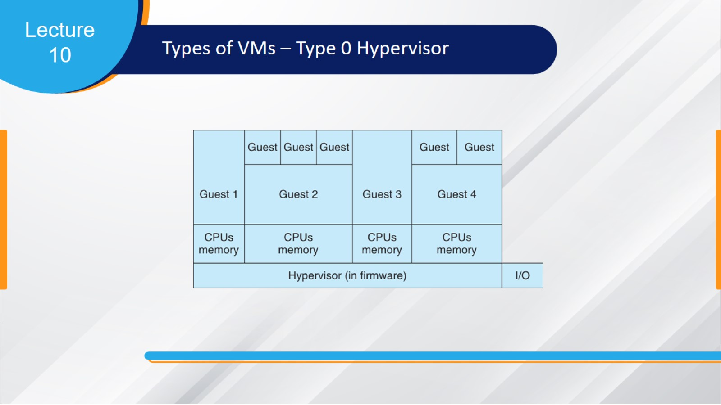

Slide 15
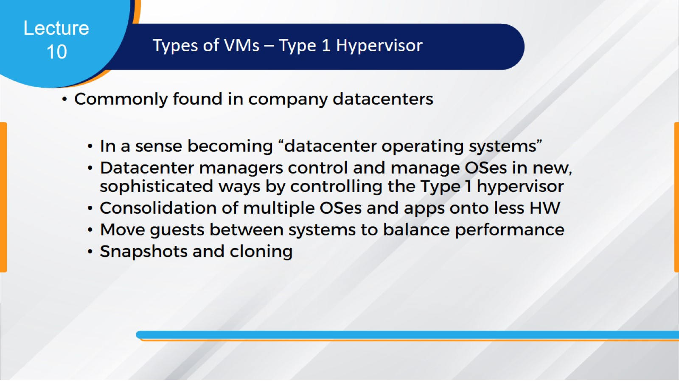

Slide 16
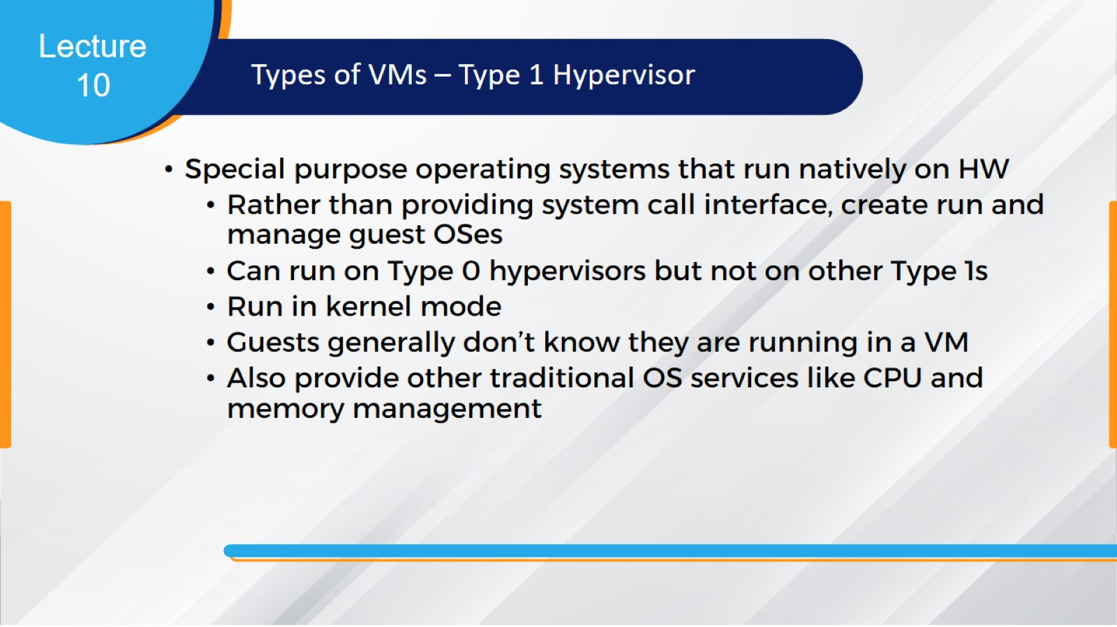

Slide 17
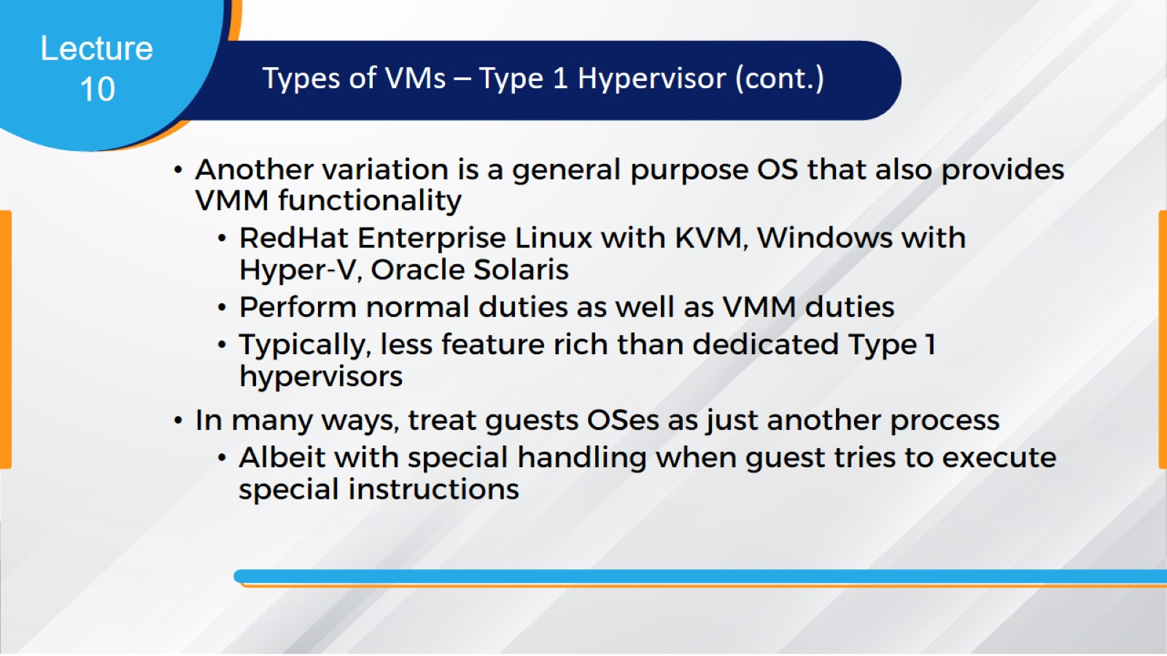

Slide 18
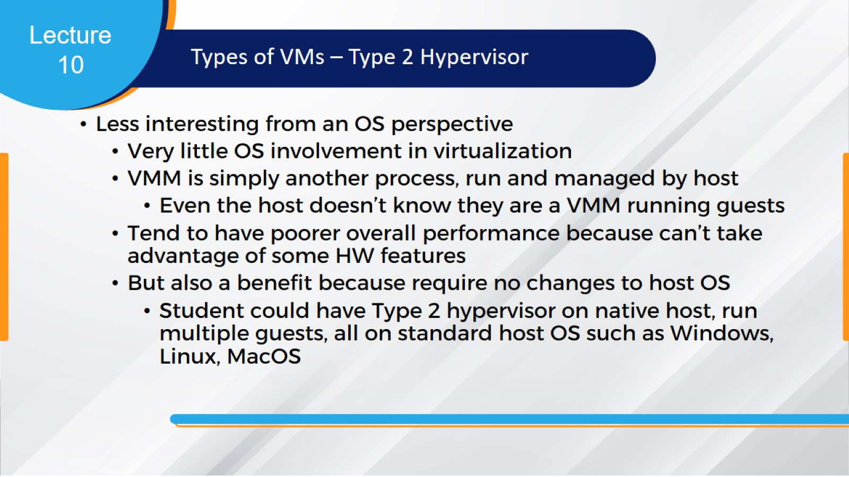

Slide 19
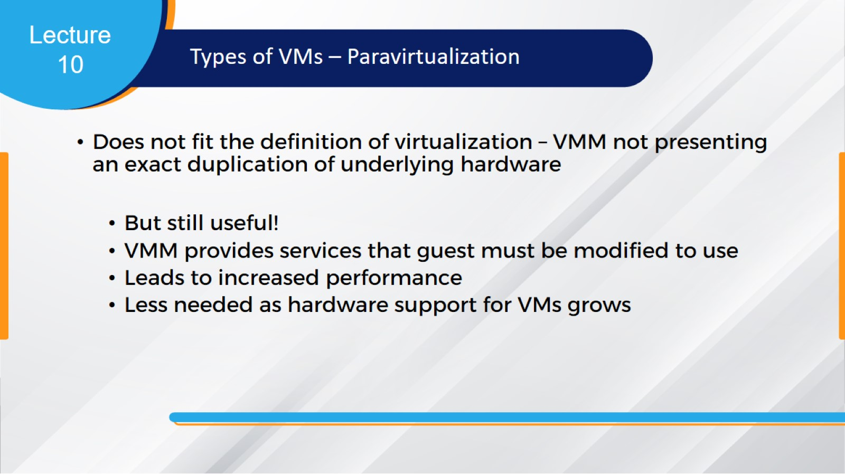

Slide 20
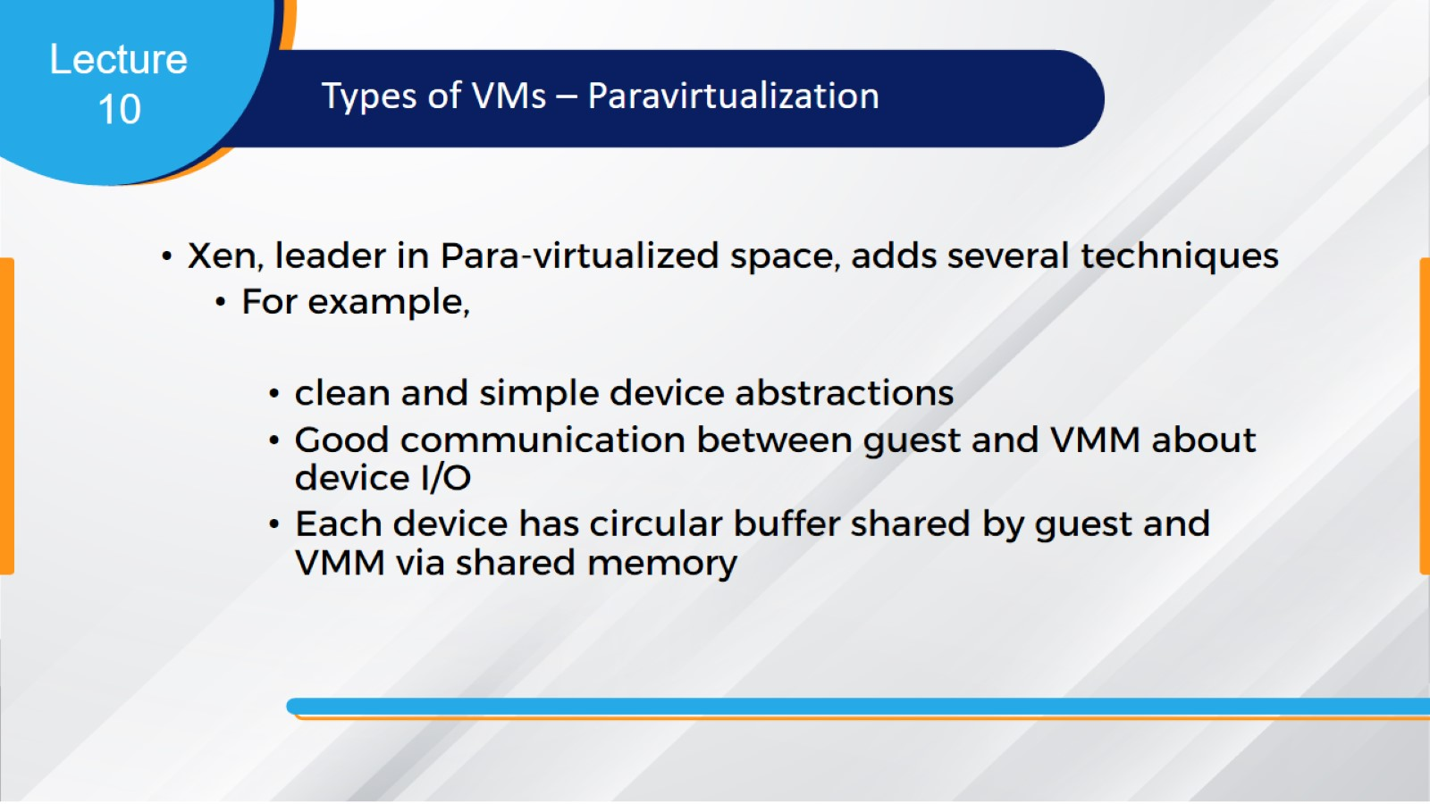

Slide 21
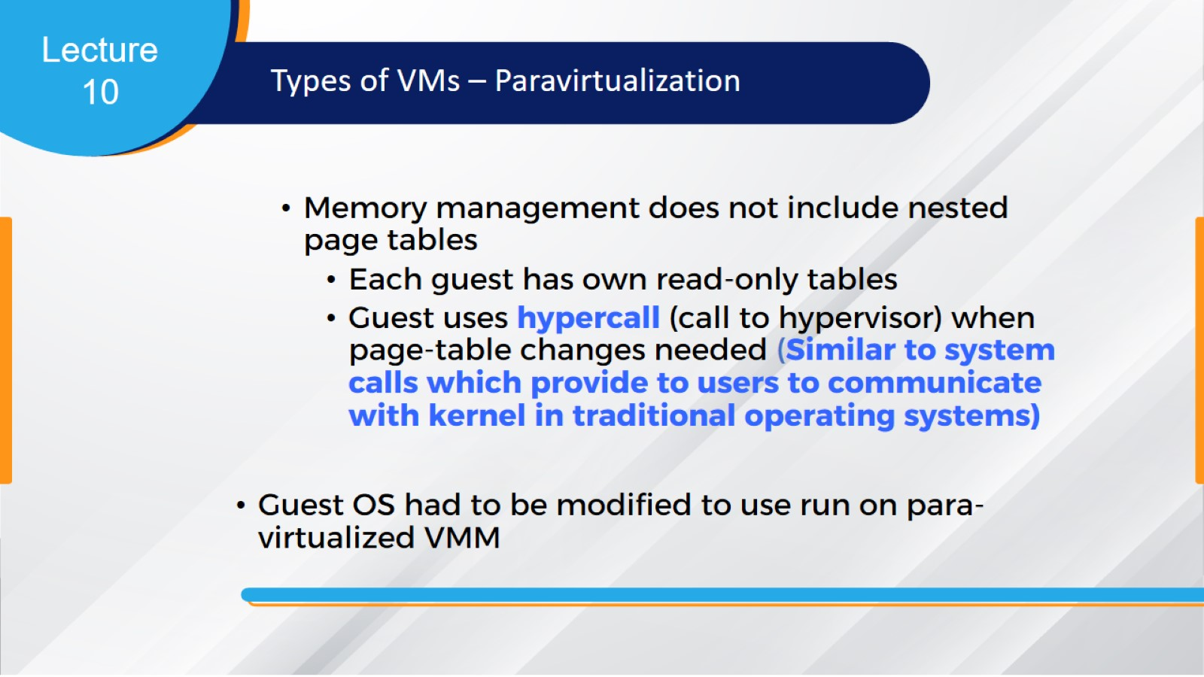

Slide 22
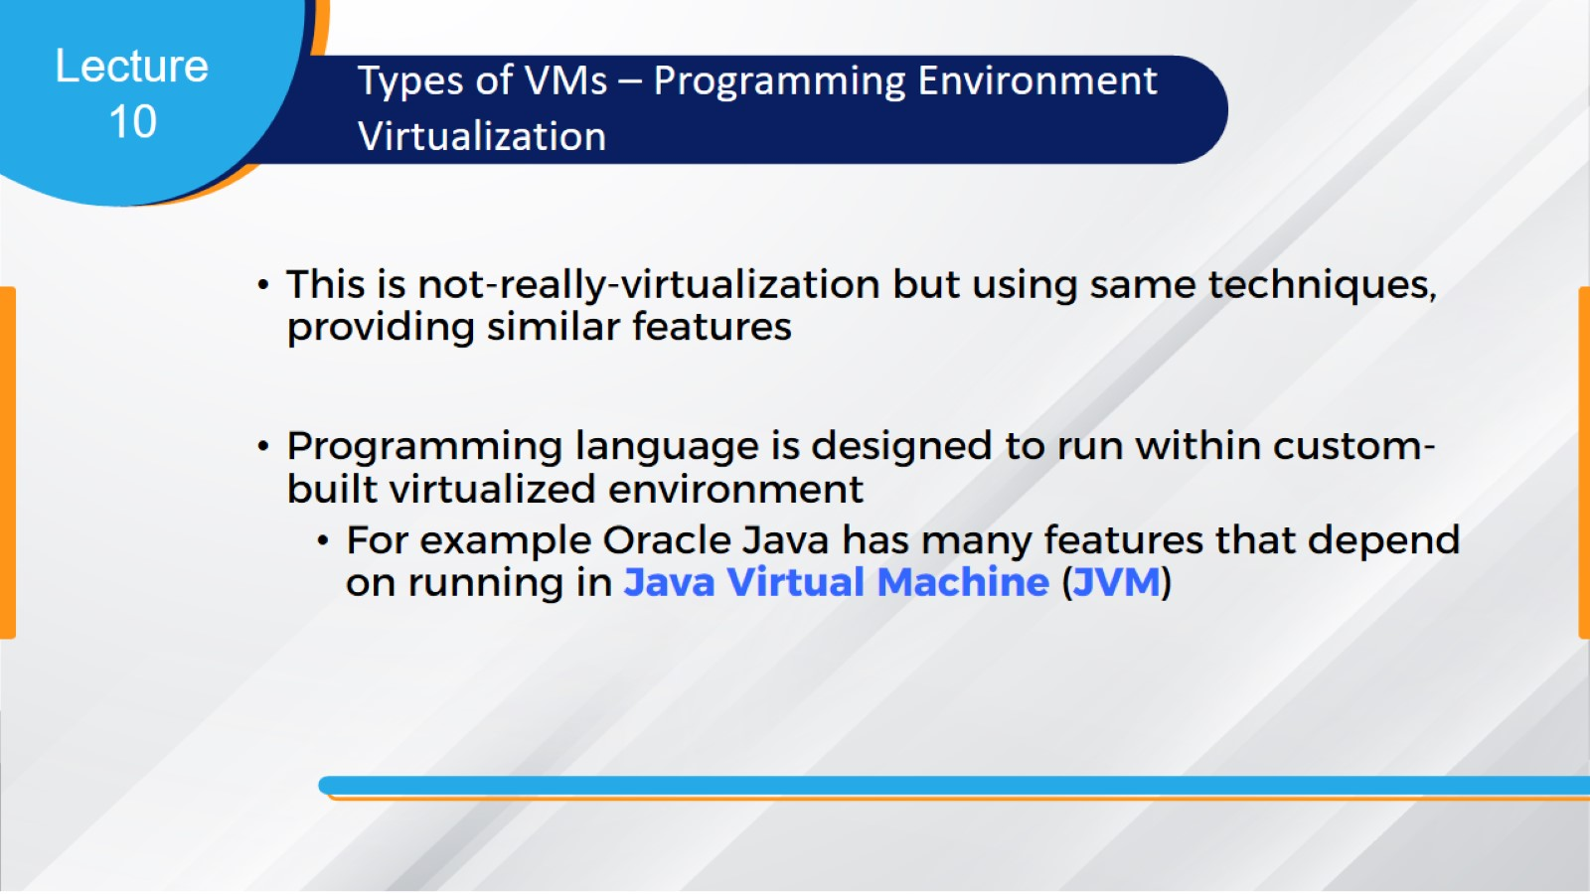

Slide 23
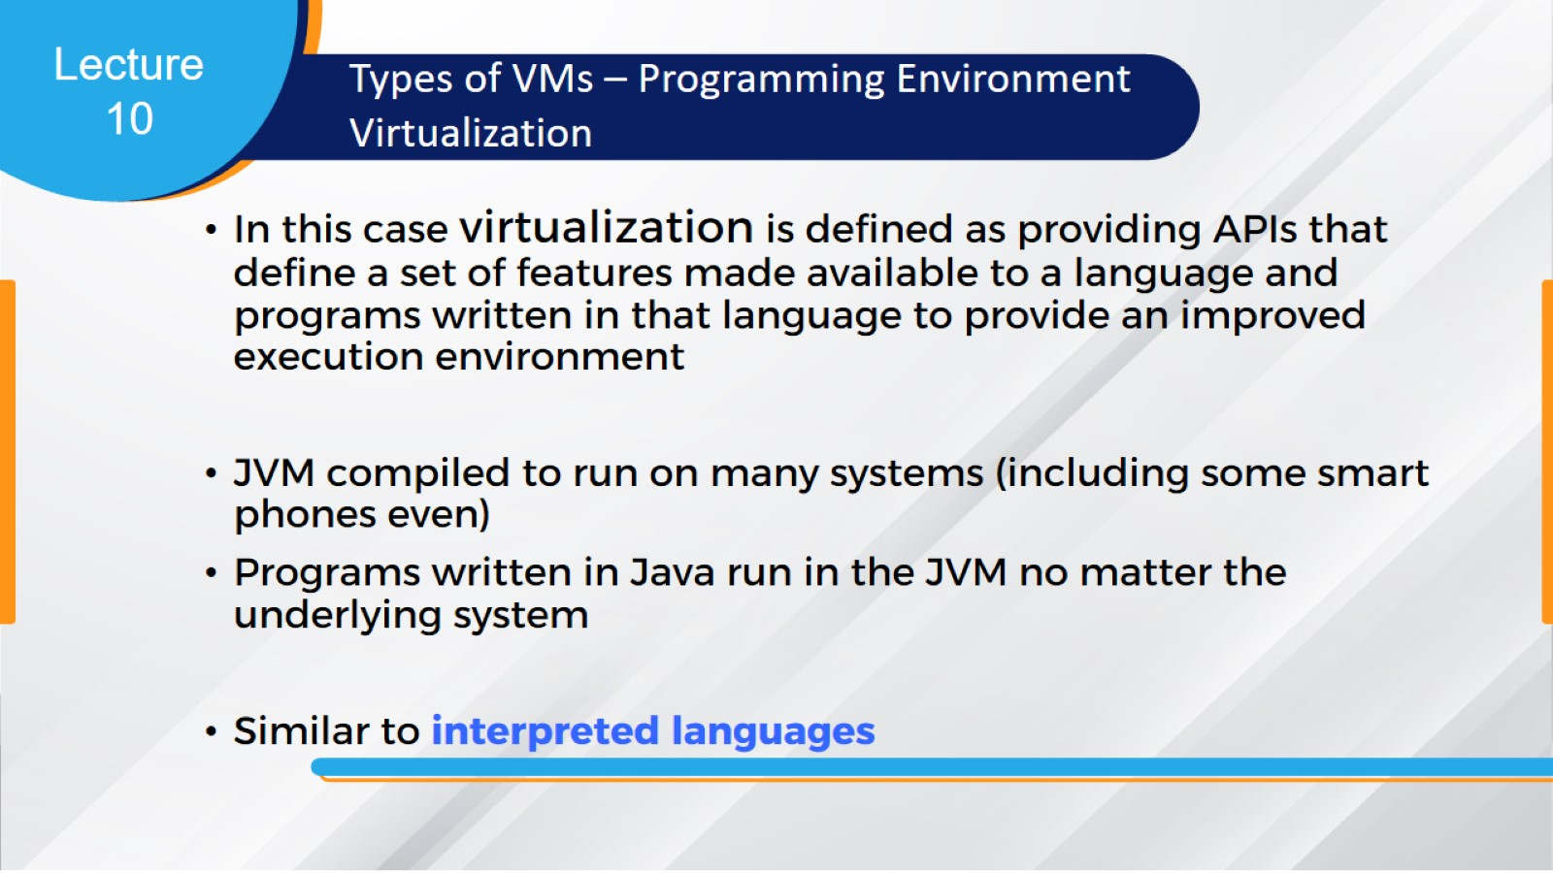

Slide 24
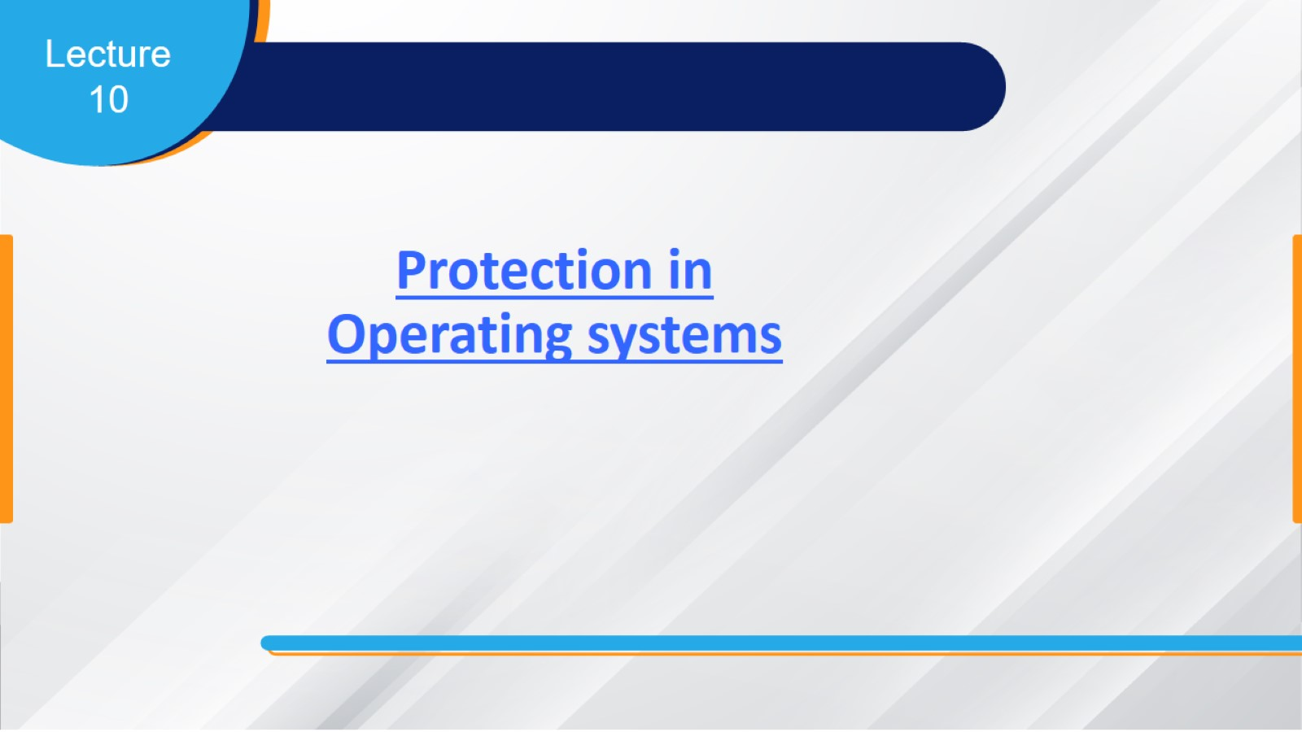

Slide 25
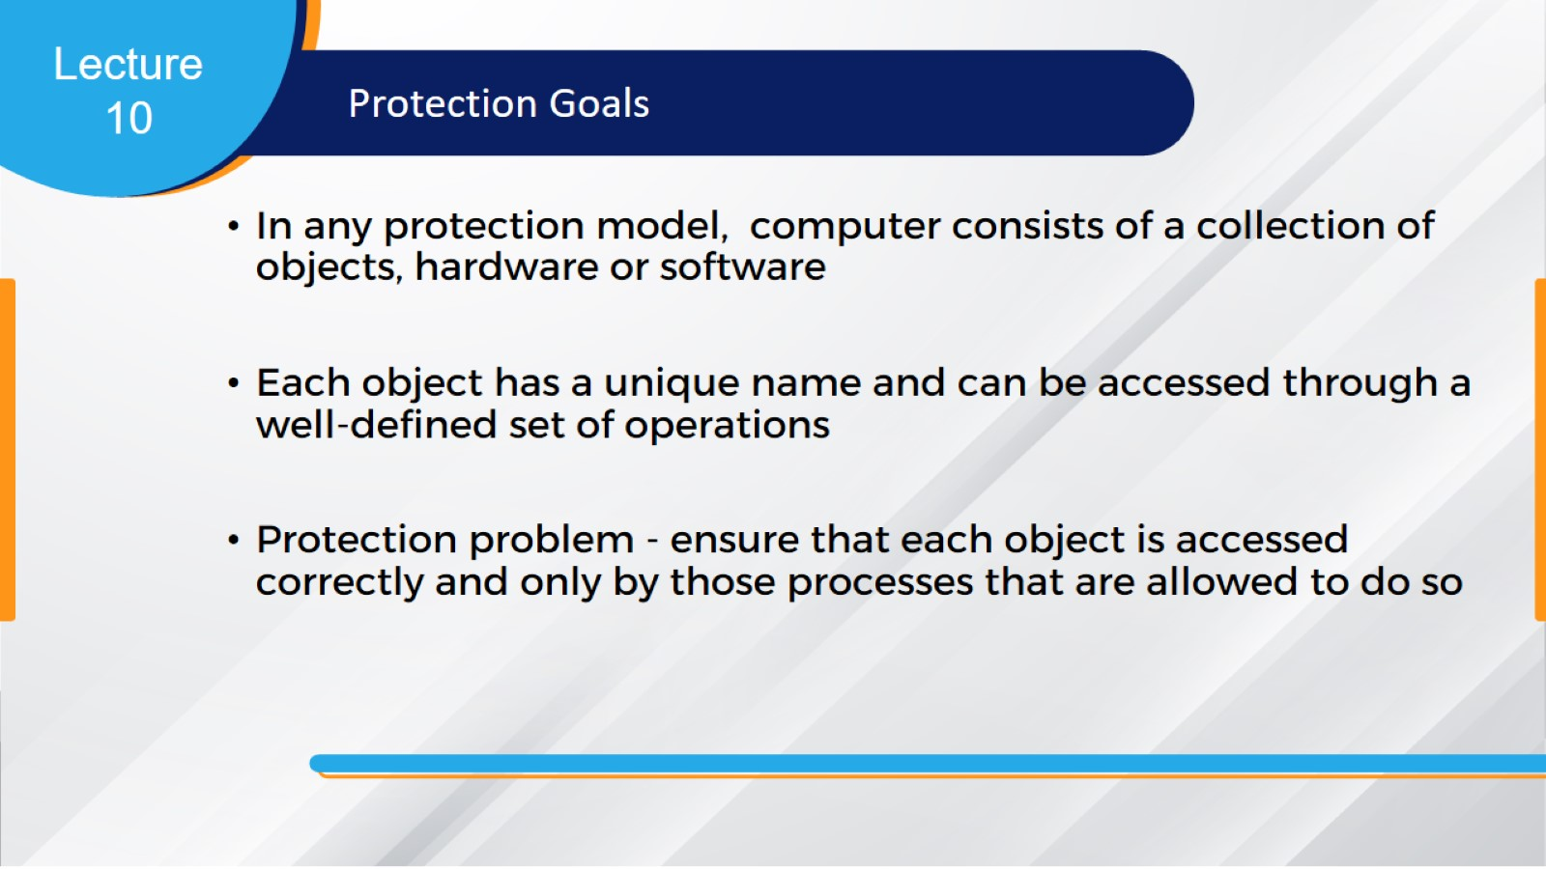

Slide 26
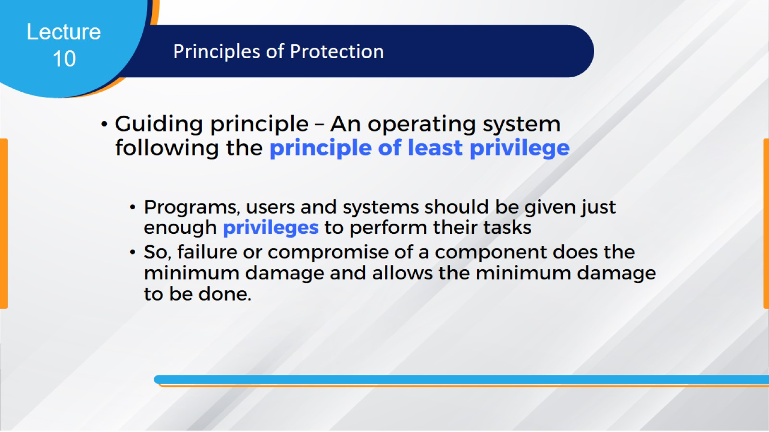

Slide 27
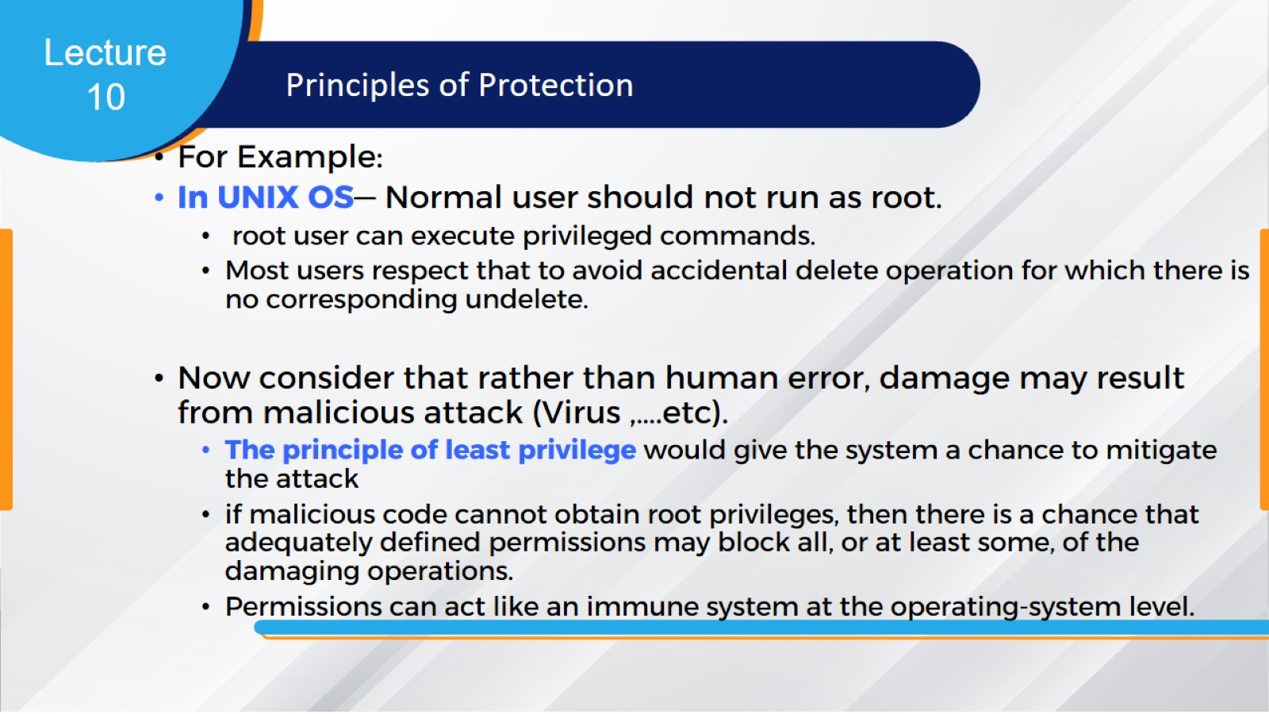

Slide 28
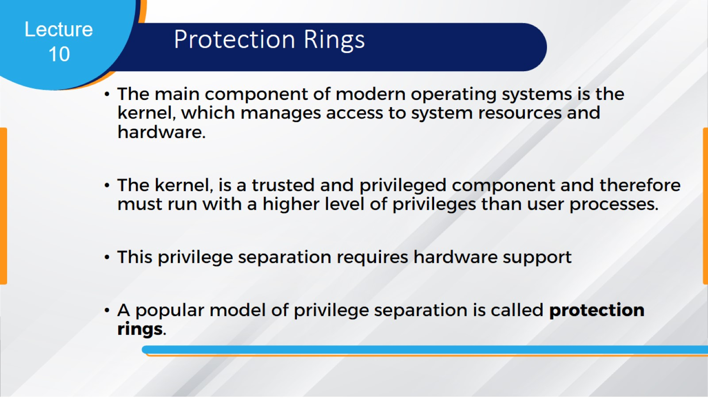
Protection Rings

Slide 29
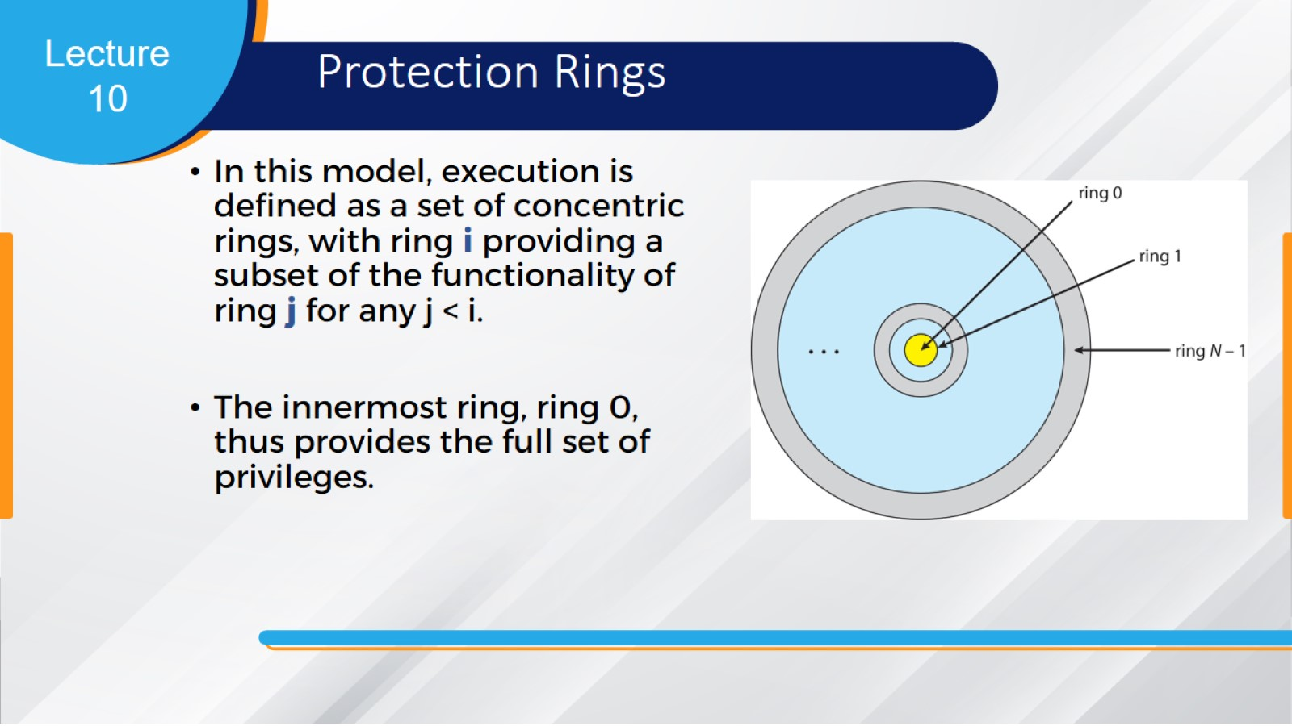
Protection Rings

Slide 30
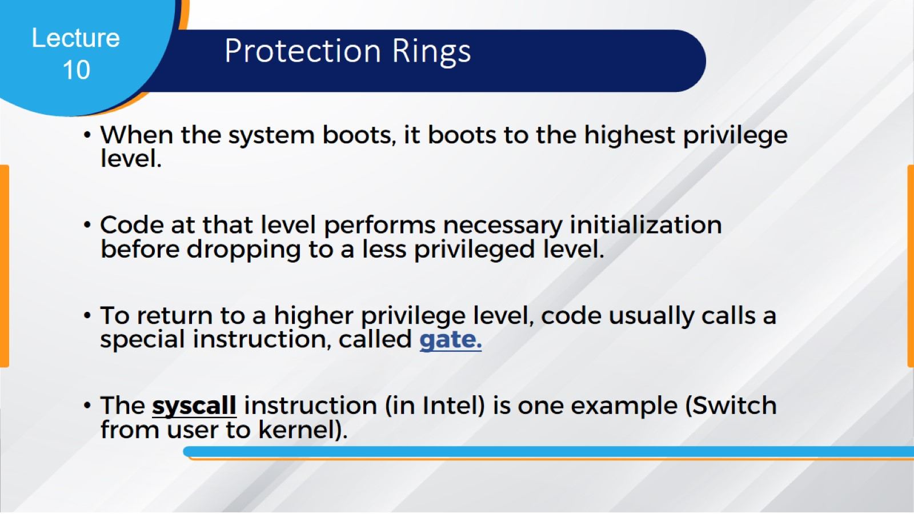
Protection Rings

Slide 31
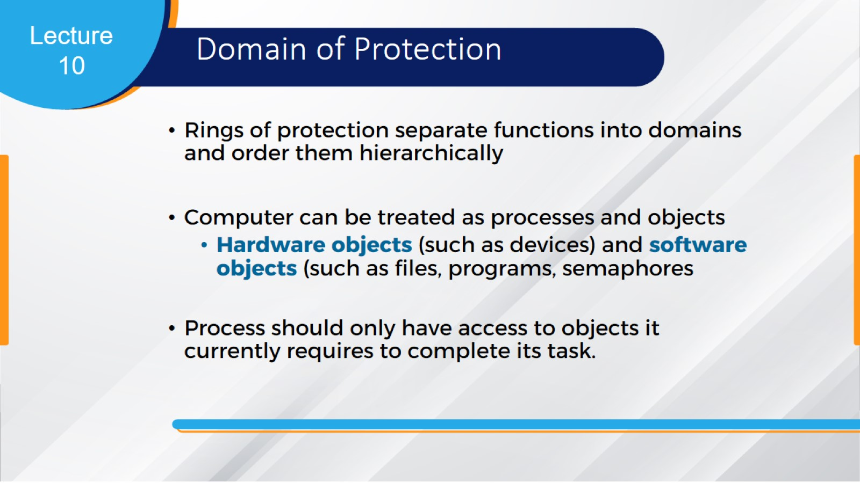
Domain of Protection

Slide 32
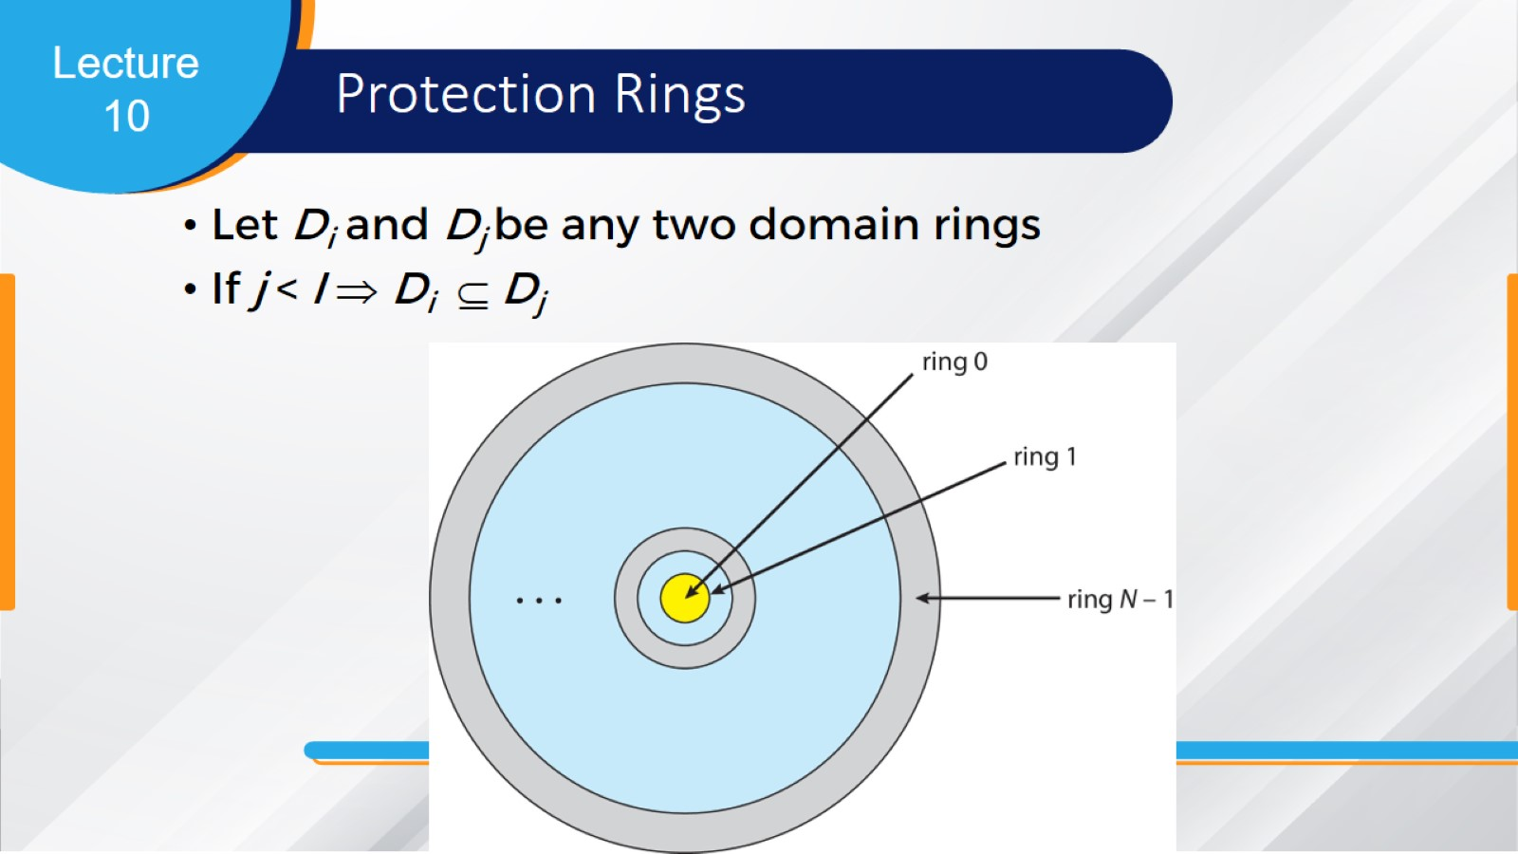
Protection Rings

Slide 33
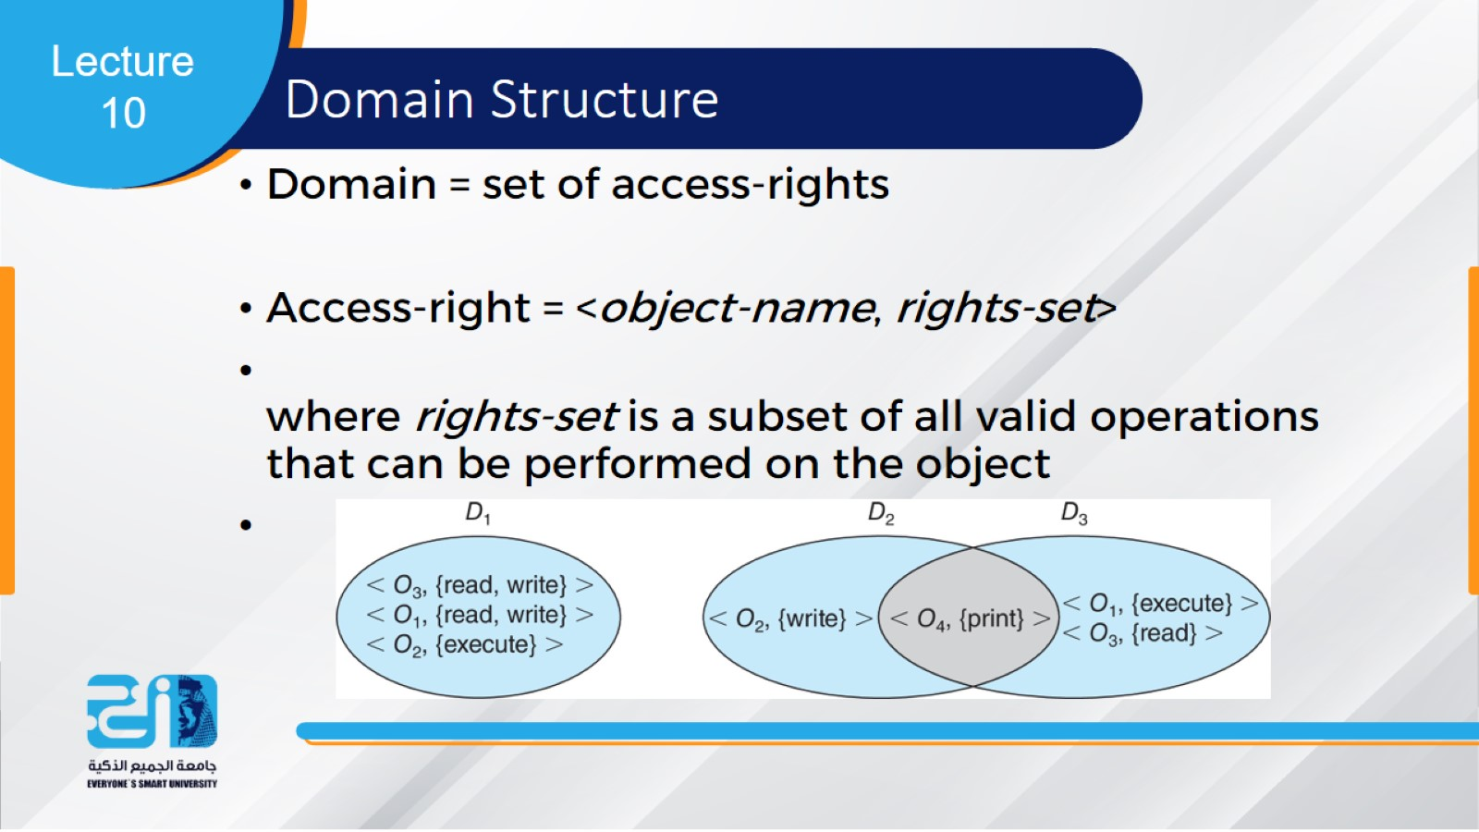
Domain Structure

Slide 34
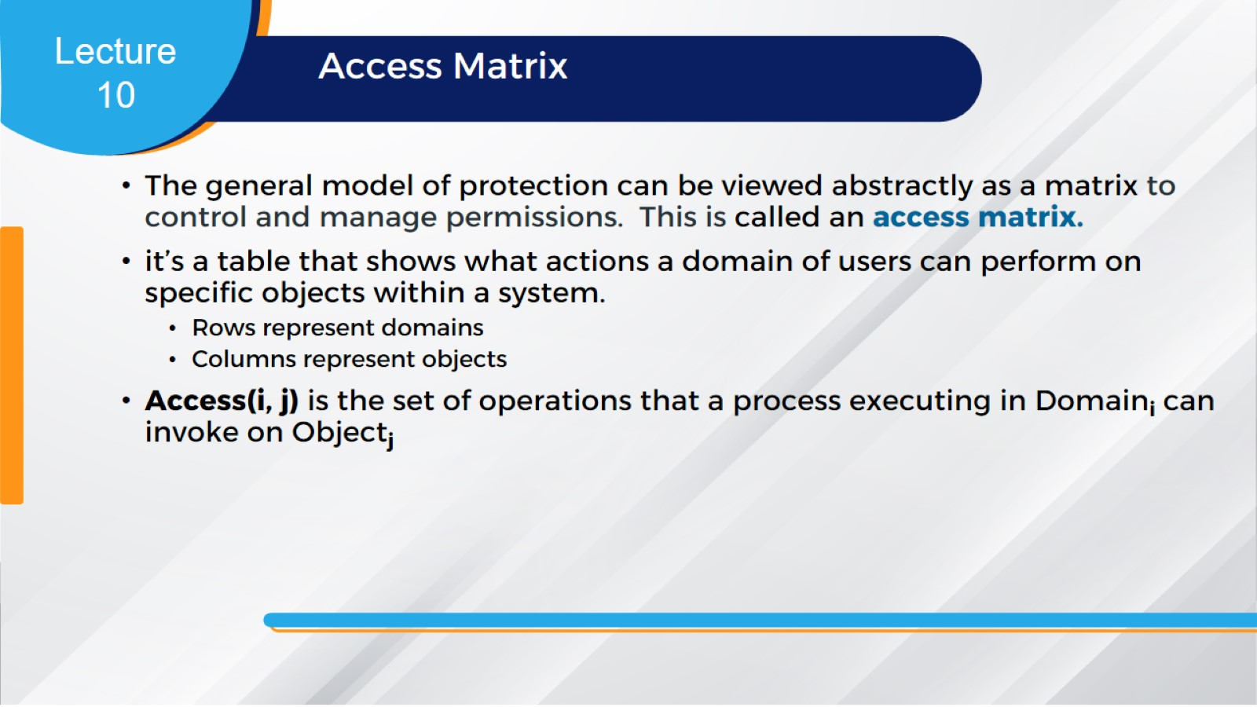
Access Matrix

Slide 35
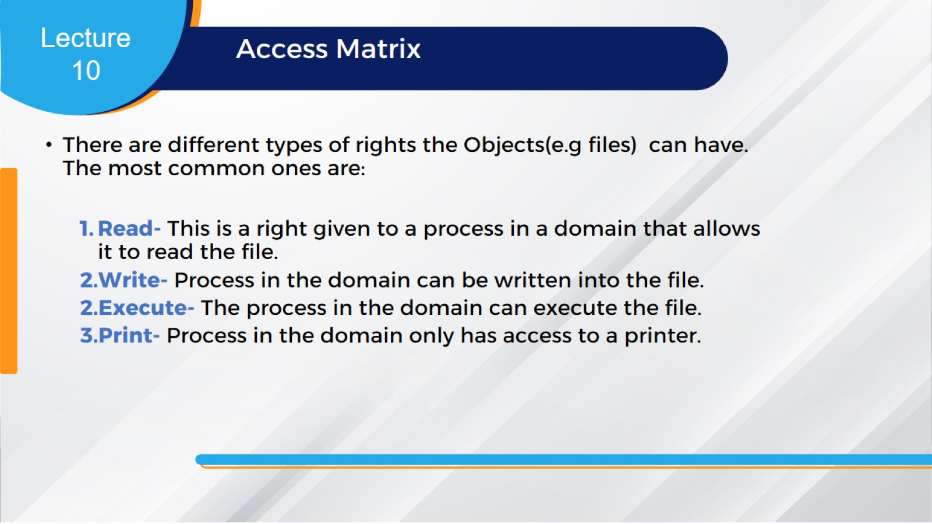
Access Matrix

Slide 36
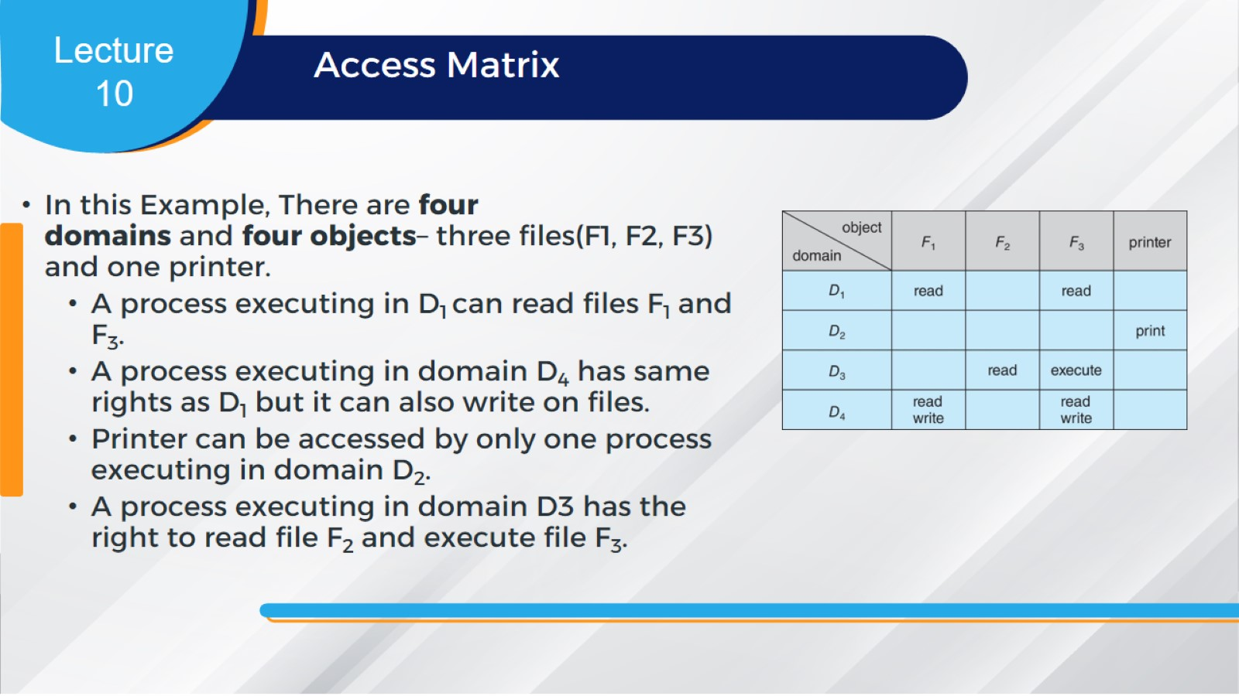
Access Matrix

Slide 37
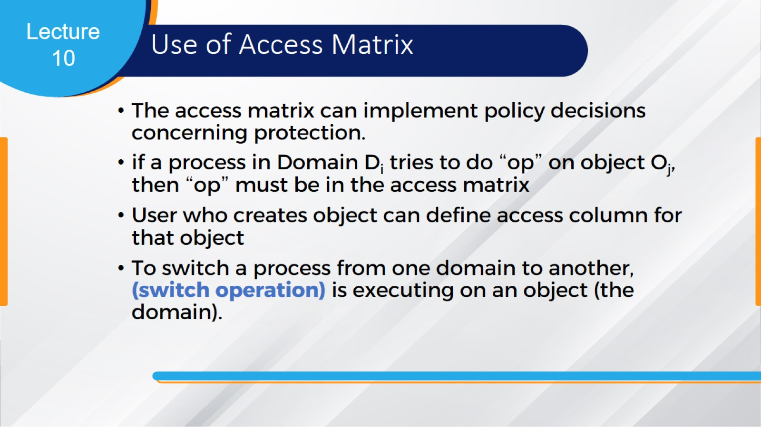
Use of Access Matrix

Slide 38
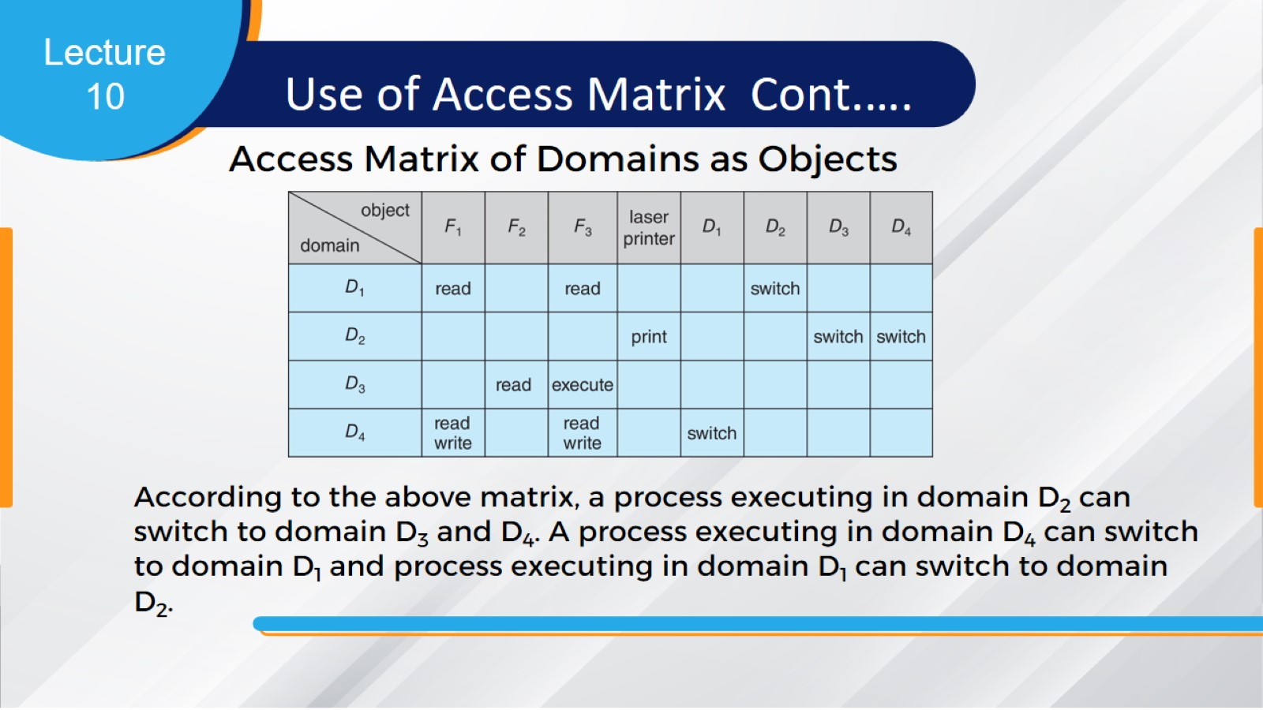
Access Matrix of Domains as Objects

Slide 39
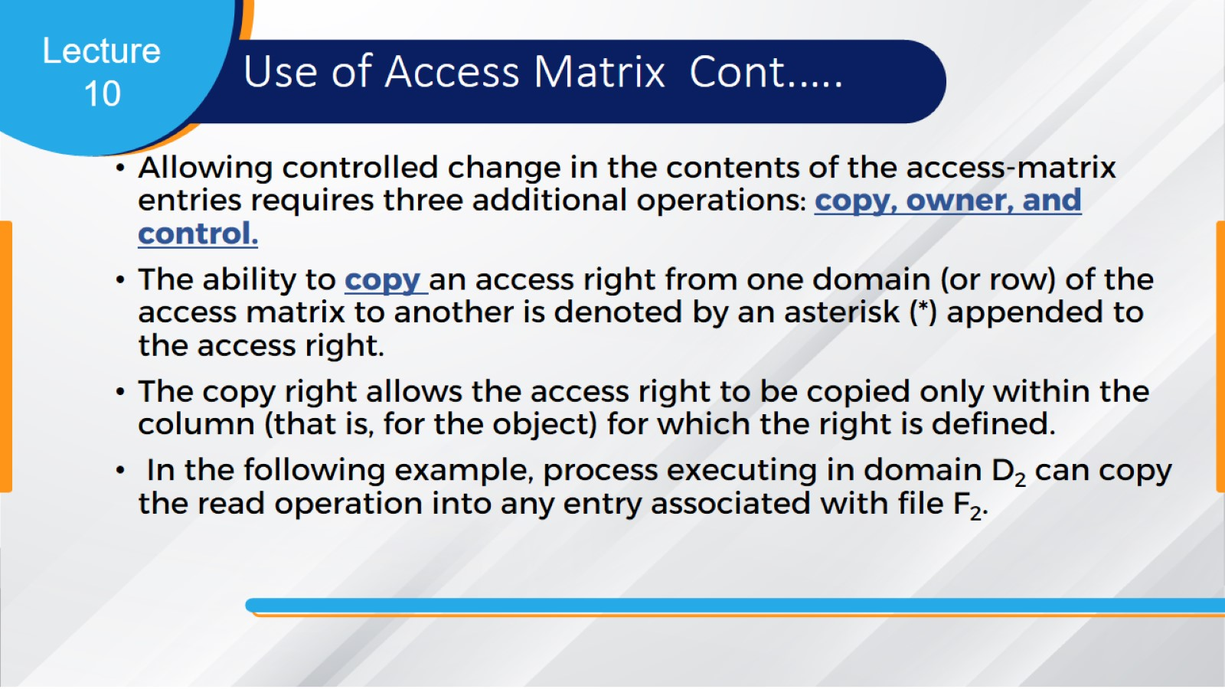
Use of Access Matrix Cont.….

Slide 40
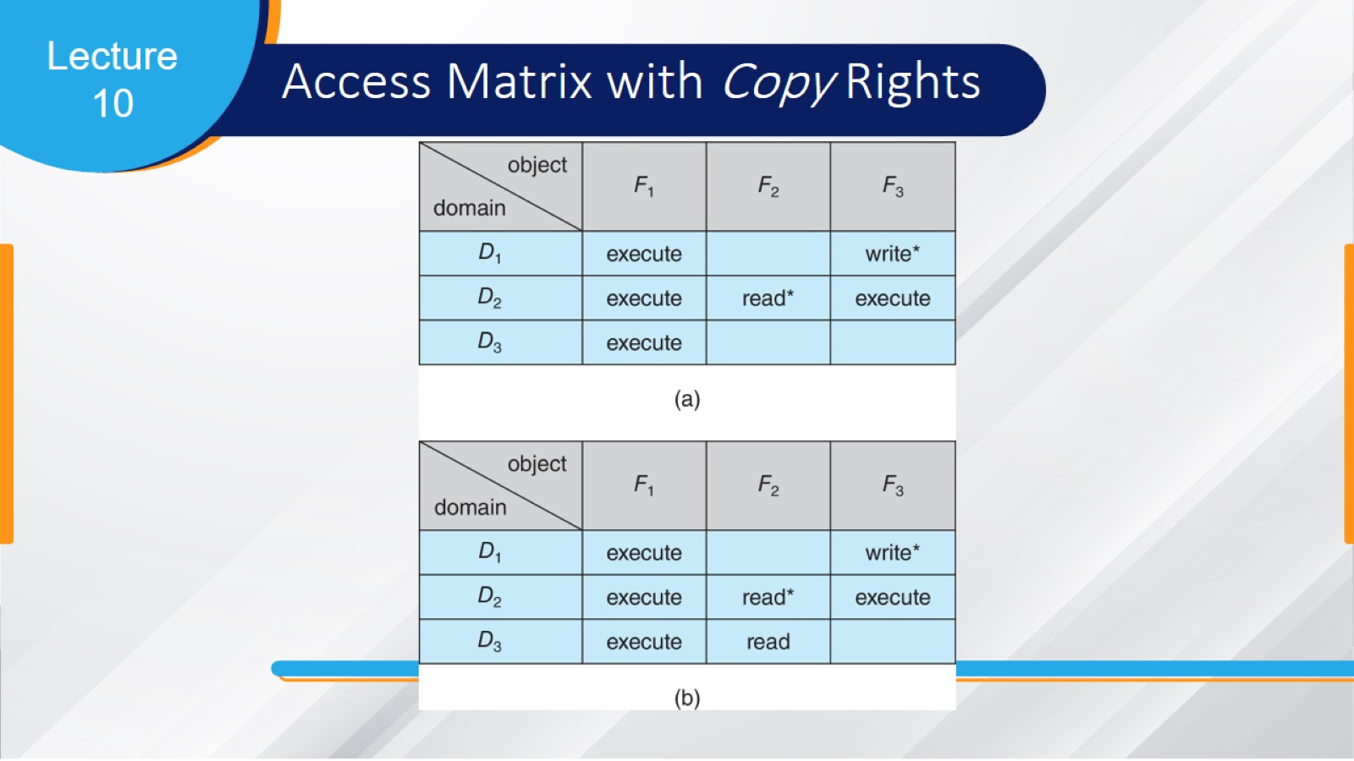
Access Matrix with Copy Rights

Slide 41
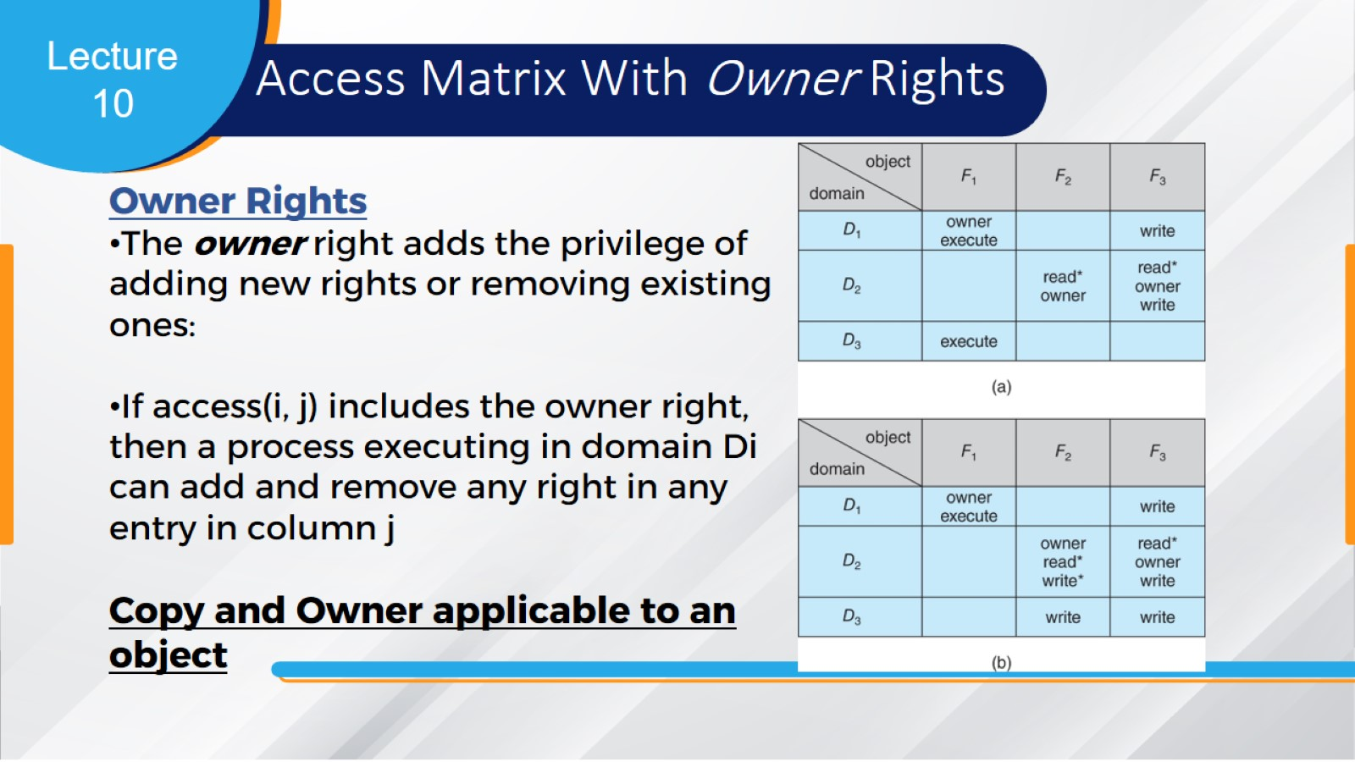
Access Matrix With Owner Rights

Slide 42
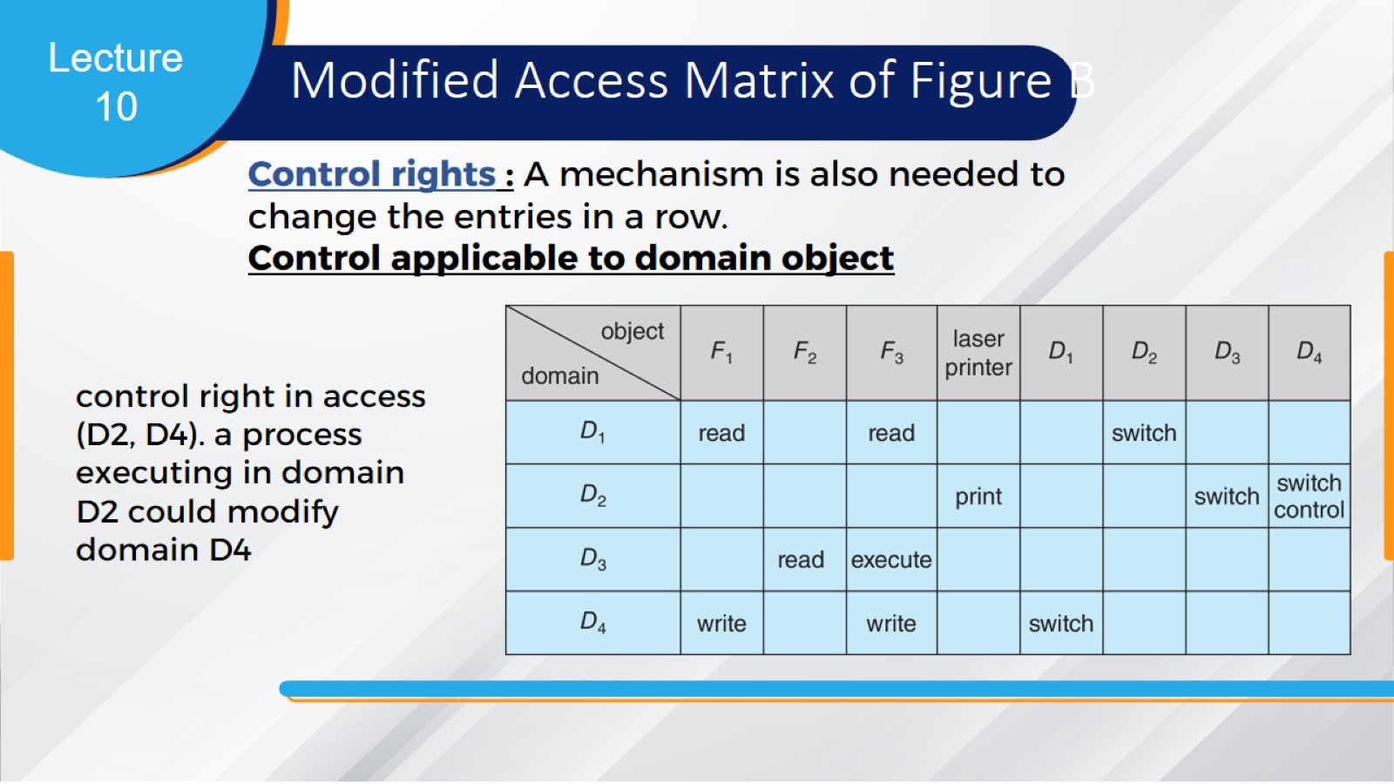
Modified Access Matrix of Figure B

Slide 43
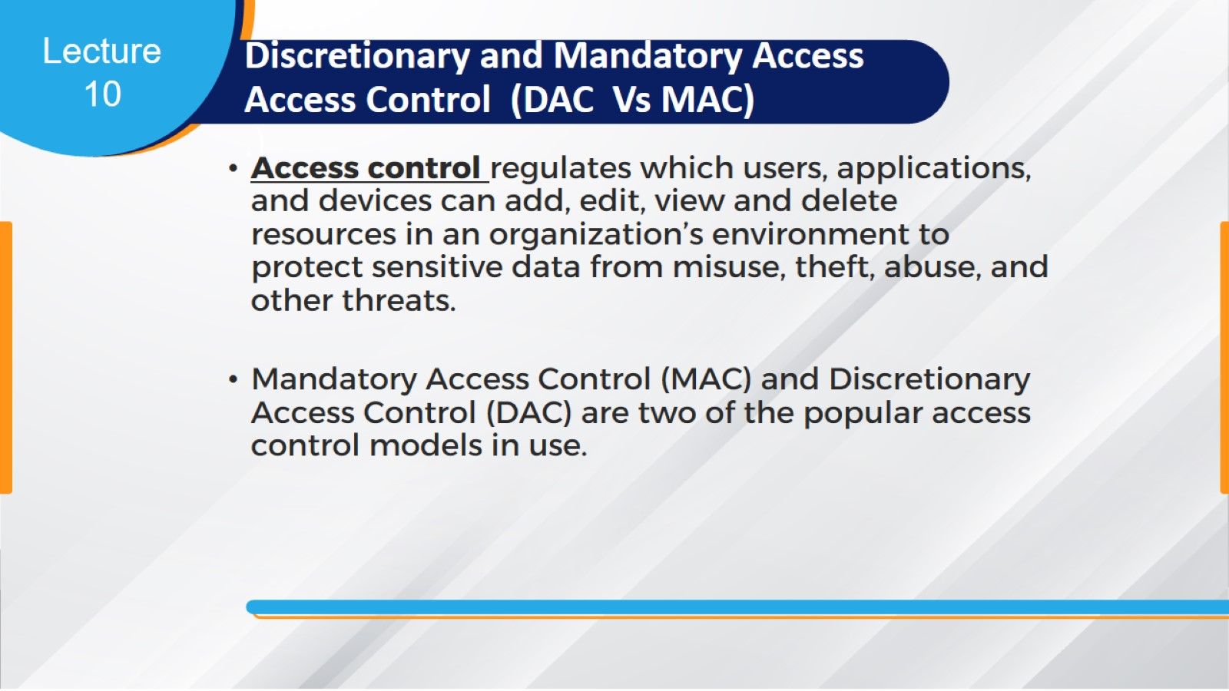
Discretionary and Mandatory Access Access Control (DAC Vs MAC)
.)

Slide 44
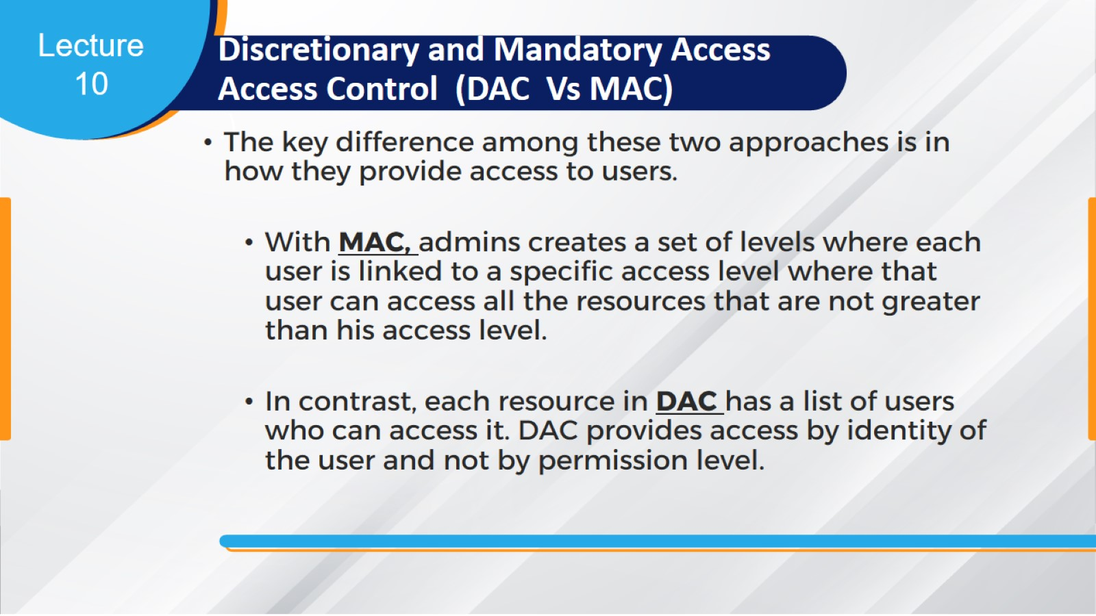
Discretionary and Mandatory Access Access Control (DAC Vs MAC)
.)

Slide 45
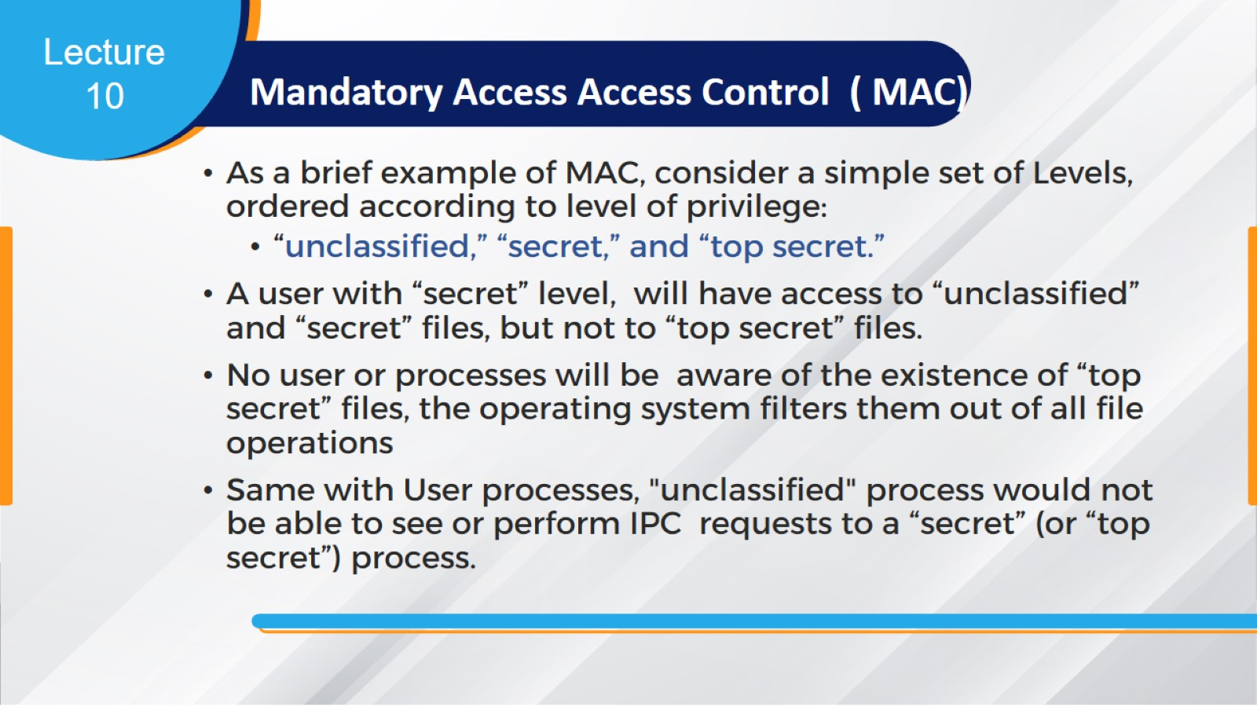
Mandatory Access Access Control ( MAC)

Slide 46
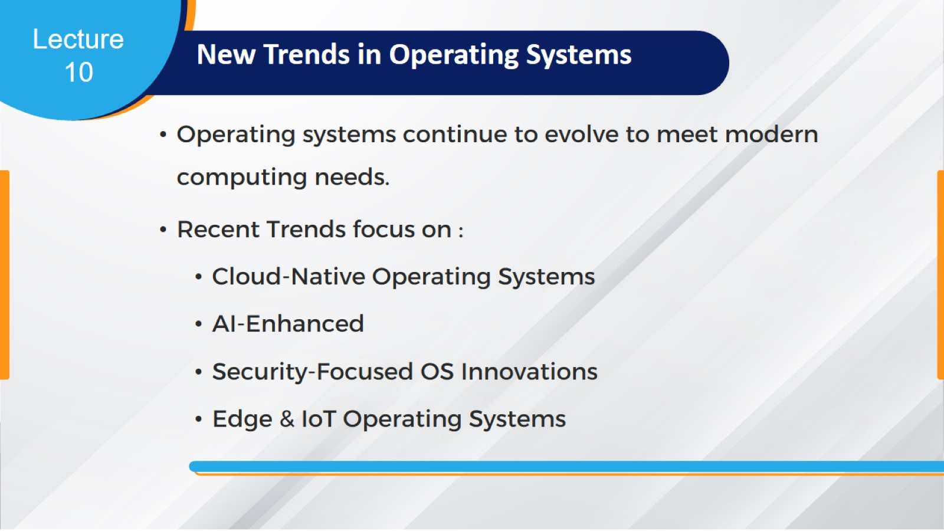
New Trends in Operating Systems

Slide 47
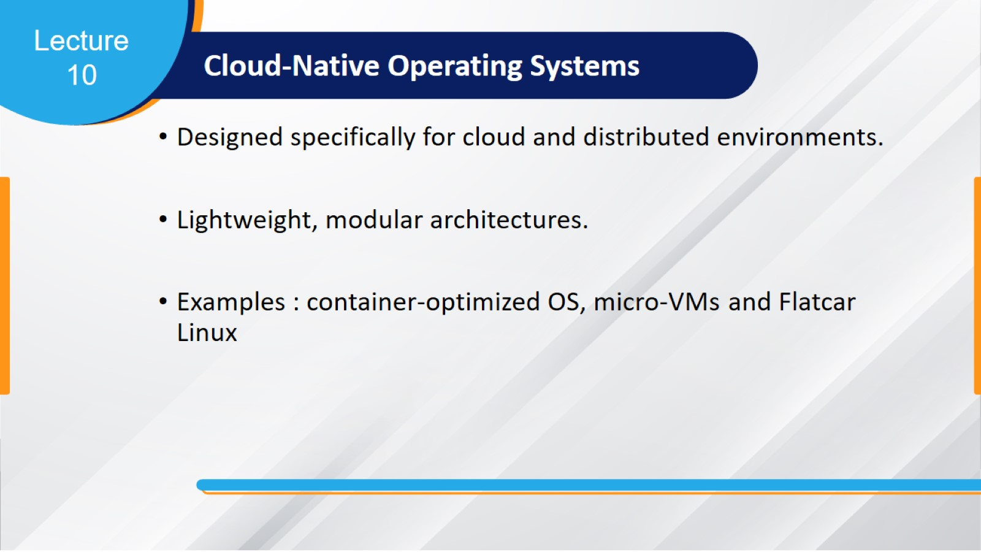
Cloud‑Native Operating Systems

Slide 48
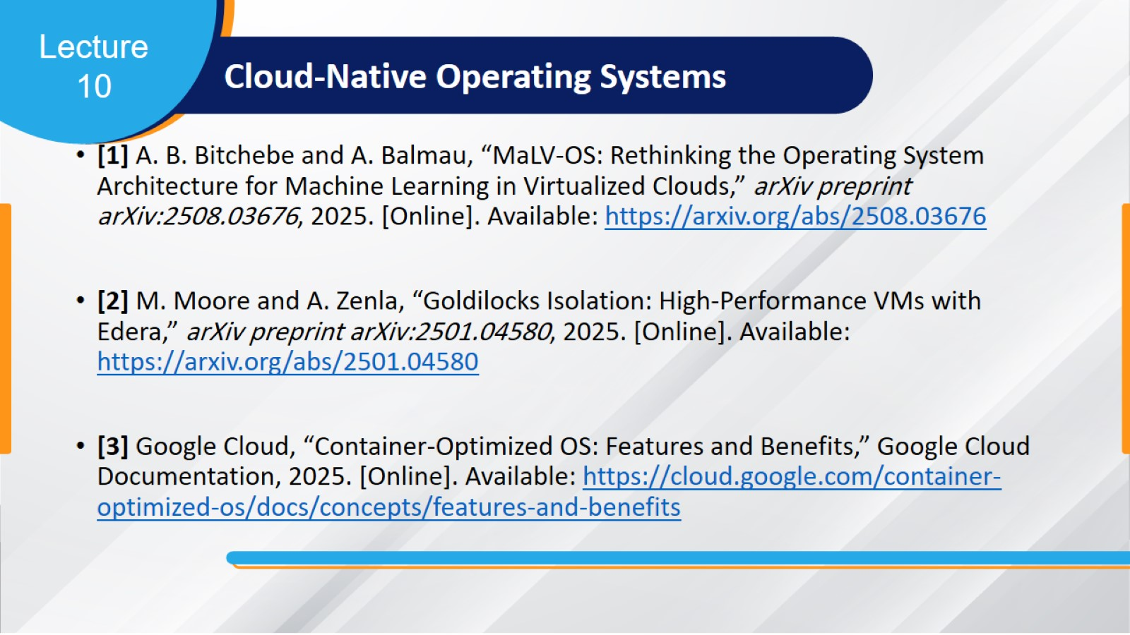
Cloud‑Native Operating Systems

Slide 49
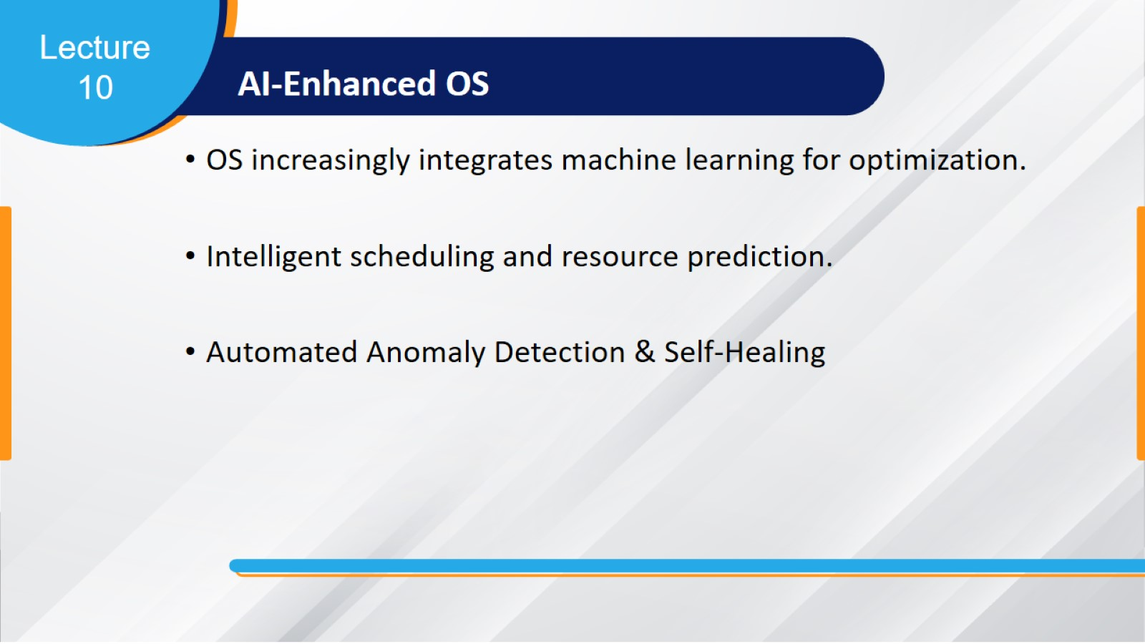
AI‑Enhanced OS

Slide 50
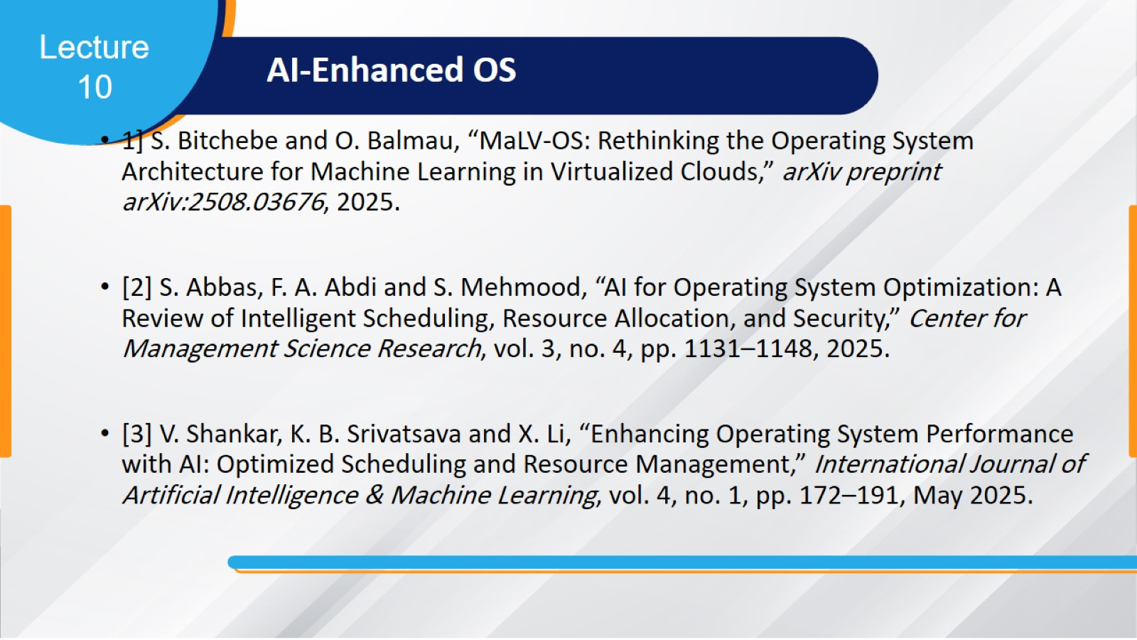
AI‑Enhanced OS

Slide 51

Security‑Focused OS Innovations

Slide 52

Security‑Focused OS Innovations

Slide 53
Security‑Focused OS Innovations

Slide 54

Edge & IoT Operating Systems

Slide 55

Edge & IoT Operating Systems

Slide 56

Overall View of Modern Trends in OSs

Slide 57


