Slide 1


DIGITAL MARKETING
APPLICATIONS
Prepared by Dr. HEBA ZIAD
COURSE CODE - MKT720
lecture 7

Slide 2
DELIVERING THE DIGITAL CUSTOMER EXPERIENCE
Chapter at a glance
Main topics
Planning websites, app design and redesign projects
Initiation of a digital experience project
Defining site or app requirements
Designing the user experience
COURSE CODE - MKT720
Lecture 7

Slide 3

What is a digital customer experience?
Digital customer experience refers to all customer interactions with your brand. An example of this can be a prospect visiting your website, interacting with your brand on social media, reading an email, or even using the mobile app.
A digital customer experience is measured as a whole, and what matters, in the end, is the perception customers take away about your brand. So, here are a few questions you must ask yourself to ensure you get the digital customer experience right:
How is it to place an order on a website or fill out a contact form? Is it bothersome or smooth?
How much time does it take for your website to load?
How do you come across on social media? Do you respond to questions on time and respond to comments?
How often do customers open your emails? Do they frequently unsubscribe to your newsletters?
Digital customer experience A brand's total digital experience includes a brand's presence on different platforms including desktop website, mobile site and apps, ads on gaming platforms and digital in-store. The quality of digital experience is based on the combination of rational and emotional factors of using a company's online services that influences customers' perceptions of a brand online.

Slide 4

Creating effective digital experiences Given the popularity of digital devices for finding out about brands and services, improving the capability to create and maintain these effective online brand presences is a key part digital marketing.
'Effective' also means the presence must support and add value to the brand to the results for the company.
Conversion rate optimization (CRO) is increasingly being used by companies to improve the commercial contribution of online presence to a business
A good site should always begin with the user.
Understand who the customer is,
how they use the channel to shop,
and understand how the marketplace works in that category.
This includes understanding who your competitors are and how they operate online. You need continuous research, feedback and usability testing to continue to monitor and evolve the customer experience online. Customers want convenience and ease of ordering. They want a site that is quick to download, well-structured and easy to navigate
Conversion rate optimization (CRO) Improving the commercial returns from a transactional site through increasing conversion to key goals such as sales, quotes, bookings or leads.
CRO combines customer and competitor research with evaluation of customer behavior using web analytics and AB and multivariate testing

Slide 5
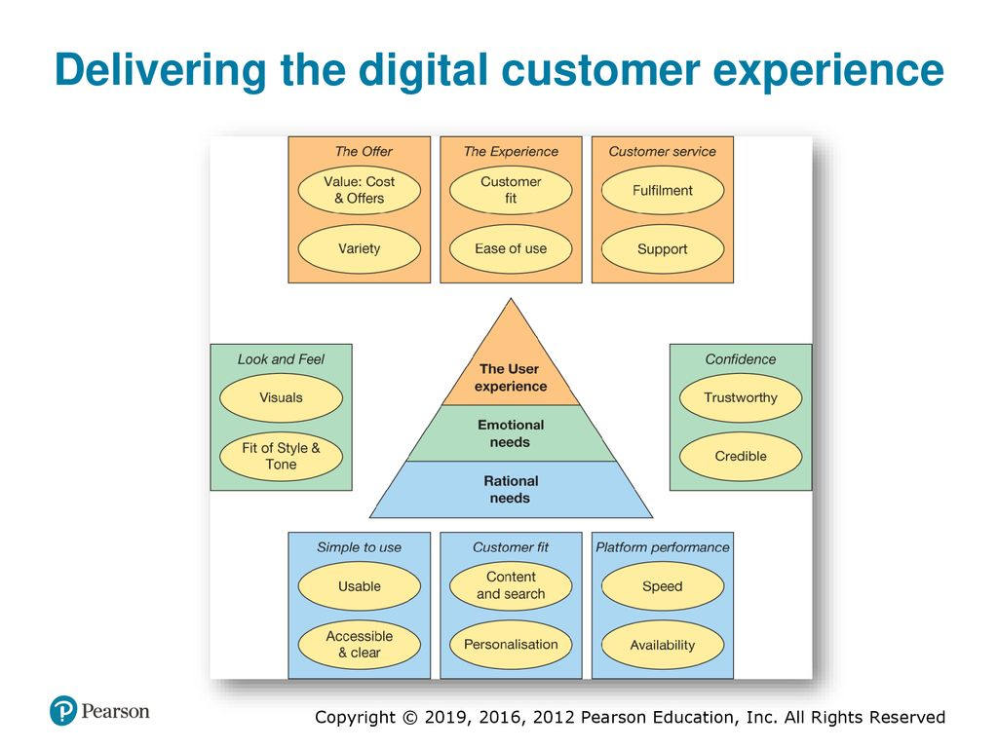


You can see that creating effective online experiences is a challenge since there are many practical issues to consider,
This is based on a diagram suggested that delivering the online experience promised by a brand requires delivering rational values, emotional values and promised experience (based on rational and emotional values).
The factors that influence the online customer experience can be presented in a pyramid form of success factors, as is shown in Figure. The diagram also highlights the importance of delivering service-quality online,

Slide 6

This analysis was performed across five dimensions of brand equity, assessed by asking the questions below - they provide an excellent framework that can be applied to assess and benchmark the quality of brand experience for different types of website:
1 Emotional connection
Q1: I feel related to the type of people who are (X]'s customers.
Q2: I feel as though [X] actually cares about me.
Q3: I feel as though [X] really understands me.
2 Online experience
Q4: [X]'s website provides easy-to-follow search paths.
O5: I never feel lost when navigating through [X]'s website.
Q6: I was able to obtain the information I wanted without any delay.
3 Responsive service nature
Q7: [X] is willing and ready to respond to customer needs.
O8: [X]'s website gives visitors the opportunity to 'talk back' to [X].
4 Trust
Q9: I trust [X] to keep my personal information safe.
Q10: I feel safe in my transactions with [X].
5 Fulfillment
Q11: I got what I ordered from [X]'s website.
Q12: The product was delivered in the time promised by [X].

Slide 7
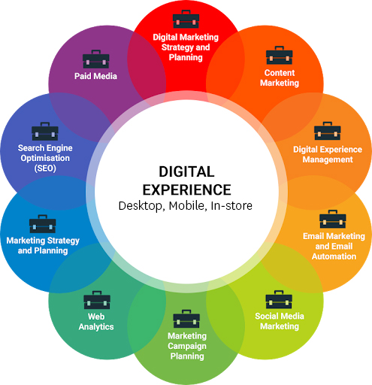
In the context of customer experience management (CXM) is limited. there remains a need for both theoretical and conceptual development, and empirical research to determine which digital CX strategies and practices have the most positive influence on organizational performance.
A digital customer experience is measured as a whole, and what matters, in the end, is the perception customers take away about your brand. So, here are a few questions you must ask yourself to ensure you get the digital customer experience right:
How is it to place an order on a website or fill out a contact form?
Is it bothersome or smooth?
How much time does it take for your website to load?
How do you come across on social media?
Do you respond to questions on time and respond to comments?
How often do customers open your emails?
Do they frequently unsubscribe to your newsletters?
Digital customer experience is the online journey your customers go through while interacting with your brand. This may include activities such as an online search for your product to understand its features, browsing through the online marketplace for reviews, enquiring about customer support or self-service portals for assistance around the service, or interaction on your mobile app.

Slide 8

Figure incorporates many of the factors that are relevant for a transactional e retail site, such as price and promotions, which together form web merchandising ,but you can see that many of the rational and emotional values are important to any website. You may not be familiar with some of the terms, such as 'usability" and‘ accessibility (which are delivered through an effective website design),
.In Figure these factors are all associated with using the website, but the online customer experience extends beyond this, so effective designs are based on integrating with the entire customer journey for different audiences and different scenarios to achieve the best result. So design of online presence also needs to look at the bigger picture:
• ease of locating the site through search engines
• services provided by partners online on other websites:
• quality of outbound communications such as e-newsletters;
• quality of processing inbound email communications from customers communications and touchpoints such as store and phone as part

Slide 9

Despite the growth in social media, the company website, which today must be effective for users accessing via desktop, smartphone and tablet devices, is still at the heart of online communications.
For the experience to be effective, a sound process is needed to design, build and refresh the online experience. In the past, it has been a common mistake among those creating a new website for the first time to 'dive in' and start creative design and content creation without sufficient forward planning. This is still a risk today, but new website design and build projects for existing businesses are less common, although still needed for new startups, new brands or new campaigns. Instead, what has become more common are website redesigns and relaunches and the continuous approach of conversion rate optimization.
This change in emphasis is illustrated by many larger businesses in the retail sector, which now have teams to continuously boost conversion rates.
Customer journey A description of modern multi channel buyer behavior as consumers use different media to select suppliers, make purchases and gain customer support
Web merchandising The aim of web merchandising is to maximize the sales potential of an online store for each visitor. This means connecting the right products with the right offer to the right visitor, and remembering that the online store is part of a broader experience including online and offline advertising, in-store visits, customer service and delivery.

Slide 10
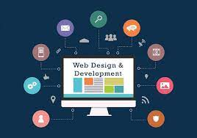
the design and optimization process involves analyzing the needs of owners and users of a site and then deciding on the best way to build the site to fulfil these needs.
Without a structured plan and careful design, costly reworking is inevitable, as the first version of a site will not achieve the needs of the end users or the business.
The process of website development summarized is idealized because, for efficiency, many of these activities have to occur in parallel.
The main development tasks that need to be scheduled as part of the planning process for any digital experience are as follows:
1 Pre-development tasks. For a new site or app, these include domain name registration and deciding on the company to host the website. They also include preparing a brief that sets out the aims and objectives of the site, and then - if it is intended to outsource the site - presenting the brief to rival agencies to bid for and pitch their offering.

Slide 11
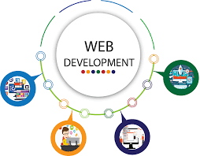
2 Discovery, analysis and design. This is a research phase involving detailed analysis a design of the site, and includes clarification of business objectives, market research identify the audience and typical customer personas and user journeys and their nee defining the information architecture of different content types and prototyping differ functional and visual designs to support the brand.
3 Content creation, coding or development and testing. Developing the site to create prototypes including integration of content management systems, database integrate usability and performance testing.
4 Publishing or launching the site or improvement. This is a relatively short stage, involve releases of different versions of an application or website update,. Often a soft launch is used, where the site is updated bi the version is not widely communicated until the owners are sure the site is stable. Son site owners such as Google test features with a limited number of users to assess the impact before the features are rolled out more widely.

Slide 12

5 Pre-launch promotion or communications. Search engine registration and optimization is most important for new sites. Although search engines can readily index a new site they don't give the same level of visibility to new sites (sometimes known as 'the Google sandbox effect), where the site is effectively on trial until it is established with links from other sites indicating its credibility: Briefing the PR company to publicize the launch another example of pre-launch promotion.:
6 Ongoing promotion. The schedule should also allow for promotion after site launch. This might involve structured discount promotions on the site, or competitions that are planned in advance. Many now consider search engine optimization, content marketing and pay-per-click marketing as a continuous, 'always-on' process, and will often employ a third party to help achieve this.

Slide 13
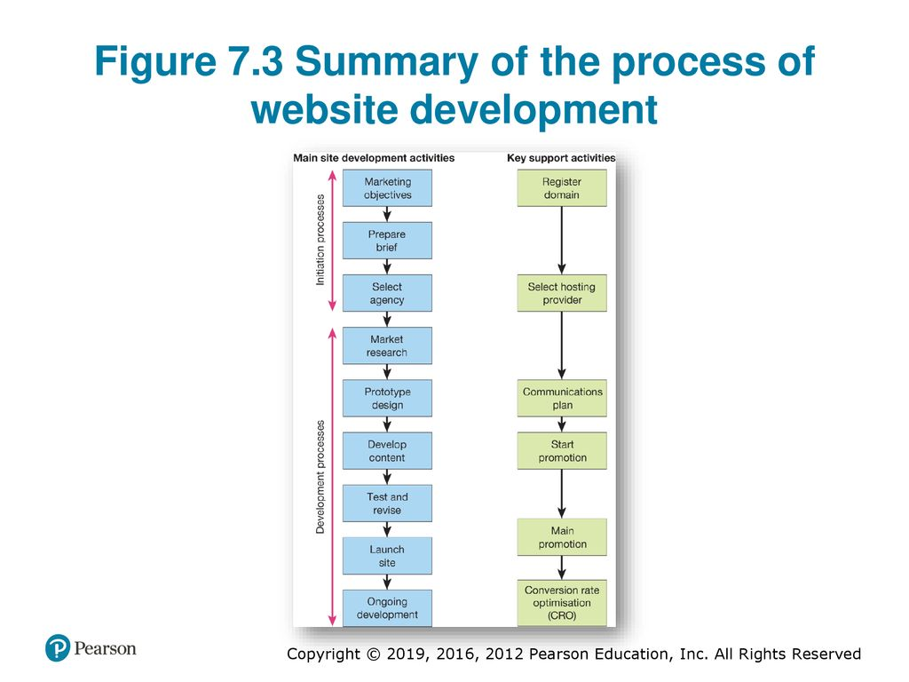
7 Ongoing development. It used to be common place for there to be a time gap of several years between major website redesigns involving new layout and typography. Although content relating to products, services and promotions would be updated, the layout of page templates remained static. Increased adoption of CRO, means that the process of 1 to 5 is repeated between major updates using an agile development process,
It's important to realize that Figure is a simplification of real-world optimization approaches. In reality, iteration of designs using agile development or prototyping is required. Then, once a working version is finalized, it should be tested through user testing and then live testing using CRO including the AB/multivariate testing approaches

Slide 14
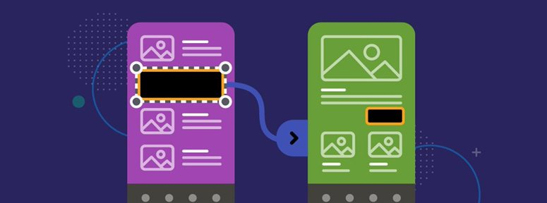
Prototyping
Prototypes are trial versions of an entire website or a part of the site being refined that are gradually refined through an iterative process to become closer to the final version. Initial prototypes or 'mockups' may simply be paper prototypes or storyboards, perhaps of a 'wireframe' or screen layout. These may then be extended to include visuals of key static pages. Finally, working prototypes will be produced as HTML code is developed.
The idea is that the design agency or development team and the marketing staff who commissioned the work can review and comment on prototypes, and changes can then be made to the site to incorporate these comments. Prototyping should result in a more effective final site that can be developed more rapidly than a more traditional approach with a long period of requirements determination.
Each iteration of the prototype typically passes through the stages which are:
Discovery or analysis. Understanding the requirements of the audience of the site and the requirements of the business, defined by business and marketing strategy (and comments input from previous prototypes).
Design. Specifying different features of the site that will fulfil the requirements of the users and the business as identified during analysis.
Develop. The creation of the web pages and the dynamic content of the website.
Test and review. Structured checks conducted to ensure that different aspects of the site meet the original requirements and work correctly.
Wireframe A simplified outline of a single-page template used to define new layout or functionality for part of a website for discussion, iteration and then a brief for implementation.
Soft launch A trial version of a site, launched with limited publicity.

Slide 15

Today, the concept of prototyping has been extended across the whole lifecycle for developing website functionality or software applications, where it is known as agile software development.
The goal of agile development is to be able to create stable releases more frequently than traditional development methodologies, i.e. new functionality will be introduced through several releases each month rather than a more significant release every few weeks, months or even years.
The approach is sometimes known as 'permanent beta'.
Another difference with agile development is the emphasis on face-to-face communication to define requirements rather than detailed requirements specifications.
Prototype A preliminary version of part, or a framework of all, of a website, which can be reviewed by its target audience or the marketing team. Prototyping is an iterative process in which website users suggest modifications before further prototypes and the final version of the site are developed.
Agile software development An iterative approach to developing software and website functionality with the emphasis on face-to-face communications to elicit, define and test requirements. Each iteration is effectively a mini-software project including stages of planning, requirements analysis, design, coding, testing and documentation.

Slide 16
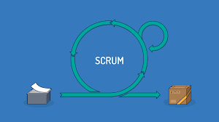
Scrum is a methodology that supports agile software development.
Scrum uses an iterative, incremental approach when delivering products to optimize predictability and control risk, and is built on the theory of empiricism.
Empiricism means that knowledge comes from experience and decisions are made based on information available at the time.
There are three pillars that support the theory of empiricism:
Transparency: Key aspects of the process must be visible to those responsible for the outcome.
Inspection: Timely and frequent inspections take place to detect unwanted variances.
Adaptation: Unacceptable variances trigger a change in the process to minimize further deviation.
Empiricism and its three pillars are underpinned by five Scrum values:
*Commitment * Courage *Focus *Openness *Respect
The idea is that working in a consistent way with the courage to learn and adapt helps to foster a culture of continuous improvement and trust.
Scrum is a methodology that supports agile software development based on 15-30-day sprints to implement features from a product backlog. 'Scrum' refers to a daily project status meeting during the sprint.

Slide 17
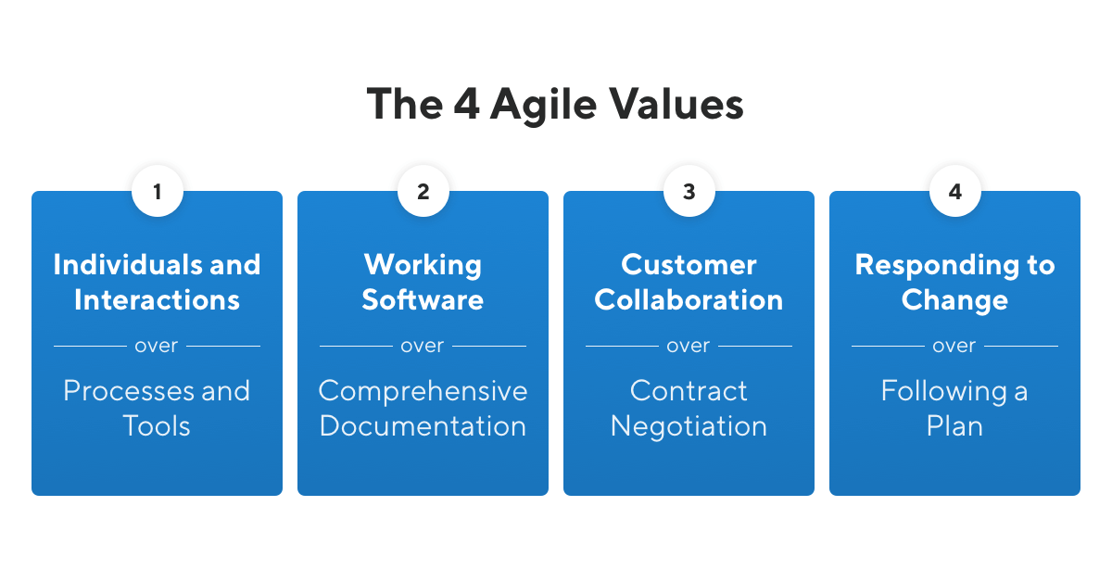
The Agile Manifesto is useful in illustrating the principles of agile programming that contrast with traditional approaches. The text of the manifesto is :We are uncovering better ways of developing software by doing it and helping others it. Through this work we have come to value:
• individuals and interactions over processes and tools;
• working software over comprehensive documentation;
• customer collaboration over contract negotiation;
• responding to change over following a plan
The Agile Manifesto is a document that sets out the key values and principles behind the Agile philosophy and serves to help development teams work more efficiently and sustainably.

Slide 18
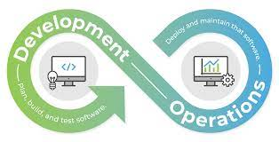
Closely related to the agile approach is restructuring using the DevOps approach.
An approach to development of systems that involves a more collaborative and closer relationship between development and operations teams with the aim of reducing deployment times and frequency of system updates and improving their stability.
The specific goals of a DevOps approach span the entire delivery pipeline, they include improved deployment frequency, which can lead to faster time to market, lower failure rate of new releases, shortened lead time between fixes, and faster mean time to recovery in the event of a new release crashing or otherwise disabling the current system. Simple processes become increasingly programmable and dynamic using a DevOps approach, which aims to maximize the predictability, efficiency, security and maintainability of operational processes.
DevOps is an approach to software development that enables teams to build, test, and release software faster and more reliably by incorporating agile principles and practices, such as increased automation and improved collaboration between development and operations teams. Development, testing, and deployment occur in

Slide 19

Growth hacking Recently, the concept of growth hacking has developed as a way of supporting the profitable growth of businesses through using an agile approach.
Growth hackers are a hybrid of marketer and coder, one who looks at the traditional question of 'How do I get customers for my product?' and answers with A/B tests, landing pages, viral factor, email deliverability, and Open Graph. On top of this, they layer the discipline of direct marketing, with its emphasis on quantitative measurement, scenario modelling via spreadsheets, and a lot of database queries.
How Can a Growth Hacker Benefit Your Business?
Bringing on board a growth hacker means introducing growth hacking into your company. This can see benefits such as:
Flexibility
The discovery of new business models, or product ideas
Building brand reputation and identity
Cost-effectiveness and improved ROI
Creating a data driven culture in your company
Conversion rate optimization
Growth hacking A mindset which focuses marketing activities on increasing the scale and profitability of a business through testing and improving techniques for improving the value of audience touch points across the customer lifecycle of Reach, Interactions, Conversion and Engagement.

Slide 20

This quote shows that many of the features such as a focus on testing and learning through conversion rate optimization (CRO) are not new, it shows a change in mindset in how business transformation can be achieved. Another key feature of growth hacking is applying techniques for how to achieve viral growth through encouraging users to share their experience
Today encouraging sharing through social sign-on and social sharing is more an approach sought by growth hackers.
what to focus on and why it matters:
• Acquisition: get people in front of your product.
• Activation: provide a great initial experience.
• Engagement: keep people engaged, deliver value.
• Virility: get people to recommend your product.

Slide 21

INITIATION OF DIGITAL EXPERIENCE PROJECT
Before the analysis, design and creation of the website, all major projects will have an initial phase in which the aims and objectives of the website are reviewed, to assess whether it is worthwhile investing in the website and to decide on the amount to invest. The initiation of the website project provides a framework for the project that ensures:
• there is management and staff commitment to the project;
• objectives are clearly defined;
• the costs and benefits are reviewed in order that the appropriate amount of investment in the site occurs;
• the project will follow a structured path, with clearly identified responsibilities for different aspects such as project management, analysis, promotion and maintenance;
• the implementation phase will ensure that important aspects of the project, such as testing and promotion, are not skimped.

Slide 22
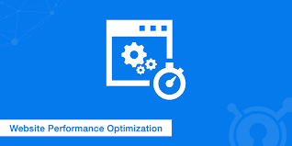
WEB SITE PERFORMANCE OPTIMIZATION
IT'S important for site, owners to recognize that page download performance is essential s success of a site, even when many users have broadband connections and sites are hosted with high bandwidth connections to the Internet . site performance has become more important with the increased adoption of smartphones, which typically have lower bandwidth connections than desktops,
the recommended average user perception of acceptable download time is two seconds, while for the average European website it is around eight seconds. Is worth noting that innovation in the protocols used for transmitting data can help site performance too.
HTTP/2 is a major revision of the HIT network protocol used by the Id Wide Web for data transfer between web browsers and servers, which is potentially and is being rolled out at the time of writing. The majority of sites are now using re "HTTPS' protocol (denoted by the padlock symbol in the browser bar). Google is encouraging sites to use https since it is more secure and it favor's secure "https:// sites when ranking sites

Slide 23
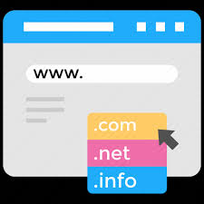
The availability of a website
is an indication of how easy it is for a user to connect to it. In theory, this figure should be 100 percent, but sometimes, for technical reasons such as failures in the server hardware or upgrades to software, the figure can drop substantially below this. Sites also need to be configured to be able to deal with increased loads at certain times,
Why is High Availability Important?
To reduce interruptions and downtime, it is essential to be ready for unexpected events that can bring down servers. At times, emergencies will bring down even the most robust, reliable software and systems. Highly available systems minimize the impact of these events, and can often recover automatically from component or even server failures.
Sites also need to be responsive in terms of speed to render pages to users, since visitors are less likely to remain on site and convert to lead or sale if a page takes a long time to load. So, it's useful to assess download speed and to optimize the design of the page so that it doesn't take too long to render. Services like the Web Page performance
Website availability is the amount of time that a website or service can be accessed by users. It is usually calculated as a percentage, and ideally, should be as close to 100% as possible. The “five nines” – or 99.999%, correspond to 5 minutes of downtime per year and is a value worth pursuing.

Slide 24
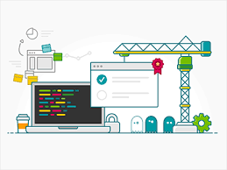
DEFINING SITE OR APP REQUIREMENTS
The discovery or analysis phase involves using different marketing research techniques to find out the needs of the business and audience, whether it's a website, mobile site, app or company social page. These needs can then be used to drive the design and content of the website. Analysis is not a 'one-off' exercise, but is likely to be repeated for each iteration of the prototype.
Although analysis and design are separate activities, there tends to be considerable overlap between the two phases.
In analysis we are seeking to answer the following types of 'who, what, why, how, when, where' questions, each of which has an associated analysis technique:
• Who are the key audiences for the site or app ?
• Why should they use the site or app (what will appeal to them)?
•What should the content of site or app be?
Which services will be provided (value proposition)?
• How will the content be structured (information architecture)?
• How will navigation occur (findability)?
•What are the main marketing outcomes we want the experience to deliver, such as registration, leads and sales, and how will we increase them (persuasion and CRO)?
• Which context, i.e. when, where and on which devices, is the experience accessed: at home, at work or while mobile?

Slide 25

To help answer these questions, web designers commonly use a research-based approach known as user-centered design, which uses a range of techniques to ensure the site meets user needs. This often involves ethnographic research used to build the website design or customer personas , where there are more details on creating personas that summaries different customer journeys).
What is User Centered Design?
User-centered design (UCD) is an iterative design process in which designers focus on the users and their needs in each phase of the design process. In UCD, design teams involve users throughout the design process via a variety of research and design techniques, to create highly usable and accessible products for them.
User-centered design (UCD) focuses on product users. By implementing various research techniques, UCD incorporates the needs and feelings of users to guide each phase of product design and development. UCD also heavily emphasizes iteration — ideas are tested and redesigned to achieve usable, satisfying, and emotionally impactful products.

Slide 26
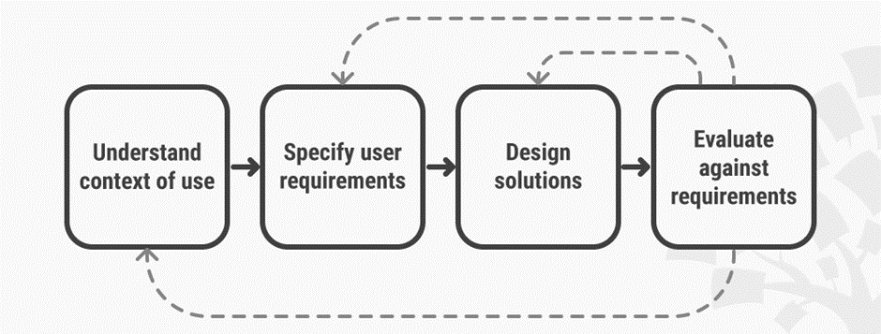
4 Phases in User-centered Design
Generally, each iteration of the UCD approach involves four distinct phases. First, as designers working in teams, we try to understand the context in which users may use a system. Then, we identify and specify the users’ requirements. A design phase follows, in which the design team develops solutions. The team then proceeds to an evaluation phase. Here, you assess the outcomes of the evaluation against the users’ context and requirements, to check how well a design is performing. More specifically, you see how close it is to a level that matches the user's’ specific context and satisfies all of their relevant needs. From here, your team makes further iterations of these four phases, and you continue until the evaluation results are satisfactory. User-centered design is an iterative process that focuses on an understanding of the users and their context in all stages of design and development.

Slide 27

With a focus on user- centered design, there is a risk that business requirements to achieve marketing outcomes may be marginalized. A marketing-led site design is informed by marketing objectives and tactics. A common approach is to base the design on achieving the performance drivers of successful digital marketing
Design will be led by these performance drivers as follows:
• Customer acquisition. The online value proposition must be clear. Appropriate incentives for customer acquisition and permission marketing
• Customer conversion. The site must engage first-time visitors. Call to action for customer acquisition and retention offers must be prominent, with benefits clearly explained. The fulfilment of the offer or purchase must be as simple as possible to avoid attrition during this process.
• Customer retention. Appropriate incentives, content and customer service information to encourage repeat visits and business must be available
• Service quality. This has been covered in this chapter. Service quality is affected by site navigation, performance, availability and responsiveness to enquiries.
• Branding. The brand offer must be clearly explained and interaction with the brand must be possible. Marketing-led site design is also known as persuasion marketing.

Slide 28
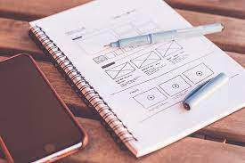
During the wireframe and storyboard phase we ask three critical questions of every page a visitor will see:
1 What action needs to be taken?
2 Who needs to take that action?
3 How do we persuade that person to take the action we desire?
a model to inform persuasive design. The Behavior Model asserts that for a person to perform a target behavior, the must
be sufficiently motivated,
have the ability to perform the behavior
be triggered to perform the behavior.
These three factors must occur at the same moment, otherwise the behavior will not happen. Before we review user- centered design processes
A website wireframe is used to map out the main features and navigation of a new website design. It gives an idea of the site's functionality before considering visual design elements, like content and color schemes.
A storyboard in web design is a visual representation of a website’s layout, structure, and content. It’s a crucial tool that designers use to plan out every aspect of a website before it’s built.

Slide 29

Usability requirements
Usability is a concept that can be applied to the analysis and design of a range of product that defines how easy they are to use.
usability is defines as: the extent to which a product can be used by specified users to achieve specified goals with effectiveness, efficiency and satisfaction in a specified context of use. You can see how the concept can be readily applied to website design - web visitors often have defined goals, such as finding particular information or completing an action such as booking a flight or viewing an account balance.
usability described as follows: An engineering approach to website design to ensure the user interface of the site is learnable, memorable, error free, efficient and gives user satisfaction. It incorporates testing and evaluation to ensure the best use of navigation and links to access information in the shortest possible time. A companion process to information architecture.
In practice, usability involves two key project activities.
Expert reviews are often performed at the beginning of a redesign project as a way of identifying problems with a previous design.
Usability testing involves:
1 identifying representative users of the site and identifying typical tasks;
2 asking them to perform specific tasks such as finding a product or completing an order,
3 observing what they do and how they succeed.
Usability/user testing Representative users are observed performing representative tasks using a system
Expert review An analysis of an existing site or prototype by an experienced usability expert who will identify deficiencies and improvements to a site based on their knowledge of web design principles and best practice
Usability An approach to website design intended to enable the completion of user tasks.

Slide 30
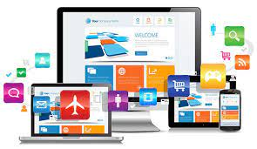
For a site to be successful, the user tasks or actions need to be completed:
• Effectively. Effectiveness defined as 'accuracy and completeness with which users achieve specified goals'. Digital experience usability specialists measure task completion; for example, only three out of ten visitors to a website may be able to find a telephone number or other piece of information
• Efficiently. efficiency defined as 'resources expended in relation to the accuracy and completeness with which users achieve goals'. Digital experience usability specialists also measure how long it takes to complete a task on-site, or the number of clicks it takes.
In the web, usability is a necessary condition for survival. If a website is difficult to use, people leave. If the homepage fails to clearly state what a company offers and what users can do on the site, people leave. If users get lost on a website, they leave. If a website's information is hard to read or doesn't answer users' key questions, they leave. Note a pattern here?

Slide 31

WEB ACCESSIBILITY REQUIREMENTS
Web accessibility is the practice of making websites usable for all visitors, including those with disabilities, impairments, and limitations. Web accessibility involves following certain design principles which ensure that people who experience difficulties or limitations have the same or a similar experience as those who do not. This ensures your content is accessible for every user.
Who manages web accessibility on the internet?
So, who's in charge of the web accessibility initiative and works to enforce it across the internet? The answer is the members of the Web Accessibility Initiative (WIP) of The World Wide Web Consortium (W3C). These organizations are responsible for publishing the Web Content Accessibility Guidelines (WCAG) and related content.
Accessibility legislation intended to protect users of websites with disabilities, including visual disability.

Slide 32

Why is web accessibility important?
web accessibility makes your website — and its content — more user-friendly and easy to understand for all visitors. This includes those with disabilities and limitations such as:
Blindness , Low vision, Learning disabilities , Cognitive disabilities , Deafness , Hearing loss , Speech disabilities , Physical disabilities.
Web accessibility isn't optional; it's a must-have, which is why web accessibility is important. By prioritizing your site's level of accessibility, you will enhance the user experience for all of your visitors — including those with disabilities or limitations who land on your site.
You'll also demonstrate your company's commitment to inclusivity. By doing this, you show your visitors, leads, and customers that you value and care about them as individuals — and in return, this investment will boost your brand loyalty and advocacy.
Meeting web accessibility standards may sound like the right thing to do at this point (and it is) — but is it required of you by law?
Web accessibility An approach to site design intended to accommodate site usage using different browsers and settings - particularly required by the visually impaired and visitors with other disabilities including motor control, learning difficulties and deaf users . Users whose first language is not English can also be assisted.

Slide 33

PERSONALIZATION REQUIREMENTS
As prospects and customers use business websites and apps, we can use technology to learn a lot about their behaviors, preferences and characteristics. This includes both implicit data based on behavior and explicit data collected through profiling forms, surveys and quizzes either by the business or through linking to third-party data sources.
Personalization aims to deliver more relevant experiences through customized recommendations that improve conversion to lead or sale or improve engagement with a brand. Although many of us will have experienced personalization through retail product recommendations like those from Amazon, the definition shows the relevance of personalization to all types of businesses. For example, B2B companies that don't sell on line can use personalization to recommend relevant content to sustain prospects' interest in a business and so nurture them towards sale.
Personalization Digital experience personalization is the dynamic serving of customized content, product or promotional offer recommendations to website visitors or app users based on their characteristics and intent behavior to support conversion and long-term engagement goals.

Slide 34
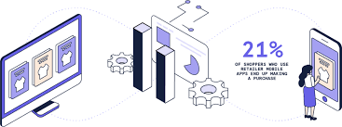
Digital personalization provider Monetate (2017) recommends that opportunities for personalization for a transactional
e -commerce business are based on three main types of implicit data that can be captured in analytics:
• Context. For example, first-time or return visits, type of device, location, time of day and referral source.
• Behavior's. For example, content viewed, particularly viewed products and categories and items in abandoned baskets.
• History. Past purchases, involvement in loyalty program me and past email interactions (also behavior's).We recommend adding a fourth, although not all personalization systems enable integration with other data sources such as profile information:
• Profile characteristics. These are explicitly disclosed data captured about details such as gender, age or company data or profile information inferred from third-party data from similar audiences related to where they live.

Slide 35
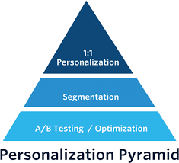
It's now a legal requirement in most countries to disclose how they will use personal data for personalization according to data protection and privacy law.
Monetate (2017) has distinguished between three different levels of personalization in their 'pyramid of personalization, which are useful for businesses to review their capabilities . These are:
1 - Optimization using AB testing. This technique is used as part of conversion-rate optimization to identify which page elements and variations are important to conversion. It isn't typically personalization based on data collected, but involves serving different content to some groups of users compared to a control.
2 - Segmentation using rules-based targeting. Here rules are set up in a personalization system to serve different content to different audience groups based on the four types of data above. For example, first-time visitors can be served a different message to repeat visitors or a 'next-best product' can be recommended to a previous purchaser.
3 - Personalization. This approach goes beyond pre-defined rules to use machine learning or predictive analytics to serve the most relevant messages to an individual based on all the known profile information and how others similar in their characteristics have responded in the past.

Slide 36

.
LOCALIZATION AND CULTURAL CUSTOMIZATION
What Is Localization Exactly?
Localization, is the process of adjusting products, services, and content to align with the needs of a local market. It is related to, but not the same as translation. While translation focuses on language alone, localization involves:
Ensuring that meaning and messaging are retained during translation
Showing respect for local culture and customs
Modifying user interfaces and displays to accommodate local dialect
Using the appropriate date and currency formats
Changing imagery and color schemes to adapt to local expectations
Adjusting content to be more relevant to local audiences
Businesses must consider every element that may come into contact with potential customers, local employees, and business associates when localizing. This scope includes websites, apps, user manuals, marketing content, and product packaging.
Localization also impacts employee manuals, contracts, schematics, technical documentation, and training materials.
Cultural customization is an essential marketing technique that consists of studying consumers' cultures as a way to create relevant content.

Slide 37

.
An evaluation framework for the level of localization:
• Standardized websites (not localized). A single site serves all customer segments (domestic and international).
• Semi- localized websites. A single site serves all customers; however, contact information about foreign subsidiaries is available for international customers. Many sites fall into this category.
• Localized websites. Country-specific websites with language translation for international customers, wherever relevant.
• Highly localized websites. Country-specific websites with language translation; they also include other localization efforts in terms of time, date, postcode, currency formats, etc. .
• Culturally customized websites. Websites reflecting complete immersion' in the culture of target customer segments; as such, targeting a particular country may mean providing multiple websites for that country depending on the dominant cultures present.
Localization :- tailoring of website information for individual countries

Slide 38

.
What Are Its Benefits?
There are numerous benefits to localization.
First, you make it easier for new customers to relate to your company and understand what you have to offer.
Second, you create goodwill by respecting local culture and being willing to meet customers’ needs.
Third, businesses that localize enjoy greater credibility.
Ultimately, localization can lead to an increase in sales.
Website localization is a more holistic process in which web content is adapted for consumption by a specific audience. This typically involves translation, formatting and usability alterations, and a consideration of particular cultural likes and dislikes.
Website localization is about transforming imagery, tone, colors, units of measurement and more to account for cultural and regional nuances. The value in localizing the content on your website is that it ensures that it is culturally appropriate for your target audience, making it more appealing and user friendly.

Slide 39
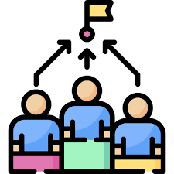
.
REVIEWING COMPETITORS WEBSITES
Benchmarking of competitors' websites is vital in positioning a website to compete effectively with competitors that already have websites.
.Benchmarking should not only be based on the obvious tangible features of a website such as its ease of use and the impact of its design. Benchmarking criteria should include those that define the companies' marketing performance in the industry and those that are specific to web marketing, as follows:
• Financial performance (available from About Us, investor relations and electronic copies of company reports). This information is also available from intermediary sites such as finance information or share dealing sites
• Conversion efficiency. Sites can be compared to published results of average conversion rates see, for example, Smartinsights.com).
• Marketplace performance. Market share and sales trends and, significantly, the proportion of sales achieved through the Internet. This may not be available directly on the website, but may need the use of other online sources.
Web performance benchmarking provides competitive insights into how your site performs in comparison to others in terms of page load time and availability.
Competitive benchmarking is the process of comparing your company's performance with major competitors.

Slide 40

.
REVIEWING COMPETITORS WEBSITES
• Business and revenue models. Do these differ from other marketplace players?
• Marketplace positioning. The elements of the marketing mix including Product, Pricing and Place.
• Marketing communications techniques. Is the customer value proposition of the site clear? Does the site support all stages of the buying decision from customers who are unfamiliar with the company through to existing customers? Are special promotions used on a monthly or periodic basis? Beyond the competitor's site, how do they promote their site? How do they make thorough use of intermediary sites to promote and deliver their services?
• Services offered. What is offered beyond brochure ware? Is online purchase possible ? What is the level of online customer support and how much technical information is available?
• Implementation of services. These are the practical features of site design that are described in this chapter, such as aesthetics, ease of use, personalization, navigation, availability and speed.

Slide 41

SUMMERY
CHAPTER AT A GLANCE
Digital customer experience
Initiation of digital experience project
Phases in user-centered design
Web site performance optimization
Personalization and mass customization
Web accessibility requirements
Personalization requirements
Localization and cultural customization
Reviewing competitors websites

Slide 42


Thank You

