Slide 1


Storage Technologies
IT403
Prepared by
Dr. Ahmed El-Douh
Lecture 8

Slide 2



Storage Technologies
Lecture 8
IT403
Business Continuity and Storage Backup technologies
Prepared by
Dr. Ahmed El-Douh

Slide 3
Objectives
Upon completion of this module, you will be able to:
  Understand the importance and challenges of Business Continuity.
  Understand the definition, standards, and the cost–risk relationship.
  Know the common Business Continuity solutions, including Backup vs Disaster Recovery.
  Understand Huawei Business Continuity and Storage Backup technologies in Datacenters.

Slide 4
Chapter
Outlines
08
Challenges of Business Continuity.
Definition of Business Continuity.
Overview of Business Continuity Solutions.
Overview Of Backup Solutions.
Architecture Of Backup Solutions.
Common Backup Networks.
Common Backup Technologies.

Slide 5


Chapter
08
Challenges of Business Continuity

Slide 6
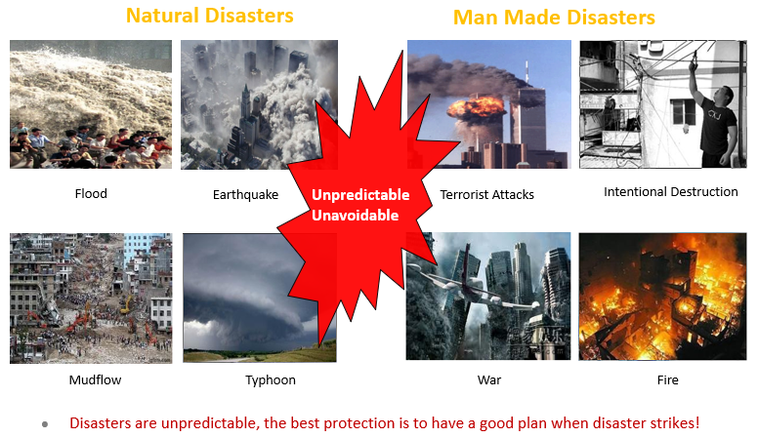
Unpredictable Natural Disasters and Man Made Disasters

Slide 7
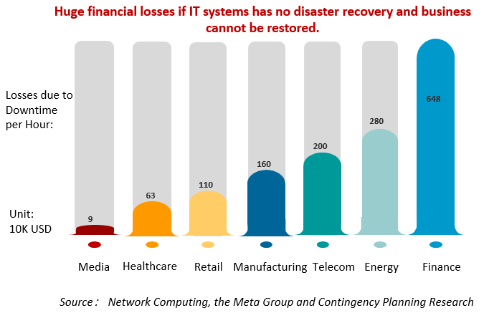
Why We Need Business Continuity and Disaster Recovery?

Slide 8
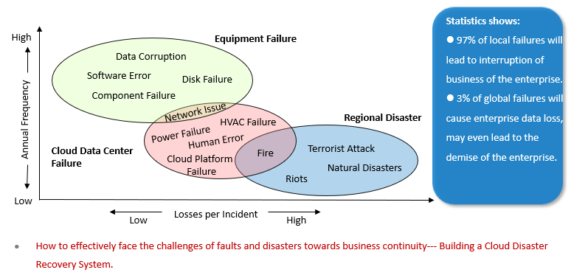
Types of Incidents That Affects Business Continuity of IT Systems

Slide 9
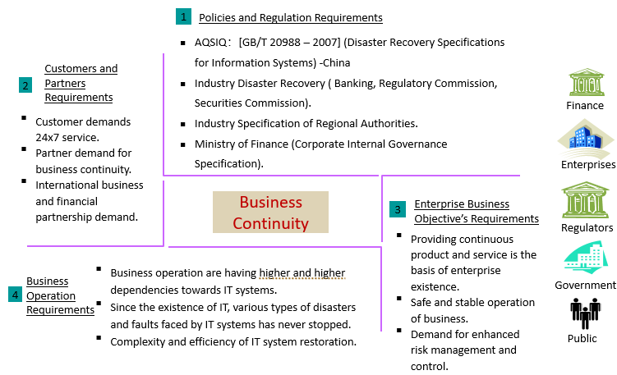
Requirements of Business Continuity

Slide 10
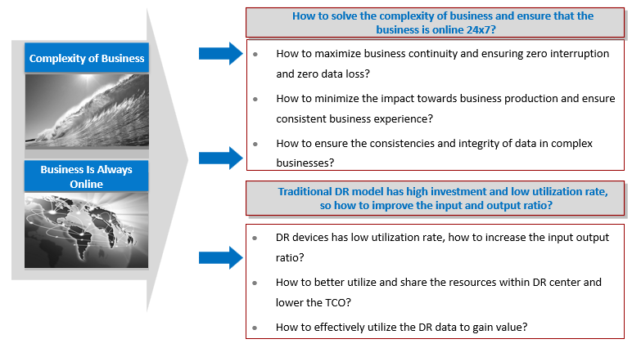
Challenges Faced By Business Continuity and Disaster Recovery (1)

Slide 11
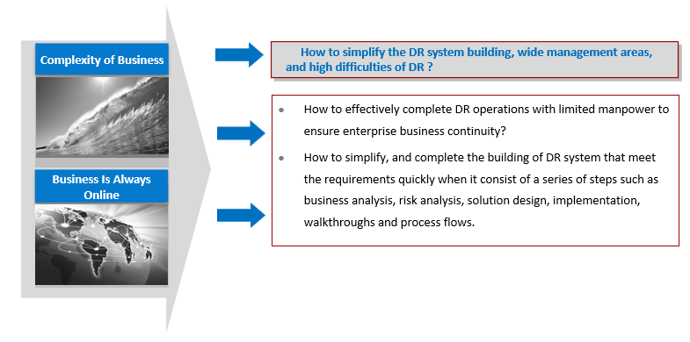
Challenges Faced By Business Continuity and Disaster Recovery (2)

Slide 12
Chapter
08
Definition of Business Continuity

Slide 13
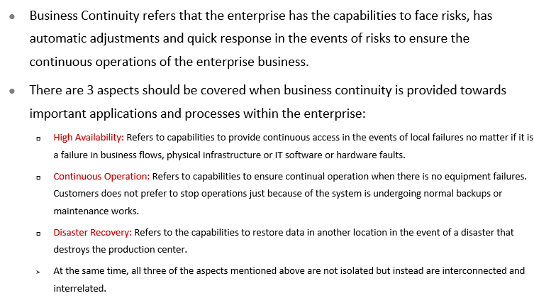
What is Business Continuity?

Slide 14
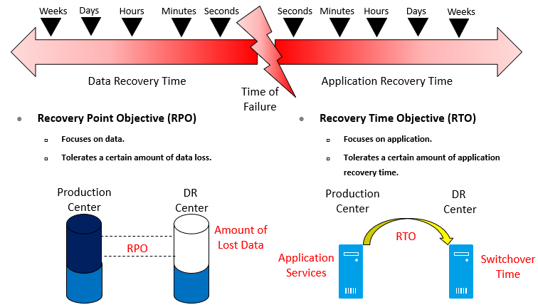
Key Indicators To Measure Disaster Recovery Systems: RTO and RPO

Slide 15
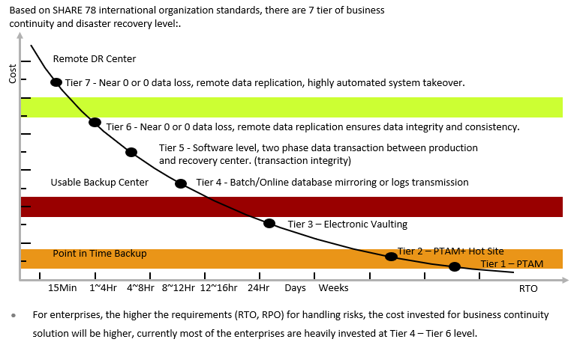
International Standards For Business Continuity System

Slide 16
Chapter
Overview of Business
Continuity Solutions
08

Slide 17
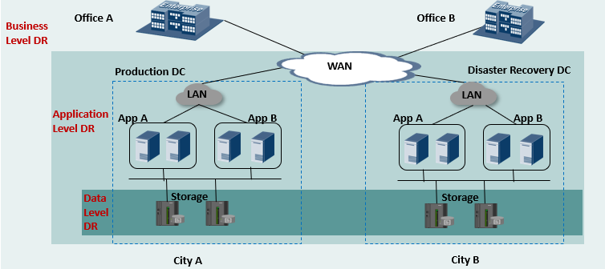
DR Classification Based on DR Effect

Slide 18
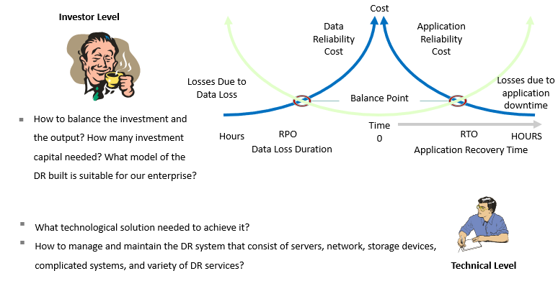
Main Challenges of Building A DR System

Slide 19
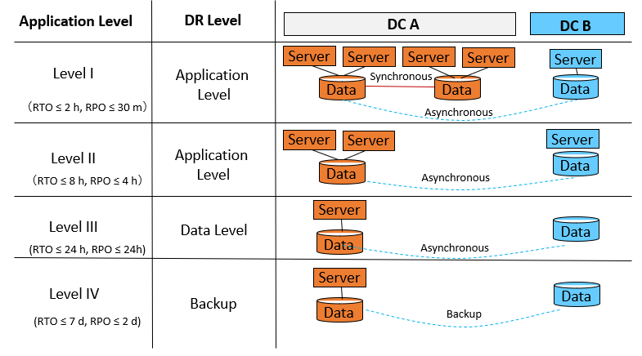
DR Solution Architecture

Slide 20
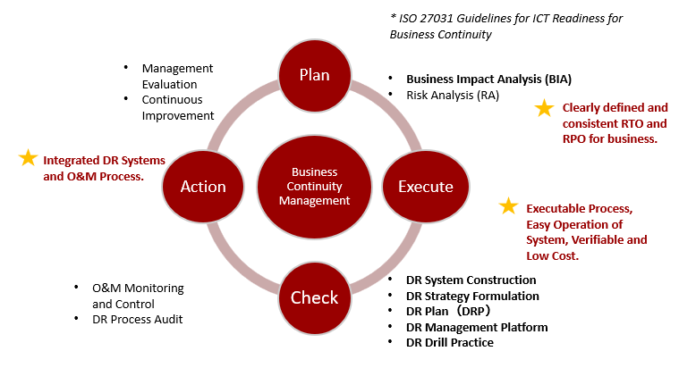
Continuous Improvement Method for DR Construction

Slide 21
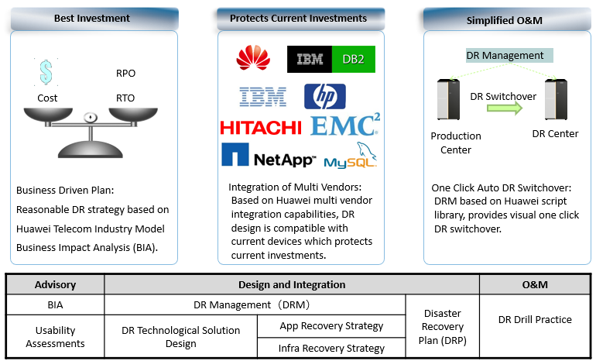
Huawei Integrated End-to-End DR Service

Slide 22
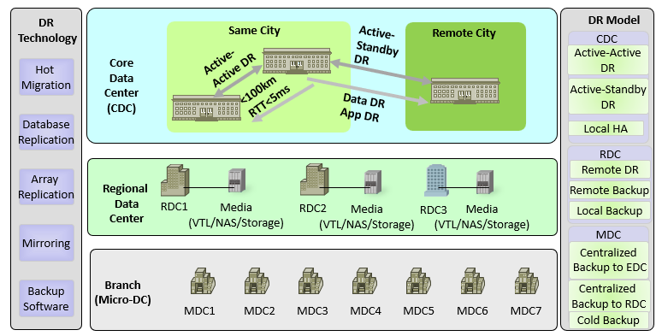
Panorama Of Huawei Integrated DR Solution

Slide 23
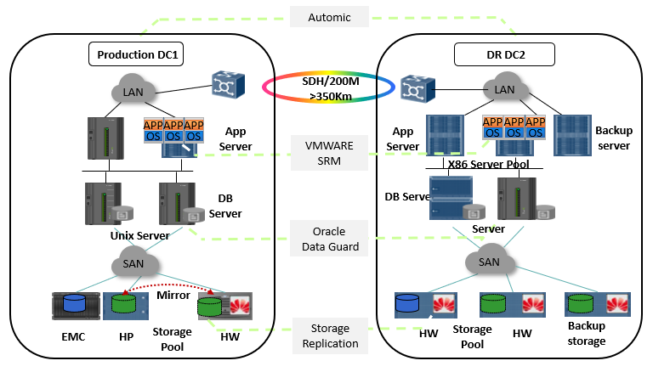
Application Case: Industry Best Practice Combined Multivendor Solution

Slide 24
Chapter
08
Overview Of Backup Solutions

Slide 25
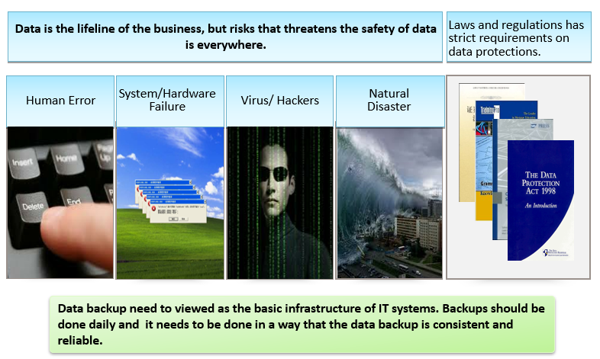
Why Do We Need Backup ?

Slide 26
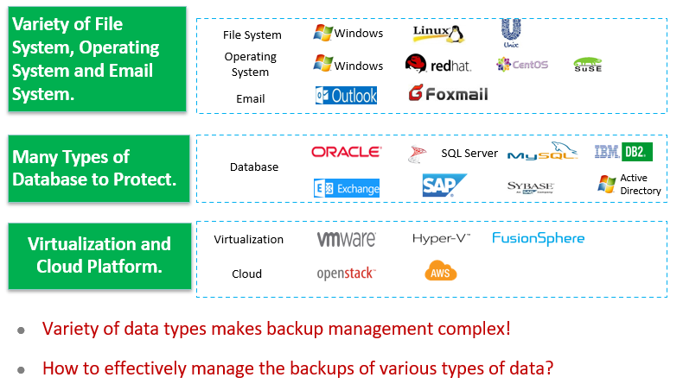
Challenges Faced By Backups: Variety of Data Types

Slide 27
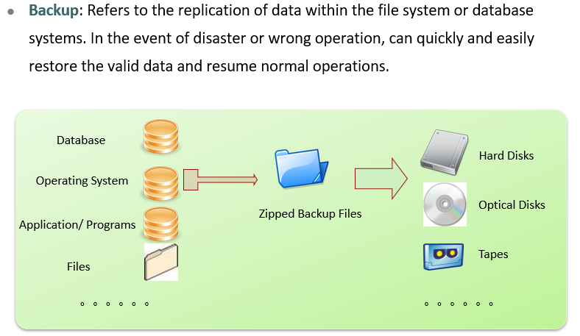
What is Backup ?

Slide 28
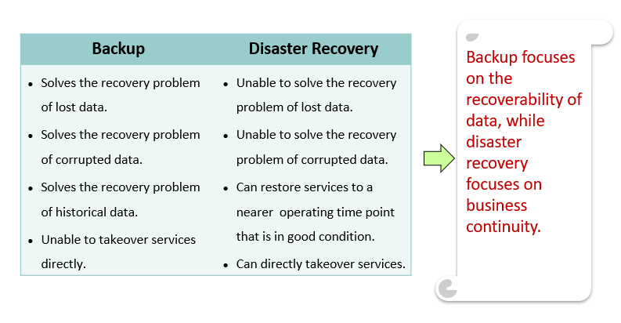
Backup VS Disaster Recovery

Slide 29
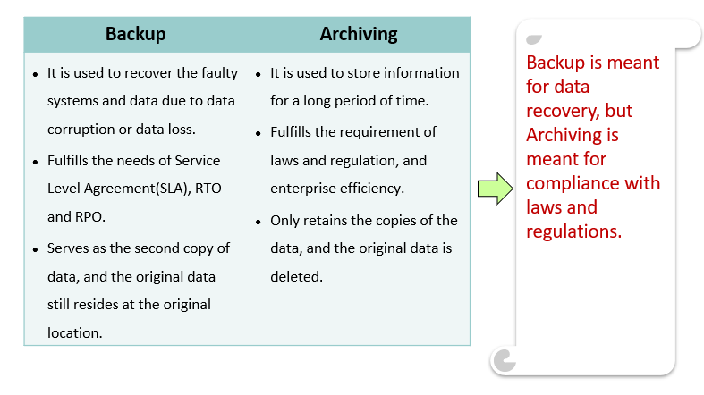
Backup VS Archiving

Slide 30
Chapter
08
Architecture Of Backup Solutions

Slide 31
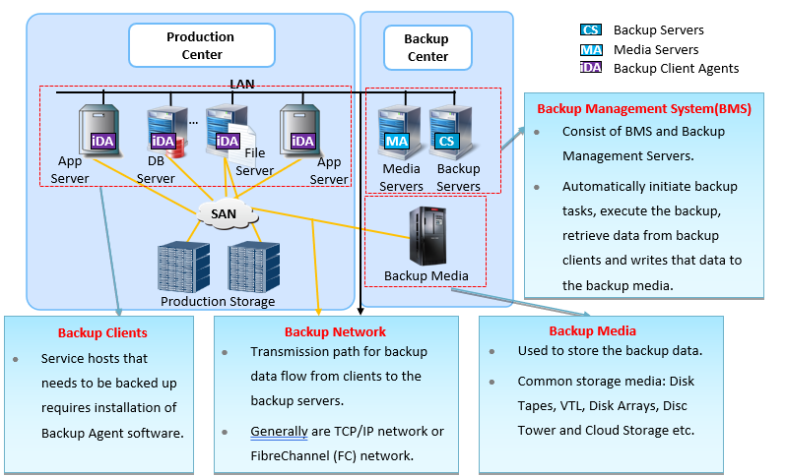
Components of Backup Systems

Slide 32
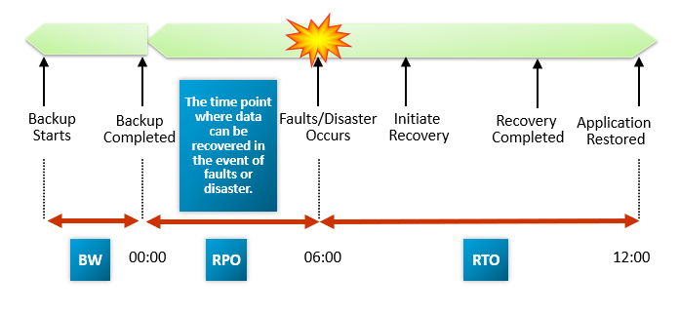
Main Elements Of Backup Systems

Slide 33
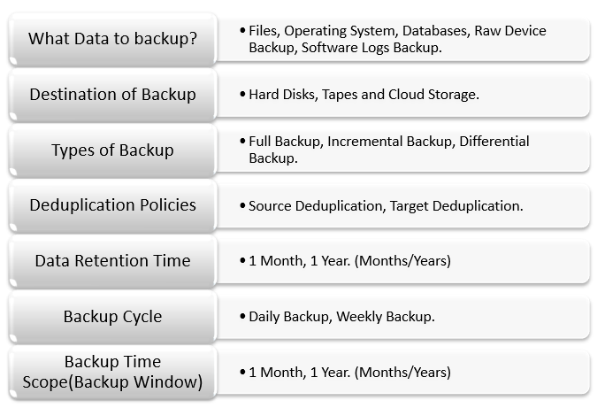
Backup Strategy & Policies

Slide 34
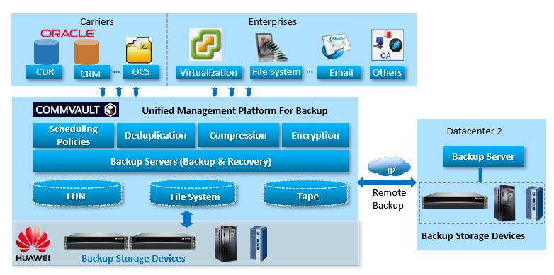
Architecture of Backup Solutions

Slide 35
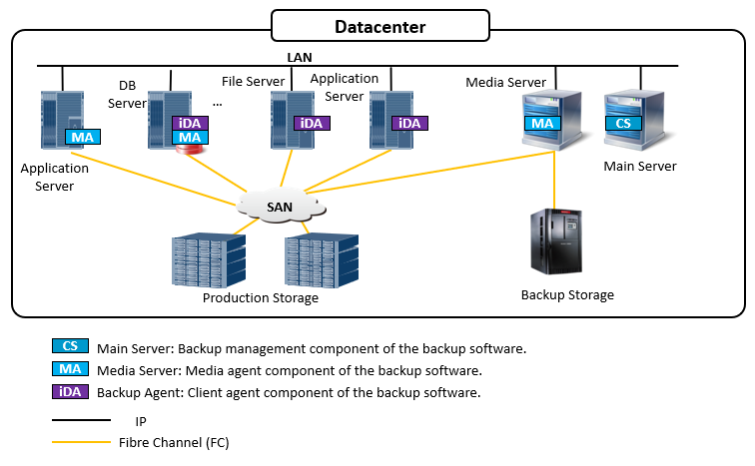
Local Centralized Backup

Slide 36
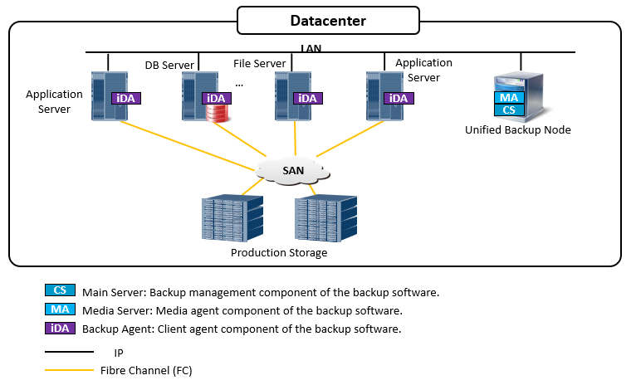
Unified Backup

Slide 37
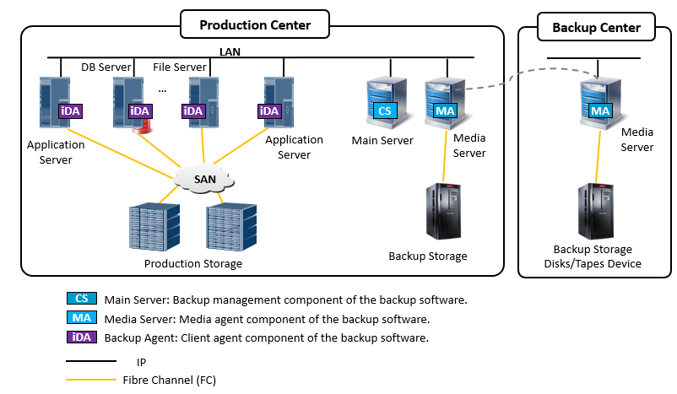
Local and Remote Centralized Backup

Slide 38
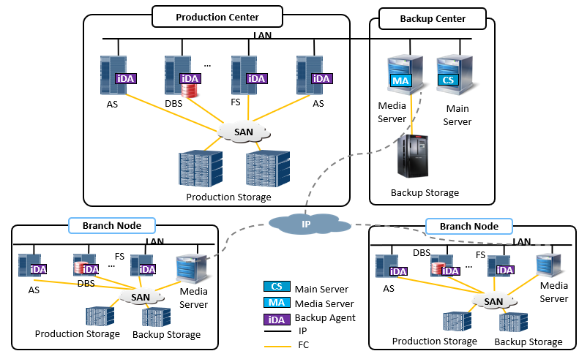
Multi Branch Centralized Backup

Slide 39
Chapter
08
Common Backup Networks

Slide 40
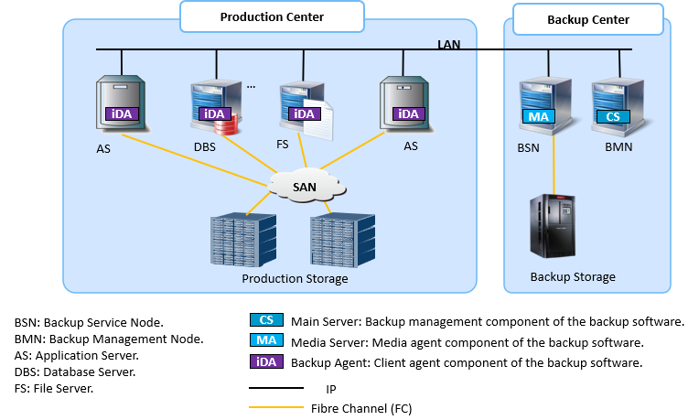
LAN - Base

Slide 41
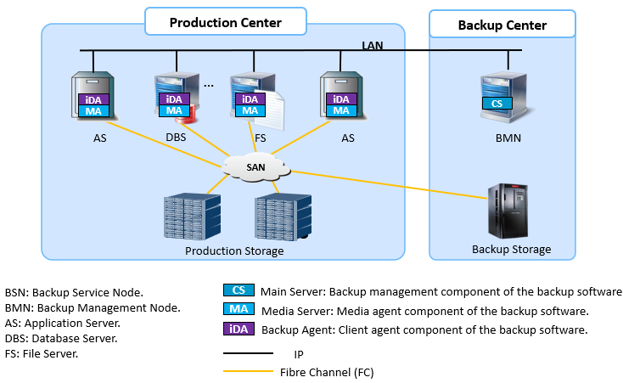
LAN - Free

Slide 42
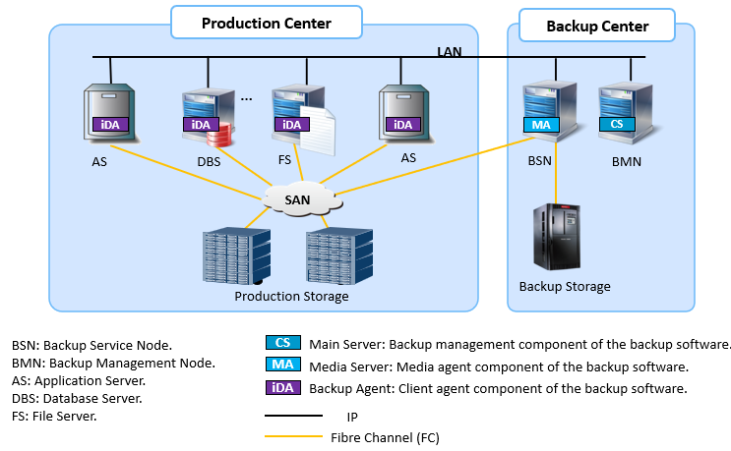
Server - Free

Slide 43
Chapter
08
Common Backup Technologies

Slide 44
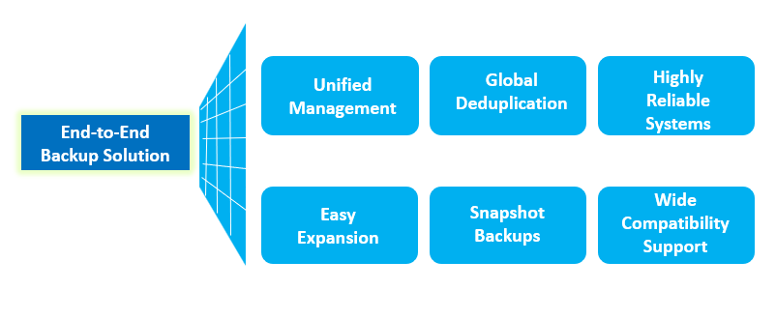
The Many Features Of Backup

Slide 45
Chapter
08
Overview Of Backup Solutions

Slide 46
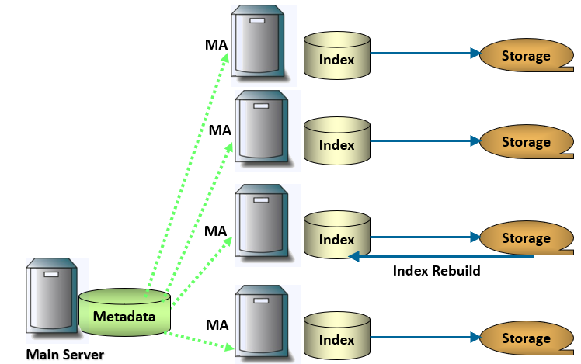
Easy Expansion: Easy Scale Out Expansion For Single Backup Domain

Slide 47
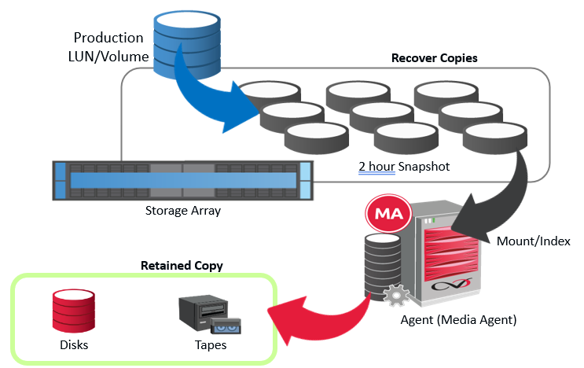
Snapshot Backup

Slide 48
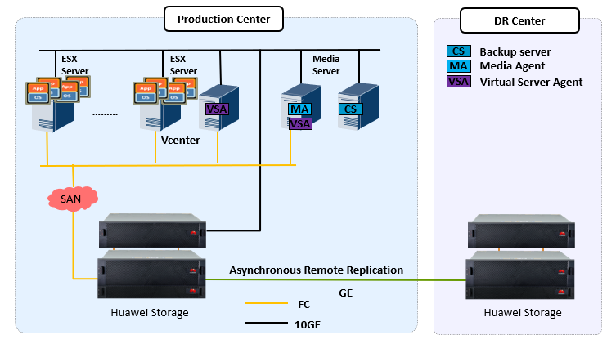
Case 1: Library Backup of XX University

Slide 49
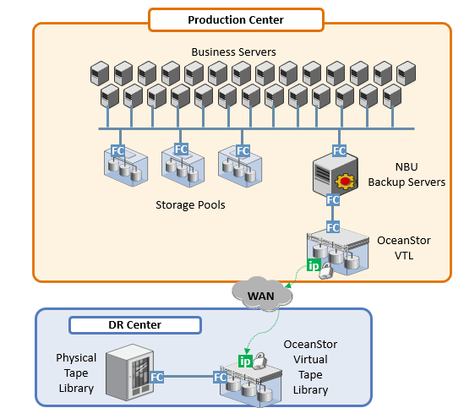
Case 2: XX Remote Backup Solution

Slide 50



Thank You

