Slide 1

MARKETING MANAGEMENT
Master of Management.
Orientation show
عرض توجيهي
Dr. Magdy al-haj
Everyone Smart University
Management Department
FALL 2022

Slide 2

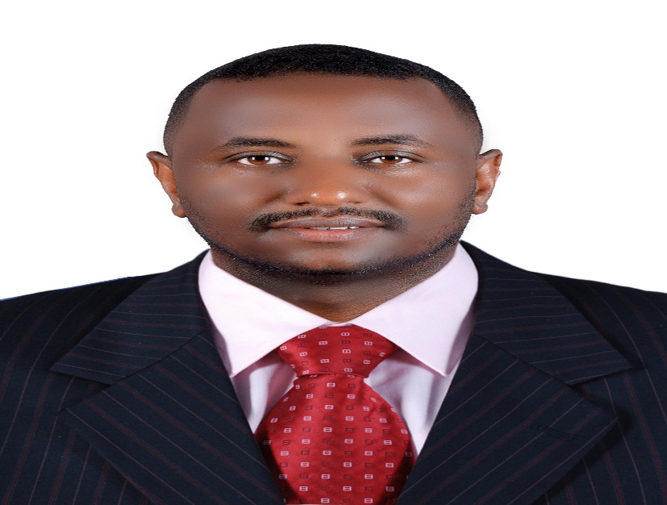

Who Am I?
DR. Magdy Ahmed Al-Haj Mahmoud
assistant's professor of Business Administration
Ph.D. in Business Administration, Omdurman Islamic University, Sudan. 2015
M.Sc. in Business Administration, University of Jazeera, Sudan.2011
B.Sc. in Textile Engineering (Hours), University of Jazeera, Sudan 2004
Worked assistant's professor at everyone smart university, Lecturer, community College king Khalid University, and, quality assurance unite coordinator, resident engineering. Published books& Researches , Professional Training,
marketing management, DR. Magdy Al-Haj , FALL 2022

Slide 3
Who Am I?
  How to reach me
    By Email at magdy@esu.ac.ae
    ( please include “Marketing management” in subject line)
  Zoom meeting
  Discussion Time (Monday At 8-9 PM) Every week
marketing management, DR. Magdy Al-Haj , FALL 2022

Slide 4
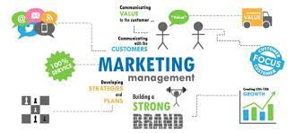
The course that will be taught
Marketing management
marketing management, DR. Magdy Al-Haj , FALL 2022

Slide 5

What is Marketing Management ?
Marketing management is a composition of two terms 'Marketing' and 'Management'. Where, the term 'marketing' is a set of actions and processes of a company associated with buying and selling of goods or services. "Management" is a function of coordinating the integrated efforts of people towards a common goal by effective utilization of available resources.
Marketing management is an organizational approach which focuses towards the accomplishment of marketing objectives of the organization such as achieving customer satisfaction, securing high sales and profit, etc.
marketing management, DR. Magdy Al-Haj , FALL 2022

Slide 6

Primary Goal of This Course
This course aims to:
Marketing management is a system of integrated business activities with each other, which aims to plan, price, promote and distribute goods and services to current and prospective customers. Marketing is a human activity aimed at satisfying the desires and requirements of consumers This course offers a complete introduction to professional marketing thought and action.
The Course explains the concepts, policies and methods associated with marketing as well as the understanding of companies' marketing strategies at present to face increasing competition in both domestic and foreign markets in terms of marketing.
The course analyses the process of market segmentation, targeting and the postponing of the products
The Course explains marketing ethics and social responsibility
Brand management
Design and Management of Integrated Marketing Communications System and Distribution Channel Management
In addition to analyzing consumer behavior, New-Product Development Strategy
pricing strategies
marketing management, DR. Magdy Al-Haj , FALL 2022

Slide 7
Learning Outcomes
  The course will help students to gauge understanding in marketing management
Interpret complex marketing issues and problems using relevant theories, concepts
and methods with regard to ethical conduct.
Apply contemporary marketing theories to the demands of business and management practice.
Find and generate information/data needed to inform problem solving in marketing using appropriate methodology.
Analyze information/data critically and synthesize new knowledge and communicate that knowledge via engaging written and oral formats.
Organize information and data to reveal patterns and themes, and manage teams and evidence gathering and problem solving processes.
Conduct the process of inquiry, and respond to feedback, accounting for ethical, social and cultural (ESC) issues.
marketing management, DR. Magdy Al-Haj , FALL 2022

Slide 8
Learning Resources:
Credit Hours:
3 credit hours.
  Required Textbook:
Textbook: Marketing Management, 15 Global Edition, Philip Kotler, Kevin lane Keller.
  Essential References:
The main material and reference for each course will be the textbook mentioned in the course specifications. Lecture notes and slides are additional resources that are prepared by the professor.
marketing management, DR. Magdy Al-Haj , FALL 2022

Slide 9
Units of Course Contents
  Lecture Structure:
Module | Course Unit | No.of. Weeks | Contact Hours
1 | Lecture_1_Marketing Management &Marketing Function | 1st | 3
2 | Lecture_2_Market Segmentation and Targeting, and Positioning | 2nd | 3
3 | Lecture_3_Marketing Strategy | 3 | 3
4 | Lecture_4_Marketing Ethics and Social Responsibility | 4 | 3
5 | Lecture_5_Consumer Behavior | 5 | 3
6 | Lecture_6 Branding | 6 | 3
7 | Lecture_7_New-Product Development Strategy | 7 | 3
8 | Lecture_8_Designing and Managing Integrated Marketing Communications | 8 | 3
9 | Lecture_9_Pricing Strategies | 9 | 3
10 | Lecture_10_Marketing Channels Management | 10 | 3

Slide 10

Course Information
  Assessment Method:
Short Exam
  80% marks
    Count of short Exam 10 (Weekly)
    8 Marks for each of short Exam.
  20% Final Examination
marketing management, DR. Magdy Al-Haj , FALL 2022

Slide 11

autumn 2022
marketing management, DR. Magdy Al-Haj , FALL 2022

Slide 12
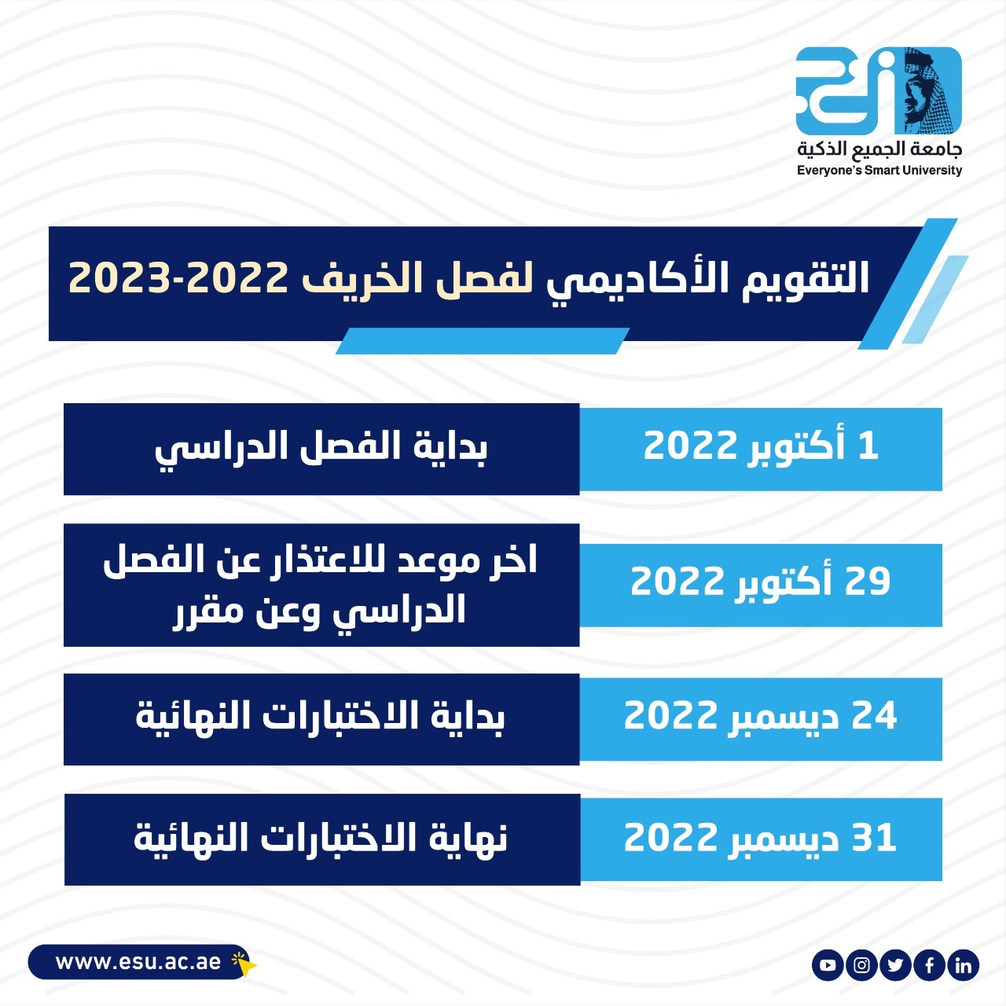
Academic Calendar
marketing management, DR. Magdy Al-Haj , FALL 2022

Slide 13
Academic Calendar
الفترة الزمنية التعليمية في الفصل الدراسي الخريف تكون مدة ١٣أسبوع
(منهم أسبوعين للاختبار النهائي)
marketing management, DR. Magdy Al-Haj , FALL 2022

Slide 14
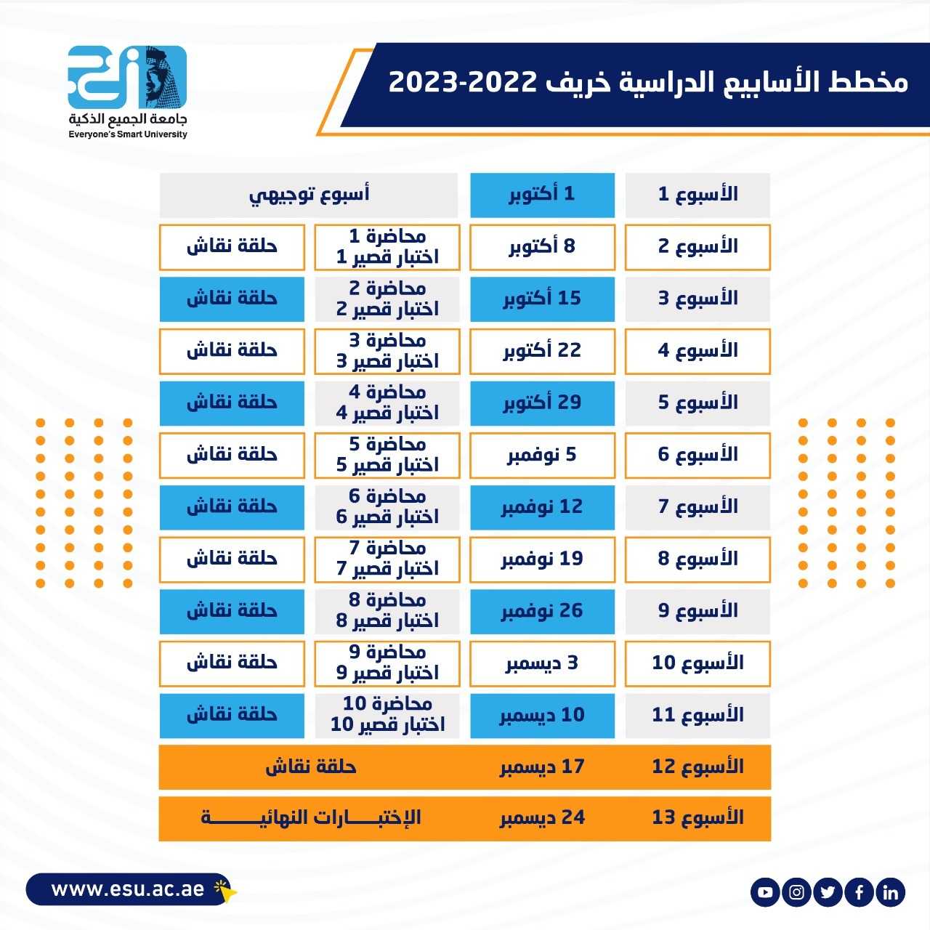
Academic Calendar
marketing management, DR. Magdy Al-Haj , FALL 2022

Slide 15
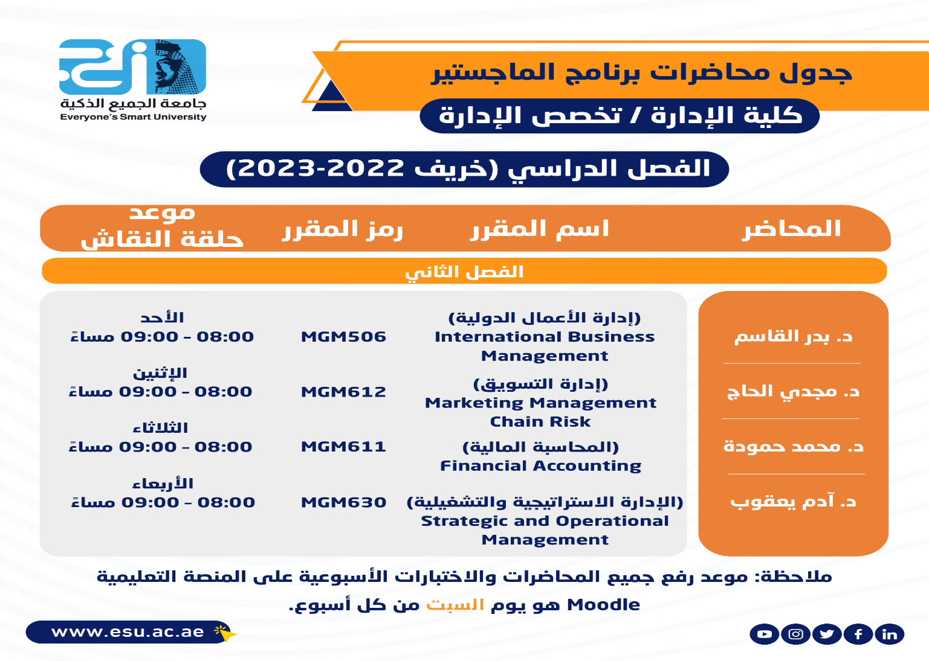
FALL 2022-2023
marketing management, DR. Magdy Al-Haj , FALL 2022

Slide 16
Academic Calendar
عبر برنامج ZOOM
سيتم تثبيت رابط حلقة النقاش على صفحة المقرر
marketing management, DR. Magdy Al-Haj , FALL 2022

Slide 17
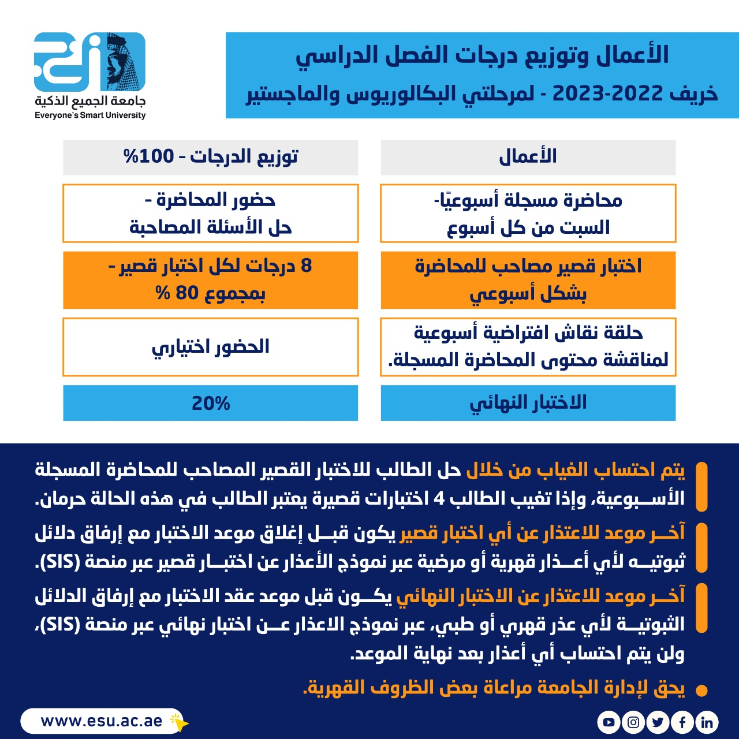
Academic Calendar
-- اللغة الأساسية في المحاضرات هي:
اللغة الإنجليزية
-- الاختبارات باللغة الإنجليزية مع وجود
ترجمة للسؤال.

Slide 18

marketing management, DR. Magdy Al-Haj , autumn 2022

