Slide 1


Project Management Technologies
PMG 312
Prepared by Dr. Majid Saad
PMG 312- LPMG 312- L5
Ch.6 - Defining a project
5

Slide 2



Project Management Technologies
PMG 312
PMG 312- L5
Ch.6 - Defining a project
Prepared by
Dr. Prepared by Dr. Majid Saad
www.midocean.ae

Slide 3
Lecture outline
CH6: Defining a project
Scope planning and definition.
Staffing and team management
Scope statement
Project and product objectives
Product or service requirements and characteristics
Product acceptance criteria
Project boundaries
Project requirements and deliverables
Project constraints
Project assumptions
Project organization/team assessment
Defined risks
Milestones
Cost estimate
Project configuration management requirements
Approval requirements.
www.midocean.ae

Slide 4
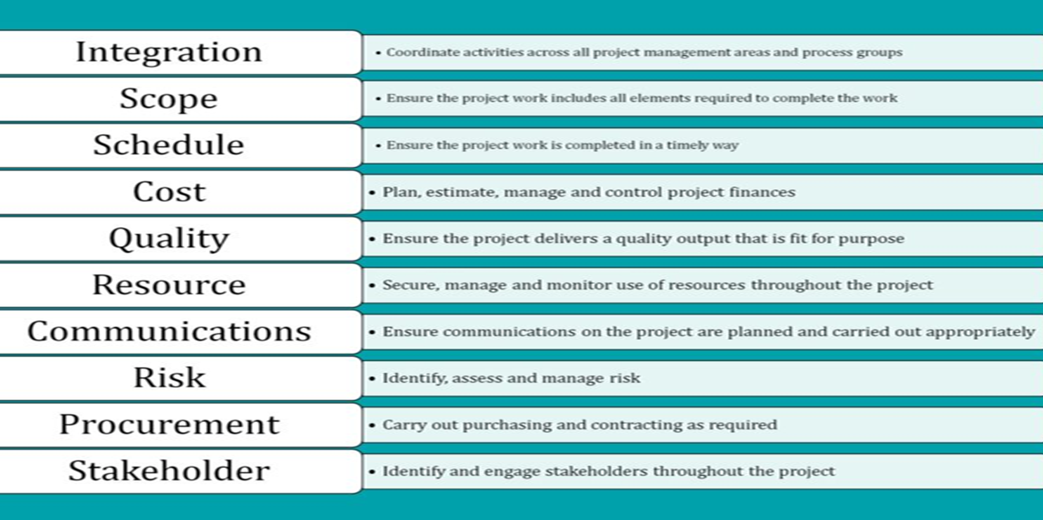
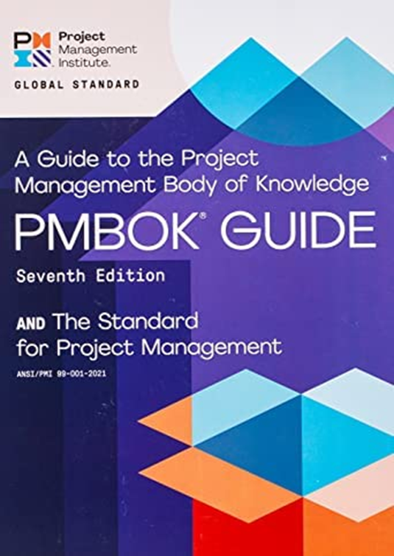
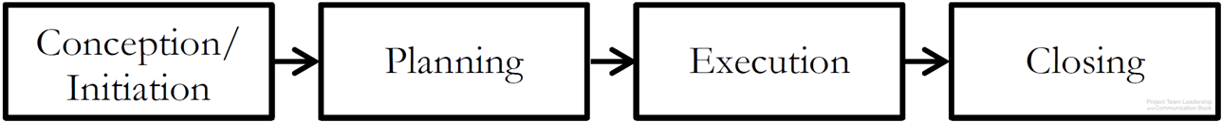
Introduction
The ten organizational knowledge management areas covered in PMBOK
www.midocean.ae

Slide 5
Introduction
The chapters in this section have the following learning objectives:
  Develop the scope management plan as part of the scope planning process.
  Develop the scope statement as part of the scope definition process
  Identify, analyze, refine, and document project requirements, assumptions, and constraints to produce a technical project and product scope definition.
  Development of a deliverables-oriented WBS created from the initial project charter, scope statement, and other project specification documents. From this definition, step technical work units are defined and will be used to facilitate detailed project planning, which is then used in the executing, monitoring and controlling, and closing processes.
  Estimating tools and techniques are described to show how development of project work unit specifications leads to a total project budget.
  Introduce the relationship of scope, time, cost, and resources into the overall management equation.
www.midocean.ae

Slide 6
Introduction
Scope definition is considered as the key initiation step for a project and one that is necessary for future success.
Scope is considered to be the prerequisite event because it is difficult to execute a project if there is no clear definition of its goals and work requirement.
www.midocean.ae

Slide 7

Introduction
Many projects fail because this step is not done well.
The creation of the scope management plan and scope statement establishes the foundation for the WBS development.
The main artifact to support this goal is the WBS which is considered to be one of the most important project artifacts.
Figure III.1 illustrates the process linkage between the three initial holy trilogy knowledge areas.
www.midocean.ae

Slide 8
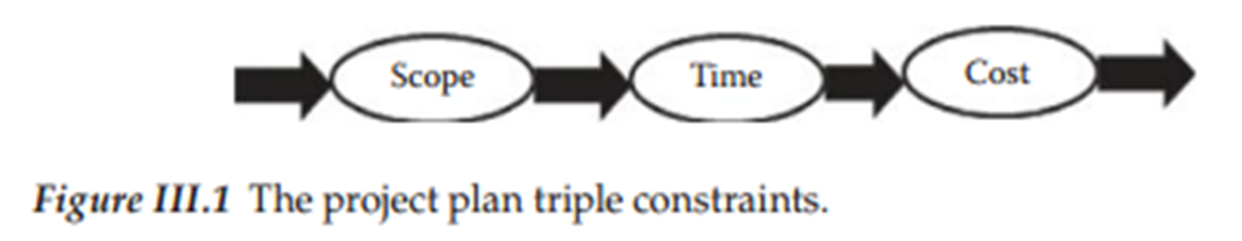
Introduction
The sequential flow illustrated in Figure III.1 and is important in that a formal scope definition provides the foundation for schedule development and the resulting schedule then becomes the base artifact for project cost and budget definition.
Many projects start off with these assumptions reversed. Schedule and cost can in fact be hard constraints, but the sequence defined here is that the flow of plan development should start with scope and let that dictate cost and schedule.
www.midocean.ae

Slide 9
Introduction
This process defines the deliverables, work processes, and other information relevant to that result.
From the scope specification, project time and cost are derived.
Even though there is a lot more to project planning than these base elements, they are the most visible plan output parameters.
www.midocean.ae

Slide 10
Introduction
In some cases, project failure is not one of poor planning, but getting the organizational participants to follow the plan.
Just recognize that a good plan is not the only condition for success.
It is a road map, but there is always unexpected environmental roadblocks found along the way.
Think of the planning process as a pathway to get from point A to point B.
www.midocean.ae

Slide 11
Introduction
Each road increment is a work unit that consumes time and resources that when added together constitutes the total trip.
Any change in this pathway has the potential to extend the estimates.
www.midocean.ae

Slide 12
Defining a project
The basic roles for a charter were also discussed which consisted of formally giving delegation of authority to the PM and formally displaying management approval for the project.
The objective of this chapter is to address the next step in the launch process which is to develop the scope planning.
This that yields a scope management plan, and the scope definition results in an updated scope management plan, scope statement and requested changes to the project scope (PMI 2008).
www.midocean.ae

Slide 13
Defining a project
PMI (2008) describes a scope management plan as how the project scope will be defined, developed, and verified.
It will also describe how the WBS will be created and defined.
Therefore, the scope management plan provides guidance on how the project scope will be managed and controlled by the PM and the team.
www.midocean.ae

Slide 14
Defining a project
A project scope statement contains a description of the project scope which consists of information such as the deliverables, assumptions, constraints, and a description of the work that is to be accomplished by the project.
The scope statement for the project is documented, so it will be the basis for making future project decisions and for confirming or developing a common understanding of project scope among the stakeholders.
The creation of the scope management plan and scope statement establishes the foundation for the WBS development.
www.midocean.ae

Slide 15
Defining a project
Successful projects are just as much about managing relationships as they are about managing change, so the PM must be vigilant in controlling the project outcome (Bourne and Walker 2005).
There is a management concept that says you cannot control what has not been defined, and scope definition is the important beginning step for project definition.
Our primary goal now is to begin our journey through planning and defining project scope.
www.midocean.ae

Slide 16
Scope planning and definition
The scope planning process yields a scope management plan
And the scope definition results in an updated scope management plan, scope statement and requested changes to the project scope (PMI 2008).
The input into scope planning is organizational factors such as: an organizational culture, project charter, preliminary scope statement, project management plan, and organizational process assets defined by PMI (2008) as information, policies, or procedures external to a project.
www.midocean.ae

Slide 17
Scope planning and definition
The process in scope planning used by organizations to produce the output, scope management plan, is templates and expert judgment.
The scope definition input is similar to the scope planning input as it not only has organizational process assets, project charter, preliminary scope statement, but also has the project scope management plan and approved project scope change requests.
www.midocean.ae

Slide 18
Scope planning and definition
The process used to produce the outputs of the project scope statement, requested changes, and updated scope management plan consists of the methods and techniques used to translate project objectives into project deliverables, expert judgment, and management of stakeholder’s needs, wants, and expectations.
A scope statement typically is a text document used to develop and confirm a common understanding of the project scope.
It should include project justification, brief description of the project’s deliverables, and summary of all project deliverables and a statement of what determines project success.
The scope statement is a first translation of the vague charter language into more specific technical language.
www.midocean.ae

Slide 19
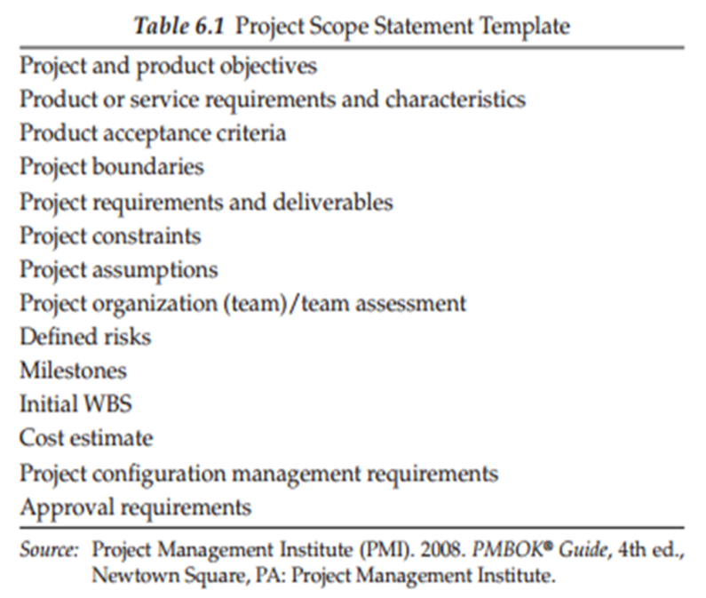
Scope planning and definition
www.midocean.ae

Slide 20
Staffing and team management
Identification of the team members is an important part of the launch process as the team will then assist the PM in creation of the scope statement as teamwork is a vital ingredient for success for the project team.
Assembling the project team requires the right mix of individuals and composition of skills that will successfully be able to accomplish the project goals.
Unclear objectives, unrealistic deadlines, and unclear management roles and lines of authority are weaknesses in project management.
Clearly defined goals are the first step prior to assigning individuals to different tasks that lead to each of the defined goals.
www.midocean.ae

Slide 21
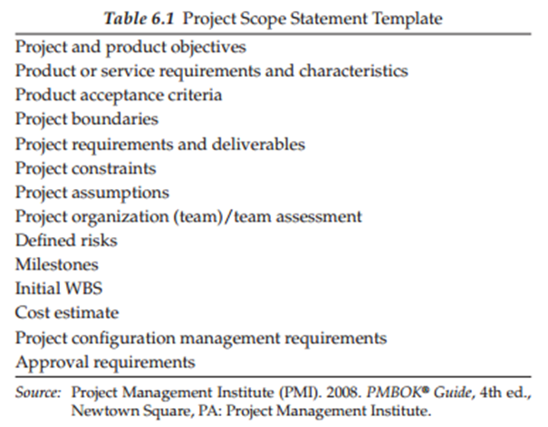
Scope statement
The scope statement can be highly detailed or broad depending on the organization and the needs of the project (PMI 2008).
The team guided by the PM’s leadership establishes the project’s objectives, deliverables, requirements, and/or specifications as well as criteria for success in terms of realistic, clear, and measurable objectives. Also, many of these steps can occur in parallel.
www.midocean.ae

Slide 22
Scope statement
It is important to limit the scope to include only the project-related (versus adding nonprojected scope) specific objectives, deliverables, requirements, specifications as well as criteria for success because including additional requests without going through the change control process will spiral the project out of control and the result unmanageable.
www.midocean.ae

Slide 23
Scope statement
A scope statement created by the team can assist in making the team cohesive in developing a shared blueprint for how the team operates (Peled 2000).
Developing this with input from stakeholders also facilitates buy-in from that segment about the project’s need for existence and ultimate purpose.
A sample template for the scope statement is displayed in Table 6.1.
www.midocean.ae

Slide 24
Project and product objectives
Objectives are defined as something that is to be accomplished by the project which can be in the form of a tangible product or possibly less tangible project items such as status reports, quality control documents, and other items related to running the project.
A project objective would be items such as delivering the defined outputs on-time, on-budget, and within scope.
A product objective would be to make sure the software is user-friendly, technical specifications met, and so on.
www.midocean.ae

Slide 25
Project and product objectives
A clear statement of objectives is important since this drives the subsequent WBS and control process.
There will obviously be changes requested during the project life cycle.
It is important to manage this process as undue volume of these will doom a project.
www.midocean.ae

Slide 26
Product or service requirements and characteristics
After describing stakeholders’ needs, wants, and expectations, the team must translate that into the work requirements necessary to produce that output.
Requirements need to be listed in priority order as typically there will not be enough resources or time to deliver every item.
Once the requirements have been identified in terms of very concise statements that no two individuals would interpret differently, the requirements should then be communicated back to the stakeholders to be certain that their needs, wants, and expectations have been properly collected and documented.
It is also important that the stakeholders agree with the prioritized listing identified.
www.midocean.ae

Slide 27
Product or service requirements and characteristics
Examples of requirement statements for a product could be stating that a cabinet be specific dimensions or that a portable game system has the ability to connect to other user’s same portable game system through Wi-Fi.
An example of a service requirement is that user’s emailed feedback comments will be responded to within 72 hours. Or a caller to the help center will be sent an email after the caller’s issue has been resolved to survey the satisfaction the user had by the technical or customer service received.
These examples demonstrate that requirements go beyond just describing what the physical product will do.
www.midocean.ae

Slide 28
Product acceptance criteria
The project scope statement outlines the criteria for which the project will be approved and therefore is a definitional guide to measuring success.
One example of acceptance criteria would be the requirement of submission of all project close-out documentation and all program code to the customer.
Another common example is schedule or cost criteria.
www.midocean.ae

Slide 29
Product acceptance criteria
In an information technology projects, examples of these could be goals related to performance and quality.
For instance, system response times or transaction rates would be performance criteria, where the number of known defects that were not corrected by the completion of the project would be quality criteria (McBride et al. 2007).
All acceptance criteria should be written in very concise statements so that no two individuals would interpret the requirement differently.
www.midocean.ae

Slide 30
Project boundaries
Project boundaries need to be set so that the PM does not find himself/herself being placed in a position where the amount of funds provided is firm, yet the scope of the project work keeps growing.
Boundaries need to be identified in the scope statement so that there will be no confusion as to what exactly will or will not be accomplished during the course of the project.
It is important to point out what is in scope and what is out of scope.
www.midocean.ae

Slide 31
Project boundaries
This will be important later as conflicts emerge on what is within scope of the project, and it protects the project team in these situations.
Physical documentation is very important for this purpose, as well as obtaining signatures from key stakeholders so that there is understanding of the scope.
This process is an important one to help deal with scope definition and scope creep issues that may occur later in the life cycle.
Creeping requirements can be avoided through having a project boundaries section (Cervone 2006).
www.midocean.ae

Slide 32
Project requirements and deliverables
A project requirement can be defined as anything that needs to be accomplished as part of the project.
PMI (2008) further defines a requirement as a system, product, service, result, standard, or anything else that is desired by a stakeholder.
Just as discussed above in the product requirements section, it is important to communicate with the stakeholders to collect and confirm their needs, wants, and expectations.
www.midocean.ae

Slide 33
Project requirements and deliverables
needs to produce requirement statements that are very concise statements that no two individuals would interpret differently.
Then, the requirement statements should be taken back to the stakeholders to be certain that their needs, wants, and expectations are linked to specific requirements so that the team gets feedback that the stakeholders’ needs, wants, and expectations were correctly interpreted.
The deliverables definition should identify the specific items that are to be produced.
These can be systems, websites, products, program codes, password documents, new processes, or technical manuals.
www.midocean.ae

Slide 34
Project constraints
Most projects have constraints which limit their degrees of freedom.
Many times, these are not recognized and therefore not obeyed.
This section provides a means for formally communicating to the key stakeholders what these constraints are for the project and its environment.
Politically, it may not be recommended to identify all constraints but, when possible, it provides clear communication internal and external to the project team.
www.midocean.ae

Slide 35
Project constraints
Constraints are merely restrictions that exist such as funds, timelines, contracts in place requiring that purchases be made from certain suppliers, system interfaces produced to be compatible with existing organization’s systems, or even space availability.
The PM as part of his/her role is responsible for realistically identifying tasks and timelines based around these constraints.
www.midocean.ae

Slide 36
Project assumptions
Assumptions are statements that the PM believes to be true such as access to some defined level of organizational resources such as all team members are provided adequate computer workstations, office supplies, equipment, and so on.
These can even be opportunities for the project.
It may also state that some external organizational group will provide support to the team.
This section is again just a way to communicate to all parties' different constraints related to the project.
This section will also contain a statement regarding the impact to the project if the assumptions are incorrect such as a project falling behind schedule if promised resources are not provided.
www.midocean.ae

Slide 37
Project assumptions
Likely, one of the most important assumptions to document and make clear to the management approval group is that of resource availability.
A perfect plan that is not supported with resources is worthless.
The supplying organizations need to be made explicitly aware that failure to support the plan will result in undesirable outcomes.
Throughout the life cycle, it is a good idea to review assumptions and verify that they are still valid.
www.midocean.ae

Slide 38
Project organization/team assessment
The team membership section of the project scope statement will likely have very little information at this stage since the project is not completely defined yet.
However, in a few cases the scope statement may have additional details if this information has already been defined.
The information in this section is more likely to not exist at this stage but instead in the final scope subsidiary plan.
Project organization and team assessment information include each team member’s name, contact information, and position.
www.midocean.ae

Slide 39
Project organization/team assessment
This section will further contain the authority that was granted to the PM in the project charter discussed in the last chapter. In addition, it will contain the details on the responsibilities of each team member.
The scope statement may list the specialty area held by various team members such as computer programmer, architecture, engineer, and so on.
It will identify the degree of involvement each team member has in terms of full-time team member, part-time team member, advisory board member, and so on.
It is often difficult to interpret the degree of authority that different team members have, so this information may be integrated into the scope statement.
www.midocean.ae

Slide 40
Project organization/team assessment
It could be as simple as to list an alternative PM signifying that a team member has the signing power in the absence of the PM.
However, this information needs to be clearly documented, so there is no room to misinterpret the degree of authority held by team members.
Generally, the team member section will identify certain team members as leads over different areas of the project which is an easy and clear way of identifying the different degrees of authority on the project charter.
There may also be a section of the scope statement that identifies the means of assessment of team members.
www.midocean.ae

Slide 41
Project organization/team assessment
It may be a statement of biannual performance review assessments that are conducted.
It may even list out key areas of assessment for team members.
These assessment areas may revolve around the same performance assessments that the PM is held to such as meeting the project schedule or quality of deliverables.
The assessments can even be in terms of how well a team member works as part of the team to collectively meet the project goals and objectives.
www.midocean.ae

Slide 42
Defined risks
The risk management process at this stage is of high level.
This process provides a way to reduce project outcome uncertainty through providing awareness, assessment, and handling of risks, thereby minimizing future threats, seizing opportunities, and achieving improved results.
It also identifies the degree to which a risk may occur and the outcome it could have in terms of impacting project success.
www.midocean.ae

Slide 43
Defined risks
Time spent in risk management up front allows those involved to not be in a crisis mode later when identifying the best way to manage the unplanned event.
Project risk management involves the identification of potential risks affiliated with a project.
Potential risk events can be identified by reviewing previous project data and other company historical records to see which risk factors have previously occurred. In addition to this, brainstorming sessions are a potential process to further identify items that may have never occurred before but still pose a threat to the project.
www.midocean.ae

Slide 44
Defined risks
Vargas-Hernadez (2011) suggests categorizing risks using major category headings such as environment, technical, resources, integration, management, marketing, and strategy.
For instance, the project may have a risk under the category of environment—that is, bad weather during some time frame.
At this stage in the project, the risk assessment is of very high level.
The more detailed assessment and quantification process will come later in the planning process which will be discussed later in the book.
At this early stage, the goal is to give the decision-makers a high-level view of this aspect of the project.
www.midocean.ae

Slide 45
Milestones
Milestones are any significant events, deliverables or achievements within a project or schedule (PMI 2008).
A significant event could signify that Phase I has been completed and Phase II is beginning.
Another example is that all system testing is completed or that a system implementation is complete at a specific location.
Completion at each location may be defined as a project milestone event.
www.midocean.ae

Slide 46
Milestones
Furthermore, it is common to signify a milestone at the end of a project to indicate that it has officially been completed which could even be to have a formal close-out celebration event if appropriate.
At this point, timeline estimates may be included indicating target milestones.
www.midocean.ae

Slide 47
Cost estimate
This section will describe the budget based on the requirements at this point which produces a high-level estimate.
As with the time and initial WBS, cost estimates will often be quite broad regarding the amount of the budget for different aspects of the project such as equipment, labor, facilities, technology, and so on.
It will also address where the funds are from in terms of funding from a specific program or department or combination of different organizational departments if this information is known.
www.midocean.ae

Slide 48
Cost estimate
Finally, within MS Project 2010, the project’s budget resource feature can be used to define the budget for different categories of items.
In some projects, it may state how some of the project income is generated from sales such as a project responsible for hosting one or more events where tickets are sold.
The event may be able to pay for entertainment, food, and so on based on the income that comes in from ticket sales.
www.midocean.ae

Slide 49
Project configuration management requirements
Configuration management is how the entire project is managed from procedures to set-up project documentation to tracking of the project milestones to team interactions.
At this point within the project, this section may be incomplete.
Each team will have different rules of engagement so to speak which are internal team processes.
These rules may be on conducting meetings, keeping sensitive information confidential, communicating within the team, tracking product quality, and so on.
www.midocean.ae

Slide 50
Project configuration management requirements
The scope statement may have a section devoted to team guidelines.
The PM will likely not publish all of the rules of engagement but there may be rules that make sense to formally display on the project scope statement.
Inaccurate configuration control is a risk that is particularly present in information technology projects (Cervone 2006).
www.midocean.ae

Slide 51
Project configuration management requirements
As part of the configuration management requirements, a system could be set-up to centralize all data and information pertaining to the project (Perkins-Munn and Chen 2004).
This would increase the speed of information being delivered to team members. Statistics of which information has been read or not read by team members could also be tracked.
Team members could be given read access and other stakeholders given access only to specific folders of information.
www.midocean.ae

Slide 52
Project configuration management requirements
The PM then could be the only one with write access or would control which members have write access.
This would be a way of making sure every team member is using the most up-to-date team information.
One aspect of configuration management is having a procedure in place for how to handle any additions, deletions, and modifications made to the project documentation.
www.midocean.ae

Slide 53
Approval requirements
Approval requirements is for the protection of the PM and the project sponsor for signatures to be obtained so that everyone agrees to the requirements contained within the project scope statement.
Just like the analogy used in the last chapter regarding the charter, the same press release analogy applies for this chapter too as the scope statement should be sent to the project team and anyone that is affected by the project.
www.midocean.ae

Slide 54
Summary
A determination is made to identify the skills needed to carry out the project to include identification of, some of the team members and the project sponsor(s).
The PM will lead the establishing of the project’s scope and criteria for success in terms of clear and measurable objectives.
After completing scope planning and definition, the next step is to further define the work by breaking it into manageable pieces which is accomplished in the following chapter.
If the scope planning and definition processes are successful, then it will help one to improve the accuracy of time, cost, and resource estimates which span over many of the book chapters.
www.midocean.ae

Slide 55



Thank You

